Slide 1
Bench Mechanics
March 27, 2021

Slide 2
Objectives:
Basic Biomechanics
Suggested Warm-ups
Technique During Bench Press Movement
Diagnosing Weaknesses
  Weakness at the Bottom
  Missing through Midrange
Addressing Common Issues
  Shoulder pain at bottom
  Elbow issues
  Wrist Pain
Key Accessory Bench Builders

Slide 3
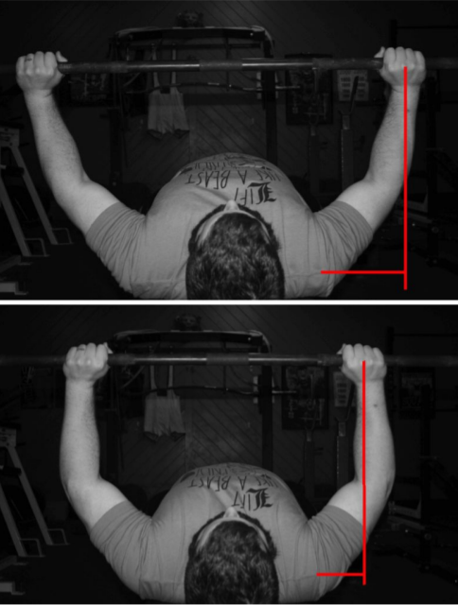
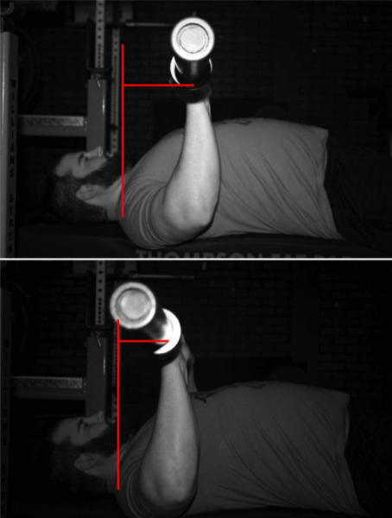
Basic Biomechanics
Three primary movements
1) Shoulder Horizontal Flexion (pecs)
2)Shoulder Flexion (anterior delts)
3)Elbow Extension (triceps)
Muscles work Synergistically!!
Notes:
Shoulder Horizontal Flexion demands are determined by the grip width. The greater the grip width, the greater lateral distance between your hands and your shoulders, the greater demands on horizontal flexion. Specifically more stressed the pecs
Shoulder flexion demands are determined by the distance of the bar in front of the shoulder joint. The further forward the bar, the harder the lift is on your shoulder flexors (specifically your front delts and to lesser degree upper chest).
While these movements are broken up, the pecs and the triceps can work synergistically at both the elbow and shoulder; the pecs help the triceps extend the elbow, and the triceps help the pecs horizontally flex the shoulder. Since the forearm itself can’t move much because the hand is planted in place, the shoulder has to horizontally flex as your triceps work to extend the elbow. The opposite is true with the pecs: Since the hands are locked in place on the bar, as your pecs work to horizontally flex the shoulder, the elbows have to extend as well.
Remember, horizontal flexion demands are the same throughout the lift, shoulder flexion demands decrease as you press the bar (as it moves back over your upper chest/shoulders), and elbow extension demands are at or near peak levels when the bar’s on your chest as well (they increase a little bit during the first part of the press if you bench with your elbows under under the bar the whole time; if you bench with your elbows in front of the bar to help your shoulders with the initial drive off your chest, however, demands on the triceps will also likely be at peak levels at the bottom of the press).
-this however would mean you’d expect the weight to be unmovable at the bottom of the movement...However, that’s not what happens for most people. On a max attempt, the bar accelerates rapidly off the chest, decelerates through the middle of the lift, and then accelerates again as you approach lockout. When most people miss, it’s after that initial acceleration, with the bar getting stuck 4-­6 inches off their chest.
-There’s a simple explanation: Muscles don’t produce the same amount of force over their entire range of motion. Muscle fibers themselves produce the most force when they’re around resting length, and their capacity to produce force increases or decreases as they lengthen or shorten (red curve below). Furthermore, passive elements in the muscle – structural proteins and connective tissue – produce increasing amounts of force as a muscle lengthens
-Additionally, you have to account for the stretch reflex – the elastic energy stored in a muscle as it lengthens, and the stronger ­than ­normal contraction that’s possible when the muscle is stretched under load (due to activation of muscle spindles).

Slide 4
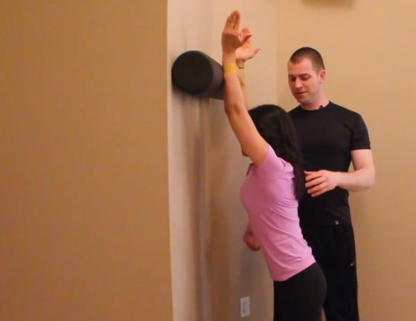
Suggested Warm ups
Arm circles (vary size)
Hands clasped together to reach back
Band loop overs (PVC pipe?)
Band pull aparts (protract and retract scapula)
Band behind the neck pulls
Band face pulls
Band rows
Band chest flys and presses
Band triceps kickbacks and band biceps curls
Facing Wall slides with resisted external rotation
Alternating banded resisted external rotations
Notes:
First thing to note, I suggest Dynamic exercises not static

Slide 5
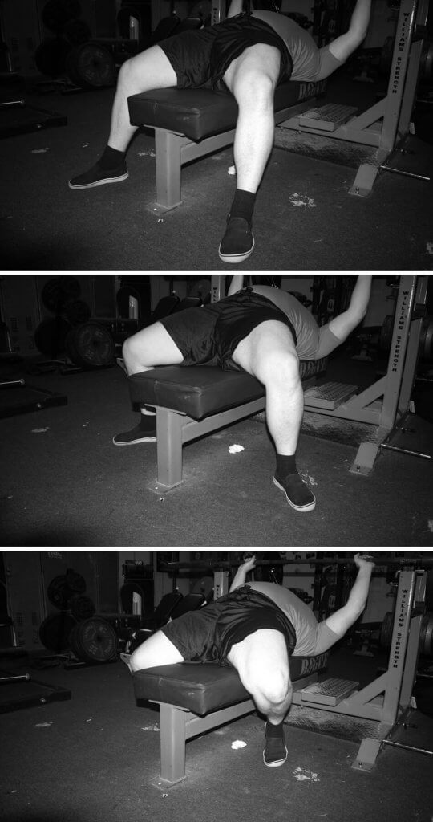
Technique - Setup
If your setup isn’t great then most of what follows will not be optimal!
Foot placement and pressure
-Wider foot placement allows for better stability
-Pressure towards toes and knees below hip level
-Long legs may need to place feet wide and more in front of them
-Short legs and flexible may be able to tuck their feet back more
Stretch: quad stretch on bench (squeeze glutes and tuck pelvis)

Slide 6
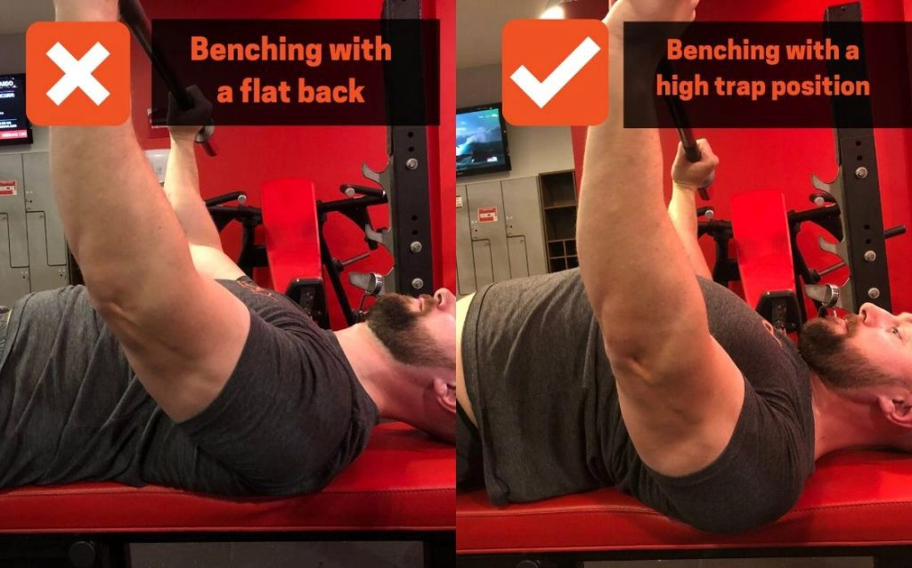
Technique - Setup
2) Upper Back Position
Important for Scapular control and injury prevention
- “high on traps” or “feel traps”
- drive your chest high not just arching lower back
There are a few ways to achieve shoulders, hip, and feet positioning:
1)set shoulders then walk feet up and set hips
(glute bridge and walk down feet)
2)set feet and hips then walk shoulders down
(swing through)
Notes:
Test ability to squeeze shoulder blades. Retract and depress- lots of tension where lower traps are
-to warmup, can do wall slides and I/Y/T raises on incline bench (BW or light weight)

Slide 7
Technique - Setup
3) Grip
-want on meat of palm
-too close to fingers results in pressure on wrists
-too close to wrists danger to slip off hand
-bar over wrists, wrists over elbows
-if wider grip, bar will touch higher on chest with more flared elbows
-if narrower grip, bar will touch lower on your chest with elbows tucked more

Slide 8
Technique - Descent
Deep breath and brace
“Rip the bar in half” or “bend the bar”
Lower controlled 2-3 seconds (decreased stress on shoulders and tendons)
touch bar to chest between nipple and bottom of sternum
- “meet the bar”
-find comfortable groove to lower down (can use chalk)

Slide 9
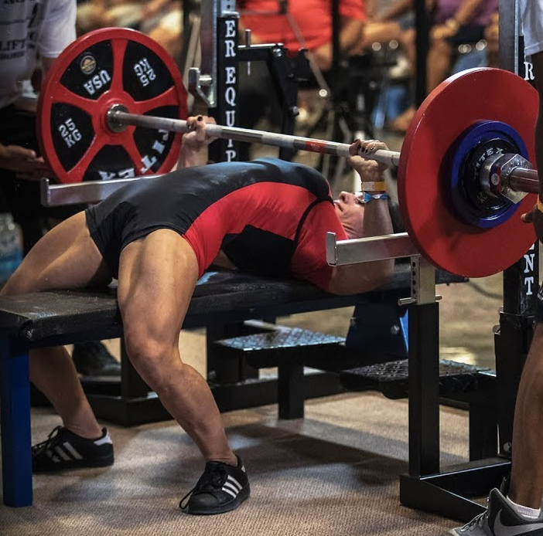
Technique - Ascent
Drive bar off chest, initiating with leg drive, and push bar up and back towards your face
Squeeze glutes tight
Leg drive
-toes into end of your shoes not through heels
-think push head off bench
-cue by lightly stepping on foot (wedge it in)
Don’t rotate elbows outwards (lose max triceps potential)
If slows, squeeze harder and “pull the bar apart”
Notes:
leg drive determines bar path: push feet down and away from you, driving toes into end of your shoes and create energy coming back towards your head that the bar will follow
once the bar touches your chest, push “back” with your feet so you are pushing your head off the bench (rotates sternum up, engage the lats, and allows straight up push)

Slide 10
Diagnosing Weaknesses:
Weakness at Bottom
Anterior Delt weakness- shoulder flexion demands greatest at bottom
Bar path too low on chest (cue not to tuck)
Pec weakness (if touch super low and significantly weaker when higher)
Support muscle strength- feel pain or unstable lowering

Slide 11
Diagnosing Weaknesses:
Missing Through Midrange
Improper Bar path (too straight up)
Just need to get stronger (pecs and triceps)
Notes:
(note:not definitive, but this is somewhere from 3-4inches off chest to point where
clearly close to lockout)
-since bar should be over upper chest or shoulders at this point, your shoulders
shouldn’t be the limiting factor. Also pecs and shoulders are in a much safer position so issues that can cause instability at the bottom are much less likely to play a factor at this point)
you just need to get stronger- pecs and triceps specifically
-this is the weakest point in the lift. The summed joint moments for
horizontal flexion and elbow extension are at peak levels or near
peak levels, the stretch reflex has dissipated, and since your
muscles aren’t stretched quite as much anymore, you’ll be getting
less help from your muscles passive contractile properties
-this can be a good sign, if the bar path is correct all it means is
you need to get stronger

Slide 12
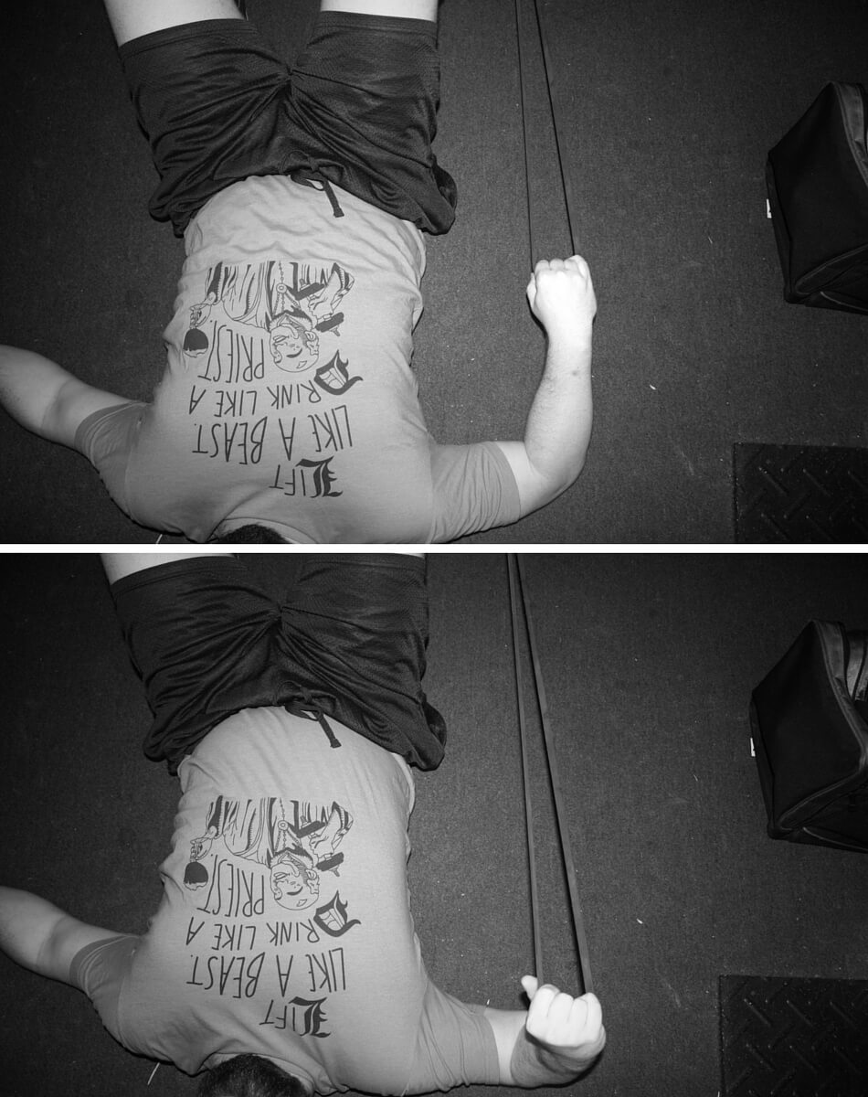
Addressing Common Issues:
Shoulder Pain at the Bottom
30-50% reduction in bench volume until discomfort subsides
Shoulder blades retracted?
  Play around with how elevated or depressed
Same set volume for pulling movements (if not more) and pushing movements
Train external rotators through internal rotation (strengthen and mobilize in same plane as benching) - lying band pulls
Train your serratus anterior
  Pushups with protraction at top
  Facing Wall slides with resisted external rotation
Notes:
Shoulder pain could come from a lot of different sources, from mild impingement (potentially from not retracting your shoulder blades when you set up), to a bit of capsular inflammation (just from the repetitive stress of benching hard), to tendonitis at the origin of your biceps (which originate just above your shoulder).
For most people, these five things will help, when coupled with a 30-­50% reduction in bench volume until the discomfort subsides:
1)make sure shoulder blades are retracted:
-if you already do this then play around with how elevated or depressed scapula
is when setting up
2)make sure you are doing pulling movements to provide stability to the joint
-at least one set of upper body pulling for every pushing set
3)train your external rotators through internal rotation
-Not only do your external rotators need to be strong, but they also need to be
extensible enough to allow your shoulders to get into enough internal rotation.
This movement will help you strengthen and mobilize your external rotators in the
plane you’ll be benching
-lying band pulls (pg. 76)
4)add pushups with shoulder protraction at the top
-train your serratus anterior
5)add light incline curls and light flys with high reps and pauses in stretched positions

Slide 13
Addressing Common Issues:
Elbow Issues
Many start as shoulder issues even if no shoulder pain.
-if can’t internally rotate enough, stress medial side of elbow
-if on backside of elbow, triceps tendonitis
-rest and below pain threshold partner assisted eccentric movements
Notes:
Many elbow issues start as shoulder issues, even without shoulder pain.
-if shoulders cant internally rotate enough, stress the medial side of the elbow
-if you have shoulder pain when benching normally but pain free during reverse grip
Benching (externally rotated shoulders), your elbow issue is likely starting at your
shoulder
If tenderness is backside of elbow, right on olecranon or slightly above, then probably triceps tendonitis. For tendonitis, rest is your ally. Lay off heavy pressing for a few weeks and ease back in slowly. Often in the meantime, do lightweight (below pain threshold and about half normal weight) eccentric exercises (preferred partner assisted concentric to get into position)
-can also be the case for pec tendonitis

Slide 14
Addressing Common Issues:
Wrist Pain
-check wrist positioning
-wrist wraps
-check grip width
Notes:
-If the pain is on the thumb side of your wrist, consider bringing your grip in a little bit. The wider the grip, the greater the odds are of a tendon getting pinched on the medial side of your wrist, or the medial side of the joint just getting compressed uncomfortably.

Slide 15
Key Accessory Bench Builders
-Rack Lockouts
-Floor Press
-Dead Bench
-Reverse Grip Bench
-Close grip Triceps Press
-weighted dips (triceps or chest focused)

