Slide 1
How to Make a
Windowsill Composter
*Adult Supervision may be needed.

Slide 2
Materials:
2 Liter Soda Bottle with cap
(a smaller bottle may be used, but you must
decrease the amounts of the contents.)
scissors – to cut the bottle
Measuring scoop or cup
Laundry Powder (dry measure) scoop or cup
(Nitrogen = green)
Grass Clippings (1 cup),
Leaves, Fruit and Vegetable Waste (2 cups) = 3 parts
(Carbon=Brown)
Shredded Newspaper (1 cup) = 1 part
Spray Bottle with water
Plastic spoons
Duct Tape
Magic Marker – Black or Red

Slide 3
*Preparing the Bottle
(Parents you may need to help with this part.)

Slide 4
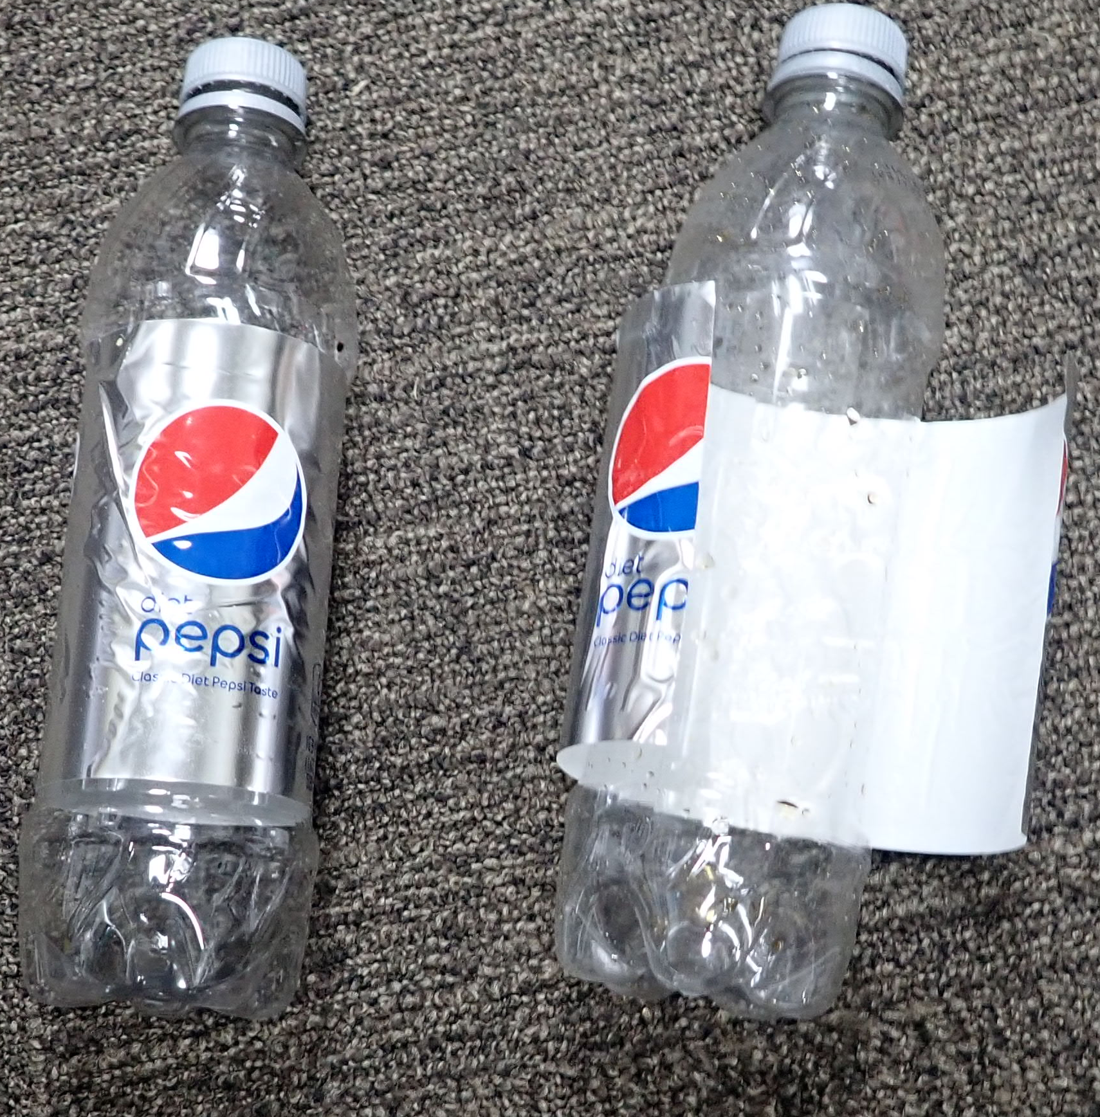
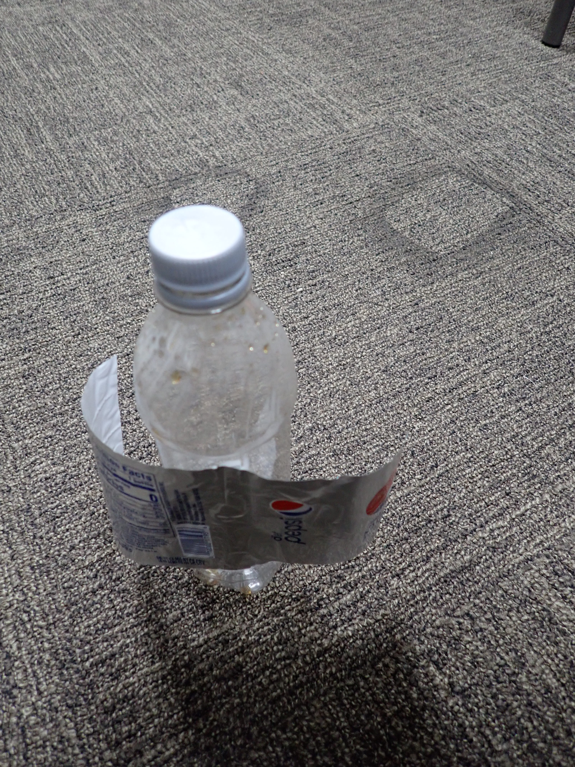
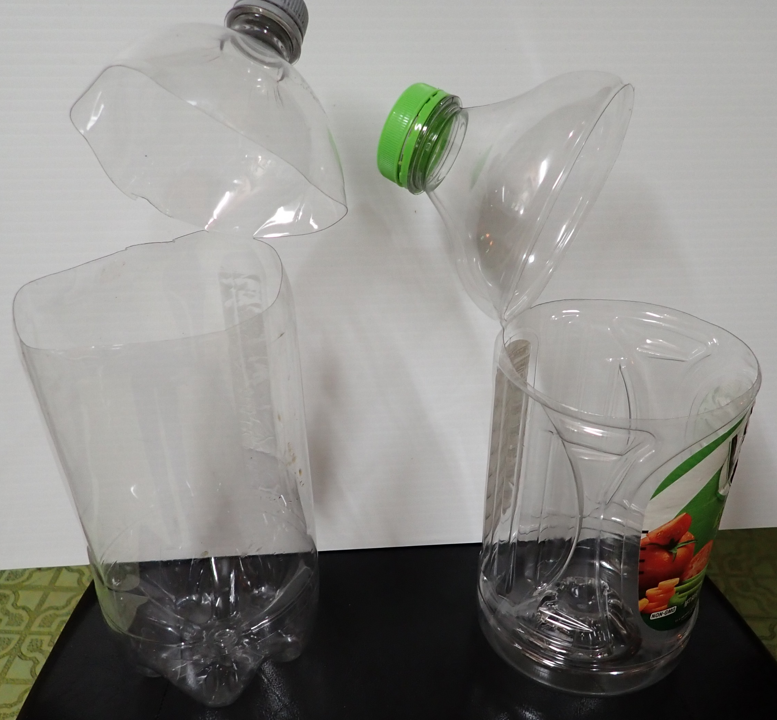
*Remove the label.
Cut the label in the front from top to bottom.
Pull the two pieces to the back, then off with a
downward motion.
With cap on the bottle, locate the area where the sides of the bottle
become straight.
Do not cut the top of the bottle off.
* You are going to leave a one-inch hinge in the back.
Start in the front. Make a cut to ½ inch from the back.
Make a second cut from the front to within a ½ inch from the back .
Bend the top back.
* Parents – you may need to help with this part!

Slide 5
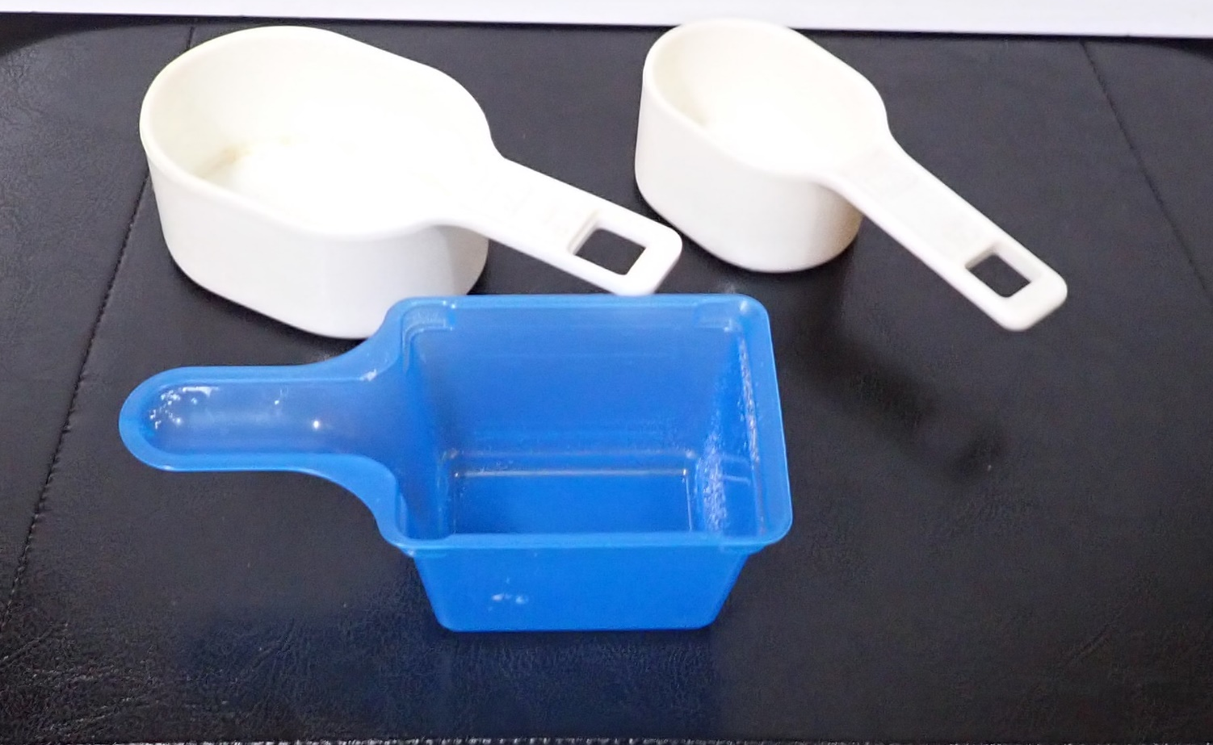
Known measuring ¼ cup
Known measuring ½ cup
Unknown measuring cup
How to Make a Measuring Device
from Materials Found Around the House
Locate measuring cups.
Locate a laundry powder cup.
How much does the laundry powder cup hold?
* Make sure the cups you are using are for solid measure.
Does it have a pour spout? If it does, it is for liquid measure.
The cups shown do not have a spout, they are for solid measure.
Using baking soda measure ½ cup and pour into the unknown cup.
Mark where the known quantity is on the cup. You now have a device that may be used to measure a ½ cup. It is best if it will completely fill the cup to the top.

Slide 6
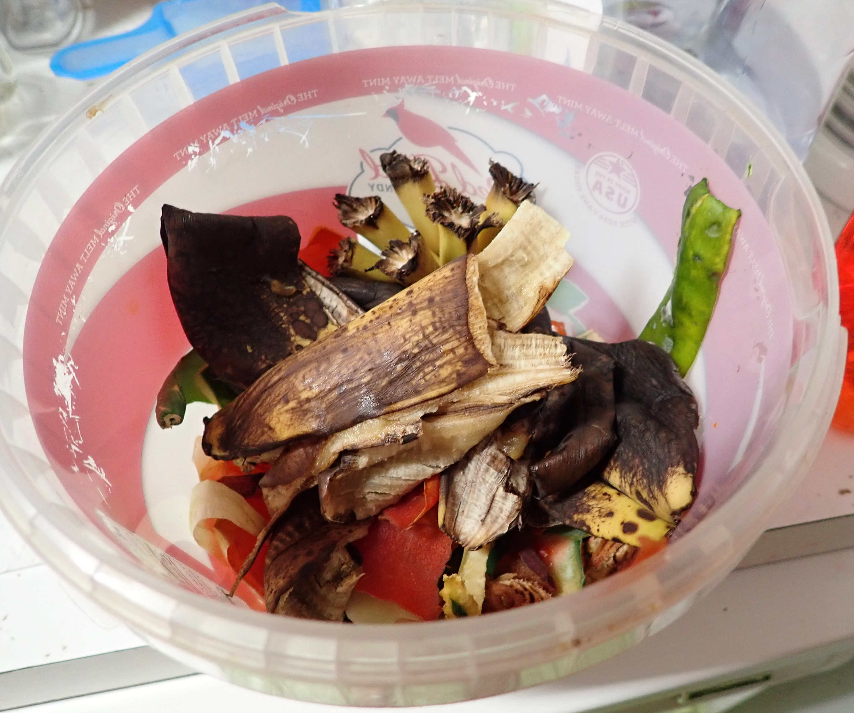
Calibrating a Measuring Cup
Why is important to make a measuring cup for this activity?
The items you will be measuring are not things you would eat. They will contaminate utensils that are used for cooking. Therefore, you want to use something that will not be used for cooking.
The items you will be measuring are:
Soil
Leaves and grass
Vegetable and Fruit peelings
Shredded newspaper

Slide 7
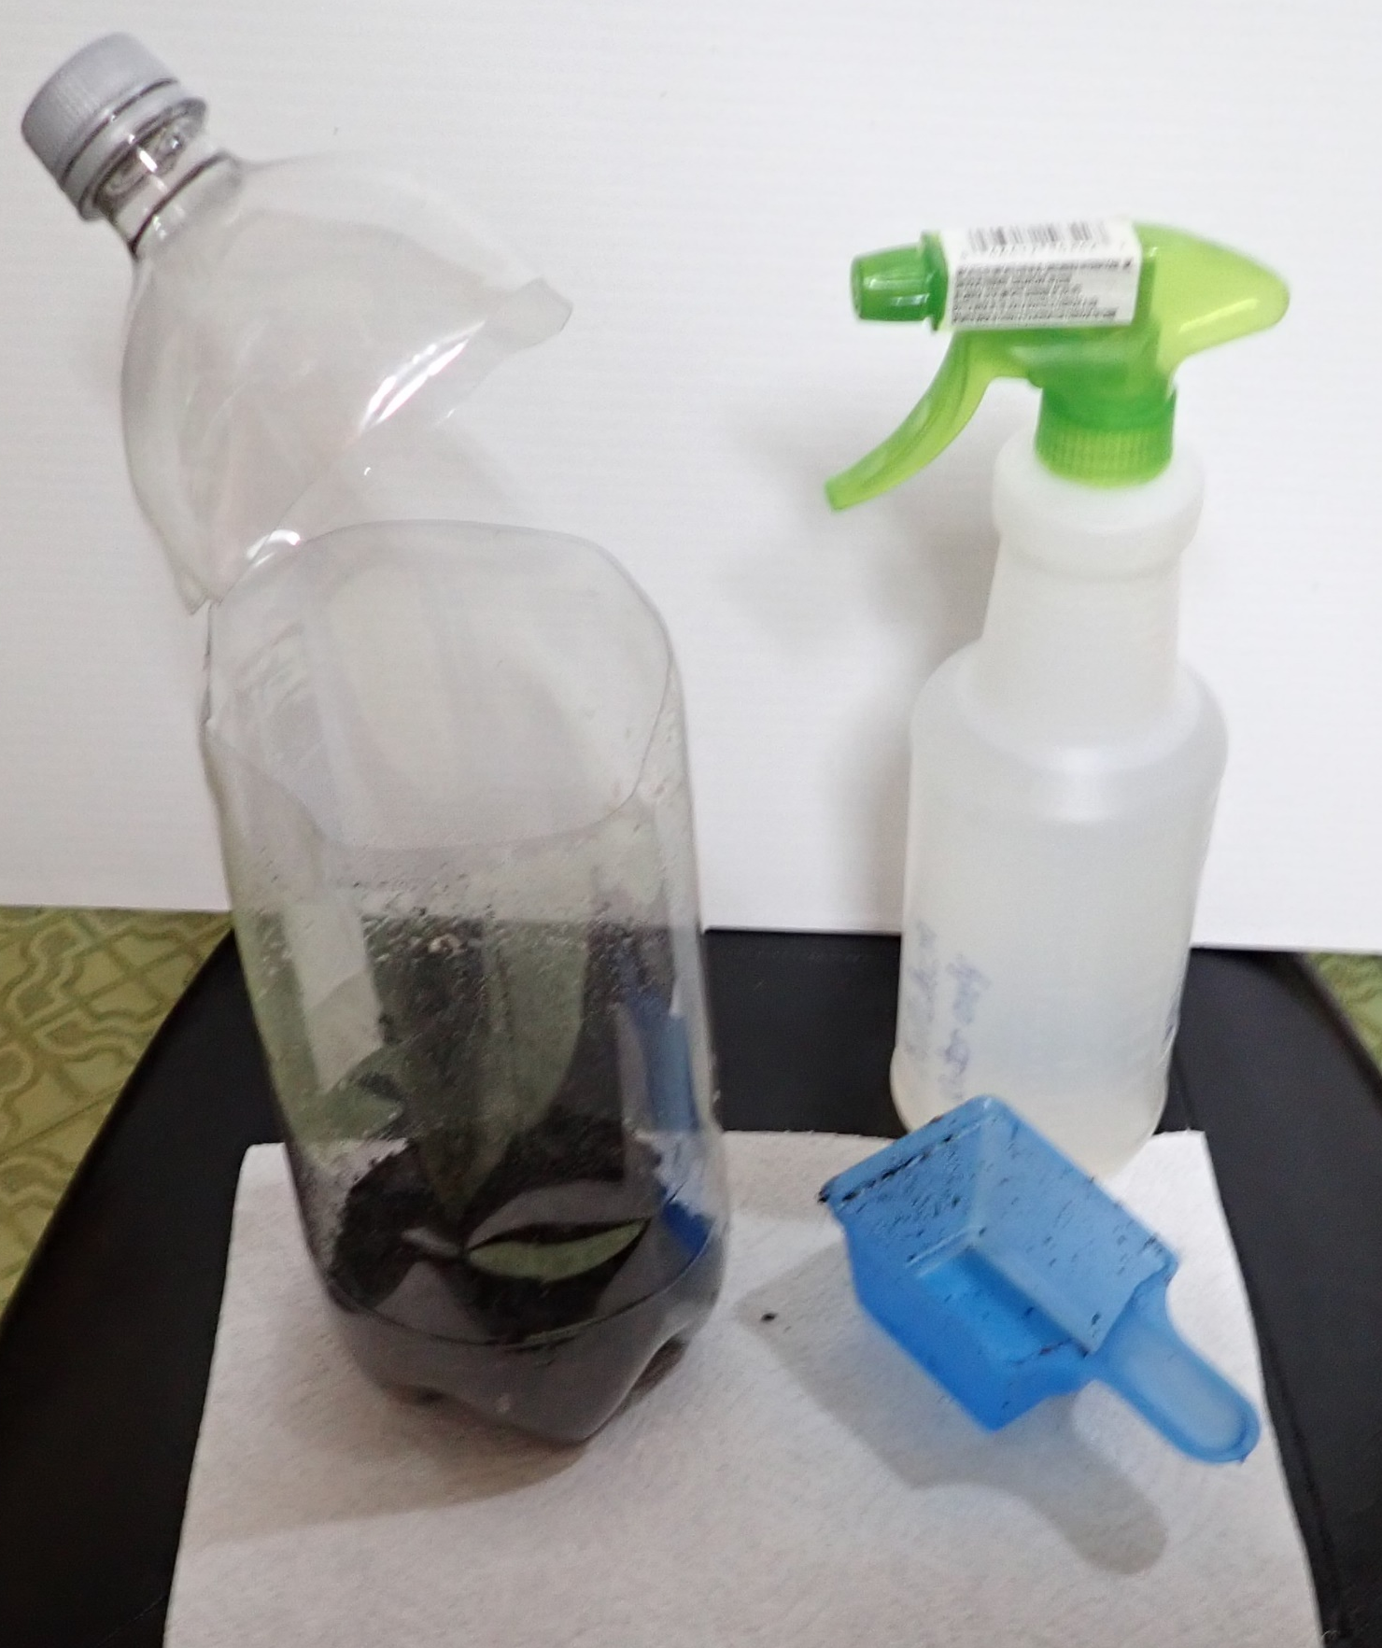
Using the prepared bottle
and calibrated measuring cup
begin putting items into the composter.
First add a scoop of potting or garden soil.
This should cover the bottom of the container.
You may need to moisten the soil by spraying it with some water.
NOTE: Between each step, tidy up.
Learn to leave areas neater and cleaner than when you started using
them. This is a sign of growing up (maturity)!

Slide 8
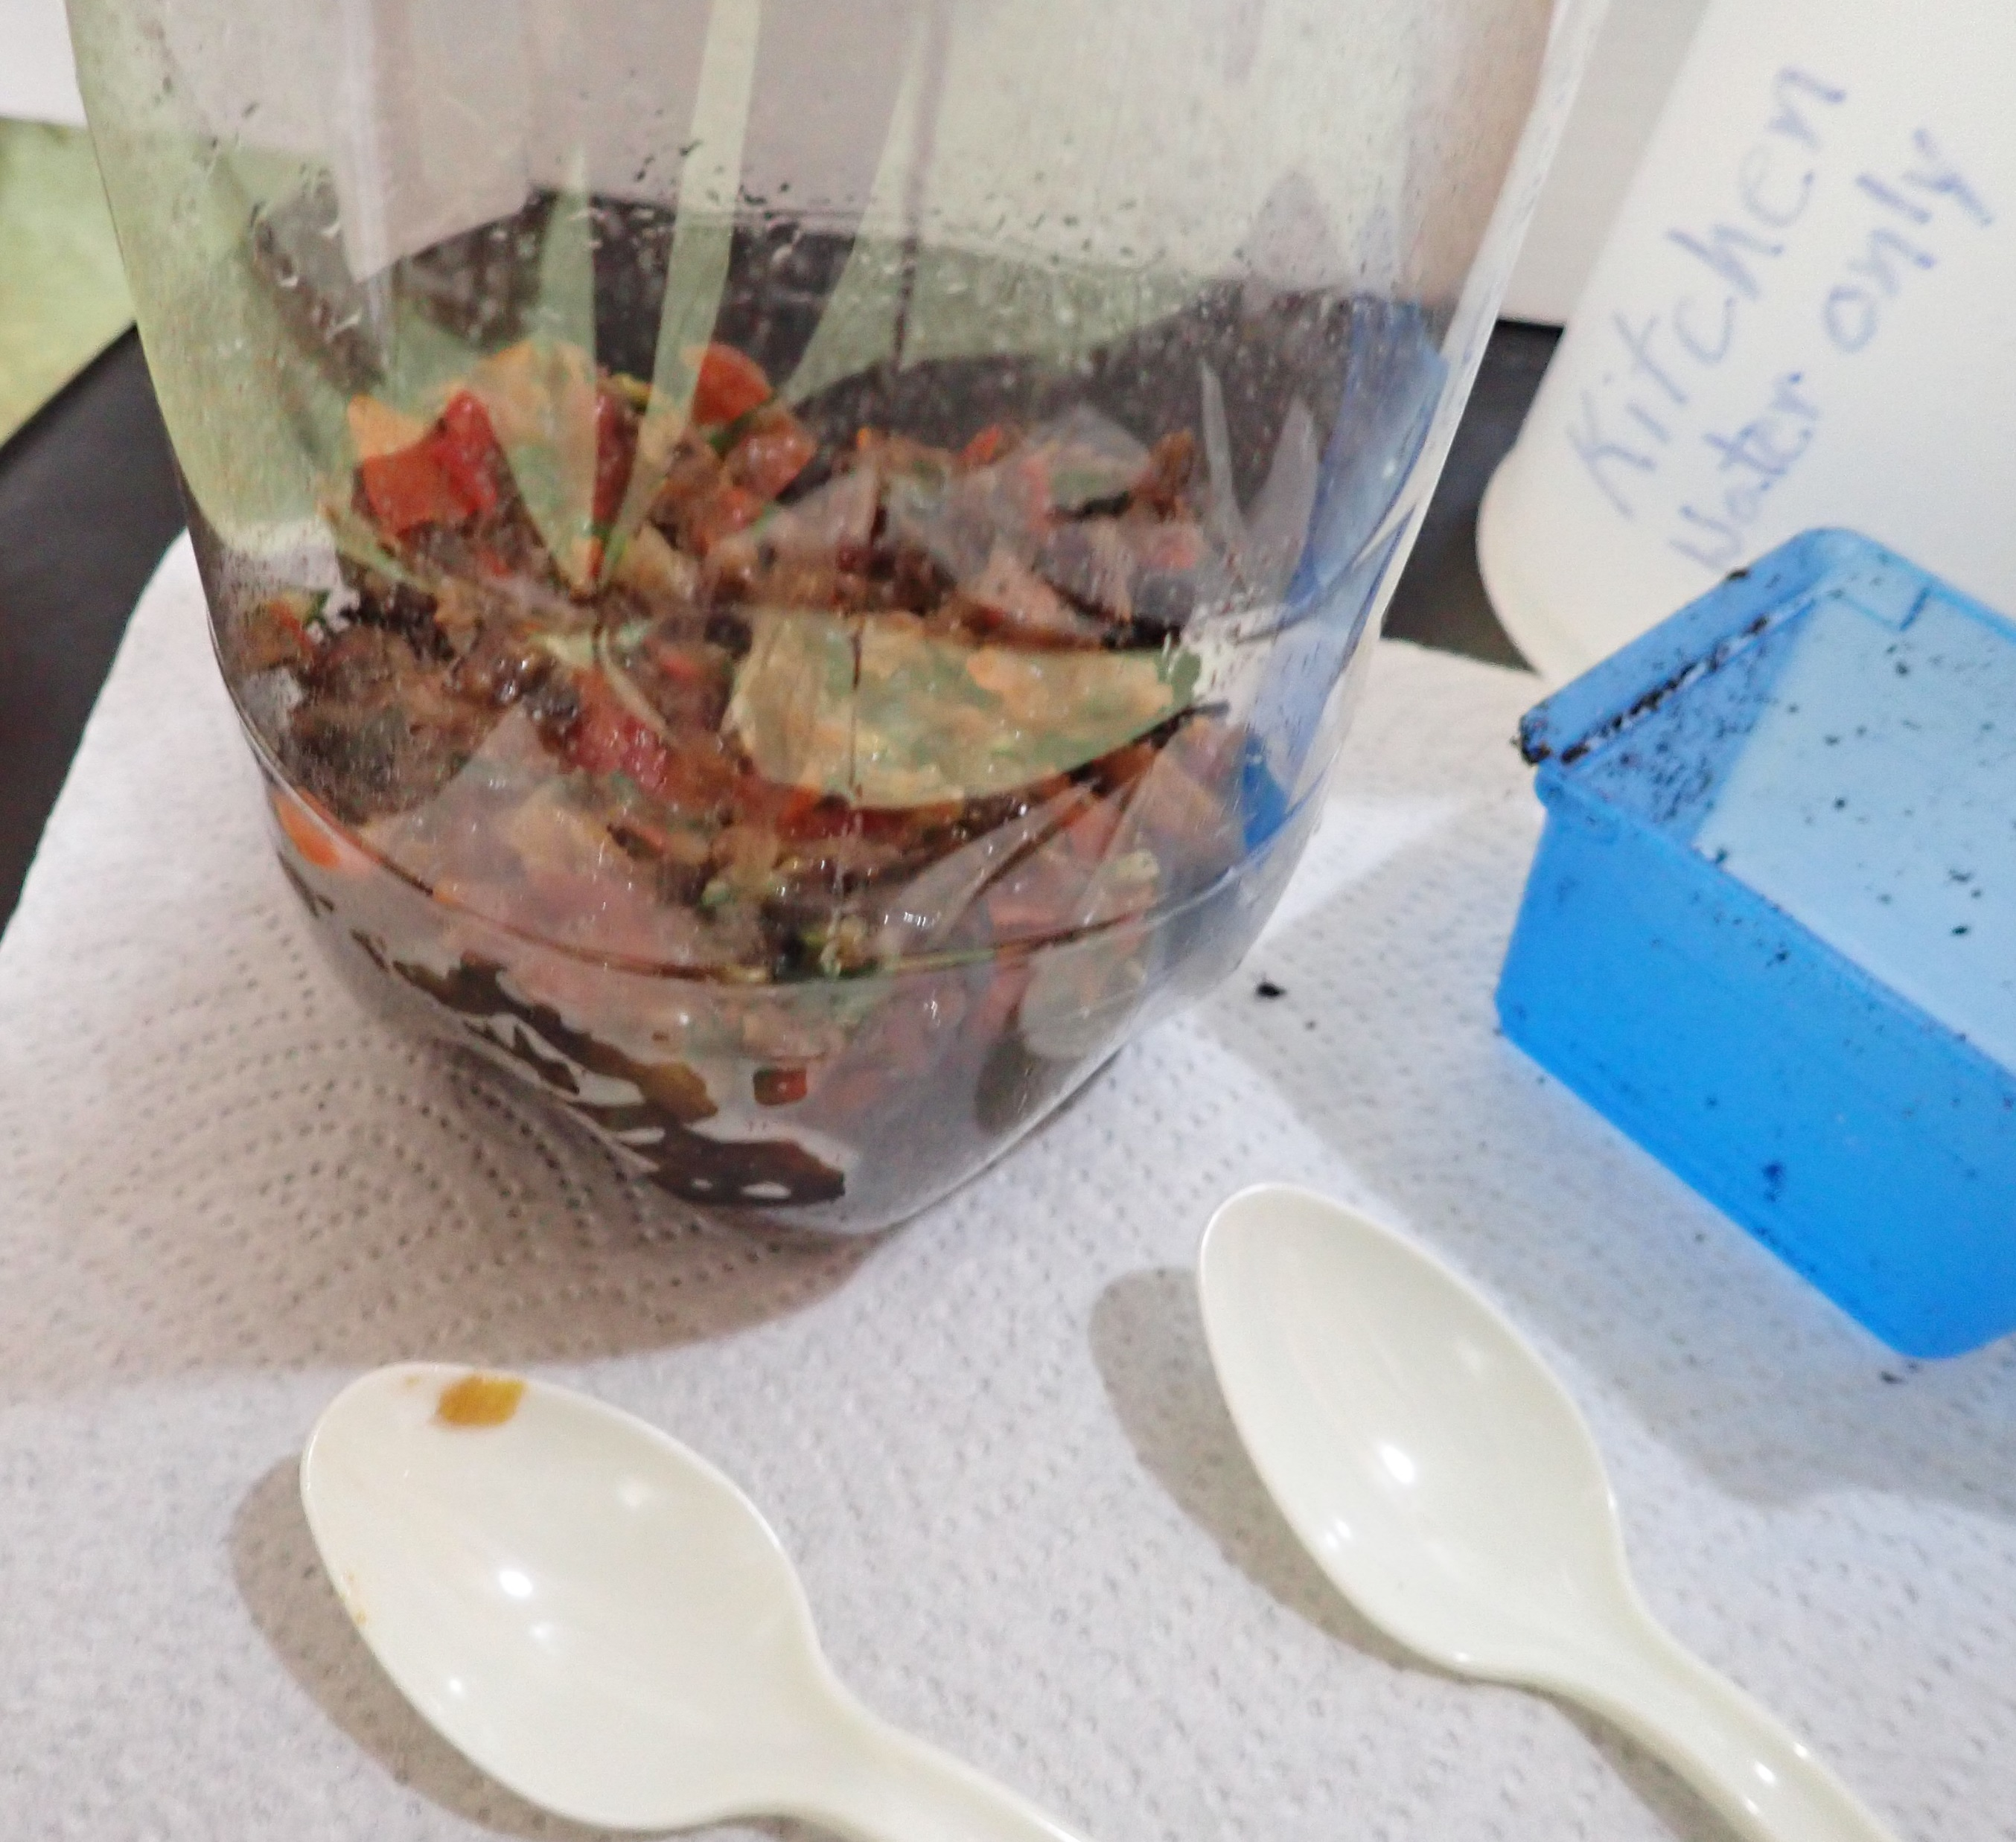
Next add some chopped up fruit and vegetable peelings.
[In a compost bin they do not need to be in small pieces,
but this is a miniature compost bin. The pieces are chopped
because of space and to speed the process.]
You may use a spoon to level out the peelings. Note the plastic
spoons, do not use kitchen spoons because of contamination with
bacteria.

Slide 9
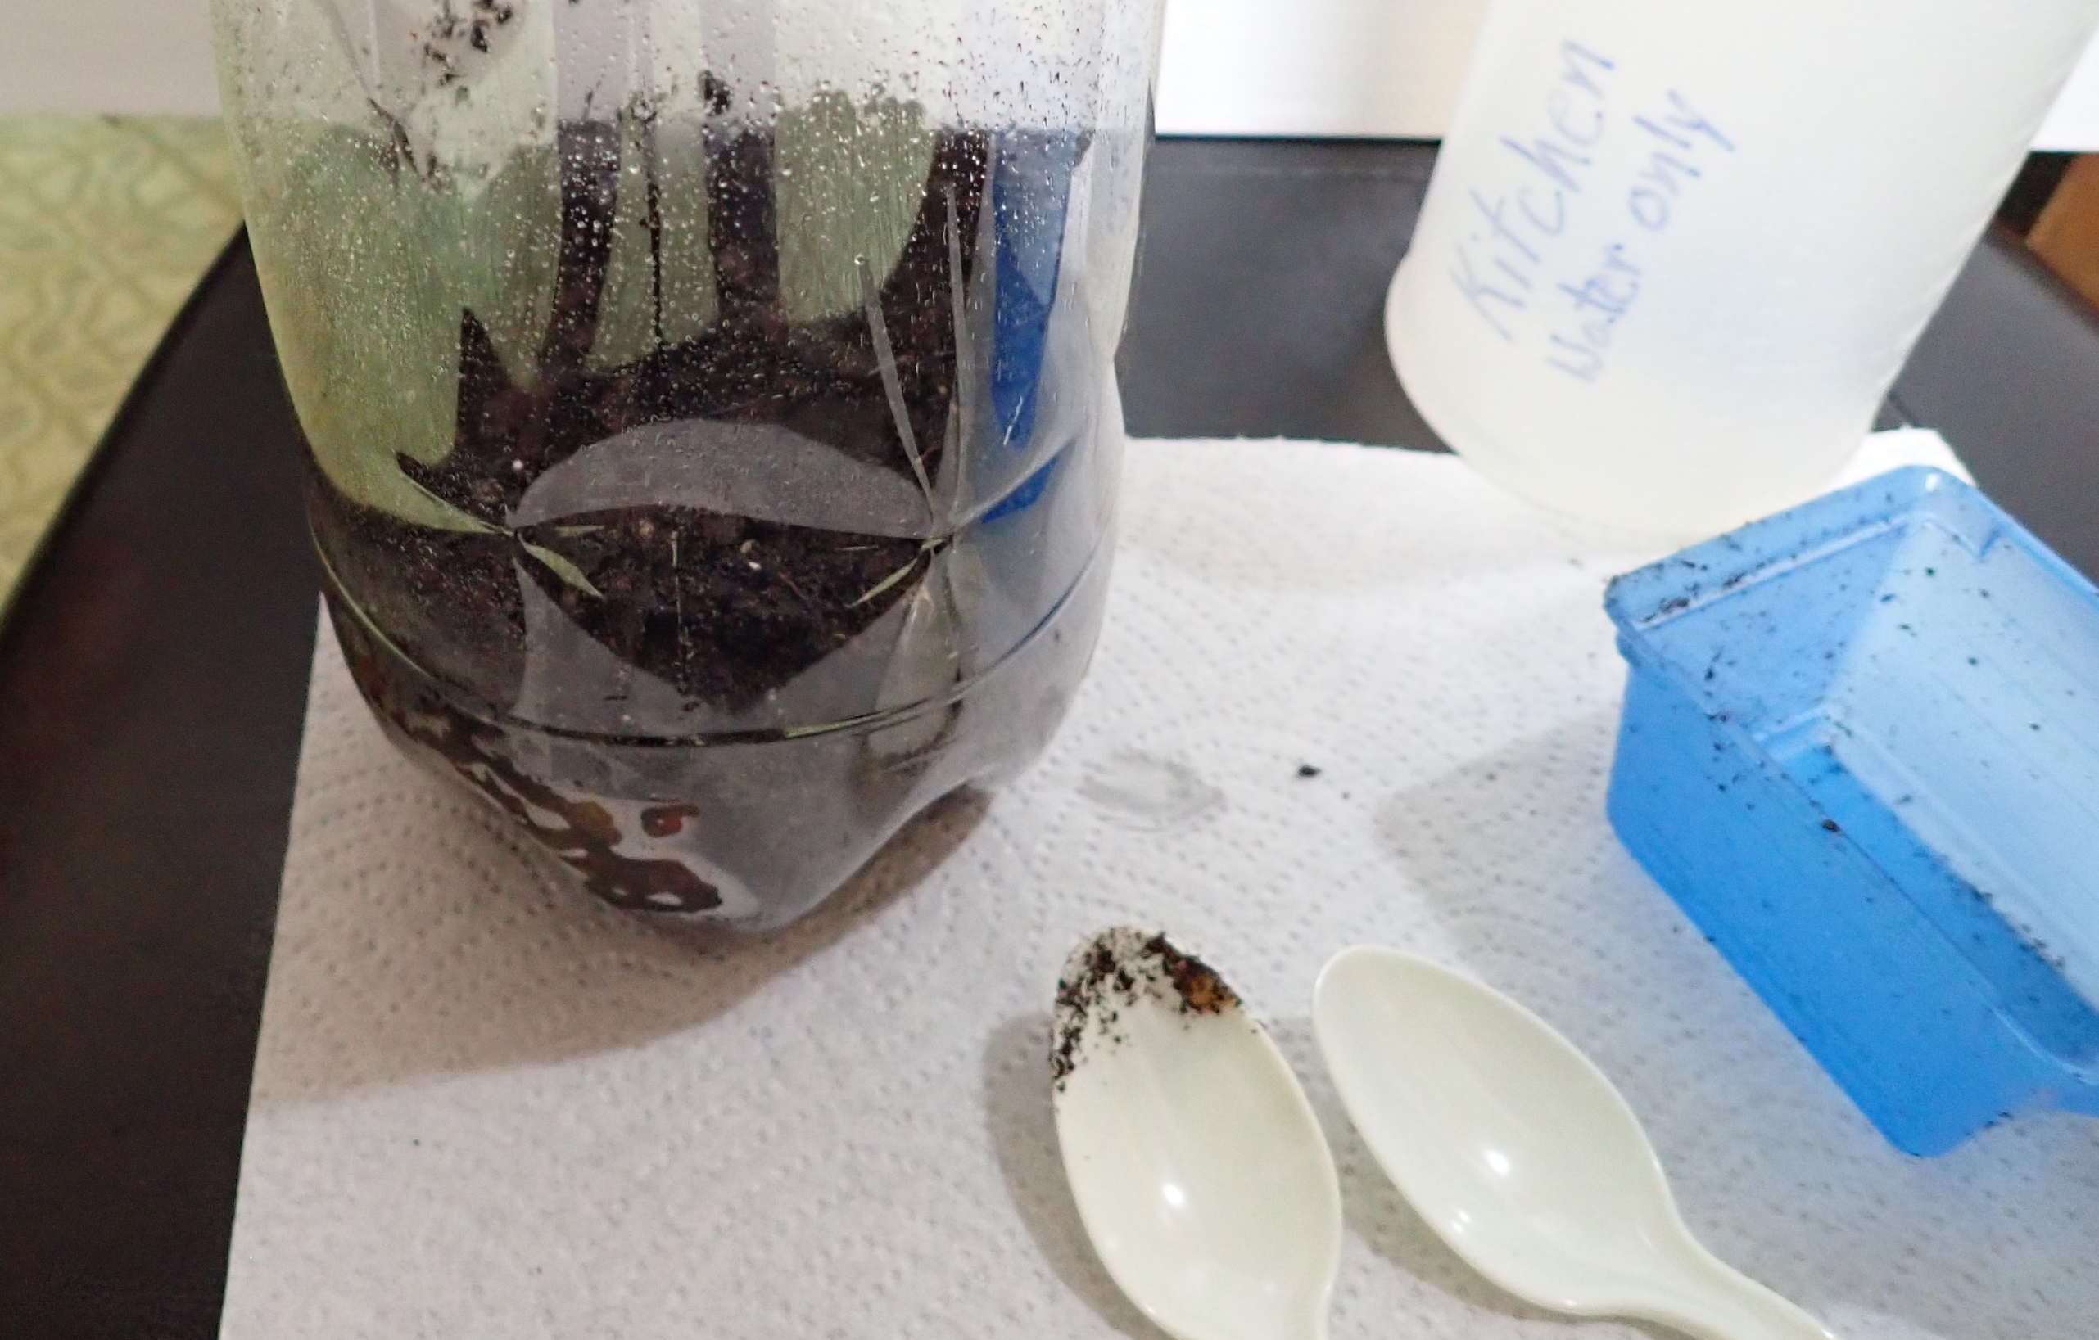
Each time a layer is added
a layer of soil is used to cover it.
This is important in the compost bin, it cuts
down on the presence of insects and wild animals
searching for food.

Slide 10
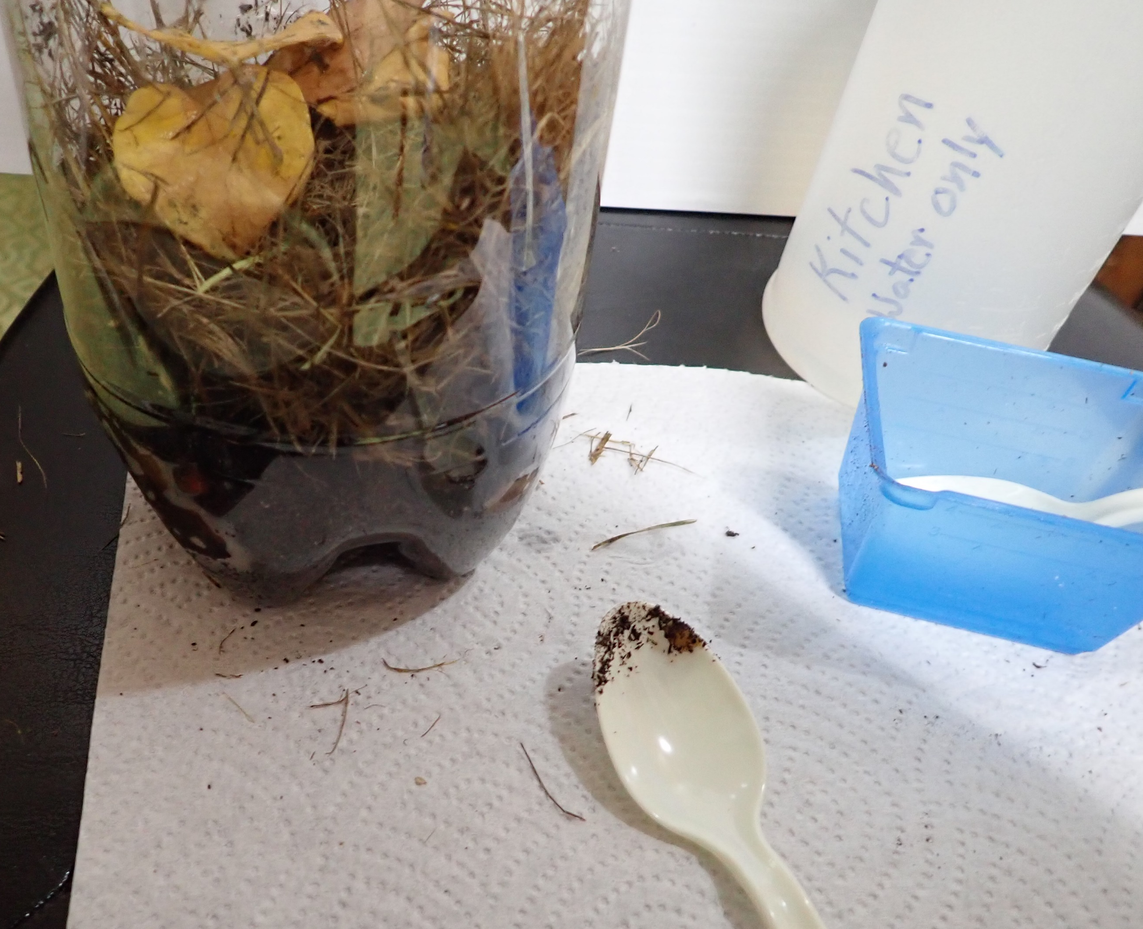
The next layer is grass and leaves. This layer will need
to be sprayed with water.
Moisture helps the decomposition process.
Notice there is a lot of space in this layer. It helps to add
air to the mix.
Air is also added when the pile is turned.
You may need to sweep the floor after this step!

Slide 11
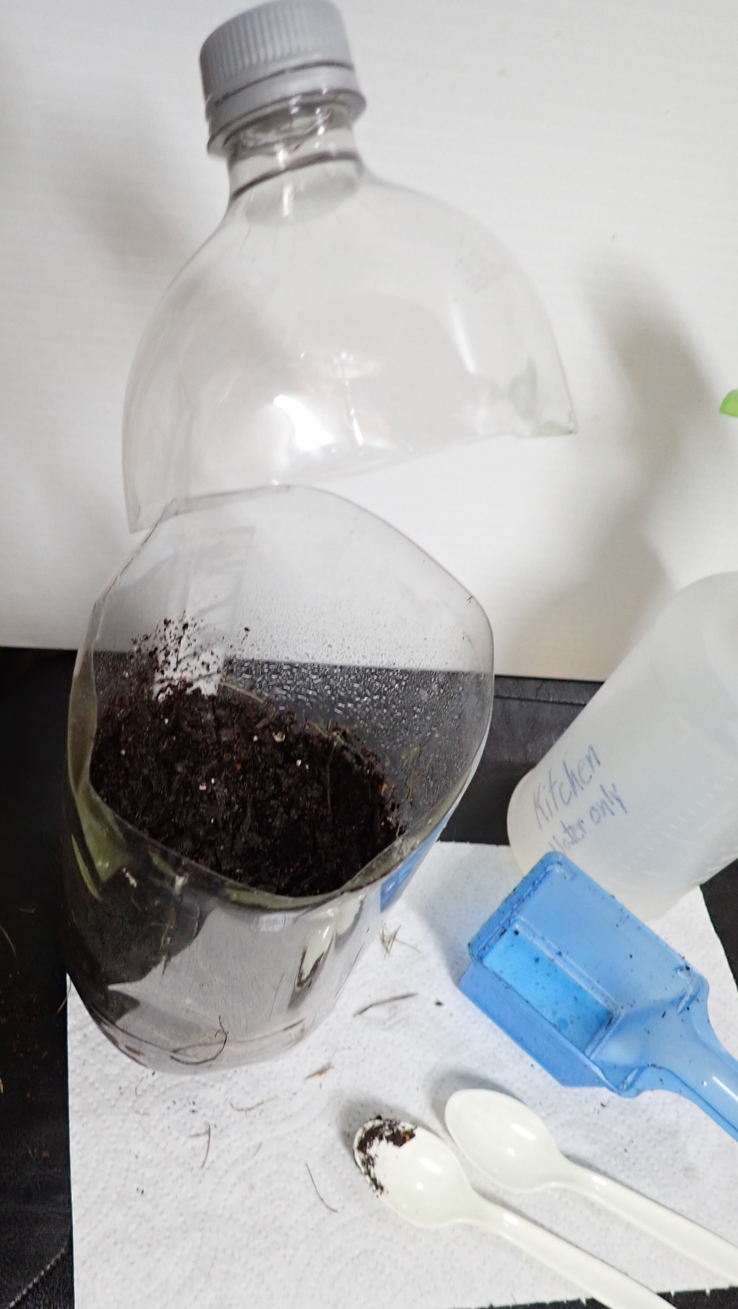
Each time a layer is added
a layer of soil is used to cover it.
Remember to spray with a little water
to dampen it.
Note the paper towel under the container.
It helps to provide a background.
It is also going to help in cleaning up.

Slide 12
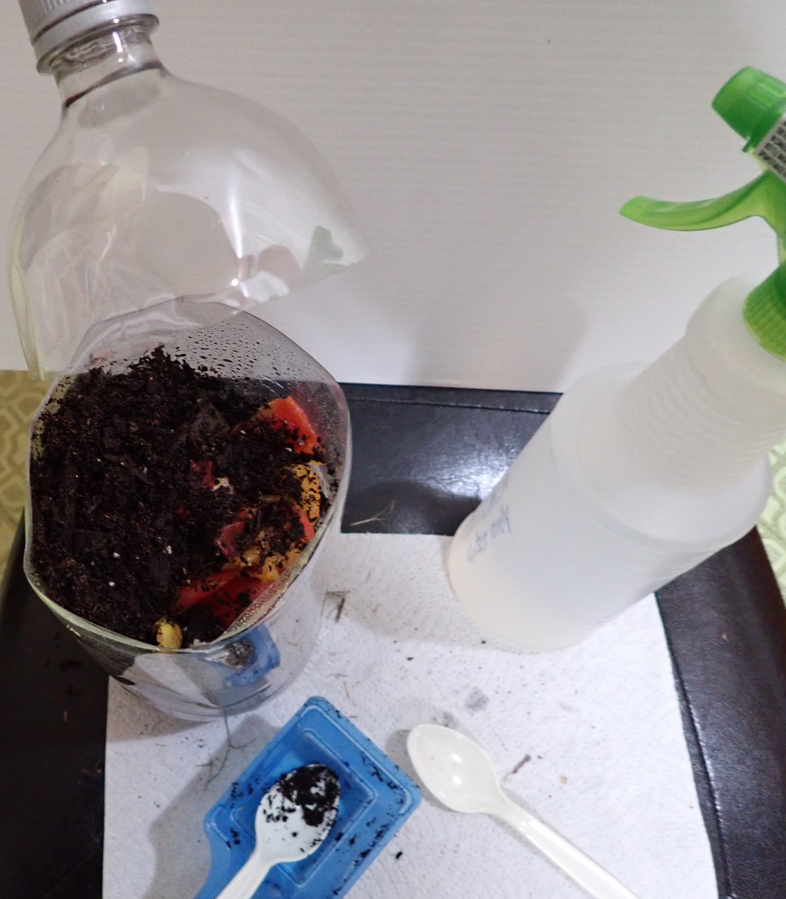
Keep adding more layers.
Remember to cover with soil between each of the layers.
The layers that are dry need to be sprayed with water.
Use the spoons to smooth the layers.
Clean as you go! Keep your area neat.

Slide 13
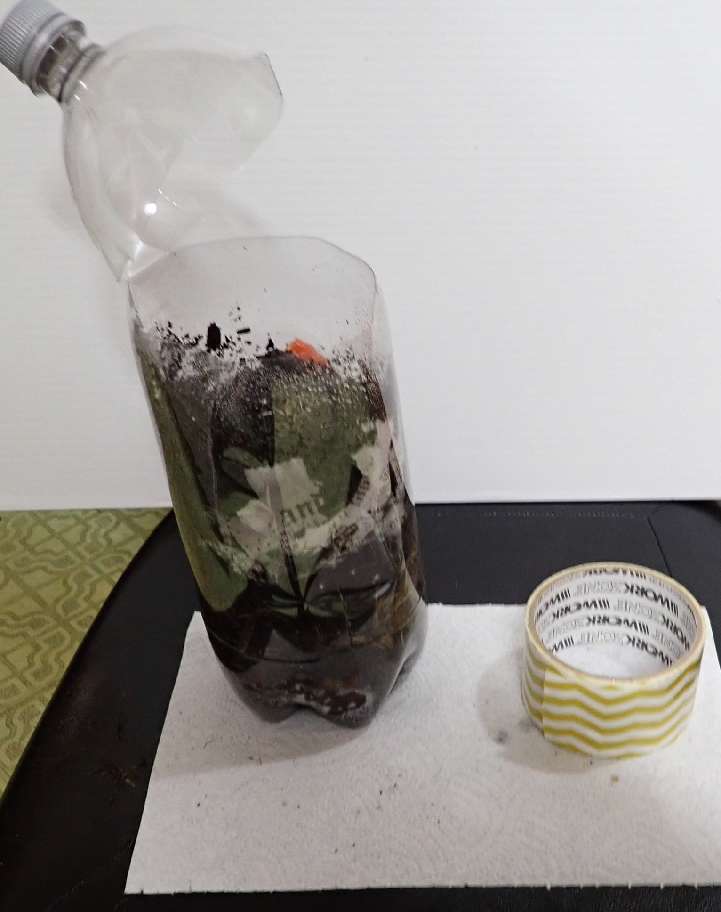
You may use shredded newspapers as a layer.
Don’t forget to moisten this layer well by spraying
with water.
Add soil. Moisten with water. You do not want it soggy!
Now the container is a few inches from the top.
It is time to seal the container closed.
Use duct tape to seal it closed. Use 2- or 3-inch pieces
starting at the front and work towards the back.
Alternate sides. You may also work from the back to the
front. Overlap the pieces. Make sure that you have securely
taped the top to the bottom.

Slide 14
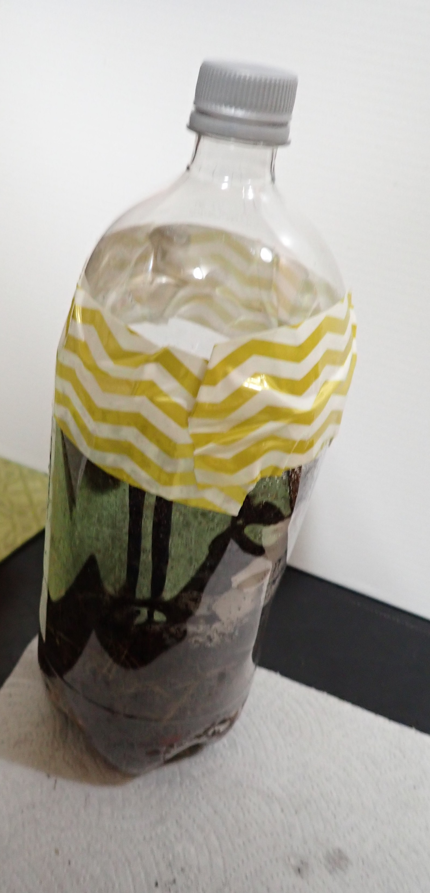
Now we have our completed
Windowsill Composter.
All of the materials have been put back
where they belong.
Some may have been put in the trash or recycle bin.
The area is cleaned up.

Slide 15
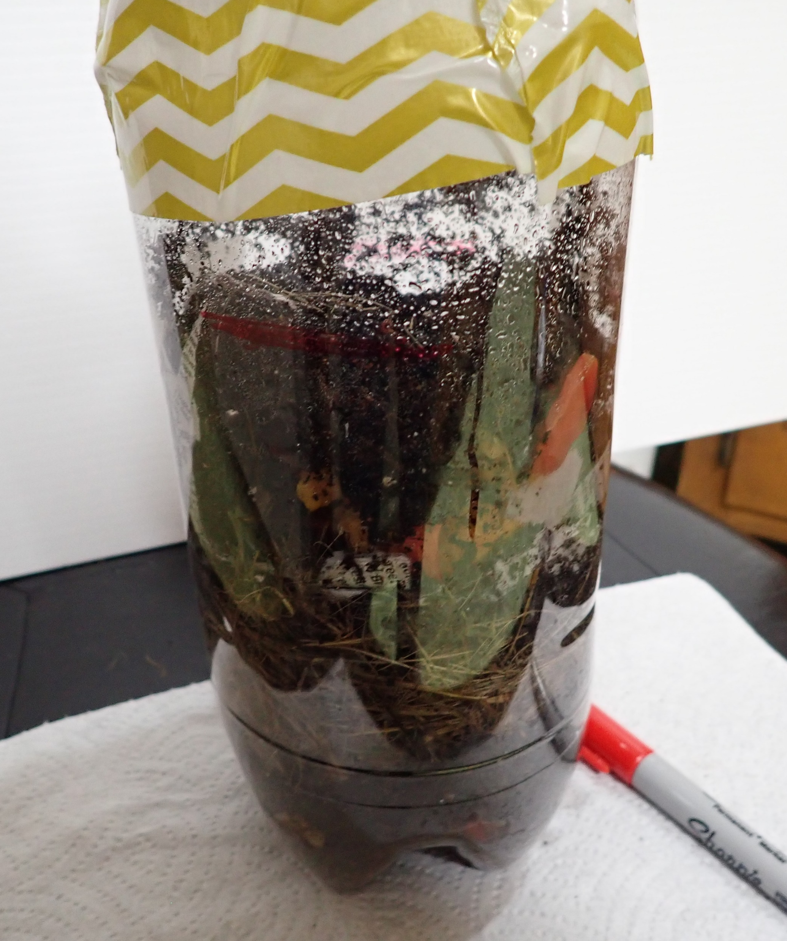
A few last things need to be done.
With a magic marker, mark the top of the material in
your composter.
Lay the composter on its side on the floor. Roll it back and forth.
You are adding air to the layers. It is ok it they get mixed up.
Sit it back up.
Find a sunny window to sit your composter.
Everyday you will repeat the process of rolling your composter. You
may shake it a little to get the layers to mix. This would be like turning
the compost pile.
Will the compost level get lower or will it get higher?
Write your answer down. This is your hypothesis. Over the next 30 days
You will be observing to see what will happen.

Slide 16
Start a journal. Write today’s date. Beside it write Windowsill Composter set up.
Write the dates for the next 30 days. This will help remind you to check your composter.
Each time you mix it note by the date what changes you are noticing.
When do you notice the first changes? Do you see water condensing in the bottle? Where?
When you don’t see moisture on the sides, this may be a sign you need to unscrew the cap and spray
more water in it.
Do Not get it too wet. If you notice water in the bottom, unscrew the cap. Let it air for a day or two.
Remember to screw the cap back on before you roll the composter.

Slide 17
When you can no longer see anything except soil, you are ready to use the compost.
Note the level of the compost. Is it lower or higher than the mark where you began. Was your hypothesis
Correct? What did you learn from this experiment?
This is the End of your first experiment.
Mix the compost with some potting soil and plant a seed or plant in it. Plant a seed or plant in just the potting soil.
Compare the two. You are beginning a new experiment!
Which is going to grow the best? What do you think is going to happen? This is a new hypothesis!
Science is exploring how things work.

