Slide 1
Parent Meeting
September 27, 2022

Slide 2
Who We Are
We are River Place Student Theatre - a volunteer run 501c3 non-profit organization that serves kids that are zoned to attend (but not associated with) River Place Elementary
RPST.show to find all information
Funding sources are:
Enrollment fees
Sponsorships & Playbill ad sales
Company matching
Show night proceeds
Currently no grants or endowments

Slide 3
The Board
Our Board has 10 members for this season
Creative Director - Dionn Schaffner
President - Vanessa Jacob
Vice President - Kelly Fieleke
Treasurer - Danielle Walker
Parliamentarian/Props - Timi Quici
Secretary/ Costumes - Jana Weaver
Communications - Marie Todd
Front of House - Christina Mohan
Production – Ellen Whitson
Production – Mayra Rivera
Sponsorship -
Sets -

Slide 4
Volunteer Organization
Every aspect of the show is run by volunteers
We can use your special talent!
We are especially looking for people interested in helping with sets or sponsorship/fundraising (reaching out to area businesses)
We try to keep you with the area you have chosen, but we reserve the right to move people around to meet the program’s needs
Contact volunteer coordinator: Kelly Fieleke

Slide 5
Volunteers
Volunteer Teams
Production- Leads: Ellen Whitson, Mayra Rivera
Costumes- Lead: Jana Weaver
Sets- Lead: Vanessa Jacob
Props- Lead: Timi Quici
Sponsorships- Lead: Kelly Fieleke
Front of House: Christina Mohan
A place for everyone
Buy-out Option: Contact Danielle Walker (rpststudenttheatre@gmail.com)
Communication: Lead to set up follow up meetings after tonight
Have fun! Meet new people! We are all in this together!

Slide 6
Program Fees
The fees are $400.00 due today through October 13th
If you have more than one child, the fee is $400 for the first child and $375 for additional children
Need based scholarships are available - See Vanessa Jacob (rpstboard@gmail.com) for information and details
Please contact our Treasurer: Danielle Walker (rpststudenttheatre@gmail.com) with any questions about tuition or if you would like to discuss payment options.

Slide 7
What Does this Fee Cover and Include?
Weekly training in musical theatre
Costumes, Props, Sets
Rental space fees for both practice location and performance venue
Production fees
Cast t-shirts
End of year yearbooks
Misc: microphones, lighting, design, decoration
Being able to be part of something big...and showcasing your talent in an amazing production
BIG end of year PARTY at the Moviehouse and Eatery

Slide 8
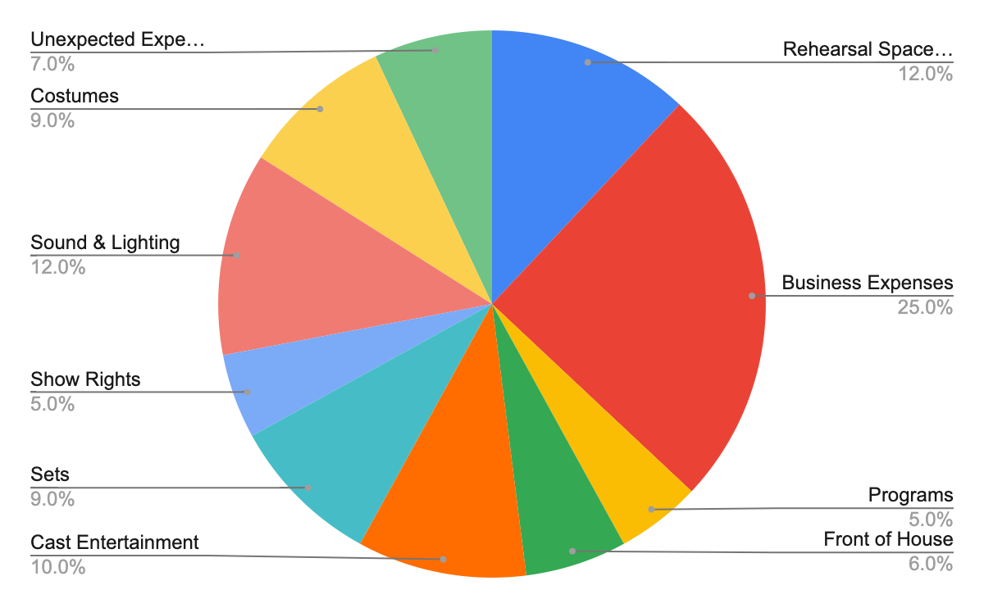
Expenses
Notes:
Business expenses: rehearsal space rental, storage unit, rental, advertising and marketing, graphic design fees, insurance, production supplies, web management and software, and audition/judges fees.

Slide 9
Sponsorships
We accept your company matching contributions (see Kelly Fieleke or Danielle Walker for information)
Important fundraising effort is the advertising sales in show program.
This is a great opportunity to advertise your services to the community.
Parent Ads are an important part of our program and the kids love them
Program sponsorship and advertising packet are available upon request
RJ Orthodontics has committed to a 10 year sponsorship!

Slide 10
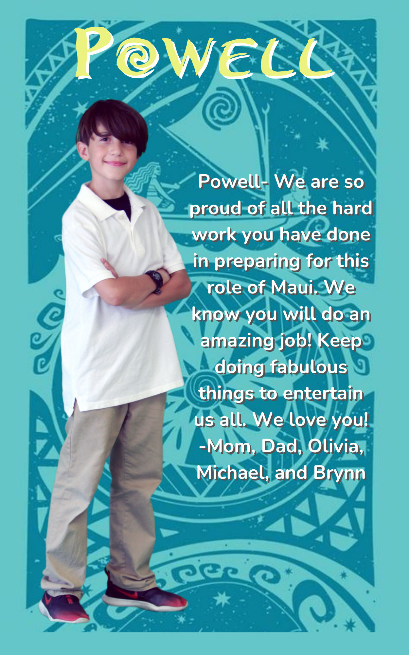
Sponsorships: Parent Ads

Slide 11
Communication
Weekly email updates Sunday evening
Add rpstboard@gmail.com to your address book!
Text 512-771-0374 (Vanessa) if you ever need to pick your child up early from practice (we keep the church doors locked)
Remind 101: Step 1: Enter this number: 81010 Step 2: Text this message: @rpstheatre
You can reply to text anytime if you have questions
Facebook- Like us so you can see videos and pictures of the rehearsals
Follow us on Instagram river_place_student_theatre
YouTube - River Place Student Theatre Practice videos

Slide 12
Rehearsals
Cast announced October 10th via email
Regular Rehearsals begin next Thursday, Oct 13th
Tuesday 3-5 PM - Full Cast rehearsal
Thursday 3-5 PM - Leads Only rehearsal
Starting January - Full cast comes both days!
Please do not leave practice early. Bring script, water bottle, closed toed shoes your child can dance in. Eat a healthy snack. Talk to your child about respecting our practice space, the volunteers and other kids.
Homework: Be part of your kid’s success by encouraging practice - Run lines, listen to the music in your car & make music accessible for your child to listen to at home. Watch practice videos on YouTube. Read all RPST communications to be sure your child is prepared.
Spirit Sticks- Kids are publicly rewarded for listening, participation and overall performance. Everyone will eventually get it!
Tech-week! Must attend every day: Feb 28th - March 4th

Slide 13
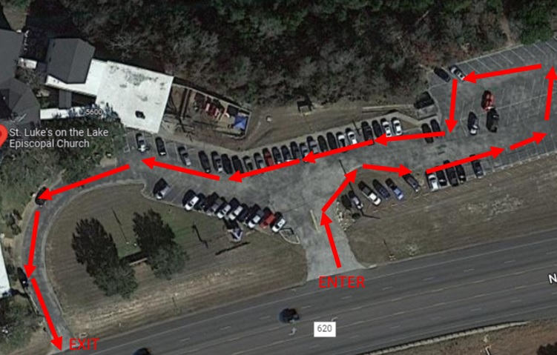
Production Changes for 2022-23
Volunteers will walk students from dropoff at St. Luke’s down to the practice space, and stay to help redirect kids as they practice or work with small groups. They help get kids into cars at dismissal.
All parents/caregivers need to have registered to volunteer in the LISD Volunteer System https://www.leanderisd.org/volunteering/ (make sure you select RPE as “campus”)
Each family needs to plan to help at 2 practice sessions https://www.signupgenius.com/go/70A0D49AFA72CA5FE3-practice (don’t worry, this link is also on the website & we will email out this link
Pick up at 5:00 PM at St. Luke’s Church
Please change transportation in the SDM app on Tuesdays and Thursdays
Give your hard working Production Team a hand - all have already donated their time and will donate at least 60 hours++ by showtime!

Slide 14
A Word About our Directors
Dionn Schaffner- Creative Director, choreographer
13 years
Ruthie Long- Vocal Director
8 years

Slide 15
A Word From Our Directors
Cast will be announced on Monday, Oct 10th
Final casting decisions for all leads done by a panel of judges
Judges are carefully selected and impartial. None of judges give classes to any cast member.

Slide 16
A Word From Our Directors
There are no small parts, only small actors!
Behavior expectations
More than 3 infractions, the actor will be dismissed from the cast
If absent, please send an e-mail or text to the Production team leads (Ellen or Mayra)

Slide 17
Important Dates - Now available at RPST.show!
10/10 Cast announcement
10/10 Club fees due
10/13 First normal day of rehearsal (leads only since it is Thursday)
10/25 Photo day (during rehearsal)
11/16 Actor Bios Due
1/3 Full cast rehearsals start Tuesday/Thursday
2/27 Tech-week!
SHOW TIME! ​
MARCH 3rd & 4th, 2022
Brentwood Christian

Slide 18
Questions?
Committee Break Out Sessions
Thank You!

