Slide 1
East regional waterline improvement project informational meeting
August 27, 2019
Presented by the Allen Water District
“This institution is an equal opportunity provider.”
3230 N. Cole Street
Lima, Ohio 45801
419-996-4679
allenwaterdistrict@allencountyohio.com

Slide 2
Meeting overview
Meeting Objective
Overview of the Allen Water District
Benefits of Public Water
History of the Project
Proposed Waterline Layout
Easement Acquisition
Use and Source of Funding
Estimated Cost to Property Owners
Waiver Information
Tentative Project Schedule
Questions

Slide 3
1. Meeting Objective
Tonight’s meeting objective is to present information to property owners regarding the proposed waterline layout, project costs and timelines.
Answer questions from the public and address concerns.
Connection to the waterline project is optional. Prior to completion of the waterline project, property owners will be given the opportunity to sign waivers to connect to the waterline project. The goal is to maximize the number of connections to the waterline in order to reduce the overall cost to individual property owners.

Slide 4
2. Overview of the Allen Water District
Allen Water District: A regional water district formed under Ohio Revised Code Section 6119, and as such, is a political subdivision of the State of Ohio. The District was formed on March 9, 1989 at the request and petition of four townships: American, Bath, Perry and Shawnee. Since the District’s formation, it has expanded its responsibilities to the balance of the 8 Townships through an agreement between the Board of County Commissioners and the District.
Mission statement: The Board of Trustees of the Allen Water District is committed to professionally managing and facilitating the installation of public water infrastructure and providing high quality and reliable public water to the customers of the District through cooperative agreements with other villages and cities supplying the water.
Board of Trustees: The Water District’s actions are directed by a seven member Board of Trustees: one appointed by American, Bath, Perry and Shawnee townships, one county member and two members-at-large.

Slide 5
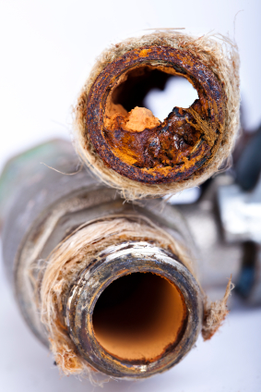
3. Benefits of Public Water
  Provides a safe, reliable drinking water supply.
Enhances fire protection by providing a dependable source of water.
In many cases, increased fire protection reduces homeowner’s insurance.
Increases marketability when selling home.
Eliminates the replacement of fixtures/electrical components due to corrosive water.
Eliminates the need for expensive and troublesome home water treatment systems/maintenance. Salt for softeners can run from $5-$25 for a 40 lb. bag depending on purity.
System | Treats | Initial Cost | Annual Maintenance | Life Cycle
Softener | Iron | $500 - $3,000 | $200/year and up | 10-15 years
Filtration System | Iron/Sulfur | $2,000 - $20,000 | $200/year and up | Filter Replacement

Slide 6
4. History of the Project
This project was initiated through a request made by the Village of Lafayette in 2014.
A Preliminary Water Study was completed in April of 2016 to determine the feasibility of the waterline project as well as waterline alignments, costs, pressures, etc. A subsequent request was received from the Village of Harrod to be made part of the project.
In July of 2017, the Allen Water District along with the City of Lima, the Allen County Commissioners and both Villages, entered into an Agreement to have a study completed to determine funding options for the project.
4. On June 26, 2019, an Informational Meeting was held with property owners and Councils from Harrod and Lafayette to present the project information.
5. The Villages of Harrod and Lafayette passed legislation necessary to move forward with the project at their respective July Council Meetings.
6. Property owner notification of initiation for project survey and design work.

Slide 7
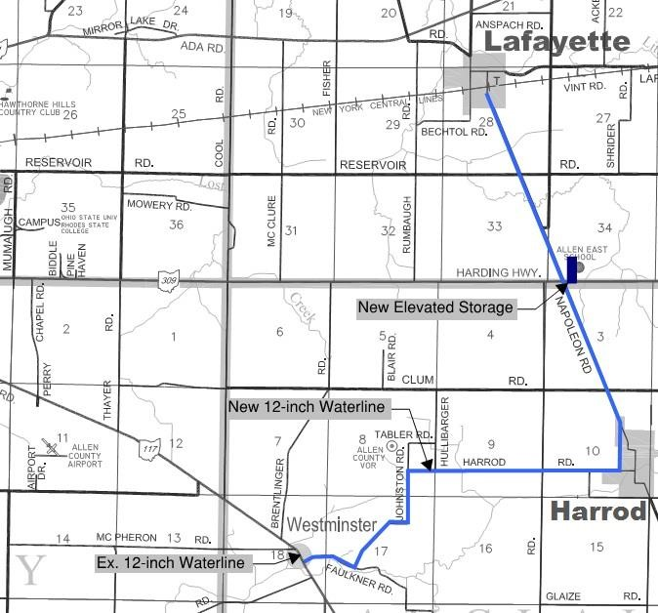
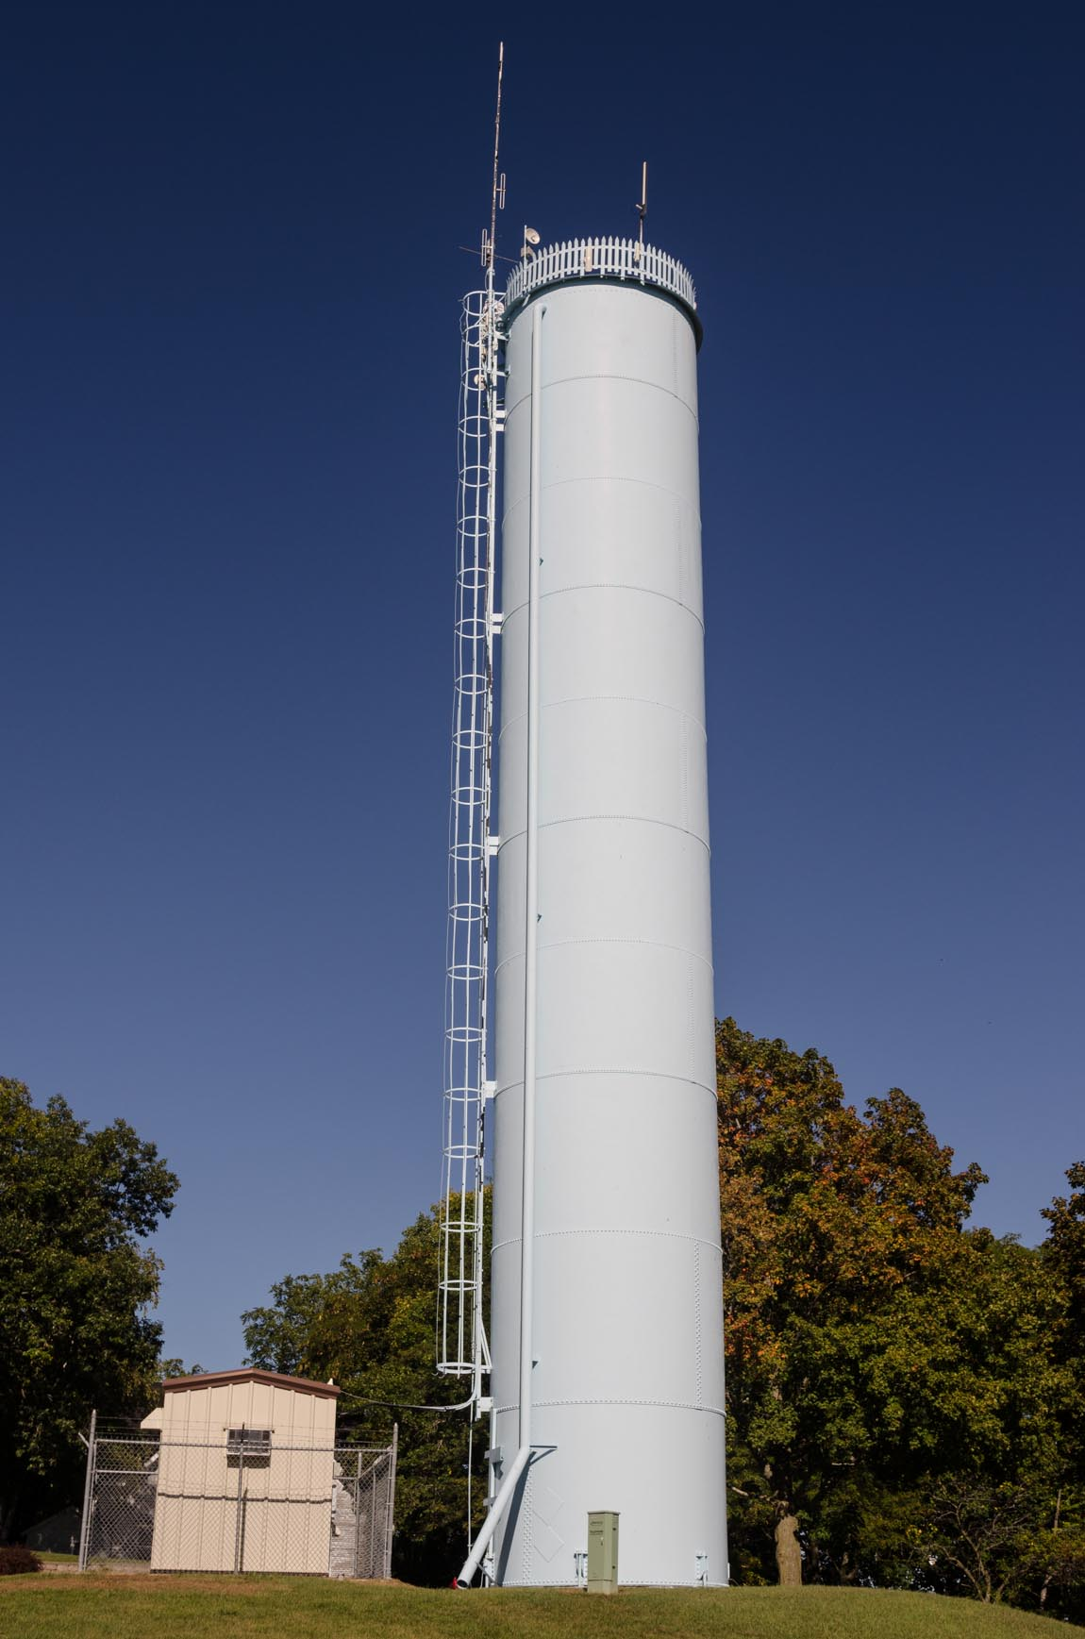
5. Proposed Waterline Layout
Waterline alignment: Ties into 12” line at Westminster and heads east to serve the Village of Harrod, then north on Napoleon Road to serve the Village of Lafayette. The project will include providing a 6” fire line to the Allen East School.
Waterline will consist of approximately 45,000 linear feet of 12” pipe and 27,000 linear feet of 8” pipe. This will include approximately 150 fire hydrants.
150,000 gallon standpipe would be located near the school to provide system pressure.

Slide 8
6. Easement Acquisition
You may be contacted to obtain a temporary or permanent easement for construction, operation and maintenance of the waterline.
If this is the case, you will be contacted by our office by mail with a letter outlining the easement process. Said mailing will include a cover letter, easement with value, description and map.
You can be compensated for the value of the easement or you may donate the easement for one dollar. The donation of easements does lower the project cost.
If you receive a packet in the mail, please complete and return as soon as possible. Feel free to contact the District with any questions.

Slide 9
7. Use and Source of Funding
Estimated Uses |  | Amount
Administrative and Legal |  | $100,000
Land Acquisition/Easements |  | $20,000
Engineering |  | $661,351
Inspection Fees |  | $372,058
Construction |  | $6,470,570
Contingency (10% of Construction Costs) |  | $647,057
Miscellaneous |  | $244,117
Total Estimated Project Cost (Uses) |  | $8,515,153
Estimated Sources |  | Amount
USDA RD Grant | 33.00% | $2,810,000
USDA RD Loan | 3.375% | $2,675,153
CDBG - W&S Competitive Grant (Lafayette) |  | $750,000
CDBG - W&S Competitive Grant (Harrod) |  | $750,000
OPWC - Loan (Lafayette) | 0% | $365,000
OPWC - Loan (Harrod) | 0% | $365,000
City of Lima Contribution |  | $250,000
Allen Co Sanitary Engineer Contribution |  | $150,000
Allen Water District Contribution |  | $250,000
Allen County Commissioners (RLF) |  | $150,000
Total Estimated Sources |  | $8,515,153

Slide 10
8. Estimated Costs to Property Owners
Waterline Project Cost by Debt Service:
Estimated Debt Service Calculation
Total Approximate Loan Amount = $3,405,153
Total Number of Estimated User Equivalencies within Villages (340) and Allen East School (44) = 340 ESFU’s
 | Village Residents Including Allen East School | Including 1/3 of Potential Outside Users
Customers (ESFU's) | 384 | 434
Principal Debt Service per ESFU | $8,867 | $7,845
USDA RD Loan (3.375% - 40 yrs) | $26.61 | $23.54
OPWC Loan (0% - 30 yrs) | $5.28 | $4.67
Total Estimated Monthly Debt Service | $31.89 | $28.21

Slide 11
8. Estimated Costs to Property Owners (cont’d)
Summary | Cost
Estimated Up-Front Property Owner Costs:
Connection Fee (City of Lima) | $500
Install Service Line - Property Owner Hires Contractor | $1,000
Estimated Monthly Property Owner Costs:
 | HH of 1 (1,800 gal/month) | HH of 2 (3,500 gal/month) | HH of 4 (6,000 gal/month)
Monthly Water Usage with COL Contract Fee (based on current City of Lima Water Rates) | $16.95 | $32.94 | $47.89
Allen Water District Administrative Fee | $7.00 | $7.00 | $8.50
Estimated Total Monthly Water Bill w/o Debt Service | $23.95 | $39.94 | $54.89
Estimated Monthly Debt Service (Waterline Project Cost) | $28.21-$31.89 | $28.21-$31.89 | $28.21-$31.89
Estimated Total Monthly Water Bill with Debt Service | $52.16-$55.84 | $68.15-$71.83 | $84.60-$88.28
*This fee is charged to cover the operating costs of the District as well as allow the District to make contributions to projects that might not otherwise be feasible. The District fees listed are based on the current fee schedule.

Slide 12
9. Waiver Information
The aforementioned project costs only apply to those property owners wishing to connect to the waterline.
Those property owners who want to be a part of the project will be given the opportunity to sign an Allen Water District Waiver and Consent Form for connection to the waterline prior to project completion.
The waiver will include a not-to-exceed amount meaning the property owner is committing to a cost of no more than what is identified on the waiver. The amount could however end up being less than the not-to-exceed amount if the final project costs come in lower.
More information will be given outlining the waiver process through mailings by the Allen Water District and at subsequent meetings.

Slide 13
10. Tentative Project Schedule
Informational Meeting with Property Owners with Allen Water District Customers (Outside the Villages) | August 27, 2019
Potential Pre-bid Project Meeting | December 2019/January 2020
Begin Construction | Spring 2020
Complete Construction | Spring 2021
Final Billing Notice | Summer 2021
Project Wrap-Up Meeting | Summer 2021

Slide 14
Questions? allenwaterdistrict@allencountyohio.com

