Slide 1
East regional waterline improvement project informational meeting
Presented by the Allen Water District
“This institution is an equal opportunity provider.”
3230 N. Cole Street
Lima, Ohio 45801
419-996-4679
allenwaterdistrict@allencountyohio.com

Slide 2
Meeting overview
Meeting Objective
Overview of the Allen Water District
Benefits of Public Water
History of the Project
Proposed Waterline Layout
Use and Source of Funding
Cost to Property Owners
Tentative Project Schedule
Questions

Slide 3
1. Meeting Objective
Tonight’s meeting objective is to present information to property owners regarding the proposed waterline layout, project costs and timelines.
Answer questions from the public and address concerns.
At the conclusion of tonight’s meeting, the Villages will be asked to make a decision on whether they would like to proceed with the waterline project by passing ordinances at their next Council Meetings.

Slide 4
2. Overview of the Allen Water District
Allen Water District: A regional water district formed under Ohio Revised Code Section 6119, and as such, is a political subdivision of the State of Ohio. The District was formed on March 9, 1989 at the request and petition of four townships: American, Bath, Perry and Shawnee. Since the District’s formation, it has expanded its responsibilities to the balance of the 8 Townships through an agreement between the Board of County Commissioners and the District.
Mission statement: The Board of Trustees of the Allen Water District is committed to professionally managing and facilitating the installation of public water infrastructure and providing high quality and reliable public water to the customers of the District through cooperative agreements with other villages and cities supplying the water.
Board of Trustees: The Water District’s actions are directed by a seven member Board of Trustees: one appointed by American, Bath, Perry and Shawnee townships, one county member and two members-at-large.

Slide 5
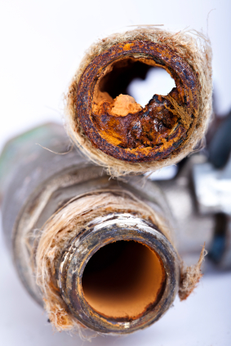
3. Benefits of Public Water
  Provides a safe, reliable drinking water supply.
Enhances fire protection by providing a dependable source of water.
In many cases, increased fire protection reduces homeowner’s insurance.
Increases marketability when selling home.
Eliminates the replacement of fixtures/electrical components due to corrosive water.
Eliminates the need for expensive and troublesome home water treatment systems/maintenance. Salt for softeners can run from $5-$25 for a 40 lb. bag depending on purity.
System | Treats | Initial Cost | Annual Maintenance | Life Cycle
Softener | Iron | $500 - $3,000 | $200/year and up | 10-15 years
Filtration System | Iron/Sulfur | $2,000 - $20,000 | $200/year and up | Filter Replacement

Slide 6
4. History of the Project
This project was initiated through a request made by the Village of Lafayette in 2014 to explore the possibility of providing public water to the Village.
A Preliminary Water Study was completed in April of 2016 to determine the feasibility of supplying public water to the Village of Lafayette including the potential waterline alignments, costs, pressures, etc.
A subsequent request was received from the Village of Harrod to be made part of the project study.
A Project Funding Committee was formed including a member appointed from each Village in order to keep both Villages involved in the process. This Committee meets monthly to provide project updates to the Village Representatives.
In July of 2017, the Allen Water District along with the City of Lima, the Allen County Commissioners and both Villages, entered into an Agreement to have a study completed to determine funding options for the proposed waterline project.

Slide 7
4. History of the Project (cont’d)
6. In order to determine the potential availability and level of funding from different funding agencies, 19 water samples were taken from a combination of both Villages to determine water quality. Random samples revealed some primary and secondary contaminants in the water:
Approximately 20% of the homes tested contained a Primary Contaminant above the Maximum Contaminant Level (MCL) determined by Ohio EPA.
Approximately 85% of the homes tested contained some Secondary Contaminant above the Secondary Maximum Contaminant Level (SMCL) determined by Ohio EPA.
Level of Contaminant | Contaminants Found
Primary | Total Coliform |  | Arsenic
Maximum Contaminant Level (MCL) | Either Present or Not Present |  | 10 ug/L MCL or higher
Secondary | Total Dissolved Solids | Iron | Manganese | Hardness
Secondary Maximum Contaminant Level (SMCL) | 500 mg/L | 0.3 mg/L | 0.05 mg/L | 120 to 150 mg/L

Slide 8
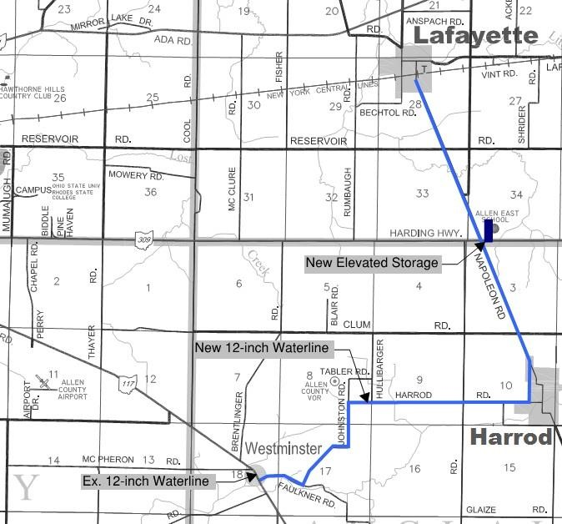
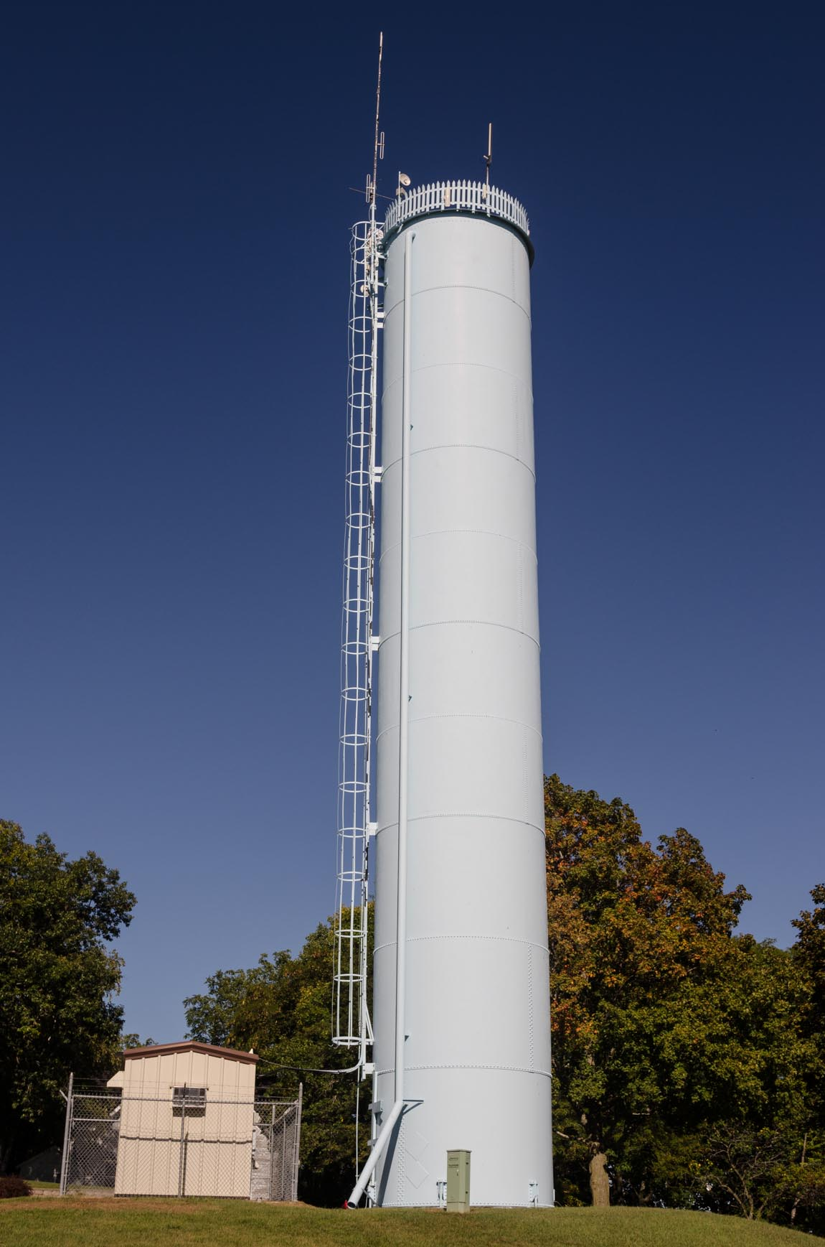
5. Proposed Waterline Layout
Waterline alignment: Ties into 12” line at Westminster and heads east to serve the Village of Harrod, then north on Napoleon Road to serve the Village of Lafayette. The project will include providing a 6” fire line to the Allen East School.
Waterline will consist of approximately 45,000 linear feet of 12” pipe and 27,000 linear feet of 8” pipe. This will include approximately 150 fire hydrants.
150,000 gallon standpipe would be located near the school to provide system pressure.

Slide 9
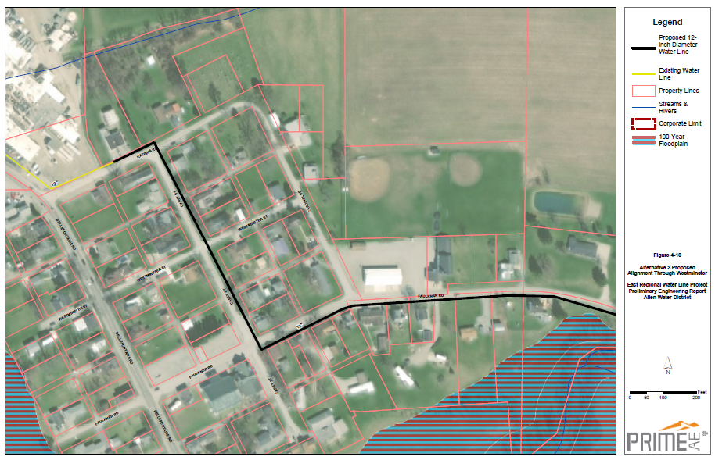
5. Westminster Proposed Waterline Layout (cont’d)

Slide 10
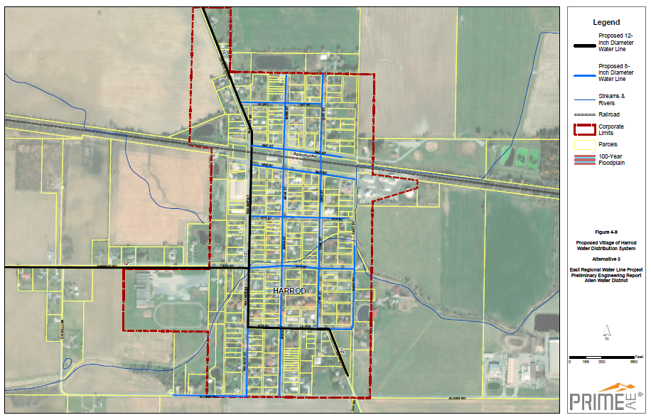
5. Village of Harrod Proposed Waterline Layout(cont’d)

Slide 11
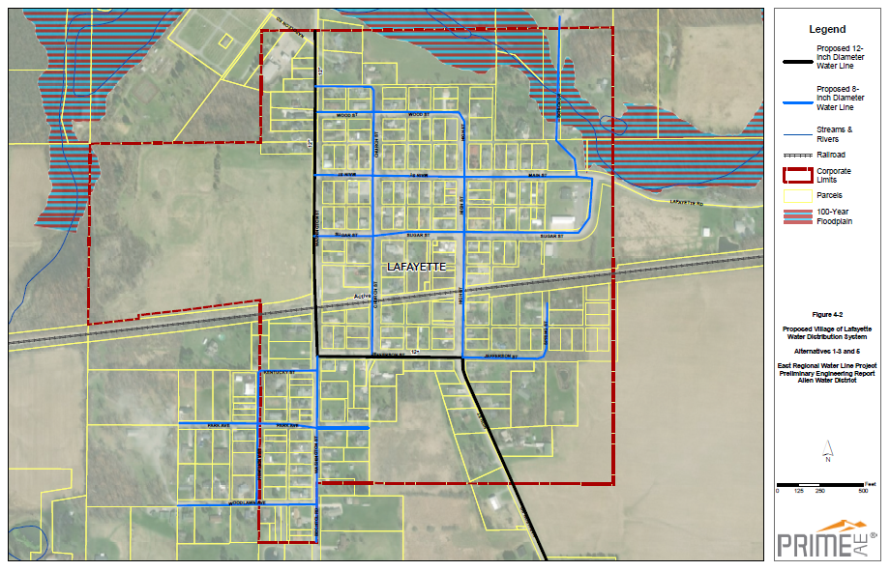
5. Village of Lafayette Proposed Waterline Layout(cont’d)

Slide 12
6. Use and Source of Funding
Estimated Uses |  | Amount
Administrative and Legal |  | $100,000
Land Acquisition/Easements |  | $20,000
Engineering |  | $661,351
Inspection Fees |  | $372,058
Construction |  | $6,470,570
Contingency (10% of Construction Costs) |  | $647,057
Miscellaneous |  | $244,117
Total Estimated Project Cost (Uses) |  | $8,515,153
Estimated Sources |  | Amount
USDA RD Grant | 33.00% | $2,810,000
USDA RD Loan | 3.375% | $2,675,153
CDBG - W&S Competitive Grant (Lafayette) |  | $750,000
CDBG - W&S Competitive Grant (Harrod) |  | $750,000
OPWC - Loan (Lafayette) | 0% | $365,000
OPWC - Loan (Harrod) | 0% | $365,000
City of Lima Contribution |  | $250,000
Allen Co Sanitary Engineer Contribution |  | $150,000
Allen Water District Contribution |  | $250,000
Allen County Commissioners (RLF) |  | $150,000
Total Estimated Sources |  | $8,515,153

Slide 13
7. Estimated Costs to Property Owners
Waterline Project Cost by Debt Service:
Estimated Debt Service Calculation
Total Approximate Loan Amount = $3,405,153
Total Number of Estimated User Equivalencies within the Villages of Harrod and Lafayette = 340 ESFU’s
Total Number of Estimated User Equivalencies for Allen East School = 44 ESFU’s
 | Village Residents Including Allen East School | Including 1/3 of Potential Outside Users
Customers (ESFU's) | 384 | 434
USDA RD Loan (3.375% - 40 yrs) | $26.61 | $23.54
OPWC Loan (0% - 30 yrs) | $5.28 | $4.67
Total Estimated Monthly Debt Service | $31.89 | $28.21

Slide 14
7. Summary of Estimated Costs to Property Owners
Description | Cost
Estimated Up-Front Property Owner Costs:
Connection Fee (City of Lima) | $500
Install Service Line -Property Owner Hires Contractor | $1,000
Estimated Monthly Property Owner Costs:
 | HH of 1 | HH of 2 | HH of 4
Monthly Water Usage with COL Contract Fee (based on current City of Lima Water Rates) | $16.95 (1,800 gal/month) | $32.94 (3,500 gal/month) | $47.89 (6,000 gal/month)
Estimated Monthly Debt Service (Waterline Project Cost) | $28.21-$31.89 | $28.21-$31.89 | $28.21-$31.89
*Allen Water District Administrative Fee | TBD | TBD | TBD
Estimated Total Monthly Water Bill | $45.16-$48.84 | $61.15-$64.83 | $76.10-$79.78
*An Allen Water District Administrative Fee shall be charged in the event the total bill based on a HH of 4 (usage of 6,000 gal/month) is less than $70/month. This fee shall be suspended for a period of 5 years if the total water bill comes in at or above $70/month.

Slide 15
9. Tentative Project Schedule
Tonight's Informational Meeting with Villages | Mid Year 2019
Legislation Considered by Villages to Move Forward with Project | July 2019
Begin Project Preliminary Design | July 2019
1st Public Meeting at Commissioner’s Office (tentative) | August 13, 2019 at 11 a.m.
2nd Public Meeting at Allen East School (tentative) | September 18, 2019 at 7 p.m.
Finalize Design | November 2019
Bid and Award Project | February 2020
Begin Construction | Spring 2020
Complete Construction | Spring 2021
Project Wrap-Up Meeting | Summer 2021

Slide 16
Questions?

Slide 17
Written Feedback From Village Residents
Please return by July 10th
Village of Harrod
Village of Lafayette
HarrodVillage@gmail.com
or
Sewer Drop Box
villageoflafayette@yahoo.com
or
Sewer Drop Box

