Slide 1
Finding Funding

Slide 2
Jessamyn Grace West
Founder, Executive Director
- Astoria Arts and Movement Center
www.astoriaartsandmovement.com/community
Executive Director
Astoria Downtown Historic District Association
www.astoriadowntown.com
Board President
Ten Fifteen Productions
www.thetenfifteentheater.com
Co-owner, Astoria Odd Fellows Building
www.jessamyngrace.com
503-791-5657
info@jessamyngrace.com

Slide 3
Please sign up for the Artist Registry!
https://www.oregonartscommission.org/
Receive information about upcoming programs and funding opportunities for individual artists.
Help ensure statewide funding opportunities reach communities across Oregon by letting us know who and where you are.
Help us create more comprehensive data about Oregon artists for planning and advocacy purposes.

Slide 4
What we’ll cover
Identify
Find it
Apply
Receive
Report
Utilize
Identify what you need funding for
Find the grant
Apply for the grant
Receive the award
Utilize the funding
Complete required reporting

Slide 5
What do you need funding for?
Project-Based Support
Play
Mural
Writer’s Group
General Operating Support
Rent
Income
Insurance

Slide 6
Where do you find funding?
Grants for individual artists can be trickier to find- there are more grants available to organizations
Some grants allow for artists to partner with an organization or use an organization as a fiscal sponsor
Start LOCAL!! Check for funding in your city, county and state
Network- join art collectives, organizations and connect with others in your artistic field
Never hesitate to contact a funding agency with questions
Enroll in grant writing workshops and classes
For organizations: https://www.instrumentl.com/

Slide 7
My favorite grants for Artists…

Slide 8
Oregon Arts Commission
Artist Relief Program
Provides general operating support due to financial hardship
$1k – 5k
2021/22 deadline tbd
Career Opportunity
supports artists by enabling them to take advantage of timely opportunities to enhance their artistic careers
$500 - $2k
Deadline: March 10, 2022
Individual Artist Fellowships
Visual Arts, Deadline: October 13, 2021
Performing Arts, Deadline: Fall 2022
Media Arts, administered by the NW Film Center
Literary Arts, administered by Literary Arts
Awards are up to 5k

Slide 9
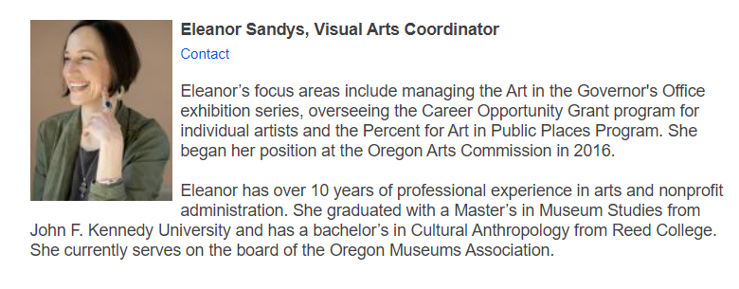
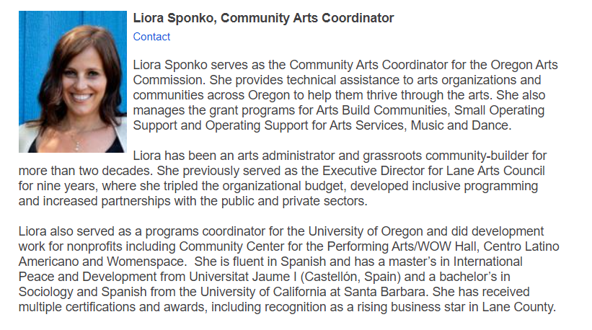
www.oregonartscommission.org
Eleanor Sandys
Visual Arts Coordinator
Oregon Arts Commission
(971) 707-3004
eleanor.sandys@oregon.gov
Liora Sponko
Senior Program Manager
Oregon Arts Commission
Oregon Cultural Trust
(971) 345-1641
Liora.SPONKO@oregon.gov

Slide 10
Clatsop County Cultural Coalition
Individuals may apply when sponsored by a non-profit fiscal agent
Arts (visual and performing), Culture and Humanities
Awards up to 2k
Deadline is October 31st, 5pm
Information@clatsopculturalcoalition.org
503-298-9258 or 503-791-6207
http://clatsopculturalcoalition.org/

Slide 11
Oregon Community Foundation
Field Artist Fellowship
Awards up to $100,000 over two years (operating support)
4 artists chosen every other year
Submit a proposal at https://www.oregonhumanities.org/
Creative Heights
$10,000 to $100,000 per project
Letters of inquiry (LOIs) will be accepted online starting January, 2022
Community Grants Program
For organizations but can be used for salaries

Slide 12
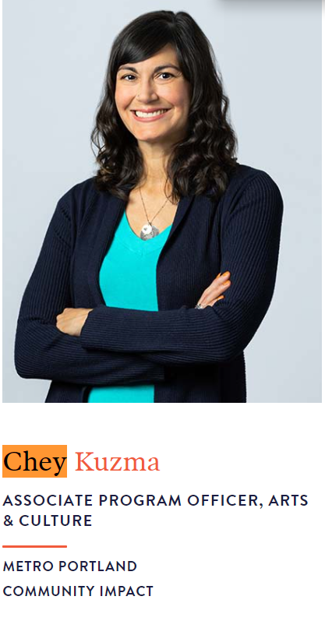
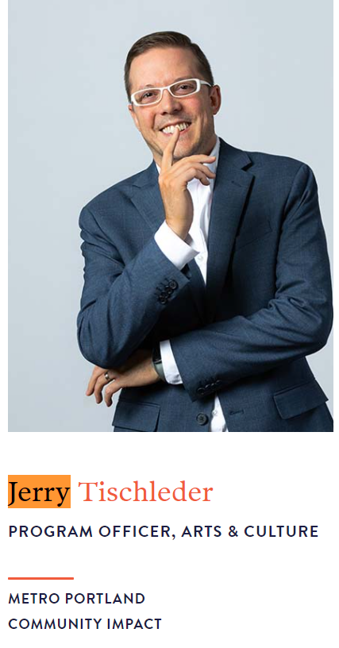
https://oregoncf.org/
Chey Kuzma
ASSOCIATE PROGRAM OFFICER, ARTS & CULTURE
(503) 227-6846 | ckuzma@oregoncf.org
Jerry Tischleder
PROGRAM OFFICER, ARTS AND CULTURE
(503) 227-6846 | jtischleder@oregoncf.org

Slide 13
More grants!
City of Astoria Arts and Culture Grant to Promote Tourism (only for organizations, also available in other cities throughout Clatsop County)
https://www.astoria.or.us/Grant_Applications.aspx
Ford Family Foundation Hallie Ford Fellowship
https://www.tfff.org/program-areas/visual-arts/hallie-ford-fellowships
PICA Precipice Grant
http://pica.org/precipice-fund
Regional Arts and Culture Council
https://racc.org/grants/
The Awesome Foundation
https://www.awesomefoundation.org/en/chapters/portland

Slide 14
How to Apply

Slide 15
Do your homework
Determine eligibility- read the fine print!
Can the project be completed within the required timeline?
Review the funding agency’s mission and funding priorities
If available, view past recipients and average grant award amount
Never hesitate to reach out to the grant contact

Slide 16
Application tips- getting started
Create an account in their system early
Stay organized- create appropriate folders
ALWAYS work in a word document, then paste into the online application
Take note of supplemental documents that may take time to acquire such as letters of support, permits, etc.
Make sure your website/social media pages are active and up to date
Name your project correctly

Slide 17
Application tips- the basics
What do you need funding for? What is your project?
How will you do it? Are partners involved?
How is it accessed?
Why is it needed?
How is it unique?
Who will it benefit? Who does it serve? How are those people involved?
What will be the outcome?
How will you measure its success?

Slide 18
Application tips- the questions
Make sure your project relates to the goal of the grant and the mission of the funding agency- you can actually use verbiage from the funder’s site
Consistently come back to your mission- this can be the mission of the organization or the goal of the project
Make sure you answer each ‘layer’ in each question
Make your case compelling- demonstrate your commitment to the artform, the cause, the community. Use your own voice in this narrative, tell your story and make it personal
Try not to use gatekeeping jargon, identify acronyms- keep things simple, to the point and powerful

Slide 19
Application tips- the budget
Project budget vs. organization’s budget (examples on next slide)
Keep it clear, concise, simple and in an easy to read layout such as excel
Must be reasonable/realistic- make sure the costs you list are allowed
Think of it as another way to demonstrate your ask- budgets are a thing, not an idea
Funders like to see support from other sources- the community, fundraising, board members, in-kind, matching funds
Make sure you answer the question about sustainability if asked- how will this project continue once the grant period has passed?

Slide 20
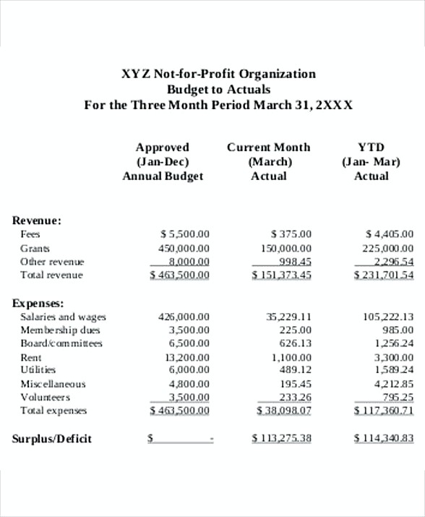

Slide 21
Application tips- submitting the grant
Review- have others review, read the application out loud, use spell check in word
Do you have all of the required documentation?
Optional materials- a short video, letters of support, etc
Submit all documentation (if uploading) in the required format using the correct naming convention (if none required keep it consistent)
Save a copy of the grant before submitting!
Submit at least 24 hours prior to the deadline!
Once submitted, add the follow up date to your calendar and mark ‘done’ if tracking grants

Slide 23
Follow-up
Send a personalized thank-you card
Share on social media (tag the funder), in local news media, etc
Set a calendar reminder for required reporting
Use the momentum to apply for other grants
Celebrate!

Slide 24
Questions?
Slides: https://astoriaartsandmovement.com/community
503-791-5657
info@jessamyngrace.com
www.jessamyngrace.com

