Slide 1


Cost-Benefit Analysis and
Return on Investment
CNB-CBAROI-01.03
Revision Date: 04/01/2016

Slide 2
Introduction
Think of a past training program.
Was it worth it?
Why or why not?
Please share an example.

Slide 3

Purpose
The purpose of this course is to teach you how to develop and present both CBA and ROI on training programs.

Slide 4

Terminal Objective
At the conclusion of this training, the learner will be able to conduct a CBA and ROI on a training program.

Slide 5
Enabling Objectives
After completing this section, the learner will be able to:
  Define CBA.
  Define ROI.
  Develop a CBA and ROI report.

Slide 6
What is a CBA?

Slide 7

CBA (Cost Benefit-Analysis)
A systematic approach to estimate the strengths and weaknesses of training investments by comparing costs to benefits.

Slide 8
What is an ROI?

Slide 9

ROI (Return on Investment)
A way to measure an investment's profitability, showing how much profit (or loss) you made compared to the initial cost.

Slide 10
Developing a CBA with ROI

Slide 11
Step 1.
Identify all costs categories and assign a dollar value to all cost.

Slide 12
Step 1. Identify all costs categories and assign a dollar value to all cost.
  Identify Direct Costs
    Trainer Fees, Travel, Materials, Facility/Venue Costs, Equipment or Technology
  Identify Indirect Costs
    Employee Time/Wages, Manager Time, Administrative Support, Opportunity Costs

Slide 13
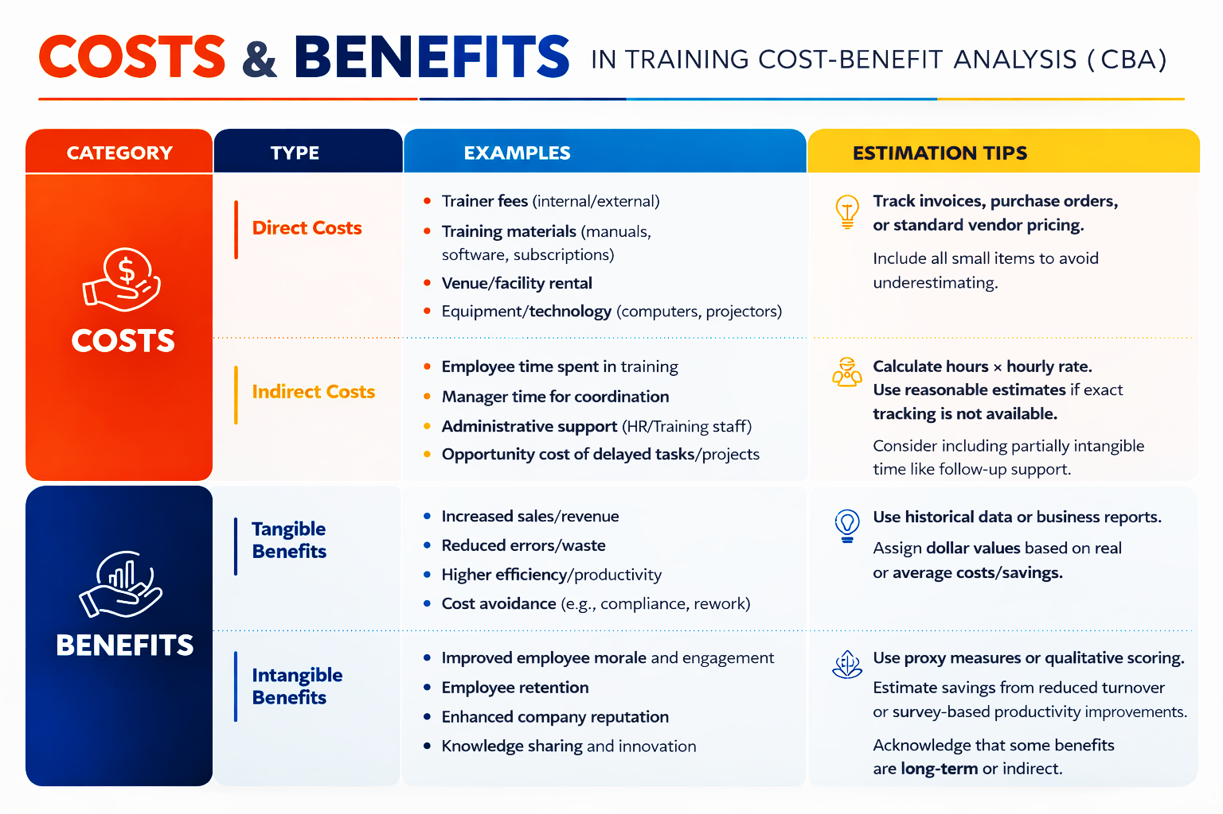

Slide 14
Step 1. Identify all costs categories and assign a dollar value to all cost.
  Assign Values to Costs
    Make assign values as accurate as possible.
  Total up all Costs
    Add everything up!

Slide 15
Step 2.
List all benefits and assign a monetary value to them.

Slide 16
Step 2. List all benefits and assign a monetary value to them.
  Identify and list all Tangible Benefits
    Increaded sales/revenue, reduction in errors/incidents/waste, higher efficiency/productivity, cost avoidance.
  Identify and list all Intangible Benefits
    Improved employee satisfaction/morale/engagement, increased employee retention, enhanced company reputation, innovation and knowledge sharing.

Slide 18
Step 2. Identify all costs categories and assign a dollar value to all cost.
  Assign Monetary Values to both Tangible and Intangible Benefits
    Make assign values on tangibles as accurate as possible.
    Estimate assigned values on intangible items.
  Total up all Benefits
    Add everything up!

Slide 19
Step 3.
Calculate the Net Benefit

Slide 20
Step 3. Calculate the Net Benefit
  Use the Costs totals and Benefit totals.
  Formula
        Total Benefits – Total Costs = Net Benefit
      Example Calculation:
        Total Benefits 4,900 – Total Costs 4,320 = 580
Notes:
Interpretation: A positive net benefit means the training provides value above the investment.

Slide 21
Step 4.
Calculate the ROI %

Slide 22
Step 4. Calculate ROI (Return on Investment)
  Use the Costs totals and Net Benefit total.
  Formula
        (Net Benefit ÷ Total Costs) x 100 = ROI (%)
      Example Calculation:
        (580 ÷ 4,320) x 100 = 13.4%
Notes:
Interpretation: For every dollar invested, the company gains about $0.13 above costs. A positive ROI supports moving forward with the training.

Slide 23
Example Study & Exercise

Slide 24
Please locate your Example Study packet.

Slide 25
Summary
Any questions?

Slide 26


