Slide 1


Global Urban Infrastructure: A Comprehensive Analysis of the World's 1000 Largest Cities
This presentation explores the critical infrastructure parameters across the world's 1000 largest urban centers. We'll examine transportation networks, vehicle usage, smart facility distribution, operational costs, and environmental impacts that shape modern cities. Our analysis provides valuable insights for urban planners, policymakers, and technology providers focused on creating more efficient, sustainable, and livable urban environments.
Smart Mobility Center v1

Slide 2
Understanding Urban Infrastructure Parameters
1 | Length of freeways in miles
2 | Length of arterial roads in miles
3 | Length of urban surface streets in miles
4 | Length of bus routes in miles
5 | Addressable population for services
6 | Number of buses
7 | Number of private cars
8 | Number of urban delivery vehicles
9 | Number of deliveries per day
10 | Number of taxis
11 | Number of rental cars
12 | Number of parking spaces
13 | Number of smart factories
14 | Number of smart education facilities
15 | Number of smart healthcare facilities
16 | Annual vehicle miles traveled (VMT) per capita
17 | Proportion of VMT by private car
18 | Proportion of VMT by truck
19 | Average cost of urban package delivery in dollars
20 | Number of electric vehicle charging points
21 | Current population of the United States of America
22 | Number of gas stations in the United States of America
23 | Population served per gas station
24 | private car operating cost dollars per mile
25 | urban truck operating cost dollars per mile
26 | private car emissions cost dollars per mile
27 | urban truck emissions cost dollars per mile
28 | electric vehicle operating cost reduction
29 | electric vehicle emissions reduction
30 | Fatalities per 100,000 population per year
31 | Injured persons per 100,000 population per year
32 | Value of time in dollars per hour
33 | average time spent traveling per person per day( minutes)
34 | cost of managing 1TB of data
35 | average data volume per day (terabytes)

Slide 3
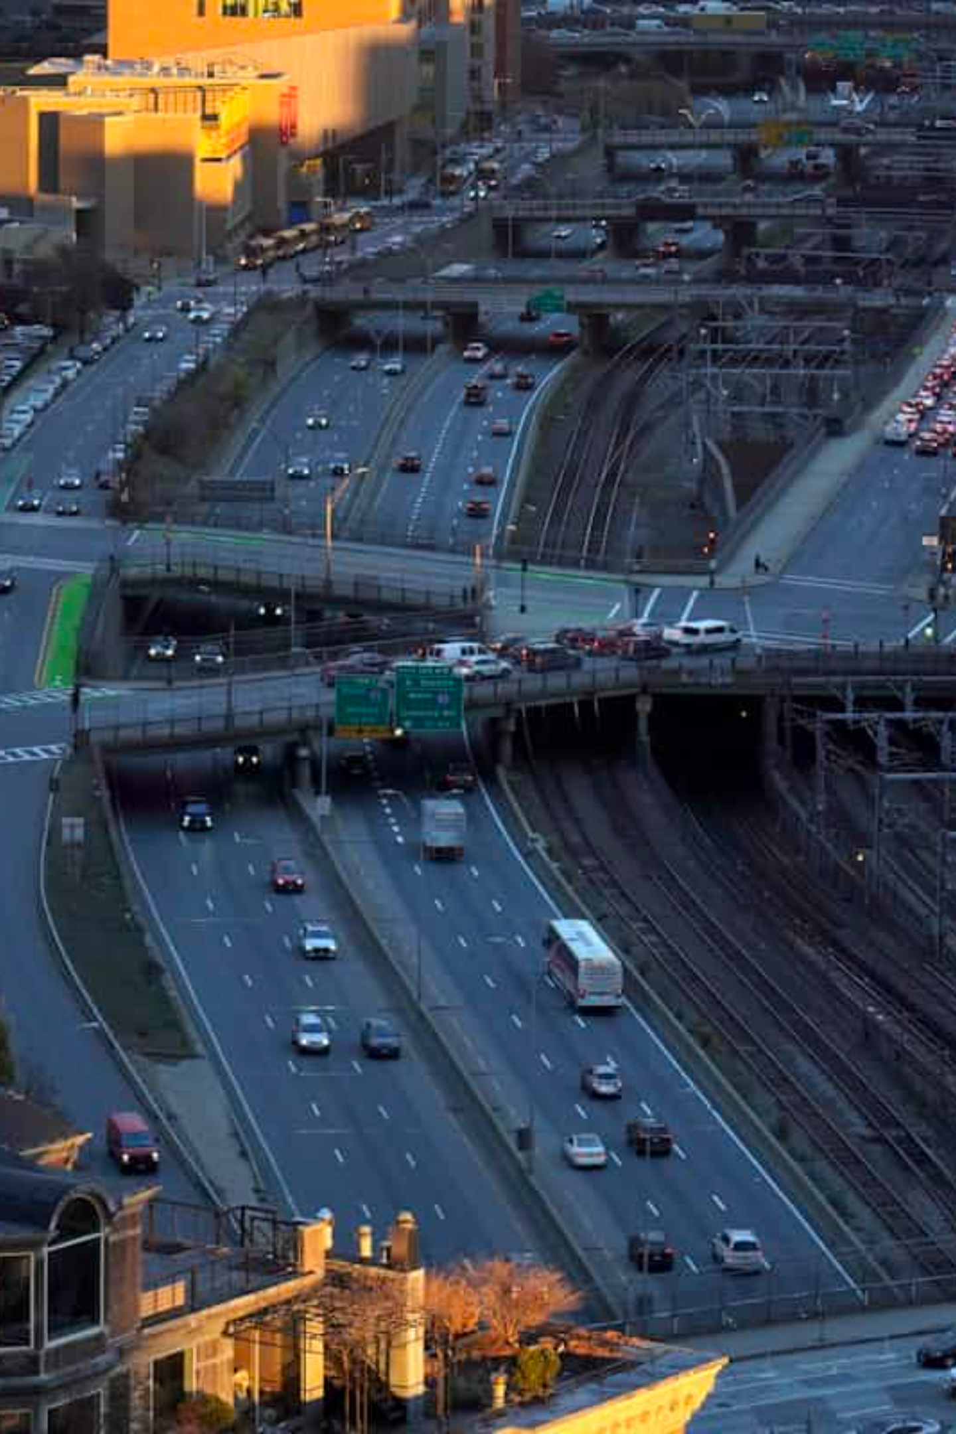
Understanding Urban Infrastructure Parameters
Transportation Networks
Cities are defined by their complex transportation networks, including freeways, arterial roads, surface streets, and public transit routes. The density and extent of these networks directly impact mobility, economic activity, and quality of life for residents.
Vehicle Ecosystems
The composition of vehicle fleets—from private cars to buses, delivery vehicles, taxis, and rental services—shapes how people and goods move throughout urban environments. These vehicle ecosystems are rapidly evolving with new technologies and service models.
Smart Infrastructure
Modern cities increasingly incorporate smart technologies into factories, educational facilities, and healthcare centers. These smart infrastructures leverage data and connectivity to improve efficiency, sustainability, and service delivery.

Slide 4

Methodology and Data Collection
Comprehensive Parameter Set
Infrastructure Metrics: Freeway length, arterial roads, surface streets, bus routes
Our analysis examines 35 distinct parameters for each city, ranging from physical infrastructure measurements to operational metrics and environmental impacts. This holistic approach provides a complete picture of urban mobility systems.
Vehicle Metrics: Private cars, buses, delivery vehicles, taxis, rental cars
Data sources include municipal transportation departments, urban planning agencies, national censuses, transportation research institutions, and global organizations like the World Bank and United Nations Human Settlements Programme.
Operational Metrics: Vehicle miles traveled, delivery costs, charging infrastructure
Efficiency & Impact: Operating costs, emissions, safety statistics, data management

Slide 5
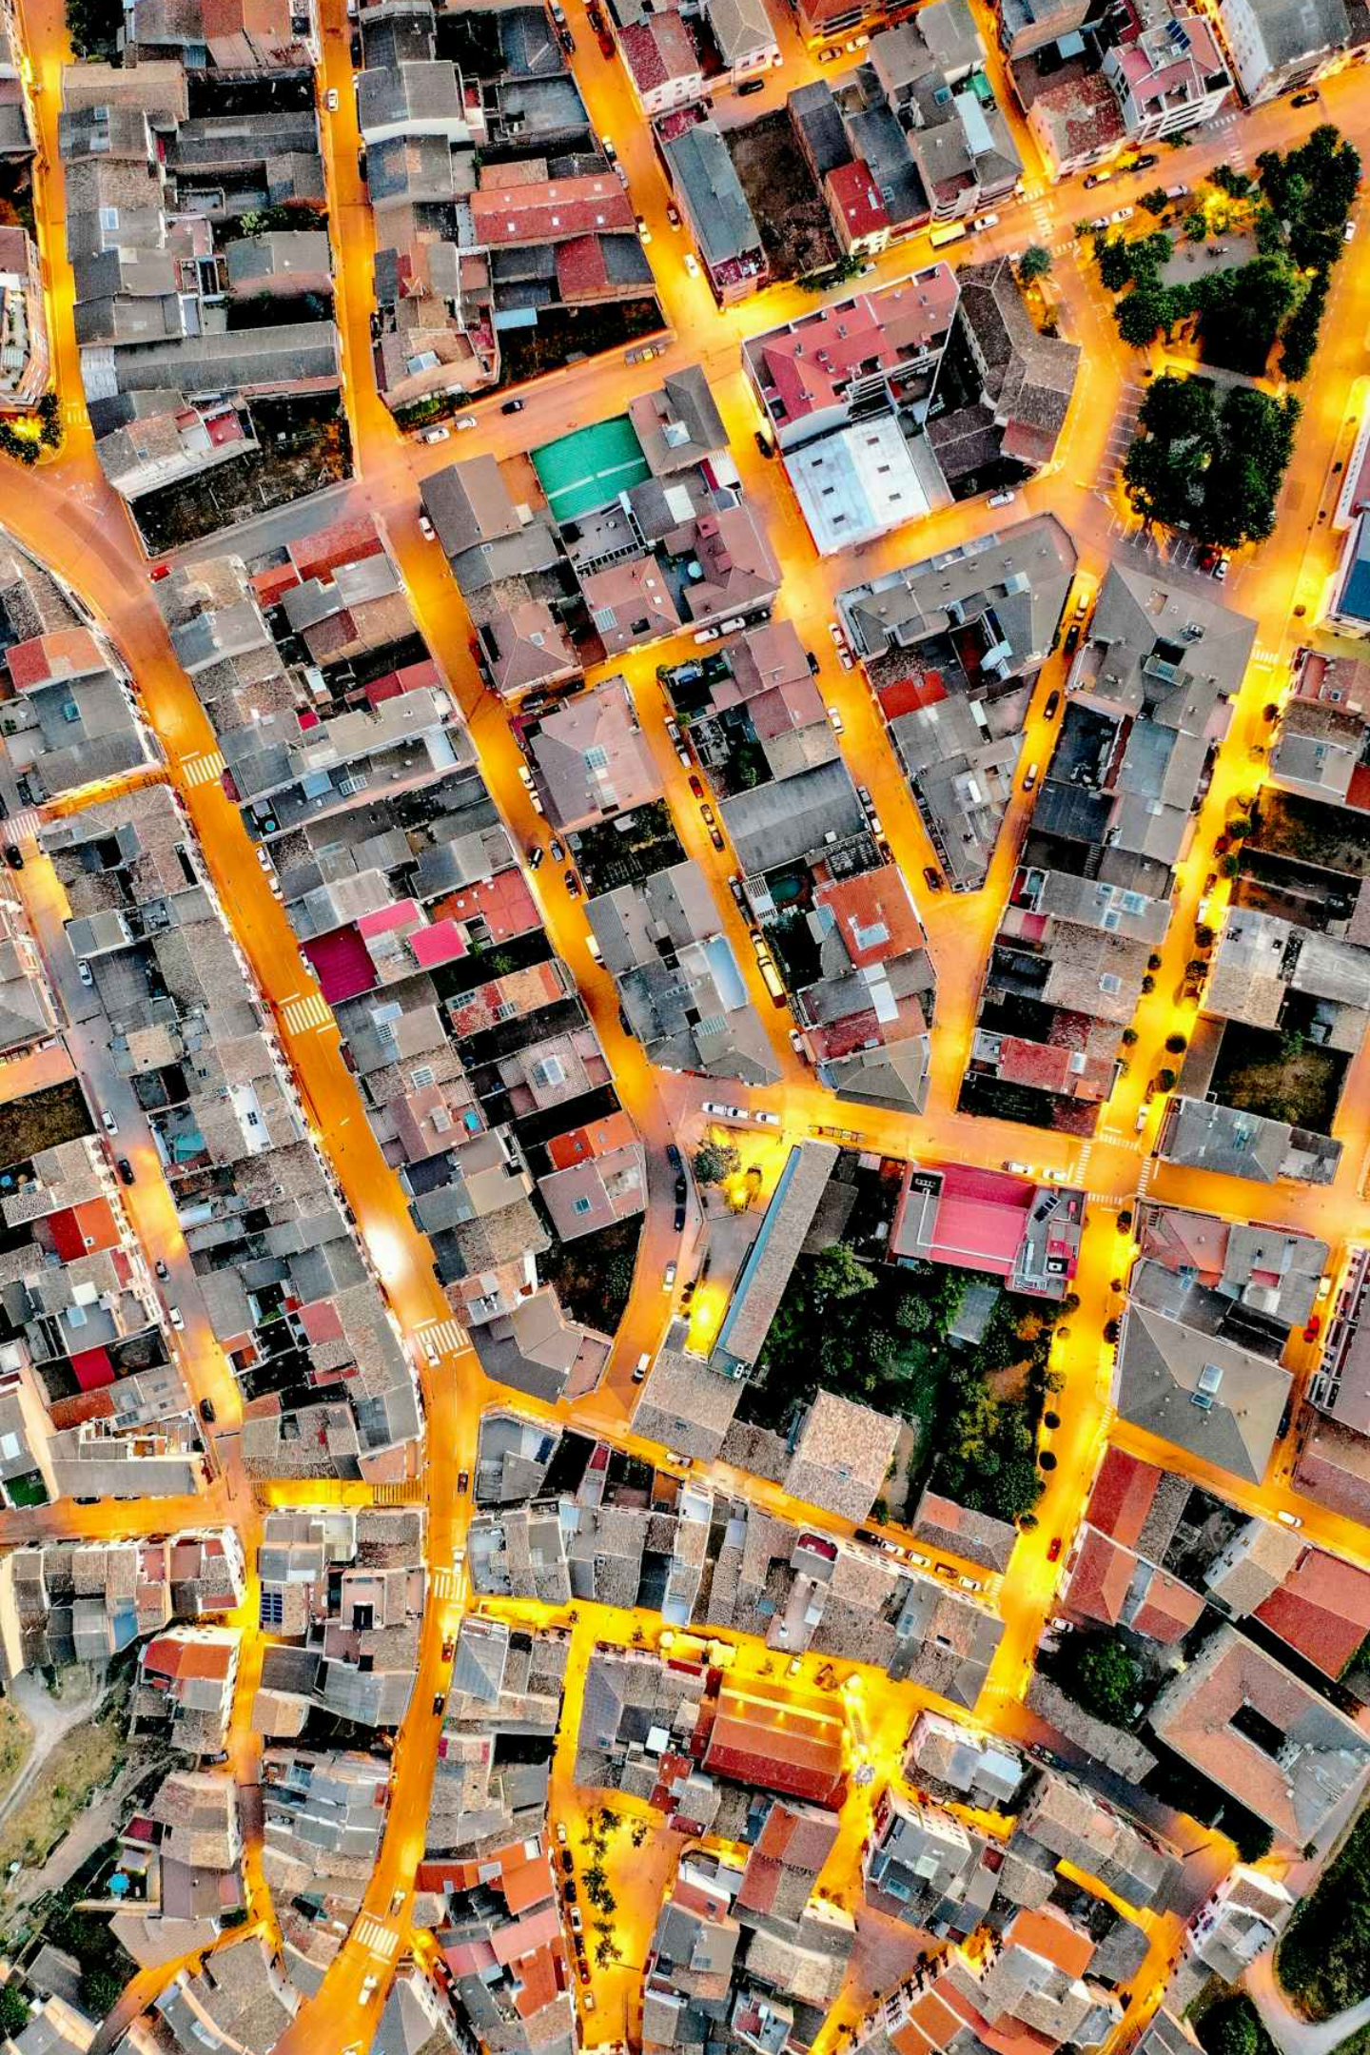
City Classification Methodology
Population-Based Classification
Cities are categorized into four tiers based on population: Megacities (10M+), Large Metropolises (5-10M), Mid-sized Cities (1-5M), and Small Cities (500K-1M). This classification helps identify how infrastructure scales with population size.
Regional Grouping
Cities are further grouped by geographic region: North America, Latin America, Europe, Middle East & North Africa, Sub-Saharan Africa, South Asia, East Asia, Southeast Asia, and Oceania. This allows for regional trend analysis.
Economic Development Consideration
Analysis accounts for economic development levels using World Bank income classifications (high, upper-middle, lower-middle, and low income), recognizing that economic factors significantly influence infrastructure development.

Slide 6
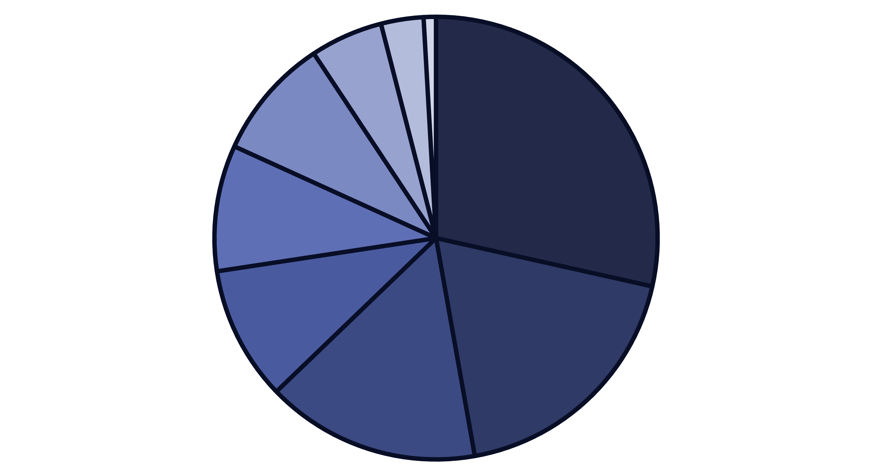
Global Distribution of the 1000 Largest Cities
East Asia
South Asia
Europe
North America
Latin America
Africa
Middle East
Southeast Asia
Oceania
The distribution of the world's largest cities reflects global population patterns and urbanization trends. East Asia dominates with 285 cities, primarily in China, while South Asia follows with 187 cities, mostly in India. Europe and North America, despite their economic influence, have fewer mega-cities due to earlier urbanization and more distributed population patterns.

Slide 7
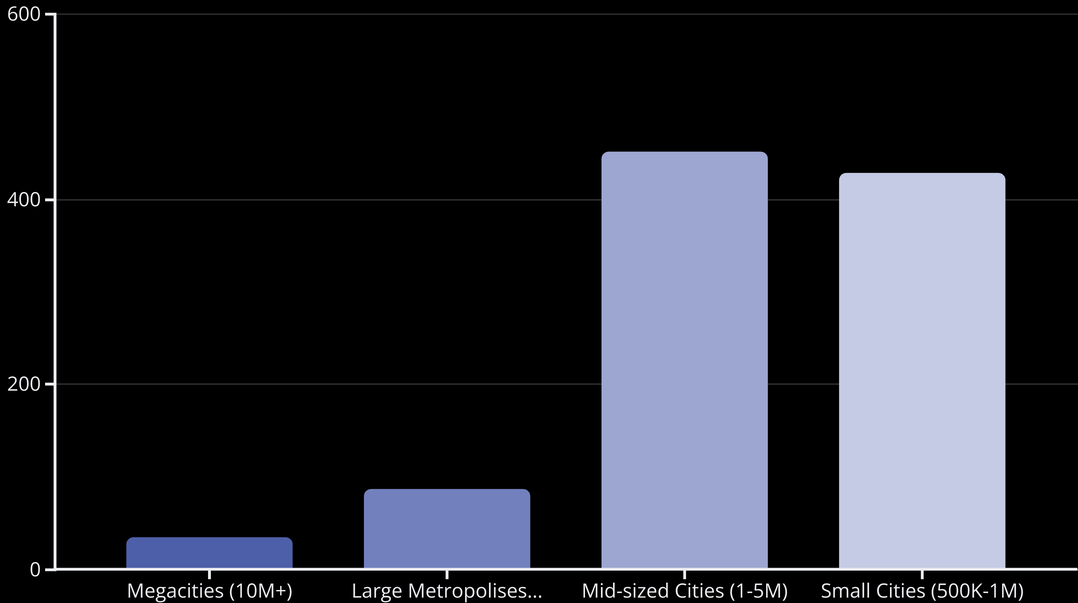
Population Size Distribution
Mid-sized cities (1-5 million residents) comprise the largest segment of our analysis at 45.2% of all cities studied. These urban centers face the dual challenges of managing rapid growth while updating aging infrastructure. Small cities (500K-1M) represent 42.8% of the dataset, while true megacities with populations exceeding 10 million account for only 3.4% of cities but contain a disproportionate 18% of the total urban population in our study.

Slide 8
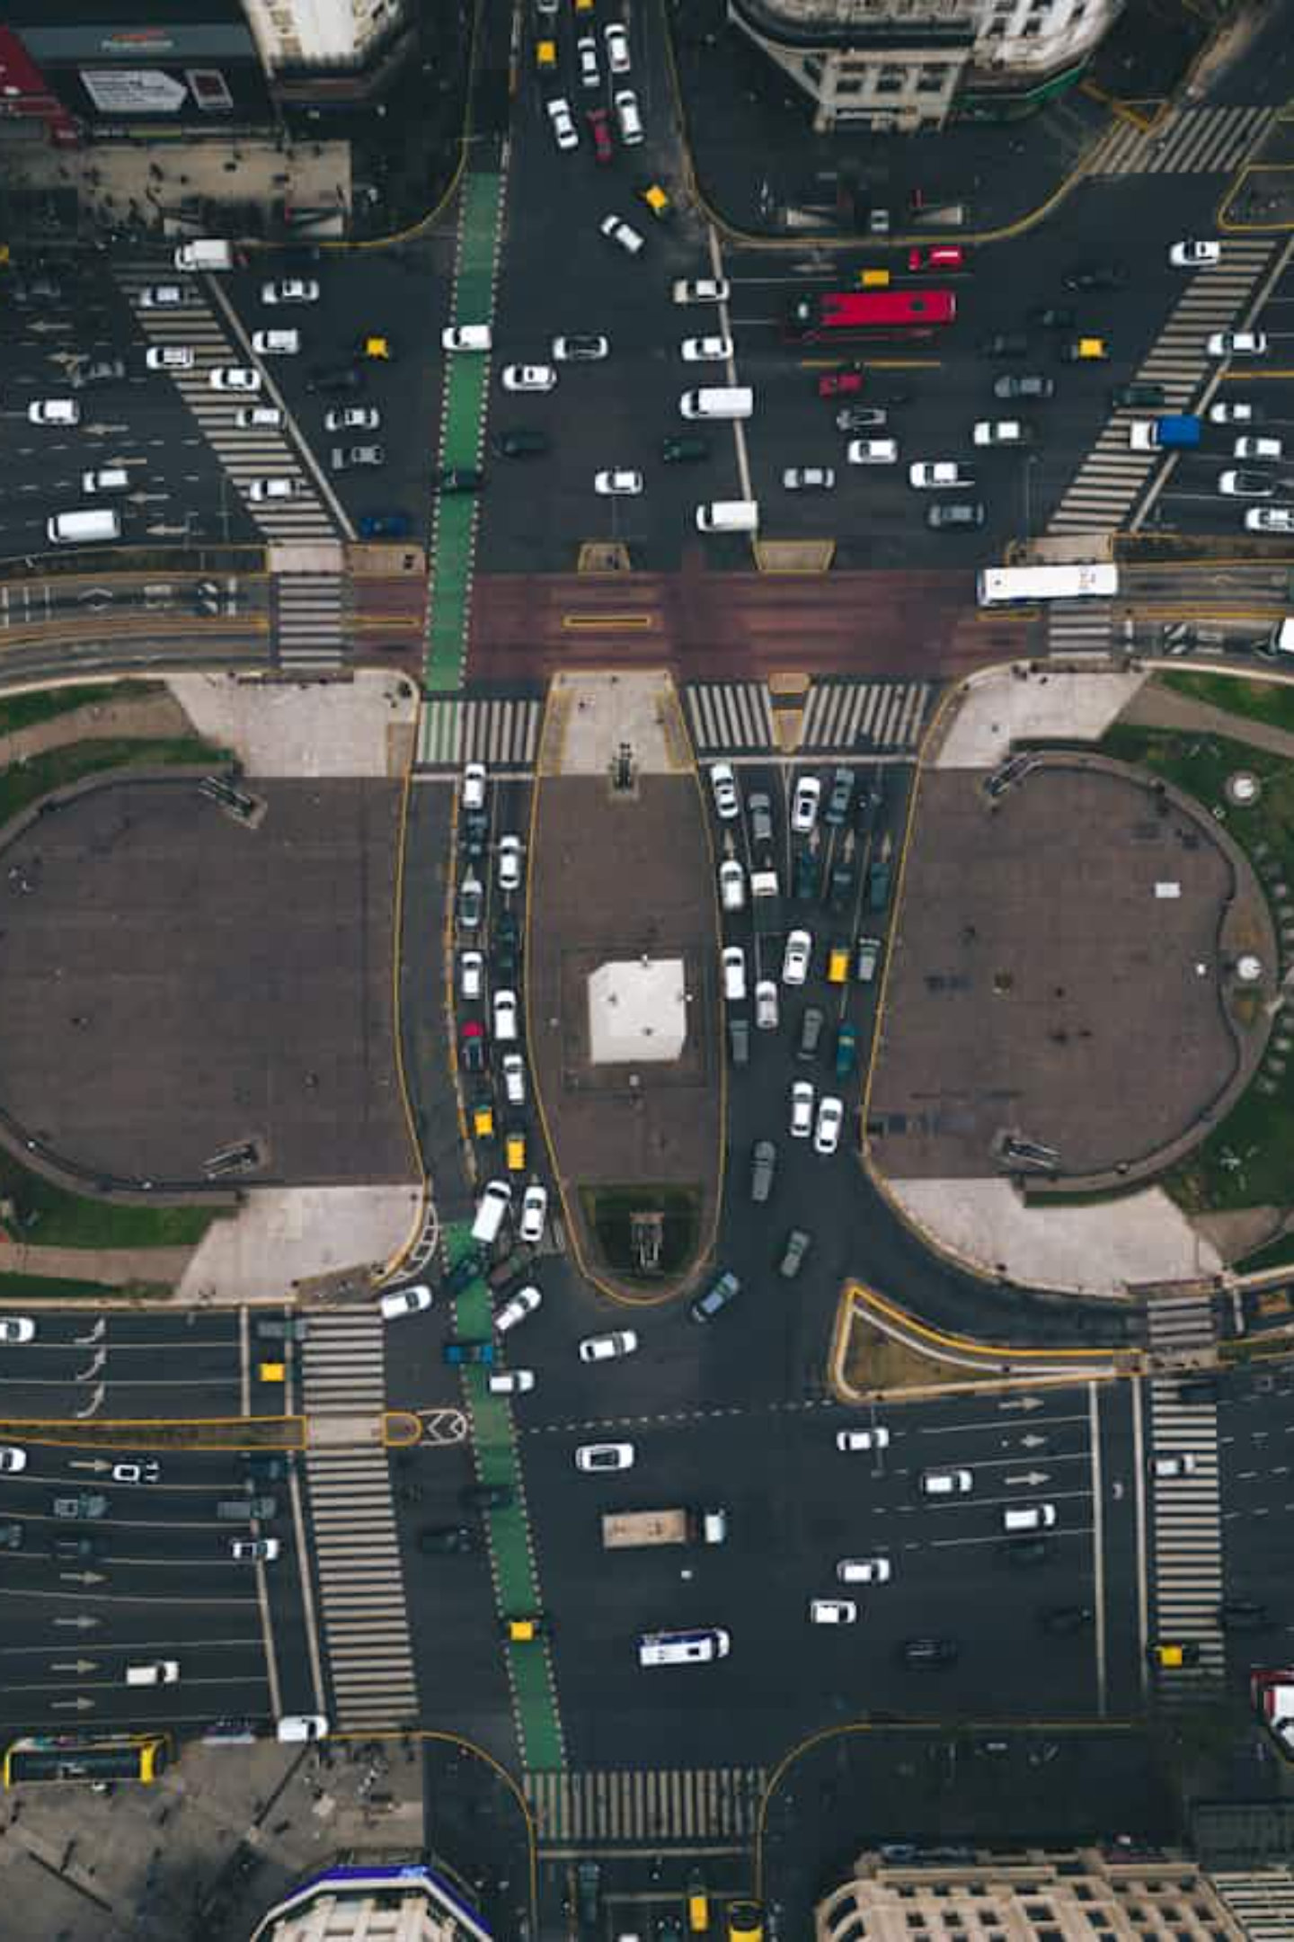
Transportation Infrastructure: Road Networks
27,500
42,800
128,400
Average Freeway Miles
Average Arterial Road Miles
Average Surface Street Miles
In megacities (10M+ population), reflecting extensive networks needed to connect sprawling urban regions
In megacities, serving as the primary corridors for moving large volumes of traffic between freeways and local streets
In megacities, forming the capillary network that provides access to individual destinations and neighborhoods
Road network extent scales with city size but not linearly. Megacities often have proportionally fewer road miles per capita than smaller cities due to higher density development and more extensive public transit systems. Regional differences are significant, with North American cities averaging 48% more road miles per capita than comparable Asian cities.

Slide 9
Transportation Infrastructure: Public Transit
14,750
2,840
Public transit infrastructure shows significant regional variations, with European and East Asian cities investing more heavily in comprehensive systems. The average megacity operates nearly 3,000 buses, though this number varies dramatically from over 16,000 in cities like São Paulo to under 1,000 in car-dependent cities.
Avg Bus Route Miles
Average Bus Fleet
In megacities, providing essential connectivity across urban regions
For megacities, with wide regional variations based on transit investment
Bus route miles correlate strongly with population size but also reflect policy priorities and historical development patterns. Cities with well-developed rail systems often have complementary rather than extensive bus networks.

Slide 10
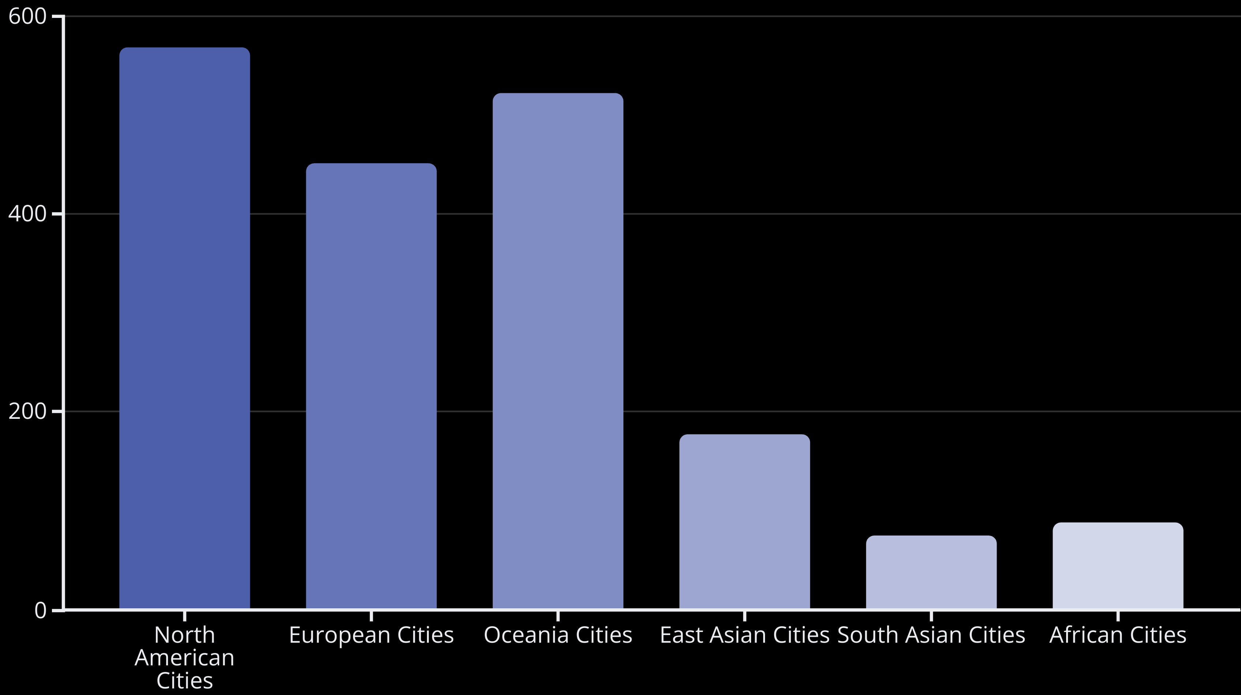
Vehicle Ecosystems: Private Cars
Private car ownership varies dramatically across regions, reflecting economic conditions, cultural factors, and urban planning approaches. North American cities lead with an average of 568 cars per 1,000 residents, nearly eight times higher than South Asian cities. This disparity affects everything from road design to parking requirements and environmental impacts.

Slide 11
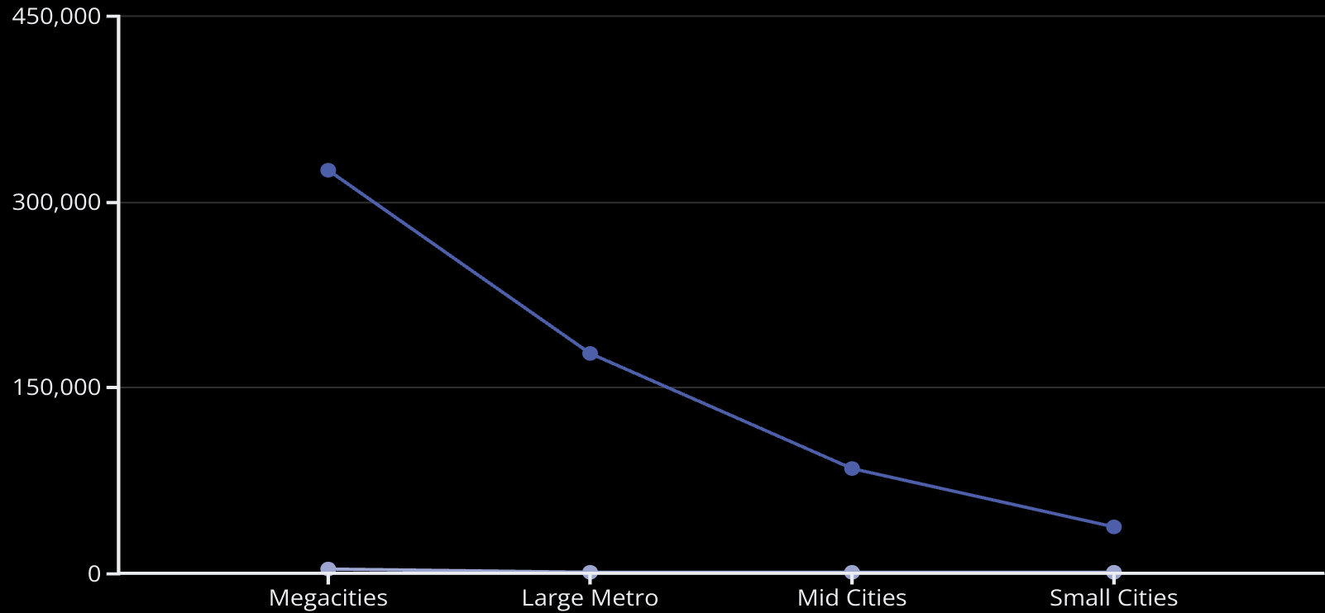
Vehicle Ecosystems: Urban Delivery
Urban delivery vehicles are a rapidly growing segment of city traffic, driven by e-commerce and on-demand services. The average megacity now hosts over 325,000 delivery vehicles making nearly 3 million deliveries daily.
The number of delivery vehicles scales with population size but has grown disproportionately in recent years, with a 47% increase since 2018 across all city categories. This growth is challenging urban planners to accommodate increased curb access demands and address associated congestion and emissions.
Avg Delivery Vehicles
Daily Deliveries (1000s)

Slide 12
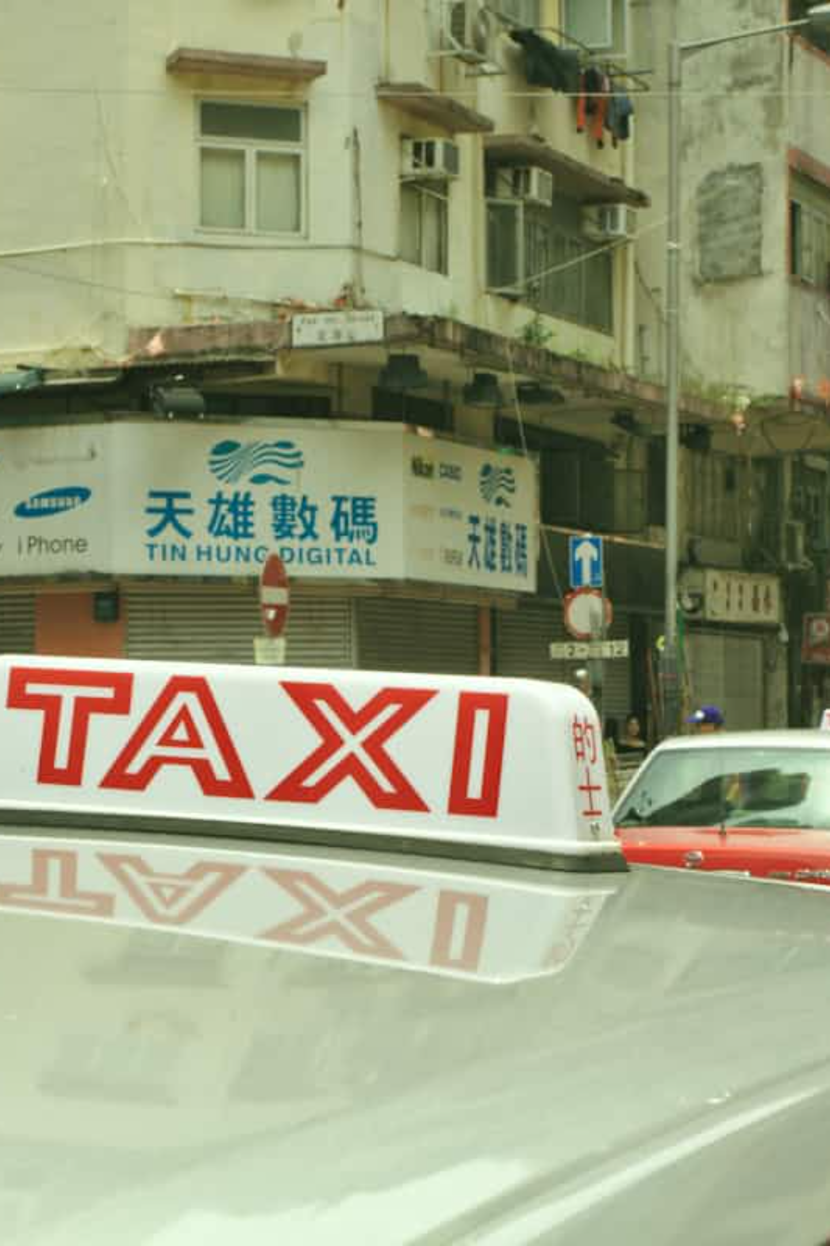
Vehicle Ecosystems: For-Hire Services
78,500
14,200
12.8M
Average Taxis & Rideshares
Average Rental Cars
Daily For-Hire Trips
In megacities, providing critical mobility services for residents and visitors
Available across megacities, serving business travelers and tourists
Completed in megacities, representing 14% of all trips in these urban centers
For-hire vehicle services, including traditional taxis, ride-hailing platforms, and rental cars, form an increasingly important component of urban mobility ecosystems. These services fill gaps in public transit and provide alternatives to private car ownership. Asian megacities show the highest taxi density, while North American cities lead in rideshare adoption. The for-hire segment continues to evolve rapidly with new business models and technologies.

Slide 13
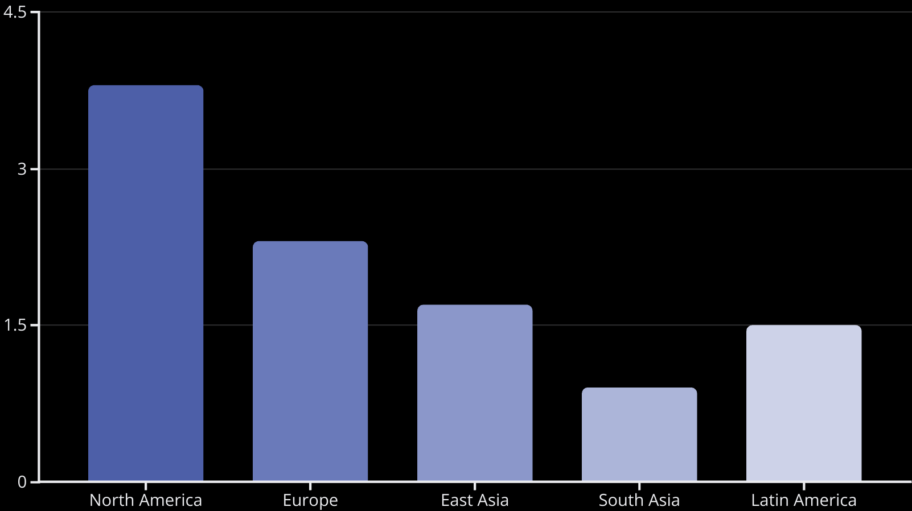
Urban Parking Infrastructure
Parking infrastructure represents one of the largest land uses in urban areas, particularly in car-dependent regions. North American cities lead with an average of 3.8 parking spaces per registered vehicle, dedicating approximately 20-30% of urban land to parking.
More transit-oriented cities in Europe and Asia have significantly lower parking ratios, with many implementing policies to reduce parking supply as part of sustainable mobility strategies. Parking management is increasingly recognized as a powerful tool for influencing travel behavior and urban form.

Slide 14






Smart Urban Infrastructure: Overview
Smart Education
Educational institutions leveraging connected technologies, digital learning tools, and smart building management to enhance learning outcomes and operational efficiency. These facilities are reshaping how knowledge is shared.
Smart Factories
Manufacturing facilities equipped with IoT sensors, automation, and data analytics to optimize production, reduce waste, and minimize environmental impact. These facilities represent the cutting edge of Industry 4.0 principles.
Smart Healthcare
Medical facilities utilizing connected devices, telehealth capabilities, and advanced data systems to improve patient care, optimize resource allocation, and enhance diagnostic capabilities and treatment options.
Smart urban infrastructure is transforming how cities deliver essential services across industrial, educational, and healthcare sectors. These connected facilities represent significant investments in the future of urban service delivery and economic competitiveness.

Slide 15
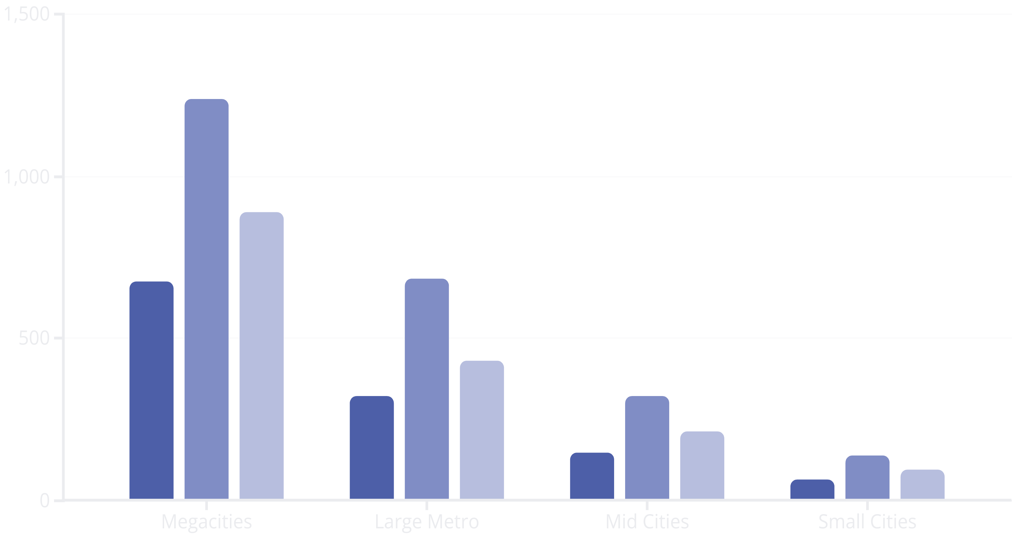
Smart Infrastructure Distribution by City Size
Smart Factories
Smart Education
Smart Healthcare
The distribution of smart infrastructure exhibits strong correlation with city size, with megacities hosting significantly more connected facilities across all categories. Smart education facilities lead across all city categories, reflecting the education sector's relatively faster adoption of connected technologies. High-income regions show 3-5 times more smart facilities per capita than low-income regions, highlighting a potential "smart divide" that mirrors broader digital access disparities.

Slide 16
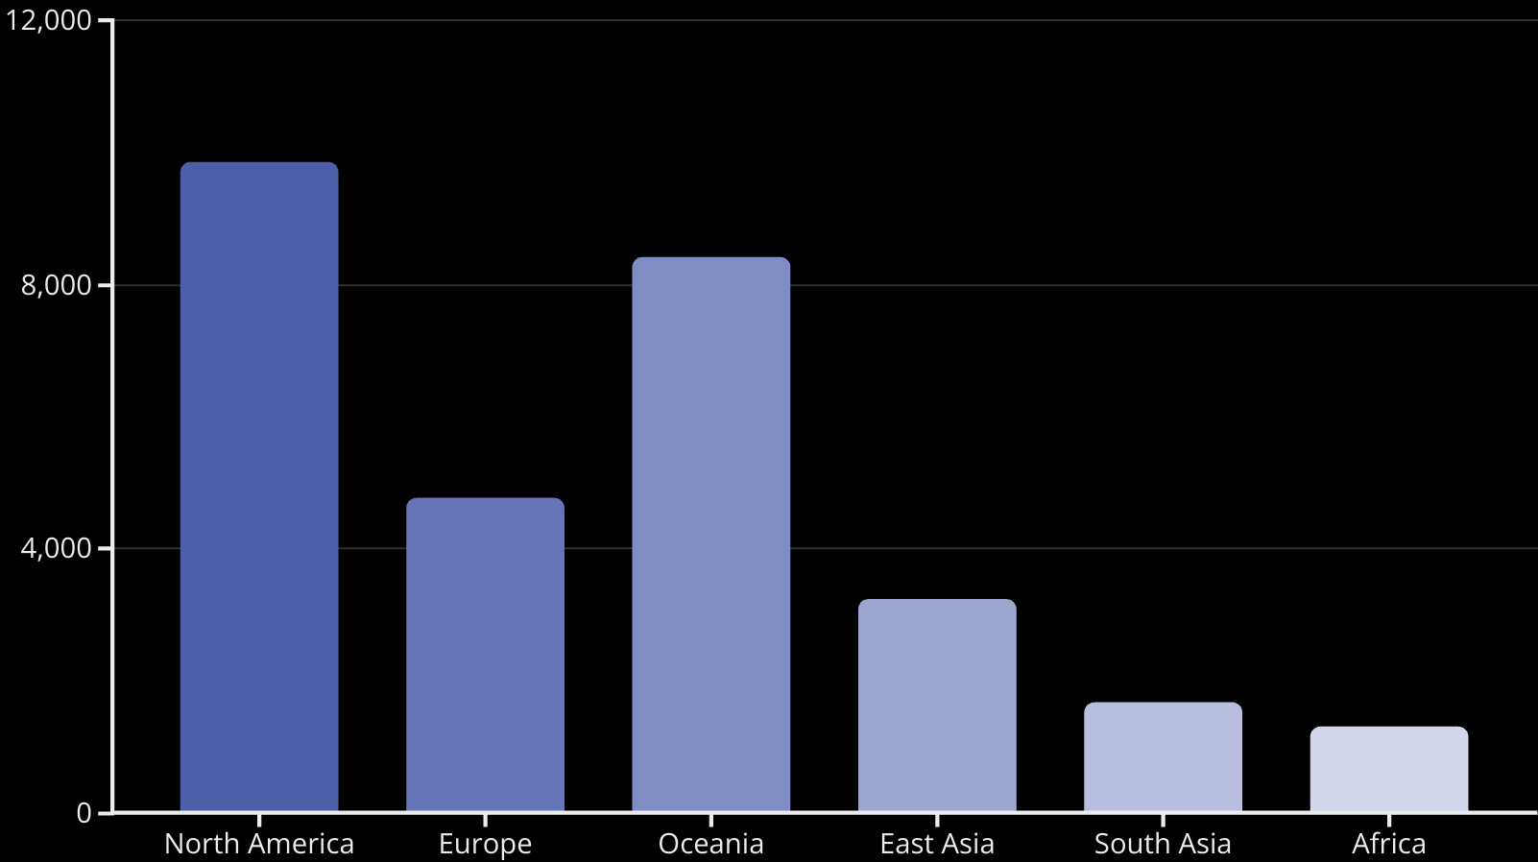
Urban Mobility Patterns: Vehicle Miles Traveled
Annual vehicle miles traveled (VMT) per capita varies dramatically across regions, reflecting different urban forms, transportation options, and economic conditions. North American cities lead with nearly 10,000 miles per person annually, while African cities average just 1,320 miles.
Even within regions, city design significantly impacts VMT. Compact, transit-oriented cities consistently show 30-45% lower VMT than sprawling, car-dependent cities of similar population. This metric serves as a key indicator of transportation system efficiency and environmental impact.

Slide 17






Modal Split of Vehicle Miles Traveled
Freight & Delivery
Represents 18-25% of urban VMT globally, with higher proportions in commercial centers and industrial cities. The rapid growth of e-commerce has increased this segment by 35% in the past five years.
Private Cars
Account for 62-78% of total VMT in high-income cities and 42-58% in middle-income cities. This dominant mode shapes infrastructure requirements and contributes significantly to emissions and congestion challenges.
Public Transit
Comprises 8-32% of passenger miles, with the highest shares in dense Asian and European cities. Transit-oriented development policies aim to increase this proportion to reduce congestion and emissions.
The modal distribution of vehicle miles traveled reveals much about a city's transportation priorities and development patterns. Cities with more balanced modal splits typically experience less congestion and lower per capita emissions. The highest performing cities actively manage this distribution through integrated land use and transportation planning.

Slide 18
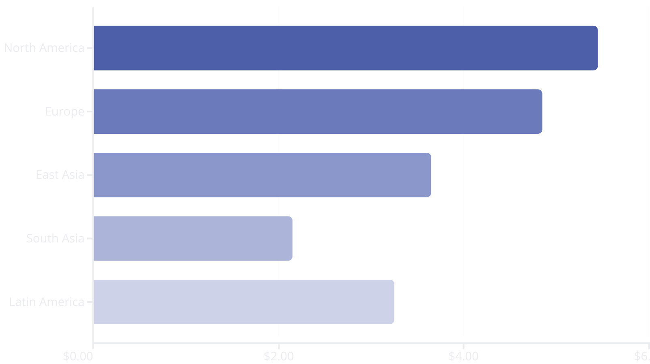
Urban Package Delivery Costs
Urban package delivery costs vary significantly across regions, influenced by labor costs, fuel prices, infrastructure quality, delivery density, and regulatory environments. North American cities face the highest costs at $5.45 per delivery, while South Asian cities achieve much lower costs at $2.15.
Congestion significantly impacts these costs, with each 10% increase in traffic density adding approximately 8-12% to delivery expenses. Cities with dedicated loading zones, time-window delivery systems, and consolidated delivery programs show 15-20% lower delivery costs than comparable cities without such initiatives.

Slide 19
Electric Vehicle Charging Infrastructure
12,840
8,650
6,750
Average EV Charging Points
Average EV Charging Points
Average EV Charging Points
In European megacities, leading the global transition to electric mobility
In East Asian megacities, reflecting strong government investment
In North American megacities, with significant regional variation
Electric vehicle charging infrastructure is expanding rapidly but unevenly across global cities. European cities lead in charging point density with an average of 25 chargers per 10,000 residents in megacities, compared to 18 in East Asian cities and 14 in North American cities. Public charging availability correlates strongly with electric vehicle adoption rates, with each 10% increase in charging points associated with a 7-9% increase in EV market share. Mid-sized cities are experiencing the fastest growth in charging infrastructure, expanding at 34% annually.

Slide 20
United States Context: Population and Service Points
331.4M
145,000
The United States represents a unique case study in transportation infrastructure due to its high vehicle ownership rates and historically car-centric development patterns. With 331.4 million residents served by approximately 145,000 gas stations, the average station serves 2,285 people.
US Population
Gas Stations
Based on current estimates, distributed across diverse urban and rural communities
Operating across the United States, providing fueling infrastructure
This ratio varies significantly between urban and rural areas, with urban gas stations serving an average of 3,750 people compared to 1,450 for rural stations. These service points form a critical but aging infrastructure network that will evolve as vehicle fleets electrify.
2,285
People per Gas Station
National average, with significant urban-rural variation

Slide 21
Vehicle Operating Costs: Conventional Vehicles
$0.59
$1.42
28%
Private Car Cost Per Mile
Urban Truck Cost Per Mile
Cost Variation
Average operating cost across global cities, including fuel, maintenance, depreciation, insurance, and taxes
Average operating cost for delivery and commercial vehicles in urban environments
Difference between highest-cost cities (Tokyo, London, New York) and global average
Vehicle operating costs vary substantially based on regional fuel prices, taxation policies, labor costs, and congestion levels. European and East Asian cities typically have 25-40% higher per-mile costs than North American cities due to higher fuel taxes and more congested conditions. These costs directly impact mobility choices, delivery expenses, and economic competitiveness. Operating cost disparities help explain different vehicle ownership patterns and modal preferences across regions.

Slide 22
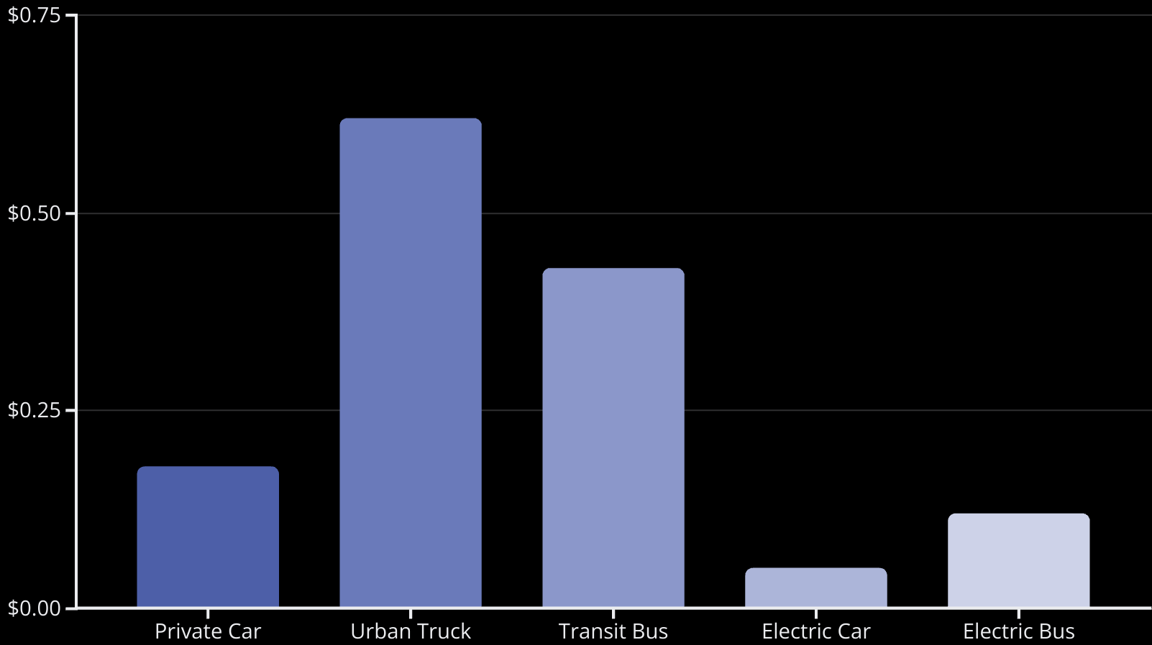
Emissions Costs of Urban Transportation
The externalized emissions costs of urban transportation represent significant unpriced impacts on public health and the environment. These costs include the monetized impacts of greenhouse gases, particulate matter, nitrogen oxides, and other pollutants.
Urban delivery trucks generate the highest per-mile emissions costs at $0.62, more than three times the impact of private cars. These externalities are rarely fully incorporated into pricing structures, though congestion and emissions pricing schemes in cities like London, Singapore, and Stockholm have begun to address this market failure.

Slide 23



Electric Vehicle Benefits
72%
85%
68%
Operating Cost Reduction
Emissions Reduction
Maintenance Cost Reduction
Average decrease in per-mile operating costs for electric vehicles compared to equivalent internal combustion models
Average decrease in lifecycle emissions for electric vehicles in cities with clean electricity generation
Average decrease in maintenance costs due to fewer moving parts and simplified systems
Electric vehicles offer substantial operational and environmental advantages over conventional vehicles. The 72% operating cost reduction stems from lower energy costs, reduced maintenance needs, and various incentives. The emissions benefit varies significantly based on the local electricity generation mix, ranging from 95% reduction in cities with predominantly renewable electricity to 60% in coal-dependent regions. These benefits are driving rapid electrification, particularly in fleet applications where high utilization magnifies cost advantages.

Slide 24
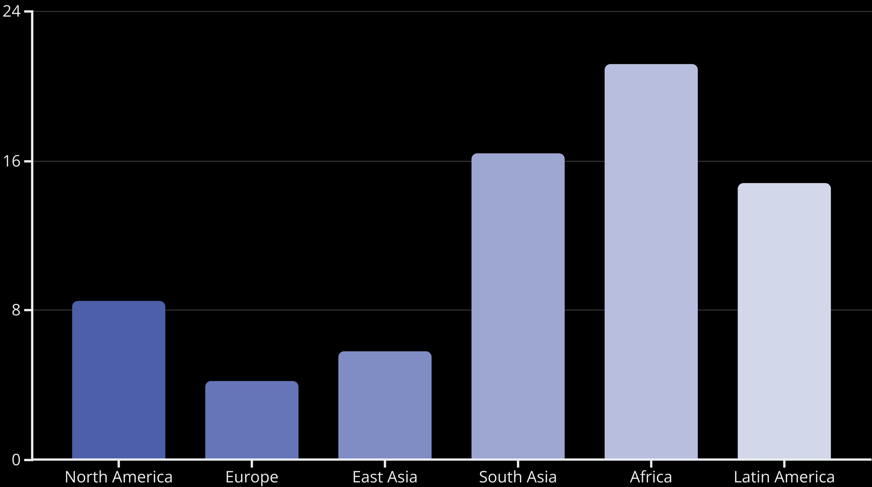
Urban Road Safety: Fatalities
Road safety outcomes vary dramatically across global cities, with fatality rates ranging from 2.1 per 100,000 in the safest cities to over 25 in the most dangerous. European cities consistently demonstrate the best safety performance, with an average of 4.2 fatalities per 100,000 population—approximately half the rate of North American cities and one-fifth the rate of African cities. Urban design plays a crucial role, with cities implementing "Vision Zero" principles and traffic calming measures achieving 35-40% lower fatality rates than comparable cities without such approaches.

Slide 25

Urban Road Safety: Injuries
Beyond fatalities, road injuries represent a significant public health burden in urban areas. Globally, the average city experiences 650 injuries per 100,000 population annually, though this figure varies widely by region and city design.
North American cities average 820 injuries per 100,000 residents, while European cities report 410. This disparity reflects differences in vehicle speeds, infrastructure design, enforcement practices, and vulnerable road user protections. Cities with comprehensive bicycle infrastructure report 42% fewer cyclist injuries, while those with complete sidewalk networks show 35% fewer pedestrian injuries.
Vehicle Occupants
Pedestrians
Cyclists
Motorcyclists

Slide 26
Time Value in Urban Transportation
$18.45
78
$4.3T
Average Value of Time
Daily Travel Minutes
Annual Time Value
Per hour across global cities, representing the economic value of travel time savings
Average time spent traveling per person per day across all modes
Total economic value of time spent traveling in the 1,000 largest cities
The economic value of time in transportation represents a critical but often overlooked component of mobility system costs. This value varies significantly by region, with high-income cities averaging $28-35 per hour compared to $8-12 in middle-income cities. The average urban resident spends 78 minutes traveling daily, with megacity residents averaging 94 minutes. This time represents a substantial economic cost that transportation investments aim to reduce. Time value considerations are increasingly incorporated into project evaluation frameworks to capture these benefits.

Slide 27
Urban Data Management
$0.035
48.5
Modern urban transportation systems generate massive data volumes from traffic sensors, transit systems, payment platforms, and connected infrastructure. The average megacity produces 48.5 terabytes of transportation-related data daily, with management costs averaging $0.035 per gigabyte.
Data Management Cost
Daily Data Volume
Average cost in USD per gigabyte of urban operational data
Average terabytes generated daily in megacities from transportation systems
This represents a significant operational expense but also creates opportunities for optimization and service improvement. Cities with integrated data management systems report 12-18% efficiency improvements in transportation operations. Data volumes are growing at approximately 32% annually as more systems become connected.

Slide 28
Regional Comparison: Megacities (Part 1)
Parameter
North American Megacities
European Megacities
East Asian Megacities
Freeway Miles
32,450
21,850
28,750
Arterial Miles
48,650
36,420
43,280
Surface Street Miles
154,200
128,650
102,450
Bus Route Miles
12,850
16,450
15,820
Addressable Population
14.8M
12.6M
17.2M
Number of Buses
2,450
3,240
4,650
This comparison of infrastructure parameters across megacities in different regions reveals distinct patterns in urban development and transportation priorities. North American megacities feature significantly more extensive road networks, particularly surface streets, reflecting their more sprawling development patterns. European megacities, despite smaller populations, maintain more extensive bus route networks, demonstrating stronger public transit orientation. East Asian megacities serve larger populations with relatively compact road networks and substantial bus fleets.

Slide 29
Regional Comparison: Megacities (Part 2)
Parameter
North American Megacities
European Megacities
East Asian Megacities
Private Cars
7.8M
5.4M
6.2M
Delivery Vehicles
345,000
285,000
365,000
Daily Deliveries
2.8M
2.4M
3.2M
Taxis
65,000
48,000
98,000
Rental Cars
24,500
16,800
10,500
Parking Spaces
28.5M
12.8M
10.6M
Vehicle ecosystem comparisons reveal North American megacities' extreme car orientation, with nearly 8 million private vehicles and a staggering 28.5 million parking spaces—more than two parking spaces for every resident. East Asian megacities show the highest delivery activity, reflecting dense commercial districts and strong e-commerce adoption. The taxi fleet size varies dramatically, with East Asian cities operating nearly twice as many taxis as North American cities, while North American cities maintain the largest rental car fleets, reflecting their tourism and business travel patterns.

Slide 30
Regional Comparison: Megacities (Part 3)
Parameter
North American Megacities
European Megacities
East Asian Megacities
Smart Factories
620
585
845
Smart Education Facilities
1,180
1,320
1,450
Smart Healthcare Facilities
850
920
950
Annual VMT per Capita
9,850
4,780
3,240
VMT by Private Car (%)
76%
68%
58%
VMT by Truck (%)
18%
21%
24%
Smart infrastructure deployment shows regional variations, with East Asian megacities leading in all categories, particularly in smart manufacturing facilities. This reflects regional industrial policies promoting Industry 4.0 adoption and digital transformation. The starkest contrast appears in mobility patterns, with North American residents traveling more than three times the annual vehicle miles of their East Asian counterparts. The modal split also differs significantly, with North American cities showing much higher private car dependence compared to more balanced distributions in European and Asian contexts.

Slide 31
Regional Comparison: Megacities (Part 4)
Parameter
North American Megacities
European Megacities
East Asian Megacities
Package Delivery Cost (USD)
5.45
4.85
3.65
EV Charging Points
6,750
12,840
8,650
Car Operating Cost (USD/mile)
0.56
0.68
0.61
Truck Operating Cost (USD/mile)
1.38
1.58
1.46
Car Emissions Cost (USD/mile)
0.18
0.15
0.21
Truck Emissions Cost (USD/mile)
0.62
0.58
0.68
Operational metrics reveal efficiency and cost variations across regions. North American megacities face the highest package delivery costs due to lower density and labor costs. European cities lead in electric vehicle charging infrastructure, with nearly twice the deployment of North American cities. Vehicle operating costs are highest in European cities due to fuel taxation policies, while emissions costs show mixed patterns. The higher emissions costs in East Asian cities reflect greater population density and exposure, translating to larger health impacts per mile traveled despite newer vehicle fleets.

Slide 32
Regional Comparison: Megacities (Part 5)
Parameter
North American Megacities
European Megacities
East Asian Megacities
EV Operating Cost Reduction
68%
75%
72%
EV Emissions Reduction
82%
90%
78%
Fatalities per 100,000
8.5
4.2
5.8
Injuries per 100,000
820
410
620
Value of Time (USD/hour)
28.50
26.80
22.40
Daily Travel Minutes
86
72
98
Safety and time-value metrics highlight critical quality-of-life differences between regions. European megacities demonstrate substantially better safety outcomes, with fatality and injury rates approximately half those of North American cities. The value of time is highest in North American cities, reflecting higher average incomes, while daily travel time is lowest in European cities due to more compact development patterns and efficient transit systems. East Asian residents spend the most time traveling daily despite shorter trip distances, likely due to congestion and transit crowding in extremely dense urban environments.

Slide 33
Regional Comparison: Megacities (Part 6)
Data management metrics reflect regional technological capabilities and digital infrastructure investment. East Asian megacities generate the highest data volumes, averaging 58.2 terabytes daily from transportation systems alone, while also achieving the lowest per-gigabyte management costs.
Parameter
North American Megacities
European Megacities
East Asian Megacities
Data Management Cost (USD/GB)
0.038
0.041
0.032
This advantage stems from newer digital infrastructure, greater integration across systems, and targeted investments in smart city capabilities. European cities face slightly higher data management costs despite lower volumes, potentially reflecting more fragmented governance structures and older systems requiring more complex integration.
Daily Data Volume (TB)
42.6
38.4
58.2

Slide 34
Showcase City: Tokyo, Japan
Infrastructure Parameters
Smart Infrastructure & Mobility
Freeway Miles: 29,850
Smart Factories: 920
Arterial Roads Miles: 45,620
Smart Education Facilities: 1,580
Surface Streets Miles: 98,750
Smart Healthcare Facilities: 1,120
Bus Routes Miles: 16,480
Annual VMT per Capita: 2,850
Addressable Population: 37.4 million
VMT by Private Car: 42%
Buses: 5,240
VMT by Truck: 26%
Private Cars: 5.8 million
Package Delivery Cost: $3.45
Urban Delivery Vehicles: 380,000
EV Charging Points: 10,280
Daily Deliveries: 3.6 million
Car Operating Cost: $0.72/mile
Taxis: 108,000
Truck Operating Cost: $1.58/mile
Rental Cars: 12,400
Car Emissions Cost: $0.19/mile
Parking Spaces: 7.5 million
Tokyo represents the epitome of transit-oriented development, with the world's most extensive rail system complemented by efficient bus networks. Despite serving 37.4 million residents in its metropolitan area, Tokyo maintains relatively low vehicle ownership rates and achieves the lowest VMT per capita among global megacities. Its integrated transportation and land use planning creates a model for sustainable urban mobility.

Slide 35
Showcase City: Tokyo, Japan (Continued)
Efficiency & Impact Metrics
Tokyo achieves exceptional safety outcomes with just 3.2 traffic fatalities per 100,000 residents—among the lowest rates globally for a megacity. This success stems from comprehensive traffic calming, excellent pedestrian infrastructure, and cultural factors promoting safety.
Truck Emissions Cost: $0.64/mile
EV Operating Cost Reduction: 68%
EV Emissions Reduction: 72%
Fatalities per 100,000: 3.2
The city generates massive transportation data volumes (68.5 TB daily) while maintaining low management costs, reflecting sophisticated digital infrastructure. Despite high transit use, Tokyo residents spend more time traveling (104 minutes daily) than many peer cities, a consequence of the region's vast size and complex commuting patterns across multiple transit systems.
Injuries per 100,000: 380
Value of Time: $26.80/hour
Daily Travel Minutes: 104
Data Management Cost: $0.028/GB
Daily Data Volume: 68.5 TB

Slide 36
Showcase City: New York, USA
Infrastructure Parameters
Smart Infrastructure & Mobility
Freeway Miles: 32,650
Smart Factories: 580
Arterial Roads Miles: 49,820
Smart Education Facilities: 1,240
Surface Streets Miles: 145,650
Smart Healthcare Facilities: 920
Bus Routes Miles: 13,780
Annual VMT per Capita: 6,850
Addressable Population: 20.1 million
VMT by Private Car: 68%
Buses: 4,650
VMT by Truck: 22%
Private Cars: 6.2 million
Package Delivery Cost: $5.65
Urban Delivery Vehicles: 320,000
EV Charging Points: 7,620
Daily Deliveries: 2.9 million
Car Operating Cost: $0.64/mile
Taxis: 78,000
Truck Operating Cost: $1.52/mile
Rental Cars: 28,500
Car Emissions Cost: $0.21/mile
Parking Spaces: 19.8 million
New York City represents the most transit-oriented metropolis in North America, with a unique dual transportation character. Manhattan exemplifies dense, transit-first urban design, while the broader metropolitan region follows more typical American auto-centric patterns. This creates stark contrasts in mobility behaviors within the same urban area. Despite having the most extensive subway system in the United States, the region still maintains high car ownership and usage rates compared to global peers.

Slide 37
Showcase City: New York, USA (Continued)
Efficiency & Impact Metrics
New York exhibits significantly better safety outcomes than the American average, with fatality rates 32% below the national urban average. This achievement reflects the city's walkable core, extensive transit use, and recent Vision Zero initiatives.
Truck Emissions Cost: $0.68/mile
EV Operating Cost Reduction: 72%
EV Emissions Reduction: 85%
The city values time at $32.40 per hour—among the highest globally—reflecting the region's economic productivity. With nearly 20 million parking spaces serving its 20 million residents, New York still dedicates enormous land resources to vehicle storage despite its reputation for transit orientation, highlighting the ongoing challenge of transitioning from car-centric infrastructure.
Fatalities per 100,000: 5.8
Injuries per 100,000: 620
Value of Time: $32.40/hour
Daily Travel Minutes: 92
Data Management Cost: $0.035/GB
Daily Data Volume: 58.2 TB

Slide 38
Showcase City: London, UK
Infrastructure Parameters
Smart Infrastructure & Mobility
Freeway Miles: 21,450
Smart Factories: 540
Arterial Roads Miles: 38,620
Smart Education Facilities: 1,380
Surface Streets Miles: 126,850
Smart Healthcare Facilities: 980
Bus Routes Miles: 18,240
Annual VMT per Capita: 4,150
Addressable Population: 14.8 million
VMT by Private Car: 62%
Buses: 8,750
VMT by Truck: 23%
Private Cars: 4.8 million
Package Delivery Cost: $4.95
Urban Delivery Vehicles: 265,000
EV Charging Points: 15,840
Daily Deliveries: 2.4 million
Car Operating Cost: $0.74/mile
Taxis: 65,000
Truck Operating Cost: $1.68/mile
Rental Cars: 18,500
Car Emissions Cost: $0.16/mile
Parking Spaces: 11.2 million
London pioneered congestion pricing for urban centers, fundamentally reshaping its mobility ecosystem since implementation in 2003. The city maintains the most extensive bus network among our showcase cities, with 18,240 route miles served by nearly 9,000 buses. London has also emerged as a global leader in electric vehicle charging infrastructure, with nearly 16,000 public charging points—the highest density among major global cities.

Slide 39
Showcase City: London, UK (Continued)
Efficiency & Impact Metrics
London achieves exceptional road safety outcomes with just 2.8 fatalities per 100,000 residents—among the lowest rates globally. This success stems from comprehensive traffic calming, 20 mph (32 km/h) residential speed limits, and protected infrastructure for vulnerable users.
Truck Emissions Cost: $0.59/mile
EV Operating Cost Reduction: 78%
EV Emissions Reduction: 92%
Fatalities per 100,000: 2.8
The city's relatively clean electricity grid enables 92% emissions reductions from vehicle electrification, among the highest benefits globally. Despite high operating costs due to congestion and fuel taxes, London residents spend less time traveling (84 minutes daily) than many peer cities, reflecting the efficiency of its multimodal transportation system.
Injuries per 100,000: 380
Value of Time: $29.60/hour
Daily Travel Minutes: 84
Data Management Cost: $0.042/GB
Daily Data Volume: 42.5 TB

Slide 40
Showcase City: Shanghai, China
Infrastructure Parameters
Smart Infrastructure & Mobility
Freeway Miles: 26,850
Smart Factories: 1,240
Arterial Roads Miles: 42,620
Smart Education Facilities: 1,680
Surface Streets Miles: 94,350
Smart Healthcare Facilities: 980
Bus Routes Miles: 14,820
Annual VMT per Capita: 2,850
Addressable Population: 27.8 million
VMT by Private Car: 48%
Buses: 16,500
VMT by Truck: 28%
Private Cars: 4.2 million
Package Delivery Cost: $3.25
Urban Delivery Vehicles: 420,000
EV Charging Points: 24,850
Daily Deliveries: 4.2 million
Car Operating Cost: $0.56/mile
Taxis: 82,000
Truck Operating Cost: $1.42/mile
Rental Cars: 9,500
Car Emissions Cost: $0.24/mile
Parking Spaces: 6.2 million
Shanghai exemplifies China's rapid transportation infrastructure development, building the world's largest metro system in just 25 years. The city maintains an impressive balance between different transportation modes while serving 27.8 million residents. Shanghai leads globally in electric vehicle charging infrastructure with nearly 25,000 public charging points, reflecting China's aggressive electrification policies. The city's 16,500 buses represent the largest fleet among our showcase cities.

Slide 41
Showcase City: Shanghai, China (Continued)
Efficiency & Impact Metrics
Shanghai demonstrates the highest adoption of smart manufacturing facilities, with 1,240 smart factories reflecting China's focus on advanced manufacturing and Industry 4.0 principles. The city generates an extraordinary 86.5 terabytes of transportation data daily—the highest among our showcase cities—while maintaining the lowest data management costs at $0.022 per gigabyte.
Truck Emissions Cost: $0.72/mile
EV Operating Cost Reduction: 68%
EV Emissions Reduction: 58%
Fatalities per 100,000: 4.8
Injuries per 100,000: 520
Value of Time: $18.40/hour
Despite impressive electrification infrastructure, Shanghai's EV emissions benefits are limited to 58% due to coal-dominated electricity generation. This highlights how grid composition can significantly impact the environmental benefits of vehicle electrification.
Daily Travel Minutes: 96
Data Management Cost: $0.022/GB
Daily Data Volume: 86.5 TB

Slide 42
Showcase City: São Paulo, Brazil
Infrastructure Parameters
Smart Infrastructure & Mobility
Freeway Miles: 24,450
Smart Factories: 240
Arterial Roads Miles: 38,620
Smart Education Facilities: 680
Surface Streets Miles: 124,850
Smart Healthcare Facilities: 420
Bus Routes Miles: 16,240
Annual VMT per Capita: 5,250
Addressable Population: 22.4 million
VMT by Private Car: 72%
Buses: 14,850
VMT by Truck: 18%
Private Cars: 8.2 million
Package Delivery Cost: $3.85
Urban Delivery Vehicles: 280,000
EV Charging Points: 4,250
Daily Deliveries: 2.2 million
Car Operating Cost: $0.58/mile
Taxis: 38,000
Truck Operating Cost: $1.46/mile
Rental Cars: 12,500
Car Emissions Cost: $0.22/mile
Parking Spaces: 9.8 million
São Paulo represents the largest urban area in South America and exemplifies the transportation challenges facing rapidly growing middle-income cities. Despite significant investments in bus rapid transit (BRT) systems, with nearly 15,000 buses serving over 16,000 route miles, the city struggles with severe congestion. São Paulo operates an innovative time-based vehicle restriction system (rodízio) that limits vehicles from entering the central city on specific days based on license plate numbers.

Slide 43
Showcase City: São Paulo, Brazil (Continued)
Efficiency & Impact Metrics
São Paulo residents face the longest average daily travel times among our showcase cities at 118 minutes, reflecting severe congestion challenges despite innovative traffic management approaches. The city's road safety outcomes lag significantly behind high-income cities, with fatality rates more than four times higher than London's.
Truck Emissions Cost: $0.64/mile
EV Operating Cost Reduction: 64%
EV Emissions Reduction: 82%
Fatalities per 100,000: 12.4
Injuries per 100,000: 840
Electric vehicles benefit from Brazil's relatively clean electricity grid dominated by hydropower, offering 82% emissions reductions compared to conventional vehicles. However, EV adoption remains limited by the city's modest charging infrastructure, with just 4,250 public charging points serving 22.4 million residents.
Value of Time: $14.20/hour
Daily Travel Minutes: 118
Data Management Cost: $0.048/GB
Daily Data Volume: 32.5 TB

Slide 44
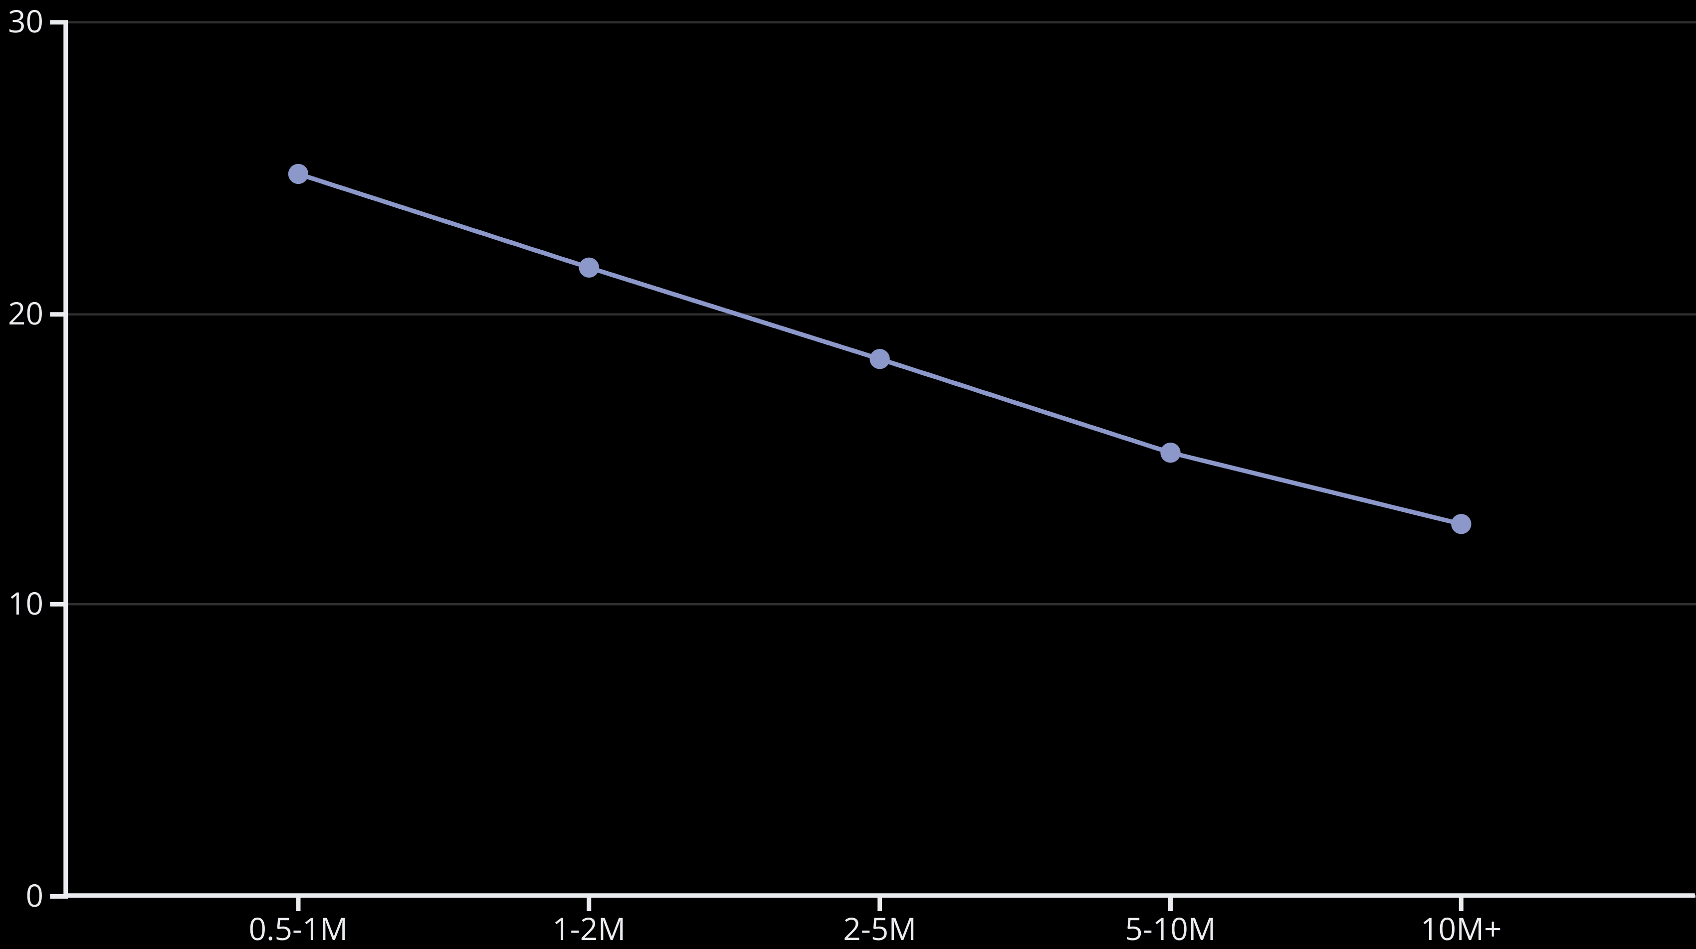
Road Network Scaling with City Size
Road network density exhibits consistent patterns of declining per capita provision as city size increases. This reflects the greater efficiency of larger urban areas, where higher densities reduce the road miles needed to serve each resident. Smaller cities average 24.8 road miles per 1,000 residents, nearly double the 12.8 miles provided in megacities. This pattern holds consistent across regions, though absolute values vary based on development patterns. American and Australian cities consistently provide 30-40% more road miles per capita than comparable European or Asian cities regardless of size category.

Slide 45
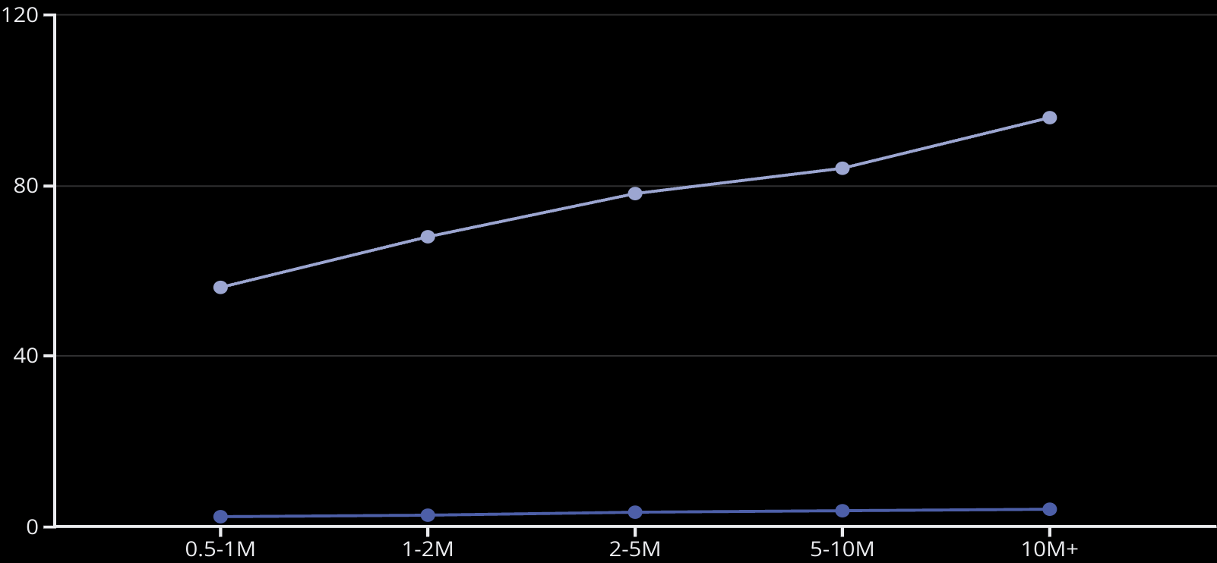
Public Transit Scaling with City Size
Unlike road networks, public transit provision typically increases on a per capita basis with city size. Larger cities provide more extensive bus route networks and higher bus fleet ratios, reflecting greater transit viability and necessity in larger urban environments.
Megacities average 4.2 bus route miles per 1,000 residents—75% more than small cities with 0.5-1M population. This pattern reflects the economic viability of high-frequency transit in dense urban environments and the necessity of efficient mass transportation to maintain mobility in congested large cities where road expansion becomes prohibitively expensive.
Bus Route Miles per 1,000 P...
Buses per 100,000 People

Slide 46
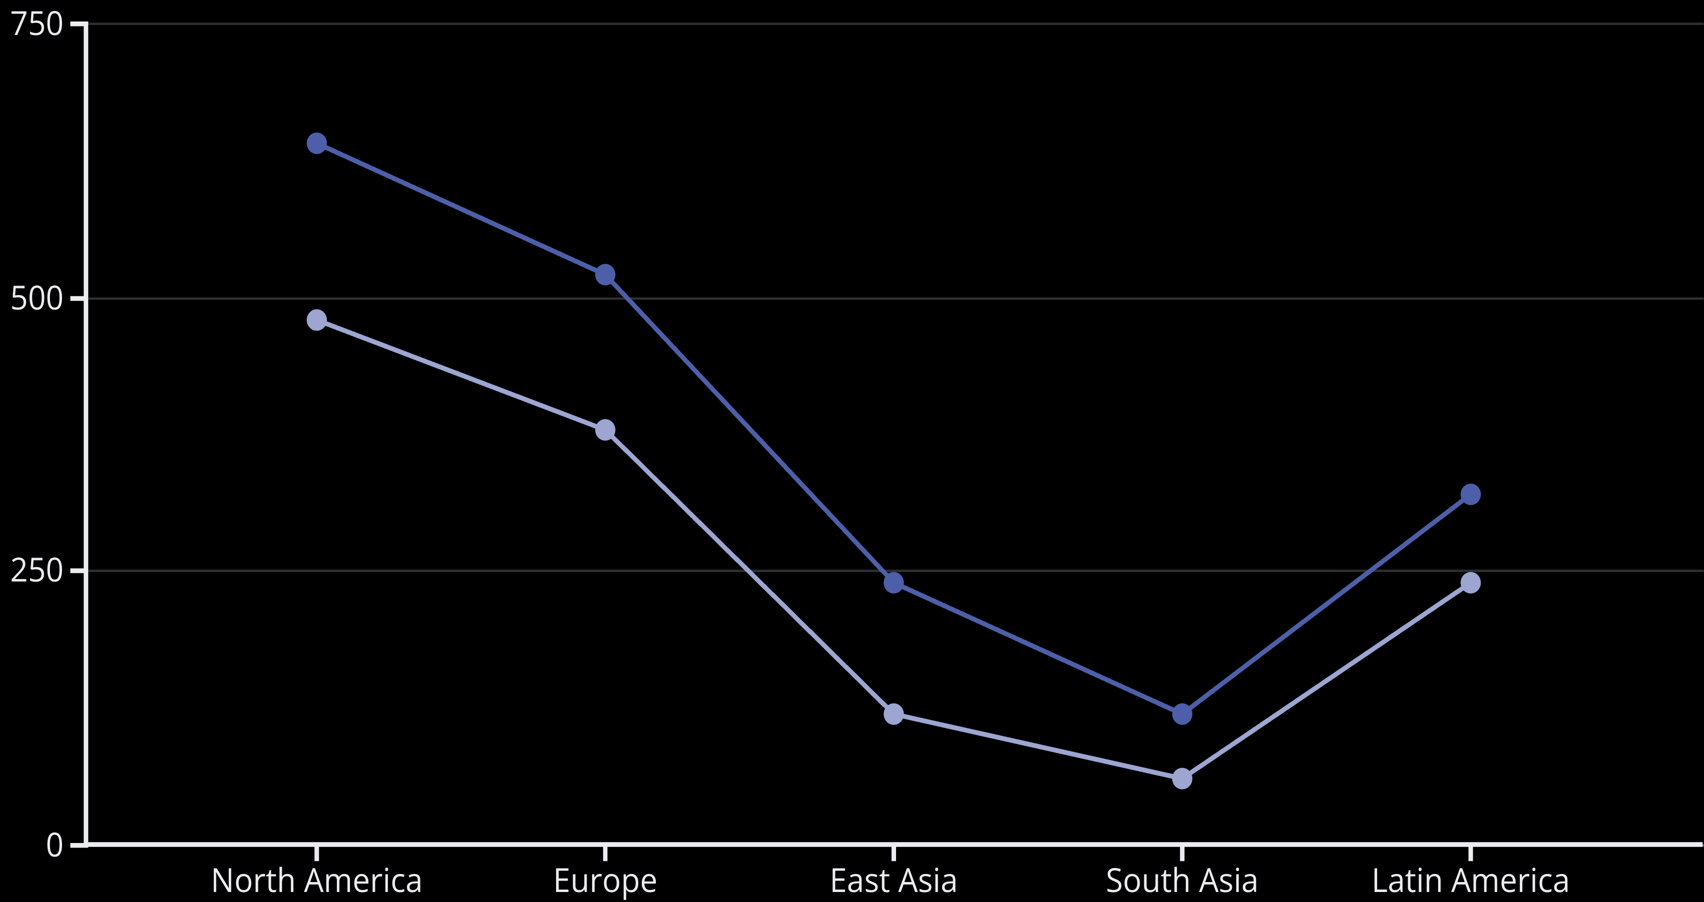
Vehicle Ownership Patterns by City Size
Cars per 1,000 (Small Cities)
Cars per 1,000 (Large Cities)
Private vehicle ownership consistently declines with increasing city size across all regions, though absolute levels vary dramatically. North American small cities average 640 cars per 1,000 residents compared to 480 in megacities—a 25% reduction. This pattern is even more pronounced in East Asia, where megacities have 50% lower car ownership than small cities. This decline reflects the higher costs of vehicle ownership in large cities (parking, congestion), combined with better alternative transportation options. The impact of income is evident, with high-income regions showing 4-5 times higher car ownership than low-income regions across all city sizes.

Slide 47
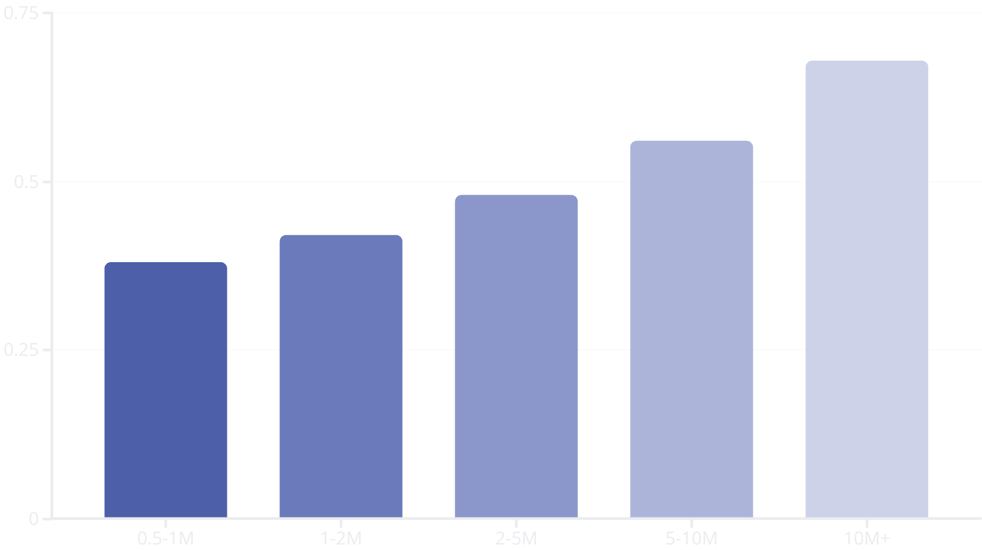
Urban Delivery Patterns by City Size
Urban delivery activity intensifies with city size, with megacities generating 79% more deliveries per person than small cities. This pattern reflects several factors: larger cities typically have higher commercial density, more specialized retail options, higher incomes, and greater e-commerce adoption.
The delivery ecosystem is also shaped by city size, with larger cities showing greater specialization in delivery vehicle types. While small cities are predominantly served by general-purpose vans and trucks, megacities develop specialized fleets including cargo bikes for last-mile delivery, microhubs for package consolidation, and dedicated urban delivery vehicles optimized for narrow streets and frequent stops.

Slide 48
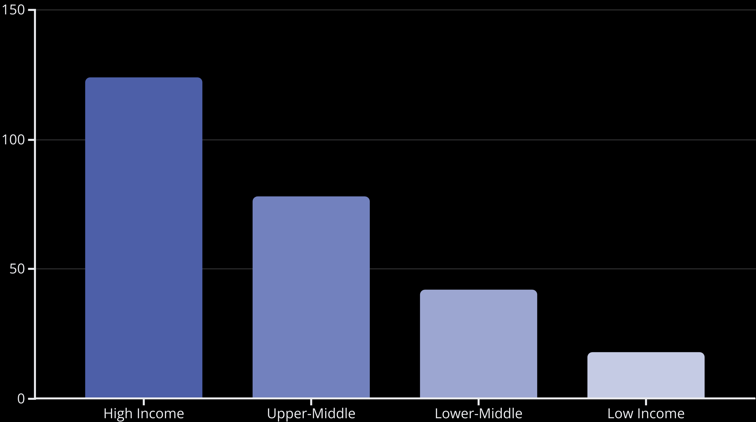
Smart Infrastructure Adoption by Income Level
Smart infrastructure adoption shows a clear correlation with income levels, creating a "smart divide" between high and low-income urban areas. High-income cities deploy nearly 7 times more smart facilities per capita than low-income cities. This disparity reflects differences in investment capacity, digital infrastructure readiness, and regulatory frameworks. However, the gap is narrowing in specific sectors, with lower-middle income cities showing rapid adoption of smart education facilities and mobile-based service delivery systems that leverage existing telecommunications infrastructure. Upper-middle income cities in East Asia are closing the gap particularly quickly, with 63% growth in smart facility deployment over the past five years.

Slide 49
Transportation Costs and Affordability
12.8%
18.5%
25.6%
Transportation Expenditure
Transportation Expenditure
Transportation Expenditure
Average percentage of household income spent on transportation in high-income cities
Average percentage of household income spent on transportation in middle-income cities
Average percentage of household income spent on transportation in low-income cities
Transportation affordability presents a paradox across income levels. Despite lower absolute costs, residents of low-income cities spend a significantly higher proportion of their income on transportation than those in high-income cities. This transportation cost burden is particularly acute for the urban poor, who often live in peripheral areas with limited transit access. Cities with comprehensive public transit systems consistently show lower household transportation expenditures across all income levels. Vehicle ownership represents the largest cost component in high and middle-income cities, while in low-income cities, transportation costs are dominated by transit fares and informal transport services.

Slide 50
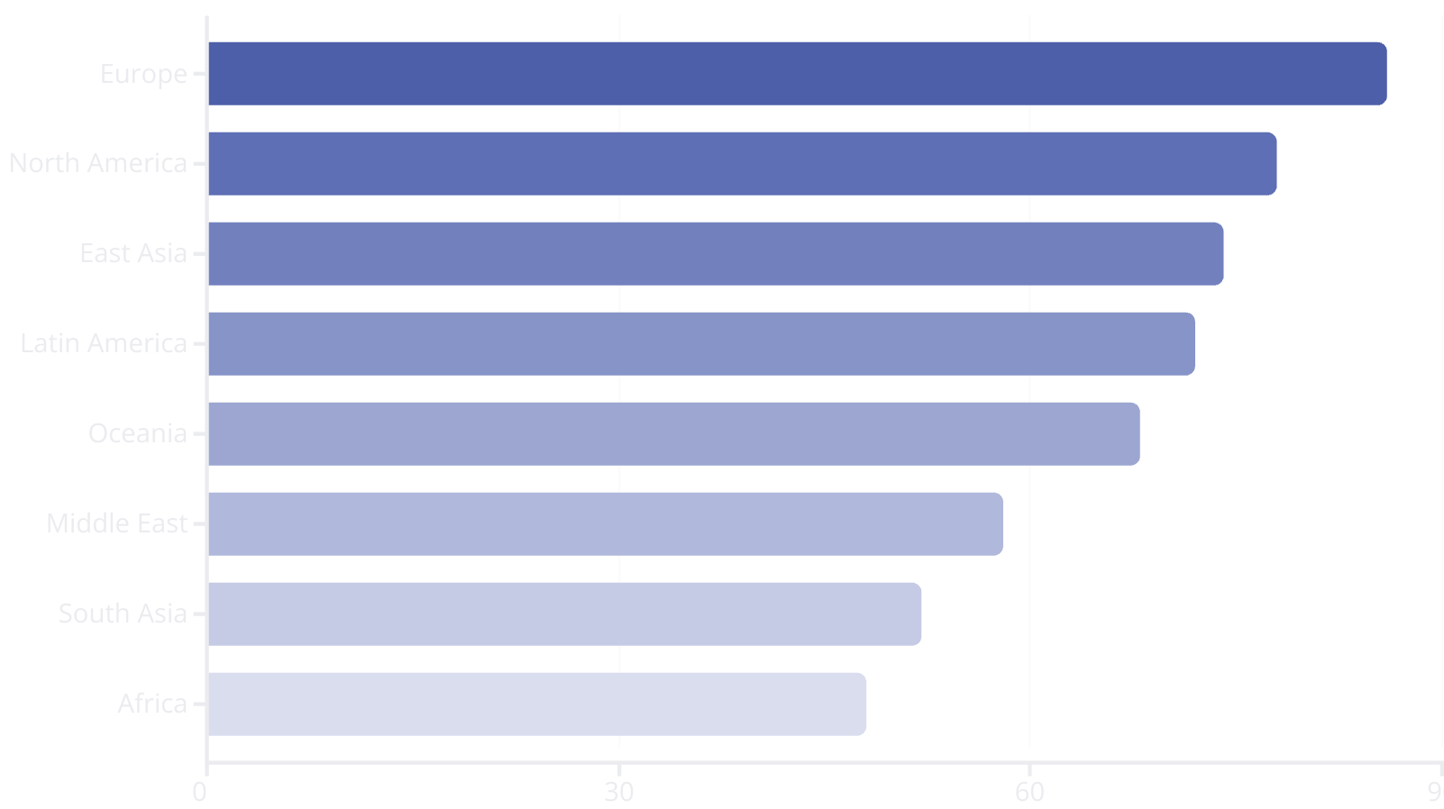
Electrification Potential by Region
Electrification potential varies significantly across regions based on a composite index incorporating electricity grid carbon intensity, reliability, charging infrastructure, policy support, and vehicle ecosystem suitability.
European cities lead with high scores reflecting clean electricity generation, strong policy incentives, and well-developed charging networks. Latin American cities score surprisingly well due to hydropower-dominated electricity generation. Sub-Saharan African and South Asian cities face greater challenges due to grid reliability issues and infrastructure gaps, though targeted applications like electric buses on fixed routes with depot charging show significant potential.

Slide 51
Emission Reduction Opportunities
85%
42%
38%
Private Car Electrification
Modal Shift to Transit
Freight Consolidation
Potential reduction in emissions from complete transition to electric private vehicles in cities with clean electricity generation
Potential reduction in transportation emissions from 20% shift from private cars to public transit in typical cities
Potential reduction in delivery vehicle emissions from comprehensive urban freight consolidation programs
Urban transportation emissions reduction potential varies significantly by strategy and context. Vehicle electrification offers the largest technical potential in cities with clean electricity, though implementation timelines extend over decades due to fleet turnover rates. Modal shift strategies can deliver more immediate benefits and require less capital investment but face behavioral and political barriers. Freight consolidation represents a high-impact opportunity in congested urban cores, where last-mile delivery inefficiencies create disproportionate emissions impacts. The most successful cities pursue comprehensive approaches combining all three strategies tailored to local conditions.

Slide 52




Safety Improvement Strategies
Speed Management
Street Design
Implementing comprehensive speed reduction programs through engineering, enforcement, and education. Cities with 20 mph (30 km/h) limits on residential streets show 40-60% reductions in severe crashes.
Reconfiguring streets with protected infrastructure for vulnerable users, narrower travel lanes, and traffic calming features. Complete streets redesigns demonstrate 30-45% crash reductions.
Intersection Treatment
Vehicle Technology
Enhancing high-risk intersections with protected turning phases, pedestrian islands, and reduced crossing distances. Targeted intersection improvements reduce crashes by 25-35%.
Accelerating adoption of advanced driver assistance systems and connected vehicle technologies. Cities with higher penetration of vehicles with automatic emergency braking show 15-20% fewer rear-end collisions.
Urban road safety improvements require coordinated system-wide approaches rather than isolated interventions. Cities achieving "Vision Zero" success implement comprehensive strategies addressing infrastructure, vehicle technology, enforcement, and education simultaneously. The most successful programs prioritize safety over traffic flow in policy frameworks and project design criteria.

Slide 53








Urban Mobility Data Ecosystem
Data Collection
Data Processing
Networks of connected sensors, cameras, vehicle probes, and user devices continuously gathering mobility information. Modern cities deploy 8,000-12,000 connected transportation sensors per million residents.
Cloud and edge computing systems analyzing vast data streams to extract actionable insights and detect patterns. Transportation management centers process 12-25 TB of data daily in typical megacities.
Planning & Analysis
Operational Response
Using historical data to identify trends, evaluate interventions, and guide infrastructure investments. Data-driven planning approaches reduce project delivery times by 15-20% and improve outcome predictions.
Real-time adjustments to traffic signals, transit operations, enforcement resources, and user information based on current conditions. Advanced systems can reduce congestion by 8-15% through dynamic management.
The urban mobility data ecosystem represents a critical but often invisible infrastructure layer supporting transportation operations. Cities increasingly view this digital infrastructure as equally important to physical infrastructure in managing complex urban mobility systems. Leading cities have established standardized data-sharing protocols and governance frameworks to balance operational needs with privacy protection. The most advanced systems integrate data across multiple agencies and modes to provide comprehensive system management capabilities.

Slide 54








Infrastructure Funding Mechanisms
Traditional Taxation
User Charges
Fuel taxes, vehicle registration fees, general revenue, and property taxes remain the primary funding sources in most cities. These mechanisms are increasingly challenged by fuel efficiency improvements, electrification, and competing budget priorities.
Direct charging systems including road tolls, congestion pricing, parking fees, and usage-based insurance. These approaches better align costs with usage but face equity and implementation challenges.
Alternative Models
Value Capture
Innovative approaches including public-private partnerships, infrastructure banks, green bonds, and mobility-as-a-service subscriptions. These emerging models can accelerate project delivery and distribute risks.
Mechanisms leveraging increased property values from transportation investments, including tax increment financing, special assessment districts, and development impact fees. These tools connect infrastructure with land use more effectively.
Urban transportation infrastructure funding faces mounting challenges from traditional mechanisms' declining revenue adequacy. Cities increasingly adopt diversified funding portfolios combining multiple mechanisms tailored to local contexts. The most sustainable systems integrate transportation funding with broader urban development strategies and explicitly address equity considerations in revenue collection and investment allocation.

Slide 55
Future Trends: Autonomous Mobility
Autonomous vehicle technology continues advancing toward urban deployment, though timelines have extended beyond early optimistic projections. Commercial deployment follows a segmented pattern, with controlled-environment applications (dedicated lanes, campuses, logistics yards) advancing more rapidly than general urban operation.
2023-2025
1
Expanded deployment of Level 4 autonomy in geofenced areas, dedicated AV shuttle routes, and controlled environments. Limited commercial robotaxi services in optimal conditions.
2
2025-2030
Full autonomy in complex urban environments remains a significant technical challenge, with edge cases and unpredictable interactions creating persistent barriers. Most cities now plan for extended transition periods with mixed fleets of human-driven and autonomous vehicles operating simultaneously.
Growing commercial deployment in favorable urban environments. Expansion of operational design domains to include more weather conditions and traffic scenarios. Integration with public transit systems.
2030-2040
3
Widespread commercial deployment in major urban areas. Significant penetration in freight, transit, and for-hire passenger services. Persistent geographic and operational limitations remain.

Slide 56



Future Trends: Mobility as a Service
Integrated Platforms
Subscription Models
Dynamic Optimization
Single-interface systems combining planning, booking, and payment across multiple mobility services. Leading platforms now integrate 8-12 modes including public transit, rideshare, micromobility, carshare, parking, and intercity options, with unified account management and seamless transfers.
All-inclusive mobility packages offering unlimited or tiered access to multiple services for a fixed monthly fee. Early pilots demonstrate 20-30% increased transit usage among subscribers and 15-25% reduction in private vehicle trips, though financial sustainability remains challenging.
AI-powered systems that continuously optimize mobility recommendations based on real-time conditions, user preferences, and system-wide efficiency. Advanced platforms incorporate weather, events, and even individual health data to personalize recommendations.
Mobility as a Service (MaaS) continues evolving from concept to operational reality, though with significant regional variation in implementation models. Public-sector led approaches (common in Europe) prioritize transit integration and equity goals, while private-sector platforms (more common in North America) focus on commercial services and user experience. The most successful systems combine strong public governance frameworks with innovative private service delivery. Regulatory structures and data sharing protocols remain critical barriers to full implementation in many cities.

Slide 57
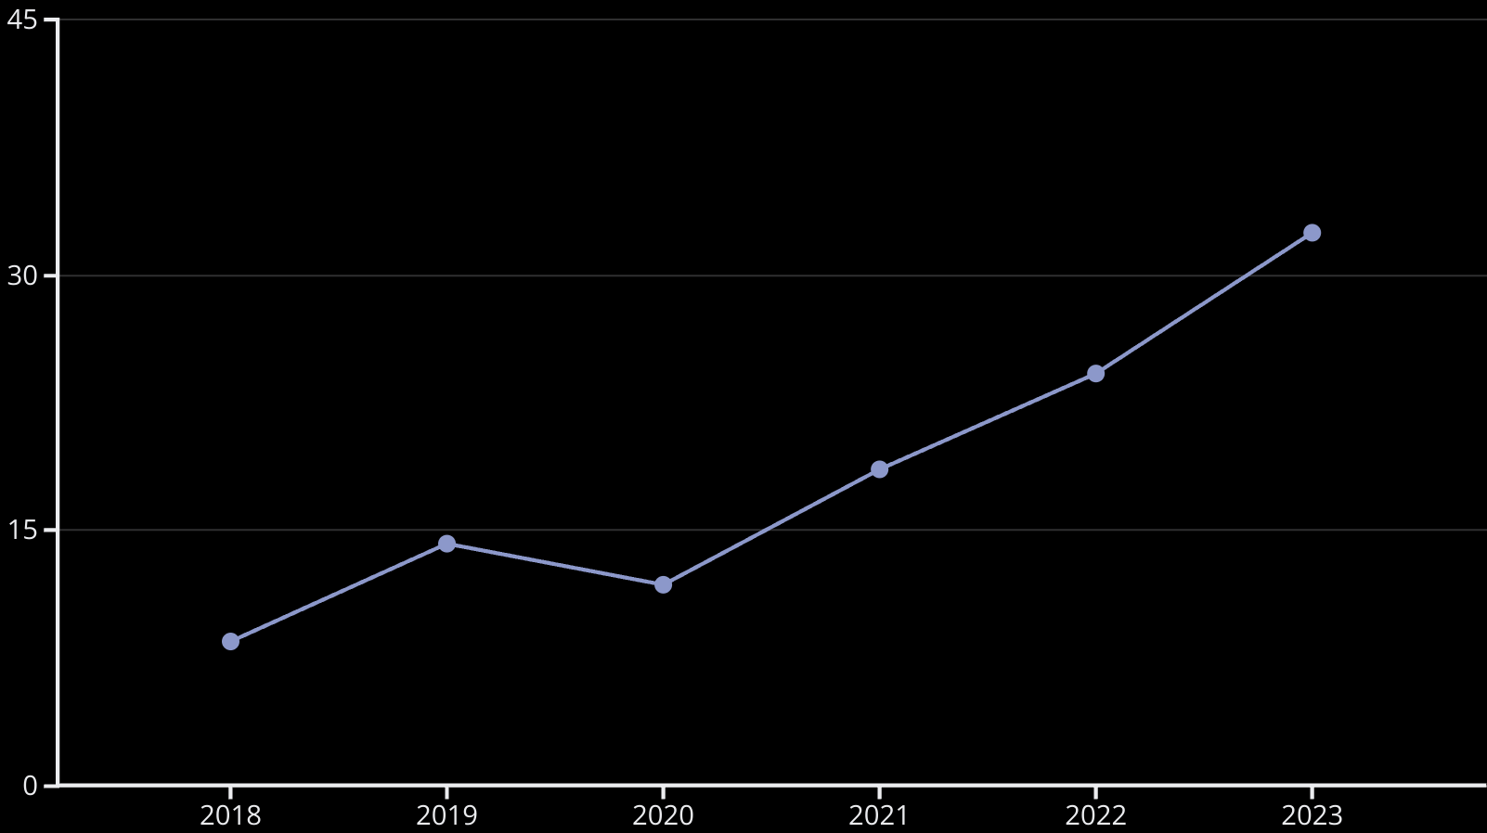
Future Trends: Micromobility Evolution
Micromobility continues rapid growth following post-pandemic recovery, with global trip volumes increasing 34% year-over-year. The sector is evolving from early disruptive models toward more integrated approaches with stronger public oversight and infrastructure coordination.
Vehicle design diversity is expanding beyond basic scooters and bikes to include cargo-oriented options, weather-protected designs, accessibility-focused vehicles, and specialized forms for different trip types. This diversification helps address a broader range of urban trips and user needs. Cities increasingly manage micromobility through structured programs with designated parking areas, data sharing requirements, and equity provisions to ensure balanced service distribution.

Slide 58
Infrastructure Adaptation Strategies
Digital Integration
Flexible Infrastructure
Embedding connected technology into physical infrastructure to enhance functionality and adaptability. Smart intersections with integrated sensor systems can adjust operations based on real-time conditions and accommodate emerging vehicle technologies without physical reconstruction.
Tactical Urbanism
Designing adaptable systems that can evolve with changing technologies and needs. Examples include convertible lanes with movable barriers, modular street furniture, and reprogrammable curb space management. These approaches extend infrastructure lifespan and improve return on investment in rapidly changing contexts.
Rapid, low-cost interventions using temporary materials to test new street configurations. These approaches reduce implementation timelines from years to weeks and allow real-world evaluation before permanent investment. Cities report 60-70% cost savings and significantly higher public engagement compared to traditional processes.
Urban infrastructure adaptation strategies aim to reconcile long-lived physical assets with rapidly evolving mobility technologies and behaviors. Leading cities are moving away from rigid, single-purpose infrastructure toward more flexible approaches that can be continuously refined. This shift represents a fundamental change in planning philosophy from deterministic forecasting to adaptive management. The most successful programs combine strong community engagement with technical innovation to ensure adaptations serve local needs while accommodating emerging technologies.

Slide 59





Policy Recommendations for Urban Mobility
Integration
1
Coordinate mobility, land use, and technology policies through unified governance frameworks
2
Outcome-Based Planning
Establish clear performance metrics tied to sustainability, equity, and economic goals
3
Adaptable Infrastructure
Develop flexible physical systems that can evolve with changing needs and technologies
4
Equitable Access
Ensure mobility benefits reach all communities through targeted investments and inclusive design
Sustainable Funding
5
Establish diverse revenue streams that align pricing with system costs and usage patterns
Effective urban mobility policies must address the complexity of modern transportation ecosystems while maintaining focus on fundamental outcomes rather than specific technologies. Cities achieving the greatest success implement comprehensive approaches that cross traditional departmental and modal boundaries. Progressive policies explicitly acknowledge uncertainty in future mobility patterns and build in mechanisms for regular reassessment and adjustment. Transparent data sharing frameworks support evidence-based decision-making while protecting individual privacy through appropriate aggregation and anonymization protocols.

Slide 60
Implementation Roadmap for Cities
Assessment (3-6 months)
Pilot Programs (12-18 months)
Comprehensive evaluation of current infrastructure, services, and performance against peer cities. Identification of critical gaps and high-potential improvement areas. Stakeholder engagement to understand community priorities and challenges.
Implementation of targeted interventions in priority areas to demonstrate concepts, test approaches, and build support. Rigorous evaluation of pilot outcomes against established metrics. Refinement of approaches based on real-world performance.
1
2
3
4
Strategy Development (6-9 months)
Scaled Implementation (3-5 years)
Creation of integrated mobility vision aligned with broader city goals. Development of specific objectives, metrics, and implementation strategies. Establishment of governance framework and coordination mechanisms across departments and agencies.
Systematic expansion of successful pilots to citywide scale. Integration of physical infrastructure improvements with policy changes and digital systems. Continuous evaluation and adjustment based on performance data and stakeholder feedback.
Successful urban mobility transformations follow structured implementation processes while maintaining flexibility to adapt to changing conditions. The most effective programs start with comprehensive baseline assessment against peer cities to identify specific improvement opportunities. Early pilot programs build momentum and provide valuable learning before major investments. Stakeholder engagement throughout the process is critical to ensure solutions address community needs and maintain support through implementation challenges.

Slide 61
Key Takeaways: Building Resilient Urban Mobility Systems
Infrastructure Patterns Follow Consistent Scaling Laws
Integration Is Critical for System Performance
Cities achieving the best mobility outcomes integrate transportation planning with land use, technology, and governance systems. Siloed approaches consistently underperform regardless of investment levels. The most effective integration occurs at both strategic planning and day-to-day operational levels.
Road networks show declining per capita provision with increasing city size, while public transit provision typically increases. These patterns hold across regions despite significant differences in absolute values. Understanding these relationships helps benchmark appropriate infrastructure investments for growing cities.
Flexibility Creates Resilience in Uncertain Conditions
Data Ecosystems Are Essential Infrastructure
Modern urban mobility management depends on robust data collection, processing, and application systems. Leading cities view this digital infrastructure as equally important to physical infrastructure in creating efficient, responsive transportation systems. Effective governance frameworks balance operational needs with privacy protection.
Urban transportation systems face unprecedented uncertainty from technological, social, and environmental changes. Building adaptable infrastructure and management systems allows cities to respond effectively to evolving conditions without sacrificing long-term goals.

