Slide 1
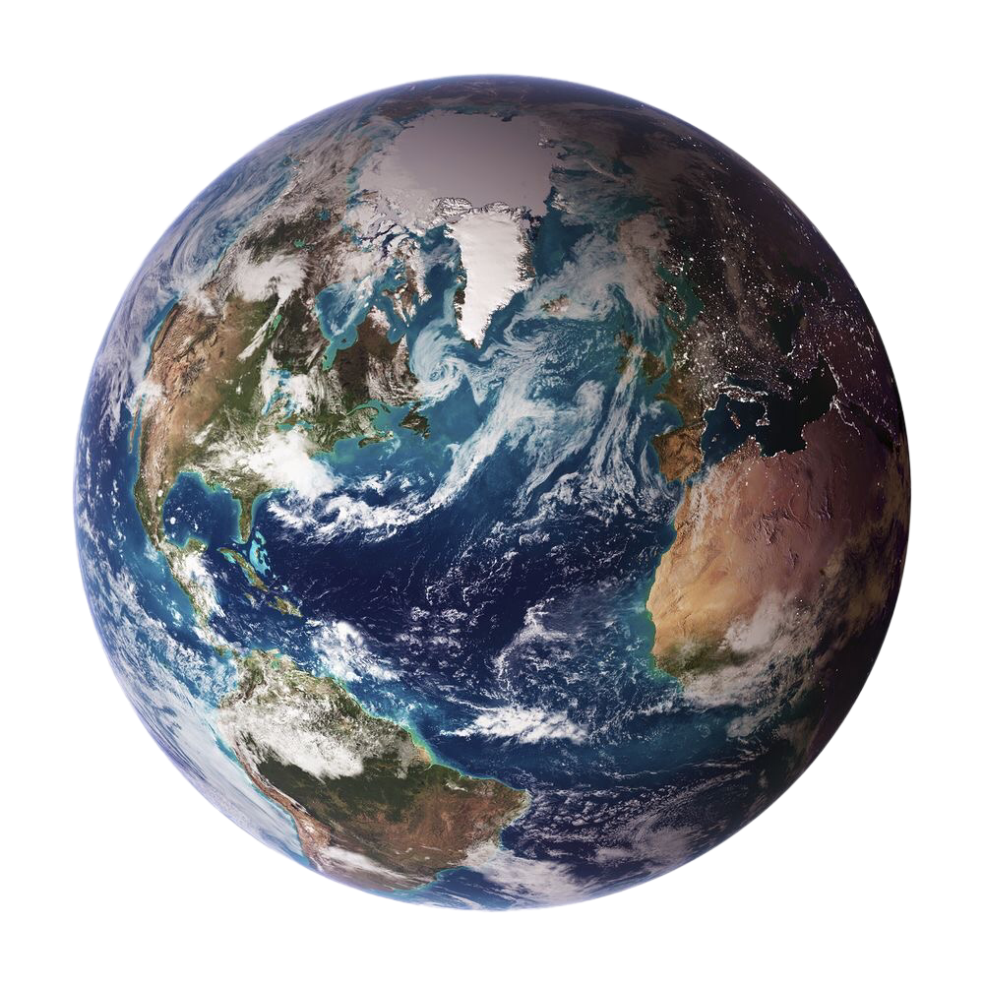
THE EARTH’S
SUBSYSTEMS
A Presentation by:
Xyryl Mae B. Cacayurin
Kate Cassandra D. Arenas
Kimberly M. Cloma
Henny N. Halasan
Steffanie Margarette A. Macaranas
12 (STEM) - Genesis

Slide 2
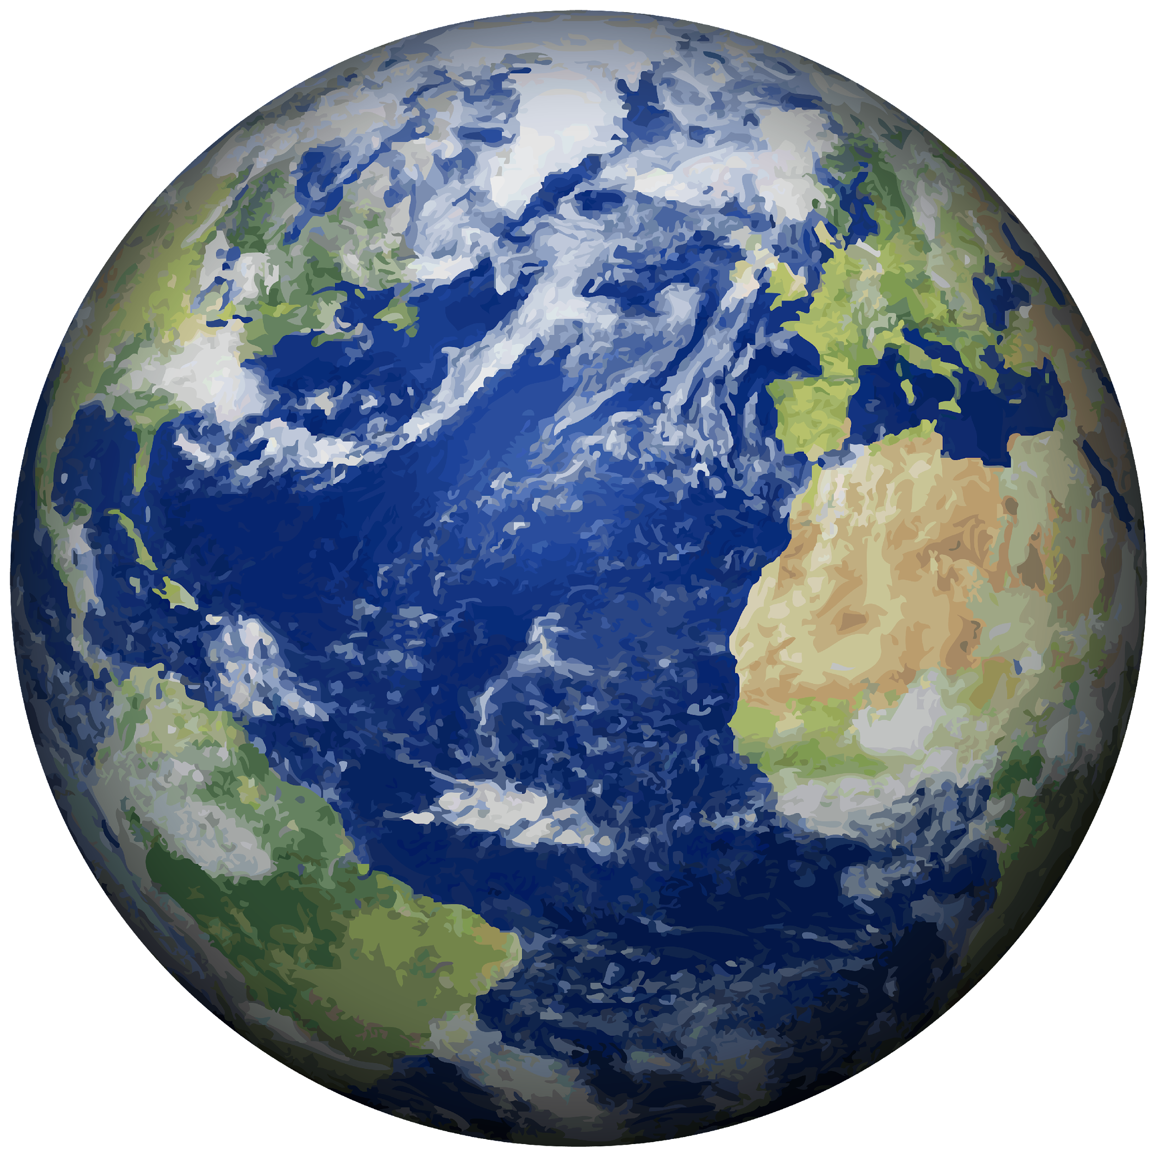
the third planet from the sun
The Earth
1
serves as harbor of life for billions of years
2
has different systems that interact to harbor life
4
3
provides all the necessities in order for life to continue to prosper

Slide 3
The Earth’s Subsystems
Earth is a complex system of interrelating physical, chemical, and biological processes. It is a system in which sets of interconnected components are interacting to form a unified whole. Earth is comprised of four major smaller systems known as subsystems.

Slide 4
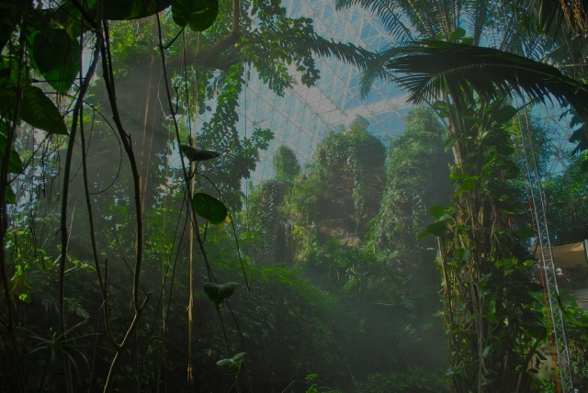


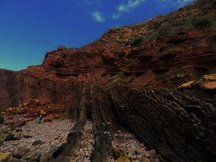
THE FOUR EARTH’S SUBSYSTEMS
BIOSPHERE
ATMOSPHERE
HYDROSPHERE
GEOSPHERE

Slide 5
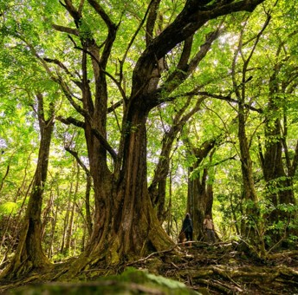
BIOSPHERE
came from the Greek word “bios” meaning life
includes all animals, microbes, and plants
“space of our planet that is taken up by living beings”

Slide 6
BIOSPHERE
composed of all living things from the upper atmosphere to the deepest part of oceans
each organism plays an important role to the food web
where the interaction between the different subsystems is most dynamic

Slide 7
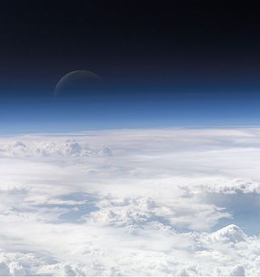
ATMOSPHERE
serves as the Earth’s blanket
from the Greek word ‘atmos’ meaning gas and ‘sphaira’ meaning globe
composed of gases in varying amounts

Slide 8
ATMOSPHERE
affected by the Earth’s gravity
protect the Earth from harmful UV rays and keeps the planet warm
its relative abundance is also crucial in different parts of the earth

Slide 9

HYDROSPHERE
composed of all the water on Earth in any form
came from Greek word ‘hydro’ which means water
permanently frozen part of this subsystem is called cryosphere

Slide 10
HYDROSPHERE
constantly and consistently moving because of temperature and salinity
includes ice, water vapor and liquid water
plays an important role in absorption and redistribution of solar radiation

Slide 11

GEOSPHERE
the solid part of the Earth
came from the Greek word ‘geos’ meaning ground
has three layers named as crust, mantle and the core

Slide 12
GEOSPHERE
composed of loose particles of rocks called regolith
comprises the geologic landforms such as mountains and hills
composed of naturally occurring solid aggregate of minerals, organic material, and rocks

Slide 13
Flow of Matter and Energy
Matter and energy flows and cycle between the four subsystems to sustain and make life on Earth possible.
The processes that move matter and energy from one sphere to another is called as sphere interaction.

Slide 14
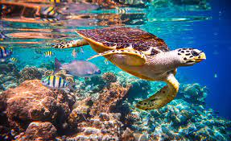
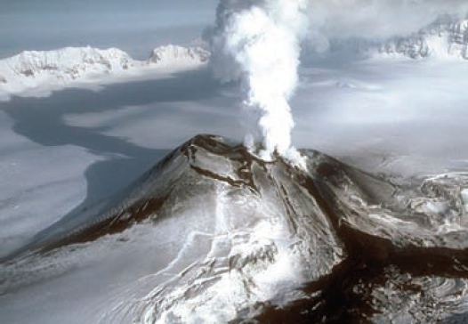
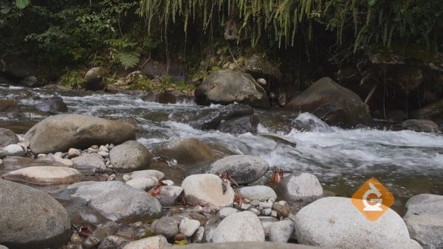
SPHERE INTERACTION
It allows the circulation of important nutrients that form and support life like carbon, oxygen, nitrogen, phosphorus, calcium, and water.
It also maintains the balance of substances in the different subsystem of the Earth.
Any disturbances in the flow of matter and energy may cause damage to any of the subsystems and its components.

Slide 15
“Because these subsystems interact with each other, they work together to influence the climate, trigger geological processes, and affect life all over the Earth.”
(Lee, 2021)

Slide 16
REFERENCES
Earth’s 4 Major Geological Subsystems. 2020. Retrieved from https://study.com/academy/practice/quiz worksheet-earth-sgeological- subsystems.html
eSchooltoday. 2020. How do the Earth’s Spheres Interact?. Retrieved from https://eschooltoday.com/learn/interaction/
Examveda. 2020. Retrieved from https://www.examveda.com/whatis-the-ecological-system-integrating-all-living-beings-and-theirrelationships-86060/
Medina, M. 2020. Earth System and Subsystems. Retrieved from https://slideshare.net/maleigh/grade-11-earth-life-scienceearth-systems-subsystems
National Geographics Society. 2020. Earth’s Systems. Retrieved from https://www.nationalgeographic.org/article/earths-systems/
National Ocean Service. 2020. What is the Carbon Cycle?. Retrieved from https://oceanservice.noaa.gov/facts/carbon-cycle.html
Ritter, Michael E. 2020. The Physical Environment: An Introduction to Physical Geography. Retrieved from https://www.earthonlinemedia.com/ebooks/tpe_3e/title_page

