Slide 1
Fitness 101: Leading edge practices for regaining life-long fitness
Let nothing stop you from chasing your dreams.
Start
Completion time: 45 min

Slide 2
Course Objectives
1
Discover a fresh perspective on fitness: don’t just exercise but train!.
2
Understand the 5 components of fitness and how to develop each component to meet your bodies physical demands
3
Incorporate our 3-D model of healing to develop lifelong fitness habits.
4
Avoid the pitfalls that derail us from sticking to a fitness regimen
5
Learn to pace and progress rehab with graded return to activity to prevent re-injury

Slide 3
Health Related Fitness
Physically Capable
Would you rather be sexy or healthy? Look good or be able to perform well?
The fitness industry would have us believe that aesthetics and fitness go hand in hand. Think about any fitness commercial you have seen; models drip sweat all the while keeping a smile on their face. The truth is, aesthetics are a shallow representation of fitness.
Fitness is not about how you look, but how you perform. It’s not about exercising but training for something! Can you move freely and fully with the strength and endurance needed to accomplish the task at hand? True fitness is having the physical capability to accomplish whatever physical task you set your mind too.
Embed Flash Video
Notes:
Video Narrative: I hear the phrase, “ I want to get more fit” frequently thrown around. Sounds good, but what does getting fit actually mean? All too often when we think of fitness we automatically associate it with aesthetics. But the reality is that looks are fleeting and our bodies are constantly changing. A better definition of fitness would be - Do you have the physical capability to accomplish your goals. Stop for a second and think of your health goals. Do you want to run a 5k? Be able to play with your grandchildren without hurting your back? Join the men’s league soccer club? These are realistic health and fitness goals. The purpose of this course is to give you a fresh perspective on fitness and then give you practical tips to help you achieve lifelong fitness.

Slide 4
Human Capability
Physically Capable
The human body is capable of accomplishing amazing feats. Athletes have shown the ability to throw a baseball >90 mph, scale mount everest, and swim across oceans.
It’s not that one athlete is more fit than the other, instead they have honed their craft to achieve their individual fitness goals.
It is important to keep in mind that fitness is a process. You do not get ‘fit’ over night and in reality you can never be 100% fit. Instead, fitness is a journey of towards self-improvement. Fitness is a constant struggle to increase your physical capabilities.
Fitness is individual. It is a craft. It is a journey.

Slide 5
Components of Fitness?
Components of Fitness
Embed Flash Video
Strength: The ability of muscular units to apply force on an external object.
Endurance: The ability of body systems to gather, deliver, and process oxygen into fuel.
Power: The ability of muscular units to apply maximum force in minimum time.
Mobility: The ability achieve full range of motion at a given joint
Agility: The ability to minimize transition time from one movement pattern to another.
Notes:
Non-narrative video: Illustration of strength, endurance, power, mobility, agility.

Slide 6
Strength
Components of Fitness
Strength is paramount in any fitness program. Regardless of the physical demand, contracting muscles must generate enough force to accomplish the task.
Guidelines to Develop Strength
Overload Principle: muscle must be challenged beyond its current force capability
Specificity Principle: adaptations in the metabolic and physiological body systems depends on the type of overload imposed
Reversibility Principle: benefits of training are not sustained unless muscles are routinely challenged

Slide 7
Endurance
Components of Fitness
Cardio is often the most dreaded exercise, but endurance is far more than just cardiovascular output. Endurance encompasses cardiovascular, muscular, and mental stamina
Guidelines to Develop Endurance : FITT Equation
Frequency- The number of exercise session per week. If training at low intensity then frequent exercise is indicated
Intensity - The rate of overload (challenge) in a given exercise session. Intensity should work toward progressive overload of body systems.
Time - The duration spent completing an exercise. Training time should be equal to or greater than the duration of the physical demand of the sport.
Type - The given exercise should specifically train the body systems in a way that meets the physical demand of the sport.

Slide 8
Power
Components of Fitness
Power is the combination of strength and speed; think lineman. To increase your power is to increase your force production.
Guidelines to Develop Power
Low Repetition: Aim for 3-6 reps. Power activities should not tire you so as to keep intensity as high as possible
Moderate Resistance: 40-60% of your one rep maximum is sufficient to increase maximal power output.
High Speed: Target fast twitch muscle fibers by garnering explosive movements (i.e. jumping, throwing, sprinting).

Slide 9
Mobility
Components of Fitness
When it comes to injury prevention, mobility is king. Countless sport injuries are a result of dysfunctional mobility (non-traumatic ACL rupture, torn rotator cuff ect...) Don’t let poor joint mobility leave you sidelined.
Guidelines to Develop Mobility
Muscle Flexibility: The ability of musculotendinous units to elongate as the body segment moves through a range of motion
May come from either static or dynamic stretching
Joint Mobility: The ability of a joint to move freely through unrestricted, pain-free range of motion
May come from mobilization of specific joint in respect to convex/ concave rule

Slide 10
Agility
Components of Fitness
Agility is often the last component of fitness to be mastered. Agility is a highly skilled movement pattern that involves an integration of balance, coordination, and reflex response.
Guidelines to Develop Agility
Challenge Dynamic Balance: Agility training should challenge the ability to maintain body control during highly dynamic movements.
Increasing Coordination: When you have mastered simple movement patterns it is time to add more complex and multilevel movements.
Rapid Reflex Response: Agility requires that our bodies have a quick reaction time to external influences. The best way to train our reflex is to limit the time it takes to process movement information.

Slide 11
Summary
1
Fitness is a individualized and should be crafted in such a way that allows you to accomplish your physical goals.
2
Components of fitness: strength, endurance, power, mobility, and agility.
3

Slide 12
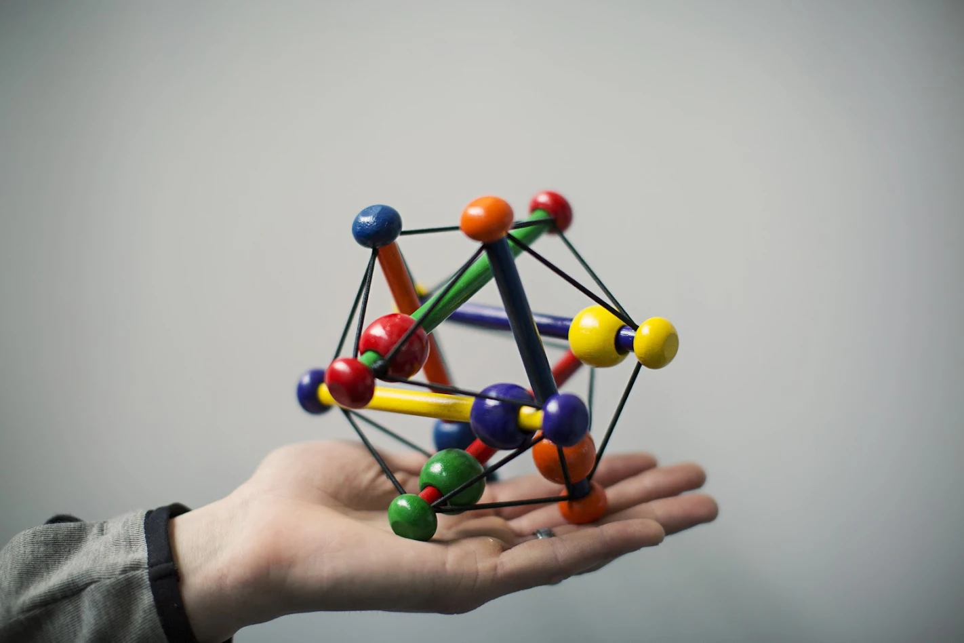
3-D Integrity of Fitness
Defend: Do not become subject to the hottest fitness trends.
Develop: Learn to develop each component of fitness to accomplish your fitness goals.
Demand: The fitness journey is seasonal. There will be easy summer months and hard, long winter months. Demand more from the winter months.

Slide 13
Defend Against the Trend
Defend
Embed Flash Video
Some of the fastest growing trends rise and fall within the fitness industry.
Do not become a follower!
There will be fads that try to offer shortcuts to improving your fitness. Let me give you a hint, there are no shortcuts! There is no such things as a 6-pack in 6 minutes per day.
Whatever your fitness goals are, I can guarantee three things; it will take hard work, it will take time, and it takes dedication.
Notes:
Video Narrative: In American culture it is common that we want results and we want them now. Due to our insatiable desire for a quick fix, we become followers of fitness trends. I am guilty of it… (story of _______________). The reality is that it is easy to be persuaded to join the next fad. We follow experts that claim to have “found It… the new secret formula to fitness.” The reality is that there is proven methods that work. And unfortunately these methods of building fitness take time and dedication. Do not become a follower! No matter what the ‘experts’ say there is no easy fix. So be prepared to carve out time in your schedule and get to work.

Slide 14
Defensive Mindset
Defend
If you were planning to build a new home would you not first sit down and calculate the costs?
It should be the same with your fitness journey. Know the costs of of becoming fit before you even begin...
Time
Hard Work
Consistent Effort
This means that your fitness routine must find time within your daily schedule. Maybe you wake up early or stay up late. Perhaps you take a shorter lunch break at work. If fitness is important to you, then make the time and put forth the effort.

Slide 15
At the Starting Line
Develop
If you have ever competed in a road race, you know that the fastest competitors make their way to the front of the pack just prior to the race beginning. You can often tell who the most competitive athletes are because they seem focused and prepared.
We all find ourselves at the starting line of fitness at some point in our lives. The following slides will teach you how to prepare and develop each component of fitness.

Slide 16
Develop Strength
Develop
Embed Flash Video
It takes 6-8 weeks of consistent training to develop muscle hypertrophy (increase in muscle size).
Outcome | % 1 Rep Max | Repetition Range | # of sets | Rest Intervals
Hypertrophy | 70-80% | 8-12 | 1-6 | 30-120 sec
Maximum Strength | 80-100% | 1-8 | 1-5+ | 2-5 min

Slide 17
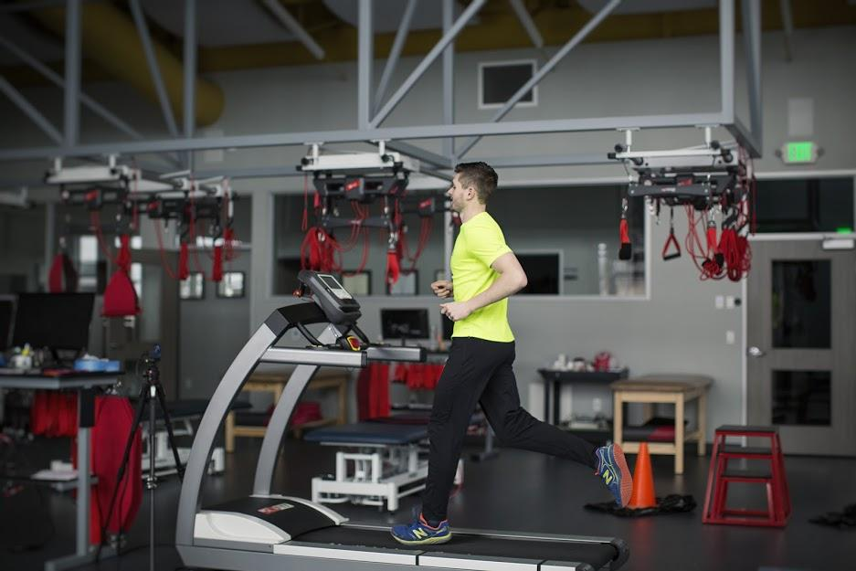
Develop Endurance
Embed Flash Video
Develop
It takes 6-10 weeks to increase VO2Max (oxygen utilization) [1].
Calculate your target heart rate
220 - age = max HR
Calculate your target 1 rep max
Perform exercise with maximal weight
Outcome | Frequency | % of 1 Rep Max | Repetition Range | # of sets | Duration
Cardiovascular Endurance | 5-7 x per week | 60-80% max HR | N/A | 1 | 20-30 minutes
Muscular Endurance | 3-5 x per week | < 70% | 12-20 | 1-3 | 2 min between exercise

Slide 18
Develop Power
Develop
Power (P) = Force (F) x Velocity (V)
Embed Flash Video
It takes 6-8 weeks of consistent training to increase force production.
Outcome | Frequency | % of 1 Rep Max | Repetition Range | # of sets | Speed Per Rep
Force Production | 3-5 x per week | 30-50% [2] | 1-5 | 3-5 | 90-100%

Slide 19
Develop Mobility
Develop
Embed Flash Video
Through work as a physical therapist, I can attest that some regions of the body are more susceptible to movement restrictions than others. The most important regions to maintain mobility are the ankle, hip, and thoracic spine.
Decoupling (unlocking) the big three
Ankle decouple
Hip decouple
Thoracic Decouple

Slide 20
Develop Agility
Develop
Embed Flash Video
The key to developing agility is to offer structured variability into the training program. To challenge agility into any athletic task combine the following variables:
Dynamic Balance
Perform the same task with a balance component
Coordination
Tasks that involve all four limbs
Reflex Response
Limit reaction time

Slide 21
Demand Success
Demand
We have established that becoming fit takes time, hard work, and consistent effort. We have also reviewed the basic concepts to developing well-rounded fitness. The last obstacle to tackle is that of motivation.
Motivation, or rather lack thereof, is the primary reason that people fail to stick to their fitness goals.

Slide 22
Seasons of Fitness
Demand- Lifestyle Fitness
My favorite season of the year is spring. As the sun thaws the frozen ground and trees begin to sprout buds, I am reminded that the cold, dark days of winter have passed and nature is being renewed. This sense of renewal gives me motivation and increased energy.
At these times, it is easy for us all to stay on top of our fitness goals. When you feel good, you perform at your best. But what about the winter months? Life becomes hard, and often we fail to thrive at our fitness goals. With this in mind, fitness is not about performing well in spring, but rather surviving winter.

Slide 23
Surviving Winter
Demand- lifestyle fitness
If you find yourself saying things like, “I will start exercising on Monday” or “ I’ll run everyday this month” then you are in the winter season.
Winter is that season where motivation is at an all time low. When life is busy and uncomfortable, excuses are abundant. I do not need to state the benefits of exercise. We all know we should exercise, however, knowing and practicing are two completely different scenarios.
The primary reason we fall into ruts is because we do not have a concrete plan. Being fit for the sake of being fit will not carry us through the winter.

Slide 24
The Fitness Plan
Demand
Embed PDF File for Plan to developing Fitness
Establish Goals: short term and long term
Identify weaknesses
Don’t Exercise but Train!

Slide 25
Summary
1
Use this slide to summarize the course or an individual chapter.
2
Identify what skills students have acquired.
3
Recommend learners the next course or module of study.

Slide 26
Failure is not an option
Rehab Pitfalls
Do not simply wish to become fit, demand it. Know that you deserve to have a healthy and strong body that meets your physical demands.

Slide 27
Quiz Slide
Insert your quiz on this slide.

Slide 28
Research
Bacon, A. P., Carter, R. E., Ogle, E. A., & Joyner, M. J. (2013). VO2max Trainability and High Intensity Interval Training in Humans: A Meta-Analysis. PLoS ONE, 8(9). doi:10.1371/journal.pone.0073182
Thomas, G. A., Kraemer, W. J., Spiering, B. A., Volek, J. S., Anderson, J. M., & Maresh, C. M. (2007). Maximal Power At Different Percentages Of One Repetition Maximum. Journal of Strength and Conditioning Research, 21(2), 336-342. doi:10.1519/00124278-200705000-00008

