Slide 1
Rehab 101: Leading edge rehab to achieve full recovery after orthopedic surgery
Take charge of your rehab with proven methods to fully heal and recover quickly from surgery. Discover the rehab methods designed to achieve a faster recovery after surgery. Our in-depth guide of structure and function sets the stage for achieving mobility, strength and balance. Offers an easy method to track and progress each phase of rehab
Start
Completion time: 45 min

Slide 2
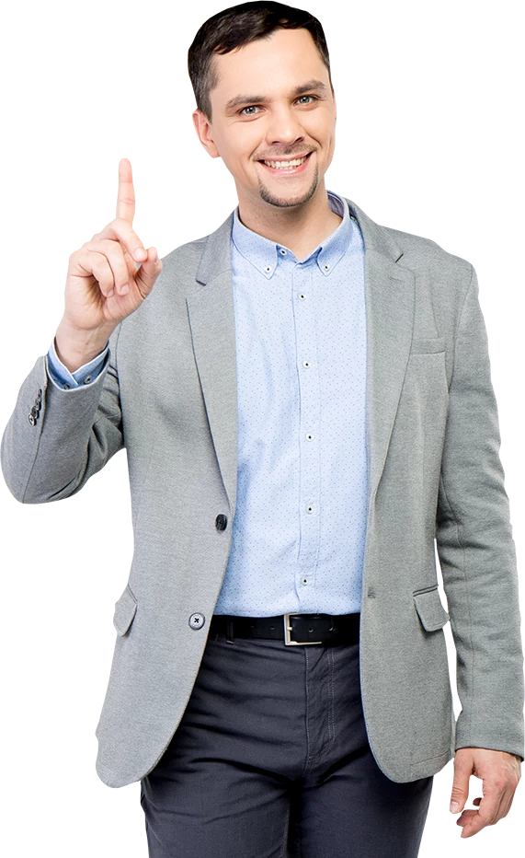
Course Objectives
1
Discover the importance of balance, stability and strength throughout the neuromusculoskeletal chain
2
Learn the proven methods to successfully prepare for surgery and speed your recovery
3
Understand the role of pain mechanisms and put your brain to work for a healthier recovery
4
Avoid the pitfalls or delay in recovery due to improper or inadequate treatment
5
Learn to pace and progress rehab with graded return to activity to prevent re-injury

Slide 3
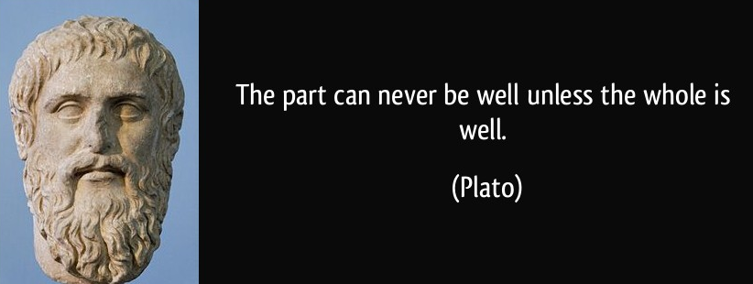
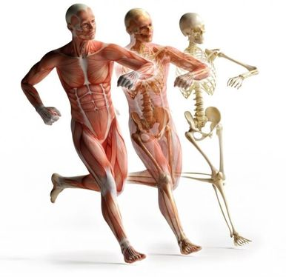
Neuromuscular chain
3D Integrity
It’s all connected. Modern medicine has advanced in disease treatment but lacks a whole body approach for treating dysfunctions. Rather than viewing the entire body, medicine encourages specialists to focus on their area of expertise. This is great for the specialist but bad for the patient seeking a full rather than partial recovery
An orthopedic injury affects the entire body. It changes how you feel and impacts movement and function in multiple dimensions. Surgery is the first step towards recovery, but it is not a fix. No surgery can fully address all the neural compensations and myofascial dysfunctions associated with the orthopedic condition

Slide 4
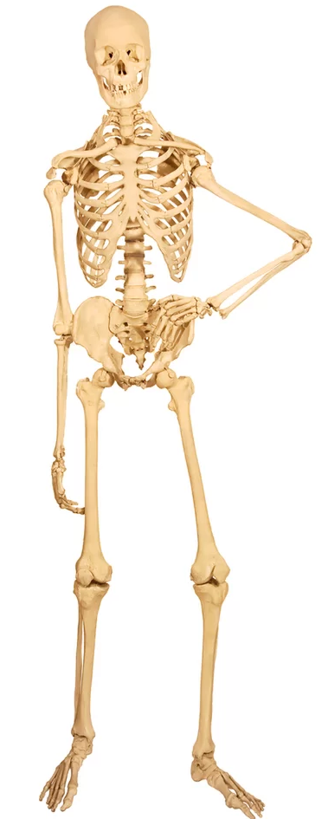
Articular Patterns
3D Integrity
Joint movement patterns rely upon the joint structure (design) and function of the neuromuscular chain (control). It’s pointless to consider a joint problem without respecting the supporting ligaments, cartilage and neuromuscular chain. For instance, the hinge joint of the knee sets the stage for bending and rotary motions with round femoral condyles and flat tibial plateau. It’s the neuromuscular chain which creates the motion with loading supported by the cartilage & ligaments
Change is constant. During youth activity encourages bones to grow and take on new shapes as they mature to full development. As adults, our level of activity and natural aging continues to shape bones at the articular interface. Surgery alters the natural ability of articular tissue to recover quickly and absorb the stress caused by an active lifestyle

Slide 5
Articular Patterns
3D Integrity
Flash video on Posture and dysfunction of rings
Structure meets Function
Spine: Vertical chain of vertebrae and disc designed to protect nervous system (brainstem & spinal cord)
The human spinal column consists of bony vertebrae and discs which require strong, mobile support from muscle to withstand the load of daily activity
Shld/Pelvic Girdle: Horizontal chain of ribs & flat bones (scapula & ilia) designed to protect viscera
Rings of bone are designed to provide a mobile base of stability offering protection and limited motion. Posture is important to achieve optimal alignment of supporting links. For instance, a protracted shoulder girdle limits shoulder joint motion. Similar to how an excessive pelvic tilt can restrict hip mobility
Protect

Slide 6
Articular Patterns
3D Integrity
Flash video on joint loading and movement/dysfunction
Structure meets Function
Hip: Very stable joint due to ball and socket structure but muscles share a primary role in shock absorption. Weakness in the supporting muscles can cause bony changes which lead to arthritis of the hip
Ankle: Stable joint with dome in mortise structure relies upon ligaments and muscles to absorb loading. Poor neural drive to the ankle impairs balance and can increase risk for ankle sprains or instability
Getting these joints balanced with good muscle support is very important to allow shock absorption with the joint in a centered position
Absorb

Slide 7
Articular Patterns
3D Integrity
Flash video on joint movement/dysfunction
Structure meets Function
Shoulder: Most mobile joint in the body which leaves stability mostly dependent upon supporting muscles
Mobility requires stability, which is why a mobile shoulder requires a strong, stable shoulder girdle. Lack of stability can lead to tissue overload of the cuff muscles and labrum
Elbow/Knee: Mobile hinge type joints which transmit rotary force into bending force to dampen torque in the movement chain. Very important to have strong control from neuromuscular chain to protect ligaments and cartilage from effects of torque and shear
These bending joints lack independent motion which makes them reliant upon the joints above and below for control. For instance, the hip is a primary suspect for weakness in knee disorders
Agile

Slide 8
Articular Patterns
3D Integrity
Flash video on compensation patterns
Structure meets Function
Head/Hands/Feet: Oriented towards fine motor tasks with high density of nerves to control primary functions of posture and awareness
The head is home to the senses which is why the head must be able to orient to our environment very quickly. Impaired orientation or limited movement can cause some vague symptoms such as dizziness, vertigo, and tinnitus
Our brain map dedicates huge portions of awareness and neural drive to these areas. Sometimes the brain can get stuck in a particular pattern; such as, a protective pattern due to fear of injury/pain which causes more tissue loading further up/down the chain due to increased effort during daily activities. For instance, tension headaches can lead to TMD or jaw pain. Wrist instability can cause shoulder impingement simply due to increased effort throughout the neuromuscular chain
Manual

Slide 9
Movement Patterns
3D Integrity
Flash video on muscle chain tension/dysfunction
Tension and neural drive are the basic determinants of human motion. What about strength? Actually, the nervous system (neural drive) only recognizes tension. If strength (tension) is lacking in one chain it will simply create stiffness (tension) in an adjacent chain to compensate. The problem is the presence of increased tissue loading (joint/cartilage/ligament) which occurs due to this compensatory pattern
Surgery does not correct movement patterns. The neural drive will not automatically change after surgery. It is important to understand the myofascial chains of tension and their most efficient means of applying tension to restore normal movement patterns

Slide 10
Movement Patterns
Balance and Stability
Flash video on muscle chain compensations
The Myofascial chain
Interdependent: Each myofascial chain works in unison with it’s counter or opposite chain. A balance of tension between the chains is necessary to achieve optimal performance of movement
Interconnected: Fascial layers within and between muscles are connected though a network of loose connective tissue. Essentially the entire body is connected via fascia forming continuous layers which must have freedom of movement
Integrated: The myofascial system is integral to the nervous and visceral system. This is often the cause of referred pain where muscle problems can easily mimic visceral or nerve pain

Slide 11
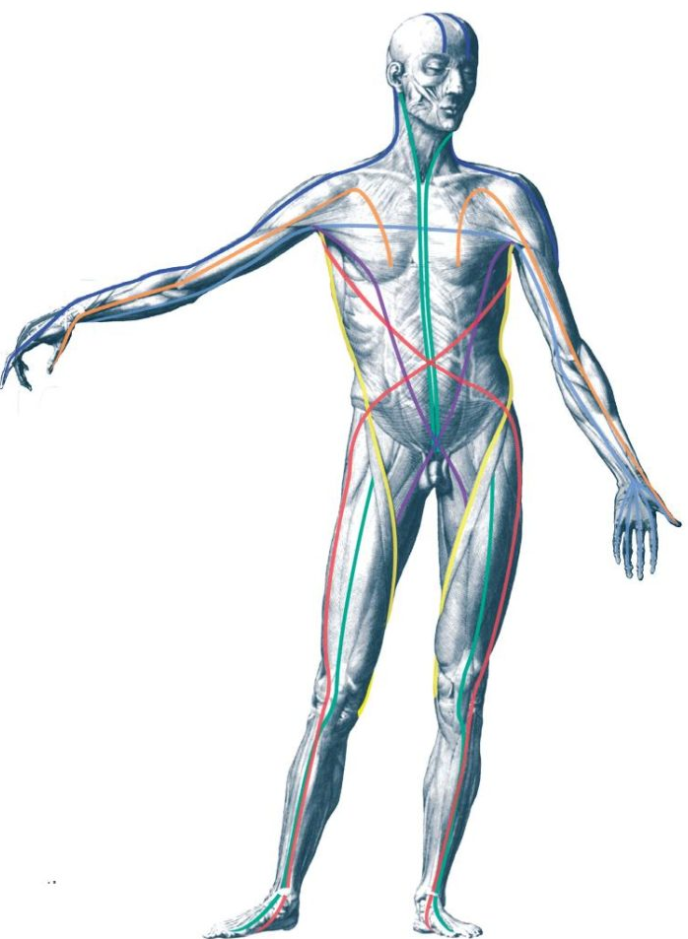
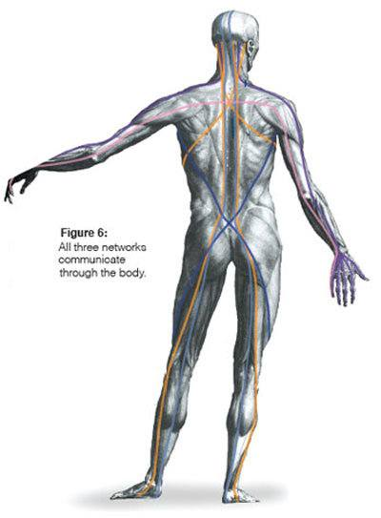
Movement Patterns
Balance and Stability
The Myofascial chain
Unidimensional: These workhorses of the tension sequences (myofascial chains) perform the basic function of bending and straightening the skeletal chain
Power: Able to generate significant force due to length and orientation of chain. Tends to stiffen in response to weakness in other chains due to high density of neural drive and primitive reflexes
Compressive: Overactivity (stiffness) in the sagittal sequence leads to excessive joint compression and reduced mobility. Balance of tension requires addressing weakness in other planes of movement (Frontal or Transverse)
Sagittal

Slide 12
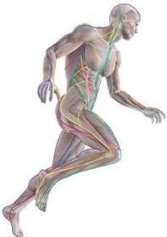
Movement Patterns
Balance and Stability
The Myofascial chain
Bidimensional: The guidewires of the tension sequences manage position and awareness throughout the body. Reinforce ligament support of agile joints
Endurance: Slow and steady muscle chain designed to maintain equilibrium and balance
Fatigue: Overactivity in the frontal sequence leads to impaired postural and reduced awareness requiring greater effort from other chains to perform movement. Stiffness in this chain typically indicates weakness in the opposite side
Frontal

Slide 13
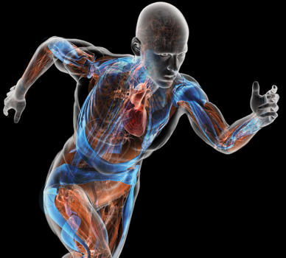
Movement Patterns
Balance and Stability
The Myofascial chain
Multidimensional: The tension mechanisms of controlled motion and combined movement patterns. Rotation myofascial chains allow us to maneuver with skill and minimal joint loading
Responsive: Able to respond quickly to joint loading and assist with shock absorption. A tension basis for movement requires 3D strength to create a stable platform which is mobile and agile
Tension: The only system capable of reducing compressive force and limiting joint loading. Stiffness in this chain typically indicates weakness in an adjacent link along the same plane of movement
Transverse

Slide 14
Neural Matrix
Balance and Stability
Flash video on neural matrix/dysfunction
Protective: Survival is the basic response to any threat. The neural drive will access the most efficient and readily available movement pattern to protect against harm. Unfortunately, even when the threat of injury is resolved it’s typical for the protective pattern to persist
Task Oriented: It’s nearly impossible to think or instruct your way out of a protective pattern. Novel and challenging tasks must be performed to reactivate a balance of movement patterns
Adaptable: Ability to adapt to a changing environment requires a removal of threats and awareness of movement rather than fear of injury

Slide 15
Balance and stability of the neuromusculoskeletal chain. The systems which make it possible
1
Articular chain is the mechanical framework for movement. Structure relies upon support from neuromuscular chain. Change is constant
2
Myofascial chain is the functional machine to guide movement and control joint loading. Compensatory patterns increase tissue loading
3
Neural matrix is the brain and all its connections which direct movement and receive vital information on threats

Slide 16
Pre-surgery (Prehab)
Post-op care
Be Prepared: Know your options and do your homework. No surgery is without risks. Imaging alone is rarely a reliable source for identifying the source of pain. Surgery success depends on how well you prepare and recover
Eat & Sleep Well: Recovery is a Responsibility. Healing well requires a basic level of wellness. Check out Wellness 101
Activate the Chains: Some critical myofascial links have been inactive or weak due to pain or injury. Now is the time to begin triggering those weak links to fire more effectively
Train the Brain: Believe in your recovery. Start seeing yourself achieving new milestones towards a healthier life. Remember that pain is rarely resolved fully with surgery, it requires a period of retraining and regaining full function

Slide 17
Faster Recovery
Post-op care
Get moving: Limit down-time and maintain a level of fitness. Follow post-surgical limits but maximize your opportunity to get breathlessness (Check out Fitness 101)
Know your strengths: Work ahead by performing the strengthening exercises on the unaffected area. The carry over will help your surgical site once you are ready to progress
Pace yourself: Don’t go back to work or activity too soon. Most re-injuries or surgery failures occur due to not adhering to a steady transition back to normal activities

Slide 18
Rehab Phases
Post-op care
Protect: Monitor swelling and avoid stiffness. Use elevation and light pumping exercises to keep circulation steady. Avoid prolonged static positions
Restore: Range of motion is critical during the early stages. Set goals and be consistent with exercise. Begin light isometrics in various positions to activate weak muscles
Regain: Strengthen in a gradual fashion with multiple bouts and low resistance with emphasis on endurance and speed
Resume: Begin a gradual return to skilled activity. Break activity down into components to practice each level with coordination and proper timing

Slide 19
Phase I: Protect
Post-op care
Control Swelling: Decreased lymphatic circulation and reduced freedom of motion sets the stage for edema and blood clots (thrombosis). Limit down-time (sitting/lying) and be diligent with elevation / pumping
Signs of infection: Typically accompanied by increased swelling, pain and tissue changes
Excessive Stiffness: Frozen joint or loss of motion may be indicators of an adverse reaction to surgery. More likely, it’s a factor of slow progress and delayed recovery
Irritable pain: Some acute pain is normal after surgery due to tissue damage which requires time to heal. Increased pain without any of the above signs may simply be an on-going protective pattern of the neuromatrix

Slide 20
Phase II: Restore
Post-op care
Range of motion: Slow and steady progression of movements to regain full joint motion. Perform at least 5x a day for 5min
Activation: Prolonged isometric exercises on unaffected limb. Perform 10reps for 10sec each
Weight-bearing: Gradual transition of functional positions with varying degrees of support. Practice throughout the day
Goals: Full motion and progressive weightbearing

Slide 21
Phase III: Regain
Post-op care
Controlled motion: Practice coordinated and skilled tasks. Make it fun and challenging to avoid protective pain patterns. Perform at least once a day for 5min
Strength: Progressive resistance (low load, high reps) in mid-range of motion. Perform a set of 3-4 exercises for 25 reps each
Balance: Progressive challenge to balance with varying support. Combine with controlled motion to increase difficulty
Goals: Progressive strength and balance

Slide 22
Phase IV: Resume
Post-op care
Return to work: Get back to work as soon as possible. Delay in return increases risk for disability and depression. Reduce the risk for re-injury with recognizing the potential workplace hazards and limiting your exposure
Athletic readiness: Start slow and remember that a certain level of fitness is required to resume activities such as running, swimming or cycling
Sports participation: Test yourself and be prepared to practice at a level below pre-surgery performance. Don’t compete until you have excelled at practice tests
Goals: Ready for action and reduced risks for re-injury

Slide 23
Rehab Tracker
Post-op care
Flow sheet for exercise with different phases as titles

Slide 24
Summary
1
Prepare for surgery by being informed and establishing a basic level of wellness
2
Recovery is your responsibility. Keep active and maintain steady progression through rehab phase
3
Track your compliance and establish goals for return to activity

Slide 25
Pain Rehab
Post-op care
Pain is multifactorial and complex. It rarely comes from a single source nor is it isolated to the tissue. Pain must be perceived before it exists. Working through pain does not give you a high pain tolerance.
Understand why you are having pain. Is it the tissue input or the neural matrix output? Often it’s a combination of both
Reduce the fear of pain. Anxiety and fear are not conducive to healing. We can’t guard against injury, instead we must prepare and fight for survival. Tissue strength, joint mobility and stability are the keys to avoiding injury
Train the brain to recognize less pain. Easier said than done. It takes practice and steady reassurance to regain confidence with movement and functional awareness based upon the tasks rather than the pain

Slide 26
Brain Games
Post-op care
No pain, no gain. Pain is no longer a threat, it’s simply an opportunity to begin the process of recovery
I no longer feel pain, I only feel …. (stiffness, weakness, load, position)
Say no more. Adhere to a strict limit on how you tell others about your pain. Only discuss pain with medical providers
Use activity and social relations as a prescription for pain relief. Avoid increasing pain medication without advice from medical provider

Slide 27
Pacing return to activity
Post-op care
Set Goals: Be realistic and realize your limits. Make the most of your recovery by successfully accomplishing each phase of rehab. Set reasonable goals for return to work and some form of athleticism which will lead to improved fitness
Establish milestones: List 3 attainable milestones for each goal. Get help from a skilled and competent therapist if recovery is delayed or plateaued
Track progress and be prepared to adjust program to meet goals. Consider a group fitness or gym based routine to increase program variability

Slide 28
Summary
1
Pain is not always a sign of injury or tissue harm. Surgery does not eliminate pain but it can set the stage for a recovery towards less pain
2
Don’t wait to get better before you feel better. Your neural matrix needs to remap the surgical site to reduce the painful signals
3
Gradual return to work and activity requires successful completion of all rehab phases. Listen and seek guidance from the medical team

Slide 29
Failure is not an option
Rehab Pitfalls
No one wants a repeat surgery for the same condition. Remember, surgery is not a fix. It simply offers the chance to start creating a healthier joint or tissue.
Get help from a competent physical therapist to progress rehab phases and achieve goals. Do your homework and stick to the program

Slide 30
Signs of worry
Rehab Pitfalls
Some problems may arise which require immediate consult with medical provider.
Sudden increase of swelling: Some swelling is normal but a sudden change in swelling or edema needs to be evaluated by a medical provider
Loss of sensation: Often times the surgical site will have some areas of numbness. Any increase of neural symptoms should be evaluated thoroughly
Signs of infection: Increased pain and tissue changes (Redness, increased pain and swelling) require medical attention

Slide 31
Quiz Slide
Insert your quiz on this slide.

