Slide 1
THINGS TO CONSIDER WHEN
BUYING A HOME
WINTER 2019
EDITION

Slide 2
TABLE OF CONTENTS
3
4 Reasons To Buy A Home This Winter
WHAT'S HAPPENING IN THE HOUSING MARKET?
5
2 Factors To Watch In Today's Real Estate Market
7
Home Prices Over The Last Year
8
Buying Remains Cheaper Than Renting In 38 States!
9
Do You Know The Cost Of Waiting To Buy?
10
Where Are Mortgage Interest Rates Headed?
WHAT YOU NEED TO KNOW BEFORE YOU BUY
12
Buying a Home? Do You Know The Lingo?
13
Why Pre-Approval Should Be Your First Step
14
You Do NOT Need 20% Down To Buy Your Home!
16
The True Cost Of NOT Owning Your Home
17
Starting To Look For A Home? Know What You Want Vs. What You Need
18
61% Of First-Time Buyers Put Down Less Than 6%
WHAT TO EXPECT WHEN BUYING A HOME
19
5 Reasons To Use A Real Estate Professional
20
Have You Put Aside Enough For Closing Costs?
22
Ready To Make An Offer? 4 Tips For Success

Slide 3
4 Reasons To Buy A Home This Winter
Below are four great reasons to consider buying a home today instead of waiting.
Prices Will Continue to Rise
CoreLogic’s latest Home Price Index reports that home prices have appreciated by 5.6% over the last 12 months. The same report predicts that prices will continue to increase at a rate of 4.7% over the next year.
The bottom in home prices has come and gone. Home values will continue to appreciate for years. Waiting no longer makes sense.
Mortgage Interest Rates Are Projected to Increase
Freddie Mac’s Primary Mortgage Market Survey shows that interest rates for a 30-year mortgage have increased by nearly a full percentage point to around 4.8% in 2018. Most experts predict that rates will rise over the next 12 months. The Mortgage Bankers Association, Fannie Mae, Freddie Mac, and the National Association of Realtors are in unison, projecting that rates will increase by this time next year.
An increase in rates will impact YOUR monthly mortgage payment. A year from now, your housing expense will increase if a mortgage is necessary to buy your next home.
3

Slide 4
Either Way, You Are Paying a Mortgage
There are some renters who have not yet purchased a home because they are uncomfortable taking on the obligation of a mortgage. Everyone should realize that unless you are living with your parents rent-free, you are paying a mortgage - either yours or your landlord’s.
As an owner, your mortgage payment is a form of ‘forced savings’ that allows you to have equity in your home that you can tap into later in life. As a renter, you guarantee your landlord is the person with that equity.
Are you ready to put your housing cost to work for you?
It’s Time to Move on with Your Life
The ‘cost’ of a home is determined by two major components: the price of the home and the current mortgage rate. It appears that both are on the rise.
But what if they weren’t? Would you wait?
Look at the actual reason you are buying and decide if it is worth waiting. Whether you want to have a great place for your children to grow up, you want your family to be safer, or you just want to have control over renovations, maybe now is the time to buy.
If the right thing for you and your family is to purchase a home this year, buying sooner rather than later could lead to substantial savings.
4

Slide 5
2 Factors To Watch In Today's Real Estate Market
When it comes to buying or selling a home there are many factors you should consider. Where you want to live, why you want to buy or sell, and who will help you along your journey are just some of those factors. When it comes to today’s real estate market, though, the top two factors to consider are what’s happening with interest rates & inventory.
Interest Rates
Mortgage interest rates have been on the rise and are now over three-quarters of a percentage point higher than they were at the beginning of the year. According to Freddie Mac’s Primary Mortgage Market Survey, rates have climbed to around 4.8% for a 30-year fixed rate mortgage.
The interest rate you secure when buying a home not only greatly impacts your monthly housing costs, but also impacts your purchasing power.
Purchasing power, simply put, is the amount of home you can afford to buy for the budget you have available to spend. As rates increase, the price of the house you can afford to buy will decrease if you plan to stay within a certain monthly housing budget.
The chart below demonstrates the impact rising interest rates would have if you planned to purchase a $400,000 home while keeping your principal and interest payments between
$2,020-$2,050 a month.
With each quarter of a percent increase in interest rate, the value of the home you can afford decreases by 2.5% (in this example, $10,000). Experts predict that mortgage rates will be
over 5% by this time next year.
Buyer’s Purchasing Power
6.00 | $ 2,398 | $ 2,338 | $ 2,278 | $ 2,218 | $ 2,158
5.75 | $ 2,334 | $ 2,276 | $ 2,218 | $ 2,160 | $ 2,100
5.50 | $ 2,272 | $ 2,214 | $ 2,158 | $ 2,100 | $ 2,044
5.25 | $ 2,208 | $ 2,154 | $ 2,098 | $ 2,044 | $ 1,988
5.00 | $ 2,148 | $ 2,094 | $ 2,040 | $ 1,986 | $ 1,932
4.75 | $ 2,086 | $ 2,034 | $ 1,982 | $ 1,930 | $ 1,878
4.50 | $ 2,026 | $ 1,976 | $ 1,926 | $ 1,874 | $ 1,824
 | $ 400,000 | $ 390,000 | $ 380,000 | $ 370,000 | $ 360,000
 |  | -2.5% | -5% | -7.5% | -10%
RATE
Principal & Interest Payments rounded to the nearest dollar amount
5

Slide 6
Inventory
A ‘normal’ real estate market requires there to be a 6-month supply of homes for sale in order for prices to increase only with inflation. According to the National Association of Realtors (NAR), listing inventory is currently at a 4.3-month supply (still well below the 6-months needed), which has put upward pressure on home prices. Home prices have increased year- over-year for the last 80 straight months.
The inventory of homes for sale in the real estate market had been on a steady decline and experienced year-over-year drops for 36 straight months (from July 2015 to May 2018), but we are starting to see a shift in inventory over the last five months.
The chart below shows the change in housing supply over the last 12 months compared to the previous 12 months. As you can see, beginning in June, inventory levels have started to increase as compared to the same time last year.
HOUSING SUPPLY Year-Over-Year
Jun
Jul
Aug
Sep
Oct
Last 12 Months
Bottom Line
If you are planning to enter the housing market, either as a buyer or a seller, let’s get together to discuss what changes in mortgage interest rates and inventory could mean for you.
6

Slide 7
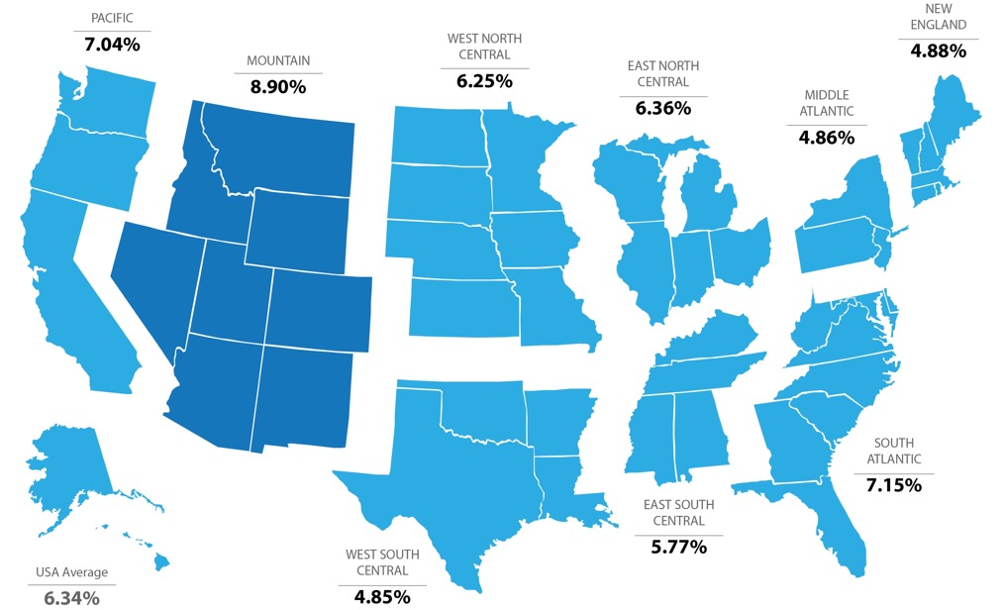
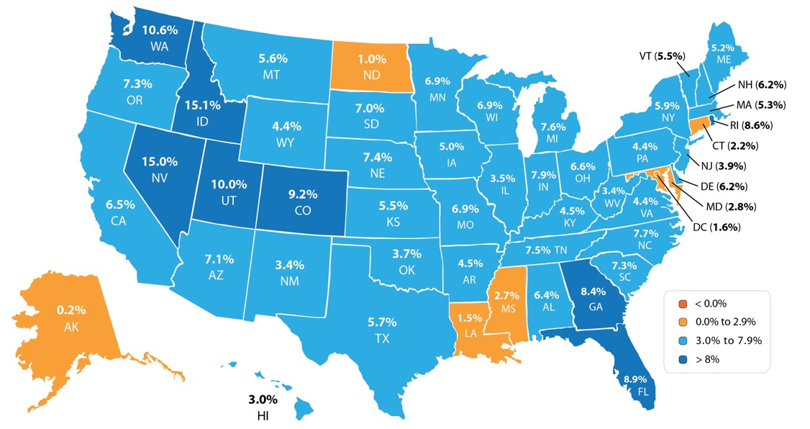
Home Prices Over The Last Year
Every quarter, the Federal Housing Finance Agency (FHFA) reports on the year-over-year changes in home prices. Below, you will see that prices are up year-over-year in every region.
Looking at the breakdown by state, you can see that each state is appreciating at a different rate. This is important to know if you are planning on relocating to a different area of the country. Waiting to move may end up costing you more!
7

Slide 8
Buying Remains Cheaper Than
Renting In 38 States!
In the latest Rent vs. Buy Report from Trulia, they explained that homeownership remains cheaper than renting with a traditional 30-year fixed rate mortgage in 98 of the 100 largest metro areas in the United States.
It’s no surprise that the two metros where renting became cheaper than owning are San Jose and San Francisco, CA, where median home prices have jumped to over $1 million dollars this year. Home values in San Jose have risen 29% in the last year, while rents have remained relatively unchanged. The range for the rest of the country is an average of 2% less expensive in Honolulu (HI), all the way up to 48.9% in Detroit (MI), and 26.3% nationwide!
A study by GoBankingRates looked at the cost of renting vs. owning a home at the state level and concluded that in 38 states, it is actually cheaper to own. In six states the difference between buying & renting would account for less than a $50 monthly difference, leaving the choice up to the individual family.
WA
MT
ND
VT
ME
OR
MN
NH MA
ID
SD
WI
NY
WY
MI
RI
NE
IA
PA
CT
NV
UT
IL
IN
OH
NJ
CA
CO
KS
MO
WV
VA
DE
KY
MD
NC
DC
AZ
NM
OK
TN
SC
AR
MS
AL
GA
TX
LA
AK
FL
HI
Rent vs. Own
Cheaper to Own Cheaper to Rent Difference of ≤ $50
Bottom Line
Homeownership provides many benefits beyond the financial ones. If you are one of the many renters out there who would like to evaluate your ability to buy this year, let’s get together to find your dream home.
8

Slide 9
Do You Know The Cost Of Waiting To Buy?
CoreLogic recently shared that national home prices have increased by 5.6% year-over-year. Over that same time period, interest rates have remained historically low which has allowed many buyers to enter the market.
As a seller, you will be most concerned about ‘short-term price’ – where home values are headed over the next six months. As a buyer, however, you must not be concerned about price, but instead about the ‘long-term cost’ of the home.
The Mortgage Bankers Association (MBA), Freddie Mac, and Fannie Mae all project that mortgage interest rates will increase by this time next year. According to CoreLogic’s most recent Home Price Index Report, home prices will appreciate by 4.7% over the next 12 months.
What Does This Mean as a Buyer?
If home prices appreciate by the 4.7% predicted by CoreLogic over the next twelve months, here is a simple demonstration of the impact an increase in interest rate would have on the mortgage payment of a home selling for approximately $250,000 today:
 | Mortgage | Interest Rate* | Payment (P&I)**
Today | $250,000 | 4.8% | $1,311.66
2019 | $261,750 | 5.3% | $1,453.51
 |  |  | $141.85
Difference in Monthly Payment
*Rates based on Freddie Mac’s prediction at time of print
Monthly | Annually | Over 30 Years
$141.85 | $1,702.20 | $51,066
Bottom Line
If buying a home is in your plan for this year, doing it sooner rather than later could save you thousands of dollars over the terms of your loan.
9

Slide 10
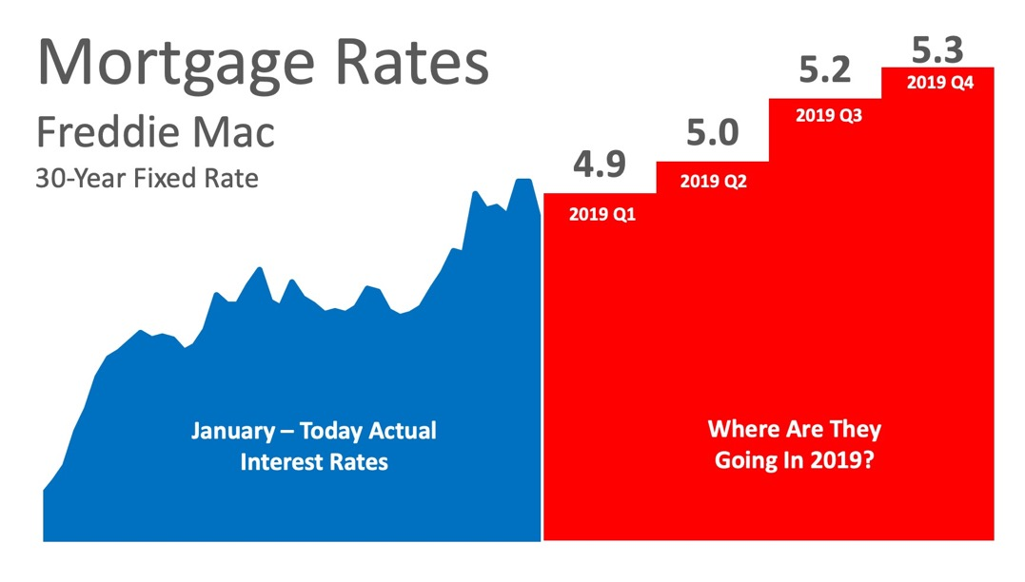
Where Are Interest Rates Headed?
The interest rate you pay on your home mortgage has a direct impact on your monthly payment. The higher the rate, the greater the payment will be. That is why it is important to know where rates are headed when deciding to start your home search.
Below is a chart created using Freddie Mac’s U.S. Economic & Housing Marketing Outlook. As you can see, interest rates are projected to increase steadily through the end of 2018 and into 2019.
10

Slide 11
How Will This Impact Your Mortgage Payment?
Depending on the amount of the loan that you secure, a half of a percent (.5%) increase in interest rate can increase your monthly mortgage payment significantly. But, don’t let the prediction that rates will increase stop you from purchasing your dream home this year.
Let’s take a look at a historical view of interest rates over the last 45 years.
Bottom Line
Be thankful that you can still get a better interest rate than your older brother or sister did ten years ago, a lower rate than your parents did twenty years ago, and a better rate than your grandparents did forty years ago.
11

Slide 12
Buying A Home? Do You Know the Lingo?
To start you on your path with confidence, we have compiled a list of some of the most common terms used when buying a home.
Appraisal – A professional analysis used to estimate the value of the home. A necessary step in validating the home’s worth to you & your lender to secure financing.
Closing Costs – The cost to complete the real estate transaction. Paid at closing, they include: points, taxes, title insurance, financing costs, items that must be prepaid or escrowed. Ask your lender for a complete list of closing cost items.
Credit Score – A number ranging from 300-850, that is based on an analysis of your credit history. Helps lenders determine the likelihood that you’ll repay future debts.
Down Payment – Down payments are typically 3-20% of the purchase price of the home. 0% down programs also exist, ask your lender for more information.
Mortgage Rate – The interest rate you pay to borrow money to buy your house. The lower the rate, the better.
Pre-Approval Letter – A letter from a lender indicating that you qualify for a mortgage of a specific amount.
Real Estate Professional – An individual who provides services in buying & selling homes. Real estate professionals are there to help you through the confusing paperwork, find your dream home, negotiate any of the details that come up, and to help you know exactly what’s going on in the housing market.
The best way to ensure that your home-buying process is a confident one is to find a real estate pro who will guide you through every aspect of the transaction with
‘the heart of a teacher,’ putting your family’s needs first.
Freddie Mac – My Home Section
12

Slide 13
Why Pre-Approval Should Be Your First Step
In many markets across the country, the number of buyers searching for their dream homes greatly exceeds the number of homes for sale. This has led to a competitive marketplace where buyers often need to stand out. One way to show you are serious about buying your dream home is to get pre-qualified or pre-approved for a mortgage before starting your search.
Even if you are in a market that is not as competitive, knowing your budget will give you the confidence to know if your dream home is within your reach.
Freddie Mac lays out the advantages of pre-approval in the 'My Home' section of their website.
“It’s highly recommended that you work with your lender to get pre-approved before you begin house hunting. Pre-approval will tell you how much home you can afford and can help you move faster, and with greater confidence, in competitive markets.”
One of the many advantages of working with a local real estate professional is that many have relationships with lenders who will be able to help you with this process. Once you have selected a lender, you will need to fill out their loan application and provide them with important information regarding “your credit, debt, work history, down payment and residential history.”
Freddie Mac describes the '4 Cs' that help determine the amount you will be qualified to borrow:
Capacity: Your current and future ability to make your payments
Capital or Cash Reserves: The money, savings, and investments you have that can be sold quickly for cash
Collateral: The home, or type of home, that you would like to purchase
Credit: Your history of paying bills and other debts on time
Getting pre-approved is one of many steps that will show home sellers that you are serious about buying, and it often helps speed up the process once your offer has been accepted.
Bottom Line
Many potential homebuyers overestimate the down payment and credit scores needed to qualify for a mortgage today. If you are ready and willing to buy, you may be surprised at your ability to do so.
13

Slide 14
You Do NOT Need 20% Down To Buy Your Home!
There are many misconceptions about buying a home that are believed to be true. Let’s take a look at two of the more common ones that may be holding you back from buying today.
1. Down Payment
Buyers often overestimate the down payment funds needed to qualify for a home loan. Urban Institute in a recent report entitled, “Barriers to Accessing Homeownership: Down Payment, Credit, and Affordability,” found that the American public is still somewhat confused about what is required to qualify for a home mortgage loan in today’s housing market.
“Consumers often think they need to put more money down to purchase a home than is actually required… 68% of renters cited saving for a down payment as an obstacle to homeownership. Thirty-nine percent of renters believe that more than 20% is needed for a down payment and many renters are unaware of low–down payment programs.”
While many believe that they need at least 20% down to buy their dream homes, they do not realize that there are programs available which allow them to put down as little as 3%.
According to the Realtors® Confidence Index from the National Association of Realtors (NAR): "74% of first-time homebuyers put down less than 20% down to purchase their
home last month."
14

Slide 15
2. FICO® Scores
Similar to the misconceptions surrounding down payment requirements, many either don’t know or are misinformed about what FICO® score is necessary to qualify for a home loan.
Many Americans believe that a ‘good’ credit score is 780 or higher.
To help debunk this myth, let’s take a look at Ellie Mae’s latest Origination Insight Report which focuses on recently closed (approved) loans.
As you can see on the right, 51.3% of approved mortgages had a credit score of 600-749.
Bottom Line
If you are a prospective buyer who is ready and willing to act now, but you are not sure if you are able to, let's meet so I can help you understand your true options today.
UP_{DATE}
15

Slide 16
The True Cost Of NOT Owning Your Home
Owning a home has great financial benefits, yet many continue to rent! Today, let’s look at the financial reasons why owning a home of your own has been a part of the American Dream for the entirety of America’s existence.
Realtor.com reported that:
“Buying remains the more attractive option in the long term – that remains the American dream, and it’s true in many markets where renting has become really the shortsighted option…as people get more savings in their pockets, buying becomes the better option.”
What proof exists that owning is financially better than renting?
Here are the top 5 financial benefits of homeownership:
Homeownership is a form of forced savings.
Homeownership provides tax savings.
Homeownership allows you to lock in your monthly housing cost.
Buying a home is cheaper than renting.
No other investment lets you live inside of it.
Studies have shown that a homeowner’s net worth is 44x greater than that of a renter.
A family who purchased a median-priced home at the start of 2018 will build more than
$49,000 in family wealth over the next five years with projected price appreciation alone.
Some argue that renting eliminates the cost of taxes and home repairs, but every potential renter must realize that all the expenses the landlord incurs are already baked into the rent payment – along with a profit margin!
Bottom Line
Owning a home has many social and financial benefits that cannot be achieved by renting.
16

Slide 17
Starting To Look For A Home? Know What You Want vs. What You Need
In this day and age of being able to shop for anything anywhere, it is very important to know what you’re looking for when you start your home search.
If you’ve been thinking about buying a home of your own for some time now, you’ve probably come up with a list of things that you’d LOVE to have in your new home. Many new homebuyers fantasize about the amenities that they see on television or Pinterest, and start looking at the countless homes listed for sale with rose-colored glasses.
Do you really need that farmhouse sink in the kitchen in order to be happy with your home choice? Would a two-car garage be a convenience or a necessity? Could the man cave of your dreams be a future renovation project instead of a make or break now?
The first step in your home buying process should be pre-approval for your mortgage. This allows you to know your budget before you fall in love with a home that is way outside of it.
The next step is to list all the features of a home that you would like, and to qualify them as follows:
‘Must-Haves’ – if this property does not have these items, then it shouldn’t even be considered. (ex: distance from work or family, number of bedrooms/bathrooms)
‘Should-Haves’ – if the property hits all of the 'must-haves' and some of the 'should-haves,' it stays in contention, but does not need to have all of these features.
‘Absolute-Wish List’ – if we find a property in our budget that has all of the ‘must-haves,’ most of the ‘should-haves,’ and ANY of these, it’s the winner!
Bottom Line
Having this list fleshed out before starting your search will save you time and frustration, while also letting your agent know what features are most important to you before beginning to show you houses in your desired area.
17

Slide 18
61% Of First-Time Buyers Put Down Less Than 6%
According to the Realtors Confidence Index from the National Association of Realtors, 61% of first-time homebuyers purchased their homes with down payments below 6%.
Many potential homebuyers believe that a 20% down payment is necessary in order to buy a home and many have disqualified themselves without even trying, but in October, 74% of first-time buyers and 52% of all buyers put less than 20% down.
Elizabeth Mendenhall, President of NAR, recently shed light on why buyer demand has remained strong,
"Despite first-time buyers struggling to achieve homeownership, Realtors® in most areas say demand is still the strongest at the entry-level segment of the market.
For prospective first-timers looking to begin their home search, competition will remain swift. That is why it’s important to be fully prepared with a pre-approval from a lender, and to begin conversations with a Realtor® early about what you’re looking for and where.”
It’s no surprise that with rents rising, more and more first-time buyers are taking advantage of low-down-payment mortgage options to secure their monthly housing costs and finally attain their dream homes.
Bottom Line
If you are one of the many first-time buyers unsure of whether or not you would qualify for a low-down-payment mortgage, let’s get together and set you on your path to homeownership!
18

Slide 19
5 Reasons
To Hire A
Real Estate Professional
Paperwork
They help with all disclosures & paperwork necessary in today’s heavily regulated environment.
Experience
They are well educated in and experienced with the entire sales process.
Negotiations
They act as a “buffer” in negotiations with all parties throughout the entire transaction.
Pricing
They help you understand today’s real estate values when setting the price of a listing or an offer to purchase.
Understanding of Current Market Conditions
They simply & effectively explain today’s real estate headlines & decipher what they mean to you.
19

Slide 20
Have You Put Aside Enough For Closing Costs?
There are many potential homebuyers, and even sellers, who believe that you need at least a 20% down payment in order to buy a home or move on to their next home. Time after time, we have dispelled this myth by showing that there are many loan programs that allow you to put down as little as 3% (or 0% with a VA loan).
Once you have saved enough for your down payment and are ready to start your home search, make sure that you have also saved enough for closing costs.
Freddie Mac defines closing costs as follows:
“Closing costs, also called settlement fees, will need to be paid when you obtain a mortgage. These are fees charged by people representing your purchase, including your lender, real estate agent, and other third parties involved in the transaction.
Closing costs are typically between 2 & 5% of your purchase price.”
We’ve heard from many first-time homebuyers that they wished that someone had let them know that closing costs could be so high. If you think about it, with a low down payment program, your closing costs could equal the amount that you saved for your down payment.
Here is a list of just some of the fees/costs that may be included in your closing costs, depending on where the home you wish to purchase is located:
Government recording costs
Appraisal fees
Credit report fees
Lender origination fees
Title services (insurance, search fees)
Tax service fees
Survey fees
Attorney fees
Underwriting fees
20

Slide 21
Is there any way to avoid paying closing costs?
Work with your lender and real estate agent to see if there are any ways to decrease or defer your closing costs. There are no-closing mortgages available, but they end up costing you more in the end with a higher interest rate, or by wrapping the closing costs into the total cost of the mortgage (meaning you’ll end up paying interest on your closing costs).
Homebuyers can also negotiate with the seller over who pays these fees. Sometimes the seller will agree to assume the buyer’s closing fees in order to get the deal finalized.
Bottom Line
Speak with your lender and agent early and often to determine how much you’ll be responsible for at closing. Finding out you’ll need to come up with thousands of dollars right before closing is not a surprise anyone would look forward to.
21

Slide 22
Ready To Make An Offer? 4 Tips For Success
So you’ve been searching for that perfect house to call 'home' and you've finally found it! The price is right and, in such a competitive market, you want to make sure you make a good offer so that you can guarantee that your dream of making this house yours comes true!
Below are 4 steps provided by Freddie Mac to help buyers make offers, along with some additional information for your consideration:
Determine Your Price
“You’ve found the perfect home and you’re ready to buy. Now what? Your real estate agent will be by your side, helping you determine an offer price that is fair.”
Based on your agent’s experience and key considerations (like similar homes recently sold in the same neighborhood or the condition of the house and what you can afford), your agent will help you to determine the offer that you are going to present.
Getting pre-approved will not only show home-sellers that you are serious about buying, but it will also allow you to make your offer with confidence because you’ll know that you have already been approved for a mortgage in that amount.
Submit an Offer
“Once you’ve determined your price, your agent will draw up an offer, or purchase agreement, to submit to the seller’s real estate agent. This offer will include the purchase price and terms and conditions of the purchase.”
Talk with your agent to find out if there are any ways in which you can make your offer stand out in this competitive market! A licensed real estate agent who is active in the neighborhoods you are considering will be instrumental in helping you put in a solid offer.
22

Slide 23
Negotiate the Offer
“Oftentimes, the seller will counter the offer, typically asking for a higher purchase price or to adjust the closing date. In these cases, the seller’s agent will submit a counteroffer to your agent, detailing their desired changes, at this time, you can either accept the offer or decide if you want to counter.
Each time changes are made through a counteroffer, you or the seller have the option to accept, reject or counter it again. The contract is considered final when both parties sign the written offer.”
If your offer is approved, Freddie Mac urges you to “always get an independent home inspection, so you know the true condition of the home.” If the inspector uncovers undisclosed problems or issues, you can discuss any repairs that may need to be made with the seller or even cancel the contract altogether.
Act Fast
The inventory of homes listed for sale has remained well below the 6-month supply that is needed for a ‘normal’ market. Buyer demand has continued to outpace the supply of homes for sale, causing buyers to compete with each other for their dream homes.
Make sure that as soon as you decide that you want to make an offer, you work with your agent to present it as quickly as possible.
Bottom Line
Whether buying your first home or your fifth, having a local real estate professional who is an expert in his or her market on your side is your best bet in making sure the process goes smoothly. Let’s talk about how we can make your dream of homeownership a reality!
23

Slide 24
CONTACT ME TO TALK MORE
I’m sure you have questions and concerns about buying a home. I would love to talk with you about what you read here, as well as help you on the path to buying your new home. My contact information is below. I look forward to hearing from you!
George Fountas
Broker/ Listing Specialist
The NC Pinnacle Real Estate Group
Huntersville, NC
gfountas@ncpinnaclegroup.com
www.ncpinnaclegroup.com(000) 704 469-6365
Equal Housing Opportunity

