Slide 1
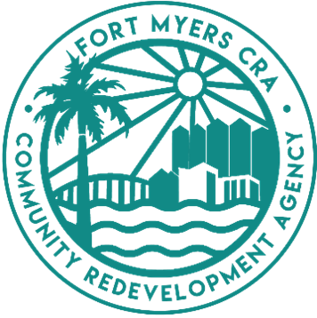
Dr. MLK Jr. Blvd. Redevelopment Plan Update
Public Workshop #3
January 23, 2025

Slide 2
Public Workshop #3
WHEN
Thursday, January 23, 2025
from 5:30 P.M. to 7:30 P.M.
WHERE
Quality Life Center of Southwest Florida
3210 Dr. Martin Luther King Jr. Blvd
Fort Myers, FL 33916
Join CRA Staff and the Consultant Team to learn and participate in preparing the Master Plan.

Slide 3
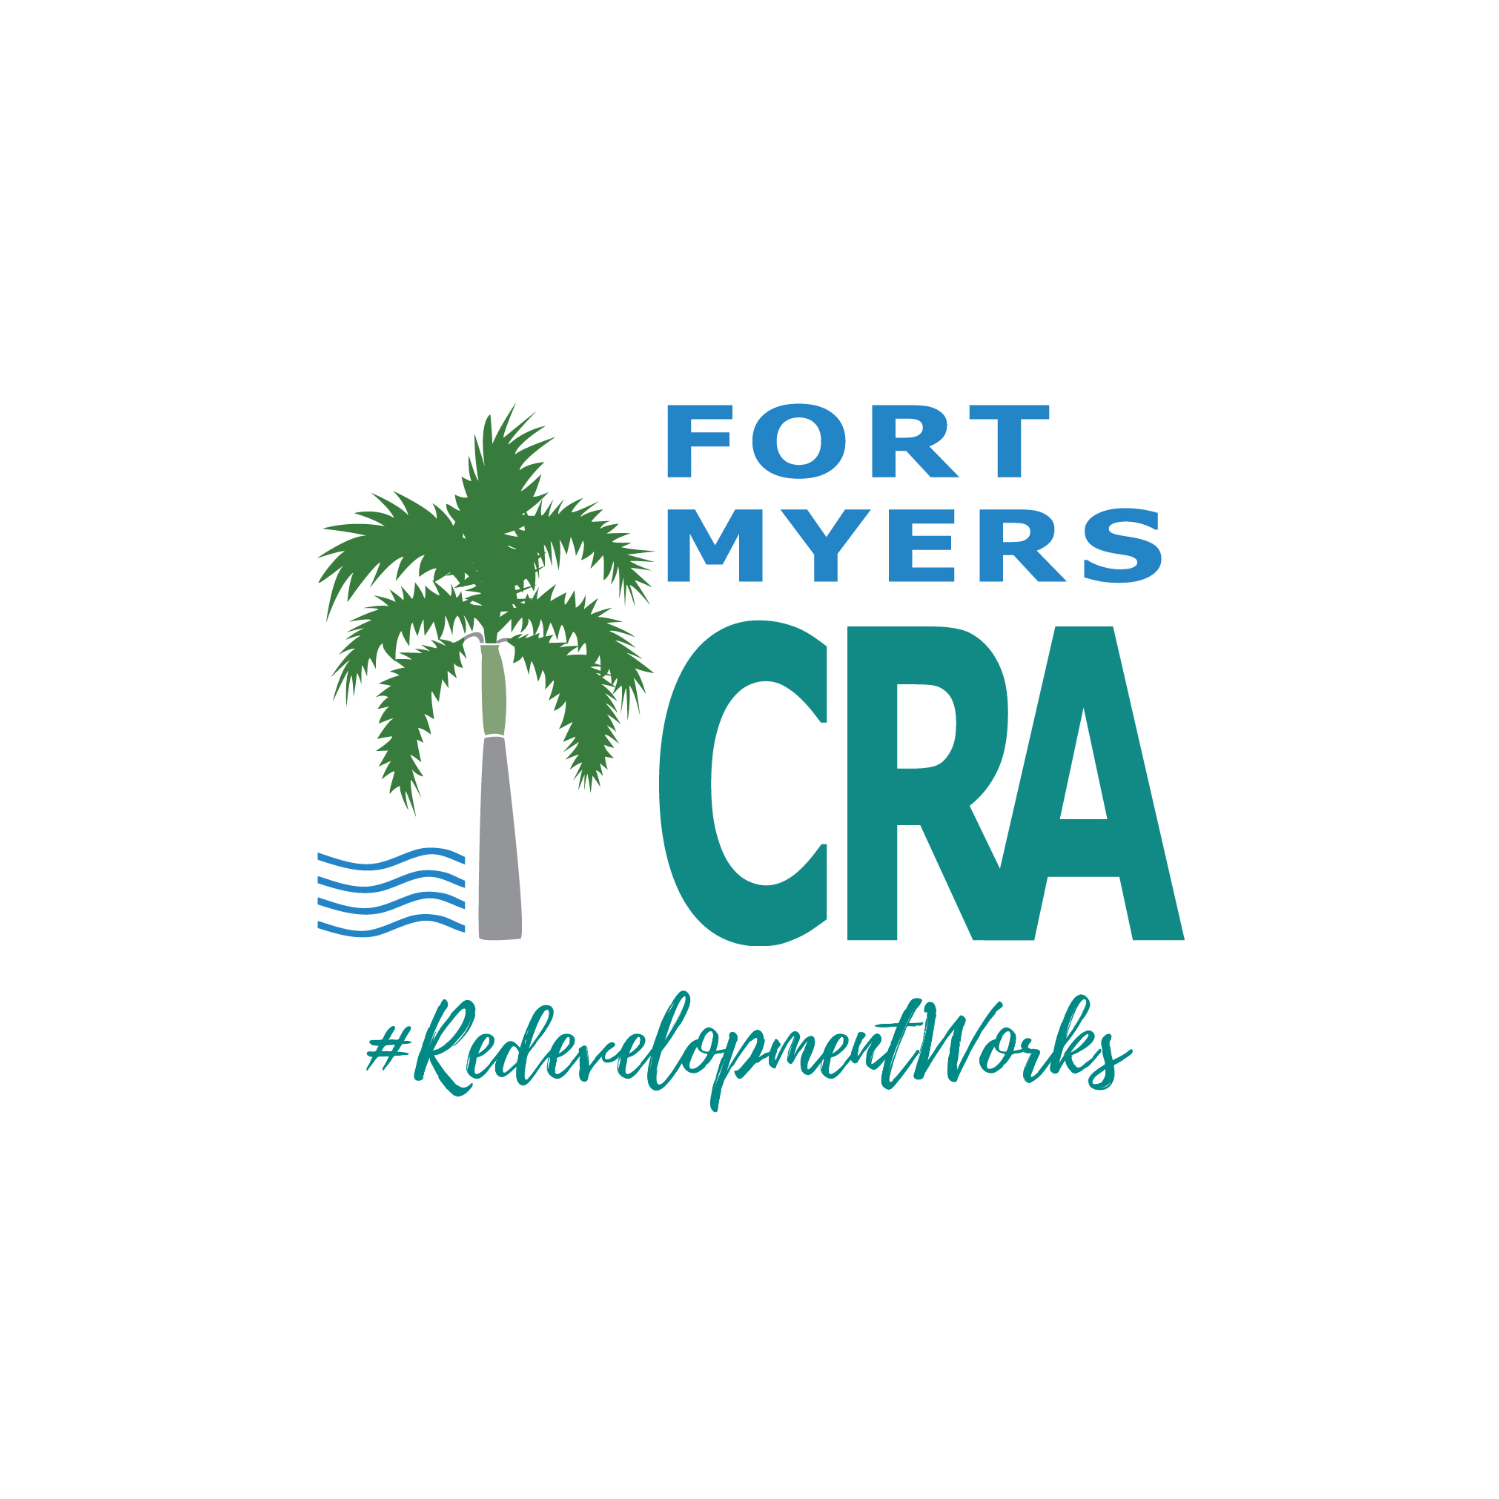
Project Team
Michele Hylton-Terry
Executive Director
Mellone F. Long. Ph.D., AICP
Assistant Director
LaShaun Collier
Deputy Director of Communications
Michael R. Harter, P.E.
Project Director
Javier E. Omana, CNU-a
Lead Land Planner / Urban Designer
Jason Collins, Ph.D., P.E., AICP
Lynn Dehlinger,
Director of Economic Development

Slide 4
CRA Initiatives & Programs
CRA Programs
Commercial Property Improvement Matching Grant
Residential Grant Program
Fort Myers CRA Home Preservation Program

Slide 5
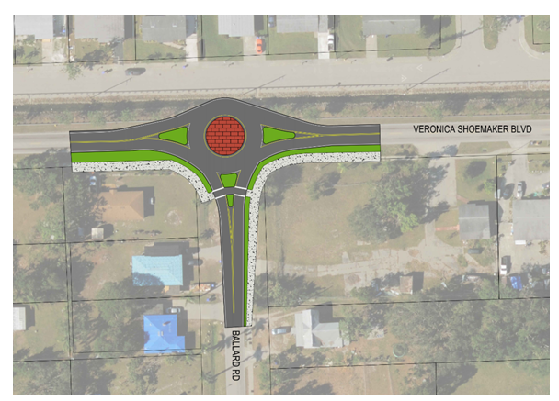
City Works within CRA
City of Fort Myers MLK Jr. CRA
Veronica S. Shoemaker Boulevard
Complete Streets Study
B. Parks & Recreation Department
Stars Complex Improvements
Dunbar Park
Billy’s Creek – Blueway + Trails Project
Roberto Clemente Park
C. Private Investments
McCollum Hall Upgrade + Expansion
Mixed Use and Residential

Slide 6
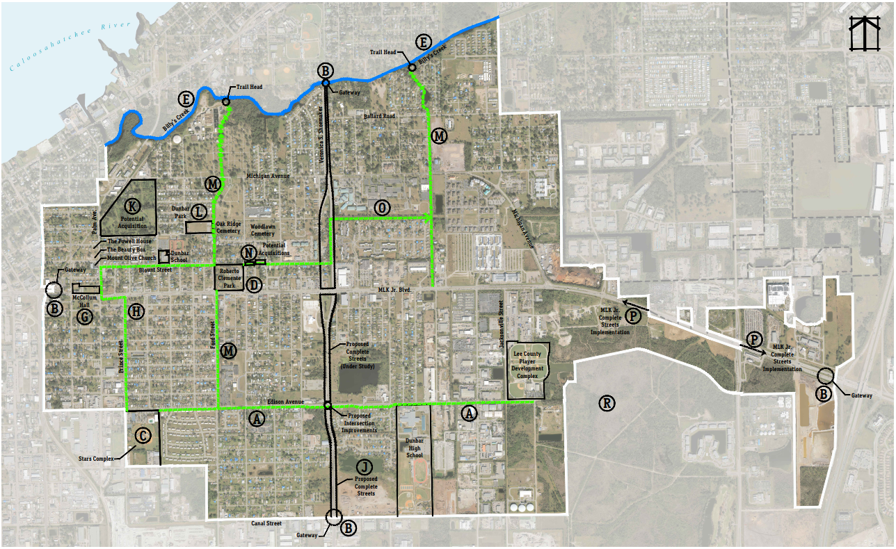
Preliminary Master Plan

Slide 7
Project Descriptions
EDISON AVENUE – “ATHLETE’S WALK”
Create a walk/trail celebrating Fort Myers High School athletes and their accomplishments.
Trail to include: street trees, banners, specialty street lighting, street furniture, interpretive signage, etc. It would run rom Stars east to Sports Complex.
GATEWAYS
Iconic signage “announcing” the MLK Jr. CRA District
STARS COMPLEX
Expansion proposed by City’s Parks & Rec Department:
Performing Arts building, enhancement of fields and splash pads
CLEMENTE PARK
Improvements by Parks & Rec Department:
Introduce niche amenities
Amphitheater
Cultural Center
Stormwater improvements
BILLY’S CREEK – BLUEWAY
Creation of Blueway: canoes and kayaks with boardwalks and trailheads
CREEK BRIDGE
By Parks & Rec Department: update bridge for safety and connectivity issues
MCCOLLUM HALL – UPLIFT
Enhancement of McCollum Hall to a mixed use project that updates original Hall and adds 26 multifamily units plus 14,200 square feet of food and Market Hall uses
HERITAGE TRAIL/WALK
Street trail/walk celebrating the rich history of the Dunbar community. To highlight historic sites/buildings in the historic area of Dunbar, to include: McCollum Hall, Powell House, Mt. Olive Church
The Beauty Box, Woodland & Oaks Cemetery, Clemente Park, and St. John Church.
Trail/walk to include: street trees, interpretive signage, specialty lighting, sidewalks, specialty pavers, etc.
VERONICA S. SHOEMAKER NORTH – COMPLETE STREETS PROJECT
Project undertaken by the City of Fort Myers to enhance multi-modal safety and enhance pedestrian connectivity

Slide 8
Project Descriptions
VERONICA S. SHOEMAKER SOUTH – COMPLETE STREETS PROJECT (PROPOSED)
Recommend that the City of Fort Myers expand Item I south to Canal Street
PROPERTY ACQUISITION – 2ND STREET PARCEL
Explore acquisition of parcel for affordable housing, fire station, and community center.
DUNBAR PARK
Park improvements by the Parks & Rec Department
GREENWAY TRAILS
Build trails:
From Clemente Park to Billy’s Creek;
From MLK Jr. Blvd. parallel to Zapato Avenue to Billy’s Creek
ACQUISITION OF PARCEL(S)
Acquire parcel(s) from Dunbar Park east to “B” Street to complete trail to Veronica S. Shoemaker
TRAIL
Construct trail from Veronica S. Shoemaker Blvd. east to Shakespeare Drive
MLK JR. BLVD. ENHANCEMENTS
Explore implementation of Complete Street elements:
Specialty lighting, street furniture, uniform bus shelter design, signage standards, thematic banners, landscaping, etc.
OVERALL DISTRICT STREET TREE/LANDSCAPE AND SIDEWALK PROGRAM
Prepare District Plan for street tree and sidewalk program
EASTWOOD VILLAGE – 50-ACRE PARK
Partnership opportunity with Housing Authority and Parks & Rec Department
OTHER POTENTIAL PROJECTS
Identify parcels for stormwater/flooding strategy (City Engineering/Public Works)
Identify parcels for Community Center south of MLK Jr. Blvd.
Identify parcels for fire station south of MLK Jr. Blvd.
Identify site for neighborhood park (4-10 acres) north of MLK Jr. Blvd.

Slide 9
Detail Drawings

Slide 10
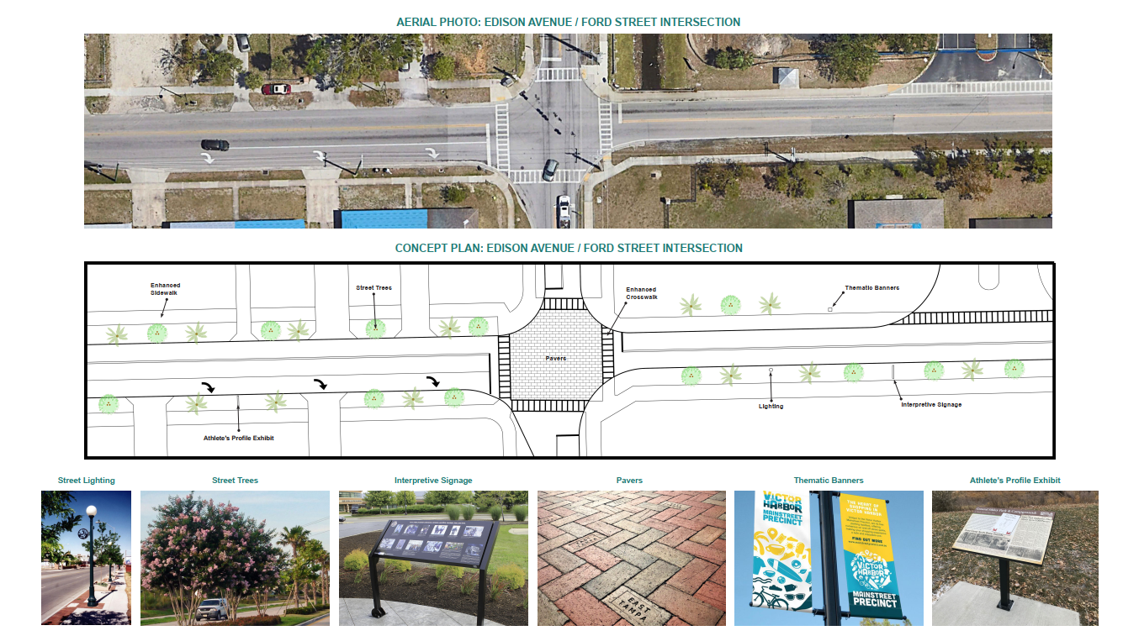
Detail Drawings

