Slide 1
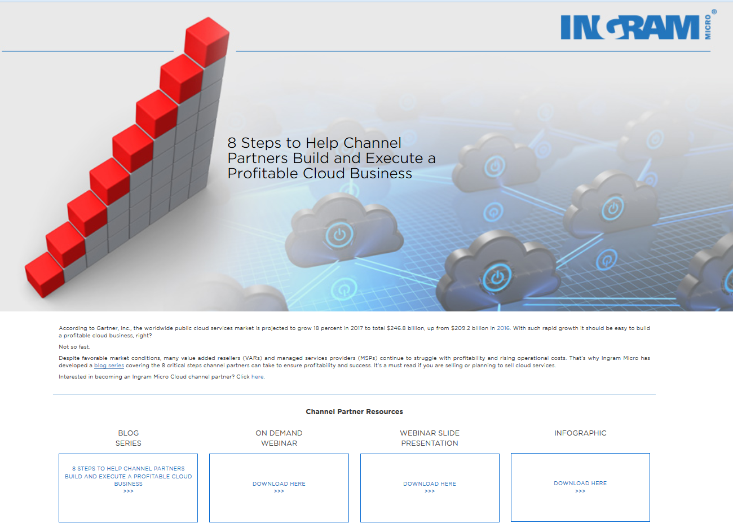
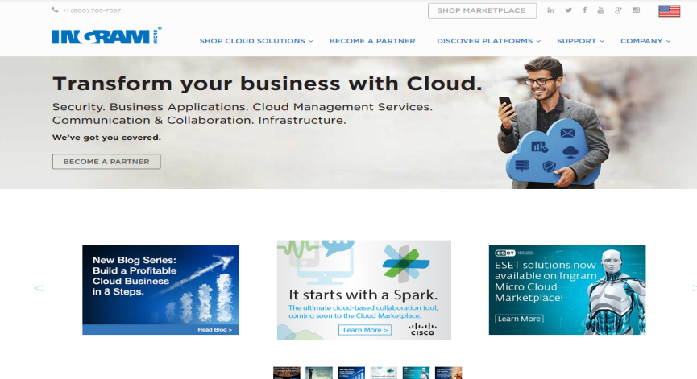
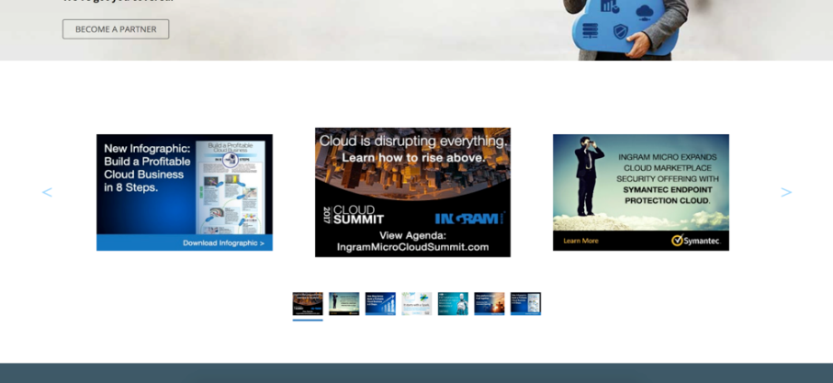
8-Step Integrated Campaign Blog, PR, Infographic, Social Media, Banner Ads, Webinar etc.
Engagement in 1st Week - 12 pages per session for www.ingrammicrocloud.com/8steps and 15 pages per session for the overview blog post (www.ingrammicrocloud.com/2017/03/24/overview-8-steps-profitable-cloud-business/)
The 8 Steps landing page has an average session duration of 3 minutes and 31 seconds, with a bounce rate of 57%. The page has 155 sessions in one week.

Slide 2
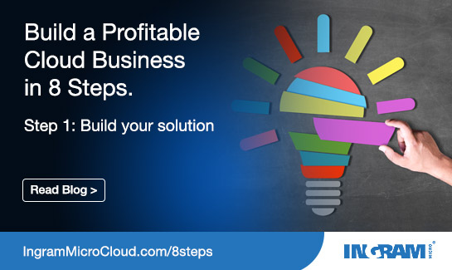
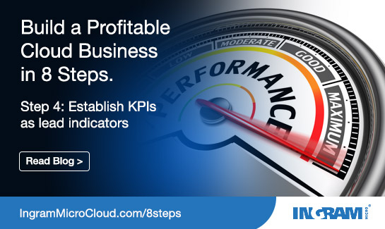
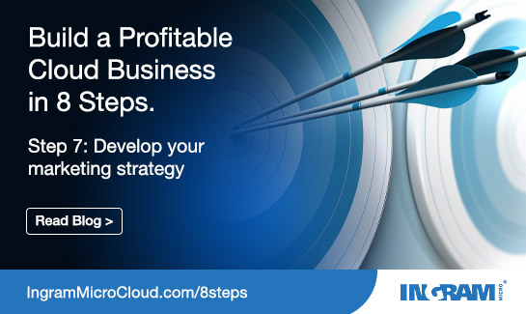
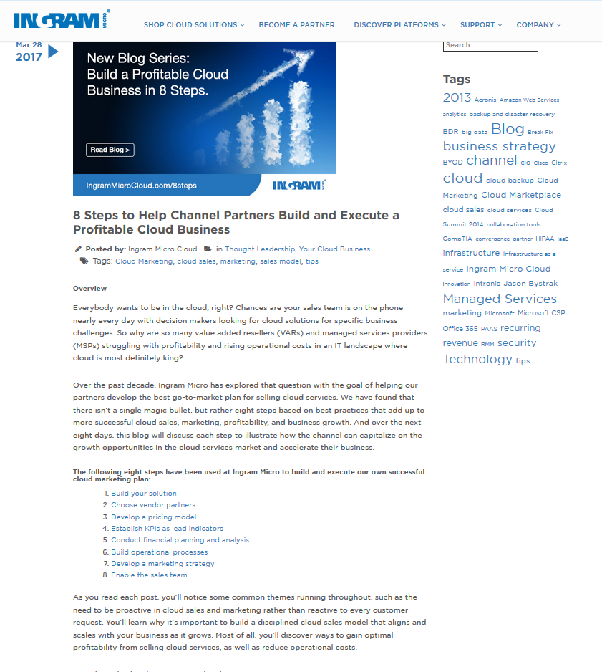
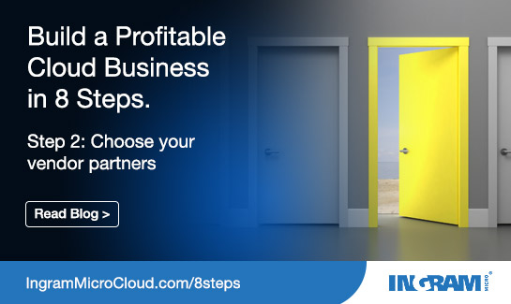
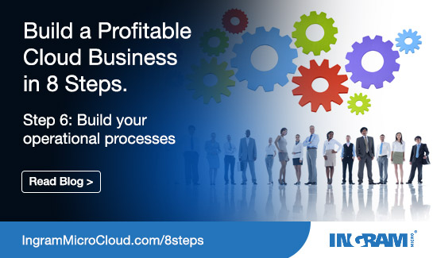
8-Step Integrated Campaign Social and Blogs

Slide 3
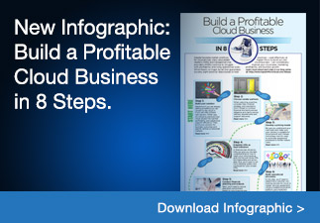
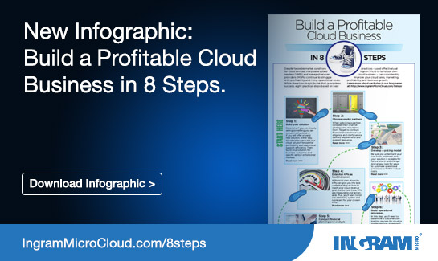
8-Step Integrated Campaign

Slide 4
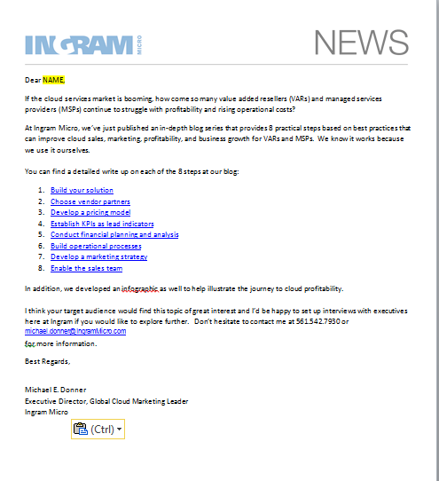
8-Step: PR Pitch
Target media and analysts
Pitch blog
Issue via Meltwater
Use social to promote coverage

