Slide 1
CX Audit Campaign
May 2020

Slide 2
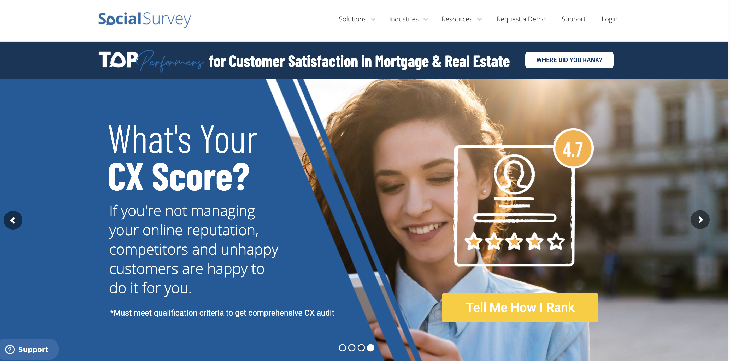
Home Page Banner

Slide 3
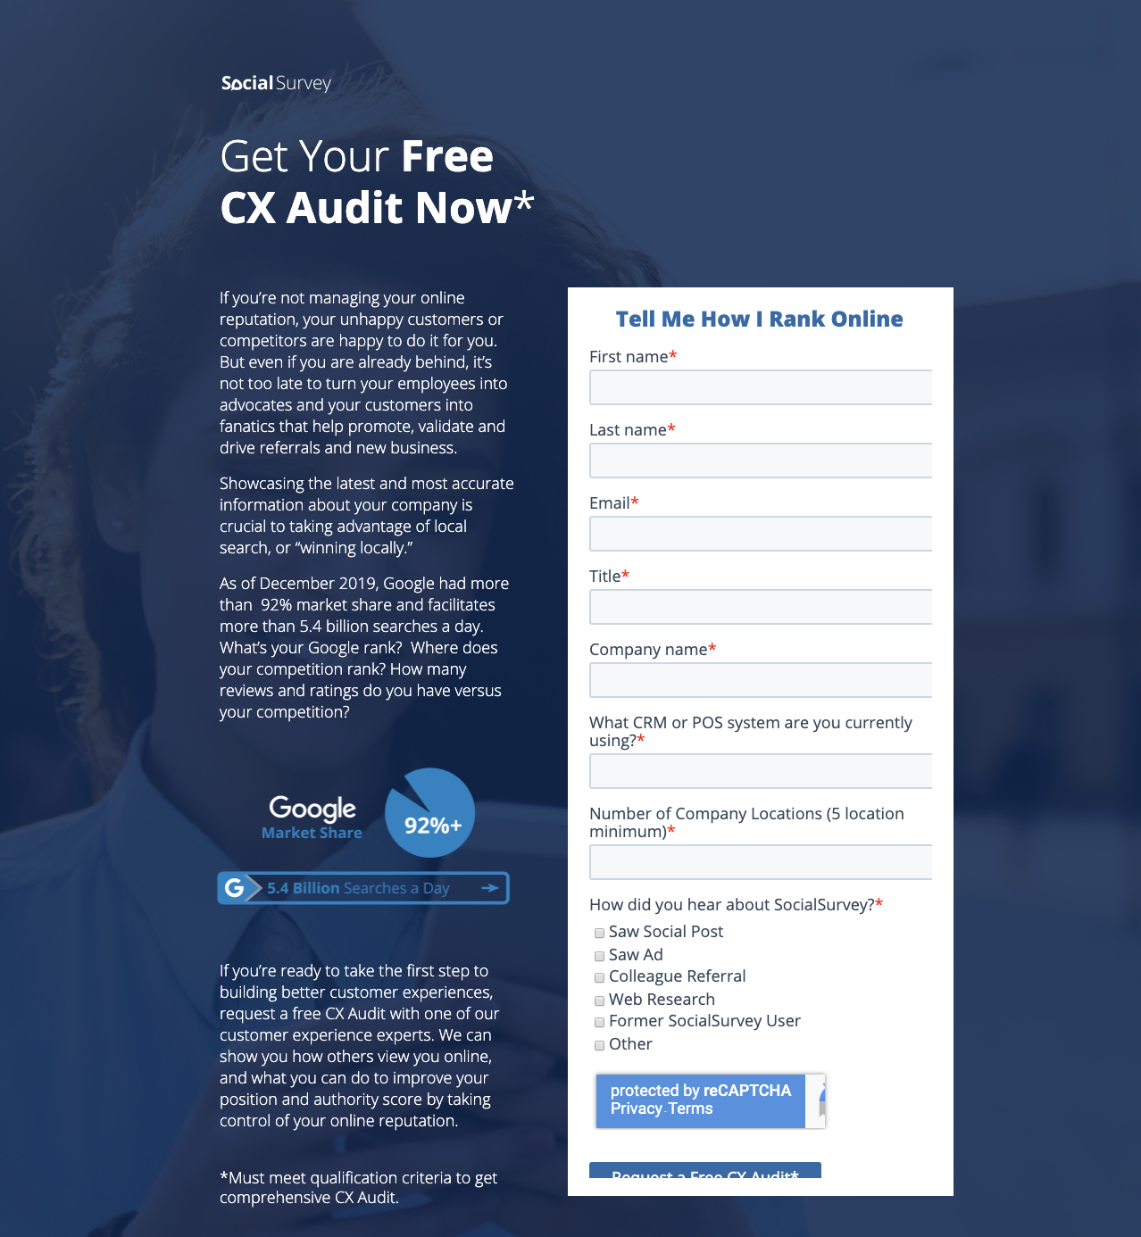
Landing Page

Slide 4
Social Media Page Banners

Slide 5
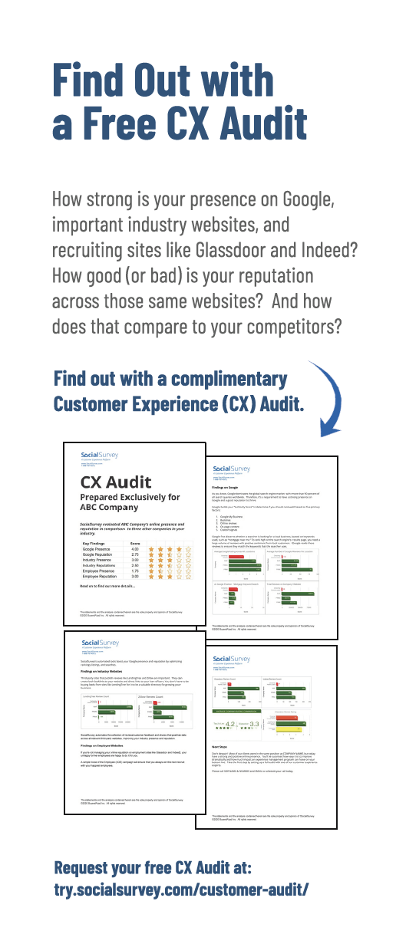
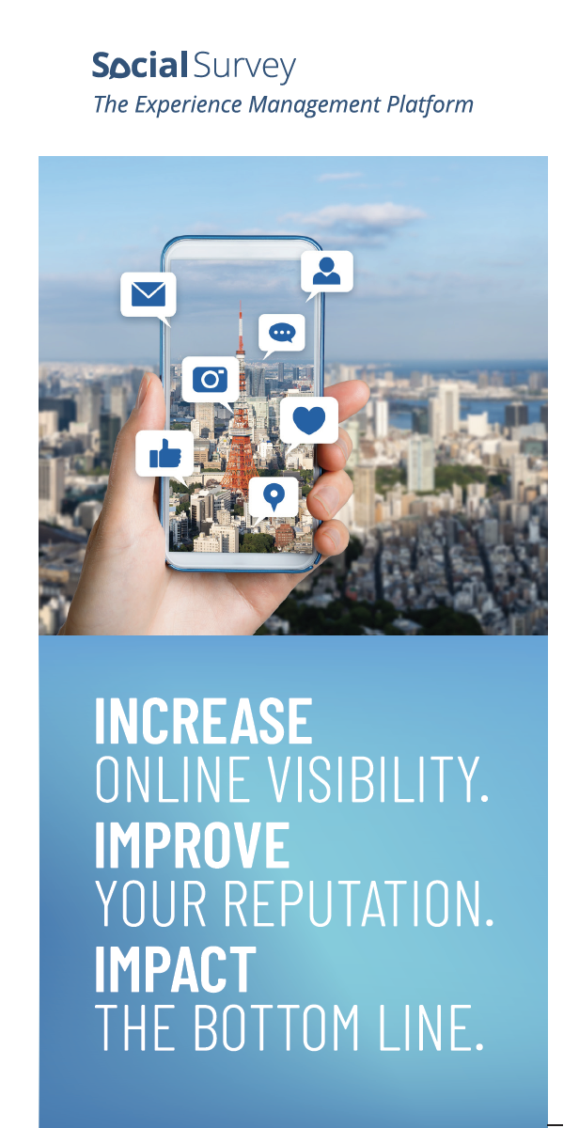
Event Collateral

Slide 6
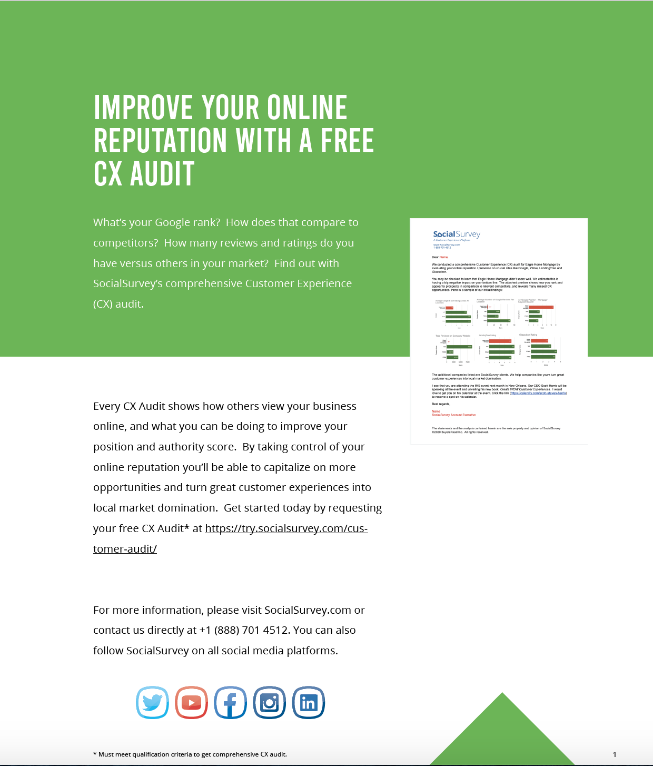
Cross Promotion in eBooks

Slide 7
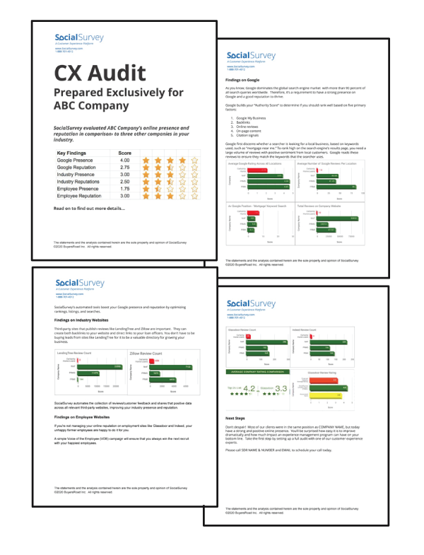
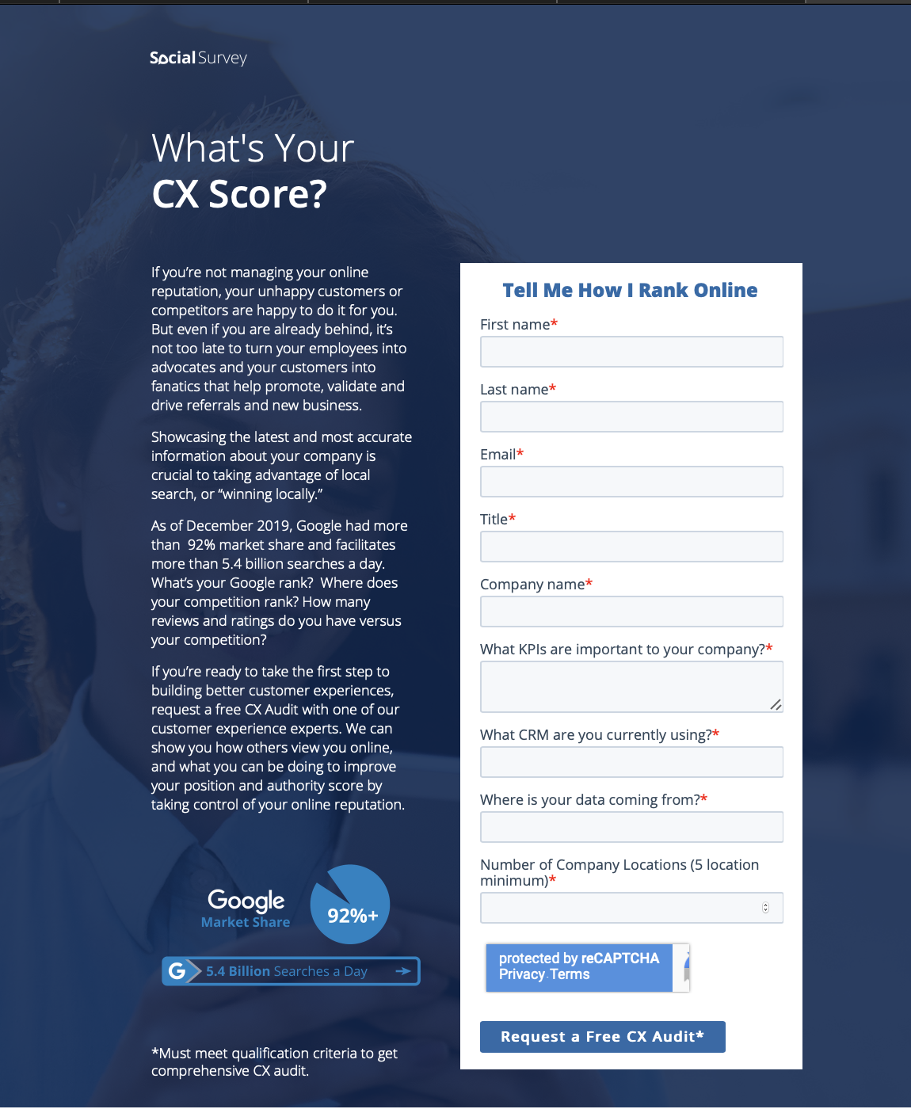
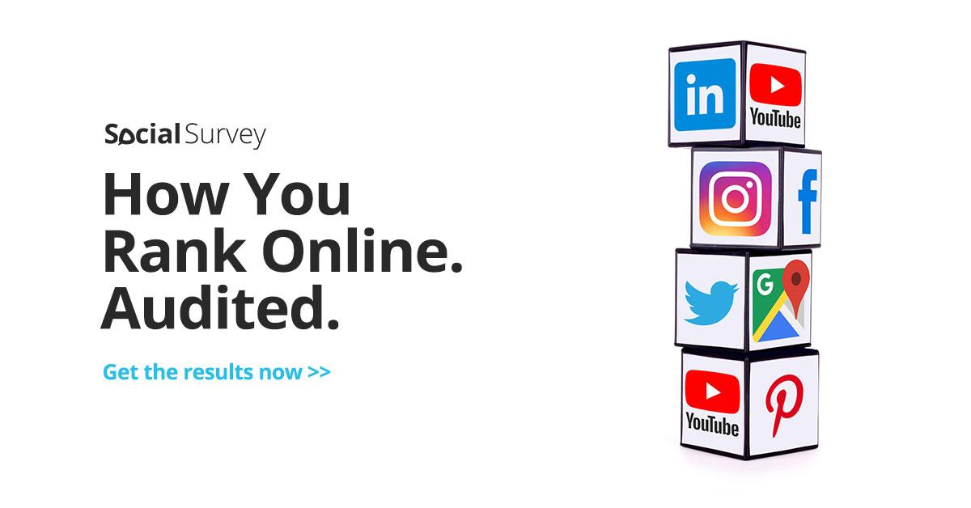
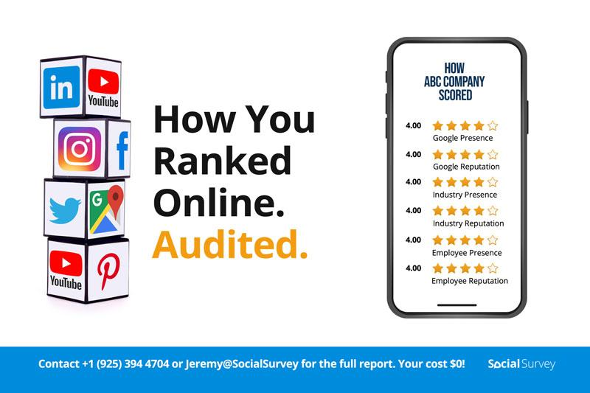
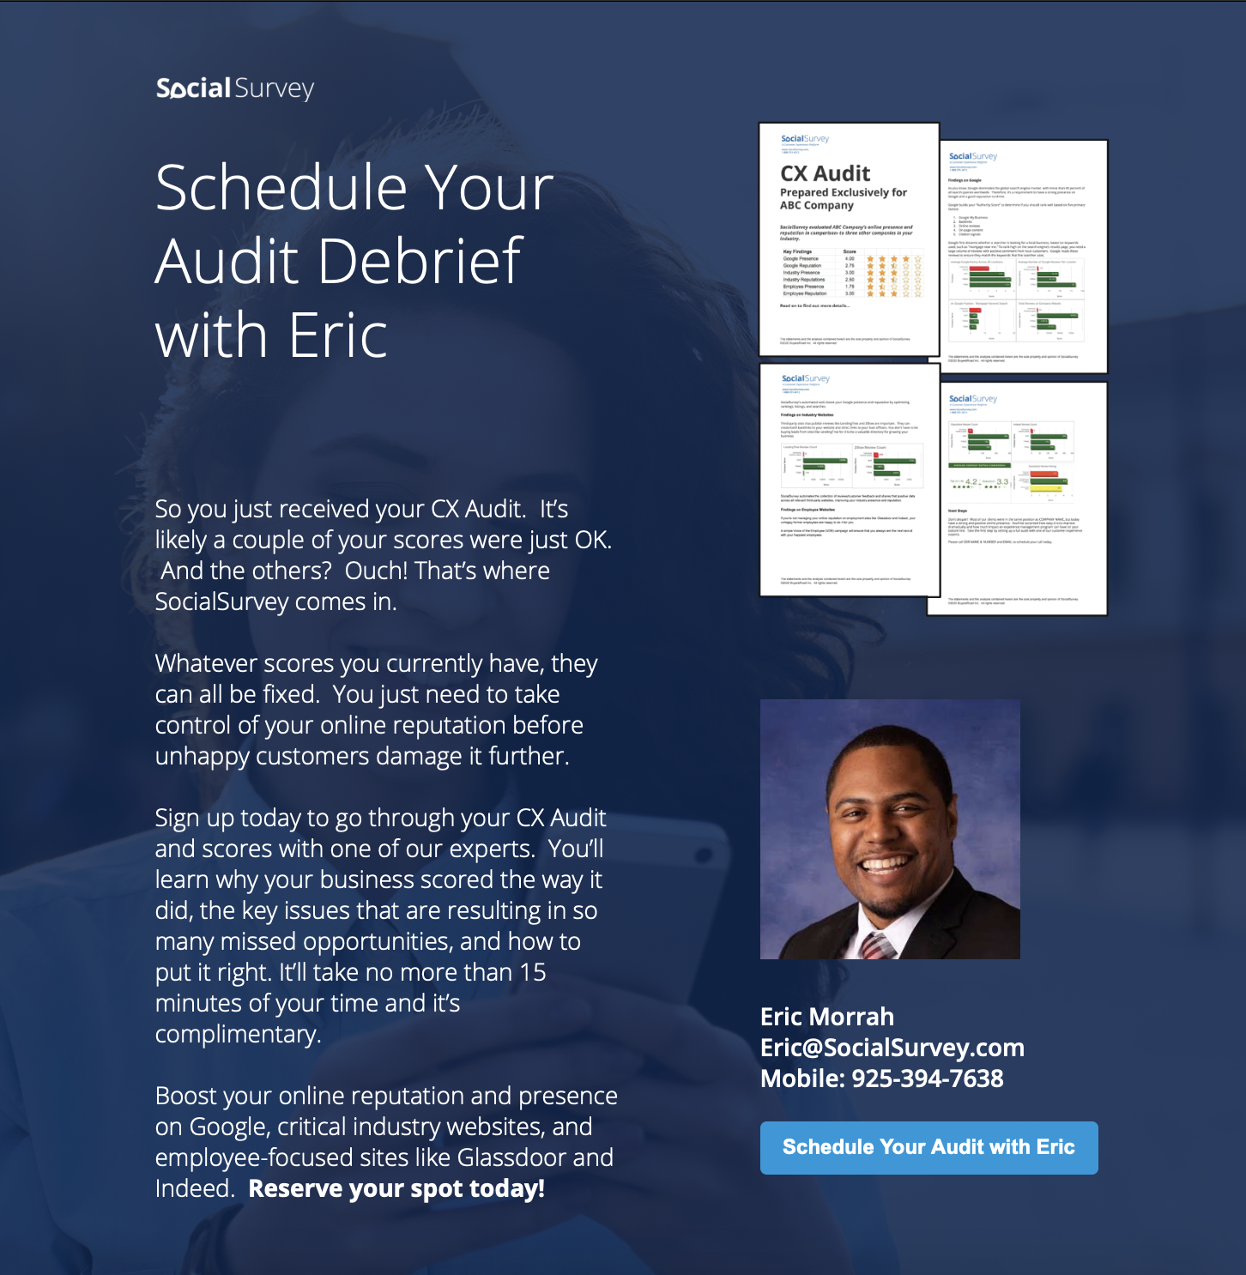
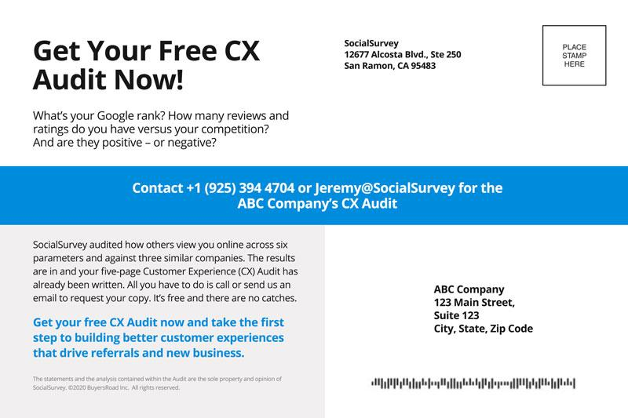
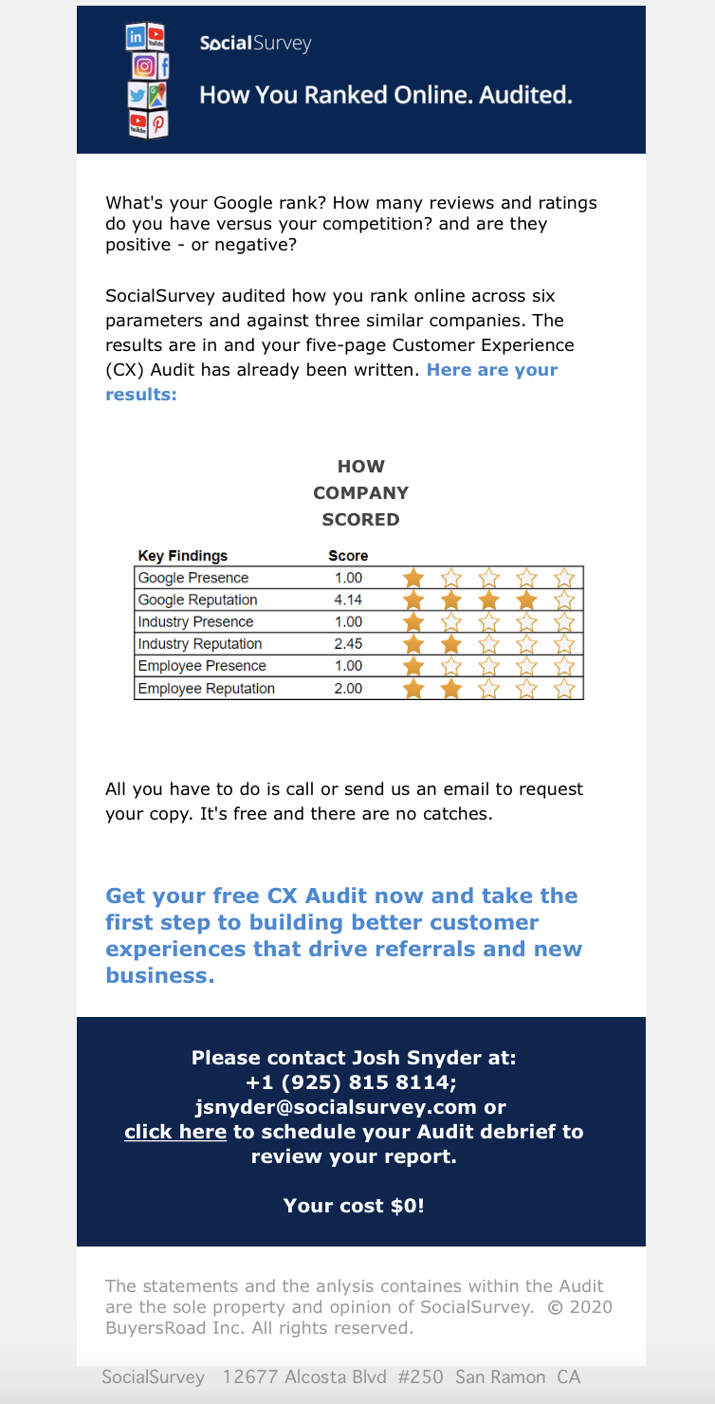
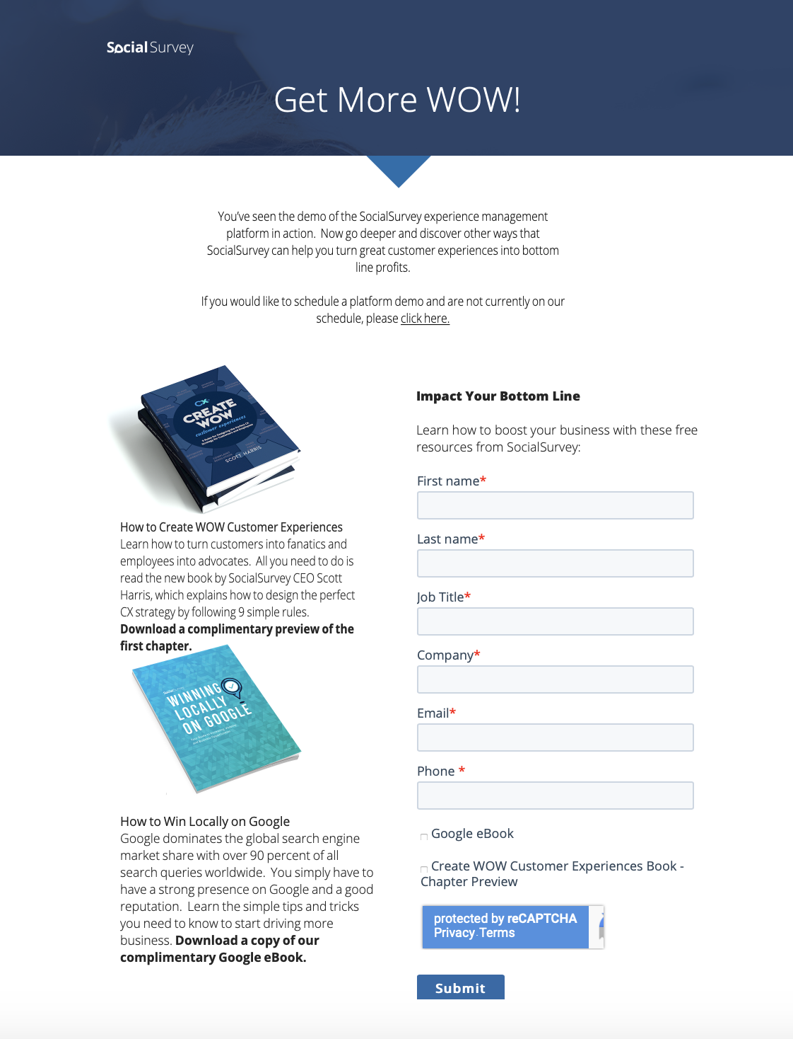
Audit Workflow Steps
BUILD LIST
CONSTRUCT AUDITS
PHASE 1 ADS
ISSUE POSTCARD MAILER
PHASE 2 ADS
SCHEDULE A DISCOVERY CALL / DEMO
ISSUE AUDIT EMAIL
SDRs FOLLOW-UP
AE Prep For DEMO
DEMO WITH AE -
STAGE 3 CREATED
PHASE 3 ADS

Slide 8
Audit Phase 1 Ads – LinkedIn, Facebook & Instagram

Slide 9
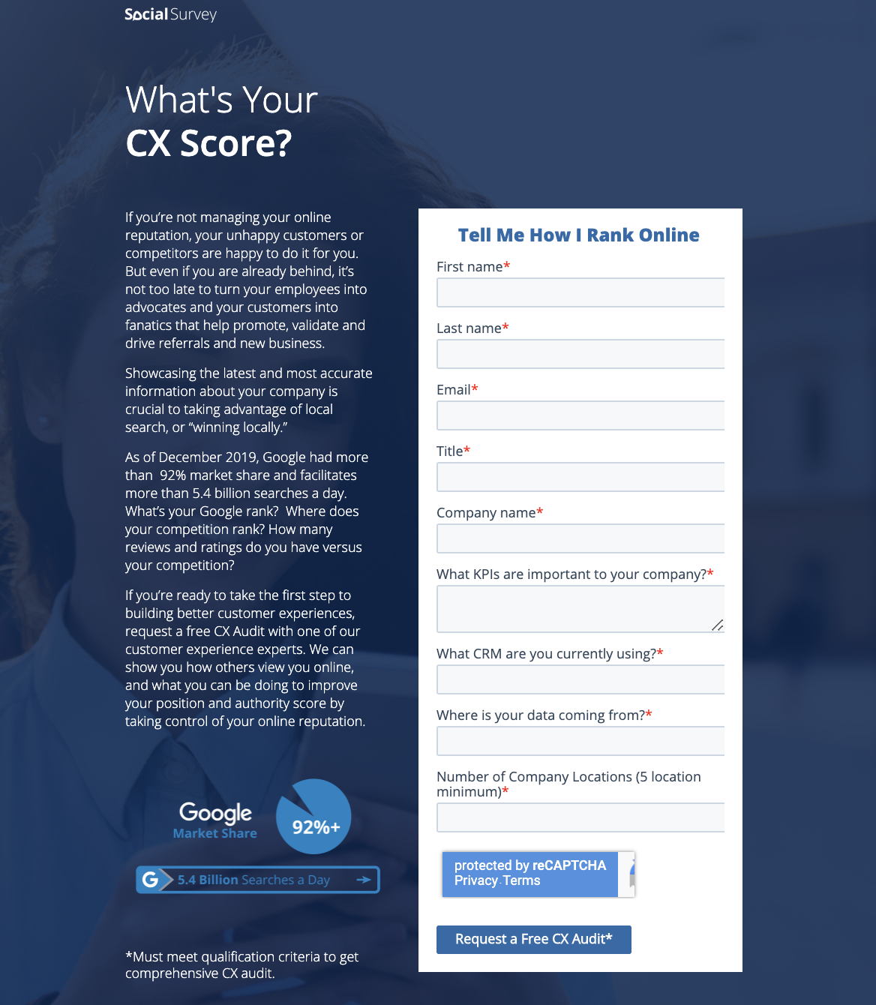
Phase 1 Landing Page Ads

Slide 10
Audit Postcard

Slide 11
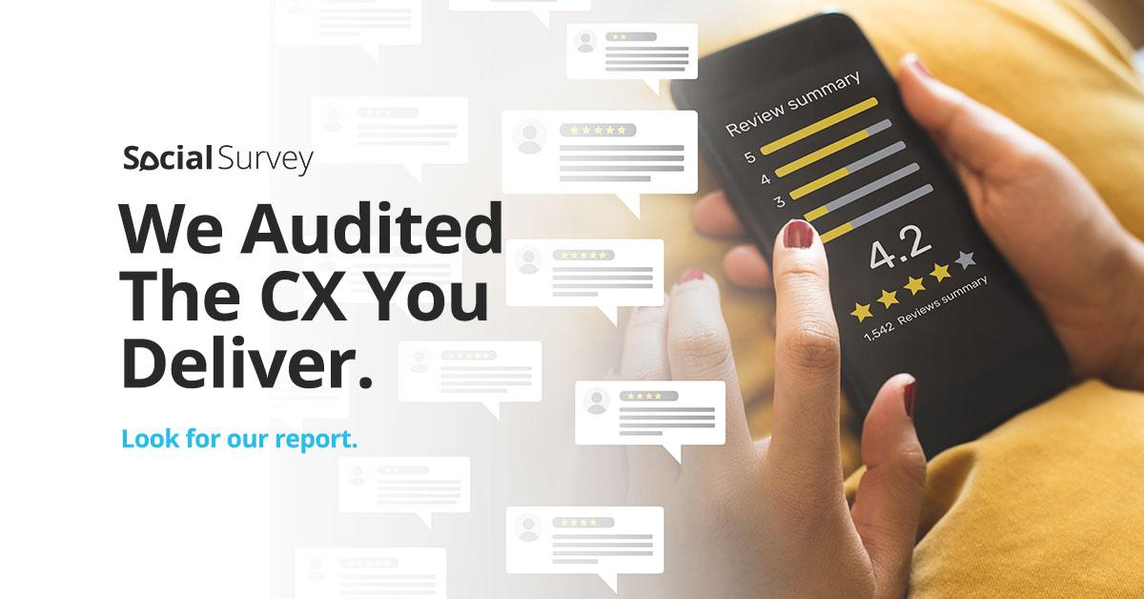
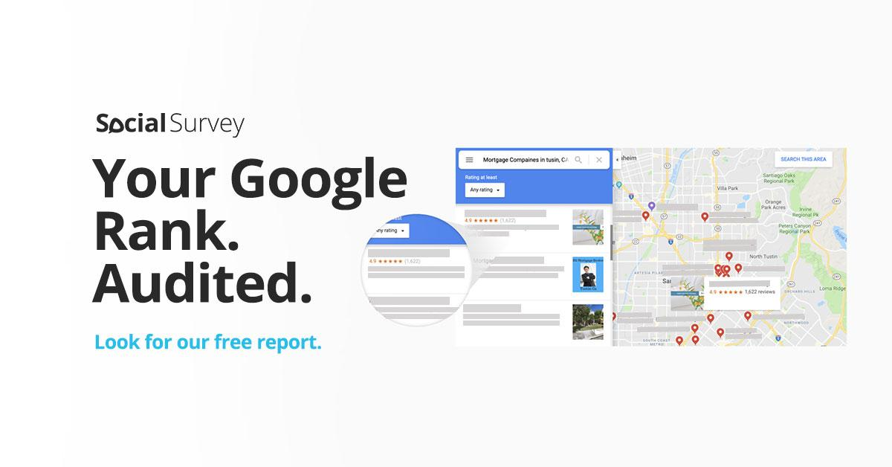
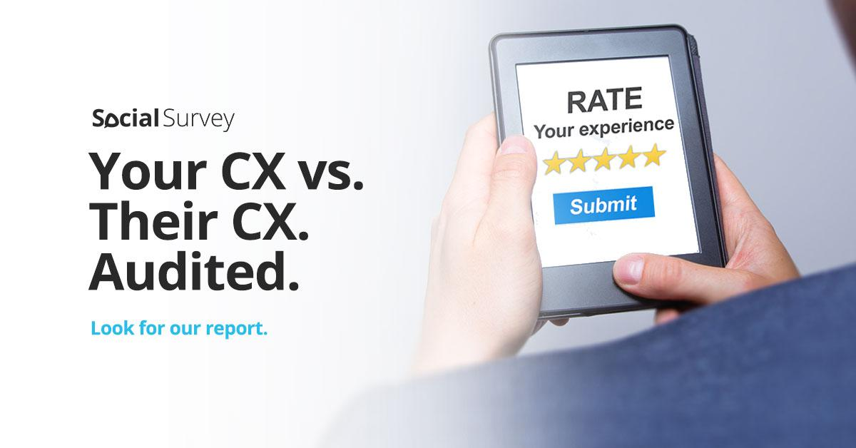
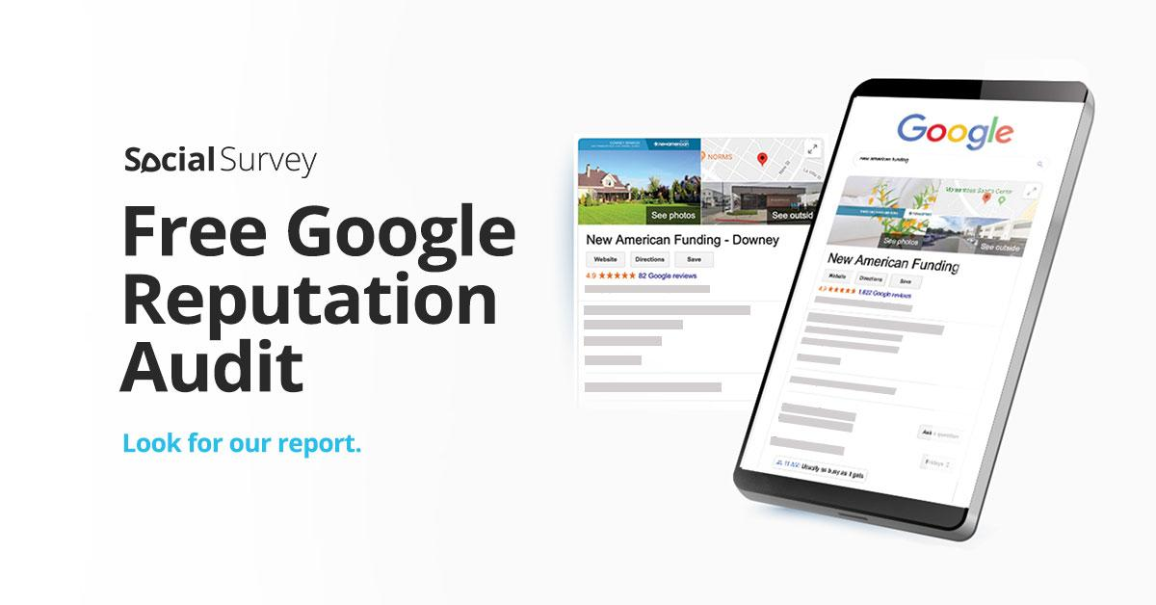
Audit Phase 2 Ads – LinkedIn, Facebook & Instagram

Slide 12
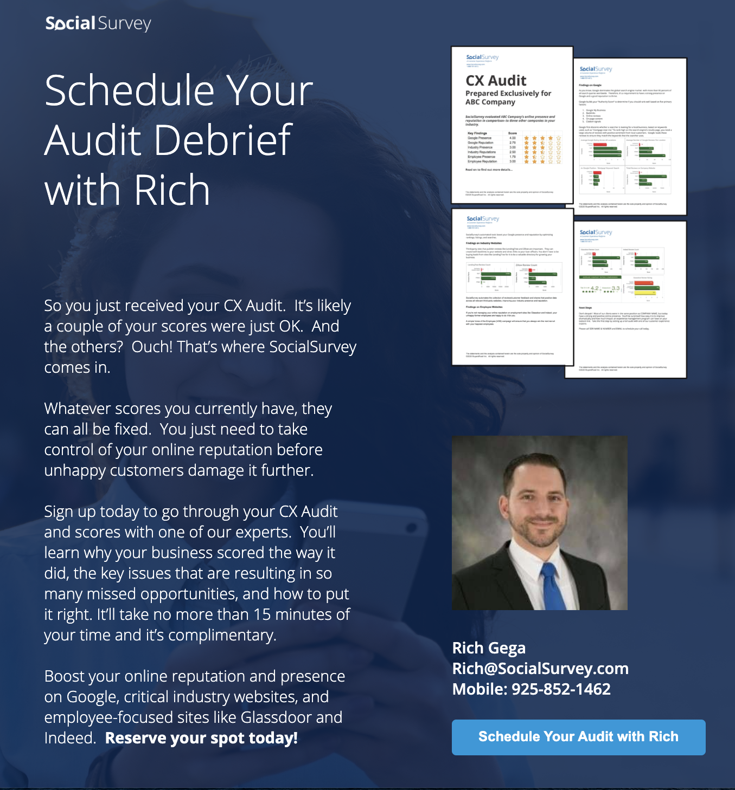
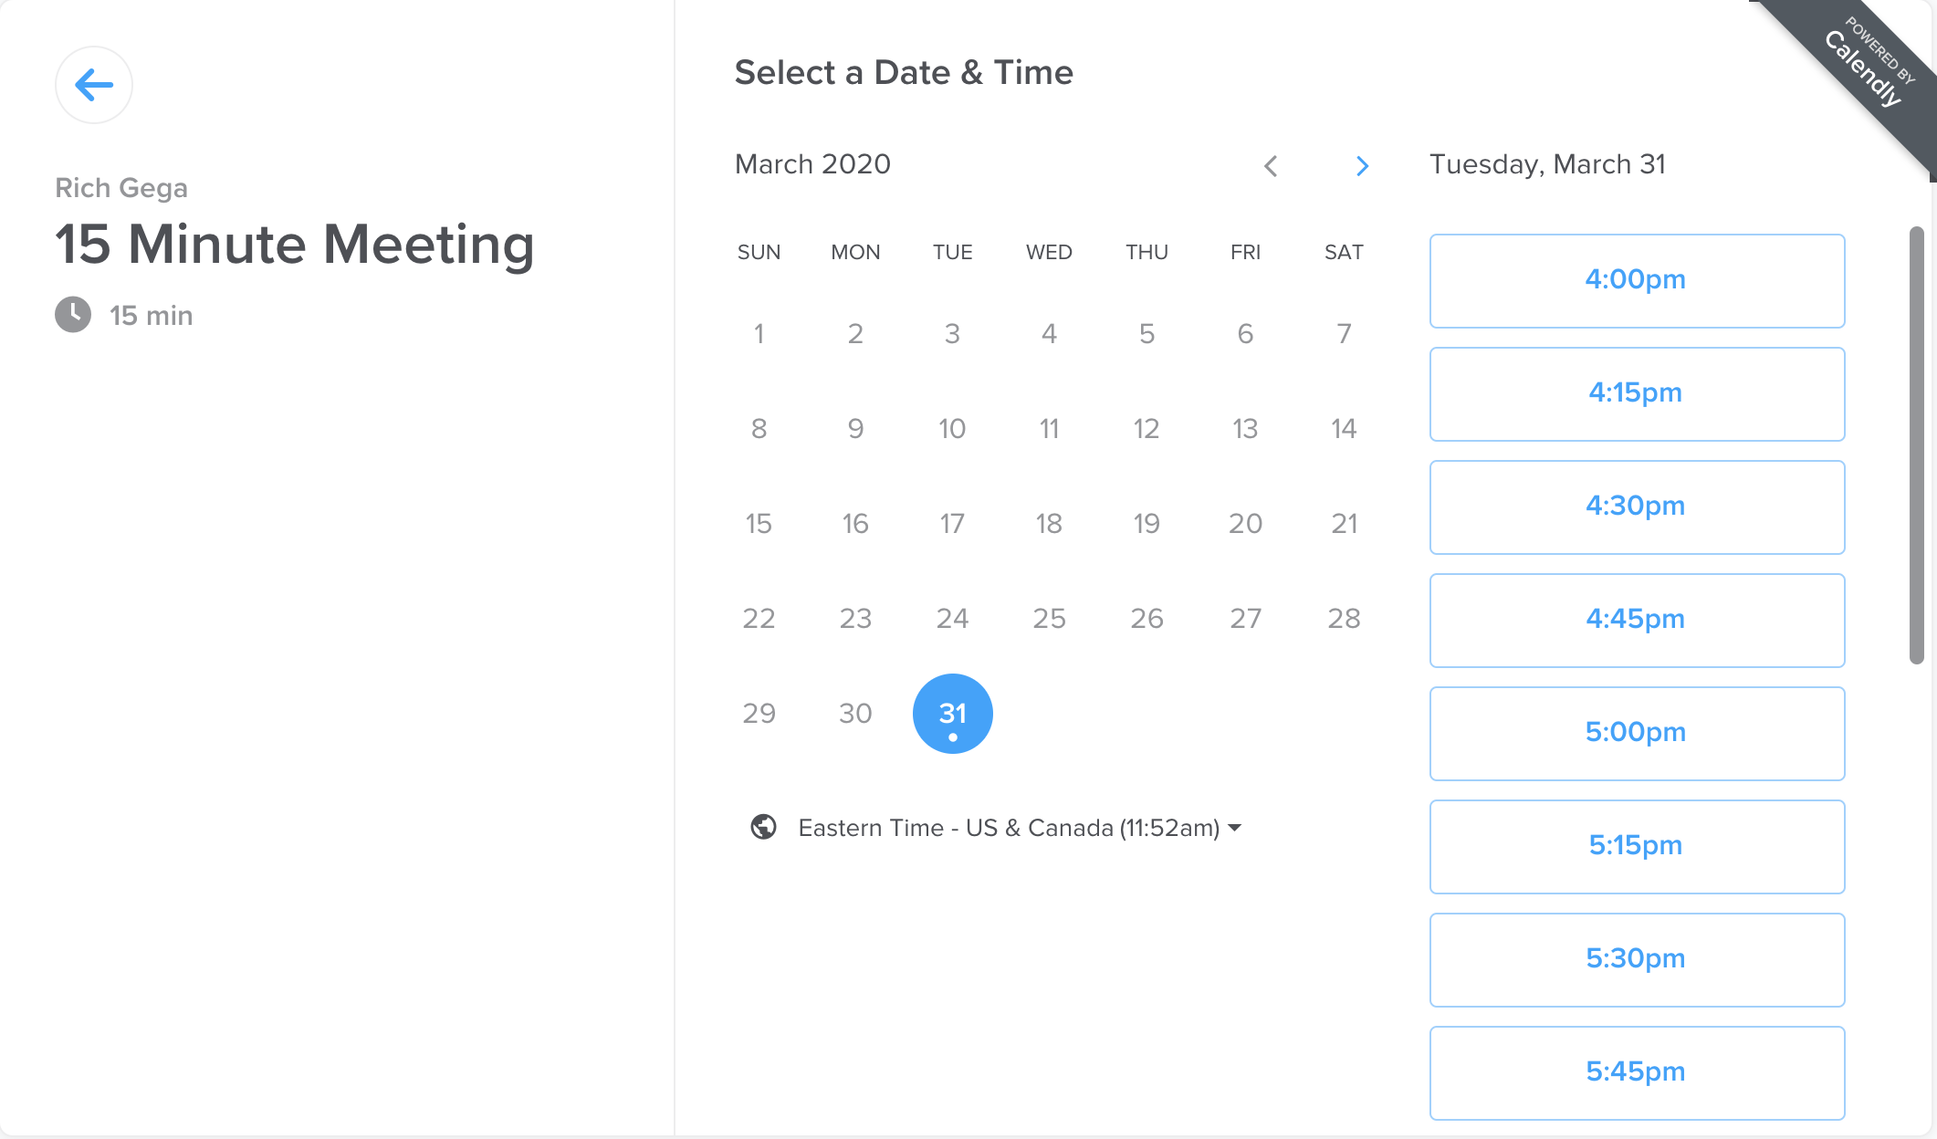
Phase 2 Landing Page Ads

Slide 13
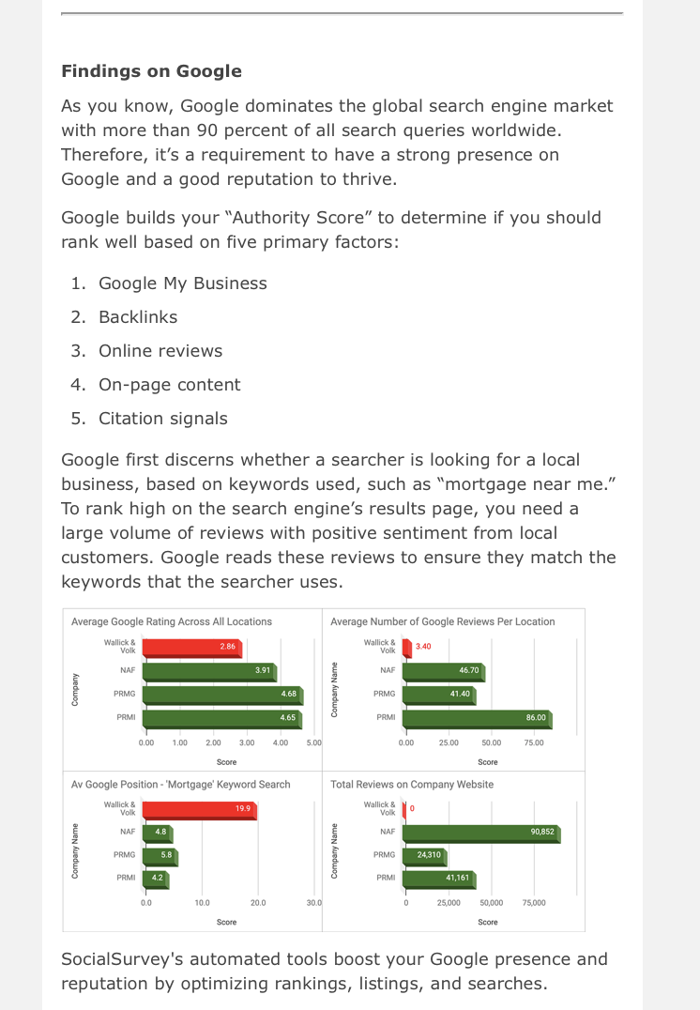
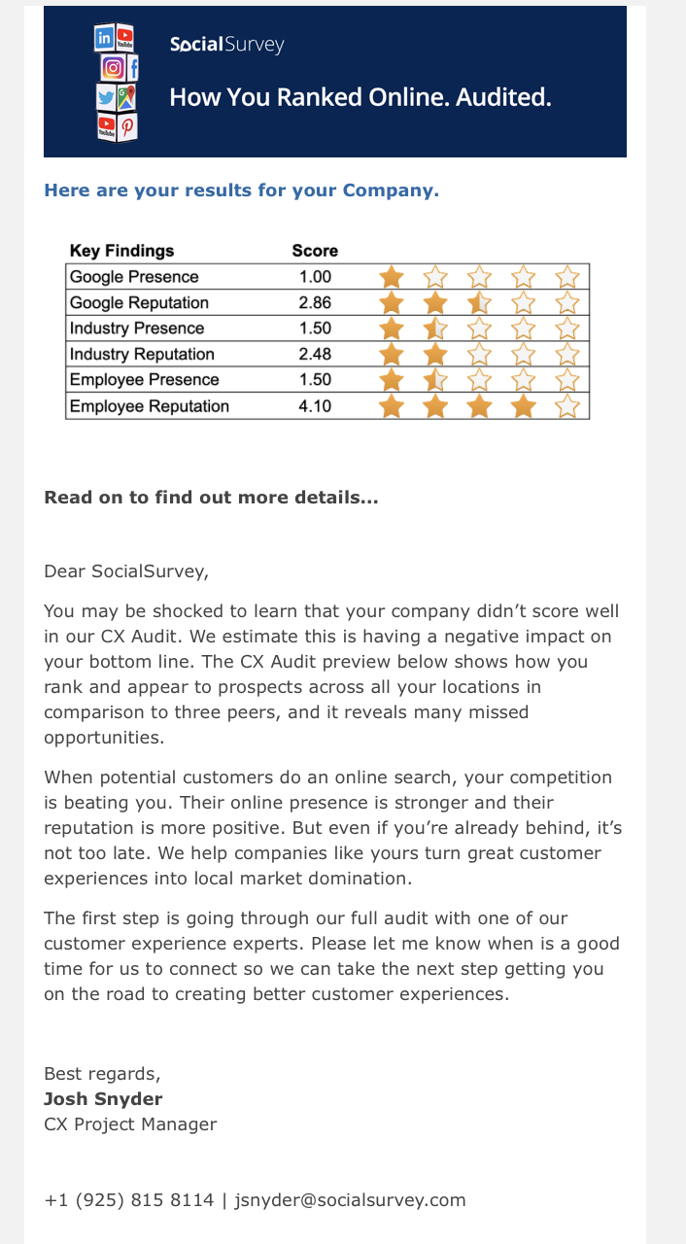
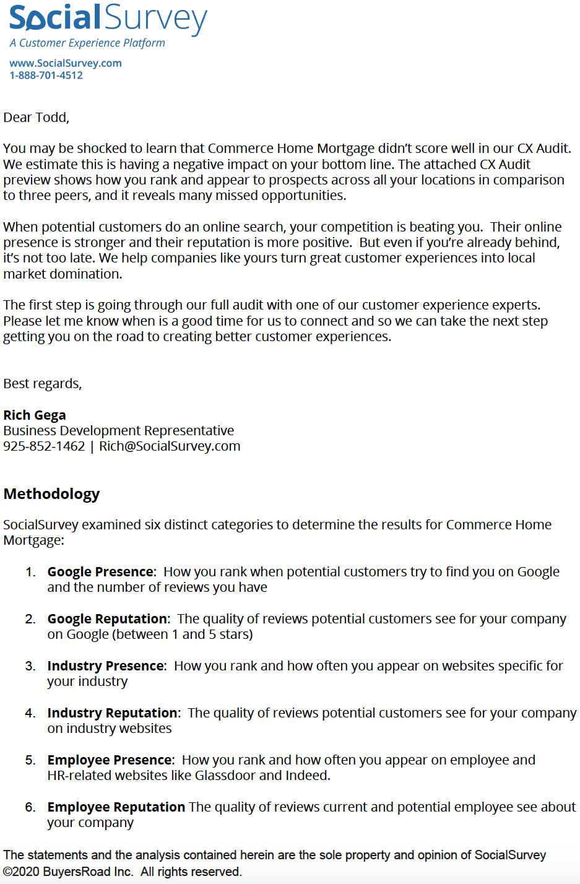
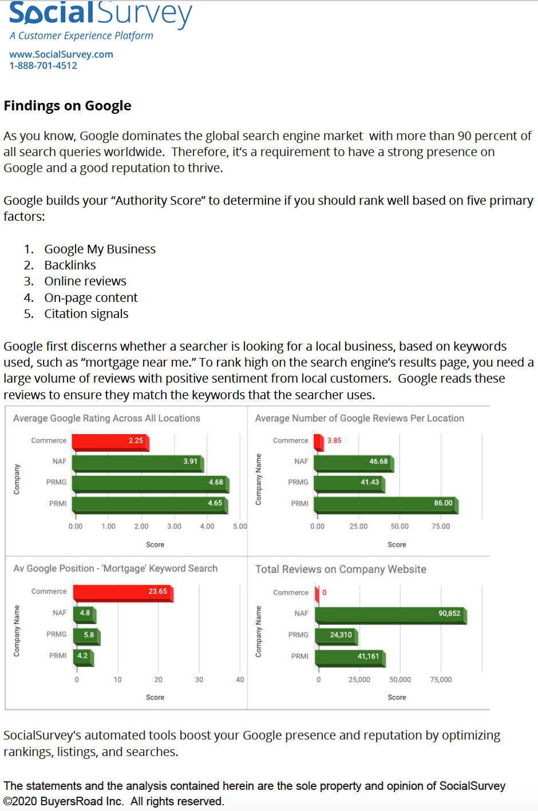
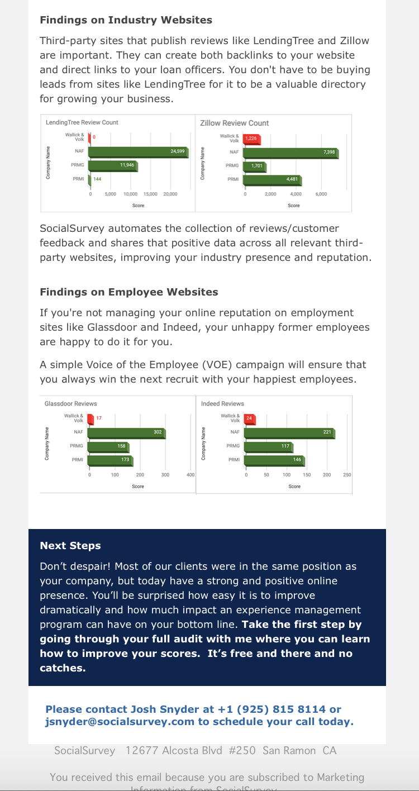
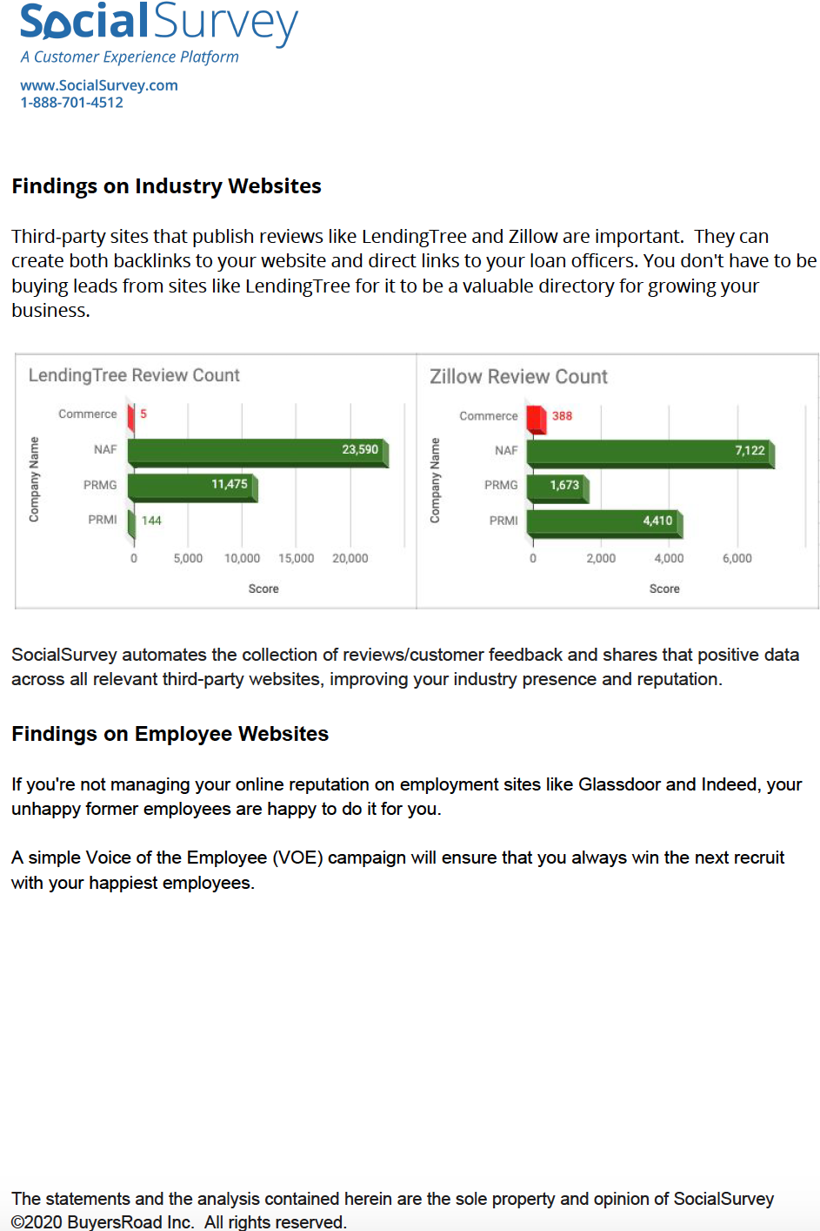
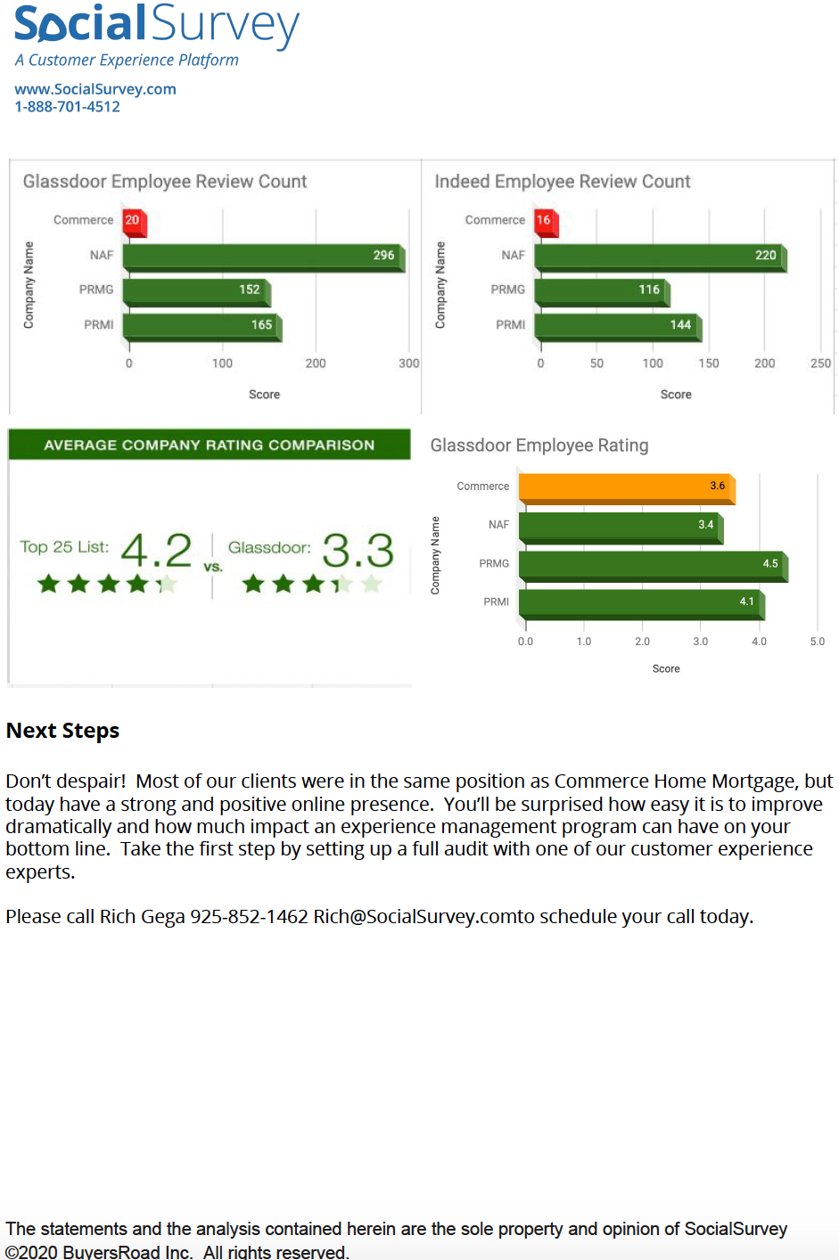
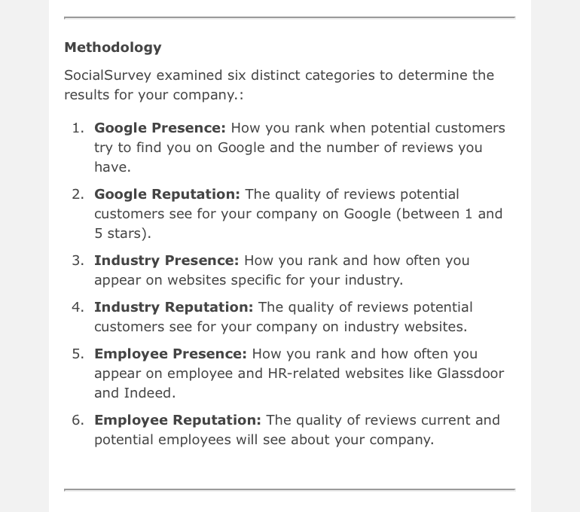
Audit HTML Mailer

Slide 14
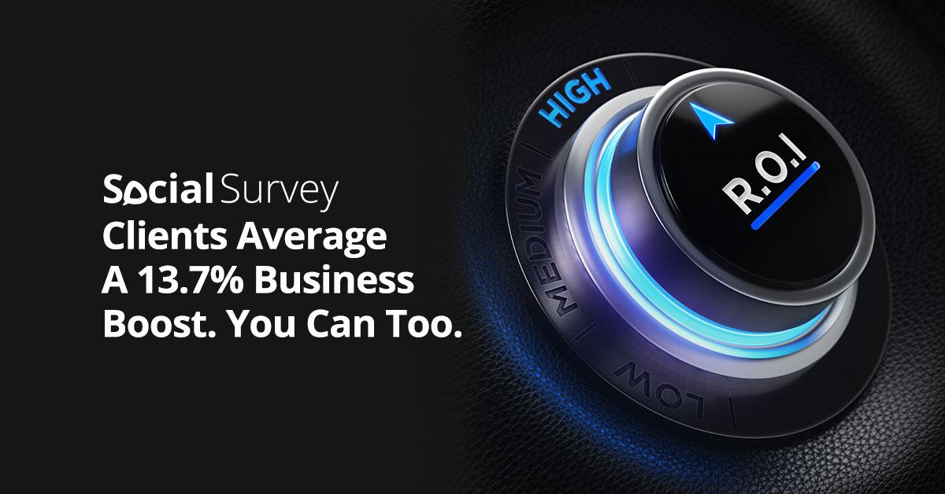
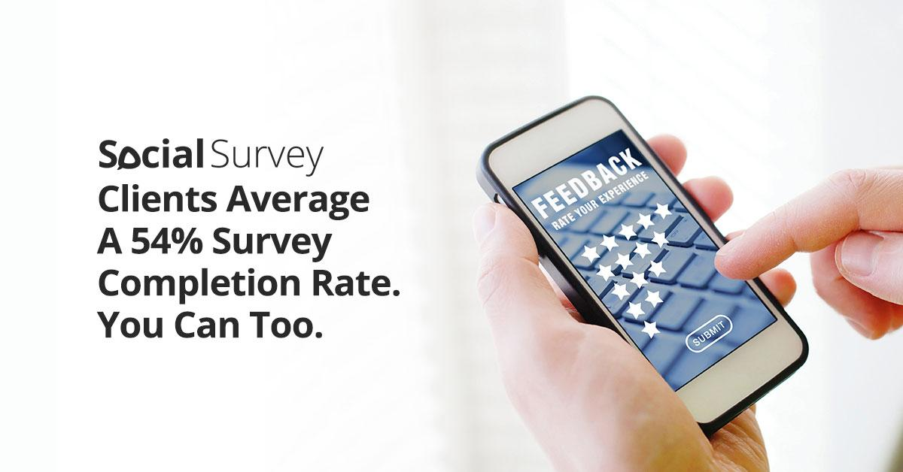
Audit Phase 3 Ads – LinkedIn, Facebook & Instagram

Slide 15
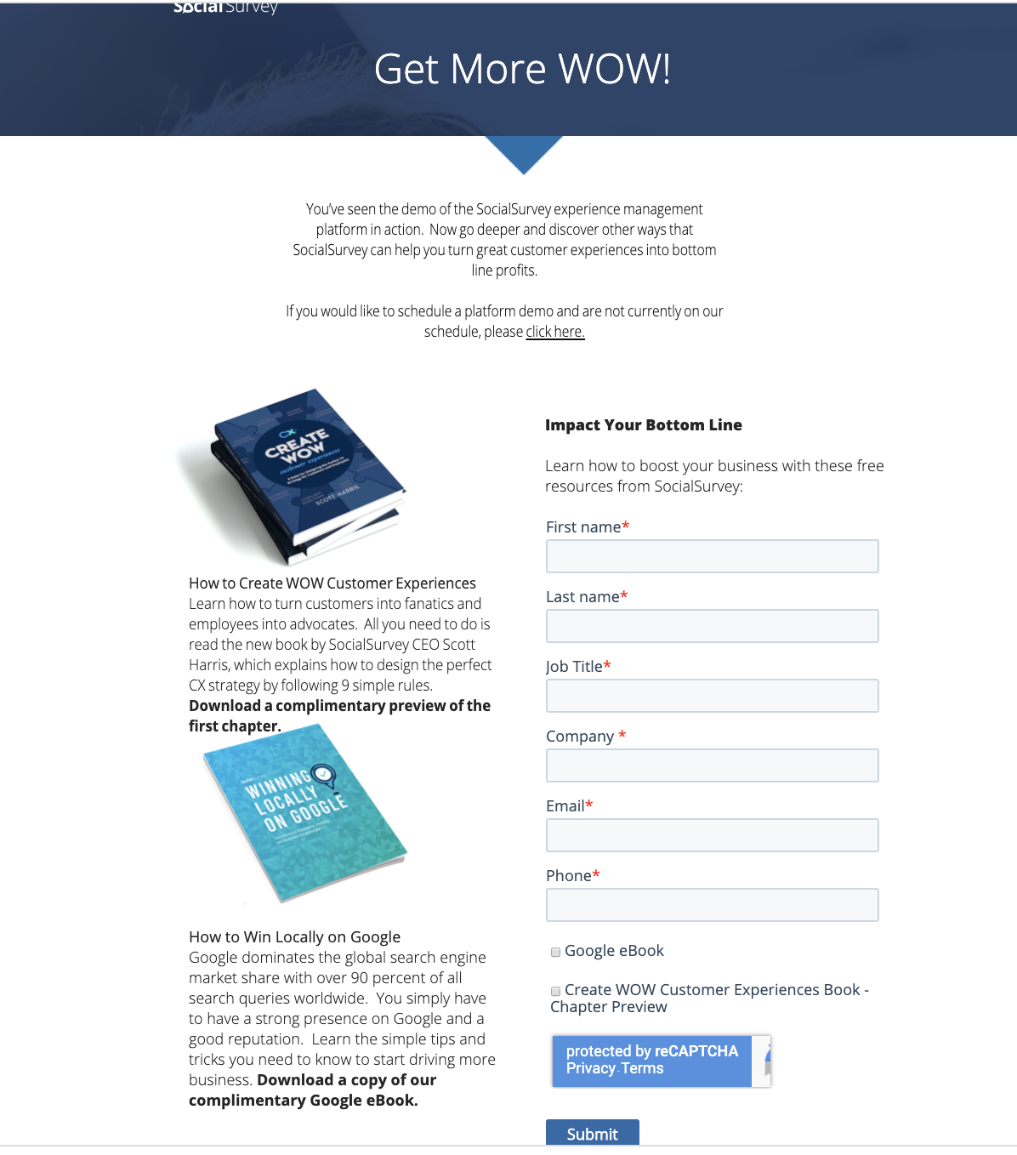
Phase 3 Landing Page Ads

