Slide 1
Infographics Campaign Assets
May 2020

Slide 2
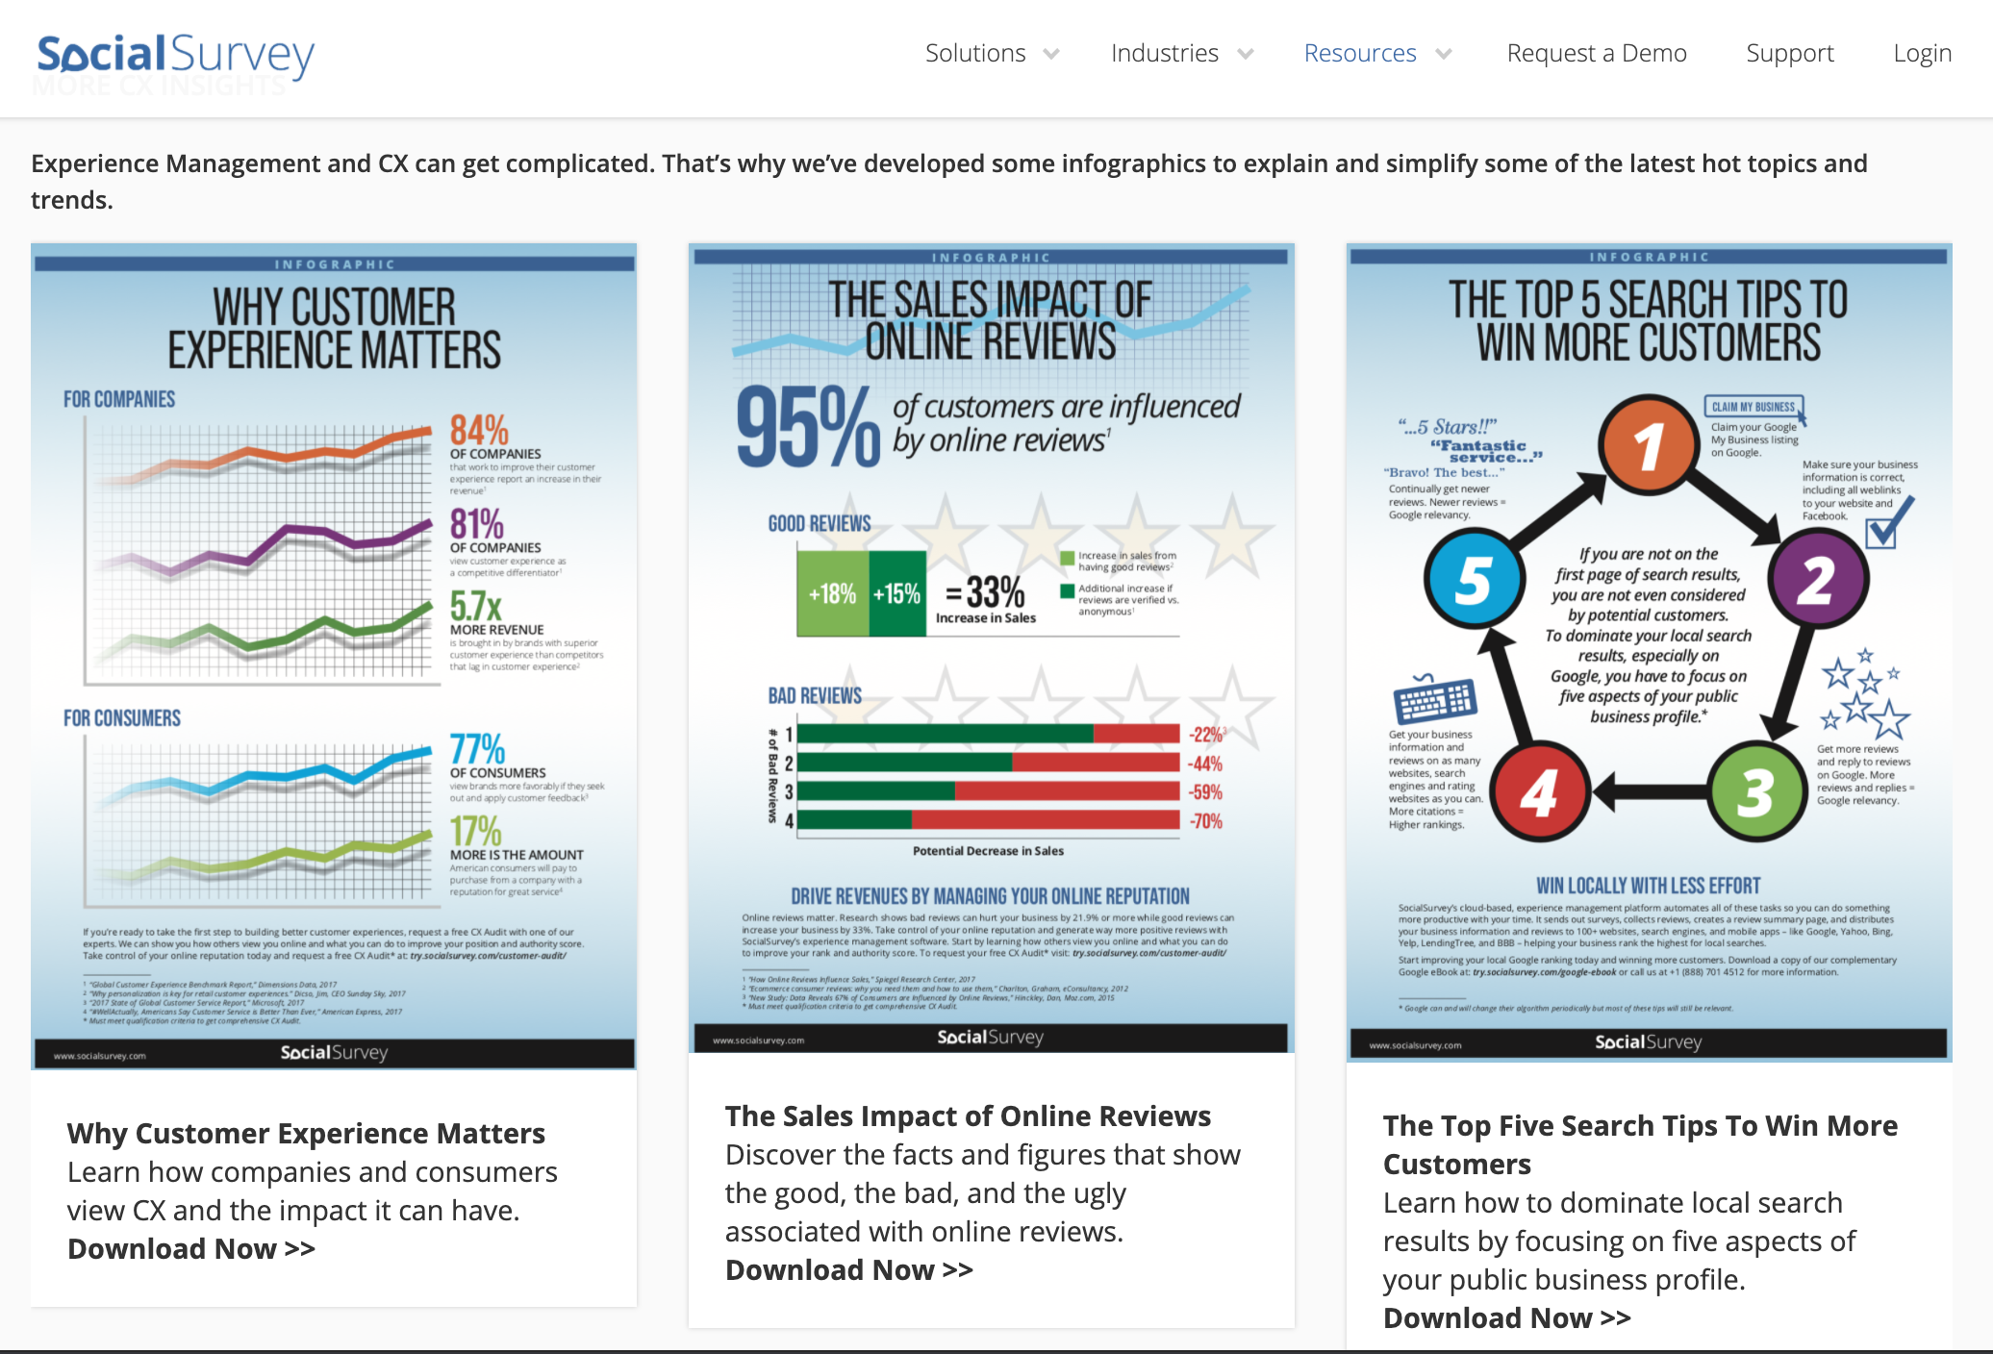
Infographic Campaigns

Slide 3
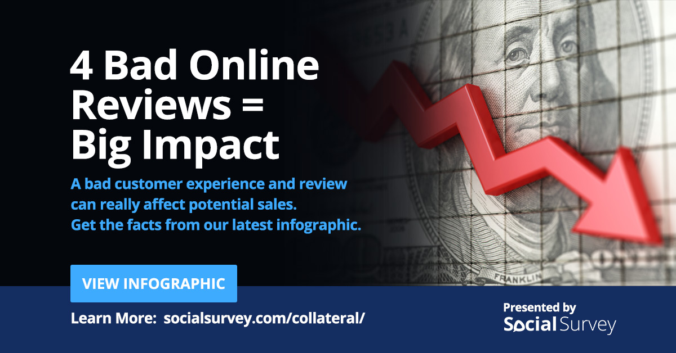
Social Campaigns:

Slide 4
Social Campaigns:

Slide 5
Social Campaigns:

Slide 6
Social Campaigns:

Slide 7
Social Campaigns:

Slide 8
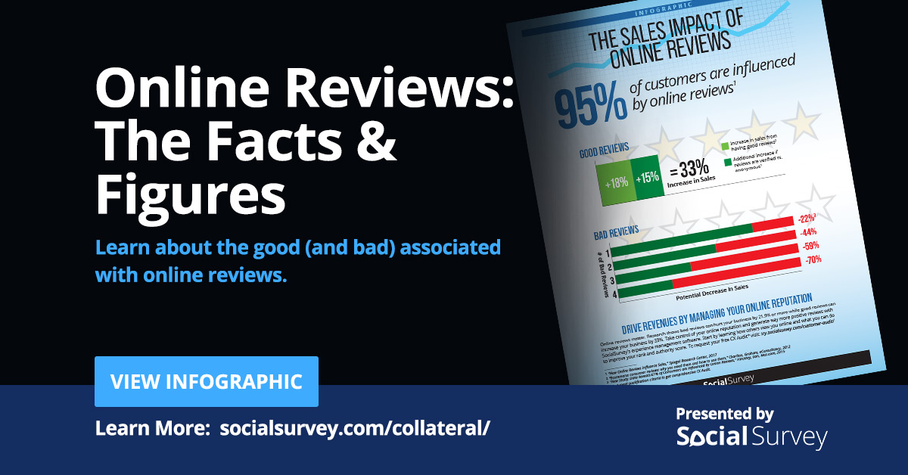
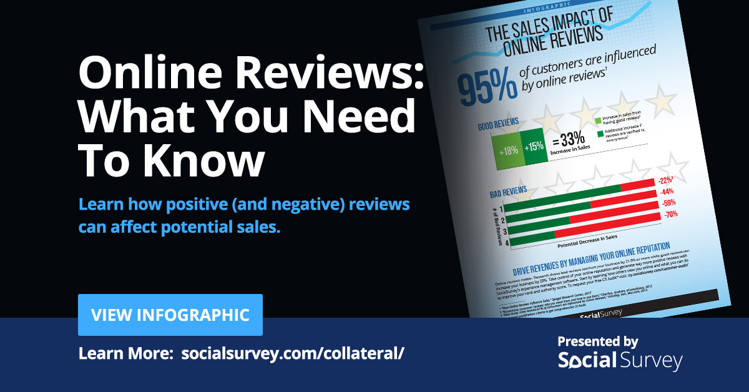
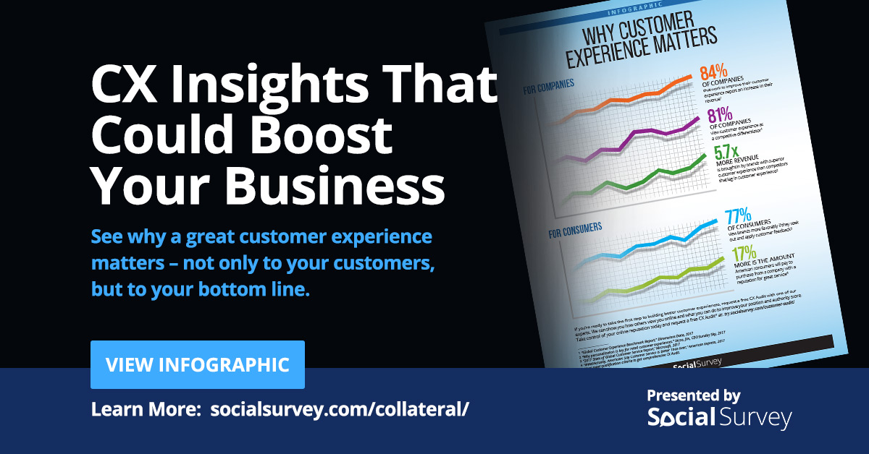
Social Campaigns:

Slide 9
Social Campaigns:

