Slide 1
New Ready to Go Campaigns

Slide 2
Ready to Go Campaigns
What is it? Complete integrated campaigns focused on seasonal conditions to increase awareness and encourage utilization
How to use it: We suggest running one campaign per month and timing each campaign to coincide with the typical occurrence of these common ailments.
How to build a campaign in 3 steps
After adding your logo, phone number and web address to these materials just follow these 3 easy steps:
Step 1 – Send out the HTML email to your eligible users
Step 2 – Post the campaign flyer in high trafficked areas as a reminder for employees to see a virtual doctor if they are experiencing symptoms
Step 3 – Take the provided blog/article copy and banners and place them on your Intranet site, website or in a company/employee/employer/health plan/health system newsletter to educate and inform

Slide 3
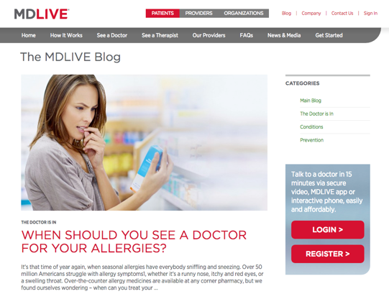
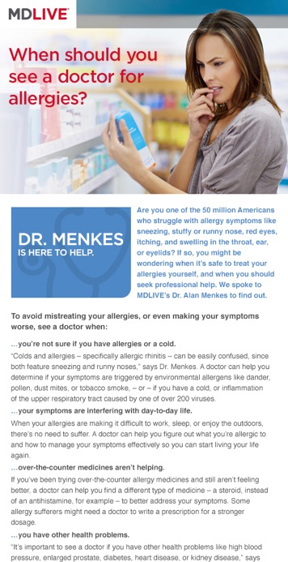
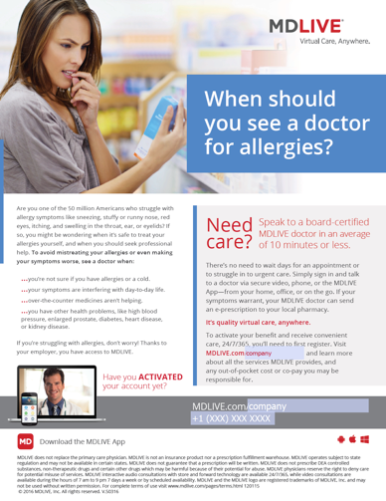
Newest May Campaign: Allergy
Web Banners
Blog &
Social Media
Flyers for Employers, Health Systems,
and Health Plans
HTML Email

Slide 4
Allergy Campaign

Slide 5
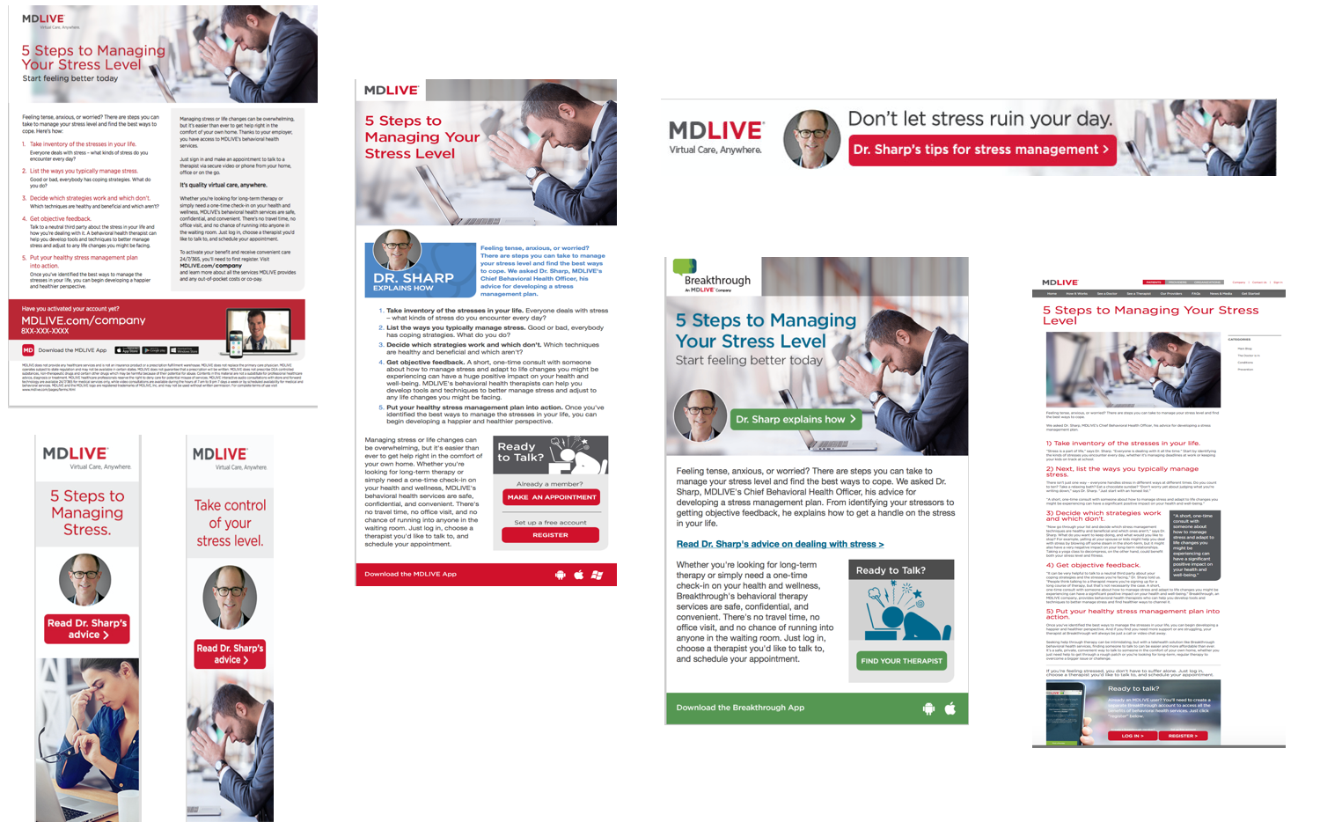
Stress Campaign

Slide 6
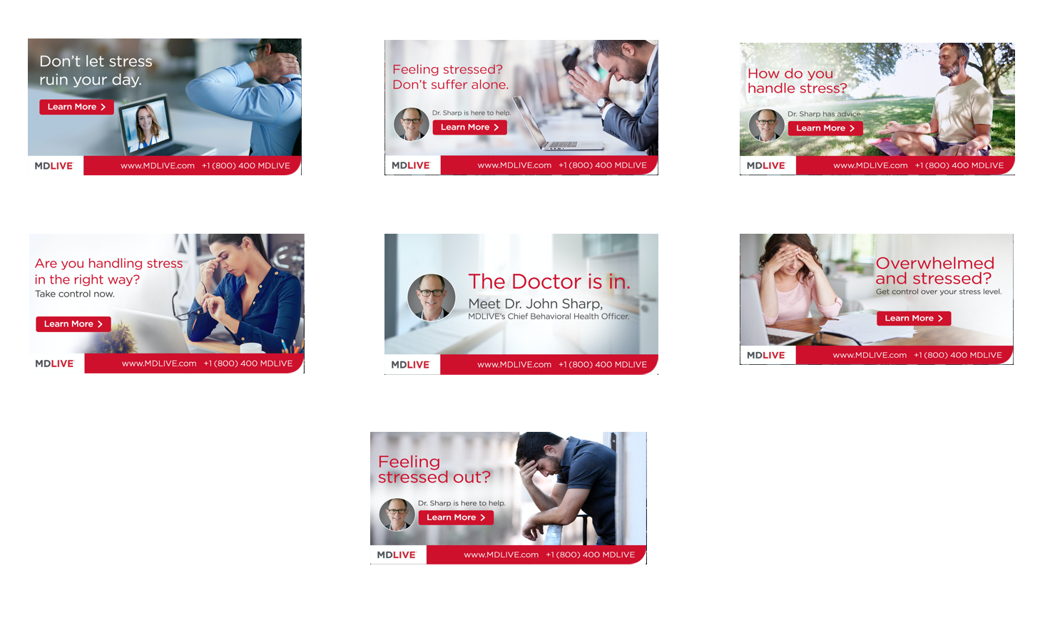
Stress Campaign

