Slide 1
Medical Welcome Kit

Slide 2
Medical – Short Copay

Slide 3
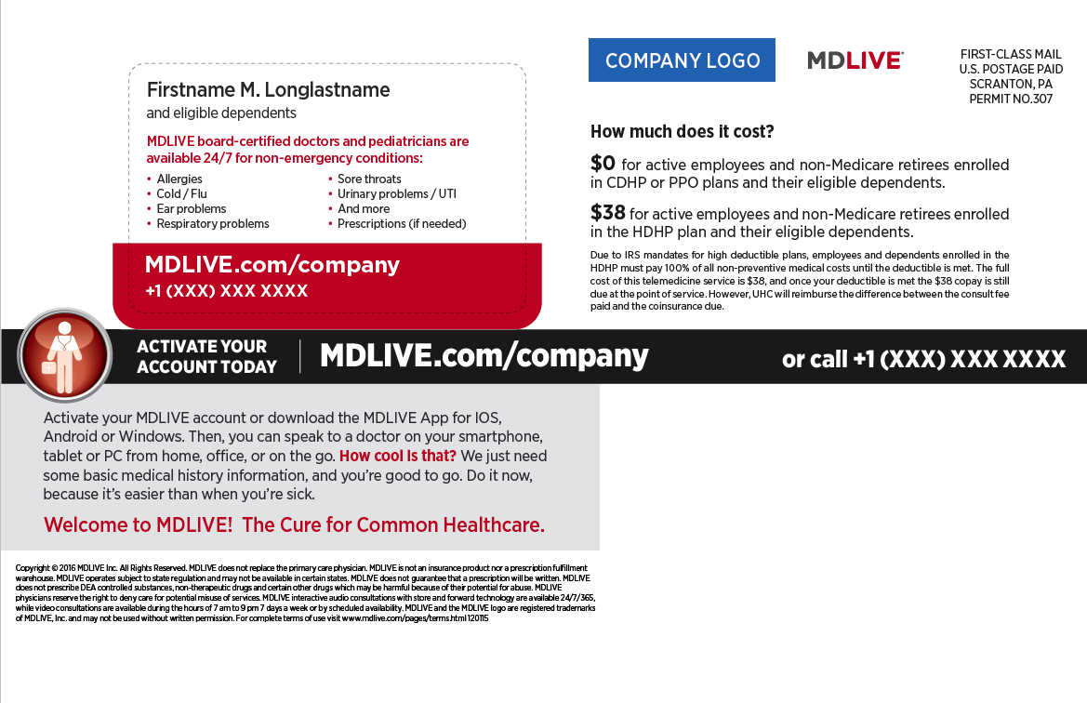
Medical – Long Copay

Slide 4
Medical & Behavioral Welcome Kit

Slide 5
Medical & Behavioral – Short Copay

Slide 6
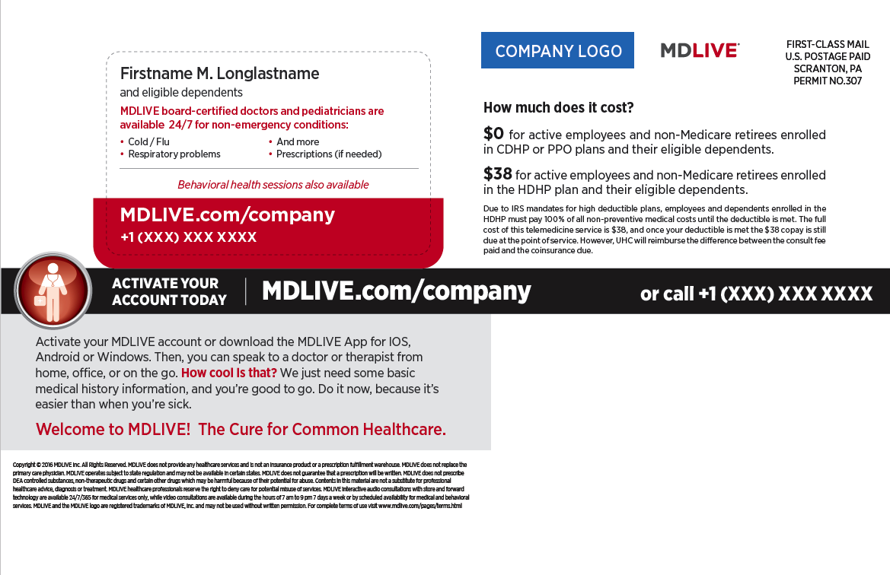
Medical & Behavioral – Long Copay

Slide 7
Spanish Medical Welcome Kit

Slide 8
Spanish Medical – Back

Slide 9
Spanish Medical & Behavioral Welcome Kit

Slide 10
Spanish Medical & Behavioral – Back

Slide 11
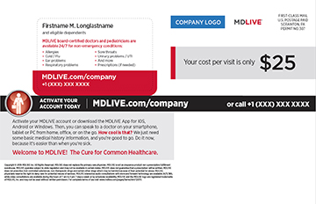
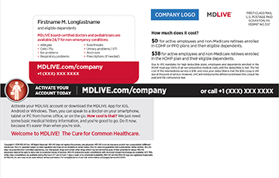
Medical Welcome Kit

Slide 12
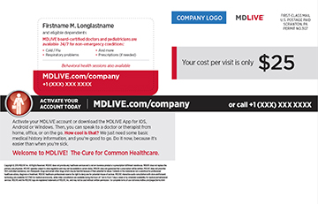
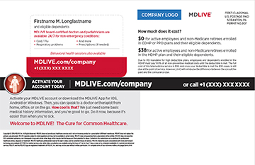
Behavioral Welcome Kit

Slide 13
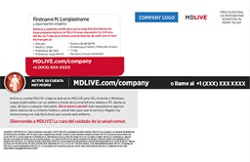
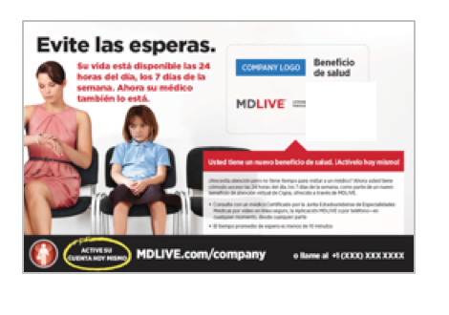
Spanish Welcome Kit
Medical
Behavioral

Slide 14
3-in-1 Insert

Slide 15
Welcome Kit Envelope (if required)

Slide 16
Health System Alternative Welcome Kit

Slide 17
Health System Alternative Welcome Kit

