Slide 1
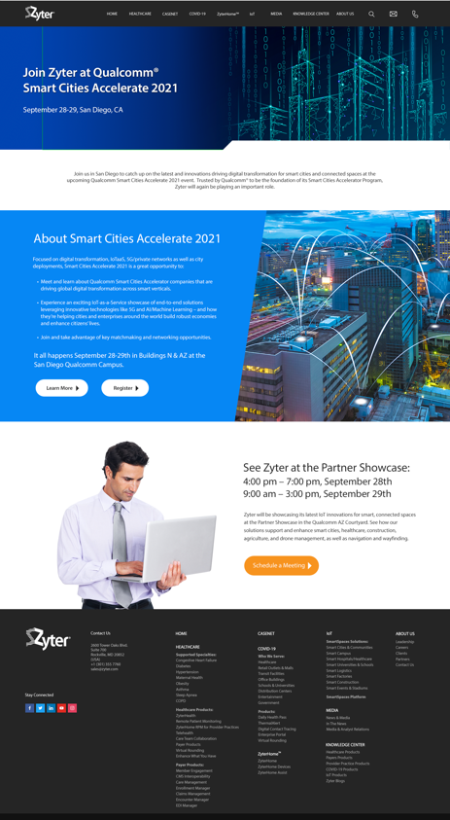
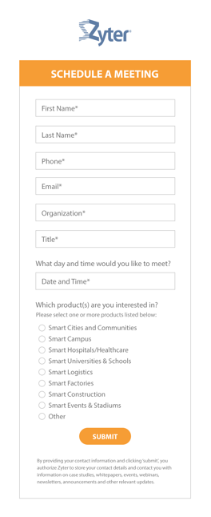

Qualcomm 2021 IoT Event

Slide 2






Qualcomm 2021 Event: Social Campaign

Slide 3
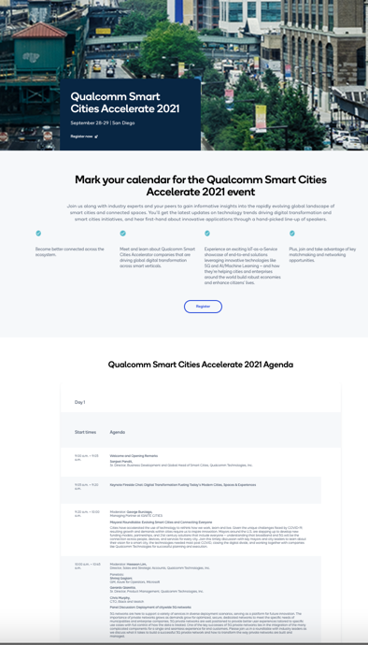
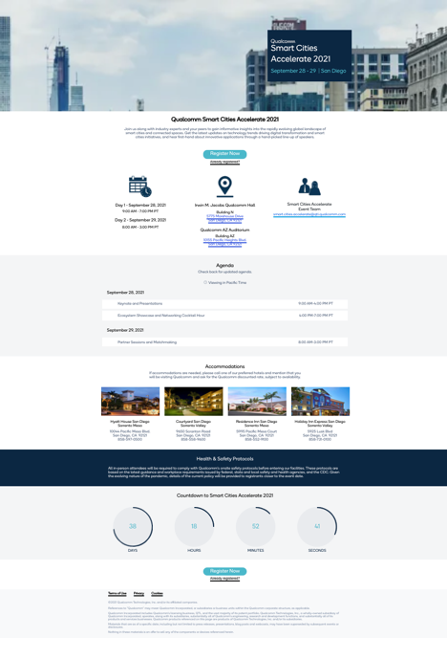
Qualcomm 2021 IoT Event: Registration

Slide 4
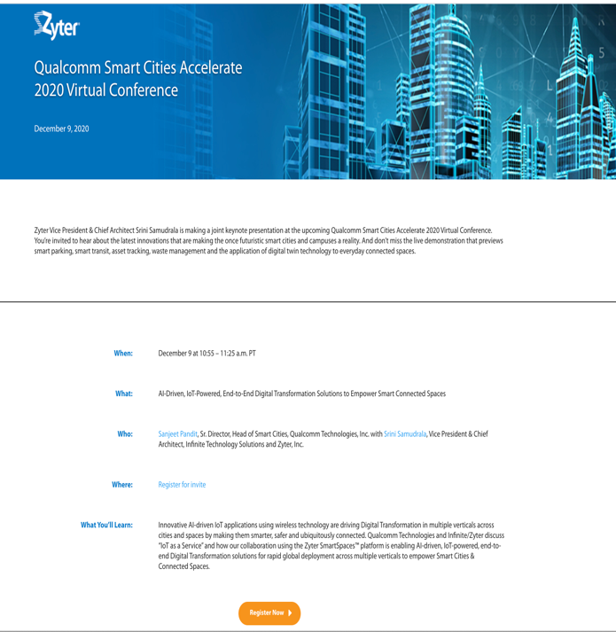
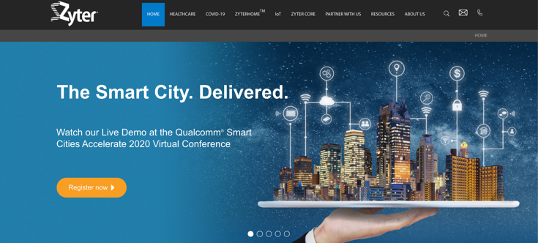
Qualcomm 2020 IoT Event

Slide 5
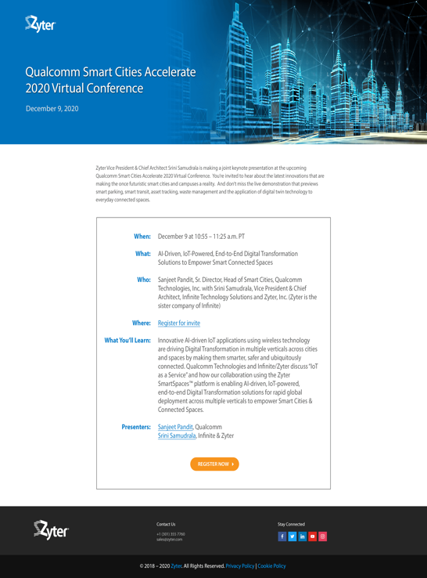

Qualcomm 2020 IoT Event: Direct Response Mailer

Slide 6







Qualcomm 2020 IoT Event: Social Campaign

Slide 7
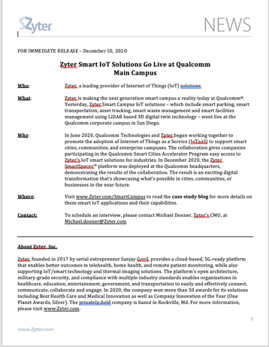
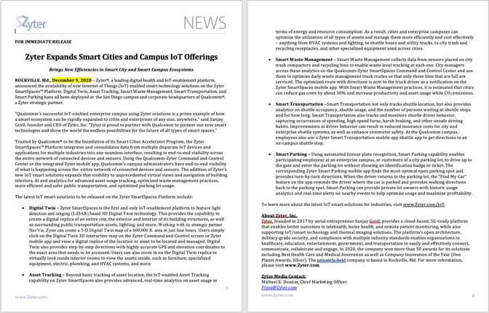
Zyter Smart Campus Launch: PR at Qualcomm Event

Slide 8

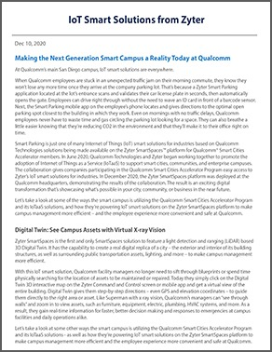
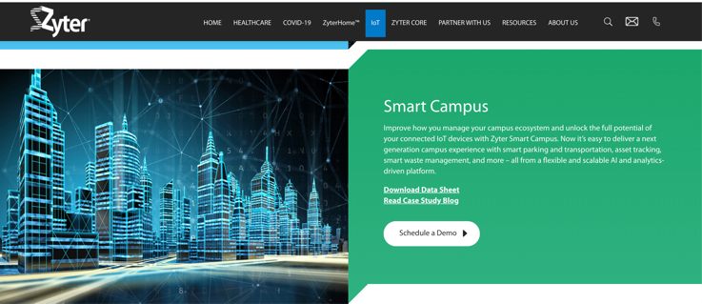
Zyter Smart Campus Launch @ Qualcomm Event

Slide 9
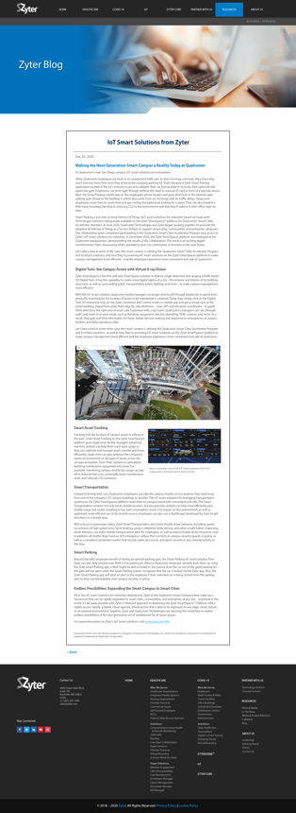
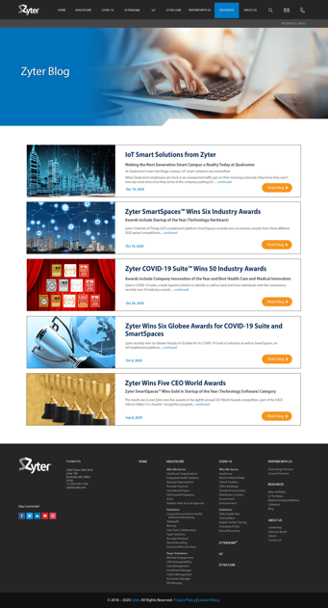
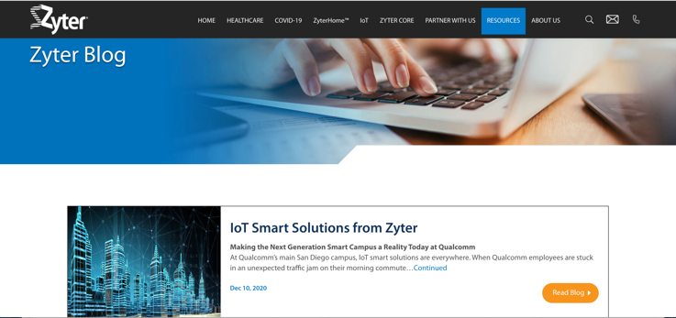
Zyter Smart Campus Launch: Blog

Slide 10



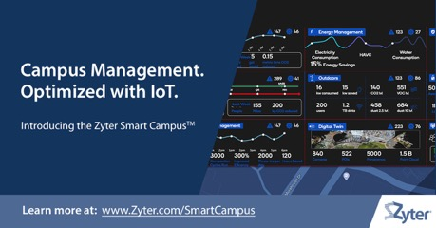



Smart Campus Launch: Social Campaign

