Slide 1
Syndicate Case Study Campaign Assets
May 2020

Slide 2
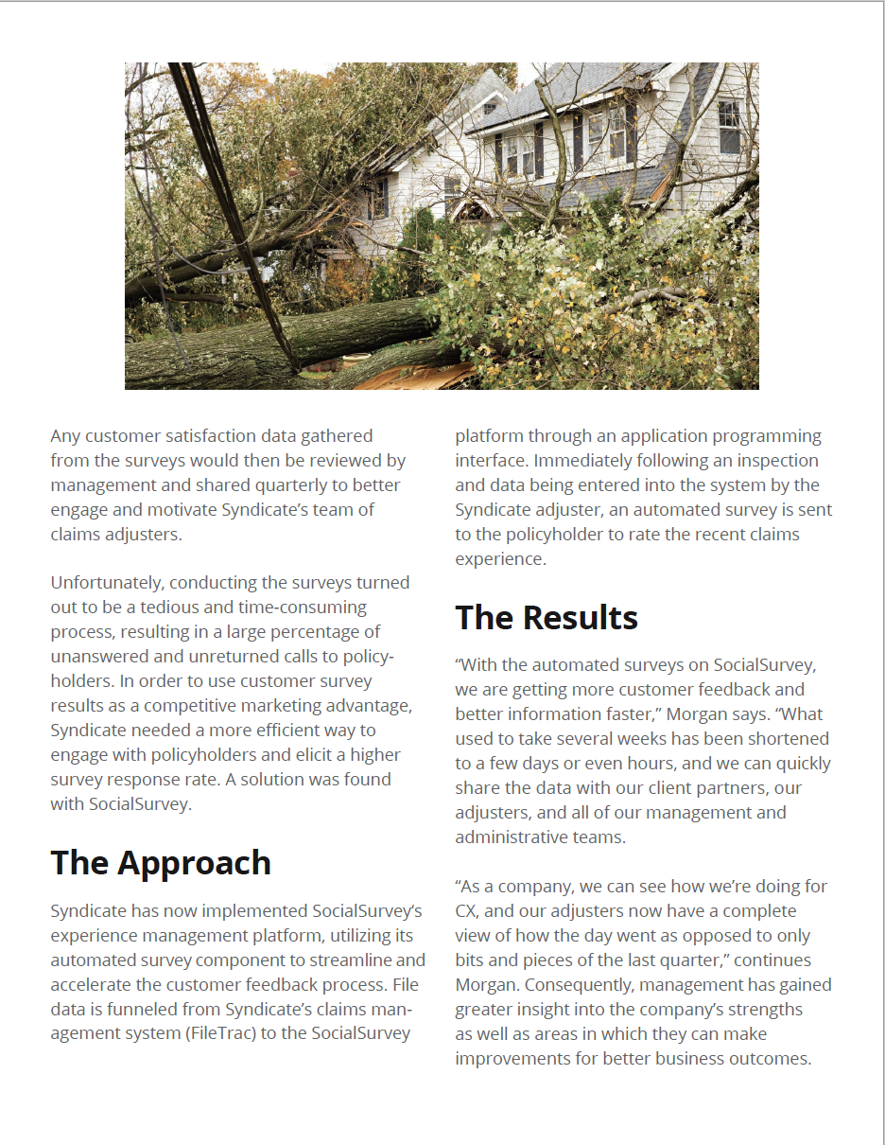
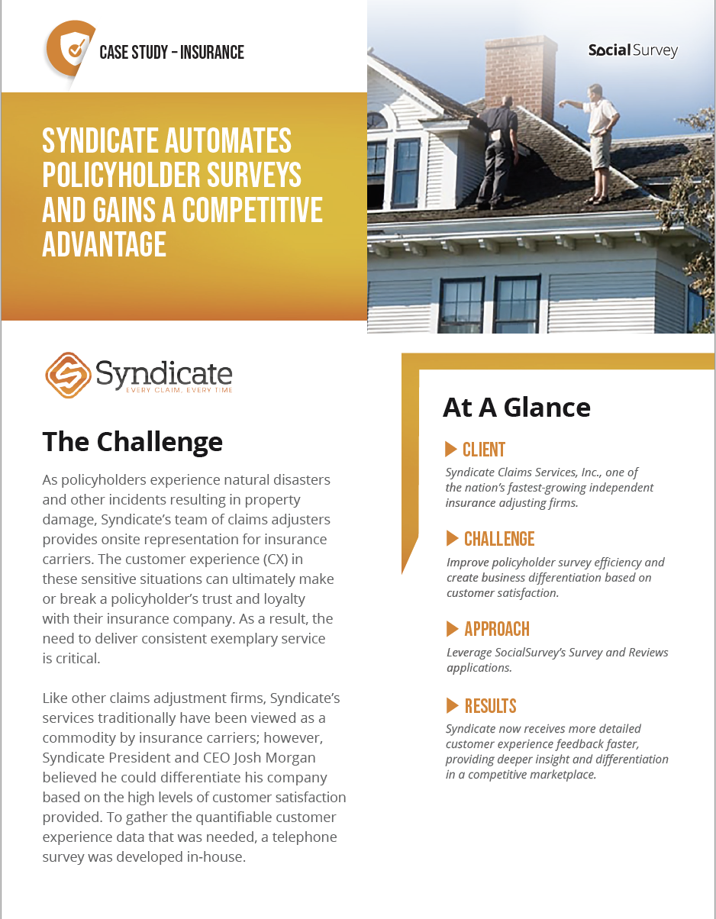
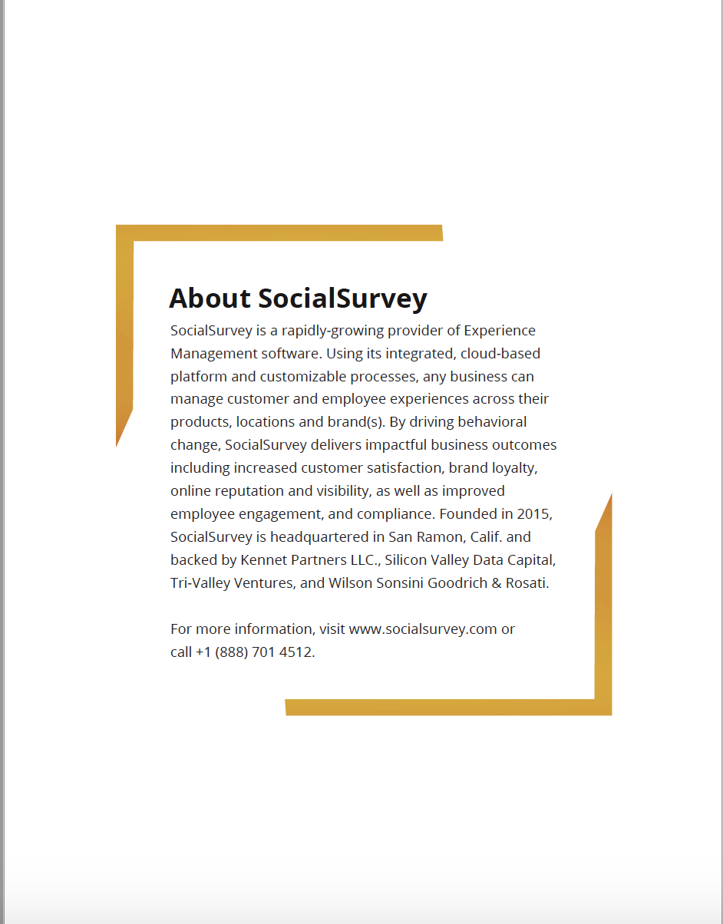
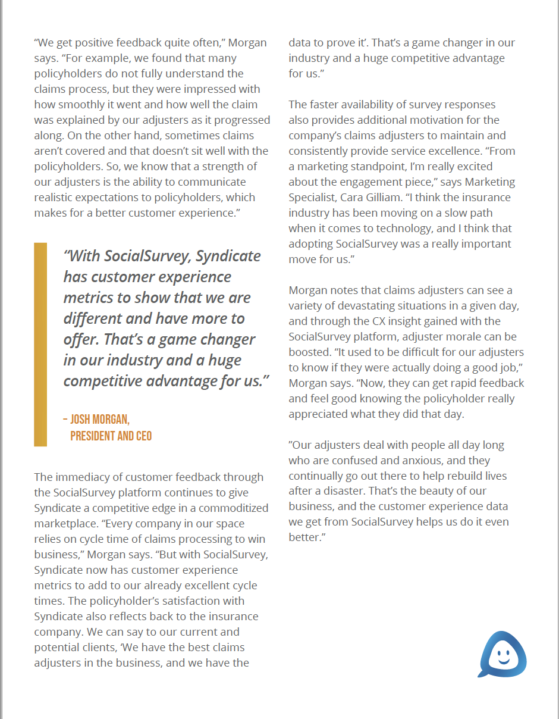
Case Study:

Slide 3
Website Banner:

Slide 4
Demand Generation: Social Campaigns

Slide 5
Demand Generation: Social Campaigns

Slide 6
Demand Generation: Social Campaigns

