Slide 1
Top Performers Campaign
May 2020

Slide 2
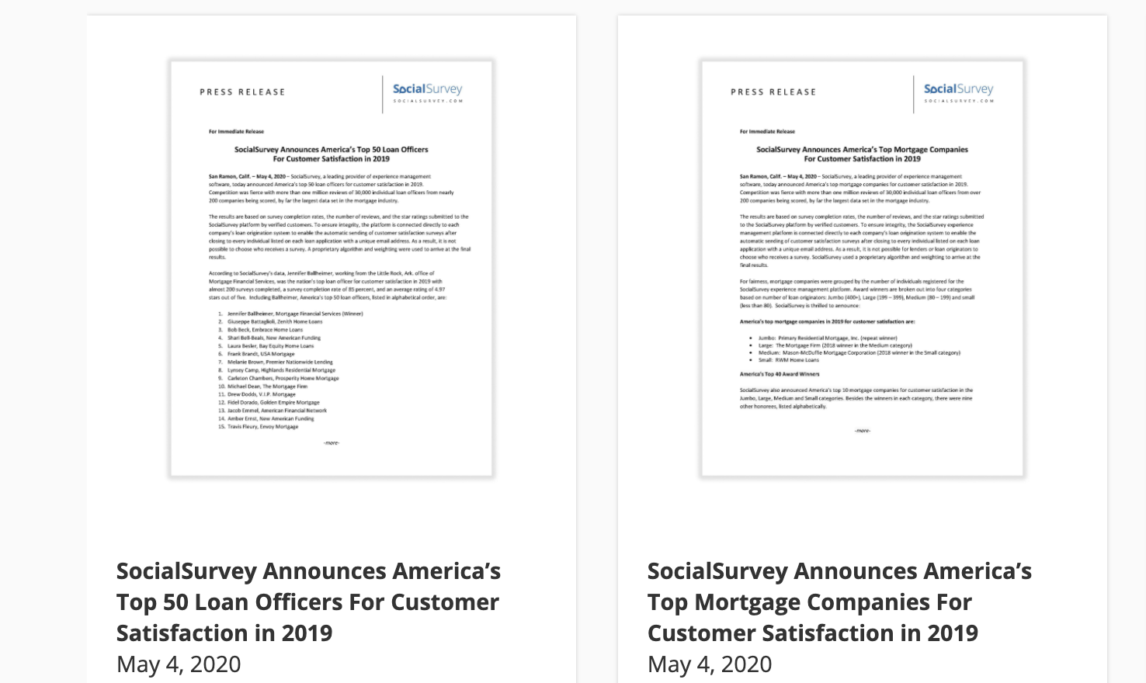
Media Relations:
Press Releases

Slide 3

Website Launch:

Slide 4




Demand Generation:
Social Campaigns

Slide 5




Demand Generation:
Social Campaigns

Slide 6




Demand Generation:
Social Campaigns

Slide 7
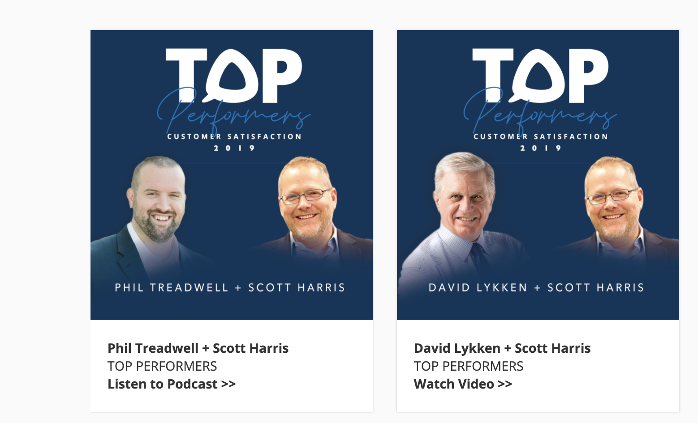
Media Placements:

Slide 8

Media Placements:

Slide 9

Website Banners:

Slide 10

Demand Generation:
Campaign Collateral

Slide 11

Demand Gen:
Lead Forms

Slide 12

Demand Generation:
Winner Videos

Slide 13

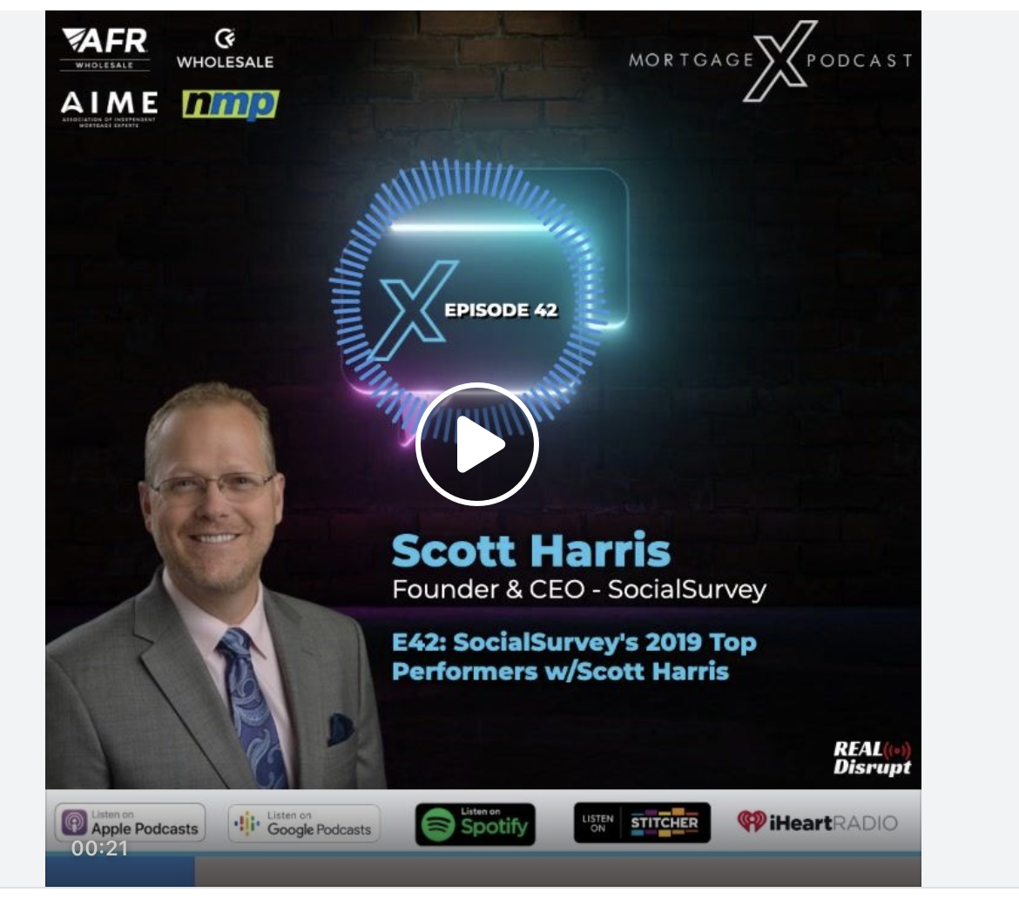

Social Buzz:

Slide 14


Social Buzz:

Slide 15


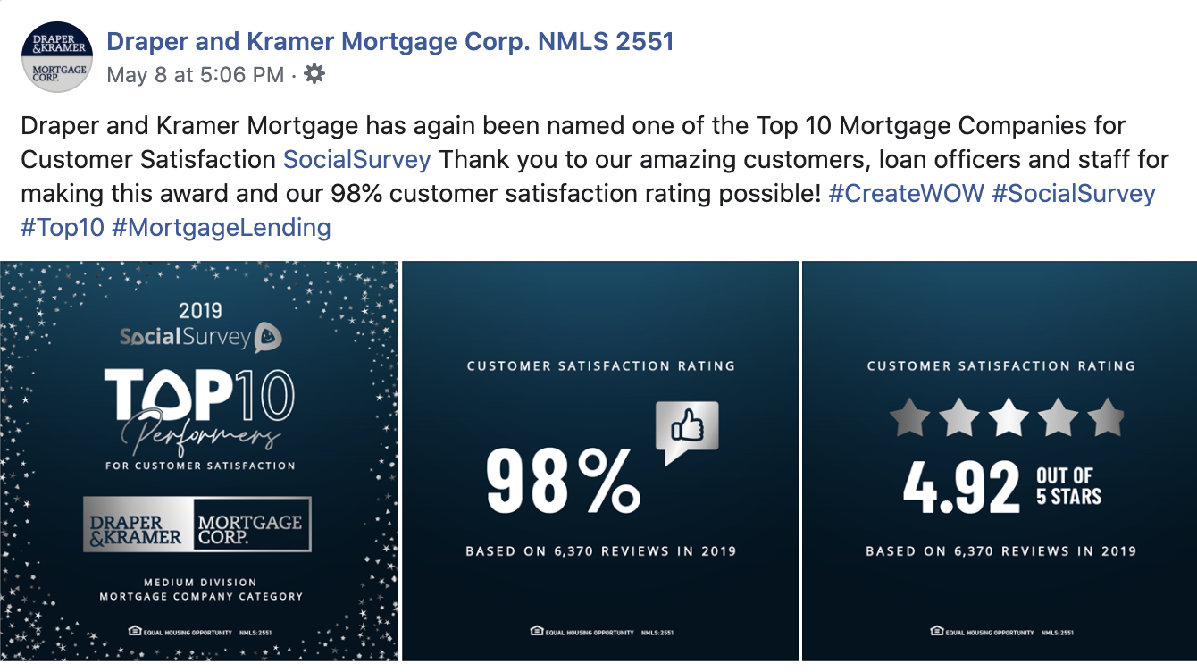
Social Buzz:

Slide 16




Social Buzz:

Slide 17

Top Performer Campaign Assets:

Slide 18

Top Performer Campaign Assets for Winners to Promote Program

Slide 19

Top Performer Campaign Assets for Winners to Promote Program

Slide 20

Top Performer Campaign Assets for Winners to Promote Program

Slide 21

Top Performer Campaign:
Winner Communications

