Slide 1
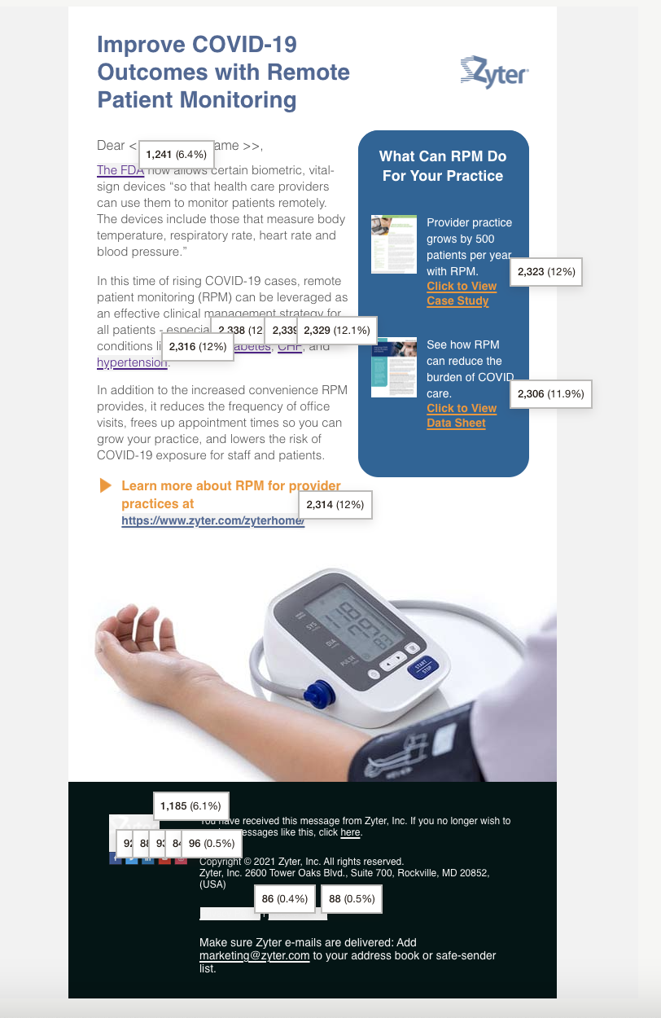
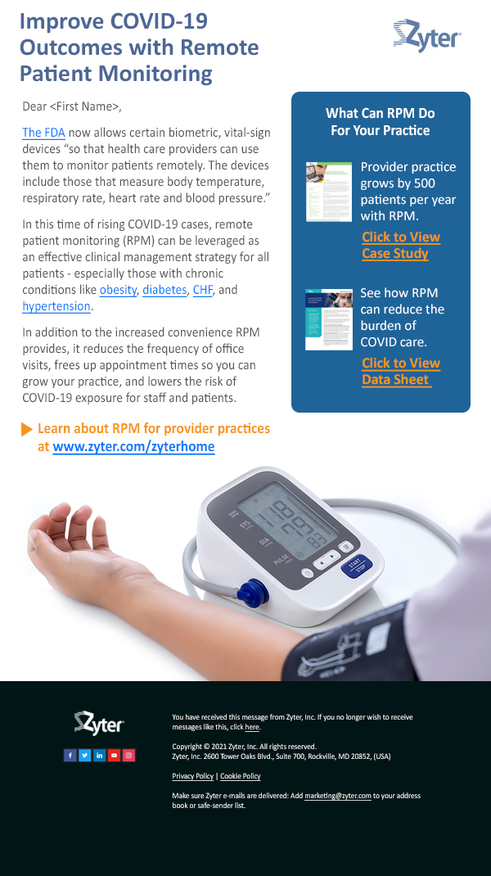
New Mailer: COVID
12.1% opens 26,562 delivered
4,088 opens
4.7% total clicks
19,318 clicks
37.4% clicks per unique open
91 unsubscribes

Slide 2
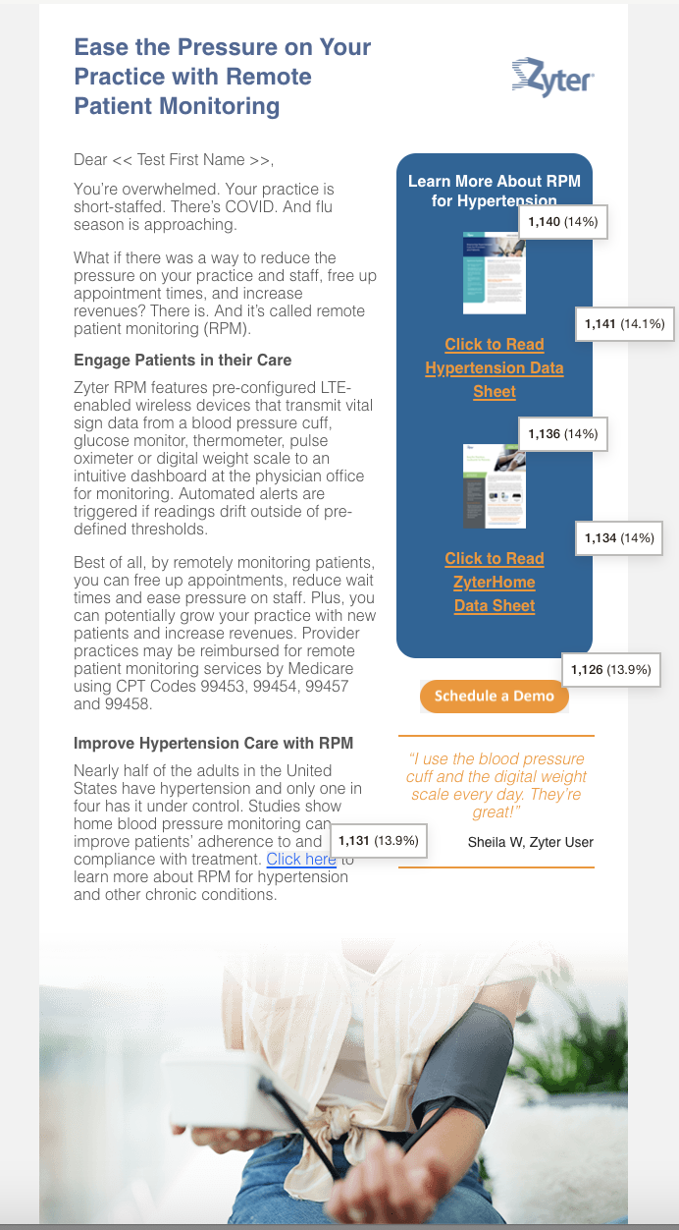
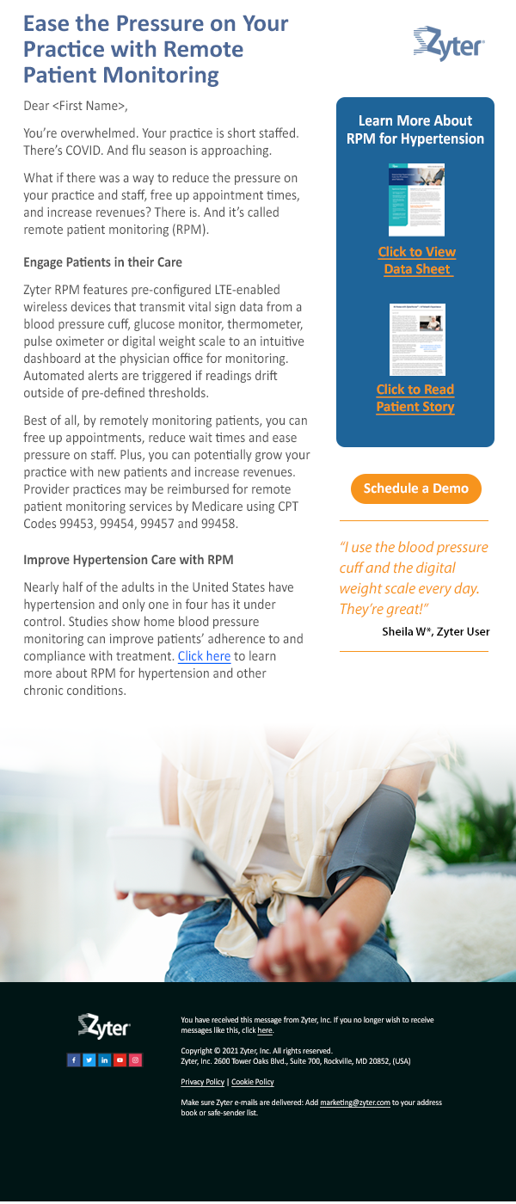
New Mailer: Hypertension
8.2% opens
26,398 (97.3%) Delivered
2,635 opens
2.3% total clicks
8,119 clicks
28.5% clicks per unique open
116 unsubscribes

Slide 3
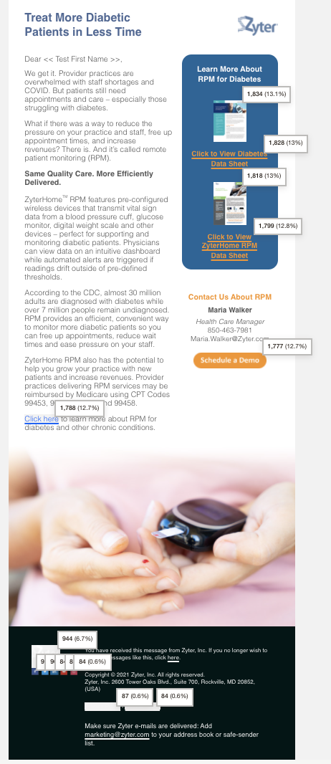
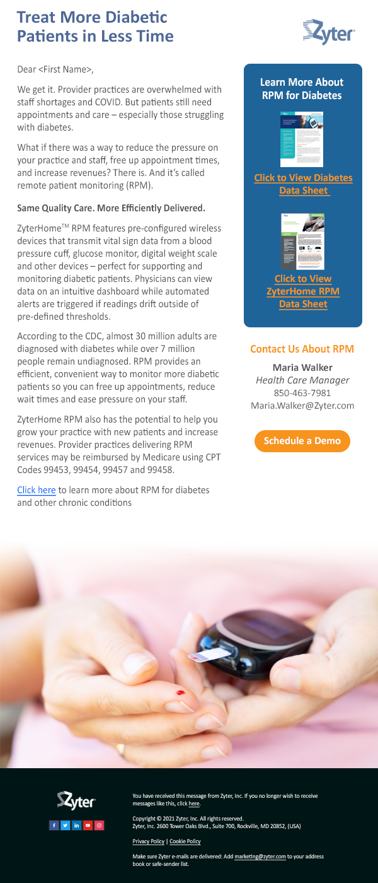
New Mailer: Diabetes
Tuesday (10/12 at 7 PM ET)
10.7% opens
3,405 Opens
4.1% Clicks
36.7% Unique Clicks Per Open
14,029 Total Clicks
89 unsubscribes
781 Bounces
26,153 Successful (97.1%)

Slide 4
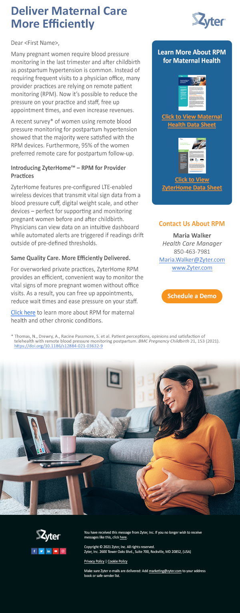
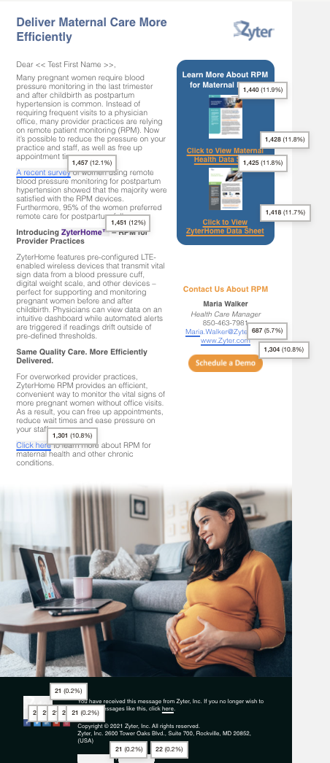
New Mailer: Maternal Health
Wednesday (11/10/21 at 6 PM ET)
10.3% opens
3,151 Opens
3.3% Clicks
31.6% Unique Clicks Per Open
12,080 Total Clicks
67 unsubscribes
727 Bounces
25,836 Successful (97.3%)
URL | Total clicks | Unique clicks
https://www.zyter.com/knowledgecenter/healthcare-specialty-maternal-health/ | 2,868 (23.7%) | 755 (11.5%)
https://www.zyter.com/knowledgecenter/zyterhome-datasheet/ | 2,843 (23.5%) | 744 (11.3%)

Slide 5
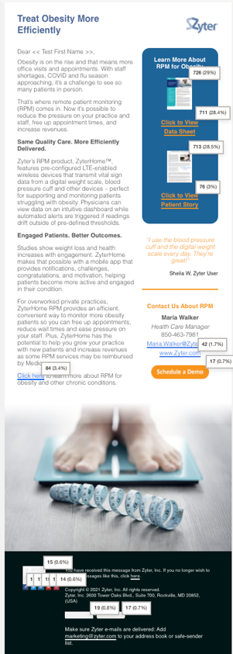
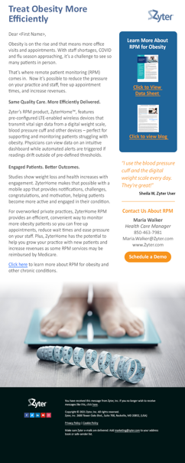
New Mailer: Obesity
Thursday (10/28)
7.7% opens
2,277 Opens
1.7% Clicks
22.3% Unique Clicks Per Open
2,504 Total Clicks
84 unsubscribes
752 Bounces
25,943 Successful (97.1%)
We had 726 unique clicks to download the Obesity Data sheet
URL: https://www.zyter.com/knowledgecenter/improving-obesity-care-for-providers-and-patients/
We had 713 unique clicks to download the ZyterHome Patient Bog
URL: https://www.zyter.com/blog/at-home-with-zyterhome-a-patients-experience/

Slide 6
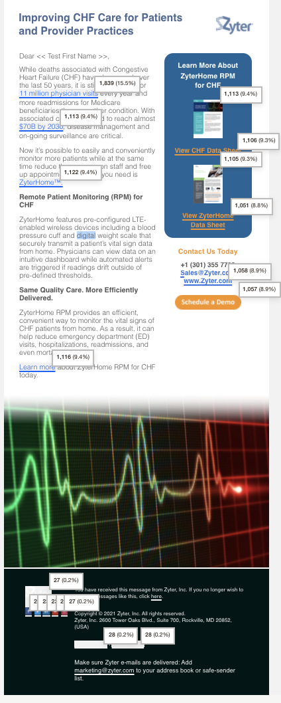
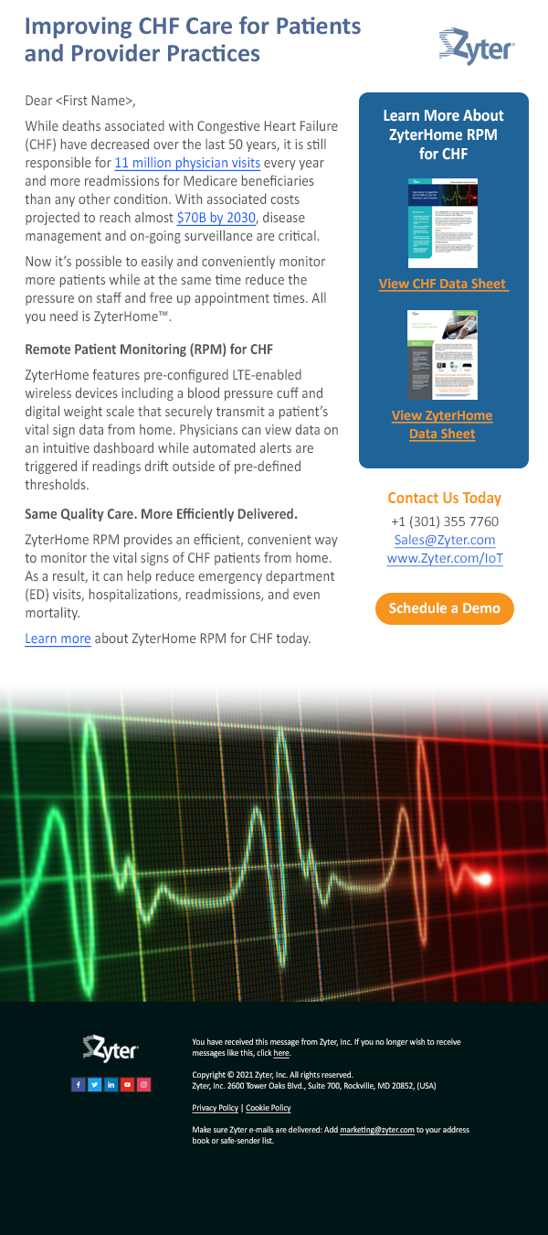
New Mailers: CHF
 | CHF - ZyterHome
 | Tuesday Dec 7 at 6 PM ET
Opens | 21.4%
Opens | 4,954
Clicks | 9.9%
Unique Clicks per open | 46.2%
Total Clicks | 11,883
Unsubscribes | 220
Bounces | 979
Successful Deliveries | 25,779 (97%)
Download Healthcare Specialty Data Sheet | 1,084 (9.4%) unique
Download ZyterHome Data Sheet | 1,076 (9.3%) unique

Slide 7
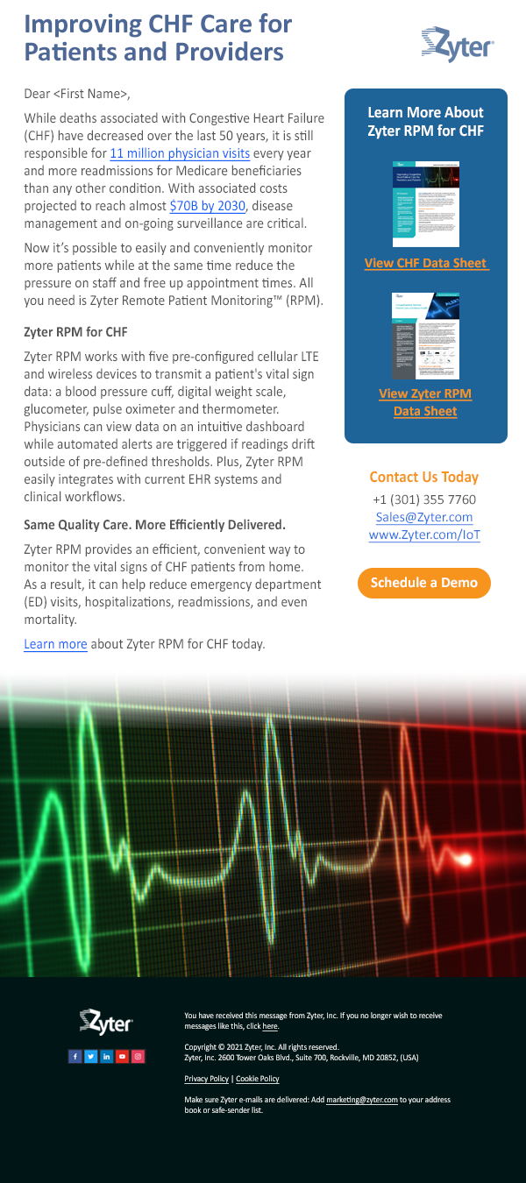
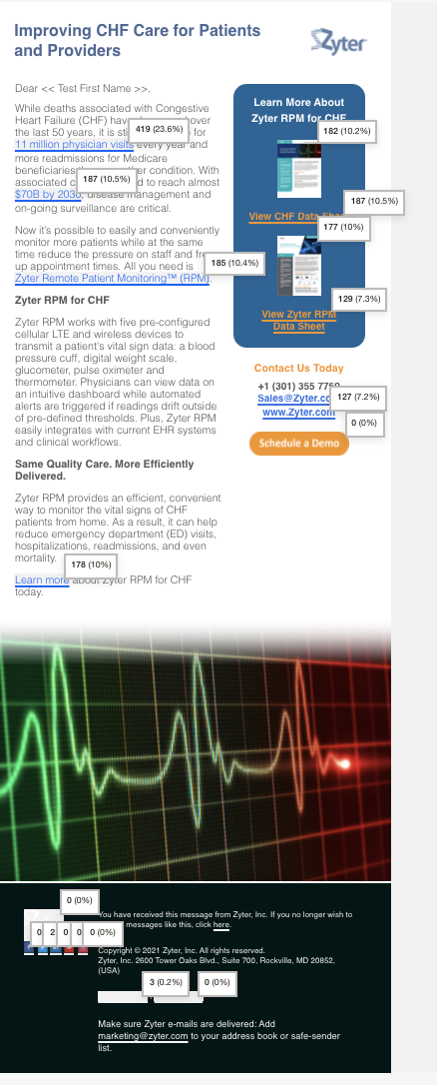
New Mailer: CHF
 | CHF – Zyter RPM
 | Thursday, Dec 9
Opens | 8.9%
Opens | 1,693
Clicks | 2.7%
Unique Clicks per open | 29.3%
Total Clicks | 1,776
Unsubscribes | 47
Bounces | 292
Successful Deliveries | 16,209 (98.2%)
Download Healthcare Specialty Data Sheet | 181 (10.5% unique)
Download Zyter RPM Data Sheet | 179 (10.4% unique)
Click to Zyter RPM Website page | 185 (10.7% unique)

Slide 8
5 Direct Response Mailer Results – As of Dec 3
 | Maternal Health | Obesity | Diabetes | Hypertension | COVID
 | Wednesday 11/10 at 6 PM | Thursday 10/28 | Tuesday 10/12 at 7 PM | Thursday (9/23) | Monday (9/13)
Opens | 10.8% | 7.8% | 11.3% | 8.6% | 12.6%
Opens | 3,383 | 2,427 | 3,528 | 2,771 | 4,158
Clicks | 3.3% | 1.7% | 4.1% | 2.3% | 4.7%
Unique Clicks per open | 30.7% | 21.5% | 35.9% | 27.3% | 37%
Total Clicks | 12,160 | 2,552 | 14,029 | 8,120 | 19,318
Unsubscribes | 70 | 94 | 96 | 127 | 94
Bounces | 784 | 812 | 842 | 807 | 1,011
Successful Deliveries | 25,779 (97%) | 25,916 (97%) | 26,092 (96.9%) | 26,337 (97%) | 26,562 (96.3%
Download Healthcare Specialty Data Sheet | 756 (11.4%) Unique Names | 400 (28.2%) Unique Names | 917 (10.8%) Unique Names | 592 (12.6%) Unique Names | 1,153 (10.7%) Unique Names
Download ZyterHome Data Sheet | 745 (11.3%) Unique Names | 392 (27.7%) Unique Names | 930 (10.9%) Unique Names | 591 (12.6%) Unique Names | 1,134 (10.5%) Unique Names

Slide 9
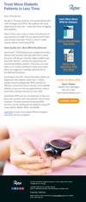
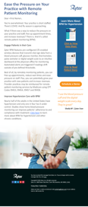
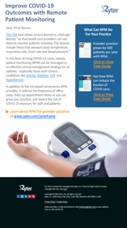
5 Direct Response Mailers

