Slide 1
Zyter Smart Events Case Study

Slide 2
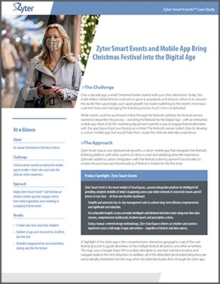
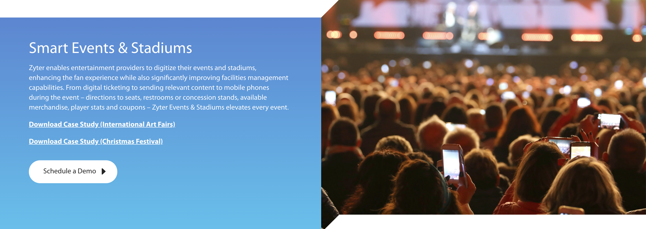
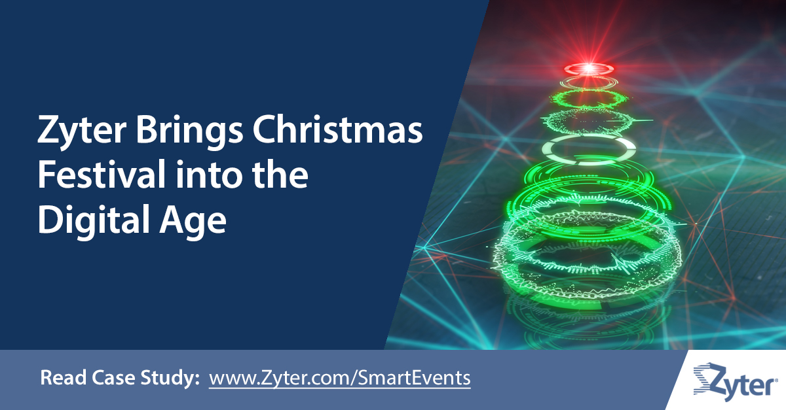
Zyter Smart Events Case Study

Slide 3
Zyter Smart Schools Case Study

Slide 4
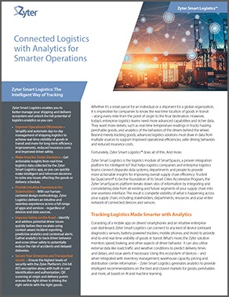
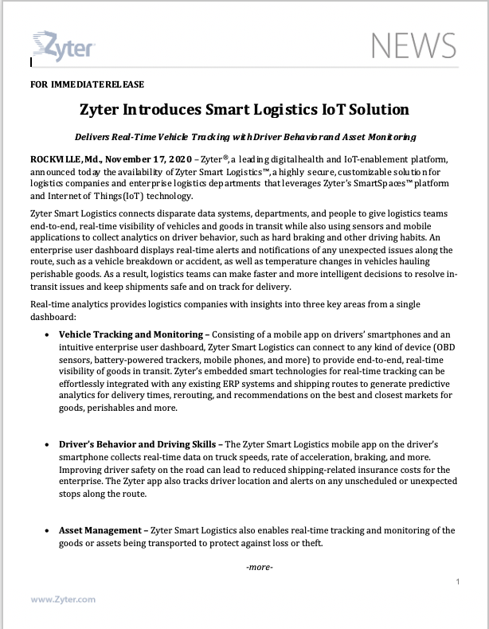
Zyter Smart Logistics Launch

