Slide 1








Zyter Telehealth Launch

Slide 2







Zyter Ghosted Case Study for Zyter Telehealth

Slide 3







Digital Health Video

Slide 4

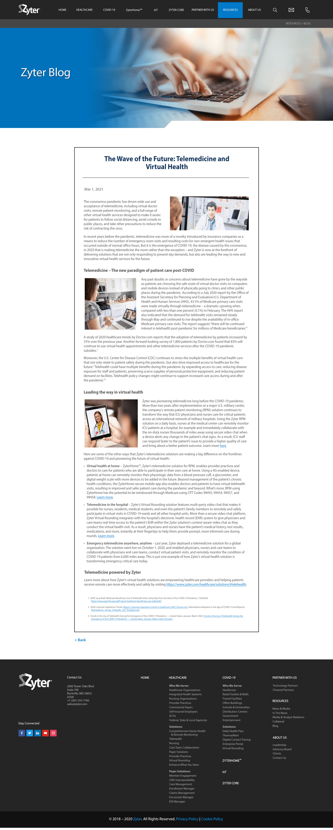

Telemedicine Blog

Slide 5







Telemedicine Blog

Slide 6
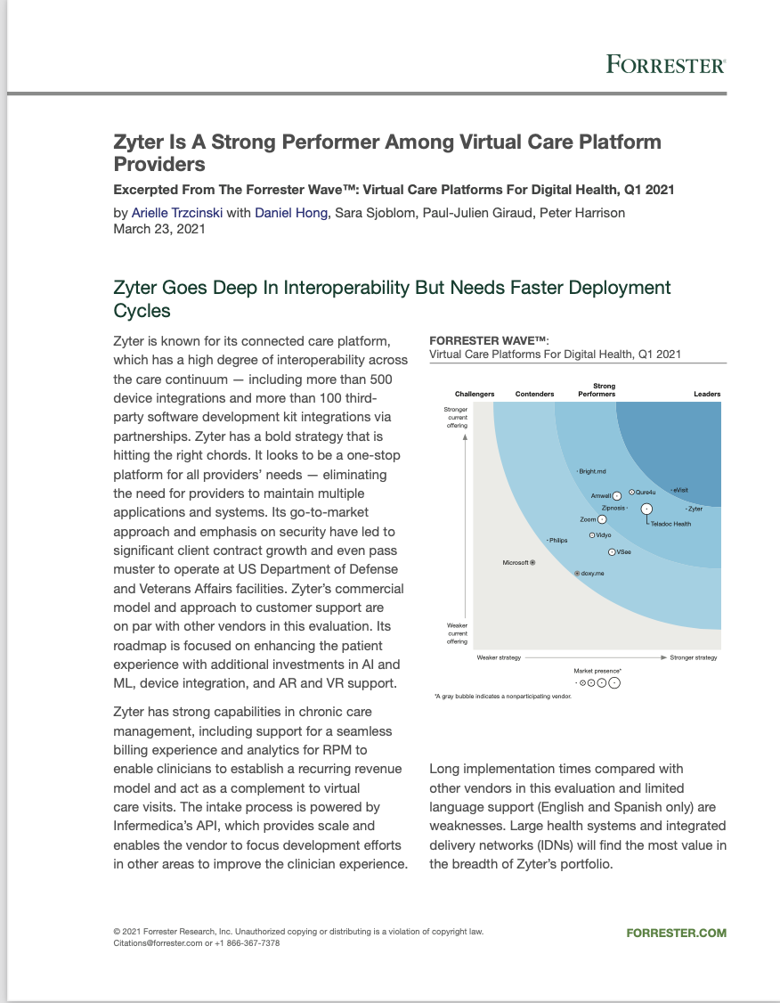

The Forrester Wave:
Virtual Care Platforms for Digital Health, Q1 2021
Full Version of Report - Reprint
Forrester Wave Evaluation Summary

Slide 7
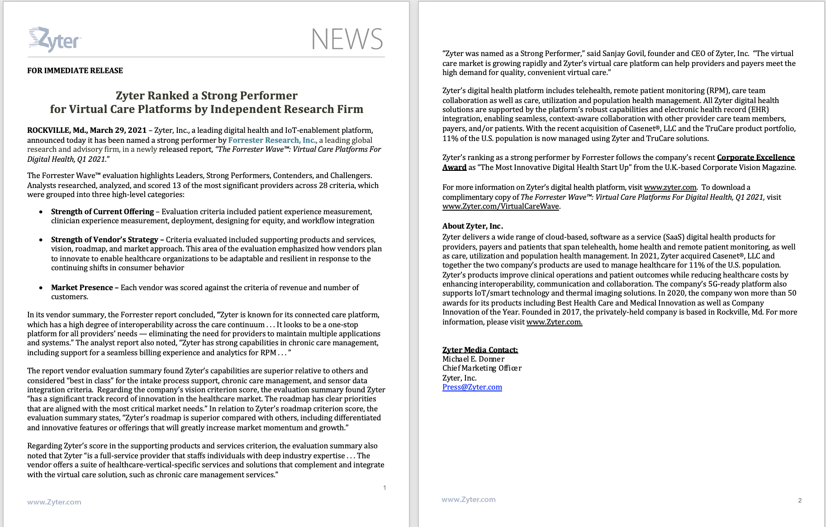
The Forrester Wave:
Virtual Care Platforms for Digital Health, Q1 2021

Slide 8
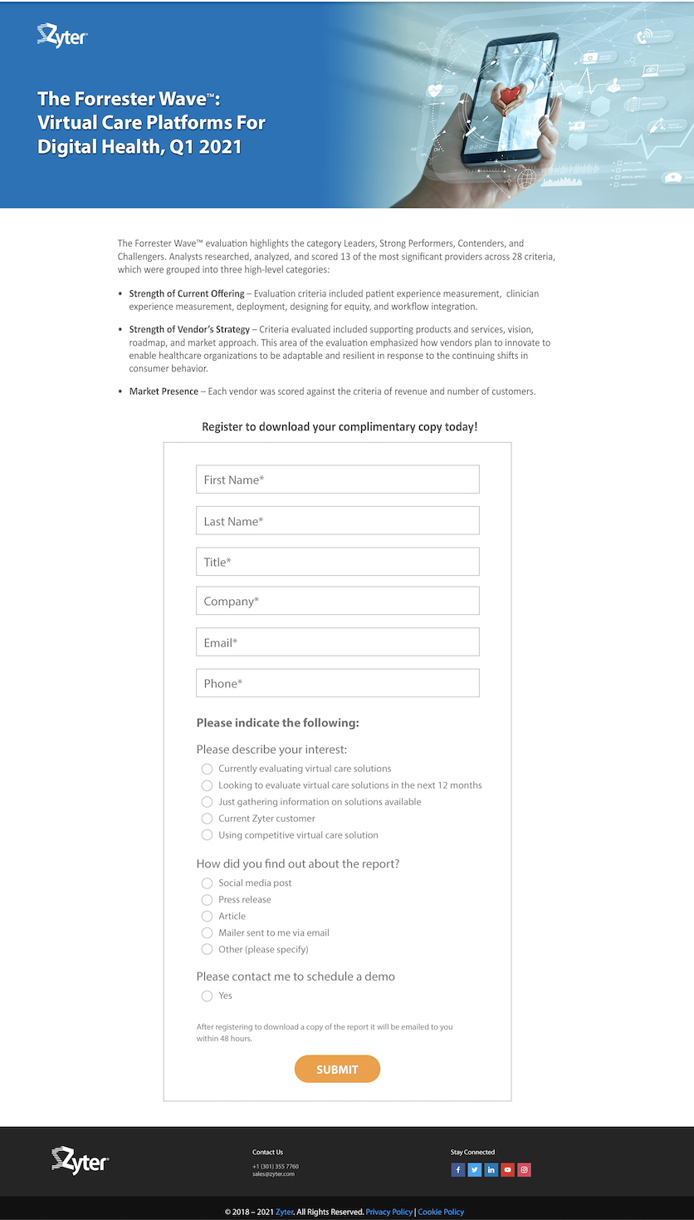

The Forrester Wave:
Virtual Care Platforms for Digital Health, Q1 2021

Slide 9









The Forrester Wave:
Virtual Care Platforms for Digital Health, Q1 2021

Slide 10






The Forrester Wave:
Virtual Care Platforms for Digital Health, Q1 2021

