Slide 1
Arrays

Slide 2









Definition of an Array
An Array is a collection of homogeneous (similar) types of data element in continuous memory.
An Array is a linear data structure because all elements of the array are stored in linear order.

Slide 3
Array declaration
All variables must be declared before they are used in the program. Therefore, the same concept also holds with array variables.
An array must be declared before it is used .During the declaration of an array ,the size of the array has to be specified.
Declaring an array involves the following specifications.
Data Type- The data type means the different kind of values it can store. The data type can be an integer, float, char,or any other valid data type.

Slide 4
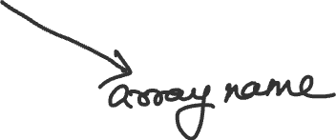


Array name-The name refers to the name of the array which will be used to identify the array.
Size -The size of an array refers to the maximum number of values an Array can hold.
Syntax-data_typearray_name[size]
Example –int salary[10];

Slide 5










Memory representation of an array

Slide 6
Calculating the address of Array elements
Array stores all its data element in continuous memory location, storing the base address(Address of the first element of the array),
Hence, the address of the other data elements can easily be calculated using the base address. The formula to find the address of elements in 1D area is as follows:
Address of data element,A[i] = Base Address(BA)+w (i-lower bound)
i is the index of the element for which the address is to be calculated, BA is the base address of the array A , and w is the size of each element(ex the size of int is 2 bytes, the size of char is 1 byte etc)

Slide 7
Calculating the address of Array element
Array stores all its data elements in continuous memory location, storing the base address( address of the first element of the Array), hence the address of the other data elements can easily be calculated using the base address. The formula to find the address of elements in a 1-D array is as follows:
Address of data element, A[i]= Base address(BA) + w(i- lower bound)
i Is the index of the element for which the address is to be calculated, BA is the base address of the Array A and w is the size of each element( for example the size of int is 2 bytes, the size Of char is 1 byte etc.)

Slide 8













Q. An Array is giving int marks[6]={ 34,53, 87, 100, 98,65}; calculate the address of marks[3] if the base address is 3000.
Sol. It is given that the base address of the array is 3000 and we know that the size of integer is 2 bytes. Hence we can easily find the address of marks[3].

Slide 9
Operations on Arrays
Traversing an array
inserting an element in an array
deleting and element in an array
Searching an element in an array
merging of two arrays
Sorting an array

Slide 10












Traversing an Array
Traversing an array means to access every element in an array exactly once so that it can be processed.

Slide 11















Slide 12
Inserting an element in an array
Insertion in Array can be done in three ways:
insertion at the beginning
insertion at the specified position
insertion at the end

Slide 13





















Insertion at the beginning

Slide 14









Algorithm for insertion in the beginning
The maximum elements that can be stored in the array is defined by size. we should first check if the array has an empty space available to store any element in it or not and then we proceed with the insertion process.

Slide 15
















Continue

Slide 16































Algorithm for insertion at a specified position

Slide 17

















Insertion at the end

Slide 18
Deleting an element in an array
Deletion in an array can be done in three ways :
deletion from the beginning
Deletion from the specific position
deletion from the end

Slide 19
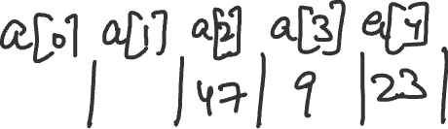









Deletion from the beginning

Slide 20

















Algorithm for Deletion from the beginning

Slide 21



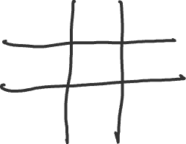

2-D Arrays/Two-dimensional Arrays
2-D arrays are organized in the form of grids or tables. They are collection of 1-D arrays. One dimensional Arrays are linearly organized in the memory.A 2-D array consists of two subscripts:
First subscript-Which denotes the row
Second subscript- which denotes the column

Slide 22
Declaration of two dimensional Arrays
For declaring two dimensional Array we must know the name of the Array, the data type of each element and the size of each dimensional (size of rows and columns).
Syntax- data_type Array_name [row_size][ column_size];
Two dimensional Array is also called an m X n array, as it contains mXn elements where each element in the array can be accessed by i and j, where i<=m and j<=n and where I,j,m,n are defined as follows:
I,j = Subscrips of Array elements,
m= number of rows
n= number of columns

Slide 23





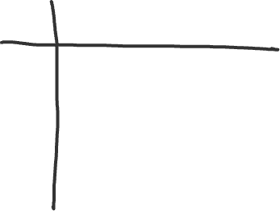


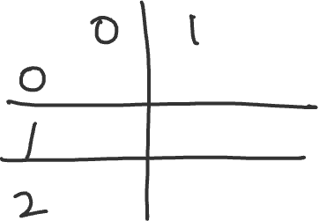





Example
Let us take an array of 3×3 elements. Therefore, the array is declared as: int marks [3][3];

Slide 24


Row major order
In row major order the elements of the first row are stored before the elements of the second, third and n rows. Here the data elements are stored in row by row basis:

Slide 25



Column Major order
In column major order the elements of the first column are stored before the elements of the second, third and n columns. Here the data elements are stored in a column by column basis.

Slide 26
















Elements in row major order

Slide 27

















Elements in column major order

Slide 28
Q. Consider a 25×5 dimensional Array of students which has a base address 500 and the size of each element is 2. Now calculate the address of the element student[15][3] assuming that the elements are stored in
row major order
column major order

Slide 29













Ans.

Slide 30











Column major order

Slide 31
Multidimensional Arrays/N-Dimensional Arrays
A multidimensional Array is also known as an n-dimensional Array. It is an array of Arrays.An n-dimensional array is an m1 X m2 X m3….. array as it contains m1 X m2 X….. Elements. Multi dimensional arrays are declared and initialized in the same way as one dimensional and two dimensional arrays.

Slide 32
Calculating the address of 3D Arrays
Just like 2D arrays we can you store 3-D arrays in two ways, row major order and column major order.
1. Element in row major order
Address([i][j][k]) =Base Address (BA) +w(L3(L2(E1)+E2)+E3)
Elements in column major order
Address ([i][j][k])=Base Address (BA) +w((E3L2+E2)L1 +E1)
Where L is length of index L=Upper bound – Lower bound +1,
E is effective address ,E=i-Lower bound
E1=i-Lower Bound
E2=j-Lower bound
E3=k-Lower Bound

Slide 33
Q. Latest date a 3D Array A(4:12, -2:1,8:14) and calculate the address of A(5,4,9) using row major order and column major order where the base address is 500 and w=4.

Slide 34









Ans.

Slide 35










Row major order

Slide 36
Operations on to the Arrays
Sum
Difference
Product
Transpose

Slide 37























Write a program to read and display of 3×3 matrix.

Slide 38



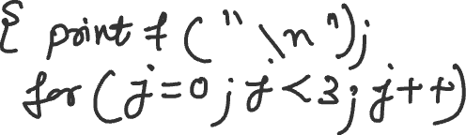













Slide 39
Q Write a program to find the sum of two matrices.
Write a program to find the transpose of a 3×3 metrics.

