Slide 1
Searching

Slide 2
Introduction of searching
Searching means to find whether a particular data item exists in an Array/ list or not.
The process of finding a particular value in a list or an array is called searching.
If that particular value is present in the array, then the search is said to be successful and the location of that particular value is returned by the searching process.
If the value does not exist or we can say that if the value is not present in the array, then searching is said to be unsuccessful.

Slide 3
Searching algorithms
Linear search or sequential search
Binary search

Slide 4
Linear search or sequential search
A linear search is also called a sequential search.
This is very simple technique used to search a particular value in an array.
A linear search works by comparing the value of the key being searched for with every element of the array in a linear sequence until a match is found.
A search will be unsuccessful if all the data elements are read and the desired element is not found.

Slide 5
The following are some important points:
It is the simplest way to search an element in the list.
It searches the data element sequentially no matter whether the array is sorted or unsorted.
Example: let as take an array of 10 elements which is declared as follows:
Int array[10] ={87,25,14,39,74,1,99,12,30,67}

Slide 6



















The value to be searched for in the array is value= 74, then search to find whether 74 exists in the array or not.
if the value is present then its position is returned. Here the position of value= 74 is position=4 ( index starting from zero).

Slide 7





















Algorithm for a linear search

Slide 8









Step 4:

Slide 9
Complexity of linear search algorithm
The execution time of a linear search is O(n), where n is the number of elements in the array.
The algorithm is called a linear search because it’s complex city can be expressed as a linear function, which is that the number of comparisons to find the target item increases linearly with the size of the data.
The best case of a linear search is when the data element to be searched for is equal to the first element of the array.
The worst case will happen when the data element to be searched for is equal to the last element in the array.
In both the cases n comparison have to be made.

Slide 10
Drawbacks of linear search
It is a very time consuming process.
It can be applied only to a small amount of data.
It is a very slow process as almost every data element is accessed in this process, especially when the data element is located near the end.

Slide 11
Binary search
A binary search is an extremely efficient searching algorithm when it is compared to a linear search.
A binary search works only when the array/ list is already sorted.
In a binary search, we first compare the value VAL with the data element in the middle position of the array.
If the match is found, then the position POS of that element is returned; otherwise if the value is less than that of the middle element, then we begin our search in the lower half of the array and vice versa. So we repeat this process on the lower and upper half of the array.

Slide 12
Binary search algorithm
Find the middle element of the area that is n/2 is the middle element of the array containing n elements.
Now, compares the middle element of the array with the data element to be searched.
A. if the middle element is the desired element, then the search is successful.
B. if the data element to be searched for is less than the middle element of the array, then search only the lower half of the array, that is those elements which are on the left side of the middle element.
If the data element to be searched for is greater than the middle element of the array, then search only the upper half of the array , that is, those elements which are on the right side of the middle element.
Repeat these steps until a match is found.

Slide 13


























Algorithm for binary search
Binary _search( ARR ,lower_ bound, Upper_ bound, VAL)

Slide 14









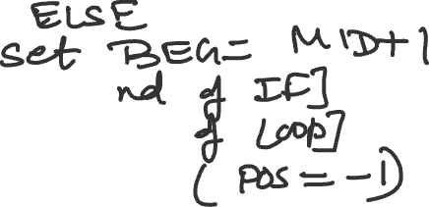








Slide 15



















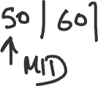









Example-

Slide 16
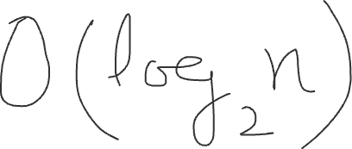
Drawbacks of a binary search algorithm
A binary search requires that the data elements in the array be sorted; otherwise, a binary search will not work.
A binary search cannot be used where there are many insertions and deletions of data elements in the array.
Complexity O(log2n)

Slide 17
Introduction to sorting
Sorting refers to the process of arranging the data elements of an array in a specified order, that is either in ascending or descending order.
Let us take an array which is declared and initialised as:
Int array[]={10,25,17,8,30,3};
Then the array after applying the sorting technique is:
Array[]={3, 8,10,17,25,30};
The two basic categories of sorting methods are:
Internal sorting -it refers to the sorting of the data elements is stored in the computer’s main memory.
External sorting-It refers to the sorting of the data elements stored in the files.It is applied when the amount of data is large and cannot be stored in the main memory.

Slide 18
Types of sorting method
The various sorting methods are:
1. Selection sort
2. Insertion sort
3. Merge sort
4. Bubble sort
5. Quick sort

Slide 19
Selection sort
Selection sort is a sorting technique that works by finding the smallest value in the array and placing it in the first position.
After that it then find the second smallest value and places it in the second position.
This process is repeated until the whole array is sorted.

Slide 20
Pass 1-Find the position POS of the smallest value in the area of N elements and interchange ARR[POS] with ARR[0] . Hanns,ARR[0] is sorted.
Pass 2- Find the position POS of the smallest value in the array of N-1 elements and interchange ARR[POS] with A[1] is sorted.

Slide 21
Algorithm for Selection Sort
Selection Sort (ARR,N)
Step 1: Start
Step 2: Repeat steps 3&4 for I=0 to N-1
Step 3: Call MIN (ARR,I ,N,POS)
Step 4: Swap ARR[I] with ARR[POS]
[End of loop]
Step 5: Exit

Slide 22
MIN (ARR,I,N,POS)
Step 1: Set Smallest =ARR[I]
Step 2: Set POS =0
Step 3: Repeat Step 4 for J=I+1 To N-1
Step 4: IF (ARR[J]<Smallest)
Set Smallest =ARR[J]
Set POS =J
[End of IF]
[End of loop]
Step 5: Return POS

Slide 23





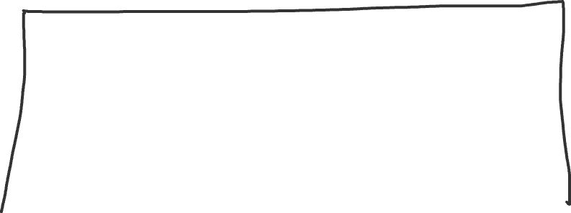




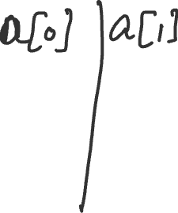








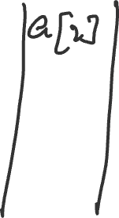



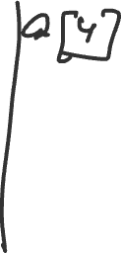

Example-

Slide 24



























Slide 25
Complexity of the Selection Sort algorithm
Selection sort is the Simple technique of sorting in this method if there n elements in the array then (n -1) comparisons or iterations are made. Thus, the selection sort technique has a complexity of O(n

Slide 26
Insertion sort
Insertion sort is another very simple sorting algorithm.
It inserts each element into its proper position in the concluding list.
To limit the wastage of memory or, we can say to save memory most implementation of an insertion sort work by moving the current element past the already sorted elements and repeatedly swapping or interchanging it with the preceding element until it is placed in it correct position.

Slide 27
Insertion sort technique
Pass 1- Initially there is only one element in the list which is already sorted. Hence, we proceed to the next step.
Pass 2- during the first iteration the first and the second element of the list are compared. The smaller value occupies the first position of the list.
Pass 3-During the second iteration the first three elements of the list are compared. The smaller value will occupy the first position in the list. The second position will be occupied by the second smallest element and so on.

Slide 28
Algorithm
Insertion sort(Arr,N)
Step 1: Start
Step 2:Repeat steps 3 to 6 for I=1 to N-1
Step 3: Set POS= Arr[I]
Step 4: Set J=I-1
Step 5: Repeat while J>=0 and POS<Arr[J]
Set Arr[J+1]=Arr[J]
Set J=J-1
[end of inner while loop]
Step 6: Set Arr[J+1]=POS, I=I+1
[end of loop]
Step 7: Exit

Slide 29

















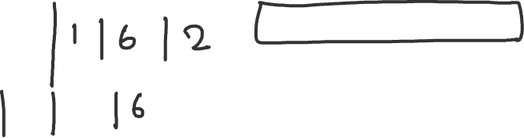

Slide 30
















Example:

Slide 31
















Pass 3

Slide 32






















Pass 4-

Slide 33

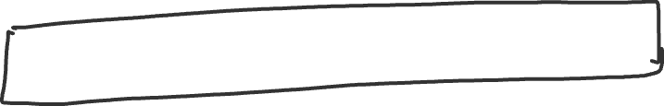














Pass. 6-

Slide 34



























Slide 35
Merge Sort
Merge sort is a sorting method which follows the divide and conquer approach.
The divide and conquer approach is a very good approach in which divide means partitioning the array having n elements into two sub array of n/2 elements each.
If an array has more elements, then it is divided into 2 sub-arrays containing equal elements in them. Conquer is a process of sorting the sub-arrays recursively using merge sort.

Slide 36
Merge sort techniques
If the array has zero or one element in it, then there is no need to sort that array as it is already sorted.
Otherwise, if there are more elements in the array ,then divide the array into two sub-arrays containing equal elements.
Each sub-array is now sorted recursively using merge sort.
Finally , the two sub-arrays are merged into a single sorted array.

Slide 37

































Example

Slide 38













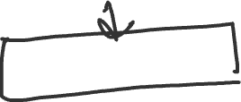
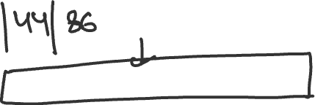


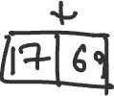

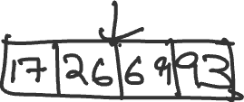

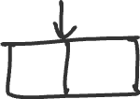



Slide 39


Complexity of merge sort

Slide 40
Bubble sort
Bubble sort is also known as exchange sort is a very simple sorting method.
It works by repeatedly moving the largest element to the highest position of the array.
In bubble sort we are comparing two elements at a time and swapping is done if they were wrongly placed.

Slide 41




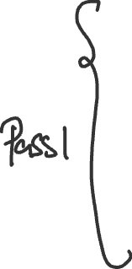















Example

Slide 42

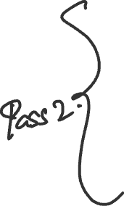








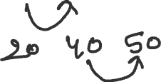


Slide 43





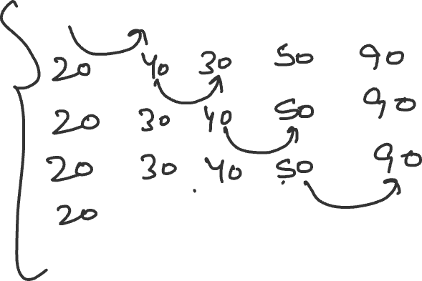




Slide 44














Slide 45




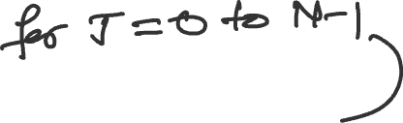


















Algorithm of Bubble Sort

Slide 46
Complexity of the bubble sort
The bubble sort is the most inefficient algorithm and hence it is not commonly used in the best case the running time of the bubble sort is 0(n), that is, when the Array is already sorted. Otherwise it’s level of complexity in average and worst case is extremely poor that is O(n

Slide 47
Quick sort
Quicksort also known as partition exchange sort.
The algorithm uses the divide and conquer approach as we have discussed in merge sort.
Working
An element called pivot is selected from the array elements.
After choosing the pivot element, all the elements of the array lesser than the pivot element will be places on left side and all the elements greater than the pivot element will be placed on the right side of the pivot element. After rearranging all the elements the pivot is now placed in its final position. Thus, this process is Known as partitioning.
Now , the two sub-arrays obtained will be recursively sorted.

Slide 48























Example
Array

Slide 49



























Slide 50







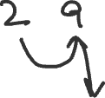









Slide 51



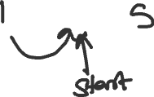
















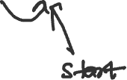


Slide 52

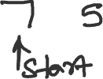












Slide 53



























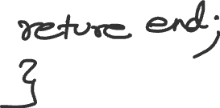

Slide 54
