Slide 1
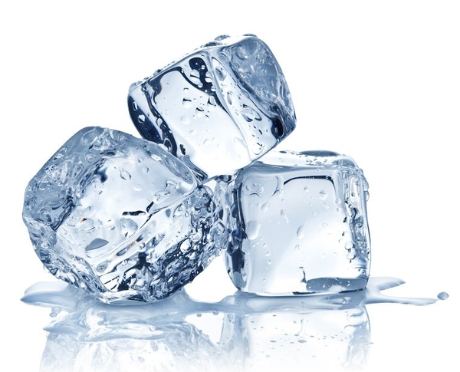
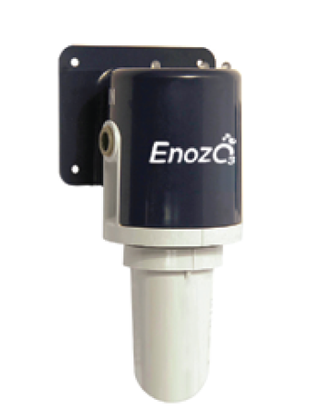

Slide 2
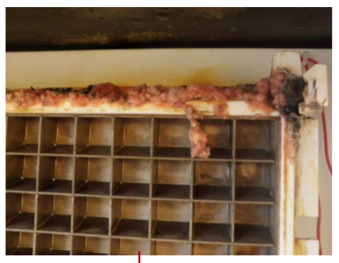
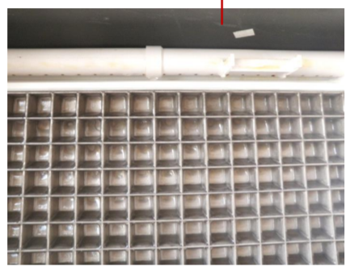
Enozo Ec0₃Ice - Introduction
Ec0₃Ice Antimicrobial Ice Protection Device is a portable, on-demand diamond electrolytic ozone generator that introduces Aqueous Ozone into the water supply for commercial ice machines.
Ec0₃Ice provides a small amount of Aqueous Ozone that works to reduce bacterial levels in water and throughout the ice making process inside of the ice machines.
A residual amount of Aqueous ozone gets trapped inside the ice as it is manufactured, allowing for your ice product to be bacteria free while remaining tasteless, odorless, and safe for consumption.
Two months using Ec0₃Ice. Same evaporator in pictures.

Slide 4
Enozo Ec0₃Ice Basics
Attaches quickly and easily to the incoming water line of ice machine
Runs silently and automatically
Uses an operator-replaceable, “twist-on” electrolytic cartridge;
lasts 6 to 24 months on average
LED indicator lights show status and tell when it’s time to replace the cartridge
Ec0₃Ice was created to protect ice….because……

Slide 5
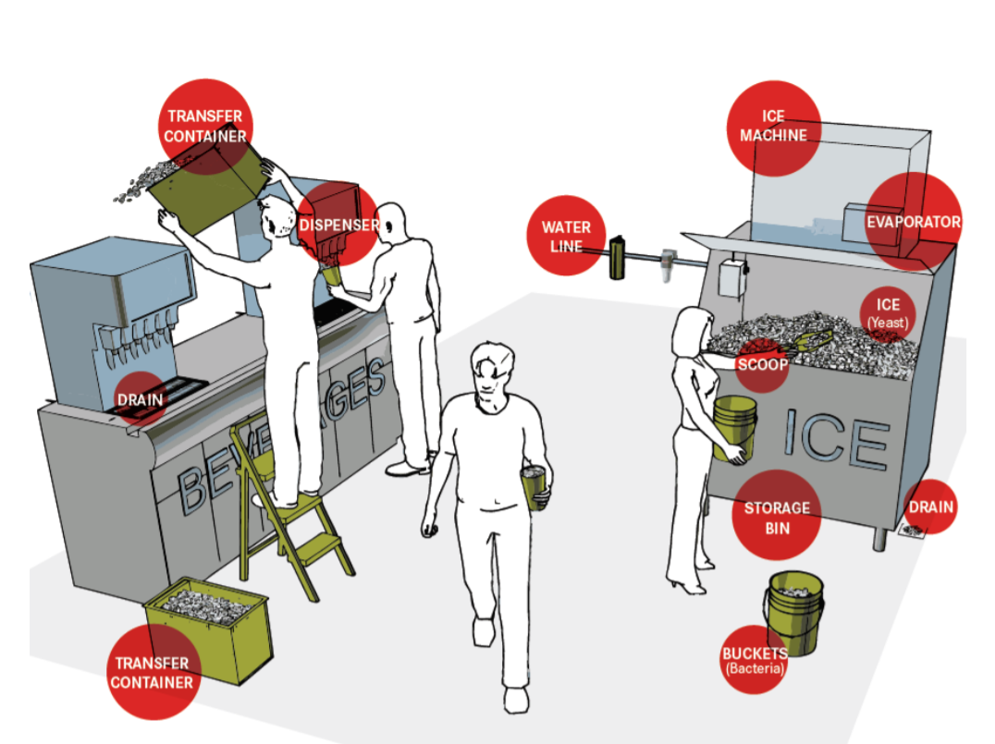

Slide 6
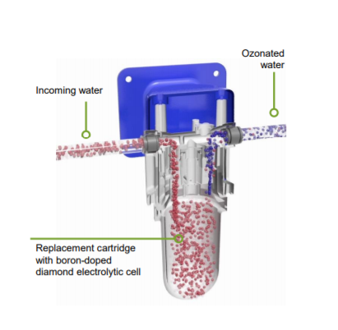
The Solution- Enozo Ec0₃Ice
Ec0₃Ice Antimicrobial Ice Protection uses a unique, industrial diamond-based technology to create a very small but effective amount of pure, aqueous ozone--nature’s own sanitizer.
Ozonated water circulates throughout the system, killing microbes on every surface it touches and retarding regrowth.
The aqueous ozone reduces slime build-up on evaporator, pump, sump, water curtain, hoses, pipes & much more.
A residual amount of ozone gas infiltrates hard-to-reach places.

Slide 7
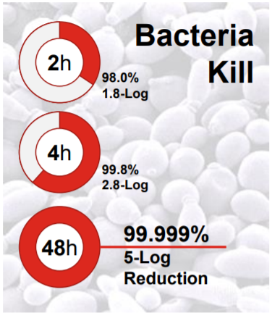
Enozo Ec0₃Ice- KILLS Microbes
Ec0₃Ice Antimicrobial device is PROVEN to:
Dramatically reduce the amount of bacteria, mold and yeast on icemaking and ice-storage surfaces.
Reduce the risk of ice contamination by microorganisms.
Inhibit formation of biofilm on ice contact surfaces.
In side-by-side machine testing, EcO3Ice kills 99.999% (5-log reduction) of E.coli after 48 hours.

Slide 8
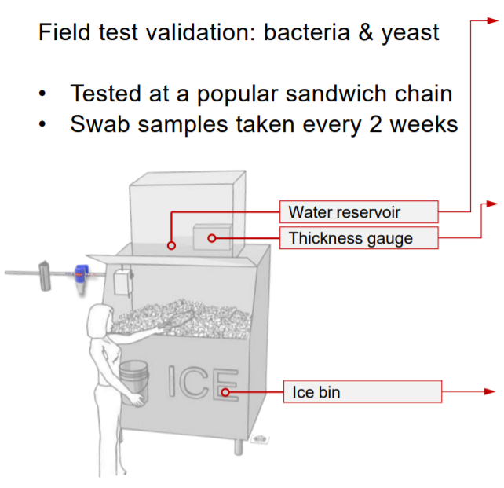
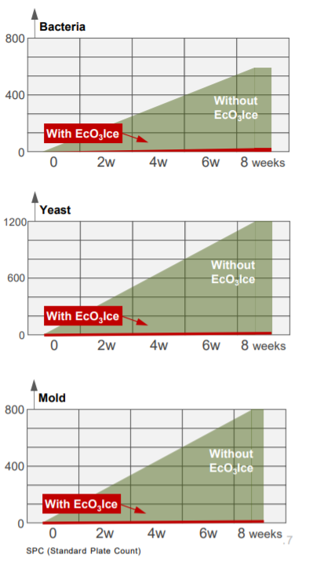
Enozo Ec0₃Ice- KILLS Microbes

Slide 9
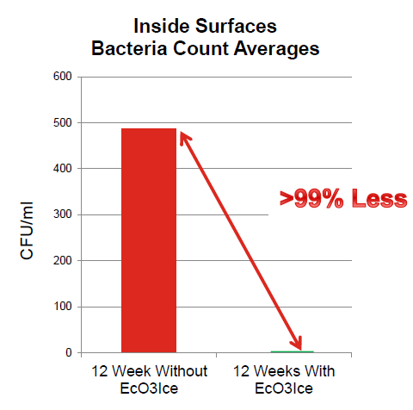
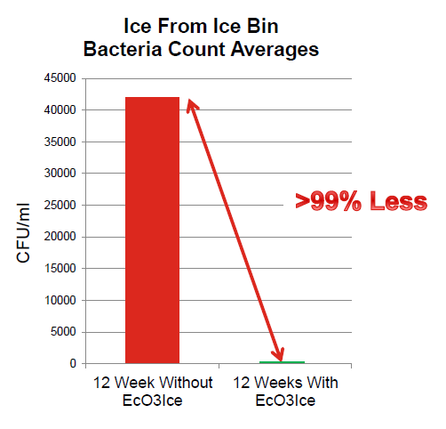
SANDWICH MAKING & BREAD BAKING CHAIN
Location: USA
Year: 2016
Test population: 1 restaurants
Length of test: 12 weeks without Ec0₃Ice v/s 12 Weeks with Ec0₃Ice
Results inside Ice machine surfaces: up to 99.8% microbial reduction after 12 weeks
Results on Ice quality: up to 99.997% microbial reduction after 12 weeks
Note: USEPA recommended minimum level for drinking water is 500 cfm/ml

Slide 10
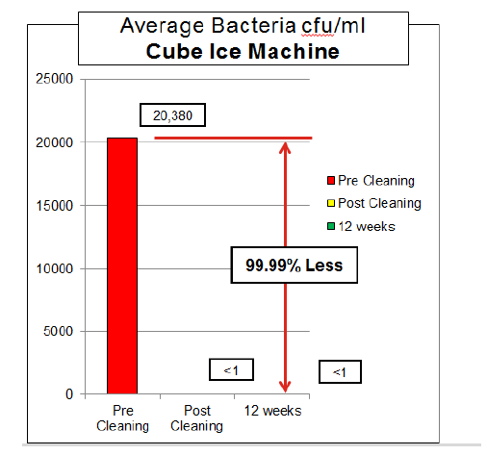
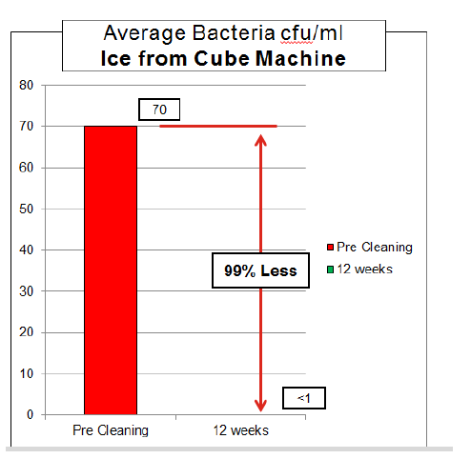
CONVENIENCE STORE CHAIN – CUBE ICE
Location: Tennessee
Year: 2017
Test population: 1 restaurants (with on site pizza bakery)
Machine: Cube Ice
Length of test: 12 weeks Results inside Ice machine surfaces: 99.99% microbial reduction after 12 weeks
Results on Ice quality: 99% microbial reduction after 12 weeks

Slide 11
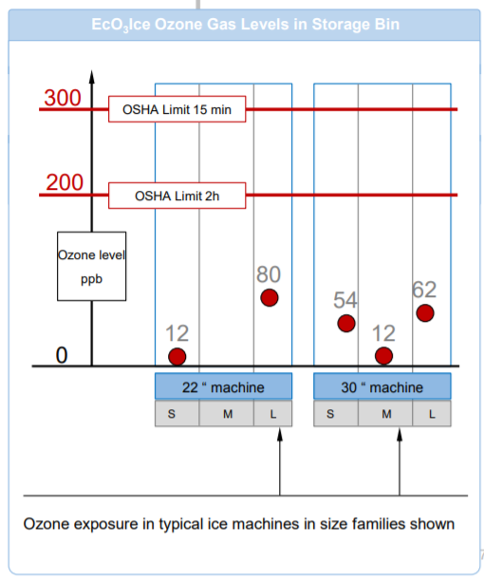
Enozo Ec0₃Ice- Is it Safe?
Stated opinion of a third-party, government regulation expert:
EcO₃Ice-created ozone levels are “well below thresholds of concern for ozone in either professional or consumer use,” in all key areas:
1. Ozone gas in storage bin
2. Handling of ice
3. Ozone gas near consumer
4. Ingestion of ice

Slide 12
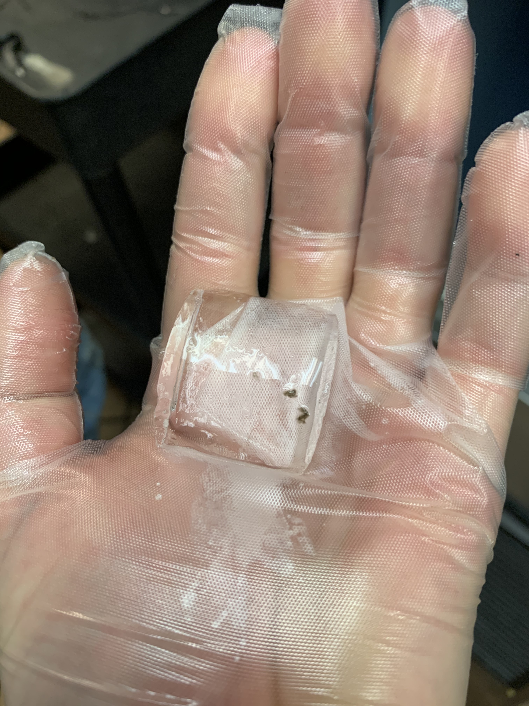
Enozo Ec0₃Ice- Does it Harm Beverage?
EcO₃Ice destroys compounds which cause odor and can negatively affect the taste of water and ice
Ozone is used to reduce contamination, taste and odors in drinking water worldwide
EcO₃Ice produces a cleaner, better ice cube with a positive effect on quality and consistency of beverages
You wouldn't serve bacteria in Food, why would you serve it in ice?

Slide 13
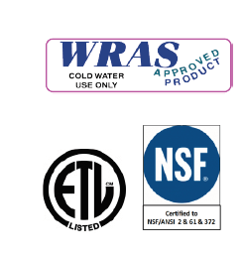
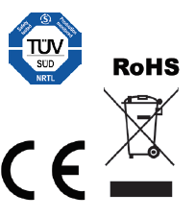
Enozo Ec0₃Ice- Certifications & Approvals
Ec0₃Ice has approvals for compatibility with the following brands of ice machines and the following certifications:

Slide 14
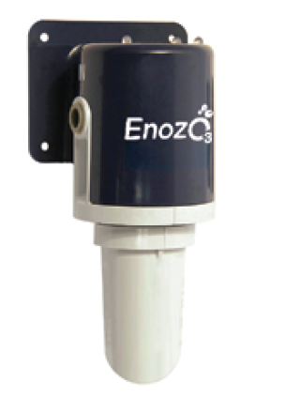
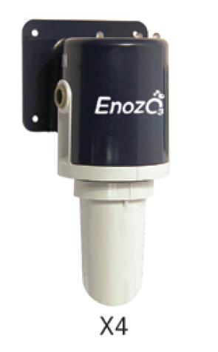
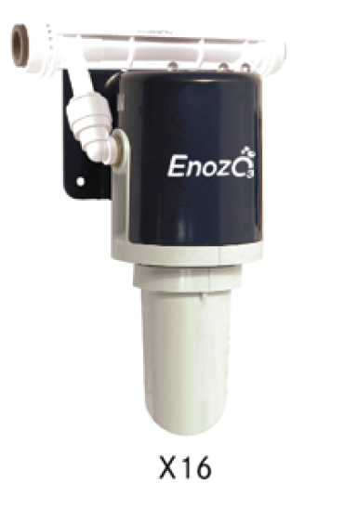
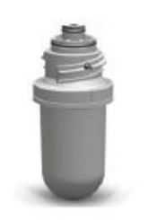
Enozo Ec0₃Ice - Model Selection
There are FOUR models of the Ec0₃Ice product to accommodate the wide variety of flow rates for commercial ice machines.
All four models are the same price to distribution partners.
The Ec0₃Ice replacement cartridge fits on all four models of Ec0₃Ice.
X1
X8
Cartridge
NOTE: All models of Ec0₃Ice are dependent upon flow rate of ice machine. For proper sizing, refer to each model spec sheet or go to enozo.com

Slide 15
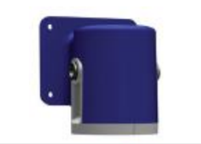
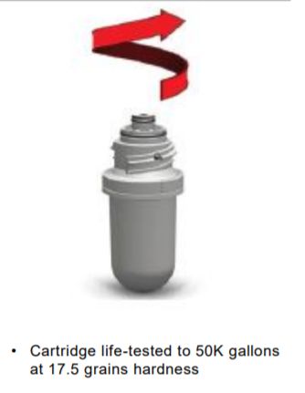
Enozo Ec0₃Ice- Cartridge Life & Replacement
Cartridge life depends on 2 factors:
1. Volume of water flowing through (i.e., amount of ice being made)
2. Quality of water (i.e., harder the water, shorter the life)
“Your mileage may vary,” within expected range of 6 to 24 months
Red LED light on head unit indicates when cartridge requires replacement
For simplicity, Enozo recommends replacing the cartridge at same interval as the ice machine’s water filter cartridge

Slide 16
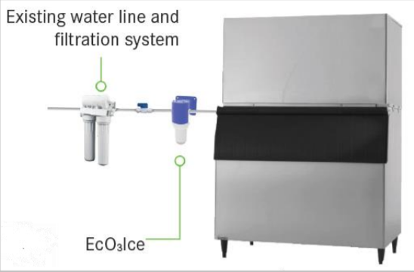
Enozo Ec0₃Ice - Requirements
EcO₃Ice installs in 15 minutes or less
Integrated mounting plate
Requires 110v outlet. Ec0₃Ice wall-wart plug can be applied to 100v or 208v power source.
Enozo EcO₃Ice plug comes with international outlet adaptors
Must be installed “down stream” of any filtration device
For best results, use standard carbon-type water filtration
EcO₃Ice is ONLY installed on new or recently deep cleaned/sanitized ice machines

Slide 17
Enozo Ec0₃Ice - Pricing and Warranty
Enozo EcO₃IceWarranty:
1 year, parts-only, on head unit
90 days parts-only on cartridge
Normal use exclusions apply, per Operating Manual
For information regarding use on other machines, please contact Enozo.
OEM Ice Machine Warranty:
Not impacted by use of EcO₃Ice when installed on ice machines listed as “Recommended” on Enozo literature.
Ec0₃Ice Global MAP Price: TBA
Ec0₃Ice Replacement Cartridge Global MAP Price:TBA

