Slide 1
Tobacco & Nicotine

Slide 2
NICOTINE ADDICTION
Understanding Nicotine Addiction
  Cigarettes are highly efficient, extremely well engineered nicotine delivery devices
  Nicotine reaches the brain in seconds which contributes to its addictive nature
  Each puff also carries with it more than 4000 toxins and about 60 carcinogens
  Average one pack a day smoker takes about 70,000 puffs a year
Notes:
Cigarettes are an extremely well engineered device
The speed at which nicotine reaches the brain (within seconds) contributes to its addictive nature
Each puff also carries with more than 4000 toxins and about 60 carcinogens
Smokers learn to associate smoking with environmental cues, which alone can lead to relapse at a later point

Slide 3
Tobacco Smoke Contents
Formaldehyde – commonly used to preserve dead bodies
Arsenic – used to kill rats
Ammonia – used to clean toilets
Acetone – used to remove nail polish
Carbon Monozide – in car’s exhaust, by-product of used Oxygen
Hydrogen cyanide – a poison used to kill

Slide 4
NICOTINE ADDICTION
Understanding Nicotine Addiction
  Acute short-term effects of nicotine
    Stimulates the dopaminergic “pleasure pathway”
    Increases attention, memory, the speed of information processing and learning especially in the context of low environmental demand
    Anti-anxiety, anti-pain and anti-depressant effects (prompting use during stress)
    Increases metabolic rate, decreases appetite
    These effects encourage a tendency to “self-medicate”
  This is positive reinforcement

Slide 5
NICOTINE ADDICTION
Understanding Nicotine Addiction
  Neurobiologically, in the acute phase, nicotine
    Competitively binds nicotinic acetylcholine receptors (nAChRs) causing prolonged activation compared to acetylcholine
    Releases dopamine, norepinephrine, serotonin
    Releases endogenous opioids
    Releases glutamate
    Release GABA

Slide 6
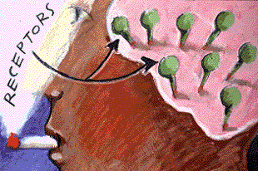
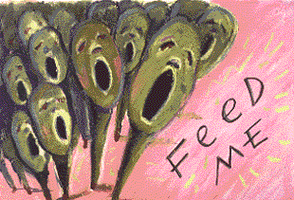
NICOTINE ADDICTION
Understanding Nicotine Addiction
  Chronic stimulation and desensitization leads to up-regulation of nicotinic receptors
  When nicotine leaves the body, these excess excitable nicotine receptors cause significant cravings and withdrawal symptoms
Notes:
Craving, dysphoria, irritability, insomnia, headache, depression, impaired concentration
-(can last for from days to weeks) that can lead to relapse
Hyperexcitability explains why first cigarette after abstinence provides more intense pleasure
Images :Courtesy Dr.Henningfield NIDA website

Slide 7
NICOTINE ADDICTION
Bupropion
  INTRODUCTION
    First-Line Agent for Smoking Cessation
    Exhibits both noradrenergic and dopaminergic activity
    Antagonist of high affinity nicotinic acetylcholine receptors
    Approved for this reason by the FDA in 1998
    Efficacy in smoking cessation is independent of its antidepressant effects
Notes:
U. S Dept of Public Health Clinical Practice Guideline- approved based on 2 large multi-center randomized control trials
- Dopaminergic activity may be relevant given nicotine’s stimulatory effect on dopaminergic pathways in the mesolimbic system of the brain

Slide 8
NICOTINE ADDICTION
Varenicline
  CONS
    Nausea is common (almost 30% in patients treated at 1mg BID)
      Discontinuation rate due to nausea was 3% during 12 weeks of treatment
      It should be taken after eating and with a full glass of water
      Can be reduced by decreasing the dose
    Other side effects that led to discontinuation were headache (0.6%), insomnia (1.2%) and abnormal dreams (0.2%)

Slide 9
NICOTINE ADDICTION
The "Five R" Model for Enhancing Motivation in Tobacco Users Not Willing to Make a Quit Attempt Now
Relevance: Encourage the patient to indicate why quitting is personally relevant.
Risks: Ask the patient to identify potential negative consequences of tobacco use.
Rewards: Ask the patient to identify potential benefits of stopping use.
Roadblocks: Ask the patient to identify barriers to quitting.
Repetition: This motivational intervention should be repeated every time an unmotivated patient meets with a clinician. Tobacco users who have failed in previous quit attempts should be told that most people make repeated quit attempts before they are successful.

