Slide 1



Motivating Nicotine addicts to quit with power
An effective strategy for churches and small groups
From FrameWork Health

Slide 2

OVERVIEW . . .
CMATCH – Case Managed Approach to Tobacco Cessation Help -- located on www.LivingSmart.Live, is a model that will provide support to tobacco cessation coaching through 14 days of instruction in lifestyle change, motivation, and encouragement, using a wholistic approach, to individuals while they are supported by initiatives of churches or other helping non-profit organizations in various ways. It will coach participants thereafter for at least 12 months.
It is designed to engage church or organization members in health promotion without the requirement of formal training, but the employment of a willing and spiritually-dedicated heart. Orientation and promotion materials are provided to recruit participants in Taking Control.

Slide 3
When God bestowed spiritual gifts on His children, He didn’t bless any single individual with all of them. He intended that we use them in concert with others to reveal a glimpse of Jesus and His character.
“As we use our gifts in harmony with others, an unmistakable image begins to emerge, a picture of Christ so rich that it instinctively stirs the hearts of all who witness it.” (Shawn Boonstra in Authentic (2019)

Slide 4
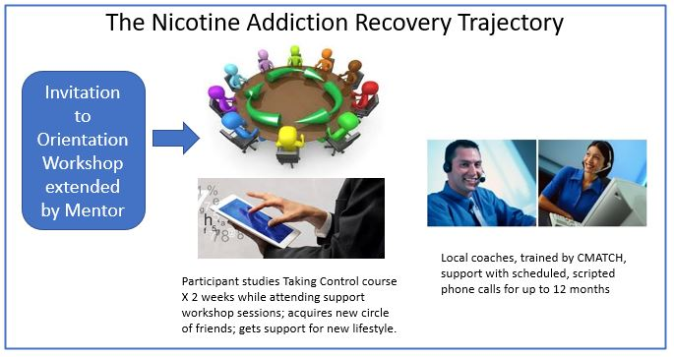

Slide 5
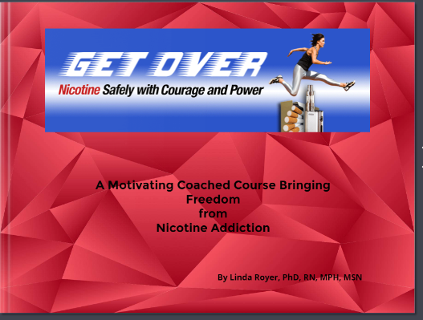
Taking Control is a video online

Slide 6
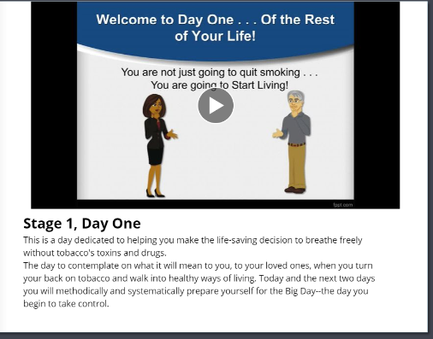
Coaching Video

Slide 7
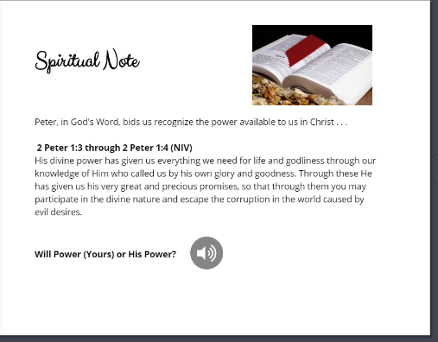
The Third dimension

Slide 8

Required ingredients of team for intervention
hospitality
a caring, loving spirit
some general knowledge of the problems of addiction and effective interventions
knowledge of leading a discussion and facilitating constructive interaction
consistent and reliable scheduling and leadership
sensitivity to opportunities for introducing a spiritual dimension

Slide 9

Smoking Cessation Support Programming Made Easy for Churches and Groups to Conduct
Designed to Coordinate with Participant’s Engagement with Taking Control.
Method
Two Preparation Sessions enhance the self-help motivational program, Taking Control, which is used daily at home for 14 days. From this little workshop or seminar group support may be organized or helping partnerships formed.
(Refer to the Workshop Outline on Website)
“Let’s Begin to Quit” Workshop

Slide 10

organize
The church(s) or groups will organize for immediate and periodic support by mentors to reinforce Taking Control coaching online.
Set a schedule for:
  Promotion of 4-6 day “Let’s Begin to Quit” workshop,
  Training/Orienting a team of mentors,
  Planning hospitality activities and orienting volunteers,
  Frequency and duration of support sessions on-going,
  Location
When the 2-week intervention is completed, then scheduling support sessions on a quarterly pattern will provide a reliable resource for the community, reinforcement for those newly free of tobacco, and an opportunity for them to help others. (Bring CMATCH graduates into the helping team.)

Slide 11
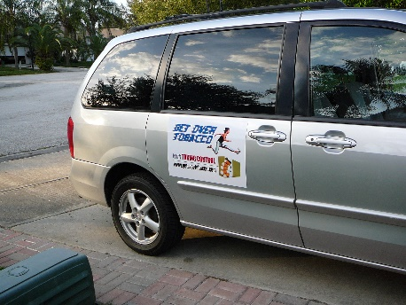
Inviting & gaining Recognition
INVITE
Invitations are one-to-one in a f2f manner (Every Member Model)
Access to the intervention must begin with attendance to first “Let’s Begin to Quit” session
PROMOTE
Advertising in community media; signage on sponsor’s property
Interviews on radio and/or TV to inform the community of the resource
Information sharing by pastor to other Christian churches, the chaplaincy of local hospitals, posters or leaflets to local industries, informing primary health care providers (physicians, nurses, dentists, health department)
Negotiate for referrals from Primary Healthcare Providers.
Inform local voluntary agencies about your ministry(American Cancer Society, American Lung Association, American Heart Association, United Way members, other community coalitions, etc.)

Slide 12
Being flexible
CMATCH offers the capability of conducting this intervention flexibly without altering the coaching material or the timeline.
Where desiring participants lack transportation to the workshops (and transportation aid is lacking), they may attend online through video conferencing with the workshop group and still have access to the necessary coaching files (Participant Workbook, assessments, and some specific articles). A Phone Coaching script, with assessment for enrollment, is posted on the Sponsoring Leader’s Resource webpage, which can be used by a coach or the mentor. If the individual lacks access to computer or internet, it is the role of the Mentor to assist with that. If the individual lives off the grid, the Mentor may take them to a connected source like the library.
Ingenuity Prevails!

Slide 13

Social design
The key is to make friends . . .
Schedule a Vegetarian Potluck meal and a motivating movie (there are some on YouTube) for participants. Organize a support group from the attendees and reach consensus on a schedule of subsequent meetings.
At or near the 14th day of online Taking Control participation, plan a “graduation” ceremony to celebrate their victory. A motivating video is available for this occasion on the website.
Schedule a Vegetarian Celebration Banquet for end of 3rd month for those in the tobacco cessation program; highlight successes and reward them, encourage continuation with support group. Those who struggle reaching success and contemplators of action are invited, this may motivate them to greater determinism and to Action—leading to participation in the next “Let’s Begin to Quit” with Taking Control.
Family-centered activities that showcase positive relationships.
Regular exercise programs: walking, swimming, softball games, aerobics, etc.

Slide 14


Extended Phone coaching
Phone Coaching is begun during or shortly after the “Let’s Begin to Quit” workshop sessions end.
The calls are outbound, scripted, and scheduled by the Coach and the Participant.
Contact is progressively less frequent (2-3 times/week in the first month) over 12 months with at least 16 calls made total.
Observation and research has noted that those previously addicted to nicotine are apt to relapse within the first 3 months of abstinence. If they are encouraged in a caring manner and held accountable from call to call, they are likely to be more successful in the new health behaviors.

Slide 15

Imagine the results!
COST:
Free to the guest participants
$150-200 donation to the CMATCH program by the church/organization /event is suggested
Visit www.LivingSmart.Live
Framework Health, Inc. is a non-profit organization with a foundation designation, located in Staunton, Virginia

