Slide 1

How to Change
Behaviors
©Arlene R. Taylor PhD
www.arlenetaylor.org
Brain References

Slide 2
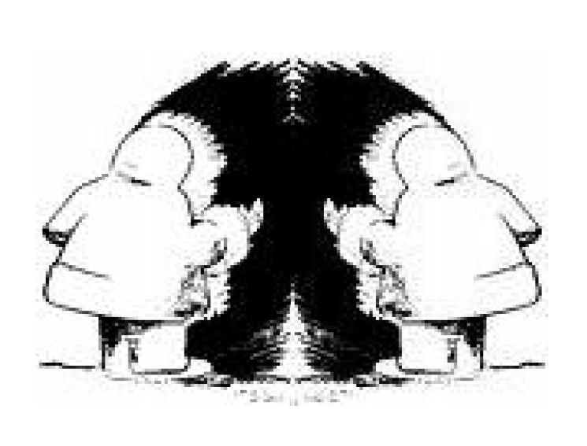
BRAIN TEASERS . . .
What Do You REALLY See?

Slide 3
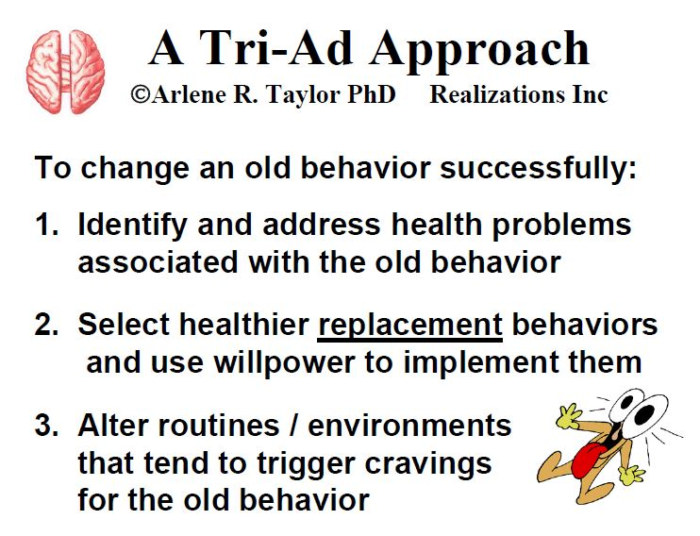
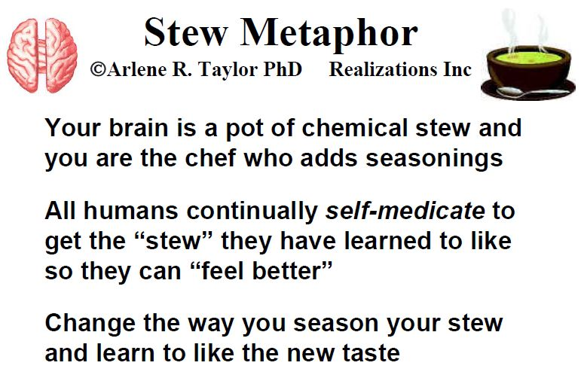
A Tri-ad approach to behavior change

Slide 4
I am a habit
It is mighty hard to shake me, in my brawny
arms I take thee, I can either make or break
thee - I am habit.
Through each day I slowly mold thee, soon
my tightening chains enfold thee, then it is
with ease I hold thee - I am habit.
I can be both good and vile, I can
e'er be worth your while, or the
cause of your decrial - I am habit.
Oft’ I've proved myself a pleasure, provided myself a priceless treasure, or a menace past all measure - I am habit.
Harmless though I sometimes seem, yet my strange force is like a magnet, like a great and greedy dragnet - I am habit.
Though you sometimes fear or doubt me, no one yet has lived without me, I am present all about thee - I am habit.
Choose me well when you are starting, seldom is an easy parting, I'm a devil or a darling - I am habit.
--Anonymous

Slide 5
Will power thru deprivation rarely works well for you
That’s why old routines and environment must be changed
The old “soup seasoning” must be changed
Live a balanced high-level wellness Lifestyle
Regular nutritious meals
Regular exercise
Adequate sleep
Work and Play
Drink plenty of water
Best of all,
Build a relationship with your Lord Jesus for REAL POWER!

