Slide 1
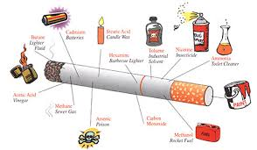
Taking Control – with Power
Through the Support of Mentoring, Loving Church Members

Slide 2


A Need We Can Respond to . . .
Smoking rate--National Average = 21% (40 million)
Tobacco use is greater in populations that are:
  Low socio-economic level
  High school or less education
  Stressed; have little hope
Smoking-caused diseases result in $96 billion in health care costs annually
480,000 deaths in US/year from smoking-
related diseases (1 in 5)
4.9 million middle and high school students
used tobacco products in 2018
https://www.cdc.gov/tobacco/data_statistics/index.htm

Slide 3


Health Ministry Opportunity
One that all adults can participate in . . .
Requires little training, but a commitment of hospitality & nurturing
Free to the participant; very little cost to the church
Must show commitment to regular scheduling and follow-through
The CMATCH Suite
Taking Control
“Let’s Begin to Quit” Workshop
Phone Coaching
Mission Field at Home

Slide 4

The Intervention Design
Taking Control is a 14-day Coaching Program online at www.LivingSmart.Live/CMATCH.
Two Options:
  1) Watch daily videos, download printed guides & supporting audio files
  2) Audio only (download files) & download printed guides
While the participant is coached with Taking Control, the church provides a “workshop” – “Let’s Begin to Quit” -- for support to bring them together with mentors as friends, who augment the wholistic teachings of Taking Control.
The natural progression is to include the participants in relevant church activities and form lasting friendships.
> All volunteers will be oriented/trained for their role

Slide 5

Recruitment
You Are Going to Invite Them . . . And Here is How Easy It Is . . .
How will we get people to come?

Slide 6

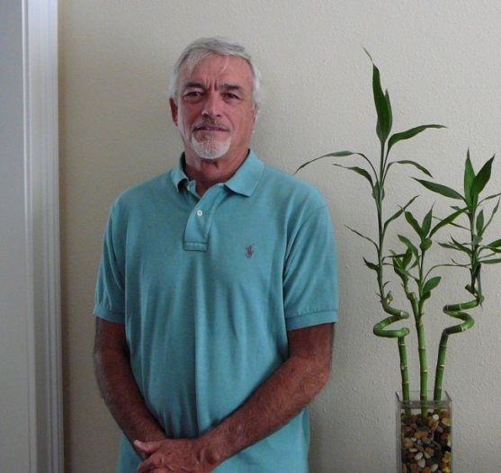
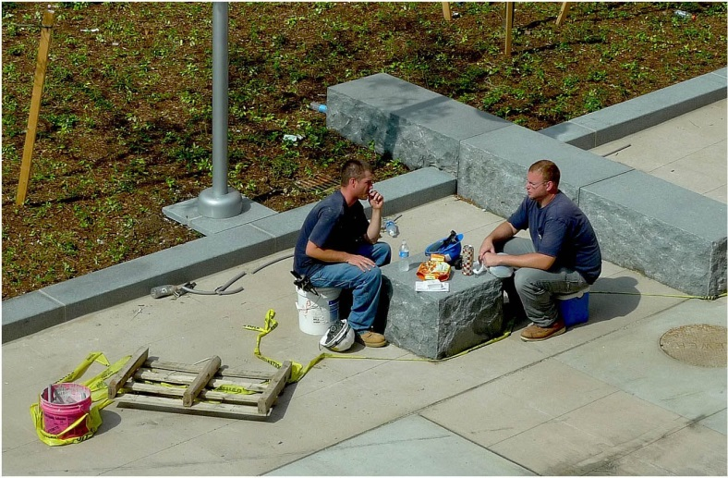
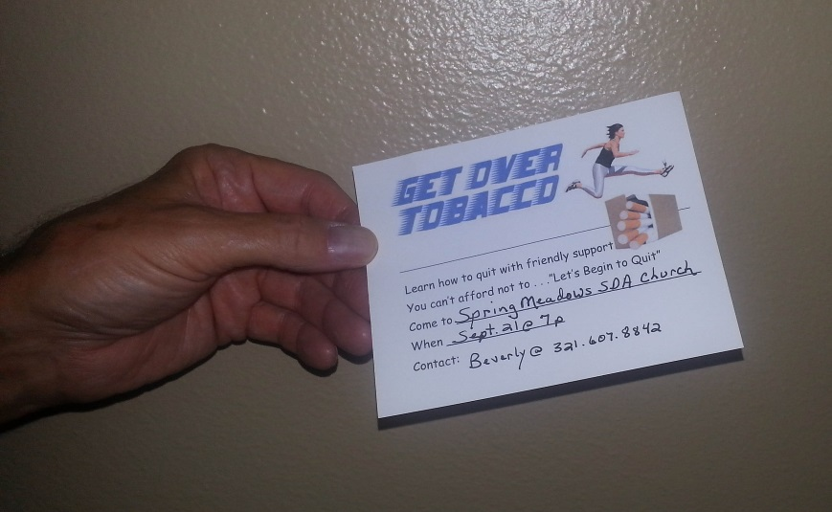
On the Job
Worksite is fertile ground
Workplace relationships may be “safer” than domestic ones

Slide 7

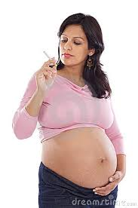

Critical & Compelling Intervention
You can save more than 1 life!
You must engage in meaningful conversation

Slide 8

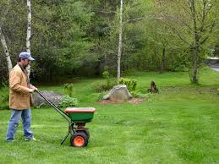
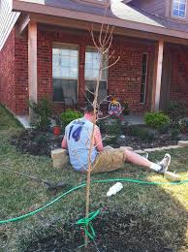
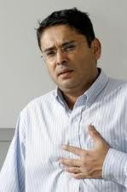
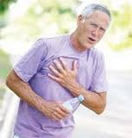
Neighbors Need You

Slide 9
Will You Join the Effort?
Positions to Fill:
Workshop Leaders
Workshop Activity Facilitators
Communications Supporters
Hospitality Planners
Mentors
www.LivingSmart.Live/CMATCH
Please Sign Up in the Lobby!

