Slide 1
He will not allow the temptation to be more than you can stand (or handle) I Cor. 10:13
God is Faithful . . .

Slide 2
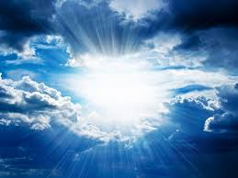
He Will lift you up . . .
Humble yourselves before the Lord, and He will lift you up.
James 4:10 (NIV)

Slide 3
Belonging to Christ brings renewal
Therefore, if anyone is in Christ, he is a new creation; old things have passed away; behold, all things have become new.
2Cor 5:17 (NKJV)

Slide 4
Calm my soul, lord
Lord teach me to trust You, to learn the secret of contentment in every circumstance: that through Christ, I can endure all things. I am weak, but You give me strength (Philippians 4:11–13). If it is Your will, I pray that You would take from me this anxious spirit and frame of mind. If not, help me to know and rejoice in and feel that Your grace is sufficient for me, and Your power made perfect in my weakness (2 Corinthians 12:8–10).

Slide 5
God gives . . .
His Love; it permeates all His creation.
He gives Life; He is the Creator and Sustainer of it
He gives Salvation in His promise of Eternal Life

