Slide 1
NICOTINE
Properties, origin, effects, recovery

Slide 2
Presentation Purpose and Sources
The purpose of this discussion is to inform you of the history of the use of tobacco products wherein nicotine is found, the addictive properties by which it has bound people of all nations, the pervasiveness of tobacco induced disorder (tid), and the realities of recovery.
Sources:
Ference, R., Slade, J., Room, and Pope, M (2000). Nicotine and Public Health, American Public Health Assoc.
Association on Smoking and Health, www.ash.org
Nation Institute on Drug Abuse (NIDA)
WebMD.com Topic information on Tobacco and Nicotine Addiction

Slide 3
General Data on Smoking and Health Risks
36.5 million Americans currently smoke (15.1% of the population)
1.1 billion people around the world smoke
1 person dies every 4.5 seconds from a tobacco-related disease (13/min.)
20% of all deaths are attributable to tobacco use
Tobacco use costs the world more than $1.4 trillion/year
Health care costs
Loss of productivity
Action on Smoking and Health https://ash.org/the-problem/

Slide 4
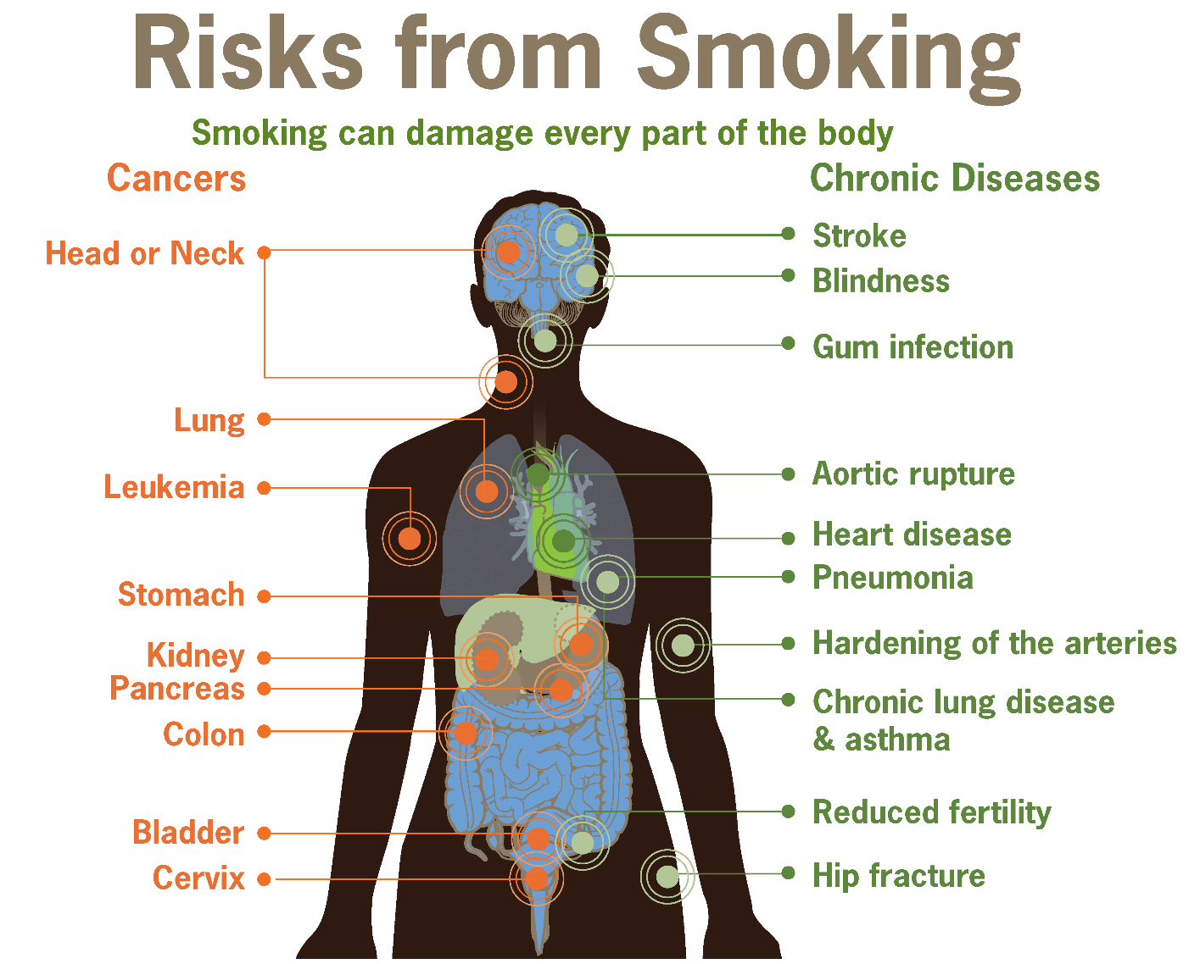
Notes:
At least 69 chemicals in tobacco smoke are carcinogenic
The overall rates of death from cancer are twice as high among smokers as nonsmokers, with heavy smokers having a four times greater risk of death from cancer than nonsmokers

Slide 5
Smoking Tobacco Contributes to Disease
Yes, it does in a very seductive way!
They are now called TIDs or
Tobacco Induced Disorders

Slide 6
TIDs and Devastating Results to Society
Foremost among the cancers caused by tobacco use is lung cancer
Mouth and throat (oral cavity and pharynx)
Esophagus, voice box (larynx)
Bronchus, and trachea
Acute myeloid leukemia
Liver
Sources: National Institute on Drug Abuse (NIDA)
Kidney and renal pelvis
Stomach
Uterine cervix
Pancreas
Urinary bladder
Colon and rectum
Notes:
Quoting from one of the sources for this presentation, Nicotine and PH:
Foremost among the cancers caused by tobacco use is lung cancer. Cigarette smoking has been linked to about 80 to 90 percent of all cases of lung cancer, the leading cause of cancer death for both men and women, and it is responsible for roughly 80 percent of deaths from this disease.^{22,47} Smoking increases lung cancer risk five to tenfold, with greater risk among heavy smokers.⁴⁸
Smoking is also associated with cancers of the mouth, pharynx, larynx, esophagus, stomach, pancreas, cervix, kidney, and bladder, as well as acute myeloid.¹ Cigarette smoking is not the only form of tobacco use associated with cancers. Smokeless tobacco has been linked to cancer of the pharynx, esophagus, stomach, and lung, as well as to colorectal cancer.⁴⁹
In addition to cancer, smoking causes lung diseases such as chronic bronchitis and emphysema, and it has been found to exacerbate asthma symptoms in adults and children. Cigarette smoking is the most significant risk factor for chronic obstructive pulmonary disease (COPD).⁵⁰
Survival statistics indicate that quitting smoking results in repair to much of the smoking-induced lung damage over time. However, once COPD develops, it is irreversible; COPD-related lung damage is not repaired with time.
Smoking also substantially increases the risk of heart disease, including stroke, heart attack, vascular disease, and aneurysm.^{51,52} Cardiovascular disease is responsible for 40 percent of all smoking-related deaths.⁵³ Smoking causes coronary heart disease, the leading cause of death in the United States. Nicotine increases heart rate and constricts some blood vessels.
Smoking is also linked to many other major health conditions—including rheumatoid arthritis, inflammation, and impaired immune function.¹
Even young smokers aged 26 to 41 report reduced health-related quality of life compared with nonsmoking peers, according to a cross-sectional population study.⁵⁴
Recent animal research also identified a pathway between the pancreas and a part of the brain active in nicotine intake, potentially linking cigarette smoking to the risk of developing Type 2 Diabetes—here you would see damaged cell activity in the brain that reduces insulin control to the pancreas and thus raising blood sugar level.

Slide 7
How Does Nicotine Contribute to Disease?
Not a carcinogen—doesn’t directly cause cancer
But, through its transport into the body on the propellants that introduce it, nicotine inflames organ tissue and causes damage and disruption of normal cellular activity that results in respiratory, cardiac, circulatory, and reproductive disorders. In addition, if the user already has hypertension (high blood pressure), persistent use invites progressive atherosclerosis, renal (kidney) disease, and uncontrollable hypertension.
Among smokers and chewers, nicotine is derived from the curing and manufacturing of tobacco, so inhaled smoke and chewed tobacco absorbed into oral tissues or saliva carry it to the cellular level.

Slide 8
Historical Origins of Nicotine
About 2000 years ago . . . On the South American continent, various plant specious of Nicotiana were discovered and consumed for their pleasurable effects, with N. rustica especially prized in high doses for its ability to alter one’s consciousness and enhance out-of-body experiences.
As aboriginal peoples migrated northward, they planted its original source (the tobacco plant) in parts of North American, such as the East and into Canada. They typically ingested nicotine by way of chewing, sucking, drinking, licking, and even rectal application through some sort of syringe. Smoking became the most useful method to them because of their spiritual beliefs of the transfer of spiritual power from the spirit world.
In the 1500’s the French explorer, Cartier, visited Canada in what is now Quebec and discovered the Iroquoian communities farmed a large enough quantity to store after drying it for year-round use. Evidence reveals that nearly 100% of Aboriginal men smoked, and some women did. And that was on a daily basis, not just for ceremonies. They believed they were pleasing their gods.
European explorers have written about the smoking practices of the Narragansett, Micmac, Eastern Abenaki, Huron, Montagnais, and Algonquin tribes and their love of its effects. They also observed the deleterious effects to health and lifestyle of their addiction.
Notes:
So, in North America, tobacco use, particularly smoking practices, developed long ago in what is now Canada. It is recorded that early Jesuit missionaries supplied tobacco to tribal men who were obviously addicted and then required them to give it up when they were converted . . .not an easy task.
The French explorers to both South and North America adopted the smoking behavior of the native peoples in the 1500s. And, of course, the tobacco plant was introduced into France. The English, likewise, returned to Europe and there introduced the practice and the devices used. Of course from there, by the 1600s and throughout the world—Africa, Japan, Mali, etc.
It is said that among the colonists in North America, people were so “bewitched” by the effects of nicotine, they would “sell their shirts”. And, soon Jamestown, Va. Became the trade center for tobacco, an economic lifeline to the development of the first settlement. At the same time (1700s) various country leaders around the world set restrictive laws against smoking tobacco including death as punishment, but their laws did not hold up long against popularity.
Even the “medical” community of Europe considered the effects of tobacco’s nicotine beneficial for many ailments because it fit into the early beliefs of the “humoral” body system. With this demand from world society the New World of the Americas became a primary source for tobacco-grown, dried, and later rolled into natural smoking devices—an industry that created demand for marketing and the need for slaves to plant, cultivate, and harvest it.

Slide 9
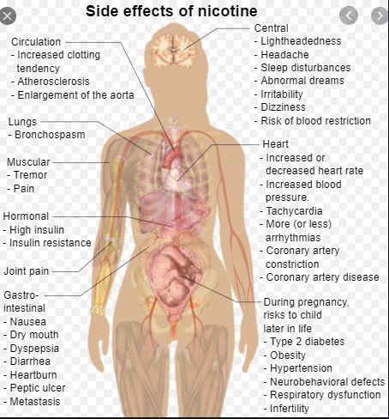
So How Does Nicotine Work in My Body?
Click on the photo below to watch a 4-minute video on YouTube.
Notes:
https://www.youtube.com/watch?v=vM6l6LzmQ-8
You may see an ad at the beginning of the video . . . Even for nicotine products that do not require harmful vaping; but remember, we are talking about the chemical harm nicotine introduces by any means because it attacks the nervous system reaching all parts of your body.

Slide 10
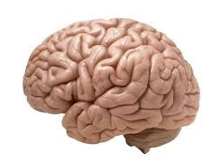
Addiction Realities
For many susceptible individuals, nicotine contributes to drug dependency—because of the ritualistic behavior it engenders in order to “enjoy” the effects—and more of concern—the chemical toxicity allowed to circulate throughout the body, initiating insult to any organs by way of circulation.
What Are the Effects on the Brain and Emotions?

Slide 11
Nicotine Addiction Realities
It has chemical structure that enables it to produce addictive effects similar to those of heroin, cocaine, and ETOH (alcohol).
Stimulates activity mislabeled as productivity
Cloaks negative feelings and perceptions of self-defeat
Produces a rewarding feeling of well-being
Notes:
In other words, it puts the user in a world of comfort and retreat from actual realities

Slide 12
Nicotine Addiction Realities about Human Performance
But there are cognitive deficits recognized in nicotine users in areas of auditory-verbal and visuospatial learning:
Visuospatial memory
Cognitive efficiency
Executive skills
General intelligence
Processing speed
Impulse control
Notes:
Attention, working memory, fine motor skills, episodic memory function are particularly affected by nicotine. These are undesired consequences on tobacco users who are of low S/E status, low education level, and psychiatric disorder (these are heavier users of nicotine-laden products). The latter are evidenced as paradoxical neuropsychiatric responses of those struggling to cope with life’s circumstances.
Positive reinforcement of nicotine use = reward; pleasurable effects > coping with life. Also, establishes a sense of “need” for repeated use.
Negative consequences=the effect on relieving the unpleasant emotional state brought on by the difficulties on the screen and others associated with the aspects of quitting or abstinence.
The attitude is: nicotine helps me “keep focused”. I Need to avoid withdrawal symptoms from nicotine if one stops use.
Therefore, defective cognitive function experiences by user’s abstinent period drives them to relapse in a cessation attempt for what is perceived as improvement in daily functioning.
This begs to question the value of using Nicotine Replacement Therapy (NRT) for cessation therapy.

Slide 13
The Answer . . .
An intervention that assures:
Evidence-based design
Recognition of the seductive mechanisms of nicotine’s actions
Wholistic approach to lifestyle change
Relationship-building for positive reinforcement
Allotted time for conversion to new lifestyle
Maintained human connection for accountability monitoring
Affordability

Slide 14
Is it Worth the Risk?
Notes:
When you consider your quality of life and all that a healthy lifestyle brings, is it worth the risk to subject your body, your mind, your emotions to the altered reality of a nicotine “haze”?

Slide 15
FrameWork Health’s (CMATCH)
Case Managed Approach to Tobacco Cessation Help
www.LivingSmart.Live

