Slide 1
Taking Control
“PowerWalking”
With Power from Heaven

Slide 2
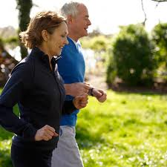
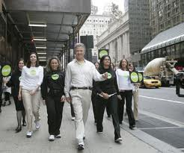
PowerWalking . . .
Notes:
What are some characteristics of physical PowerWalking?
How does one prepare?
How does that relate to the Spiritual Walk?

Slide 3
God Made us alive thru christ . . . Walking into the kingdom of god
Ephesians 2:1-5
Christians Walk With a Different Step

Slide 4
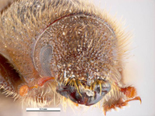
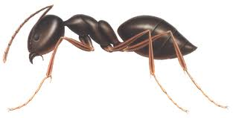
PowerWalking
Walking with Jesus Christ makes us obedient people
It is not what I think anymore
Golden-haired Beetle and Sanguine Ant
Ignoring God’s counsel causes us to reap unwanted consequences

Slide 5
Jeremiah 7:23, 24
Those on a powerwalk with Jesus are going forward—the right direction with Him
How do they act?
Humble
Gentle
Patient
Have Forbearance
Eph. 2:1-5
I cannot do it by myself . . .
But God can.
My walk with Him enables me to demonstrate His Spirit

Slide 6
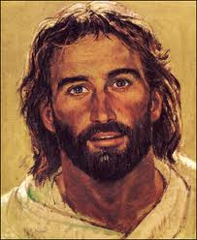
Your greatest need . . .
To be totally surrendered and committed to Jesus Christ
Do what seems impossible through faith in Him
Visualize the possibilities . . .

