Slide 1
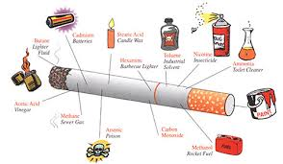
Taking Control – with Power
Help them Get Out of the Weeds
Through the Support of Mentoring, Loving Church Members

Slide 2


A Need We Can Respond to . . .
Smoking rate--National Average = 12.5% adults
Tobacco use is greater in populations that are:
  Low socio-economic level
  High school or less education
  Stressed; have little hope
Smoking-caused diseases result in $96 billion in health care costs annually
443,000 deaths in US/year from smoking-
related diseases

Slide 3

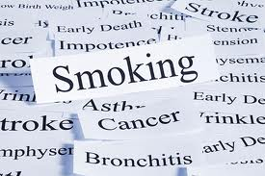
Health Ministry Opportunity
One that all adults can participate in . . .
Requires little training, but a commitment of hospitality, nurturing
Free to the participant; very little cost to the church
Must show commitment to regular scheduling and follow-through
“Let’s Begin to Quit”
Mission Field at Home

Slide 4

The Intervention Design
Taking Control is a 14-day Coaching Program online at www.LivingSmart.Live.
    1) Watch daily videos, download printed guides & supporting audio files
    2) Attend 5 Workshop sessions
    3) Engage in follow-up Phone Coaching
While participant is coached the church provides a “workshop” for support to bring them together with mentors as friends, who augment the wholistic teachings of Taking Control.
The natural progression is to include the participants in relevant church activities and form lasting friendships.

Slide 5
Preparation of Mentors & Coaches
Volunteers are Registered
1- hour Training Session to acquaint them with the roles and functions of mentoring and coaching to be held within 3 days of this announcement. Video and Manual provide preparation.
Mentors will then identify a tobacco user to aid and invite him/her to the “Let’s Begin to Quit” workshop series. A verbal contract is made to accompany the Participant supportively and an invitation card is presented.
The Phone Coach(es), after attending same training, will make connection with Participant at Graduation to arrange those follow-up sessions. They will also attend the general training for all team members.

Slide 6

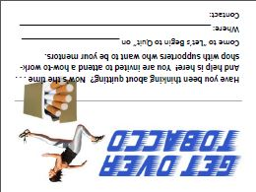
Recruitment
You Are Going to Invite Them . . . And Here is How. . .
How will we get people to come?
Notes:
Show this video on MI -- https://youtu.be/Y5L_RC5fk9w Motivation to Quit Smoking

Slide 7
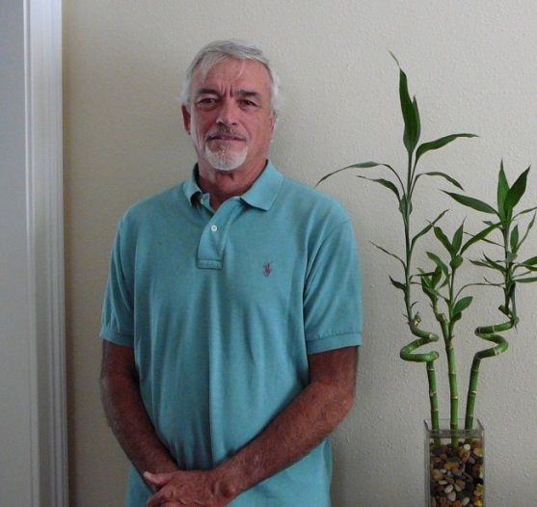
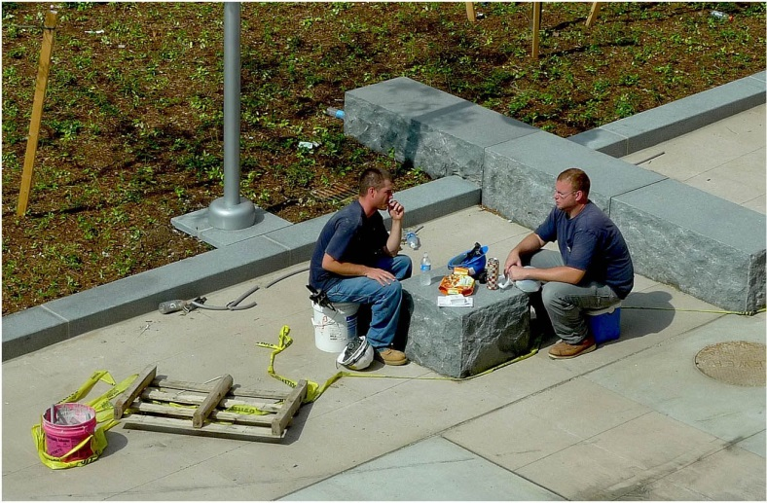
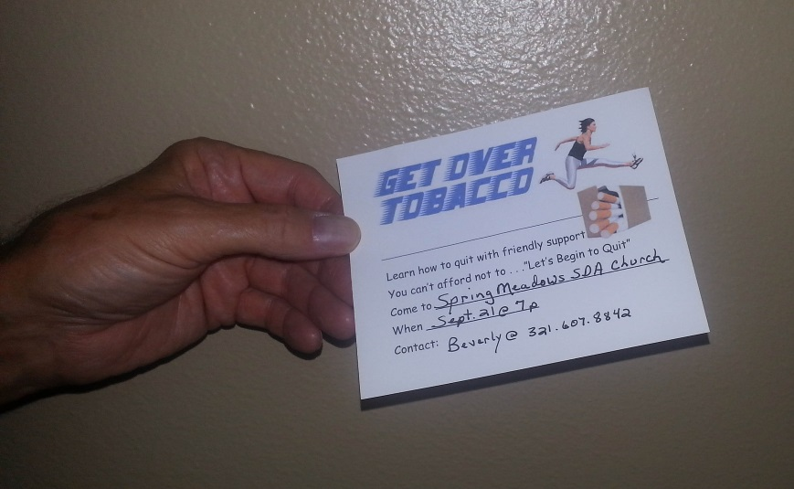

On the Job
Worksite is fertile ground
Workplace relationships may be “safer” than domestic ones
Click the speaker for the story . . .

Slide 8
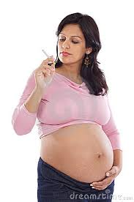


Critical & Compelling Intervention
You can save more than 1 life!
You must engage in meaningful conversation

Slide 9

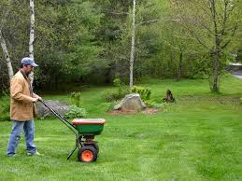

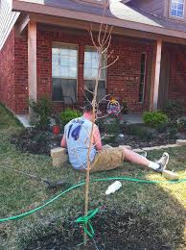
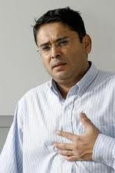
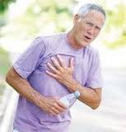
Neighbors Need You

Slide 10
Will You Join the Effort?
Positions to Fill:
Workshop Leaders
Workshop Activity Facilitators
Communications Mgr.
Hospitality Planners
www.LivingSmart.Live

