Slide 1
The Power to Change Directions
Getting Smokers to Quit
Linda Royer, RN, MPH, MSN, PhD
FrameWork Health, Inc.

Slide 2
Let’s Ask About:
Your attitude toward persistent smokers . . .
Past experiences . . .
  In helping others
  Own history
What you know about addiction . . .
Notes:
Ever since the first Surgeon General’s report in 1964, scientific information has been building a case against the use of tobacco in any form. We have been through battles with the tobacco industry over:
The content and strength of harmful materials in tobacco and its effluent smoke
Truth in advertising
Deliberate marketing to children and youth
Deliberate marketing to women
Deliberate marketing to ethnic minorities
We have seen states’ attorney generals sue for reimbursement of expenses for treating tobacco-related diseases, concluding in the Master Settlement Agreement among all states.
We are seeing smoking banned in public places from state to state.
We have seen a decline in the incidence of smoking in all age groups; but an alarming persistence in youth and young adults, now through the use of vaporized nicotine in high-tech instruments. We are aware of rising rates in Third World and developing countries, Russia, the Philippines, China and the Golden Triangle.
And, gratefully, we are witnessing prolific counter-advertising of messages revealing tobacco use for the consequence-laden burden it is.
But, why do people still smoke in the light of all they see, hear, and know? Why does an adult child take up smoking after watching his father die a miserable death with lung cancer? Why does a pregnant woman persist in smoking in spite of all the help her doctor and nurse offer her to quit? Why, if she does quit for the pregnancy, does she pick it up again a few months after delivery?
What is your attitude toward this behavior?

Slide 3

The Paradox of Control in Addiction
Perception of self of the smoker
Adopting a practice that overwhelms one’s self-control
Notes:
The old concepts remain true:
in early life peerism influences children and youth to try smoking (posturing, imitating models of behavior, stress-coping, accompanies coffee)
Once a practice of smoking (infrequently, weekends, regularly) is established, addiction occurs
A dichotomy of wanting to look good, preserve good opinion of others while using a drug that will prematurely age the youth and put longevity and quality of life at risk
Think smoking makes them more socially desirable
Once hooked, the self-esteem or self-efficacy degrades.
The paradox runs across all addiction arenas:
There is both an immediacy -- at the blood-brain barrier there is a delay of not more than 7 seconds and the drug has satisfied the begging neurotransmitter in the brain.
There is a predictability of effects – previous experience has told him/her to expect the same reaction to the drug as previously with all its accompanying memories and experiences.
The behavior pattern of smoking, interim period, smoking again on cue is under stimulus control (like Pavlov’s dog) and under the control of the reinforcing properties of the addictive experience (over and over again).
Cues in the environment (advice of others, witness to tobacco-related disease and death, advertising) and those within himself (aggravating cough, quality of appearance, respiratory difficulty, economic cost, and even MI or Cancer) go unheeded because the addict is unable to use them positively.
Sooooo, the addict appears to lack control over a behavior that is meant to control those unmanageable aspects of life!

Slide 4
Difficulties of Treatment
Reinforcing properties of drug
Perceived control it seems to have
“Alternative” method of coping
A high rate of relapse – Extrinsic control
Notes:
Because chemical deficits, created by incremental dosing with nicotine, are satisfied in the limbic system of the brain (where the seat of our emotions is), a patterning affect is laid down in the neural pathways. Each dose of nicotine reinforces the pattern that seemingly can only be satisfied with another dose of nicotine.
And if the drug is not delivered as needed, there is a disruption in the state or perception of well being. It controls stress, anxiety, stimulates one to act, “Gets me started on the day.”
Instead of applying effort to reducing stressful situations (decision-making, difficult relationships, poverty) it is easier to smoke.
Maybe because smoking was learned early, maybe for other reasons the individual lacks the self-determination or the belief in self to change behavior, lapse and relapse happen after repeated attempts to quit—alone or with even the most expensive intervention program (a week at a health spa or lifestyle treatment center).
The individual does not/cannot take responsibility for the problem. Instead, he/she attributes failure to act to people, circumstances outside of self. – timing, from a weak gene pool, too many issues now, influence of others, etc.

Slide 5
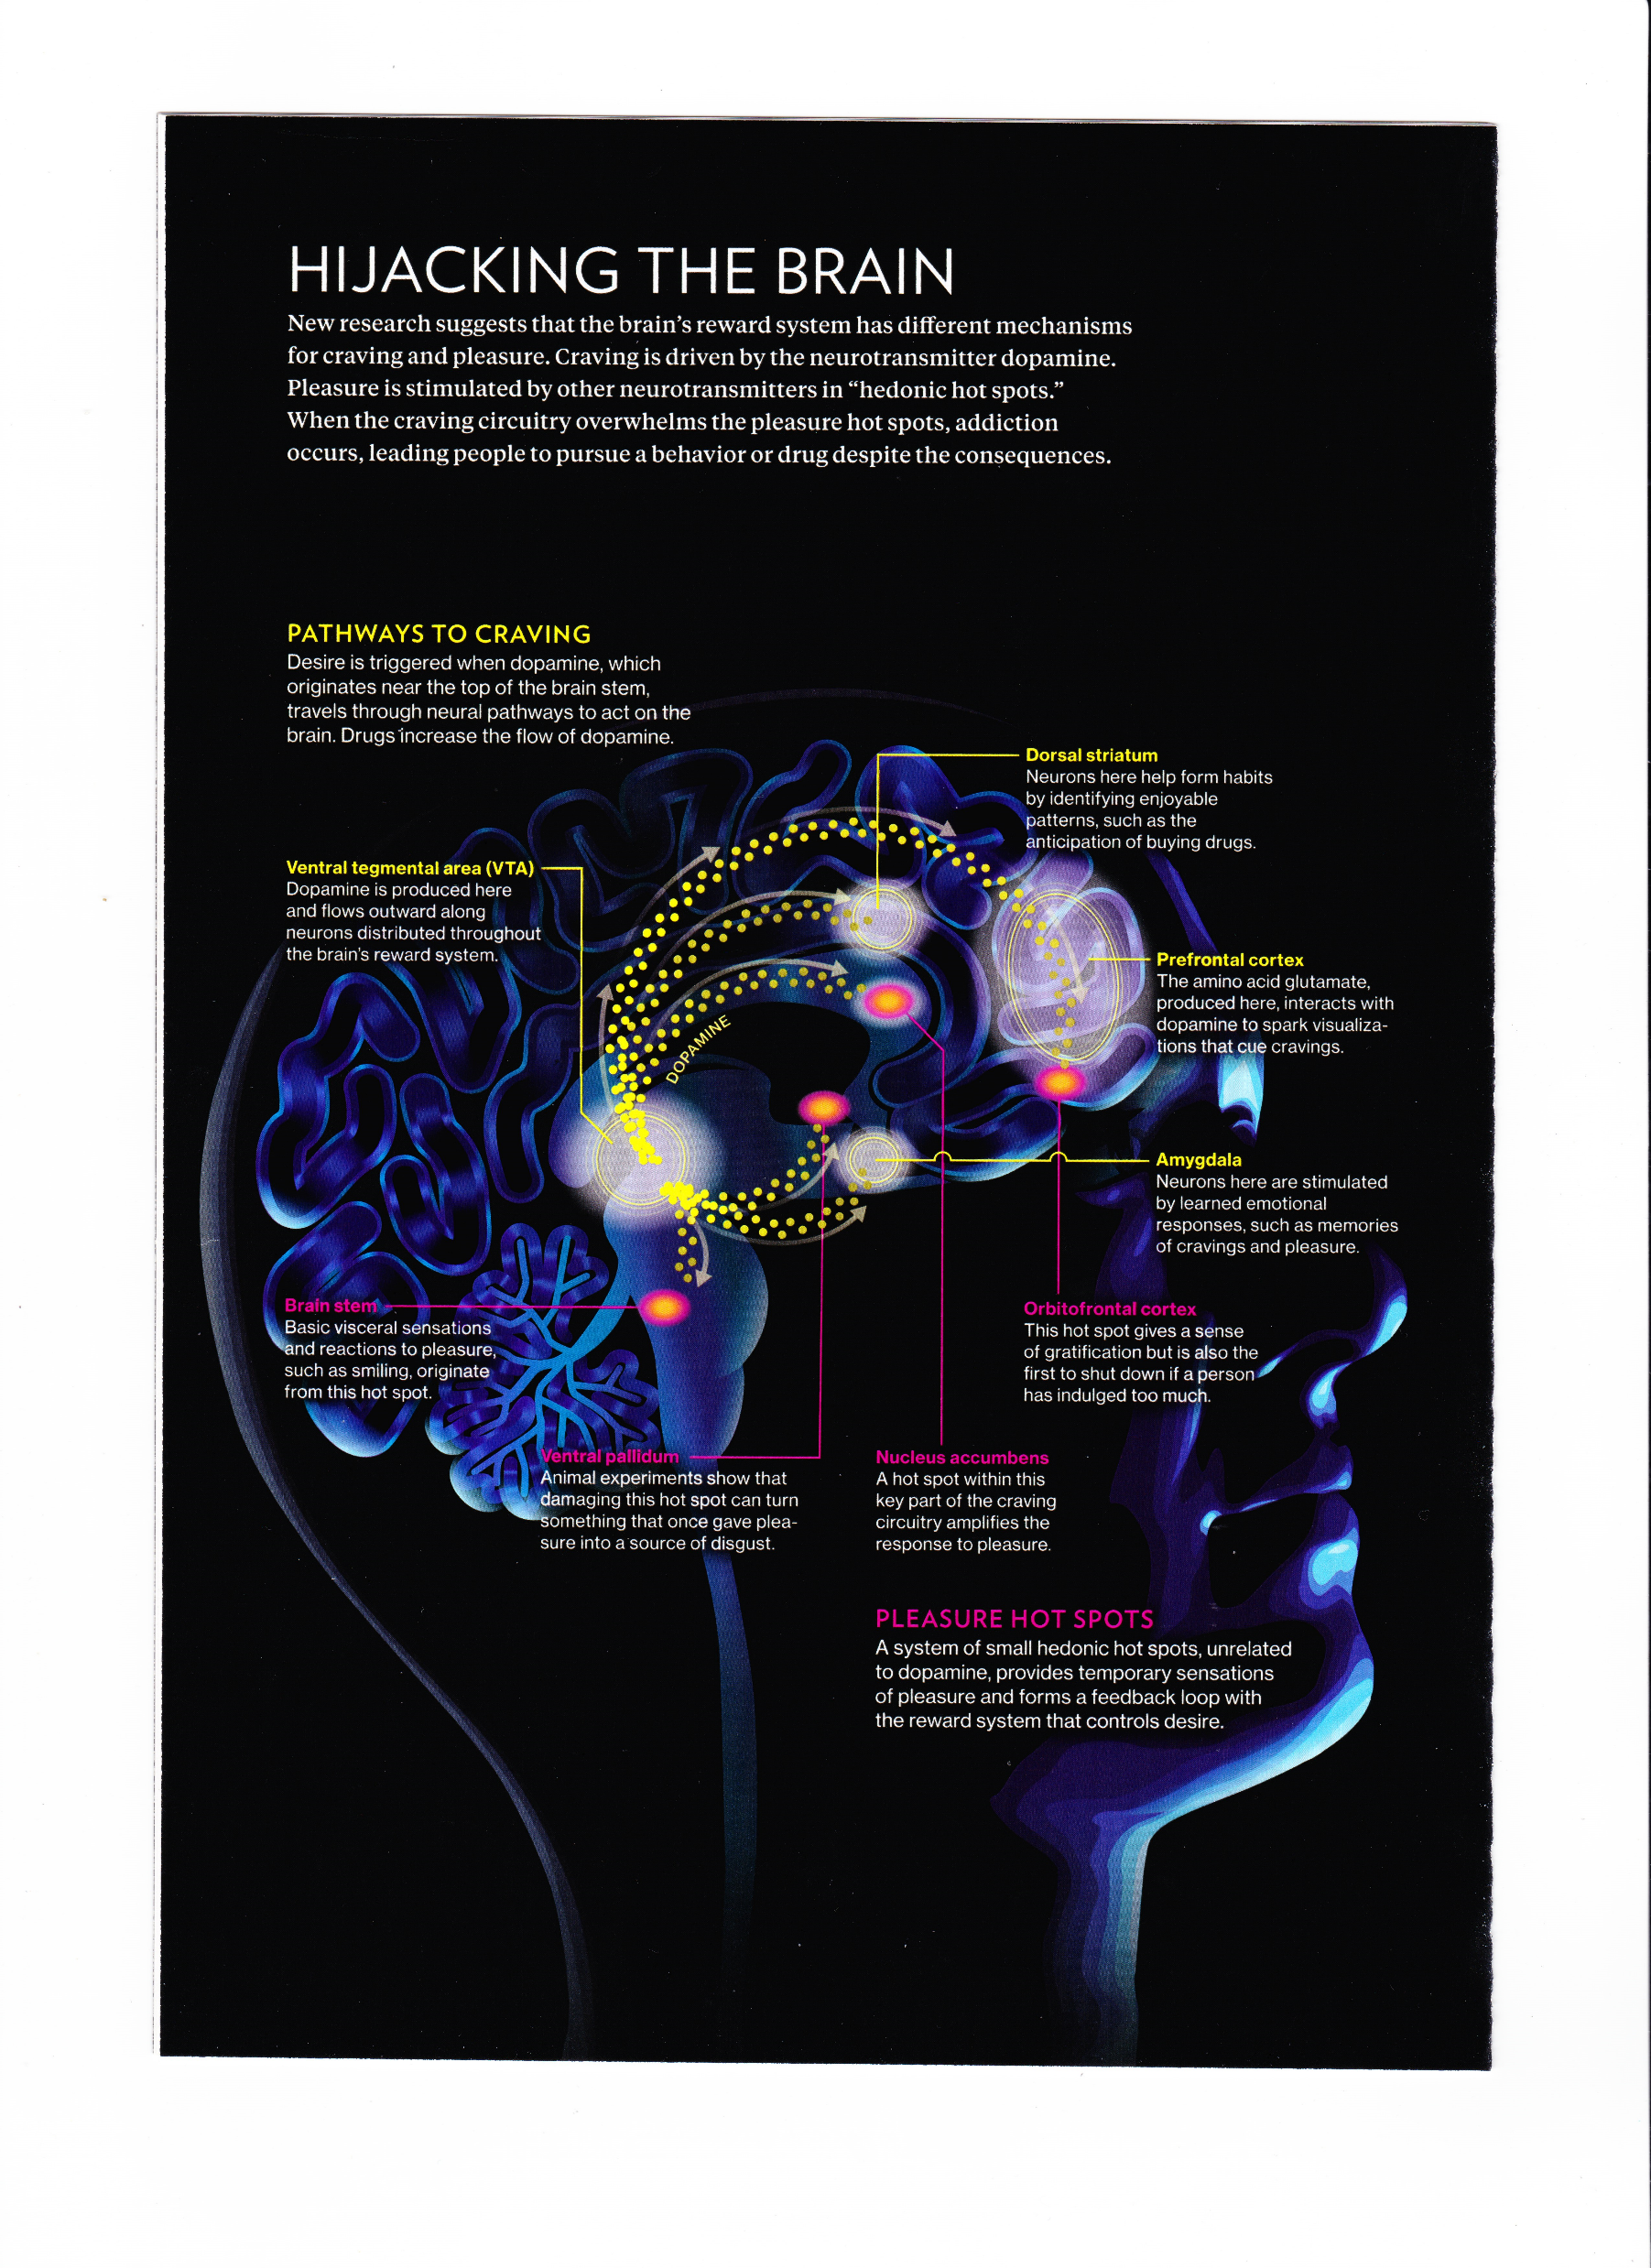
How the Brain is Functioning
Notes:
Refer to “The Active Reinforcement Model of Addiction” by Annie Hunt, Graduate Student Journal of Psychology
2014, Vol. 15, for interpretation.
The biopsychosocial model seeks to explain suffering, disease, and illness as generated by multiple
causes, including social, biological, and psychological factors. This inclusion of subjective psychological
components into the disease model expands the concept of addiction to include individual experiences,
perceptions, stressors, and perspectives as mediating factors in the expression of clinical illnesses and
medical problems . . . Three core elements of addiction can be identified – unmet psychological needs,
impaired neurological mechanisms, and problematic behaviors. But (this) fails to sufficiently demonstrate the
reciprocal relationships among them. . .
Thus, the consideration of the Active Reinforcement Model of Addiction and the application of
CBT- cognitive-behavioral Therapy. A highly standardized therapeutic process that utilizes such techniques as identifying
individual goals, focusing on present problems, exposure therapy, cognitive restructuring, behavior change, and psychoeducation.
There is a cause-effect relationship between all three elements, meaning that each element both
influences and is reinforced by the other two elements. . . the focus is shifted to the importance of
acknowledging how all three coexist and reinforce one another in an interdependent context once
an addiction has become active. From there, an altered focus for treatment and interventions can
be proposed, again shifting the focus of treatment techniques from why to how addictions function.

Slide 6
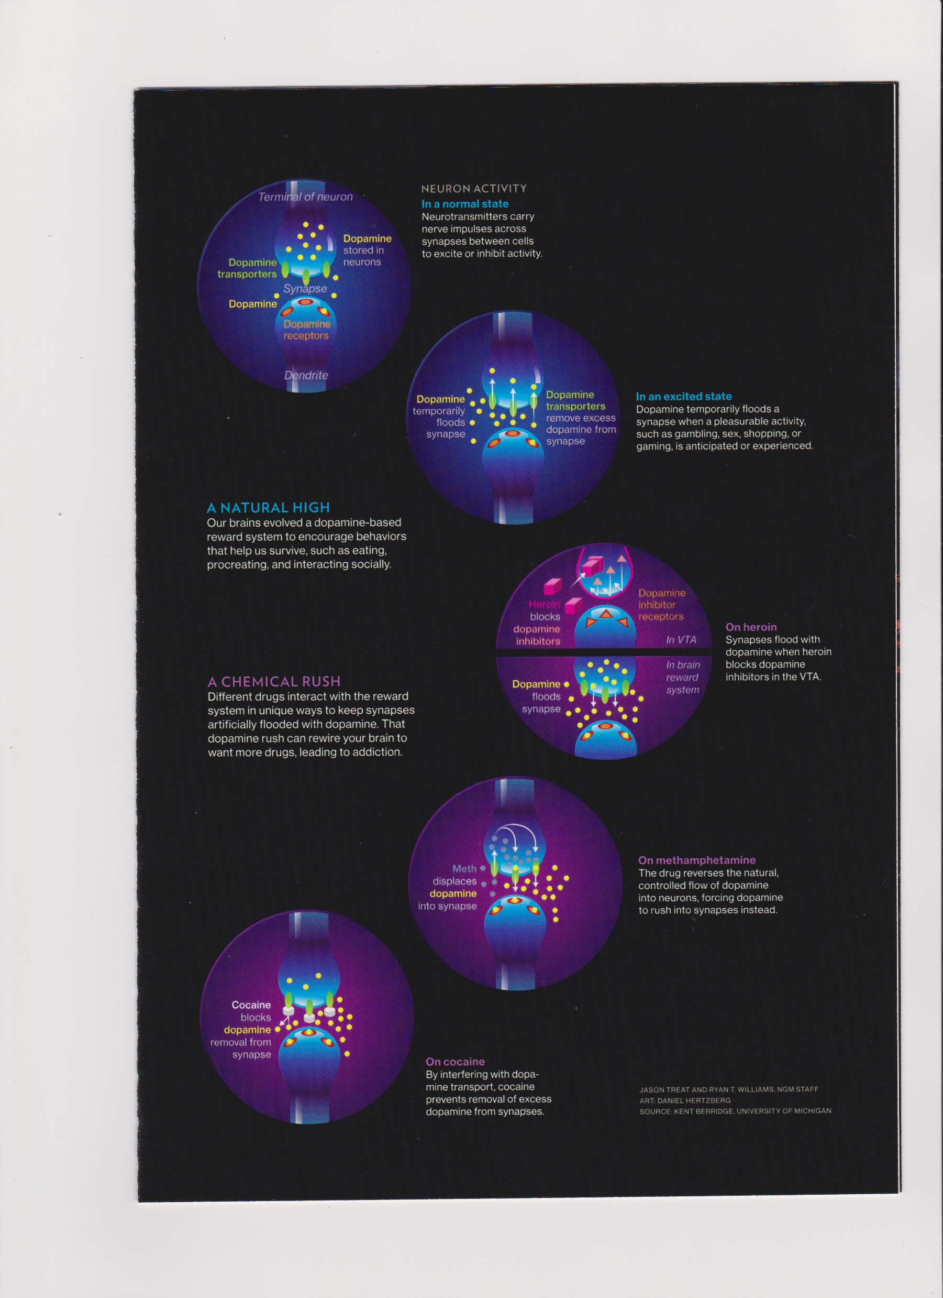
Dopamine Games

Slide 7
Stages of Change
Pre-contemplation
Contemplation
Preparation
Action
Maintenance
(Prochaska, DiClementi & Velicer)
Back
Notes:
Change occurs gradually. With a benevolent attitude, a coach may influence movement through those stages.
Handout . . . The Table of Coaching Through Stages of Change

Slide 8
Where is the Power to Move?
Spiritual – God, Friend Jesus
Cutting the ice with a sharp, firm tool
Supporting the confrontation with your commitment
Connect them with the PowerSource
Give them human strategies for corrective patterning
Pray with them, pray for them, pray about them
Notes:
For Christians, the ultimate, supreme Power comes from knowing God and relating to His Son.
But God is in the planning, also. And the smoker may not know much about God or how to relate to Him.
There isn’t anyone who has not heard that smoking (or chewing) is harmful to your health. Most are embarrassed to still be doing it in opposition to the advice of the people they most admire: their doctor, nurse, family, friends, employer.
Your approach is to “cut to the quick”: (Henry Campbell, a former smoker, would say . . .”I know a good place for that pack of cigarettes . . . Let me tell you how to change your life so that you can live forever.”
Express:
concern for their health and quality of life,
Give them permission to consider quitting
Assure them of the help they need as long as they need it
Affirm their ability because you have a connection with the PowerSource and would hand it over to them

Slide 9
Get to Know the Life of the Tobacco User
Assessment
Free-flow conversation
Family genogram
What you observe
Examine history of quitting attempts
What are the barriers to quitting?
How much does he/she know about the process of changing this behavior?
Notes:
A thorough assessment examines smoking hx, co-morbidities, attitudes, values, beliefs, knowledge of social support, confidence level, stress level, perception of QOL, wishes, goals, level of self-efficacy.
After this, conversation flows more freely as you refer back to the assessment responses and begin to educate, then develop hope in recovery as you lend support little by little. Discussing the tobacco-related illnesses in the family tree points to the reality of:
The fragility of life
The importance of the quality of life
Maybe I don’t want to go there
Kind comments about the visual effects as you observe may lead to educating about the body’s ability to restore itself and the power of the Creator
Looking back at quitting attempts and understanding the methods and their assessment of failure will point to the principles of:
Readiness
Adequate knowledge about how to quit
Adequate support
Identifying present barriers that will make quitting difficult give opportunity to build strong strategies to get through each barrier.
What are the barriers?
Unsupportive lifestyle in general: meal irregularities, unbalanced diet, dependency on caffeine or alcohol, smoking friends, smoking work environment, smoking partner/household, sabotaging partner, cultural practices (Native American ceremonial smoking), cultural beliefs (symbol of luxury to the poor—eliminating it would lower social status), stress, fear of failure, low confidence level)
Take the assessment period slowly. It is important to build a good foundation of understanding.

Slide 10
Get to Know the Life of the Tobacco User
What is a typical day like?
  Account of all the times smoking
  Dietary intake
  Fluid intake
  Exercise
  Other drugs (caffeine, sleeping pills, etc.)
  Rest and relaxation?
  Adequate sleep?
Notes:
Get to know what it is like to live out each day as a smoker.
Discussing this may facilitate your relationship as coach. It demonstrates your interest in their life.
Avoid making assumptions about their motivation for the behavior, but jot down notes about strategies of change. Bring them up at the end as a suggested Plan of Strategies for Success. Also refer to the intervention program guide you may be using.
For some, you may need to use a log or chart to map out (conceptualize) each smoking event and list the preparation activities to help avoid weakness at those moments and to list alternative behaviors.

Slide 11
Cost of Smoking
1 ½ pack/day = $3,300/yr
Multiple factors to consider:
  Cost of tobacco itself
  Paraphernalia
  Lost time
  Increased medical costs
  Increased insurance premiums
  Household
  Lost time off from work
  7-10 years of life shortened
  Threat of devastating illness

Slide 12
Cost of Quitting
Week at the Spa = $2-5000/yr.
Inhaler = $500
Gum (3 months) = $340
12 weeks of Zyban = $500
Community or hospital programs = Free to $1,000+

Slide 13
From Assessment to Solutions
Build on the data
Explore alternative to every behavior
Emphasize a wholistic approach
Use strategies that have been proven effective
Continually affirm; build confidence
With each encounter test emotional state and sense of well-being
“Be there” or have someone partner with them

Slide 14
Model Program
Don’t leave them alone without a personal guidebook or self-help program
Build positive social and spiritual support around them
Maintain contact for at least a year with deliberate interest and coaching

Slide 15
Model Program
Takes on the seriousness of an educational course
Stage One
Identifies their Stage of Change
Uses a thorough assessment
Uses motivational interviewing
Informs about the objectives of the intervention (Program)
Gets a commitment

Slide 16
The Spirit of Motivational Interviewing
Readiness to change is not a trait, but a fluctuating product of interpersonal interaction
The therapeutic relationship functions best as a partnership rather than an expert/recipient relationship
Motivation to change should be elicited from the one coached, not imposed by the coach
It is the learner’s task, not the coach’s, to articulate and resolve his/her ambivalence

Slide 17
The Spirit of Motivational Interviewing
The coach is directive in helping the smoker to examine and resolve ambivalence
Direct persuasion (do this), in which rational arguments for change are presented to the smoker by the expert, is not an effective method for resolving ambivalence.
The coaching style is generally a quiet and eliciting one that invites disclosure

Slide 18
Model Program
Stage Two
Offers a self-help guide
Formally educates re preparation
Involves the participant in planning strategies
Requires accountability
  Contract (Also fee rebatement plan)
  Regular meetings
  Keep a diary
  Report abstinence or lapse

Slide 19
Model Program
Stage Three
Progressive movement from one conquered challenge to the next
Copious “strokes” (affirmations)
Close coaching in first 10-14 days (daily)
Then weekly contact with reporting
Build social support; engage the household members from the beginning.
Worksite support partner

Slide 20
Model Program
Stage Four
Maintain coaching contact indefinitely
Use victory over tobacco to build strengths in other behavior changes
Notes:
Assure them that lapses are not failures, but are learning episodes for better strategies.
A relapse is returning to regular pattern of smoking; requires starting over—commitment must be strong and supports must be shored up.

Slide 21
In Our Favor
Excellent “in-your-face” and compelling counter ads on TV
Taxes on tobacco products going up
Children taught in school go home to beg their parents to quit
Many self-help, internet-based, and group support programs
Wealth of educational tools and visual aids
75% of smokers want to quit
Worrying concerns re lung disease and deaths d/t vaping nicotine and the toxic chemicals that carry them

Slide 22
On Our Side
While many programs in the mainstream offer the most scientific intervention design, without the spiritual component God does not have a chance to show His power and we miss the blessing of discipling

