Slide 1
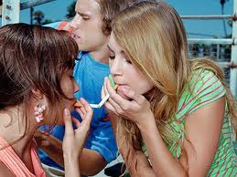
With Each Breath: Stopping Teenage Smoking

Slide 2
Startling Statistics
3000 New teenage smokers per day
4.5 million teenage smokers in the United States.
People with poor grades, low self esteem most likely to use tobacco
1200 Americans die PER DAY from smoking….. 1/3 of smokers will die from complications of smoking.

Slide 3
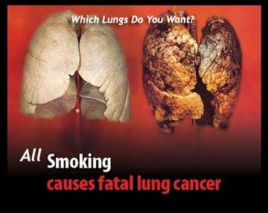
What smoking does to you
Cancer
COPD, emphysema
High blood pressure
Addicted
Decreased stamina
Bad breath
Yellowing of teeth and fingertips
Lose bone density
Fertility issues
Wrinkles

Slide 4
Did you know??
Cigarettes contain over 4000 chemicals including:
Nicotine: a deadly poison
Arsenic: used in rat poison
Methane: a component of rocket fuel
Ammonia: found in floor cleaner
Cadmium: used in batteries
Carbon Monoxide: part of car exhaust
Formaldehyde: used to preserve body tissue
Butane: lighter fluid
Hydrogen Cyanide: poison used in gas chambers

Slide 5
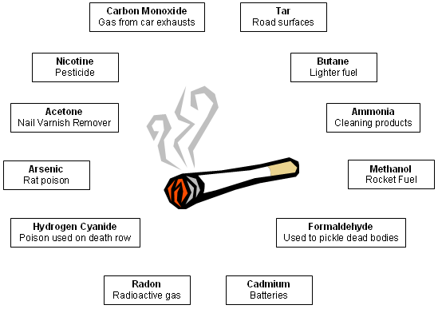

Slide 6
Did you know??
Smoking makes you smell bad, gives you wrinkles and yellows teeth
Smokers get 3X more cavities than non smokers
Lowers your hormone levels
More likely to catch a cold
Smaller lungs and weaker heart than non smokers
Beware: The next slide is stark reality of the effects of long-term smoking

Slide 7
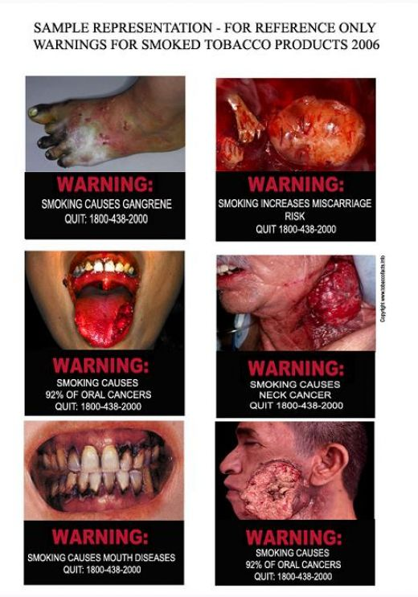

Slide 8
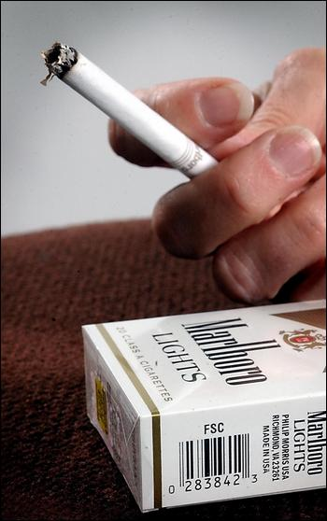
Why would you smoke??
Those prone to poor grades and lower self esteem more likely to smoke.
Peer Pressure
Think they won’t become addicted
Think it helps lose weight
Think it relieves stress
Rebellious
“Looks cool”

Slide 9
Myth Busters
Friends don’t let friends smoke. 1 of 3 smokers will die from complications of smoking. Look at 3 of your smoking friends… Do you want to say goodbye to one?
Nicotine is more addictive than cocaine or heroin… even if you only smoke 1-2 cigarettes per day you are at risk.
Does not make you lose weight. Exercise and eating are the controller of weight.
Causes stress. Expensive. Society is not tolerant.
Dying doesn’t look cool

Slide 10
Healthy choices
Never, Never use tobacco products
Less likely to develop other addictions
Exercise instead
Live healthier, longer life
Don’t let a substance control you
Save money$$$$$$

Slide 11
Remember
You only have one set of lungs.
You are not invincible
You not only hurt yourself, but those who love you too.
When you make your own decisions you take responsibility of deciding your own future. If you make good decisions, you are going to have a better future than if you make bad decisions. You are what you choose to be, so choose wisely!!

