Slide 1
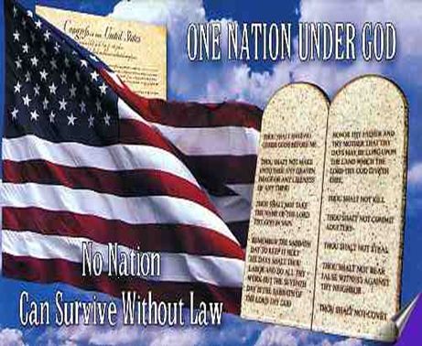
Good Shepherd Lutheran Church
~ A Church of Joy ~
June 28th, 2020

Slide 2
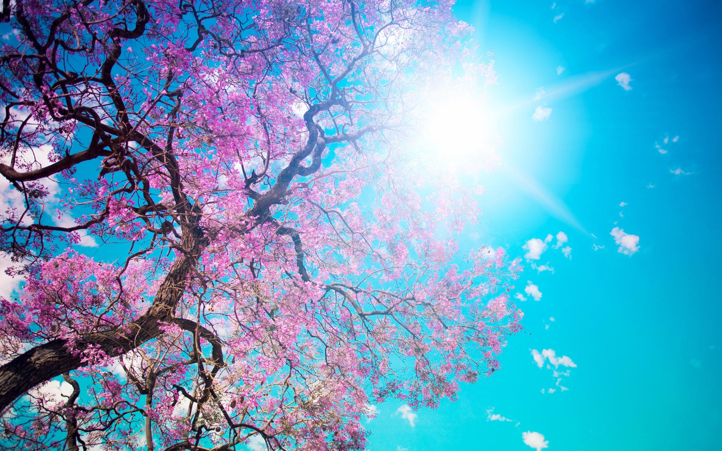
Please be seated

Slide 3
Please Stand for the
Processional Hymn
“The Battle Hymn
of the Republic”

Slide 4
Mine eyes have seen
the glory of the
coming of the Lord;
He is trampling out the vintage where the grapes of
wrath are stored;

Slide 5
He has loosed the fateful lightning of His terrible swift sword:
His truth is marching on.

Slide 6
Glory, glory! Hallelujah!
Glory, glory! Hallelujah!
Glory, glory! Hallelujah!
His truth is marching on.

Slide 7
He has sounded forth the trumpet that shall never call retreat;
He is sifting out the hearts of men before His judgment seat.
Oh, be swift, my soul, to answer Him; be jubilant, my feet!
Our God is marching on.

Slide 8
Glory, glory! Hallelujah!
Glory, glory! Hallelujah!
Glory, glory! Hallelujah!
His truth is marching on.

Slide 9
In the beauty of the lilies Christ was born across the sea,
With a glory in His bosom that transfigures you and me.
As He died to make men holy,
let us live to make men free,
While God is marching on.

Slide 10
Glory, glory! Hallelujah!
Glory, glory! Hallelujah!
Glory, glory! Hallelujah!
His truth is marching on.

Slide 12
Please Stand
for the Hymn of Praise
“America The Beautiful”

Slide 13
Majesty, worship His Majesty!
Unto Jesus be all glory,
honor and praise!
Majesty, kingdom authority,
Flow from his throne,
unto his own, his anthem raise.
O beautiful for spacious skies, For amber waves of grain, For purple
mountain majesties Above the fruited plain!

Slide 14
Majesty, worship His Majesty!
Unto Jesus be all glory,
honor and praise!
Majesty, kingdom authority,
Flow from his throne,
unto his own, his anthem raise.
America! America! God shed His grace on thee, And crown thy good
with brotherhood From sea to shining sea!

Slide 15
~Please Stand~
I believe in God the Father Almighty,
Creator of Heaven and Earth.
I believe in Jesus Christ,
His only Son our Lord.
He was conceived by
the power of the Holy Spirit,
and born of the virgin Mary.

Slide 16
He suffered under Pontius Pilate, was crucified, died,
and was buried.
He descended into hell.
On the third day He rose again.
He ascended into heaven,
and is seated at the
right hand of the Father.

Slide 17
He will come again
to judge the living and the dead.
I believe in the Holy Spirit,
the holy catholic church*,
the communion of saints,
the forgiveness of sins,
the resurrection of the body,
and the life everlasting. Amen.
*or “holy Christian Church”

Slide 18
~Please be seated~
Pastor:
Lord in Your Mercy
Congregation:
Hear our prayer!

Slide 19
Moment of Silence
Please pray for those who are effected by this illness, and the first responders and essential workers who put themselves in harms way every day.

Slide 20
~The Lord’s Prayer~
Our Father, who art in Heaven, hallowed be Thy name.
Thy Kingdom come,
Thy will be done,
on earth as it is in heaven.

Slide 21
Give us this day our daily bread, and forgive us our trespasses
as we forgive those who
trespass against us.

Slide 22
And lead us not into temptation,
but deliver us from evil.
For thine is the Kingdom,
the power and the glory
for ever and ever.
Amen

Slide 23
~Scripture Readings~
1 Peter 2:16,
Galatians 5:1
Titus 3:1-5,
Philippians 3:20-21
John 8:32

Slide 24
Please Stand
for the Sermon Hymn
“God Bless America”

Slide 25
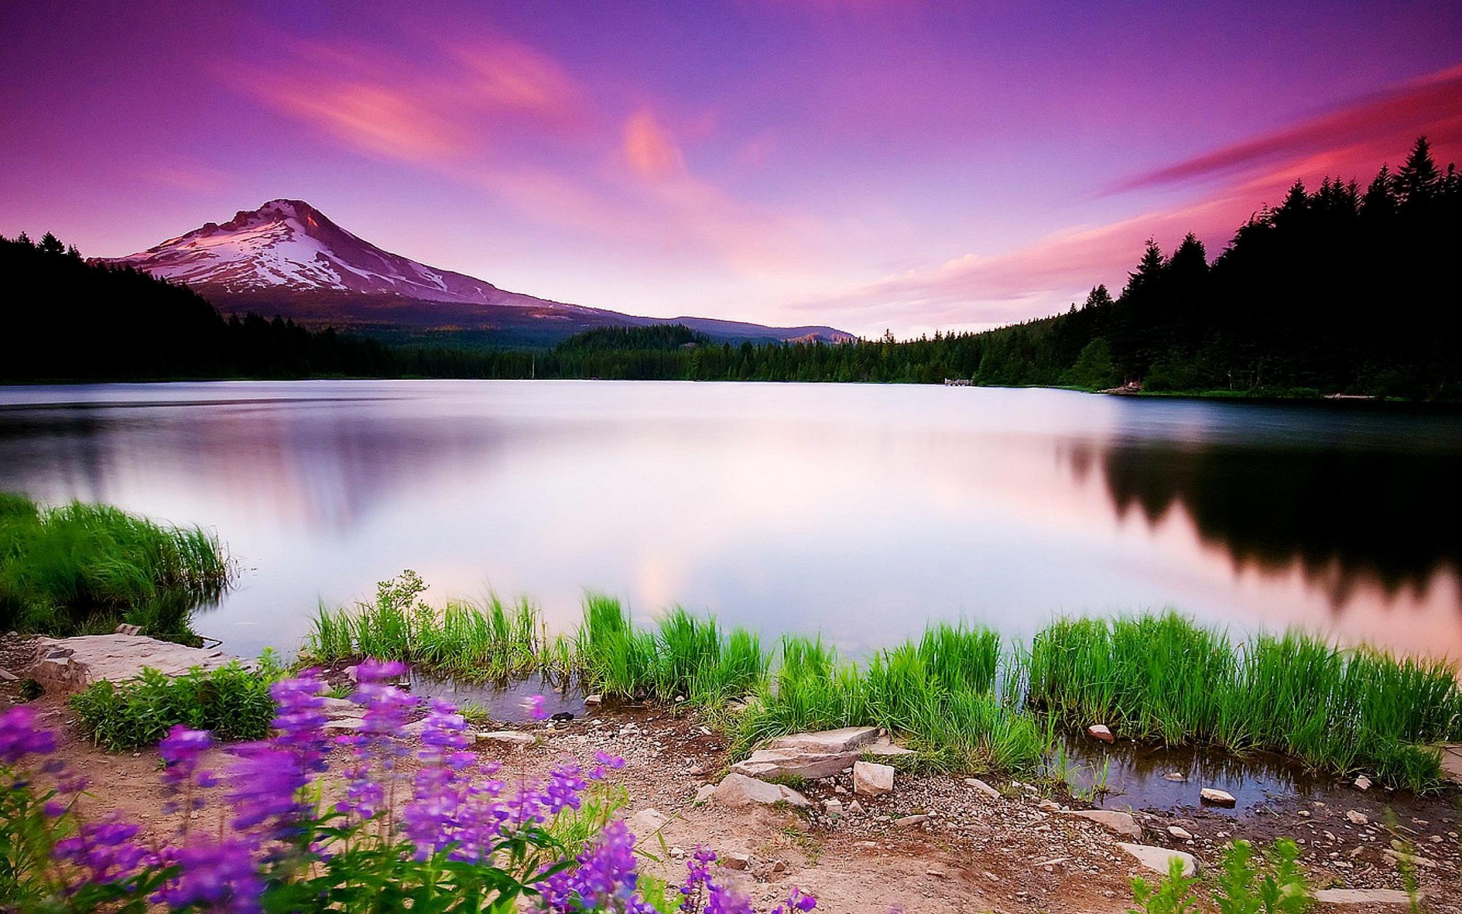
God bless America,
land that I love.
Stand beside her, and guide her,
Through the night
with a light from above.

Slide 26
From the mountains,
to the prairies,
To the oceans, white with foam!
God bless America,
my home, sweet home.

Slide 27
God bless America,
land that I love.
Stand beside her, and guide her,
Through the night
with a light from above.

Slide 28
From the mountains,
to the prairies,
To the oceans, white with foam!
God bless America,
my home, sweet home,
God bless America,
my home, sweet home !!

Slide 29
Sermon

Slide 30
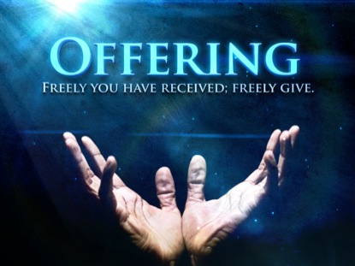
Notes:
To be displayed during the offering prayer

Slide 31
Notes:
To be displayed during the consecration of the elements.

Slide 32
P: Almighty God, to whom all hearts
are open, all desires known, and
from whom no secrets are hid:
Cleanse the thoughts of our hearts
by the inspiration of Your Holy
Spirit, that we may perfectly love
You and worthily magnify Your
Holy name, through Jesus Christ
our Lord.
C: Amen

Slide 33
P: If we say we have no sin, we deceive ourselves, and the truth
is not in us. But if we confess
our sins, God who is faithful
and just will forgive our sins
and cleanse us from all
unrighteousness.

Slide 34
P: Most Merciful God;
C: We confess that we are in bondage
to sin and cannot free ourselves.
We have sinned against You in
thought, word, and deed, by what
we have done and by what we
have left undone. We have not loved You with our whole heart;

Slide 35
We have not loved our neighbors as ourselves. For the sake of Your Son, Jesus Christ, have mercy on us. Forgive us, renew us, and lead us, so that we may delight in Your will and walk in Your ways, to the glory of Your Holy Name.

Slide 36
P: In the Mercy of Almighty God, Jesus Christ was given to die for you, and for His sake God forgives you all your sins. To those who believe in Jesus Christ He gives the power to become the children of God, and bestows on them the Holy Spirit.
C: Amen

Slide 37
Notes:
To be displayed while pastor blesses the elements as they come to the alter and introduces communion, asking people to join in on the prayer.

Slide 38
Please Stand
for the Sending Hymn
“This Land Is Your Land”

Slide 39
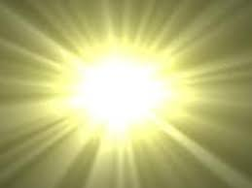
This land is your land,
this land is my land,
From California to
the New York islands,
From the Redwood Forest,
to the Gulfstream waters,
This land was made
for you and me.

Slide 40
As I was walking that
ribbon of highway,
I saw above me that
endless skyway.
I saw below me that golden valley,
This land was made
for you and me.

Slide 41
This land is your land,
this land is my land,
From California
to the New York islands,
From the redwood Forest,
to the Gulfstream waters,
This land was made
for you and me

Slide 43
P: May the God who is above you watch over you, beside you, befriend you, behind you, pick you up when you fall, ahead of you lead you every step of the way, may you go in peace, joy, and with …….
C: ENTHUSIASM!

Slide 44
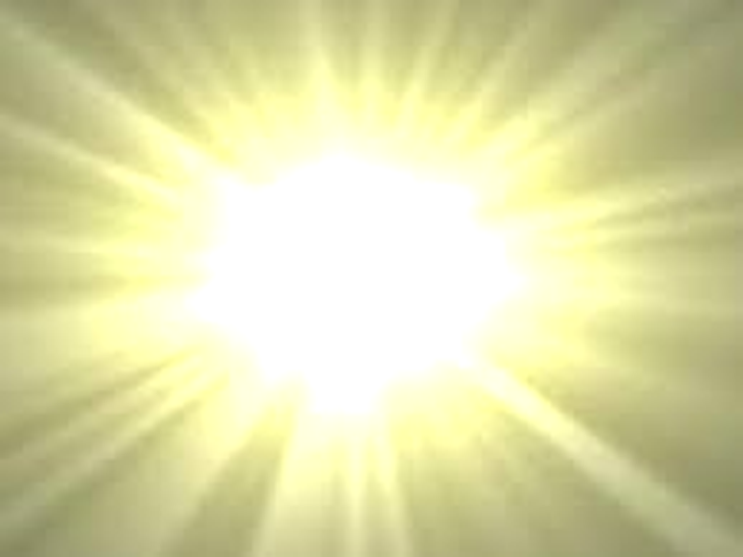
I’ve roamed and rambled,
and I followed my footsteps
To the sparkling sands of her diamond deserts.
And all around me a
voice was sounding:
“This land was made
for you and me.”

Slide 45
This land is your land,
this land is my land,
From California to
the New York islands,
From the Redwood Forest,
to the Gulfstream waters
This land was made
for you and me

Slide 46
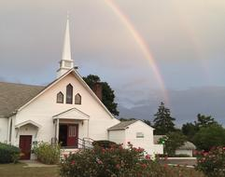
Good Shepherd Lutheran Church
~ A Church of Joy ~
Welcome Home
See you again next week!

