Slide 1
Notes:
Facilitator Note
If there’s a sponsoring executive for the workshop, let them introduce themselves.
Introduce yourself, provide brief background, and communicate that you’re excited to facilitate this workshop.
Facilitator Icebreaker (optional):
If the group is small, have them share out loud individually. If a larger group, have them share at their table. Be mindful of time spent on this.
Have each person share:
• Their favorite movie.
• If they could spend a day with anyone from history, who would it be and why.

Slide 2
Notes:
Key Statement
“Welcome to the Journey. Our goal for this workshop is to equip you with the mind set and skill set to achieve the best version of you.”
Facilitator Note
Use the “Welcome to the Journey” paragraph in the workbook as the core of your R Factor intro.

Slide 3
Today I get to…
Act with purpose
Serve people
Solve problems
Bring energy

Slide 4
Notes:
Key Statement
“Let’s start with the big picture — we call it The Performance Pathway. You see it on the screen and you see it your workbook. It’s the physics of organizational performance. Here’s what it teaches: Leaders create the culture that drives the behavior that produces results.”
“Let’s reverse engineer this and look at it from right to left. It tells us something insightful and important about the performance of every organization and team: Results come from how people choose to behave.”
“Strategy, process, budget, and technology are essential for operating the business. However, what happens if you have A+ strategy, but B- behavior? What happens if you have A+ process and budget and technology, but B- behavior?”
“The most important performance variable in any organization is how people choose to behave.”
“Culture’s job is to drive the behavior called for by the strategy. If you ask for behavior in your strategy that is not supported by your culture, you will struggle to execute. ”
“Notice the flywheel effect between culture and behavior. Behavior reinforces the culture that drives it. That either works for you or works against you.”
“If the behavior of people aligns with the stated culture standards, the flywheel is working for you. If the behavior of people doesn’t align with the stated culture standards, the flywheel is working against you.”
“Leaders are the creators and catalysts of the culture. A couple things about leadership...”
1. Leadership is not authority based on a title or a position that you’ve been given. Leadership is influence based on trust that you’ve earned.
2. (Go to next slide)
Facilitator Note
This slide is easy to get caught up in teaching too long. Be thorough but efficient to get to the next slide. You can consistently refer back to it throughout the workshop.

Slide 5
Notes:
Key Statement
“Here’s an important reality for every organization and every employee in an organization: Each person has a responsibility for 20 Square Feet of performance. The workbook provides a great description of this 20 Square Feet principle…”
Then have someone read the first paragraph on the 20 Square Feet page.
“The R Factor is a toolbox that equips you to take ownership of your 20 Square Feet.”
“Maximizing your effectiveness means you have to cultivate two skill sets: Job skills and behavior skills. Job skills are your technical competencies to do the job. Behavior skills are things like self-awareness; thinking, decision-making, and problem solving; listening and communicating; resilience and managing your emotions.”
“Here’s an example...”
• What skill set do most companies hire for — job skills or behavior skills? (participants reply “job”)
• What skill set causes the most problems — job skills or behavior skills? (participants reply “behavior”)
“No amount of technical competence can overcome a behavior skill gap.”
Facilitator Note
Before moving to the next slide, emphasize the fact that we don’t control events and circumstances outside our 20 Square Feet, therefore, “Don’t let the frustration on the outside diminish the fire on the inside.”

Slide 6
Notes:
Key Statement
“In your 20 Square Feet, you behave one of two ways: Discipline or Default. There’s a line in life — above the line is discipline-driven behavior and below the line is default-driven behavior. Discipline is intentional, purposeful, and skillful. Default is impulsive, autopilot, and resistant.”
“Discipline does not mean “punishment.” It comes from the Latin word discipulus, which means “student.” Discipline is learned. It means getting better every day by consistently applying standards and principles to your life. Discipline is not something that someone does to you, it’s something you choose to do for yourself.”
“Discipline is…”
• Intentional: You know what to do. You’re thoughtful and deliberate in your actions.
• Purposeful: You know why you do it. You understand the meaning behind your actions.
• Skillful: You know how to do it. You bring the best of your talents and abilities to bear on whatever the task is at hand.
“Default is…”
• Impulsive: Undisciplined emotion. Going with whatever emotion feels good at the time.
• Autopilot: Undisciplined habit. Getting caught in the grip of ineffective habits.
• Resistant: Undisciplined comfort. Unwillingness to do the work to get better. When life and work challenge you to get better, you say “no” and get stuck at something less than best version of you. You get stuck in the comfort zone.
“Every day is a battle for what directs your life: Discipline or Default. Discipline wins. Default at best produces mediocrity and eventually produces failure.”

Slide 7
Notes:
Key Statement
“A common default trap is BCD. Blaming, Complaining, and Defensiveness. Blaming other people, complaining about the circumstances, and getting defensive about your default behavior.”
“BCD has never solved a problem, achieved a goal, or improved a relationship. It damages everything it touches.”
“When you encounter inevitable challenges and difficulties, rather than BCD, focus on resolution or resilience. Resolution is solve the problem. Resilience is navigate the problem with a positive and productive attitude.”
Facilitator Note
If the situation calls for it, and you have time, monetize BCD for the participants:
“BCD is also a major cost for you, your team, and your
organization…”
• How many employees do you have?
• How many hours per week do people engage in BCD? Five (5) is generally a good number if they don’t provide a clear answer.
• What’s the average hourly wage?
• Multiply: (Number of employees) X (average wage) X (number of BCD hours) = weekly cost ($) wasted on BCD.
• Then, multiply the weekly cost times four (4) to get the monthly cost.
• Then, multiply the monthly cost times twelve (12) to get the annual cost of BCD

Slide 8
Notes:
Key Statement
“So here’s how we act with more discipline and less default. This is a simple, powerful framework for being intentional about the way you think, make decisions, and take action: E+R=O. Which stands for Event + Response = Outcome. The key to producing great results and outcomes is not the event or situation — it‘s how you choose to respond. ”
“E+R=O teaches us that we don’t control events, we do control how we choose to respond, and our response produces outcomes. Success in the O doesn’t come from the E, it comes from our R.”
“As you can see, a disciplined R will produce a very different O than a default R.”
“The O is feedback about how well your R is working. If you’re not getting the outcome you want, don’t blame the E, choose a better R.”
“Your R is the key variable to your success at work and at home. It’s the one thing that you can evaluate, change, and improve to produce better outcomes in your life.”

Slide 9
Notes:
Key Statement
“Let’s start building our R Factor capacity. E+R=O is a mindset first and a skill set second. The mindset is the foundation for applying the skill set. If you don’t have the mindset, you probably won’t do the work to build the skill set. Let’s look at the mindset…”
Facilitator Note
Have a different participant read each of the four mindset paragraphs aloud.
At the end of each paragraph ask, “What’s the big message there? What gets your attention about that mindset?”

Slide 10
Notes:
Key Statement
“Now that we understand the mindset, let’s work on the skill set. The six disciplines provide you with a toolbox for managing the R with intention, purpose, and skill. The daily application of these disciplines determines the quality of outcomes you produce. We’re going to spend the remainder of this workshop studying these disciplines in detail, but let’s do an overview first”
Facilitator Note
Have a different participant read each of the six discipline paragraphs aloud.
Resist the temptation to teach and give extensive commentary. You’re going to teach each in detail, this is just an overview.
Key Statement
Once the six disciplines have been read, ask the participants:
• What’s the value to you if you were to consistently live with clarity, energy, action, flexibility, impact, and growth? What could you achieve?
• Is that not best version of you?

Slide 11
Notes:
Key Statement
“OK, now we move on to R Factor Discipline #2: Get Your Mind Right. Discipline #1 Press Pause is about clarity. #2 Get Your Mind Right is about energy.”
“It’s the ability to create a disciplined mindset that energizes you to respond effectively to the situations you experience. It’s knowing how to get into a productive mental state, and knowing how to get out of a disruptive one. It’s learning how to harness your emotions to work for you, not against you.”
“Your attitude and mindset affect everything you do. Your mindset is a primary driver of what you do and how you do it. In fact, it’s important to understand that you cannot outperform your mindset. You operate at your best when you are in a positive, productive mental state.”
“Where your mind goes, you go. A distinguishing characteristic of consistently successful people is their ability to maintain a positive and productive attitude. Their mind is not cluttered or distracted by pessimism, negativity, or cynicism. As a result, they are able to focus their mental energy on exploring solutions, solving problems, and taking action in pursuit of their goals.”
“Attitude is the perspective — the mindset — that you bring to the pursuit of your purpose and goals. It is one of the few things in life that is totally under your control. Attitude doesn’t come from external circumstances; it comes from how you choose to see yourself and the situations you face.”
“You are the architect of your attitude. A bad attitude distorts what you see, disrupts how you feel, and limits what you do. A productive attitude empowers productive action and problem-solving.”
“We have all been in situations when our emotions have energized us to perform with motivation, confidence, and a sense of purpose; and we have all been in situations when we felt demotivated, discouraged, or frustrated, and therefore have not acted or performed effectively.”
• When you are caught in a disruptive emotional state, you decrease your ability to respond effectively to people and circumstances.
• When you are in a productive emotional state, you increase your ability to respond effectively to people and circumstances.
“The emotions you feed will grow.”

Slide 12
Notes:
Key Statement
“Your mindset ­— your attitude — is your choice. You can create a mindset that helps you, generates positive energy, and makes you stronger; or, you can allow a mindset that holds you back, generates negative energy, and undermines your effectiveness. Again, it’s your choice.”
Facilitator Note
Both the slide on the screen and the workbook in your hand use the word “create.”
Tell participants to find that word in your workbook and highlight it; underline it; circle it.
Key Statement
“A productive, disciplined mindset doesn’t just happen. You must do the work to create it. Managing your emotions is a learned ability, not an inherited or instinctive one. Developing emotional strength and skill is similar to developing physical strength and skill. It requires time, effort, and practice. It requires training. Cultivating a productive mindset and positive attitude is a discipline-driven skill.”
“A final thought before we move on to the next slide. Situations have the emotional significance that you assign to them. The undisciplined mind fixates on problems and focuses on how it feels. The disciplined mind acknowledges how it feel, then seeks solutions and focuses on what needs to be done.”
“You cannot outperform your mindset. Do not allow your effectiveness to be diminished by mismanaged emotions. Resist the temptation to feed emotions that undermine your effectiveness. Take ownership of your mindset.”

Slide 13
Notes:
Key Statement
“There is no singular mindset that’s appropriate for all situations. Different situations call for different mindsets and different kinds of emotional energy. This requires mental agility, which is the skill of recognizing when you need to shift your mindset quickly from situation to the next.”
“Let’s look at five different situations and consider what mindset is most productive for each...” (Go the next slide)

Slide 14
13
Notes:
Facilitator Note
Draw the group’s attention to the first two situations and the respective mindset for each. Then ask the group what they think the most productive mindset is for each of the remaining three situations. Encourage them to record their answers in their workbooks.
Key Statement
Once you’ve worked through all five situations, ask: “How many of your days do you experience all five of those situations? That’s why mental agility is so important.”

Slide 15
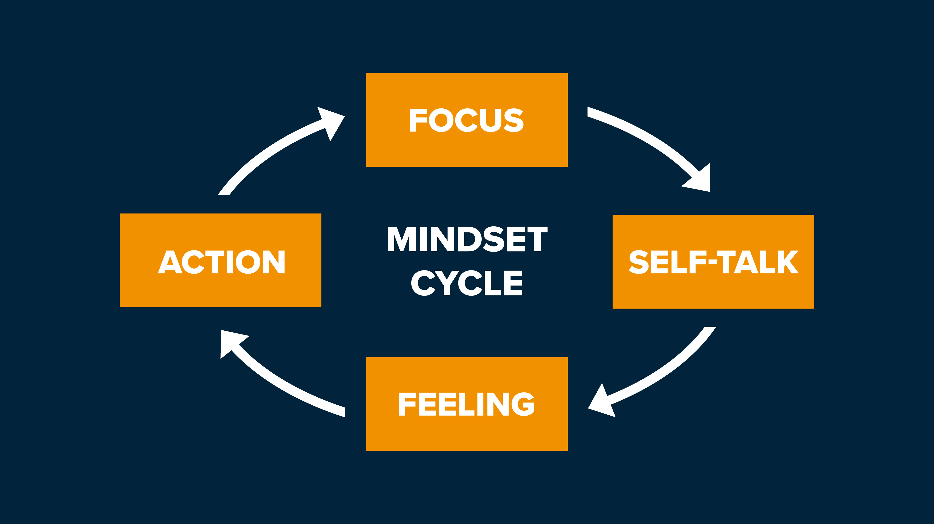
Notes:
Key Statement
“Where your mind goes, you go. In order to create a productive mental state, you must take active control of the mindset cycle.”
“You can see that the mindset cycle has four components: focus, self-talk, feeling, and action. This is the mental process that happens inside your mind as your experience events and circumstances.”
Facilitator Note
Have a different person read the descriptions in the workbook of each element of the mindset cycle.
• Focus is the visual component in our mind.
• Self-talk is the verbal component.
• Feelings are the emotional component.
• Action is the behavioral component.
Feelings and emotion are energy. Encourage the group to write “energy” next to the feeling box in workbook.
Key Statement
“Can you now see the source of positive energy in your life? Can you see the source of negative energy? If you focus on positive and productive action and you have productive self-talk, you will feed positive and productive energy. But if you focus on negative things and tell yourself negative stories, then you will feed negative energy. It’s your choice!”
“One of the most powerful truths in life is that you have the ability to bring positive energy to negative situations. So I encourage you, don’t let circumstances determine how you feel. Take ownership of the mindset cycle and create the mindset and energy you need to respond to whatever circumstances you face.”
“Question: Left to itself, how quickly does the mind cycle through these four components?” (really fast!)
“That means in order to Get Your Mind Right, you must slow it down and break it down.”
“Do not let the mindset cycle run on default! Either you are managing the cycle, or it is managing you. A productive mental state is the result of bringing discipline to the way you manage the mindset cycle.”
“The quality of your inner work determines the quality of your outer work. Win the inner battle! Here is how…”
(Go the next slide)

Slide 16
Notes:
Key Statement
“Step 4 is Respond With Disciplined Action.”
“Focus on what needs to be done, not on how you feel. How you feel is not always a good reference point for what you should do. In order to make a good decision you need good information, and there are times when your emotions give you bad information.
“When you fixate on what you don’t like about a situation, it disconnects you from productive action and solutions. Don’t dwell on how you feel. Take disciplined action even if you don’t feel like it. Sometimes you have to act your way into feeling bet-ter. More on this in the next chapter.”
“What I hope you see from this chapter is the mental/emotional nature of your behavior. Your R Factor is internal and mental first, and it is external and behavioral second. Disciplined thinking drives disciplined action. The quality of your inner work determines the quality of your outer work.”
“Do the work and win the inner battle.”

Slide 17
Notes:
Key Statement
“Don’t get stuck in a negative story. You have to be aware, mindful, and disciplined… because the default voice is quick, careless, and convincing. And there is a lot of social support for it! It is a major theme in this chapter and in The R Factor: Pay attention to your self-talk.”
Facilitator Note
Use the gray box from the workbook as the core of your message for this slide. Quickly address it and move on to the exercise. Don’t linger too long.

