Slide 1
A very special thanks to those who provided door prizes, game prizes, and silent auction items.

Slide 2

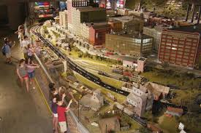

Train Journey – the World’s Largest Indoor Model Train display
Imagination Junction – children’s interactive play area
American Railroading Museum – how railroads have changed our lives
Expo Center – volunteer’s workshop, historical library, and Neil Young’s Lionel Traveling Train Display
A very special Thank You to EnterTRAINment
Junction.
For Providing a discount code to EVERY CEAO member to there facility.
For more information go to registration or any silent auction facilitator.
7379 Squire Ct, West Chester Township, OH 45069
Entire member support

Slide 3



Culligan Water provided bottled water for all the registration bags.

Slide 4


EVERY attendee receives Rooster bucks
A total of a $ 620.00 value! Thank you, Rooster!
Also two 10 dollar gift certificates for silent auction.
4 time supporter

Slide 5

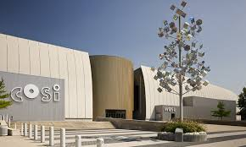
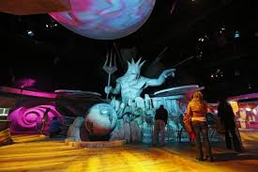
4 time supporter

Slide 6
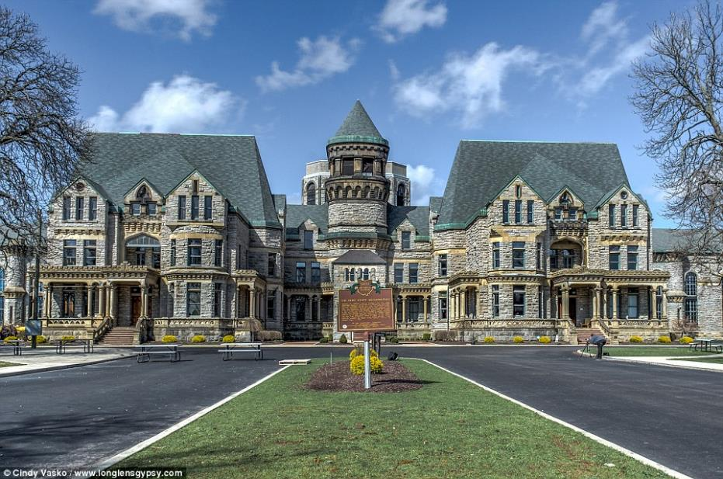

100 Reformatory Rd, Mansfield, OH 44905
4 admission tickets valued at $48.
4 time supporter

Slide 7

Provided 4 super buffet gift certificates to their Epic Buffet. Expire 10/1/21
4 time supporter

Slide 8

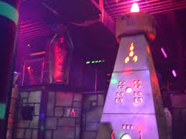
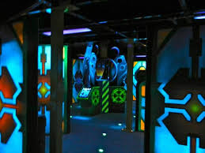
4 time supporter
4 admission passes a $32 value
533 Miamisburg Centerville Rd, Dayton 45459

Slide 9

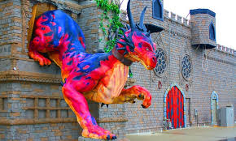

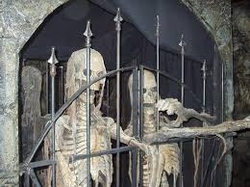
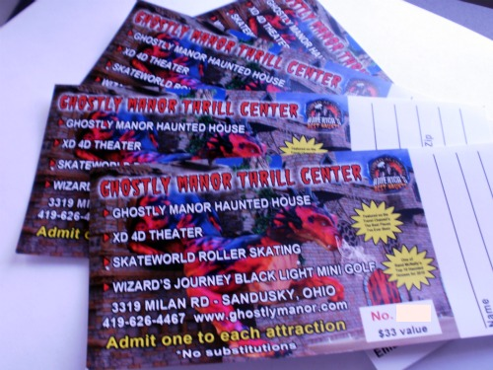
4 time supporter
Ghostly Manor has also provided 4 do it all passes
Valued at $100

Slide 10

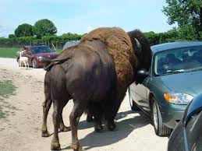
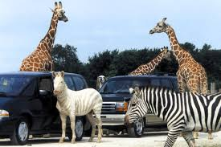
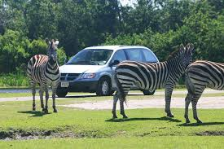
4 time supporter
A family pass valued at $191.60 Port Clinton.
Item 14

Slide 11
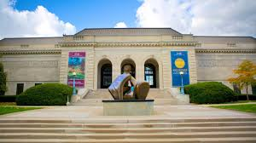


4 time supporter
4 Passes to the Columbus Museum of Art.
One pass allows for 2 adults plus children.

Slide 12

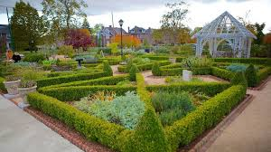
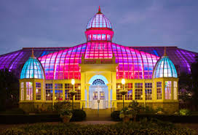

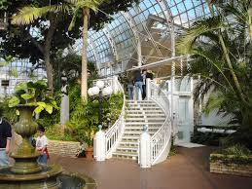
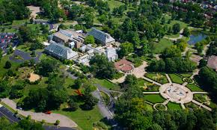
4 passes to the Franklin Park conservatory a $72.00 value
Expires 12/20
3 time supporter
Item 11

Slide 13

3 time supporter
$25 gift certificate and a T-Shirt from
Item 8

Slide 14
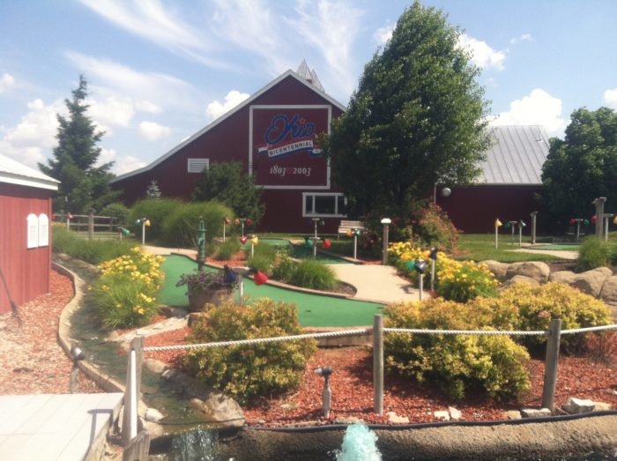

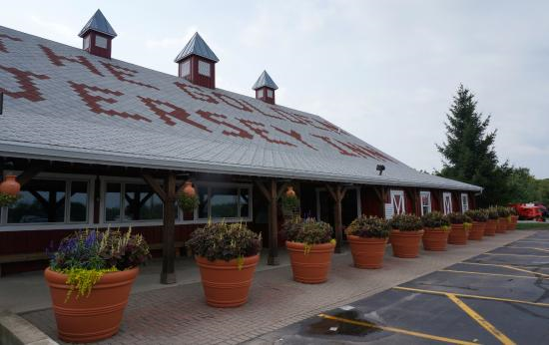
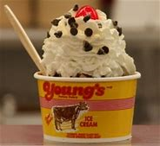
3 time supporter
$30 Family fun pass at Young’s Dairy in Yellow Springs, Ohio.
Golf passes expire 10/31/2019
Food certificates expire 12/31/2019
Item 26

Slide 15

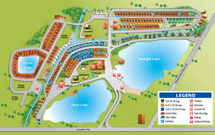

2 night stay at Arrowhead Lakes and resort in Wapakonta, Ohio a
$200 dollar value.
Expires 10/2021
2 time supporter

Slide 16




3 passes which admit 4 people to the Dayton Funny Bone.
The Greene, 88 Plum St #200
Dayton, OH 45440

Slide 17
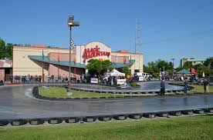


One certificate for a PARENT’s night out
Includes Golf, drinks, and popcorn retail value of $25
Expires Mar. 11, 2020.
2 time supporter
8350 Lyra Dr, Columbus, OH 43240
One certificate for a family package which
Includes 1 Laser tag game, 1 Bumper Boat ride,
1 Go Kart, and 18 holes of golf retail value of $40
Expires March 11, 2020

Slide 18
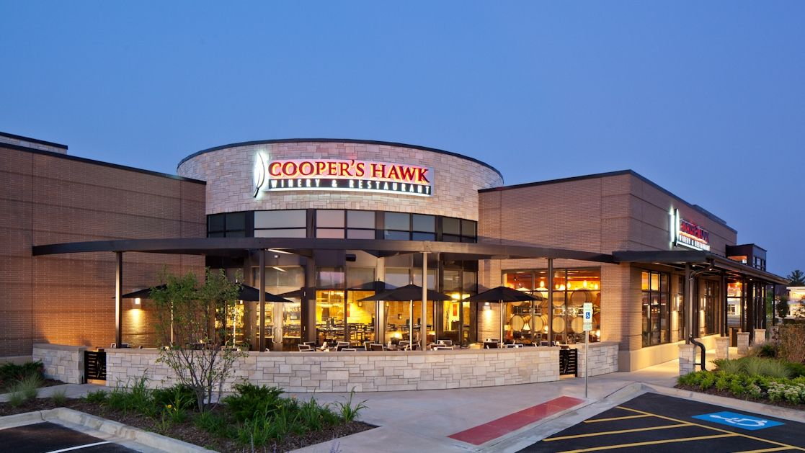



Locations in Ohio
CENTERVILLE, OH
5220 Cornerstone North Blvd
Centerville, OH 45440
CINCINNATI, OH
8080 Montgomery Rd
Cincinnati, OH 45236
COLUMBUS, OH
4230 The Strand
Columbus, OH 43219
LIBERTY TOWNSHIP, OH
7490 Bales St
Liberty Township, OH 45069
ORANGE VILLAGE, OH
27200 Harvard Rd
Orange Village, OH 44122
Wine tasting experience for 4 valued at $52.00

Slide 19

Glass Rooster Cannery &
Old Hen Guest House
1673 South State Route 605
Sunbury, Ohio 43074
GIFT CERTIFICATE $25.00 To enroll in a class provided by Glass Rooster Cannery.
Classes include canning, soap making, and a variety of cooking classes.
1st time supporter

Slide 20
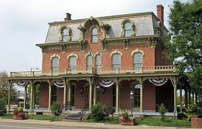
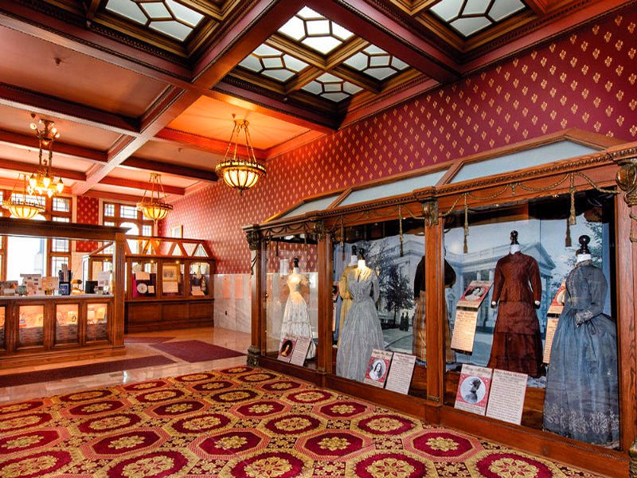

Guided tour for 4 to the only First Ladies museum in the United States, right here in Canton, Ohio.

Slide 21


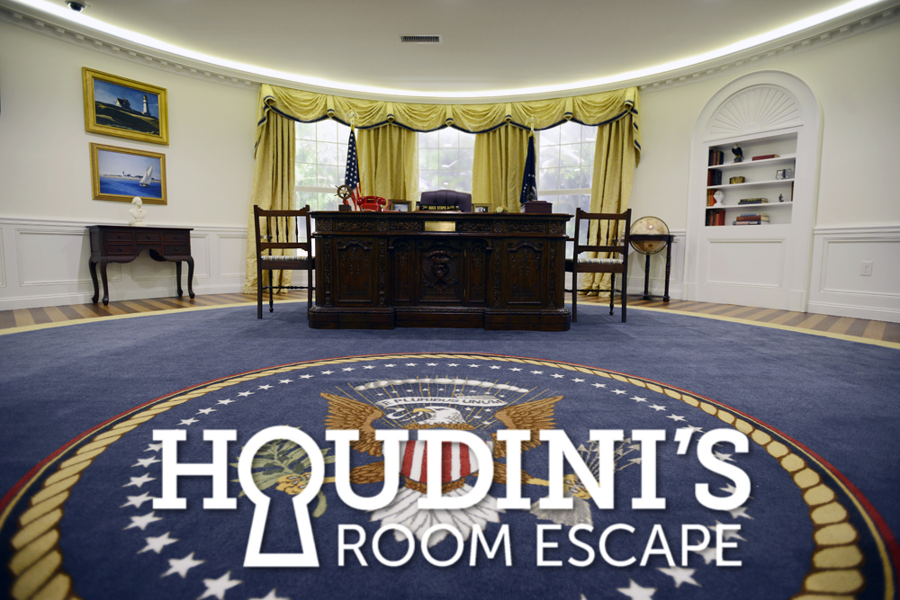
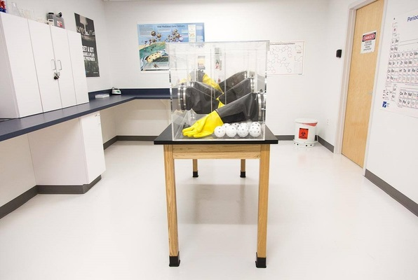
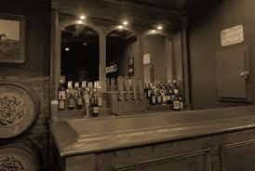
Gift certificate for 2 to Houdini’s room escape in Cincinnati, Ohio.
Family-run amusement center with 60-minute themed escape-room challenges for team building.
Address: 9309 Montgomery Rd, Cincinnati, OH 45242

Slide 22
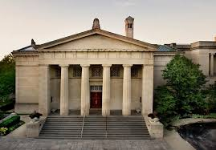
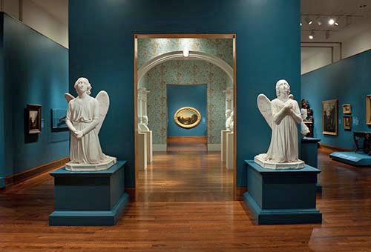
953 Eden Park Drive
Cincinnati, OH 45202
A family membership good for one year to the Cincinnati Art Museum a $75.00 dollar value.

Slide 23
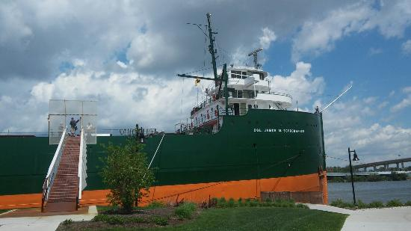
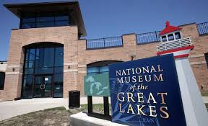

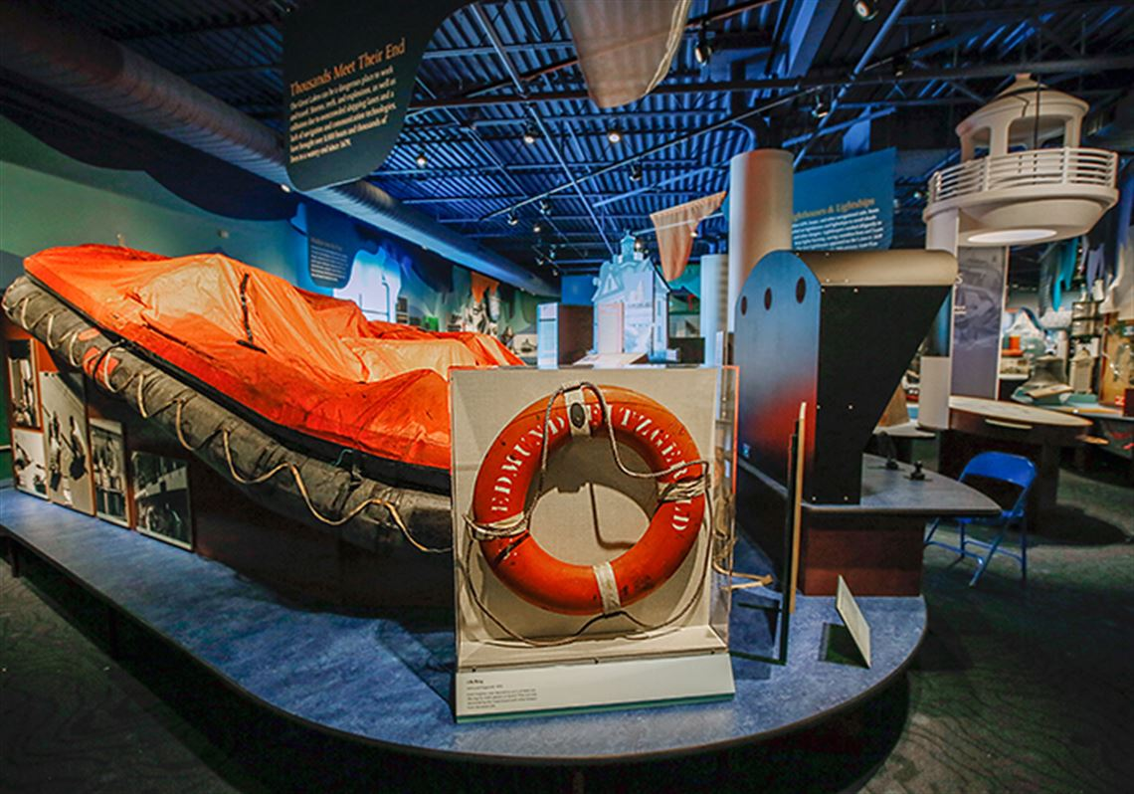
4 passes to the National Museum of the
Great Lakes a $68 value expires 10/16/2021

Slide 24

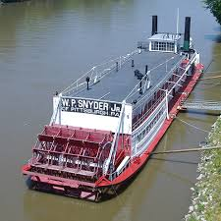

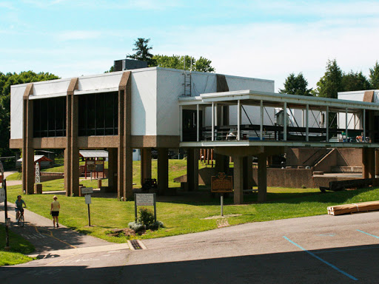
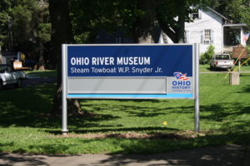

601 Front St, Marietta, OH 45750
Family pass to the Ohio River Museum

Slide 25
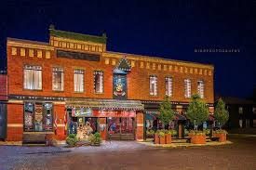
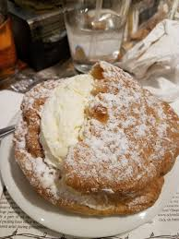


Two $20 gift certificates to Schmidts restaurant in German village.

Slide 26

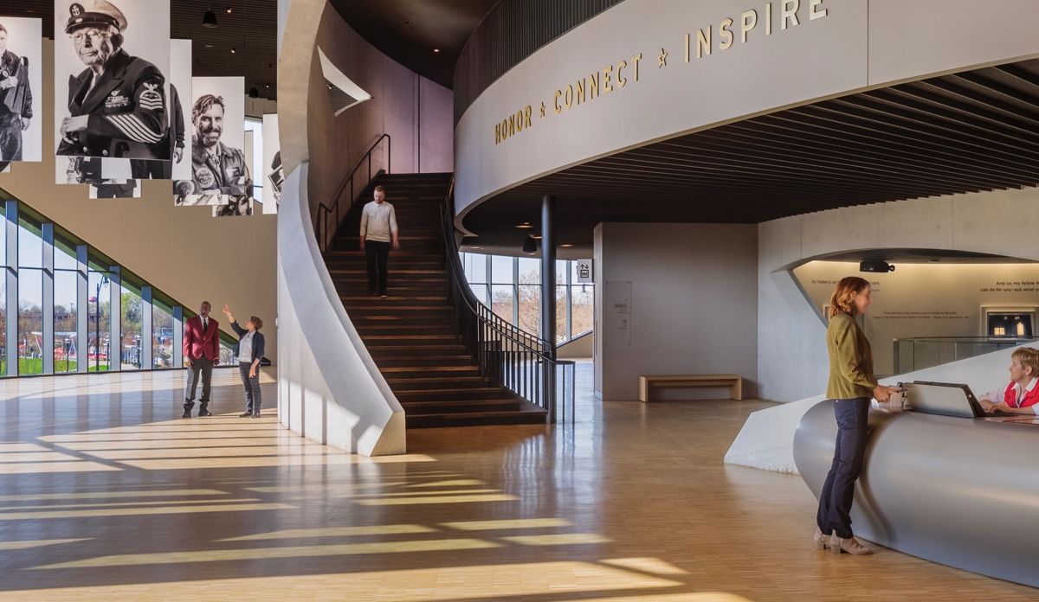
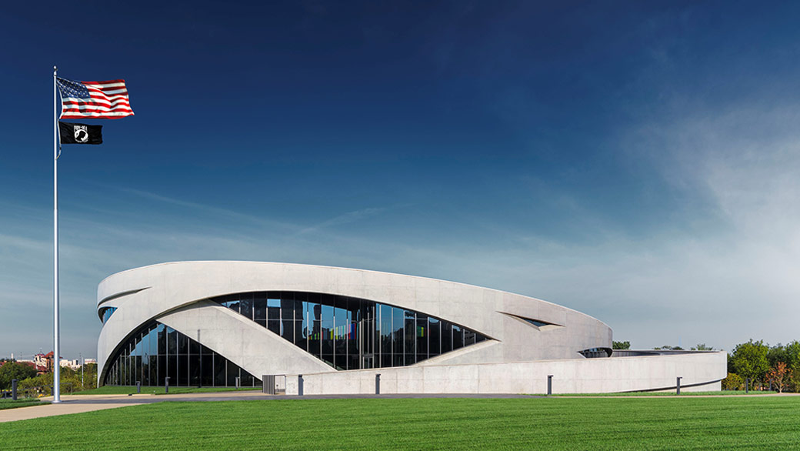
300 West Broad Street, Columbus, Ohio 43215
4 passes to National Veterans memorial museum

Slide 27


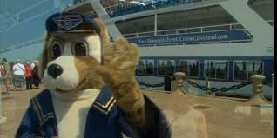
2 passes to “Narrated Sightseeing Tours”
825 E 9th St, Cleveland, OH 44114
NARRATED SIGHTSEEING TOURS
(Approximately 2-hour tours)
Saturday Cruise Times: 12Noon & 3PM
Sunday Cruise Times: 12Noon & 3PM
Memorial Day Cruise Times: 12Noon & 3PM
Adults $20.00 • Seniors $17.00 • Child $10.00 (ages 5-12) 4 & under are FREE

Slide 28
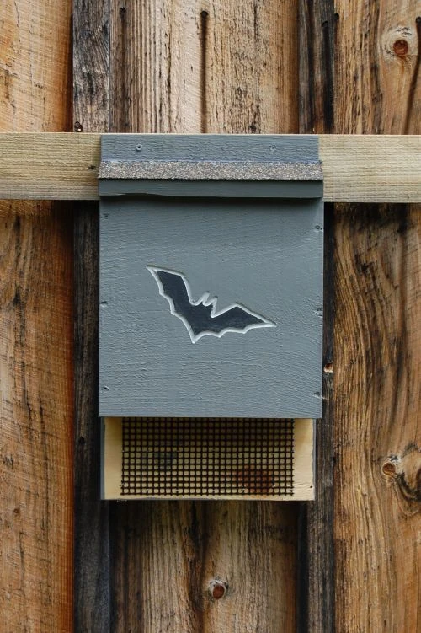
Two bat houses provided by Bill Lewis and his construction class at ORW.

Slide 29
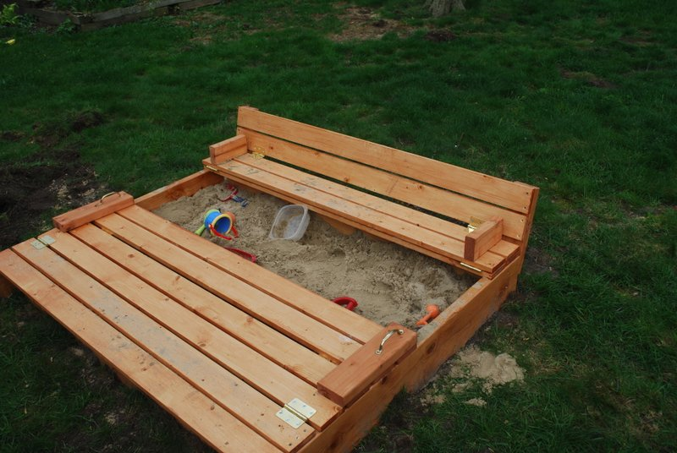
Cheyenne Boggs and his carpentry class at SECI has provided a 4 foot square sand box.

