Slide 1
A very special thanks to those who provided door prizes, game prizes, and silent auction items.
Send you bids to ceaosilentauction@gmail.com

Slide 2

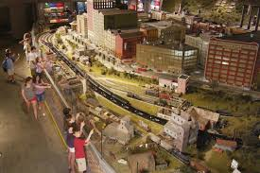

Train Journey – the World’s Largest Indoor Model Train display
Imagination Junction – children’s interactive play area
American Railroading Museum – how railroads have changed our lives
Expo Center – volunteer’s workshop, historical library, and Neil Young’s Lionel Traveling Train Display
A very special Thank You to EnterTRAINment
Junction.
For Providing a discount code to EVERY CEAO member to their facility.
For more information go to registration or any silent auction facilitator.
7379 Squire Ct, West Chester Township, OH 45069
Entire member support

Slide 3

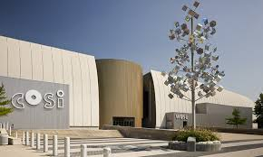
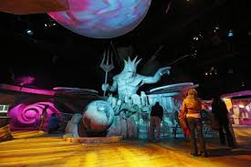
ITEM 1
4 time supporter
Send your bids to ceaosilentauction@gmail.com
Expires 6/15/2021

Slide 4
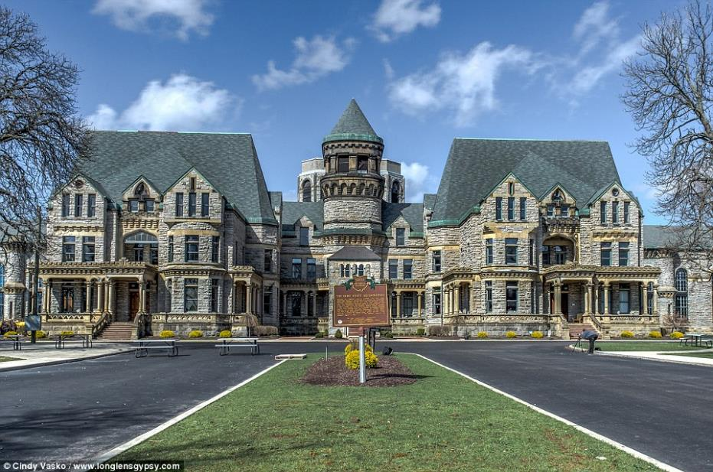

100 Reformatory Rd, Mansfield, OH 44905
2 admission tickets valued at $28.
Expires end of 2021 season
4 time supporter
Send your bids to ceaosilentauction@gmail.com
ITEM 2

Slide 5

Canceled expired
ITEM 3
Provided 4 super buffet gift certificates to their Epic Buffet. Expired 10/1/2020
4 time supporter
Send your bids to ceaosilentauction@gmail.com

Slide 6

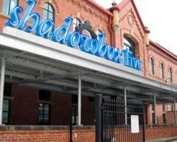
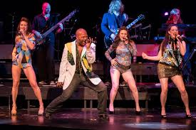
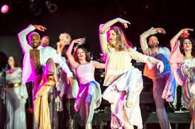
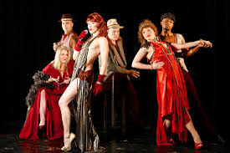

Send your bids to ceaosilentauction@gmail.com
503 S Front St #260, Columbus, OH 43215
One certificate good for up to 8 admissions to an evening show a $240 value
ITEM 4
One certificate good for up to 8 admissions to a lunch show a $80.
ITEM 5
4 time supporter
Not valid for Saturday 7:30 show
Not valid for Holiday Hoopla
Not valid for special events
Expires April 21, 2021

Slide 7

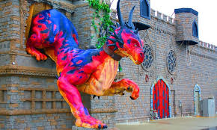

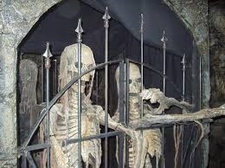
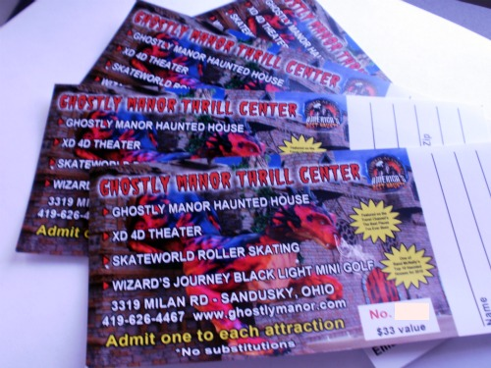
Send your bids to ceaosilentauction@gmail.com
4 time supporter
Item 6
Ghostly Manor has also provided 4 do it all passes
Valued at $100
Expire Oct 16, 2021

Slide 8

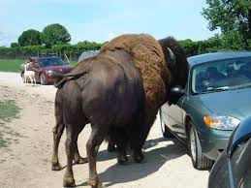
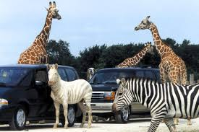
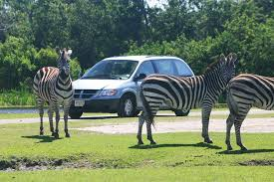
Send your bids to ceaosilentauction@gmail.com
ITEM 7
4 time supporter
A family pass valued at $191.60 Port Clinton. Expires end of 2021 season.

Slide 9

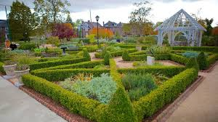
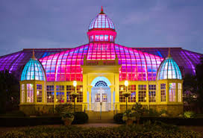

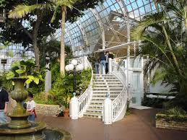
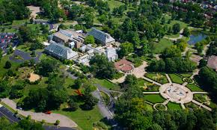
Send your bids to ceaosilentauction@gmail.com
ITEM 8
4 passes to the Franklin Park conservatory a $72.00 value
Expires 10/16/21
3 time supporter

Slide 10

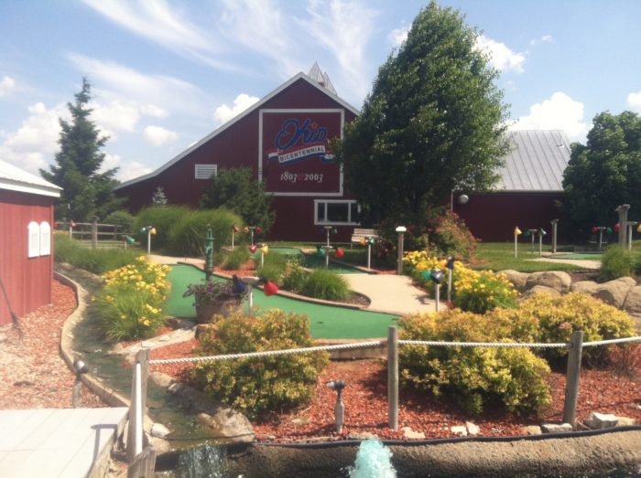
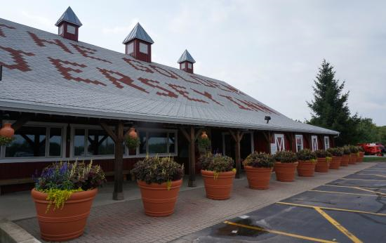
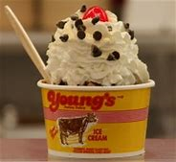
Send your bids to ceaosilentauction@gmail.com
3 time supporter
$30 Family fun pass at Young’s Dairy in Yellow Springs, Ohio.
Golf passes expires 10/30/2020
Food certificates expire 12/31/2020
ITEM 9

Slide 11

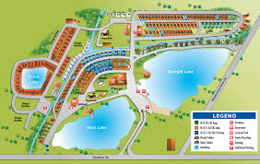

Send your bids to ceaosilentauction@gmail.com
2 night stay at Arrowhead Lakes and resort in Wapakonta, Ohio a
$200 dollar value.
Expires 10/14/2021
ITEM 10
2 time supporter

Slide 12
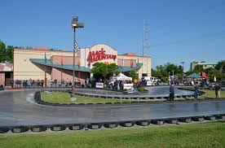


Send your bids to ceaosilentauction@gmail.com
One certificate for a PARENT’s night out
Includes Golf, drinks, and popcorn retail value of $25
Expires April 16/2021
2 time supporter
ITEM 11
8350 Lyra Dr, Columbus, OH 43240
One certificate for a family package which
Includes 1 Laser tag game, 1 Bumper Boat ride,
1 Go Kart, and 18 holes of golf retail value of $40
Expires April 16/2021
ITEM 12

Slide 13


Send your bids to ceaosilentauction@gmail.com
Glass Rooster Cannery &
Old Hen Guest House
1673 South State Route 605
Sunbury, Ohio 43074
GIFT CERTIFICATE $25.00 To enroll in a class provided by Glass Rooster Cannery.
Classes include canning, soap making, and a variety of cooking classes
Expires 12/31/2021.
ITEM 13
1st time supporter

Slide 14
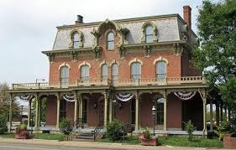
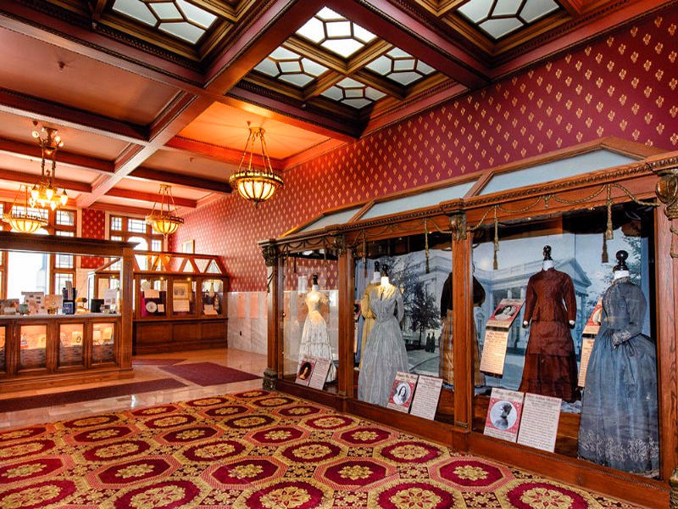


Guided tour for 4 to the only First Ladies museum in the United States, right here in Canton, Ohio. Expires 10/14/21
ITEM 14
Send your bids to ceaosilentauction@gmail.com

Slide 15
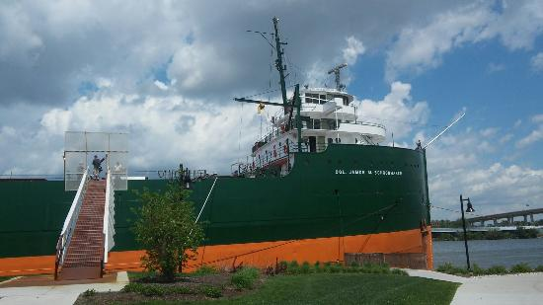
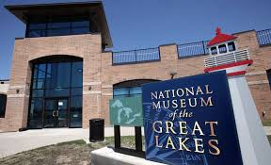

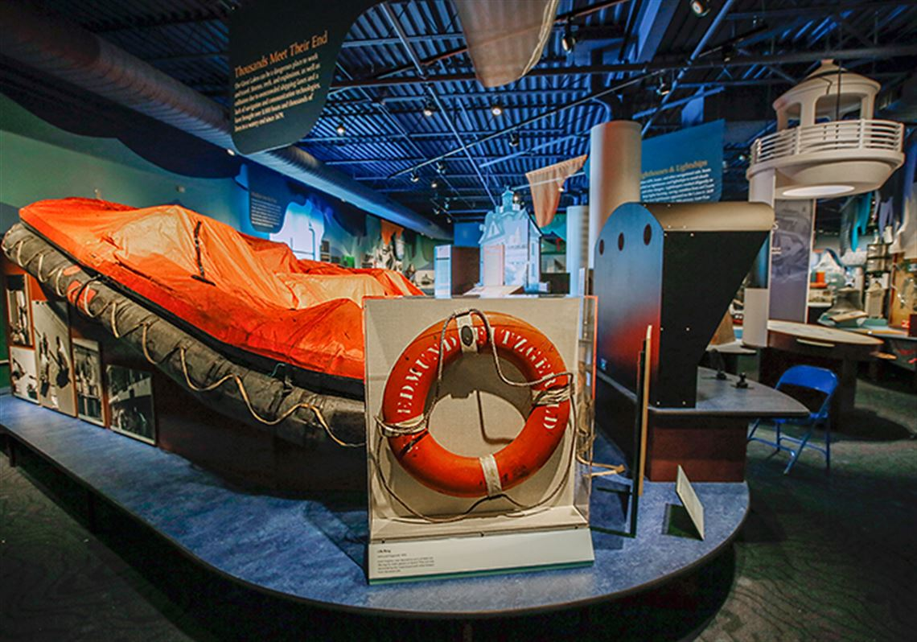

Send your bids to ceaosilentauction@gmail.com
4 passes to the National Museum of the
Great Lakes a $68 value expires 10/16/2021
ITEM 15

Slide 16

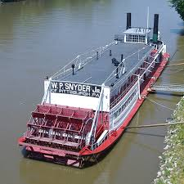

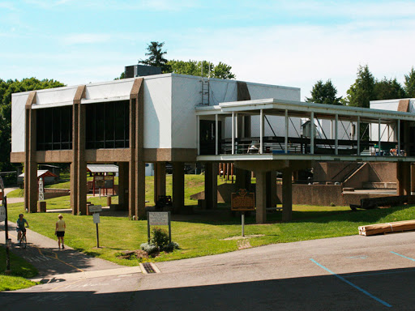
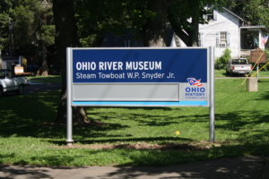

Send your bids to ceaosilentauction@gmail.com
601 Front St, Marietta, OH 45750
Family pass to the Ohio River Museum
Expires 12/31/2021
ITEM 16

Slide 17
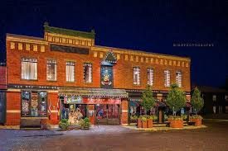
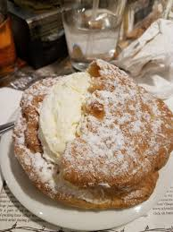


Two $20 gift certificates to Schmidts restaurant in German village. Expires 4/30/2021
ITEM 17
Send your bids to ceaosilentauction@gmail.com

Slide 18

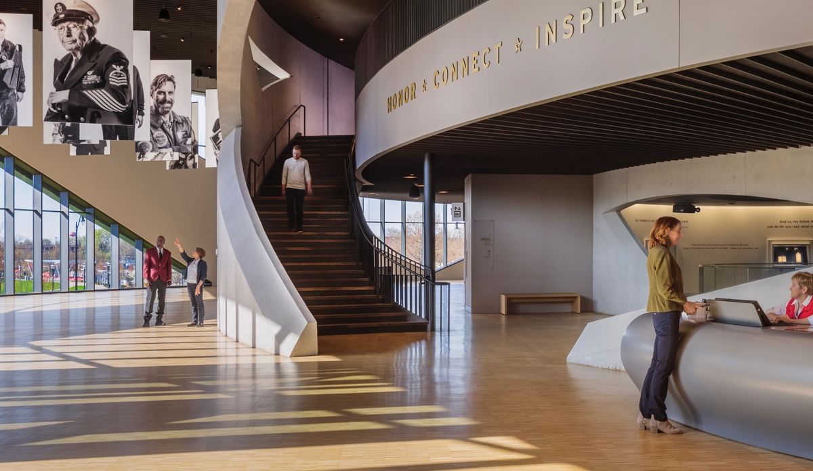
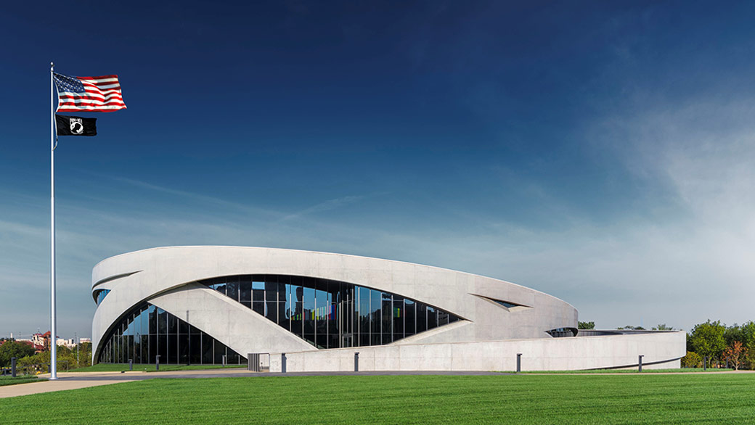
300 West Broad Street, Columbus, Ohio 43215
Send your bids to ceaosilentauction@gmail.com
4 passes to National Veterans memorial museum
Expires 12/31/2020 Valued at 17 dollars each.
ITEM 18

Slide 19


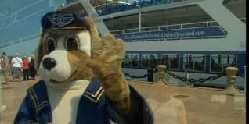
Send your bids to ceaosilentauction@gmail.com
2 passes to “Narrated Sightseeing Tours”
825 E 9th St, Cleveland, OH 44114
NARRATED SIGHTSEEING TOURS
(Approximately 2-hour tours)
Saturday Cruise Times: 12Noon & 3PM
Sunday Cruise Times: 12Noon & 3PM
Memorial Day Cruise Times: 12Noon & 3PM
Adults $20.00 • Seniors $17.00 • Child $10.00 (ages 5-12) 4 & under are FREE
ITEM 19

Slide 20
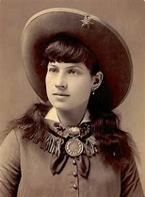
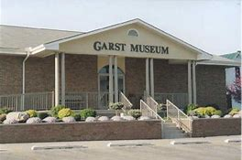

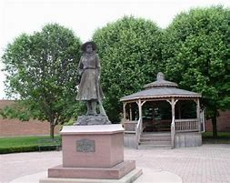

Send your bids to ceaosilentauction@gmail.com
Anne Oakley museum two admission tickets valued at 20 dollars Expires 07/01/2021
Garst Museum
205 North Broadway
Greenville, OH 45331
Phone: 937.548.5250
information@garstmuseum.org
ITEM 20

Slide 21
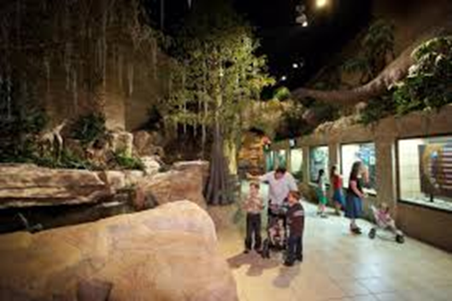
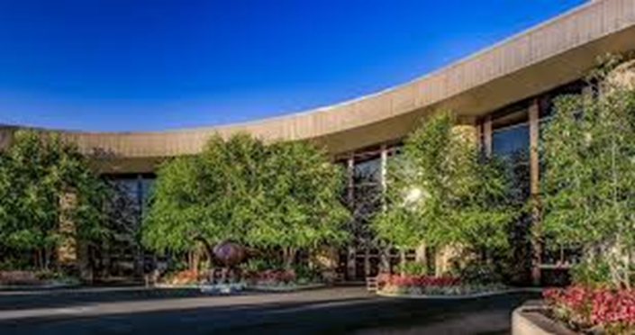




3 time supporter
Admission for 2 to the Creation Museum at $80 value located
at Bullitsburg Church R. Petersburg, Ky 41080 expires 9/2/2021
Item 21

Slide 22
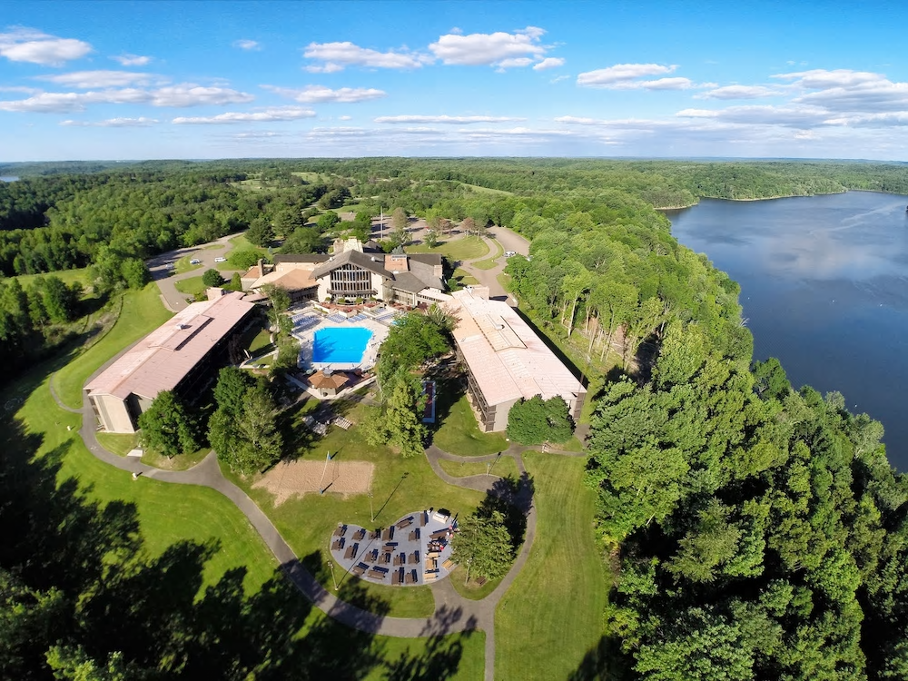
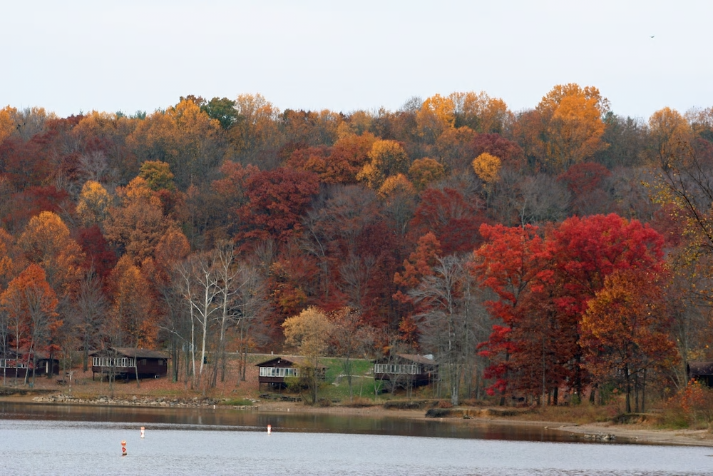
Item 22
1st time supporter
A night’s lodging for two in one of the guest rooms in the lodge at
Salt Fork Lodge and Conference Center. Certificate may be used on a
Space-available basis between Sept. 2020 and Dec. 30, 2021.
Excludes theme weekends, holidays and summer weekends (some
Blackout dates may apply.
Located On US Route 22 east, Cambridge, Ohio 43725
Estimated value of $200

