Slide 1
Industrial Hemp & Medical Cannabis
Program Manager Cody James

Slide 2
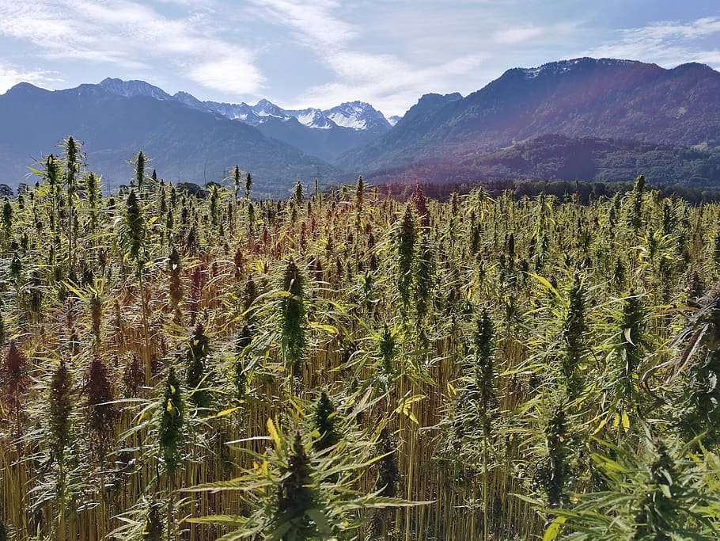
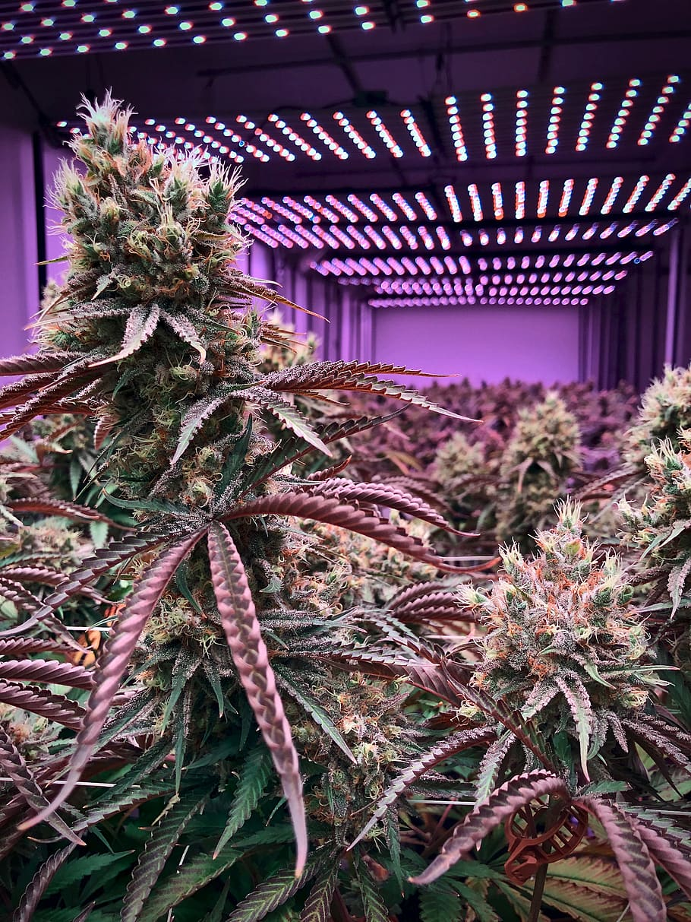
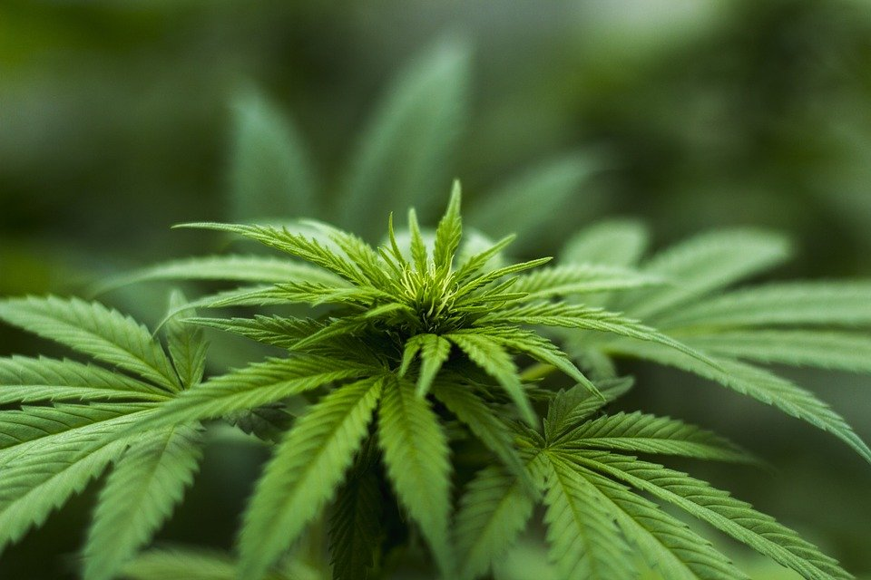
Industrial Hemp vs. Medical Cannabis
"Industrial Hemp" means any part of a cannabis plant, whether growing or not, with a concentration of less than 0.3% tetrahydrocannabinol (THC) by weight.
"Cannabis" means any part of a marijuana plant.
"Cannabis" does not mean, for purposes of this rule, industrial hemp.

Slide 3
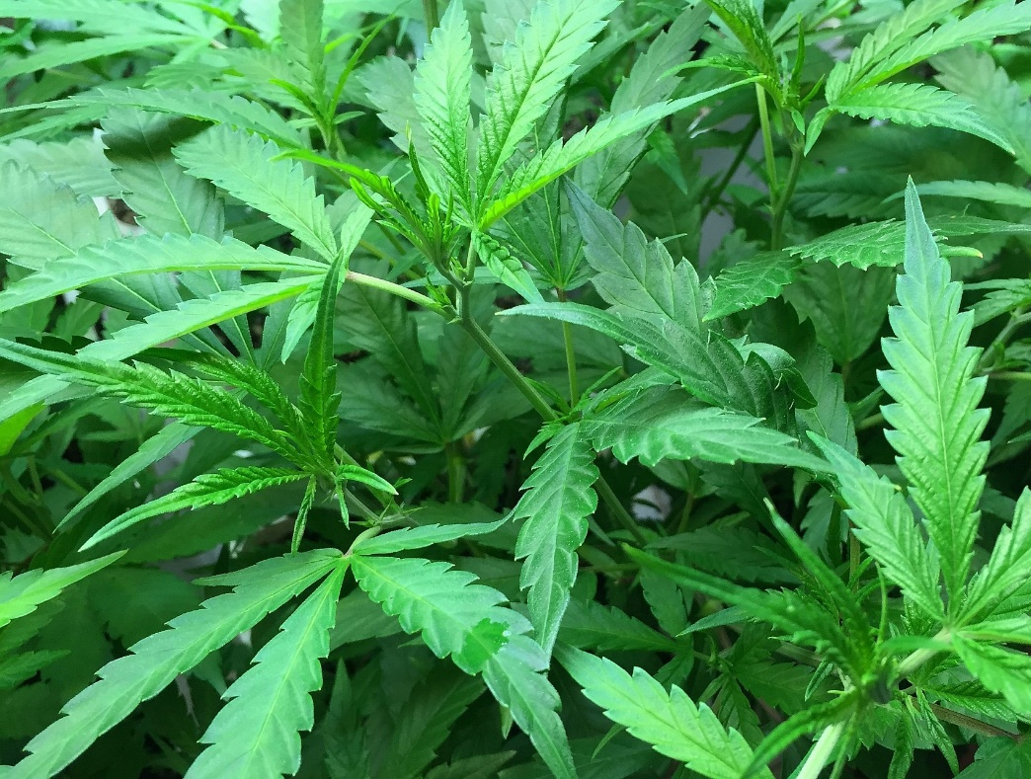
Cannabis
Industrial Hemp vs. Medical Marijuana
Industrial Hemp: Traditionally Cannabis Sativa = LESS than 0.3% THC
Medical Marijuana: Any Cannabis = MORE than 0.3% THC
For Example: Sweet Corn vs. Field Corn
Both Corn, Different Uses
Industrial hemp comes from a type of Cannabis plant and is used to produce medicinal CBD oil, consumable hemp seeds, hemp oil for cosmetics or aromatherapy, and hemp fibers for clothing and other goods
Medical Marijuana comes from a variation of Cannabis plant and is processed into a variety of formats for medicinal purposes

Slide 4
Cannabis
Fun Facts about Cannabis
Three main species and Hybrids – Indica, Sativa and Ruderalis (auto-flowering)
Most likely to have originated in Central Asia, spread to Europe, Africa then to South and North America, dating back to 12,000 BC
Cannabis is rich in cannabinoid compounds, there are currently more than 113 cannabinoids that have been isolated from various strains
THC is the only psychoactive cannabinoid currently known of
Other common cannabinoids – CBD, CBN, CBG,
All cannabis outlawed in the United States in 1937
Avg. THC content in 1978 – 1.37%
Avg. THC content in 2008 – 8.52%
Avg. THC content in 2013 – 10.05%
THC has been manipulated and engineered for decades now, just starting to see potential of where all other cannabinoids are headed
California is the cannabis capital of the world, it grew 13.5 million lbs in 2017 and only consumed 2.5 million lbs

Slide 5
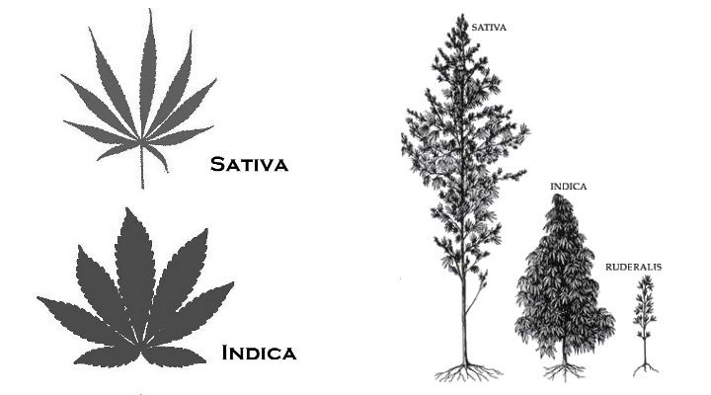
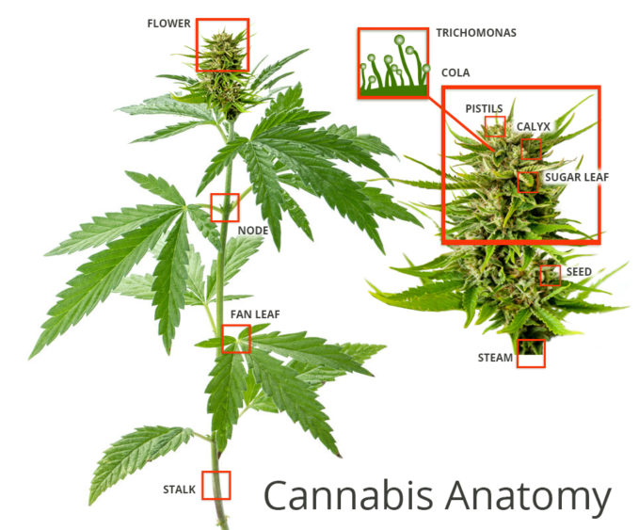
Cannabis
Species and Anatomy of the Cannabis Plant

Slide 6
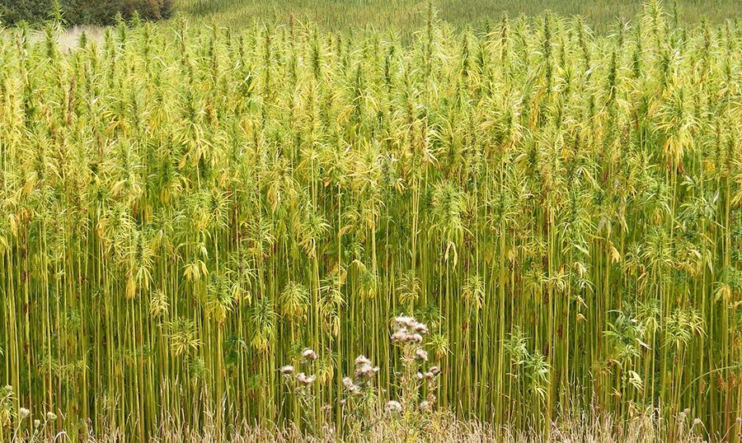
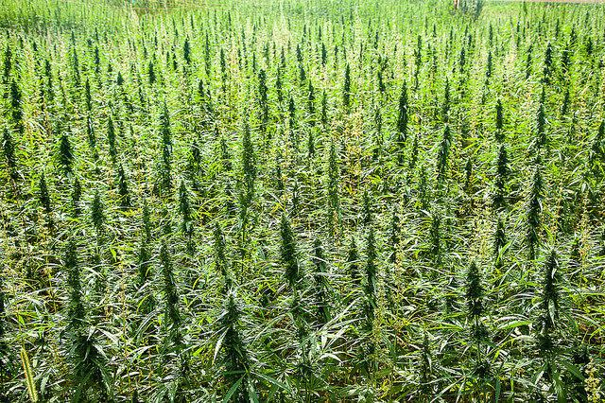
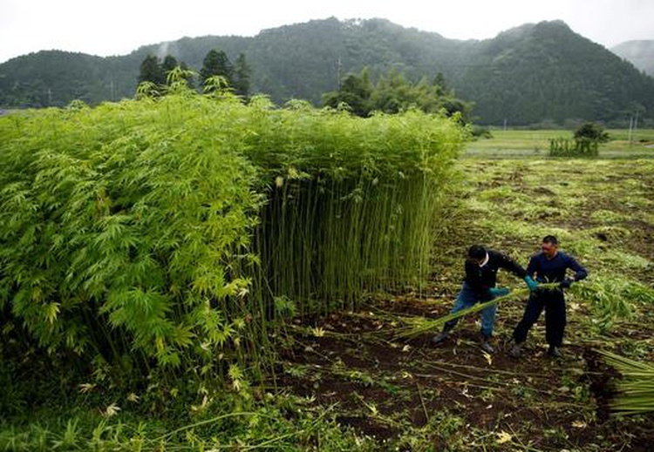
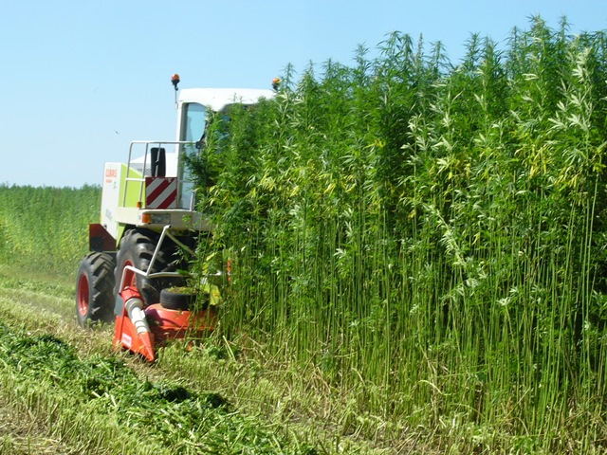
Cannabis
Traditional Hemp Cultivars used for Fiber

Slide 7
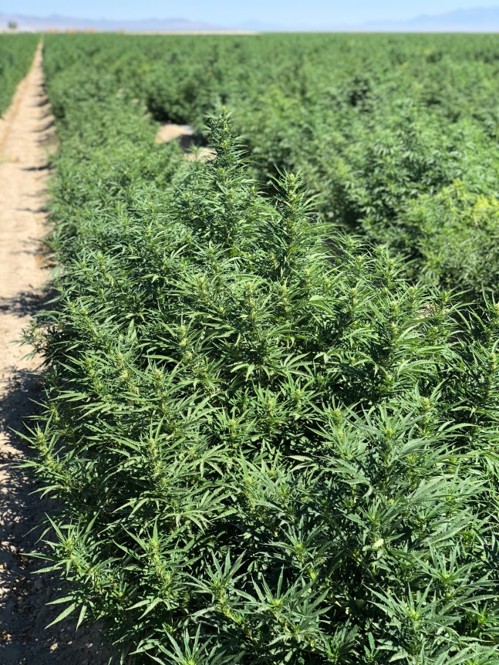
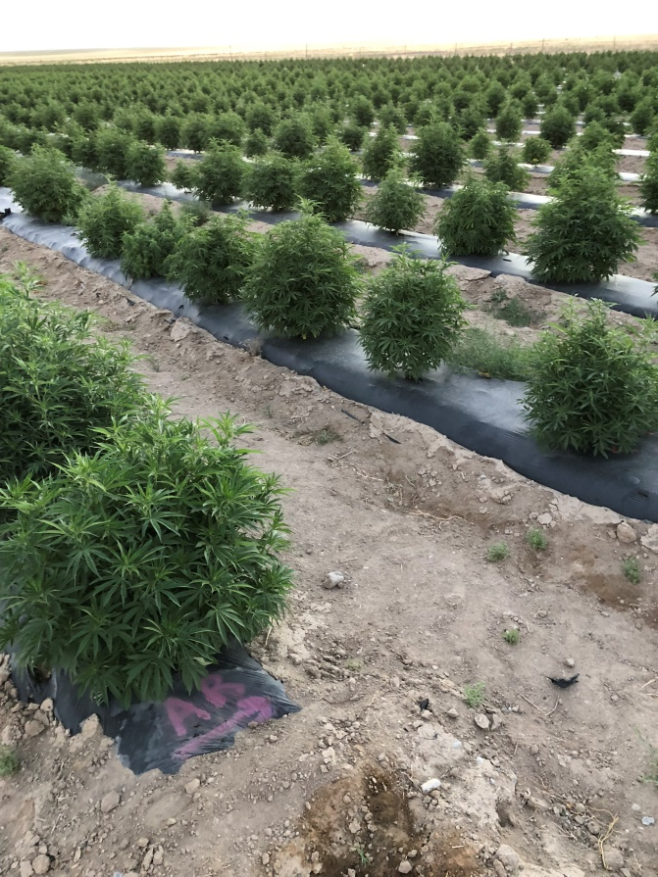
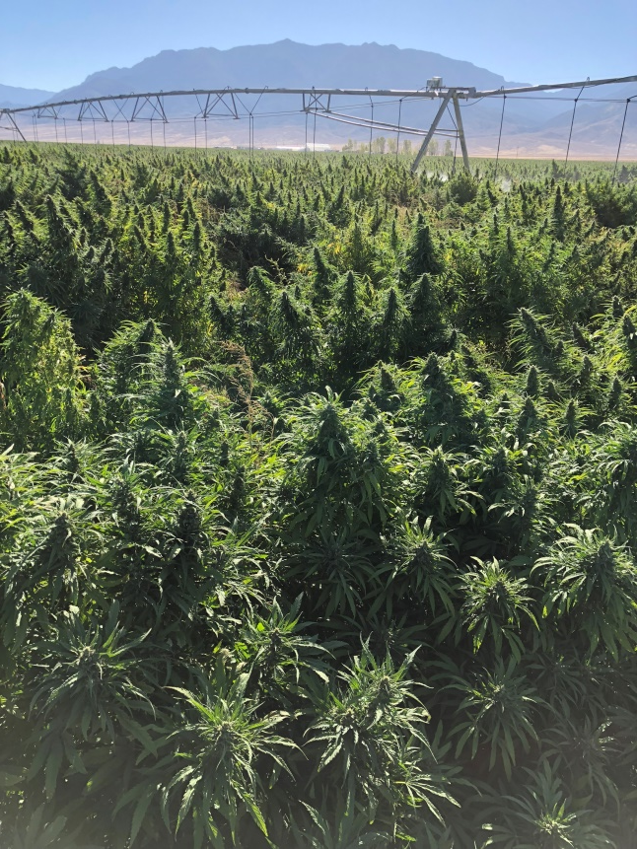
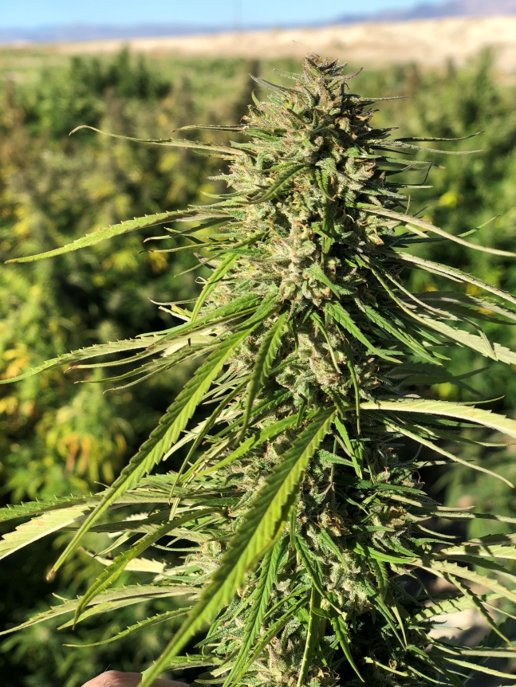
Cannabis
Modern Hemp Cultivars used for Cannabinoid Production

Slide 8
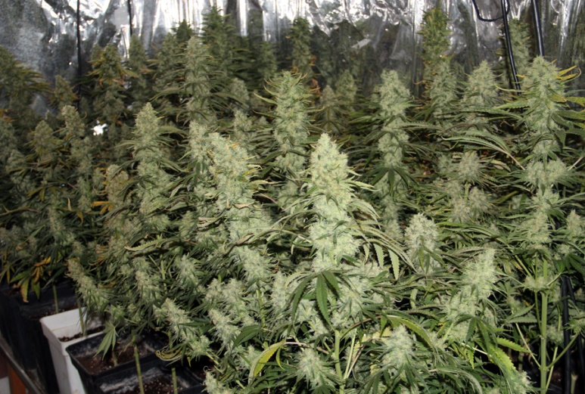
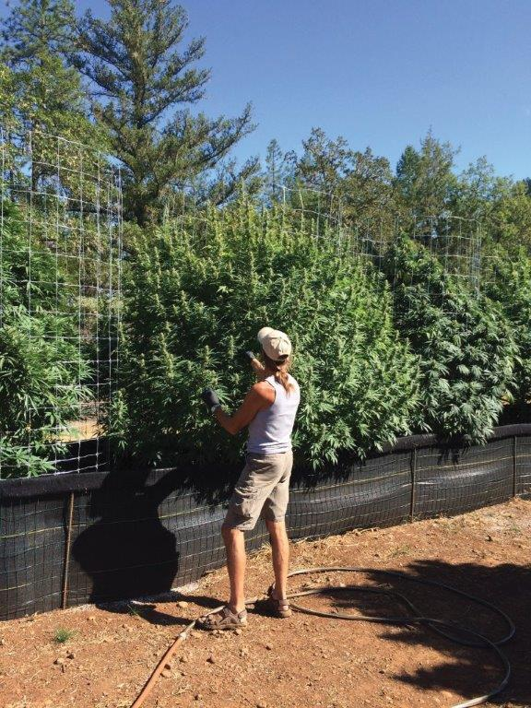
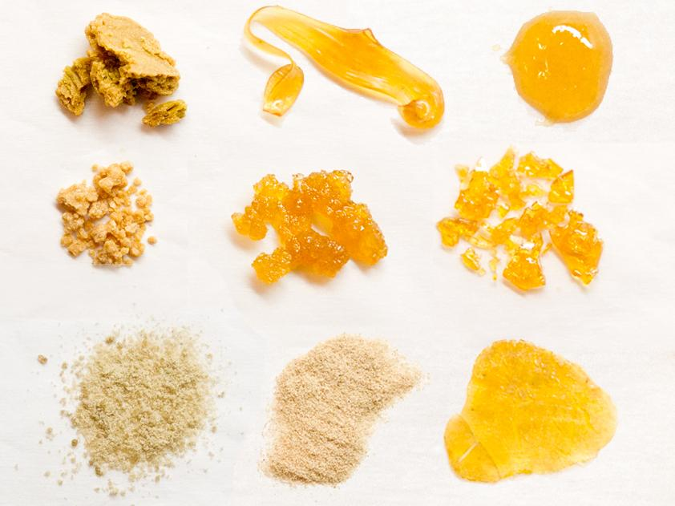
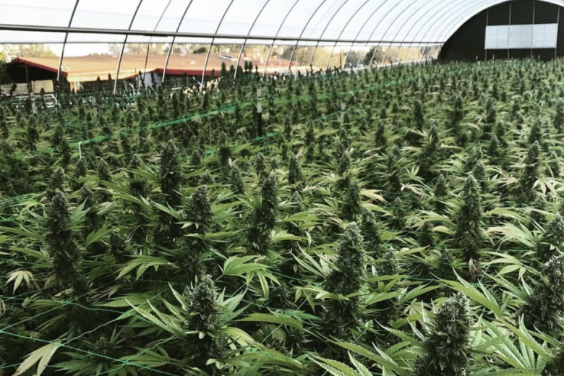
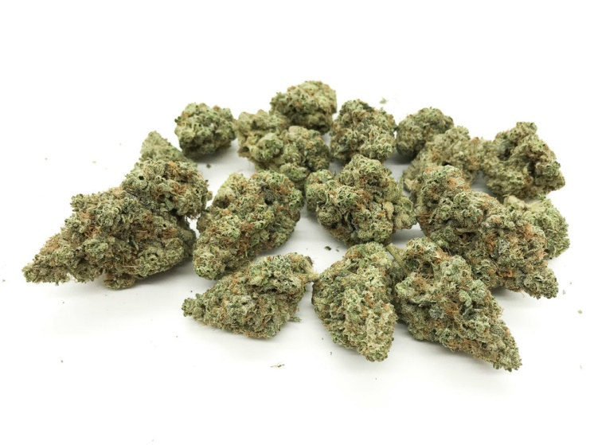
Cannabis
Cannabis Cultivars used for THC production

Slide 9
Utah Medical Cannabis Program

Slide 10
Utah Medical Cannabis Program
Utah Department of Agriculture and Food’s portion of the state’s Medical Cannabis program provides regulatory oversight and support for medical cannabis cultivators, processors and testing labs.

Slide 11
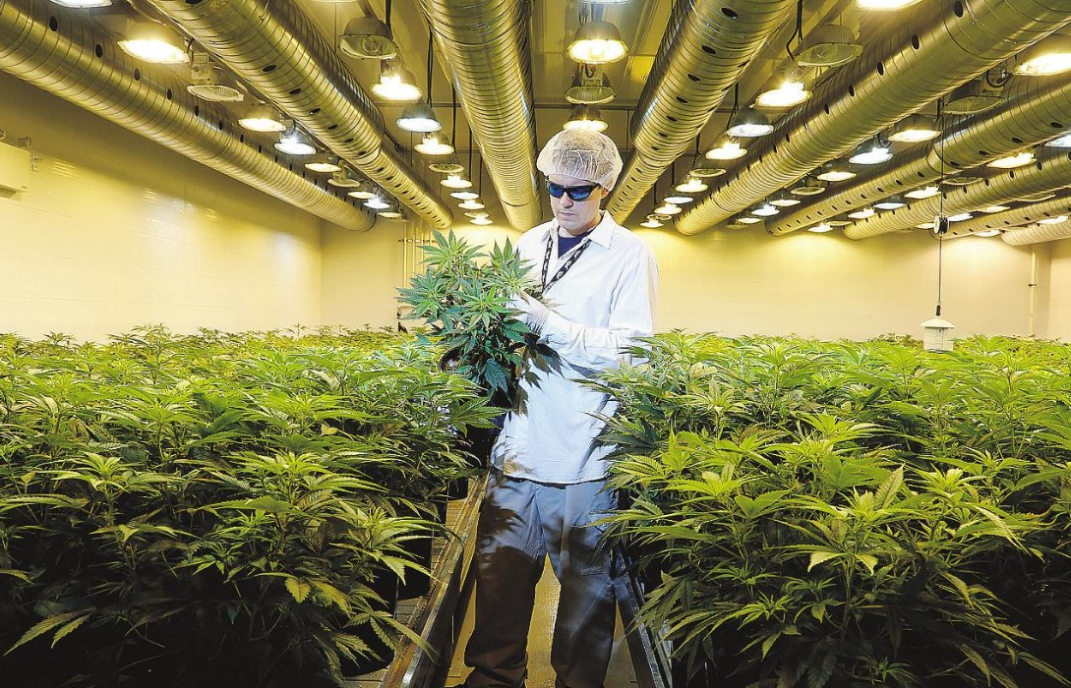
Interesting Cannabis Cultivation Laws
UDAF tasked with regulating
Medical cannabis cultivation facilities (Capped)
Currently 8 growers
Can add up to 7 more according to law
Utah Medical Cannabis Act
Indoor and outdoor cultivation facilities
Indoor limited to 100,000 sq. ft.
Outdoor limited to 4 acres
Combination of both
2 locations allowed
Municipalities and counties must allow in respective industrial and agricultural zones

Slide 12
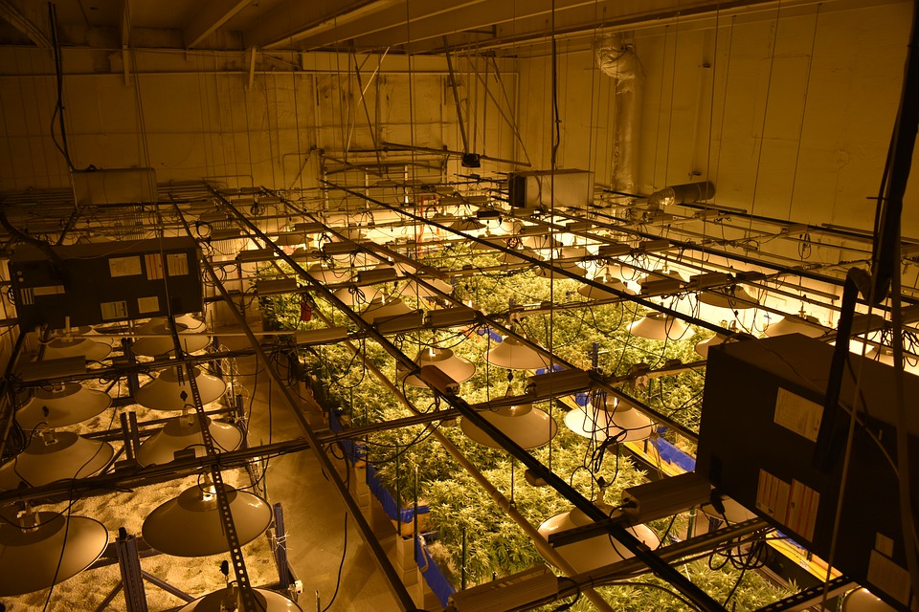
Medical Cannabis Growers - Licenses
Initial Licensing in 2019 used a Request For Proposal (RFP) platform - similar to contracts
A group of 6 Individuals independently reviewed over 80 RFP’s.
Information being scored:
Experience with
Complying with a regulatory environment
Tracking of inventory
Training, evaluating, and monitoring employees
Safety and security
Proposed Facility layout
Security - Facility, Transportation, Inventory Control
Facility meeting the requirements of layout if indoor/outdoor/both 4. Proposed location
Business Plan
short term, medium, plan, and long term plan for your cannabis cultivation facility;
Timeline
The projected first harvest date, and date product is to be sent to process.
a long term plan for production after March 1, 2020.
Licensed: 8 Growers

Slide 13
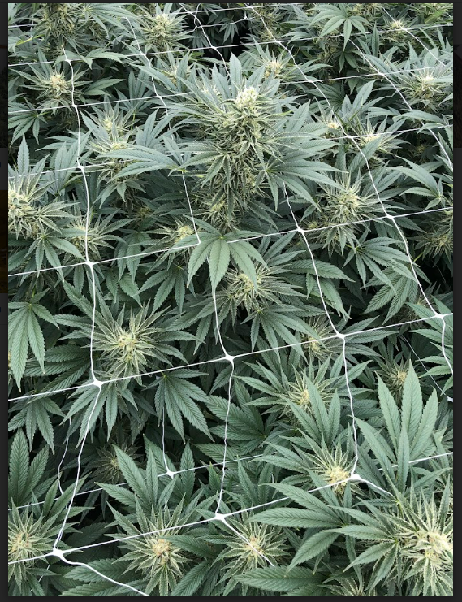
Medical Cannabis Growers - Application Requirements
Proposed name and address or, for a cannabis cultivation facility, addresses of no more than two facility locations, located in an agricultural or industrial zone.
Name and address of any individual who has: a financial or voting interest of 2% or greater in the proposed cannabis production establishment; or the power to direct or cause the management or control of a proposed cannabis production establishment;.
Operating plan that includes operating procedures that comply with state law and any law the municipality or county adopts

Slide 14
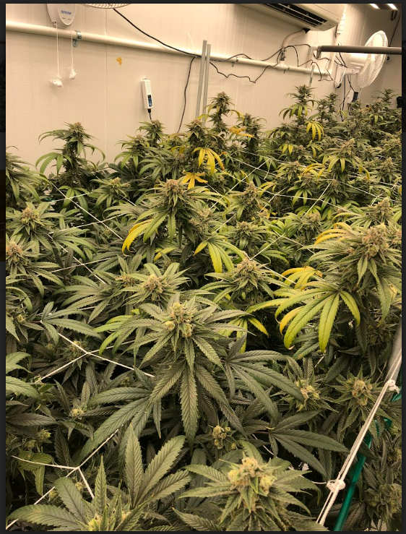
Medical Cannabis Growers - License Requirements
Obtain and maintain a performance bond of at least $100,000
Not located within 1,000 feet of a community location; or within 600 feet of a district that the relevant municipality or county has zoned as primarily residential.
Background checks each individual who has a financial or voting interest of 2% or greater in the applicant or who has the power to manage the facility

Slide 15
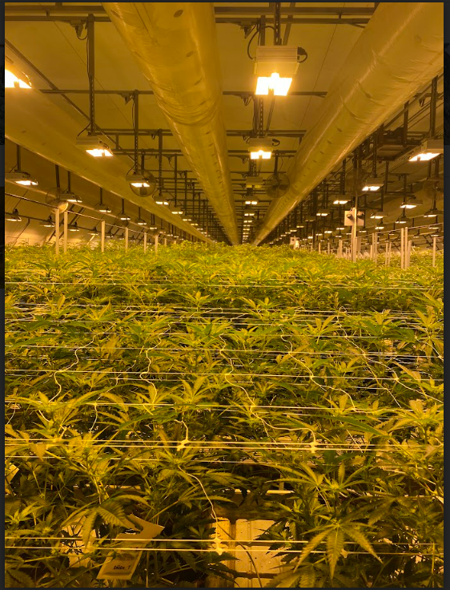
Medical Cannabis Grower - License Requirements pre -inspection
Before issuing a cannabis cultivation facility license, the department shall inspect the proposed premises to determine if the applicant complies with state laws and rules.
Inspections Include:
Verification of blueprints and security requirements
Area used for cultivation
Drying and curing methods
Emergency Procedures
Fertilizer and pesticide use
Waste Disposal
Certified scales
How they limit access to areas

Slide 16
Medical Cannabis Grower Inventory Control
Plants eight inches in height with a root ball shall be issued a unique identification number in the inventory control system
Each cannabis plant, lot of usable cannabis trim, leaves, and other plant matter, test lot, and harvest lot shall be issued a unique identification number in the inventory control system
a physical tag with the unique identification number.
reconciled in the inventory control system at the close of business each day
movement of seedling or clone to the vegetation production area;
when plants are partially or fully harvested or destroyed;
when cannabis is being transported to other facilities;
samples used for testing and the testing results;e) a complete inventory of cannabis clones, plants, trim, or other plant material;
the weight of harvested cannabis plants immediately after harvest;
the weight and disposal of post-harvest waste materials;
the identity of the individual who disposed of the waste and the location of waste receptacle; andi) theft or loss, or suspected theft or loss, of cannabis

Slide 17
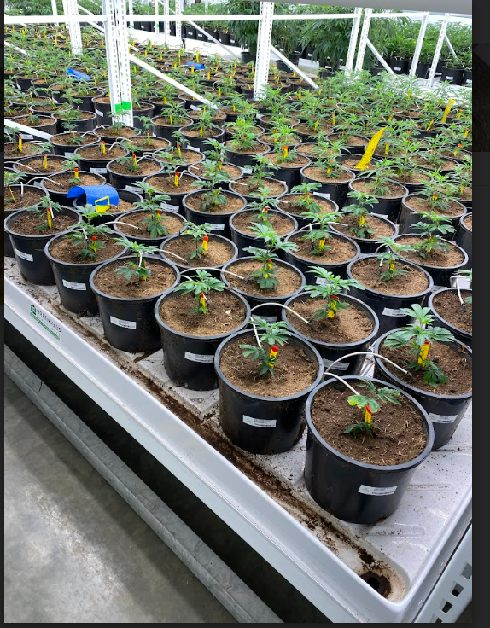
Medical Cannabis Grower Inventory Control
For plants under eight inches, the cultivation facility shall keep record of:
the number of cannabis seeds or cuttings planted;
the date they were planted;
the date the plants were moved into the vegetation area and tagged;
the strain of the seeds or cuttings;
the number of plants grown to maturity;
the number of plants disposed of; and
the date of disposal

Slide 18
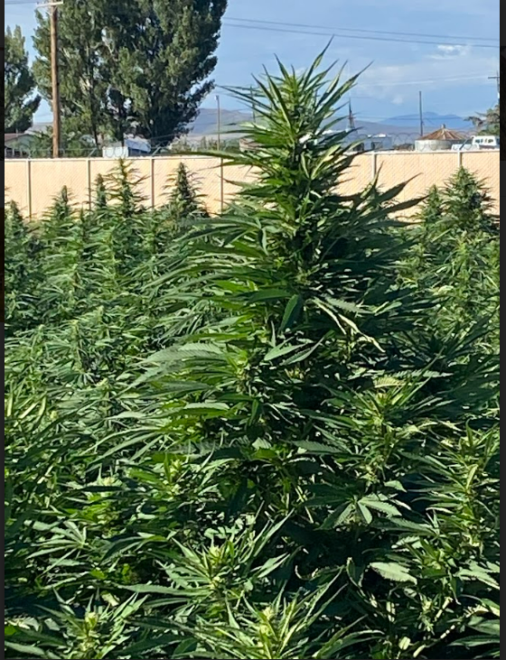
Medical Cannabis Grower License
A cannabis cultivation facility license allows the licensee to propagate, cultivate, harvest, trim, dry, cure, and package cannabis into lots for sale or transfer to a cannabis production facility.
Current Licensees: 8 Growers

Slide 19
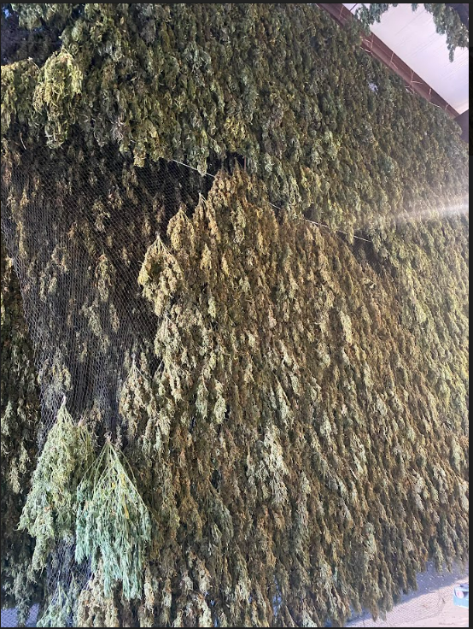
Medical Cannabis Grower Inspections
Inspections Include:
Facility/Security Requirements
Inventory/ Storage
Cannabis Cultivation Agent Cards
Pesticide and Fertilizer Use
Transportation
Waste Disposal
Inspected every 3 weeks

Slide 20
Interesting Cannabis Processing Laws
UDAF tasked with regulating
Medical cannabis processing facilities
Uncapped licenses
Utah Medical Cannabis Act
Tier 1 and Tier 2 facilities
A Tier 1 cannabis processing facility:
create cannabis concentrate
create cannabis derivative product
package and label final product.
A Tier 2 cannabis processing facility
package and label cannabis and cannabis final product
Production facilities are not allowed to advertise
Buildings and billboards not allowed
Brands are allowed

Slide 21
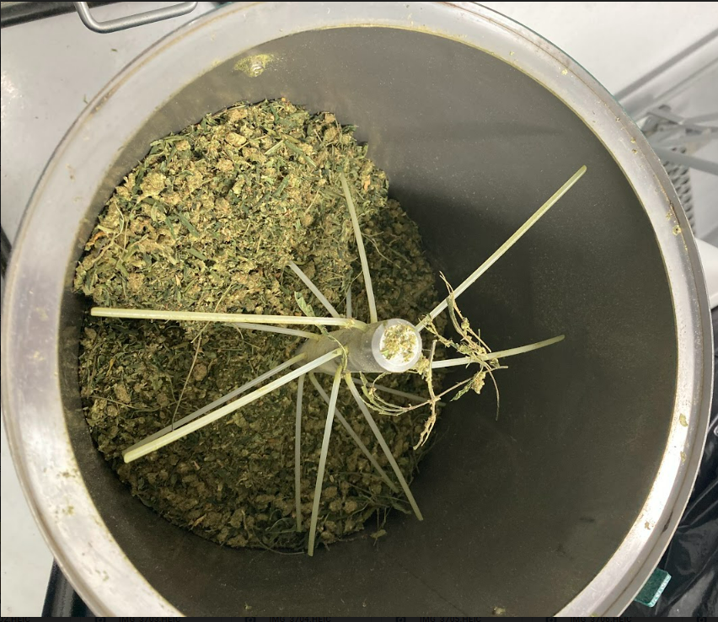
Medical Cannabis Processor - Licenses
Processors are licensed using a “normal” application process
Applications for a processor include:
statements,
forms,
diagrams,
operation plans,
copy of current Utah manufactured food establishment registration

Slide 22
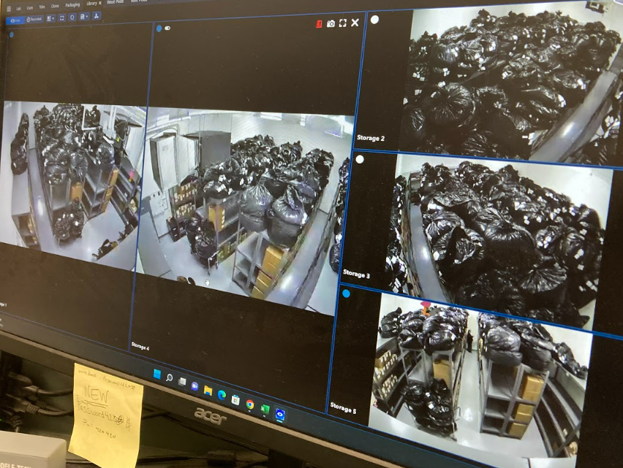
Medical Cannabis Processor - Licenses
Operating Plans
contain a blueprint of the facility containing the square footage of:
the areas where cannabis is to be extracted
the areas where cannabis or cannabis products are to be packaged and labeled
the areas where cannabis products are manufactured
storerooms for cannabis awaiting extraction
storerooms for cannabis awaiting further manufacturing
the area where finished cannabis and cannabis products are stored
the location of toilet facilities and hand washing facilities
the location of a break room and location of personal belonging lockers
the location of the areas to be used for loading and unloading of cannabis and cannabis products
the total square footage of the overall cannabis processing facility

Slide 23
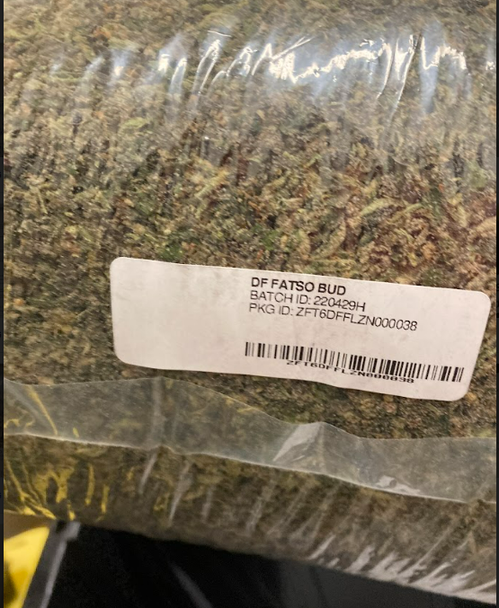
Medical Cannabis Processor - Licenses
Operating plans will include:
A cannabis processing facility shall have written emergency procedures
Fire
chemical spill
other emergency at the facility
A recall plan to handle potential recall and destruction of cannabis due to contamination

Slide 24
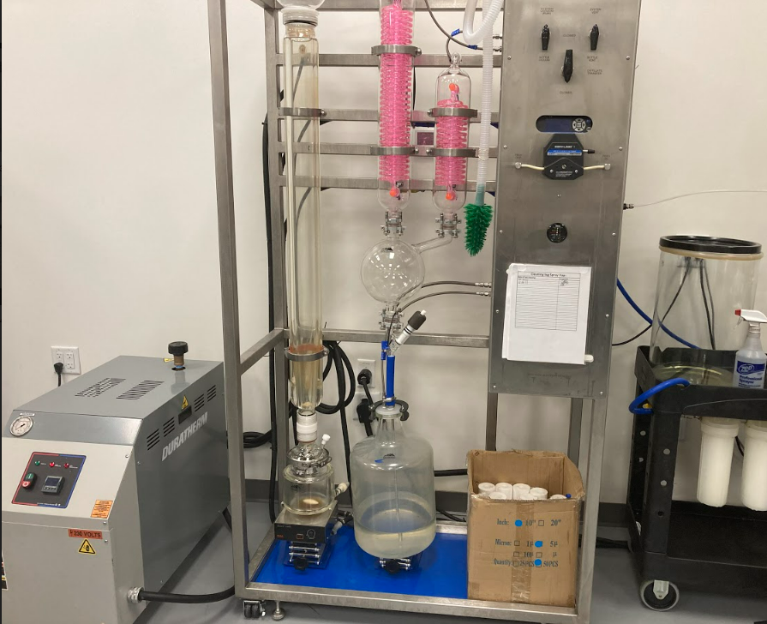
Medical Cannabis Processor - Licenses
Processors must prove that they use :
99% pure solvents for extraction
Professional grade and engineered extraction systems
Food Grade ingredients
Ability to remove solvents
And employees are fully trained in the use of the system and have access to applicable material safety data sheets.

Slide 25
Medical Cannabis Processor Inventory Control
Each batch or lot of cannabis, cannabis derivative product, cannabis product, test sample, or cannabis waste shall have a unique identifier in the inventory control system to be able to be traceable to the lot.
Each batch, lot, or sample of cannabis shall have a unique identification number that is displayed on a physical tag.
The following shall be reconciled in the inventory control system at the close of each business each day:
date and time material containing cannabis are being transported to a cannabis production establishment or medical cannabis pharmacy;
each sample used for testing and the test results
a complete inventory of material containing cannabis
cannabis product by unit count;e) weight per unit of product
weight and disposal of cannabis waste materials
the identity of who disposed of the cannabis waste and the location of the waste receptacles
theft or loss or suspected theft or loss of material containing cannabis.

Slide 26
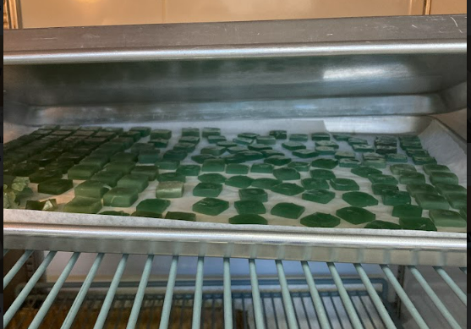
Medical Cannabis Processor Inspections
Inspections Include:
Facility/ Security Requirements
Extraction Requirements
Inventory/ Storage
Cannabis Processor Agent Cards
Transportation
Cannabis Waste Disposal
Current Licensees: Tier 1: 12 Tier 2: 2
Inspect every 2 -3 weeks

Slide 27
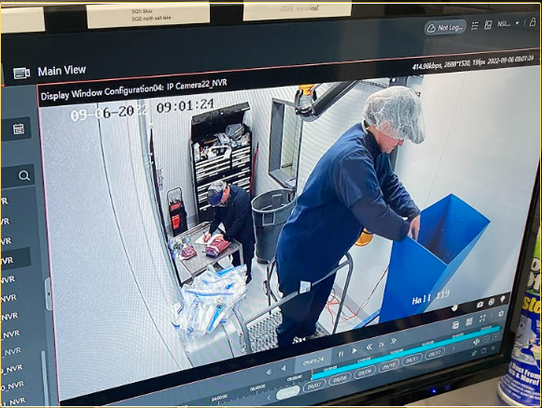
Medical Cannabis Facility Security Requirements
Security alarm system on each perimeter entry point and perimeter window.
Complete video surveillance system:
with a minimum camera resolution of 640 x 470 pixels or pixel equivalent for analog; and
that retains footage for at least 45 days.
Cameras shall be fixed, record continuously, and allow for the clear and certain identification of any person or activities in a controlled area:
each entrance and exit, or ingress and egress vantage point
each area within an indoor or outdoor room or area where cannabis is propagated, grown, harvested, dried, or trimmed
each area where cannabis is stored;
each area where cannabis waste is being moved, processed, stored, or destroyed
Security equipment- protected from tampering.

Slide 28
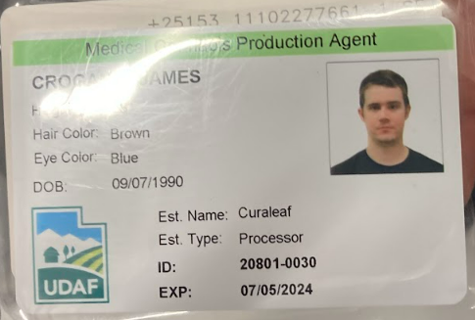
Medical Cannabis Facility Agents
Employees of cannabis production establishments must register as an agent (seasonal, temporary, or permanent employees.)
Individuals, who can’t be agents:
a pharmacist licensed under Title 58, Chapter 17b, Pharmacy Practice Act;
an advanced practice registered nurse licensed under Title 58, Chapter 31b, Nurse Practice Act;
a physician licensed under Title 58, Chapter 67, Utah Medical Practice Act, or Title 58, Chapter 68, Utah Osteopathic Medical Practice Act; or
a physician assistant licensed under Title 58, Chapter 70a, Utah Physician Assistant Act.

Slide 29
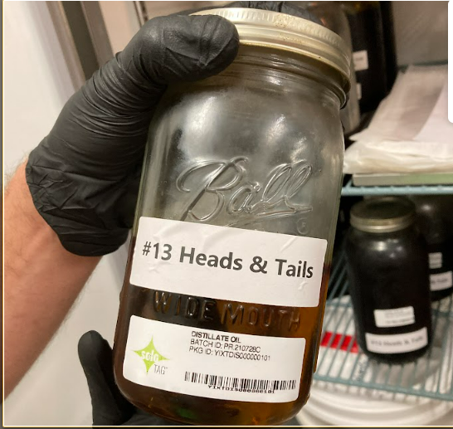
Medical Cannabis Facility Agents
Individuals must a pass a nationwide background check
the individual must not have been convicted under state or federal law of:
a felony; or after December 3, 2018, a misdemeanor for drug distribution.
Agent certification standard training:
in Utah medical cannabis law;
for a cannabis cultivation facility agent, in cannabis cultivation best practices;
for a cannabis processing facility agent, in cannabis processing, manufacturing safety procedures for items for human consumption, and sanitation best practices; and
for an independent cannabis testing laboratory agent, in cannabis testing best practices.
Registration is good for 2 years

Slide 30
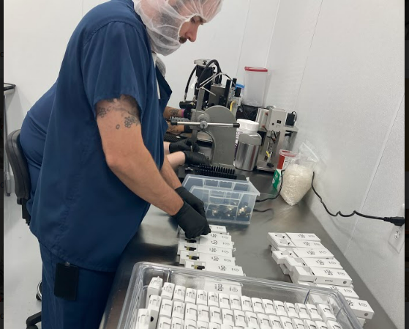
Medical Cannabis Facility Agents
Agent registration card with the agent at all times when:
on the premises of a cannabis production establishment
transporting cannabis in a medicinal dosage form, a cannabis product in a medicinal dosage form, or a medical cannabis device between:
two cannabis production establishments; or
a cannabis production establishment and a medical cannabis pharmacy
transporting raw cannabis plants to a cannabis processing facility or an independent cannabis testing laboratory.
Failure to carry the agent's cannabis production establishment agent registration card
(for a first or second offense in a two-year period:
guilty of an infraction; and subject to a $100 fine; or
for a third or subsequent offense in a two-year period:
guilty of a class C misdemeanor; and subject to a $750 fine.

Slide 31
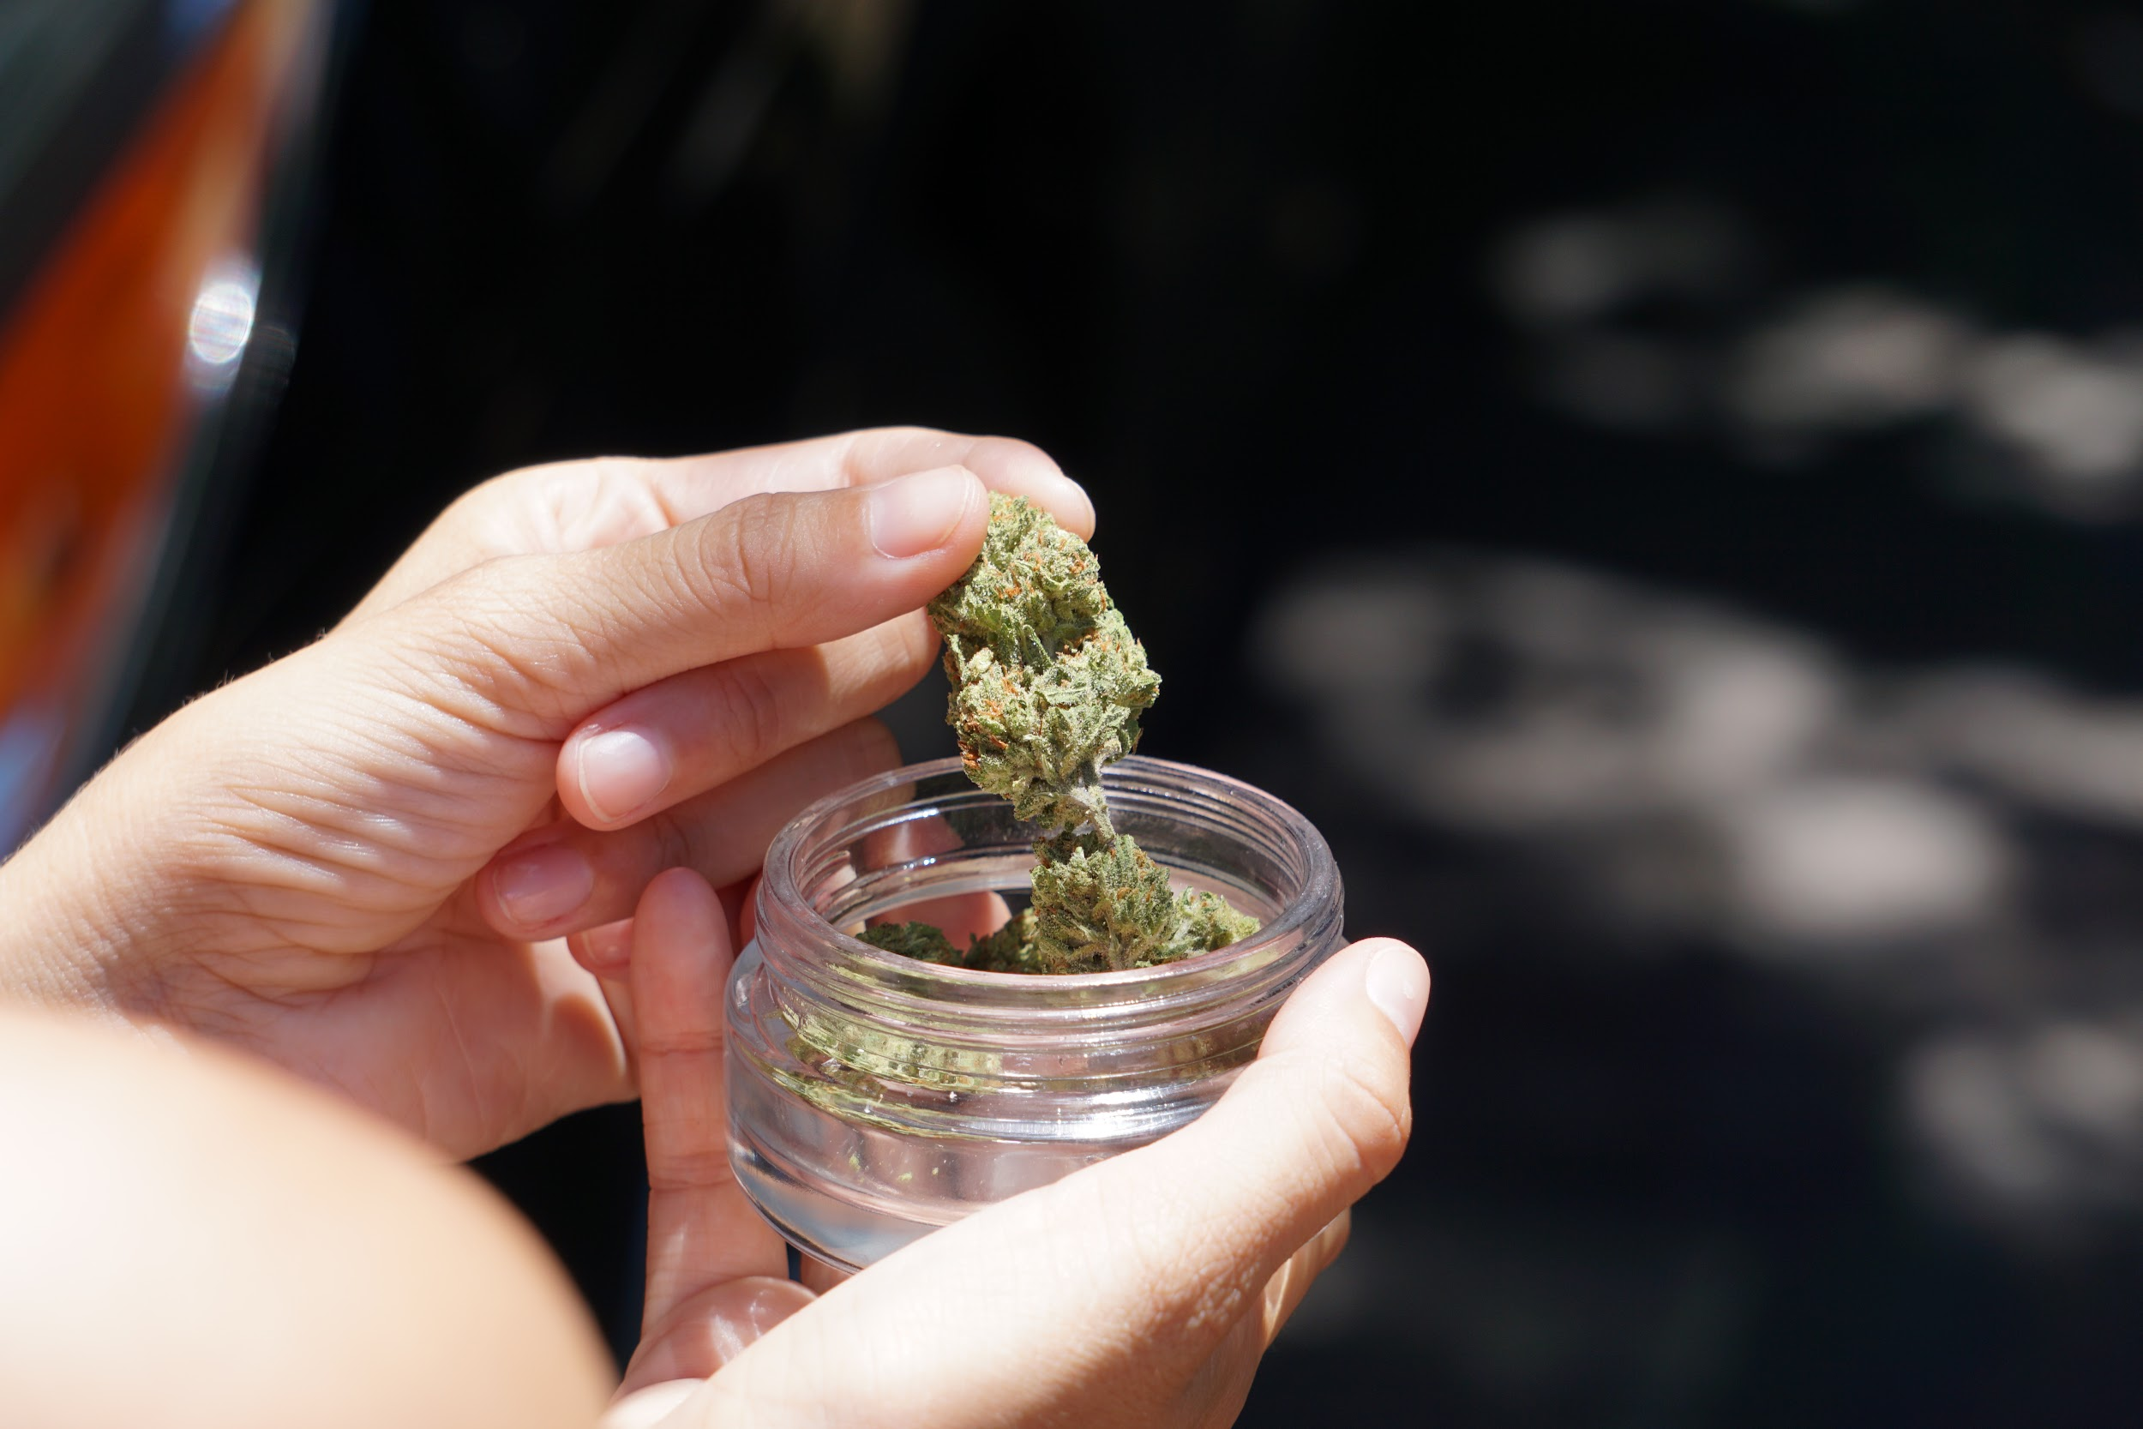
Medical Cannabis Product Regulation
Cannabis product -- Labeling
Label the cannabis or cannabis product with a label that:
clearly and unambiguously states that the cannabis product or package contains cannabis;
clearly displays the amount of total composite tetrahydrocannabinol, cannabidiol, and any known cannabinoids
a unique identification number that:
is connected to the inventory control system; and
identifies the unique cannabis product manufacturing process the cannabis processing facility used to manufacture the cannabis product;
identifies the cannabinoid extraction process that the cannabis processing facility used to create the cannabis product;
discloses each active or potentially active ingredient, in order of prominence, and possible allergen

Slide 32
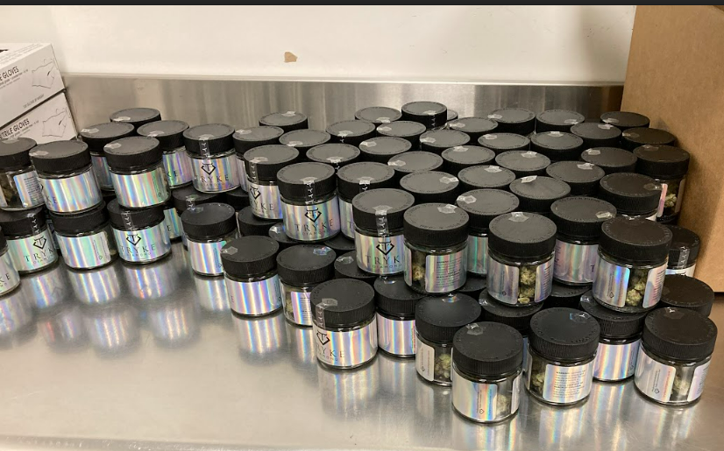
Medical Cannabis Product Regulation
R68-28-10(1) A cannabis processing facility may not produce a cannabis product that is designed to mimic a candy product.
2) A cannabis processing facility may not produce a product that includes a candy-like flavor or another flavor the facility knows or should know appeals to children.
R68-28-12. Labeling of Cannabis and Cannabis Product.
(2) A cannabis processing facility shall label cannabis and cannabis product before the sale of the cannabis or cannabis product to a medical cannabis pharmacy.

Slide 33
Medical Cannabis Product Quality Assurance and Safety
Before the sale of a cannabis product, an independent cannabis testing laboratory shall identify and quantify any cannabinoid known to be present in a cannabis product.
The department has rules on the standards, methods, practices, and procedures for the testing of cannabis and cannabis products by independent cannabis testing laboratories.
The department requires an independent cannabis testing laboratory to participate in a proficiency evaluation that the department conducts or that an organization that the department approves conducts.

Slide 34
Medical Cannabis Product Quality Assurance and Safety
Before the transfer of a cannabis product to a medical cannabis pharmacy a representative sample of the product shall be tested by an independent cannabis testing laboratory to determine:
the water activity of the sample, as determined applicable by the department; the quantity of any cannabinoid or terpene to be listed on the product label; the presence of adulterants in the sample
Adulterants are:
pesticides; heavy metals; solvents; microbial life; toxins; foreign matter

Slide 35
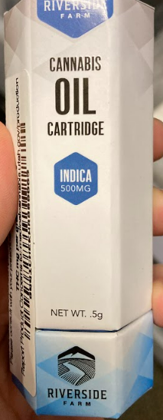
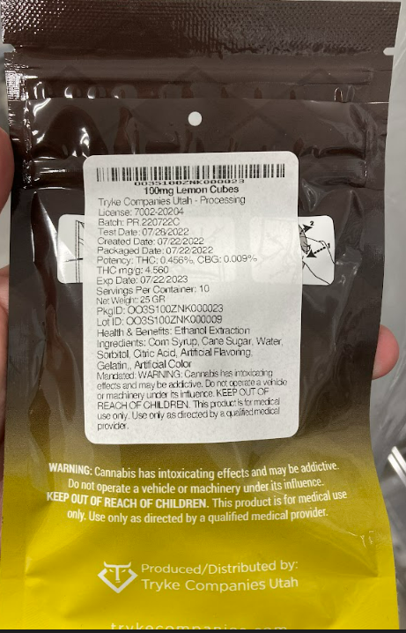
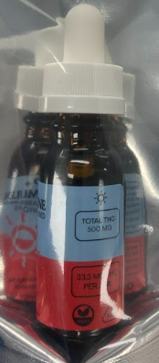
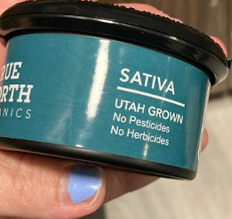
Medical Cannabis Product
Allowed Medicinal dosage form:
Tablet; capsule; concentrated liquid or viscous oil;
a liquid suspension that, after December 1, 2022, does not exceed 30 ml;
a topical preparation; transdermal preparation;sublingual preparation;
gelatinous cube, gelatinous rectangular cuboid, or lozenge in a cube or rectangular cuboid shape;
resin or wax; an aerosol; or
unprocessed cannabis flower

Slide 36
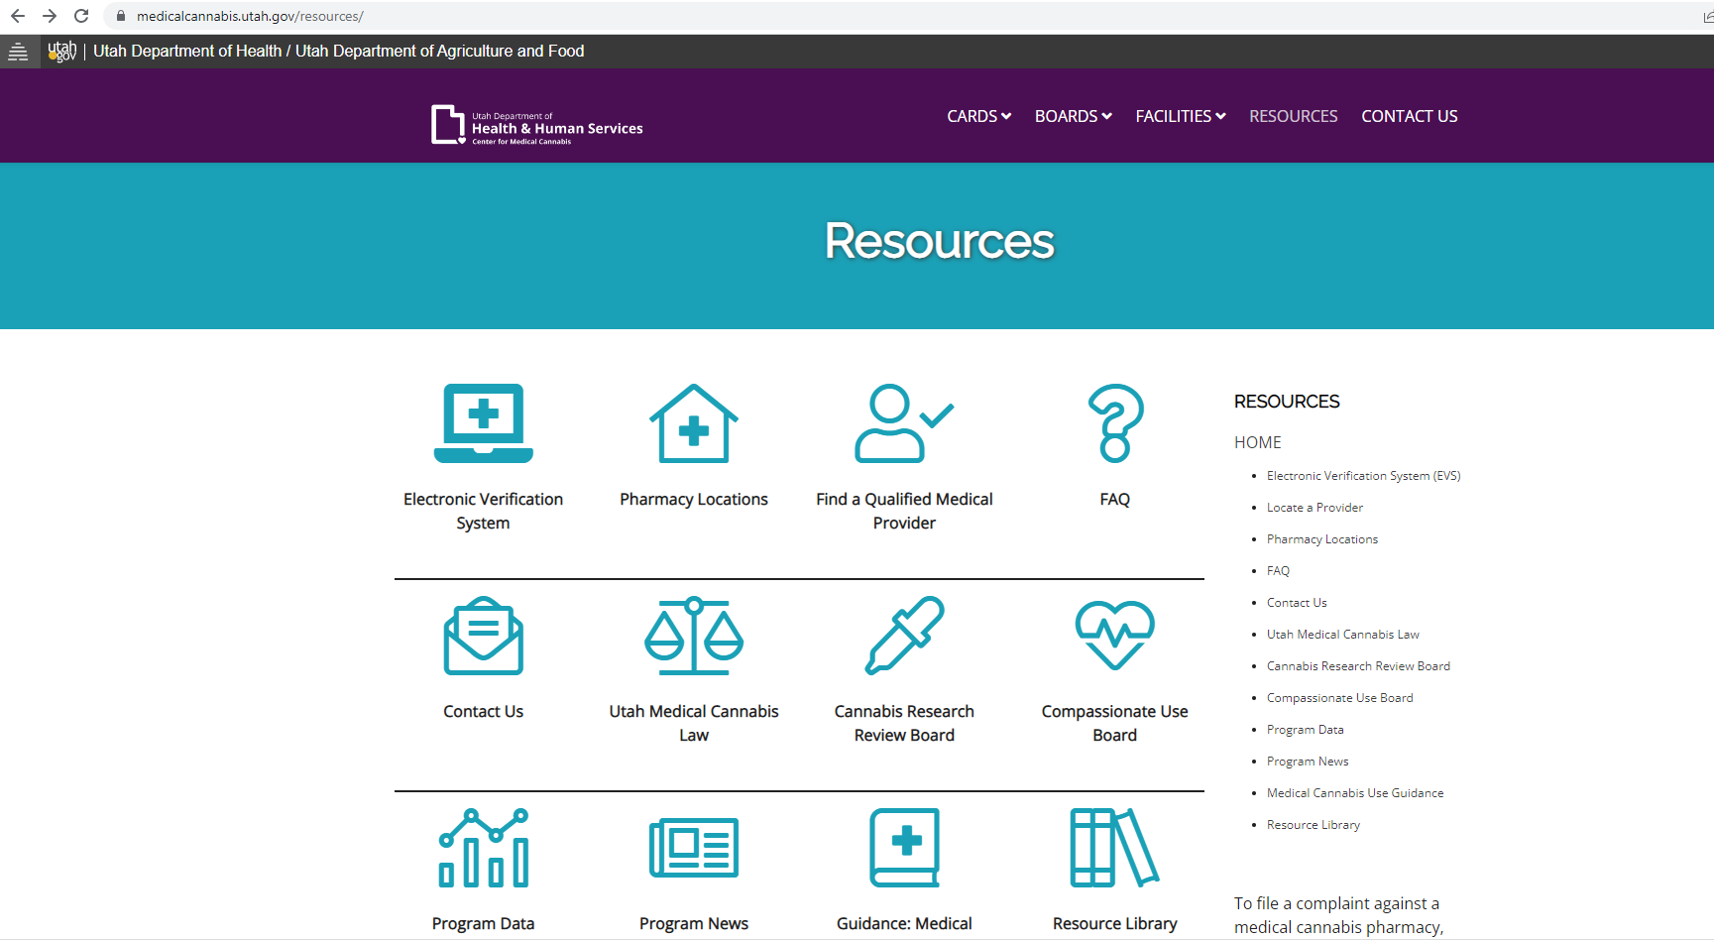
Ino for Patients, Pharmacies, Medical Providers

Slide 37
Utah Industrial Hemp Program

Slide 38
Utah Industrial Hemp Program
Ensures safety, compliance and equity to the industrial hemp industry by monitoring Utah’s processors and retail establishments. Ensures consumer safety and product integrity by approving products prior to entering the Utah market and verifying through inspections that safety and label standards are met.

Slide 39
Interesting Hemp Laws
2014 Farm Bill
Legalized the growing of hemp mostly for research
Independent cannabis testing laboratories
Utah Medical Cannabis Act
2018 Farm Bill
allows hemp cultivation not simply pilot programs
allows the transfer of hemp-derived products across state lines for commercial or other purposes.
Removes restrictions on the sale, transport, or possession of hemp-derived products, so long as those items are produced in a manner consistent with the law.
Only the growing and storage is legal. CBD is still a schedule 1 drug and FDA does not approve any cbd products other than 3 drugs (Epidiolex)

Slide 40
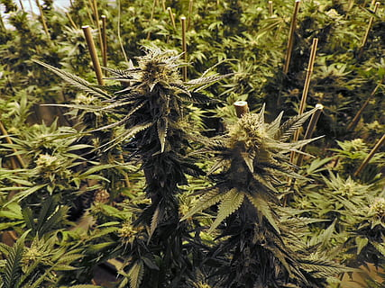
Industrial Hemp Growers
2022 H.B. 385 Hemp and CBD Amendments, the Utah Department of Agriculture and Food (UDAF) will no longer be responsible for regulating and licensing hemp cultivators in Utah. All interested cultivators will need to apply for and obtain a USDA license.
A USDA license will allow the growing and storage of your own biomass only. Any other activities such as accepting/storing biomass or concentrates from others will require a Utah processor license

Slide 41
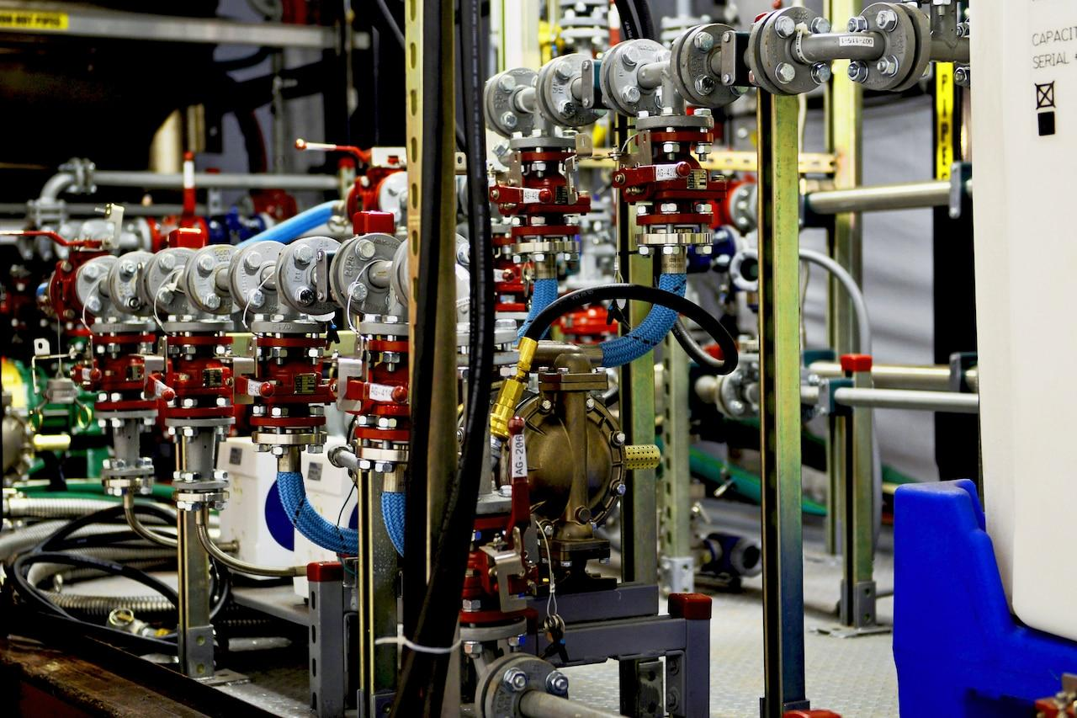
Industrial Hemp Processor
To process Industrial Hemp or Industrial Hemp products an individual/business needs to be licensed based on processing activity.
Tier 1 processor license allows a business to perform all processing activities from extraction to manufacture of final products
Tier 2 processor license allows a business to perform extraction of concentrate from raw plant material
Tier 3 processor license allows a business to repackage and label final products
Tier 4 processor license allows a business to act as a brokers/wholesalers or distributor of industrial hemp material or products

Slide 42
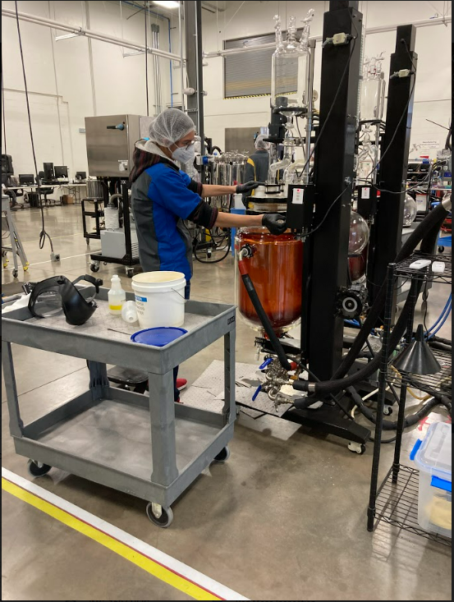
Tier 1 Processor
Receive, store, extract, transport, and sell raw plant material
Receive, store, extract, transport, and sell raw concentrate
Manufacture finished industrial hemp product
Fee: $2500
*This is the only tier that can receive above 0.3% concentrate as long as it is from another tier 1 or a tier 2 license from within the state

Slide 43
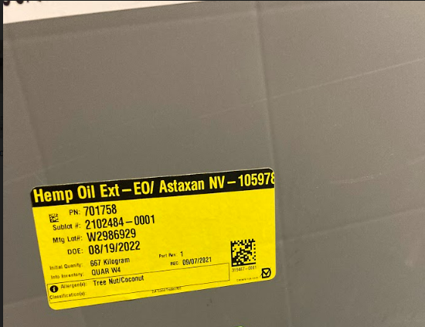
Tier 2 Processor
Receive raw plant material
Extract raw plant material into raw concentrate
Store, sell, or transport raw concentrate
Fee: $2,000

Slide 44
Tier 3 Processor
Receive, store, package, and label finished industrial hemp product
Fee: $1,000

Slide 45
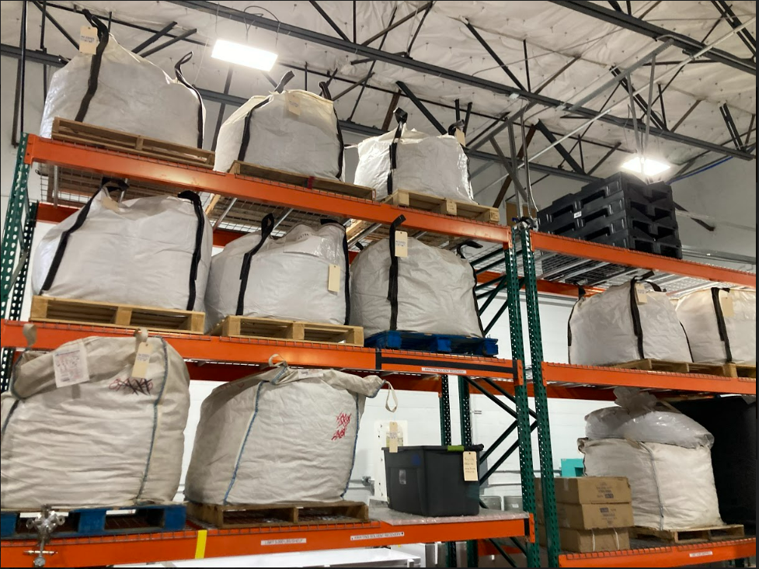
Tier 4 Processor
Receive, store, transport, or sell raw concentrate
Receive, store, transport, or sell raw plant material
NOTE: Concentrate has to be below 0.3% THC
Receive, store, transport, or sell finished industrial hemp product,
Perform minimal processing for storage only.
Fee: $750

Slide 46
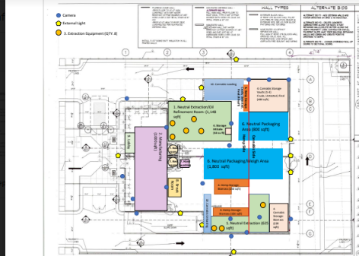
Processor License Requirements
Completed Application for an industrial Hemp Processor includes the following items:
Legal description and GPS coordinates of processing facility
Production facility map and physical description of facility
A completed criminal history report from the FBI (Background Check) see this link
The criminal history report cannot be older than three months.
Obtain a UDAF Food establishment inspection and permit. UDAF Regulatory Services

Slide 47
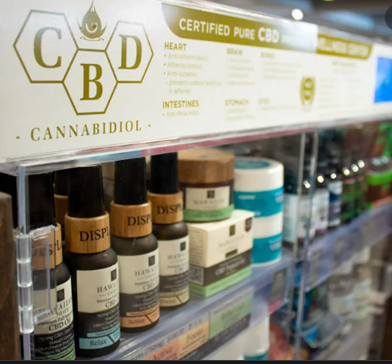
Industrial Hemp & Cannabinoid Product Retailers
All retail establishments who market and sell industrial hemp products, must apply for and maintain a current permit with the Utah Department of Agriculture and Food
Fill out an application
Pay fee of $50 per calendar year
A permit will be emailed to you
Retailer responsibilities:
ensure that an advertisement for industrial hemp product sold or marketed in Utah does not contain any medical claims unless the product has been issued a National Drug Code by the FDA
ensure that an industrial hemp product sold is properly registered with the department.

Slide 48
Industrial Hemp & Cannabinoid Product Retailer Inspections
Inspection and Testing.
The department randomly inspects retailers to ensure industrial hemp product distributed or available for distribution in Utah is in compliance
The department periodically samples, analyzes, and tests industrial hemp product distributed within the state for compliance with registration and labeling requirements, and the certificate of analysis.

Slide 49
Cannabinoid Product Registration
In order to be sold or marketed, an industrial hemp product that contains cannabinoids is required to be registered annually with the Utah Department of Agriculture and Food.
Industrial hemp products that contain no cannabinoids do not require registration.

Slide 50
Cannabinoid Product Class
Individual Hemp Product
individual hemp product is defined as a product with the same cannabinoid content with one single flavor or scent.
If a product has multiple flavors, each flavor must be registered and paid for separately.
If a product comes in different cannabinoid dosage amounts the products are considered separate products and must be registered individually. (example: 1000 mg and 2000 mg products that have the same formula)
Industrial hemp product class
individual hemp product is defined as a product with the same cannabinoid content with one single flavor or scent.
If a product has multiple flavors, each flavor must be registered and paid for separately.
If a product comes in different cannabinoid dosage amounts the products are considered separate products and must be registered individually. (example: 1000 mg and 2000 mg products that have the same formula)

Slide 51
Cannabinoid Product Registration
Requirements
A full panel certificate of analysis (COA) is required for each final product that contains cannabinoids.
the cannabinoid profile by percentage of mass; solvents; pesticides; microbials; heavy metals; mycotoxins.
A current COA will be required to be visible to the consumer at all times either on the product website or via QR code.
Product Label
Cannabinoid Products must be labeled as a dietary supplement

Slide 52
Cannabinoid Product Label

Slide 53
Cannabinoid Product Registration
Product types that are NOT allowed
Smokeable flower
Cannot be considered appealing to children
Cannot be added to conventional food or beverages
Gummies are allowed as an exception as long as they are not shaped like characters/animals
Product Label
Considered adulterants and are not allowed in any amounts
THC-O Acetate
HHC
EXO-THC
Total composite THC above .3%
Usually THCA, D9 THC and D* THC

Slide 54
Agency and Municipality Cooperation
UDAF Sister Divisions
Regulatory Services - Weights & Measures; Food Establishments
State Health Department
Medical Cannabis pharmacies; patients, medical providers
County Health Departments
regulations on electronic cigarette products
City & County Business Licensing
All Cannabis/Hemp Licenses require Business license,may differ from UDAF regs.
Building permits & Fire Marshal
Medical Cannabis Facilities & Hemp Processors
Law Enforcement

Slide 55
Questions!

Slide 56
Contact Information
Program Manager Cody James codyjames@utah.gov 1(385)515-1485
Lead Inspector Kasey King kaseyking@utah.gov 1(385)552-6633
Medical Cannabis Program Specialist Aimee Isom aimeeisom@utah.gov 1(385)256-5872
Industrial Hemp Program Specialist Thayne Dickey tdickey@utah.gov 1(385)226-7316

