Slide 1
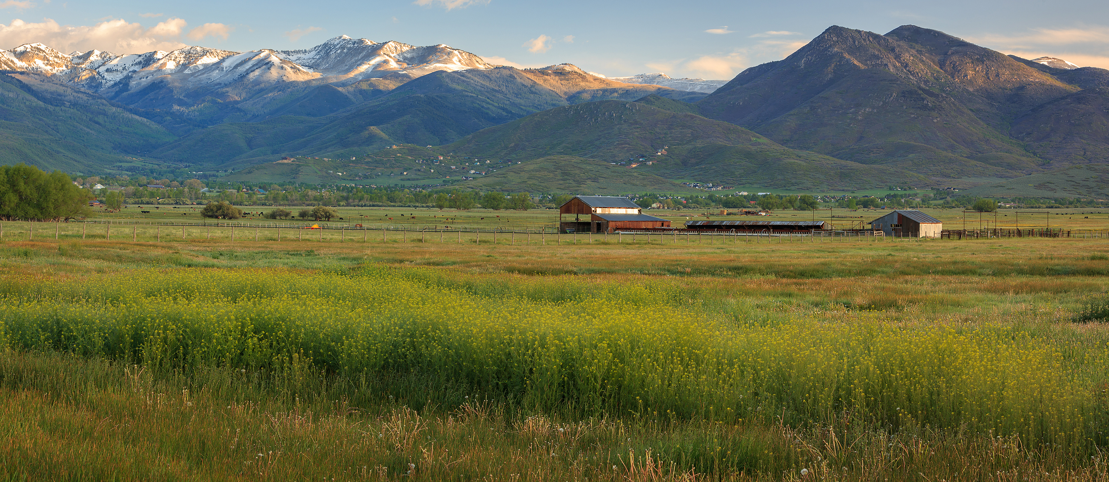
UTAH DEPARMENT OF AGRICULTURE & FOOD
Lori Hicks
Program Coordinator III
Division of Regulatory Services
i

Slide 2
Program Areas
Farmers Markets
Homemade Food Act
Cottage Food Act
The Wholesome Food Act
Retail Food
Manufactured Food
Requirements
Fee Schedule

Slide 3
Farmers Markets The following is abbreviated , condensed or a partial description
Definition of a traditional FM : 4-5-102(6) - "Farmers market" means a market where a producer of a food product sells only a fresh, raw, whole, unprocessed, and unprepared food item directly to the final consumer.
Because many farmers markets have evolved into selling much more, we look at them through the lens of being an outdoor retail establishment.
Farmers Markets are required to register with UDAF.
Farmers Market Coordinators / Managers are responsible to ensure all of their vendors are legit.
Vendors are required to be registered and inspected by UDAF, with some exception (Homemade Food Act)

Slide 4
Exceptions – Produce Stands, etc.
Farmers selling raw, unprocessed produce, direct to the consumer, at a farmers market do not have to register.
Road side produce stands selling raw, unprocessed produce, direct to the consumer do not have to register. However, if they are also selling prepackage foods or engaged in any value added processing, then they do have to register.

Slide 5
The Home Consumption and Homemade Food Act (HB 181) 4-5a The following is abbreviated , condensed or a partial description
Unregulated Homemade Food – not required to register with UDAF
Homemade food is sold directly to the consumer from the home or at an agreed upon location
Basically they can make and sell anything!
Requires declaration of responsibility, “Homemade”, allergen information
Cannot sell interstate or be used in a restaurant or commercial establishment
Restrictions: raw dairy and dairy products, meat and meat food
Exceptions: USDA 1,000 bird exemption; > 1,000 birds annually - includes chicken and rabbit
Dept. may not impose any additional limitations or requirements
4-5a-104 (2) A producer shall comply with business license requirements pursuant to Section 10-1-203

Slide 6
The Home Consumption and Homemade Food Act (HB 181) 4-5a Continued The following is abbreviated , condensed or a partial description
R-70-570-2. Direct-to-Sale Farmers Market Signage.
Direct-to-Sale farmers market signage shall
a minimum of 22"x 28";
white in color;
printed in English;
printed in red ink;
printed clearly and legibly, and;
written in capital letters not smaller than 2" in height.
Direct-to-Sale farmers market signage shall contain the phrase, "FOOD ITEMS OFFERED FOR SALE IN THIS DIRECT-T0-SALE FARMERS MARKET ARE HOMEMADE AND HAVE NOT BEEN CERTIFIED, LICENSED, REGULATED, OR INSPECTED BY STATE OR LOCAL AUTHORITIES."

Slide 7
Cottage Food (4-5-501 and R70-560) The following is abbreviated , condensed or a partial description
Home produced – Inspected
Non Potentially Hazardous Foods (Jam’s Jelly’s, Cakes, Cookies, etc.…)
Facility requirements in a nutshell: Food handler permit, cleanable surfaces, sanitary environment and safe practices, no pets or kids in and around prep area, etc...
Labeling: Name, address, ingredients, allergens, etc.
Required to register and be inspected by UDAF.
Can sell at retail, direct to consumer or farmers markets
Cannot sell interstate

Slide 8
Contact for Farmers Markets, Cottage Food and Homemade Food
Rebecca Nielsen Cottage Food/Labeling Specialist
Cell: phone 801-633-3965
email: rjnielsen@utah.gov
https://ag.utah.gov/businesses/regulatory-services/cottage-food-production/

Slide 9
Wholesome Food Act 4-5-101 Retail and Manufactured Food The following is abbreviated , condensed or a partial description
4-5-102 (10)(a) "Food establishment" means a grocery store, bakery, candy factory, food processor, bottling plant, sugar factory, cannery, farm, rabbit processor, meat processor, flour mill, cold or dry warehouse storage, or other facility where food products are manufactured, canned, processed, packaged, stored, transported, prepared, sold, or offered for sale.
These are retail or manufacturing firms who are legit and adhere to food safety and public health requirements…they want to operate as a first world entity.

Slide 10
Retail and Manufactured Food Continued The following is abbreviated , condensed or a partial description
4-5-104 – Authority to make and enforce rules
Also gives authority to adopt federal regulations (21 CFR) and provisions of the FDA Food Safety Modernization Act (FSMA).
cGMP / Preventive Controls for Human Food
Food Traceability
Mitigation Strategies to Protect Food Against Intentional Adulteration
Sanitary Transportation
Produce Safety
Voluntary Qualified Importer Program

Slide 11
Retail and Manufactured Food Continued The following is abbreviated , condensed or a partial description
4-5-105 Inspection of premises and records -- Authority to take samples -- Inspection results reported
An authorized agent of the department, upon presenting appropriate credentials to the owner, operator, or agent in charge, may:
enter at reasonable times a factory, farm, warehouse, or establishment in which food is manufactured, processed, packed, or held for introduction into commerce or after introduction into commerce;
enter a vehicle being used to transport or hold food in commerce;
inspect at reasonable times and within reasonable limits and in a reasonable manner a factory, warehouse, establishment, or vehicle and all pertinent equipment, finished and unfinished materials, containers, and labeling located within the factory, warehouse, establishment, or vehicle;
(d) obtain samples necessary for the enforcement of this chapter…

Slide 12
Retail and Manufactured Food Continued The following is abbreviated , condensed or a partial description
4-5-202 Adulterated or misbranded articles -- Tagging -- Detention or embargo -- Court proceedings for condemnation -- Perishable food.
(1) (a) When an authorized agent of the department finds or has probable cause to believe that any food is adulterated, or so misbranded as to be dangerous or fraudulent within the meaning of this chapter, the agents shall affix to the food a tag or other appropriate marking, giving notice that:
the food is, or is suspected of being, adulterated or misbranded;
(ii) the food has been detained or embargoed; and
(iii) removal of the food is prohibited as provided in Subsection (1)(b).
(b) No person may remove or dispose of detained or embargoed food by sale or otherwise until permission for removal or disposal is given by an agent of the department or the court.

Slide 13
Retail and Manufactured Food Contacts
Retail Food:
Cole Dalton, Retail Food Program Manager
Cell: 385-332-1499
Office: 801-982-2259
Email: cbdalton@utah.gov
Shannon Jaworski, Lead Retail Food Inspector
Cell: 385-262-5728
Email: sjaworski@utah.gov

Slide 14
Manufactured Food Contacts
Coreen Cogswell, Manufactured Food Coordinator
Cell 801-699-2055
email ccogswell@utah.gov
Richard Beckstrand, Manufactured Food Program Manager
Cell 801-450-8173
Email rbeckstr@utah.gov

Slide 15
Registration and Inspection The following is abbreviated , condensed or a partial description
4-5-301 Registration of food establishments -- Fee -- Suspension and reinstatement of registration -- Inspection for compliance.
The owner or operator of a food establishment shall register with the department before operating a food establishment.
Before granting a registration to the owner or operator of a food establishment, the department shall inspect and assess the food establishment to determine whether it complies
The department shall issue a registration if the department determines that the applicant meets the qualifications
If the applicant does not meet the qualifications of registration, the department shall notify the applicant, in writing, that the applicant's registration is denied.

Slide 16
Registration and Inspection - Continued The following is abbreviated , condensed or a partial description
The department may, as provided under Subsection 4-2-103(2), charge the food establishment a registration fee.
The department shall retain the fees as dedicated credits and shall use the fees to administer the registration of food establishments.
A registration, issued under this section, shall be valid from the date the department issues the registration, to December 31 of the year the registration is issued.
A registration may be renewed for the following year by applying for renewal by December 31 of the year the registration expires.

Slide 17
Fees
Because of much budgetary uncertainty at the beginning of the COVID-19 Pandemic, the Department was instructed by lawmakers to review and revise our fees for the food program so as to reduce or eliminate the dependency of General Funds.
Currently, Revenue and Expense is $2 million dollars and within $50K of each other.
General Fund allocation is currently $1.2 million, half of which will be transferred to other programs within the department.

Slide 18
Plan Review and Registration Fee Schedule
Category | Registration Fee | Parameters | Retail Food Establishment | Food Processor | Food Storage Warehouse
New Very Small | $75.00 | Square Footage | 0 | 0 | 0
 |  | Employee Count | 0 | 0 | 0
 |  | Process Areas | 0 | 0 | 0
Small | $150.00 | Square Footage | Less Than 1,000 | Less Than 1,000 | Less Than 1,000
 |  | Employee Count | Less Than 4 | Less Than 4 | Less Than 4
 |  | Process Areas | 0 - 1 | 0 - 1 | 0 - 1
Medium | $300.00 | Square Footage | 1,000 - 5,000 | 1,000 - 5,000 | 1,000 - 5,000
 |  | Employee Count | 4 or More | 4 or More | 4 or More
 |  | Process Areas | 0 - 1 | 0 - 1 | 0
Large | $500.00 | Square Footage | 5,000 - 50,000 | 5,000 - 20,000 | 5,000 - 50,000
 |  | Employee Count | 4 or More | 4 or More | 4 or More
 |  | Process Areas | 1 - 2 | 1 - 2 | 0
Super | $750.00 | Square Footage | More Than 50,000 | More Than 20,000 | More Than 50,000
 |  | Employee Count | 4 or More | 4 or More | 4 or More
 |  | Process Areas | 2 or More | 2 or More | 0

Slide 19
Plan Review and Registration Fee Schedule
Adding a new category “Very Small” – Farmers Markets, Ice Cream Trucks, Kratom Retailers, etc.
Plan Review Fee – Follows the fee schedule.
Any and all new food establishments (Retail and Manufactured) are required to submit a plan review application…ideally before moving into a new establishment or construction.
Follow Up Fee - $200 is applied for the second Follow Up Inspection for non compliance.

Slide 20
General Compliance Policy / Procedure
Note: The division may take immediate regulatory action at any step, depending on the severity of the issues found (Public Health and Safety)
Initial Inspection - No violations, we don’t return for one year or more
Follow Up Inspection – no more than 10 business days, for Priority Violations
Second Follow Up Inspection – If violations from the first Follow Up are not corrected - $200 Follow Up Fees applied and firm is sent a warning letter
Third Follow up - $200 Follow Up Fees Applied and the firm is also issued a $500 fee (per violation)
Fourth Follow Up – Cease and Desist

Slide 21
New Regulations or Statutes
HB 142 (SO1) – Donation of Food
SB 83 (SO1) Cosmetic Manufacturing Certificate Program

Slide 22
HB 142 (SO1) – Donation of Food; Changes Title 4, Chapter 34 of the Charitable Food Act
This bill:
defines terms;
addresses liability related to donated food;
establishes conditions under which wild game meat may be donated to a charitable organization;
imposes notice requirements;
imposes restrictions on the purchase, sale, or offer for sale or barter of donated wild game meat;
authorizes the Department of Agriculture and Food to act if the department has reason to believe that the donated wild game meat is unwholesome;
addresses donations to the Division of Wildlife Resources that are earmarked for costs associated with processing wild game meat for donation;
and makes technical changes.

Slide 23
HB 142 (S01) – Provisions
4-32-105 (43) "Wild game" means a species, the products of which are food, that is not classified as an amenable species or nonamenable species, including:
(a) a deer;
(b) an elk;
(c) an antelope;
(d) a moose;
(e) a bison;
(f) a rabbit;
(g) a bird.

Slide 24
HB 142 (S01) – Provisions
Donated wild game meat shall meet the following conditions:
Meat from an animal in good health before harvest;
With intact intestines;
Field dressed immediately after harvest;
Handled in a manner in keeping with generally acceptable wild game handling procedures;
Be further processed by a registered and inspected custom meat processor; and
As soon as possible after harvest;
Clearly marked “donated wild game meat”

Slide 25
HB 142 (S01) – Provisions
May not come from road kill;
Donor shall advise the charitable organization that the meat should be thoroughly cooked before human consumption;
Before serving the wild game meat, the charitable organization shall prominently post a sign indicating:
The wild game meat is donated;
The type of meat processing used;
The meat has not been inspected.
DNR may donate wild game meat in their possession.
UDAF may examine, sample, seize, or condemn wild game meat suspected of being unwholesome.

Slide 26
SB 83 (SO1) Cosmetic Manufacturing Certificate Program
This bill:
defines terms;
requires the Department of Agriculture and Food to create a process for issuing good manufacturing practices certificates to cosmetics manufacturers; and
makes technical and conforming changes.
gives UDAF rule making authority.
IS ONLY INTENDED FOR LARGE, EXISTING, MANUFACTURES (i.e. doTERRA)

Slide 27
SB 83 (SO1) – Cosmetics Provisions
Adds authority under Title 4, Chapter 2 – Administration
Does not remove or change authority in Title 26 – Utah Health Code (UDOH) - Drugs, Cosmetics and Medical Devises
Gives UDAF rule making authority – Rules may not be more stringent than:
Federal law, or
Guidance published by FDA
UDAF shall adopt a schedule of registration and GMP certificate fees to cover the costs of administering the program.

Slide 28
SB 83 (SO1) - Provisions
UDAF’s GMP certification program shall provide for the issuance of a certificate to an applicant if:
The applicant is registered with UDAF (existing Dietary Supplement MFG.).
The applicant submits application to UDAF requesting a GMP certificate for the manufacturing facility.
UDAF inspects the applicants facility and determines that it is in compliance with GMP’s.
GMP certificates shall:
Specify issuance date and expiration date; and
Be valid for a term of one to three years as determined by UDAF (rule making)…good for 3 years if firm is also ISO accredited.

Slide 29
QUESTIONS?
Lori Hicks
Division of Regulatory Services
Utah Department of Agriculture and Food
Office: (801) 982-2253
Email: lorihicks@utah.gov

Slide 30
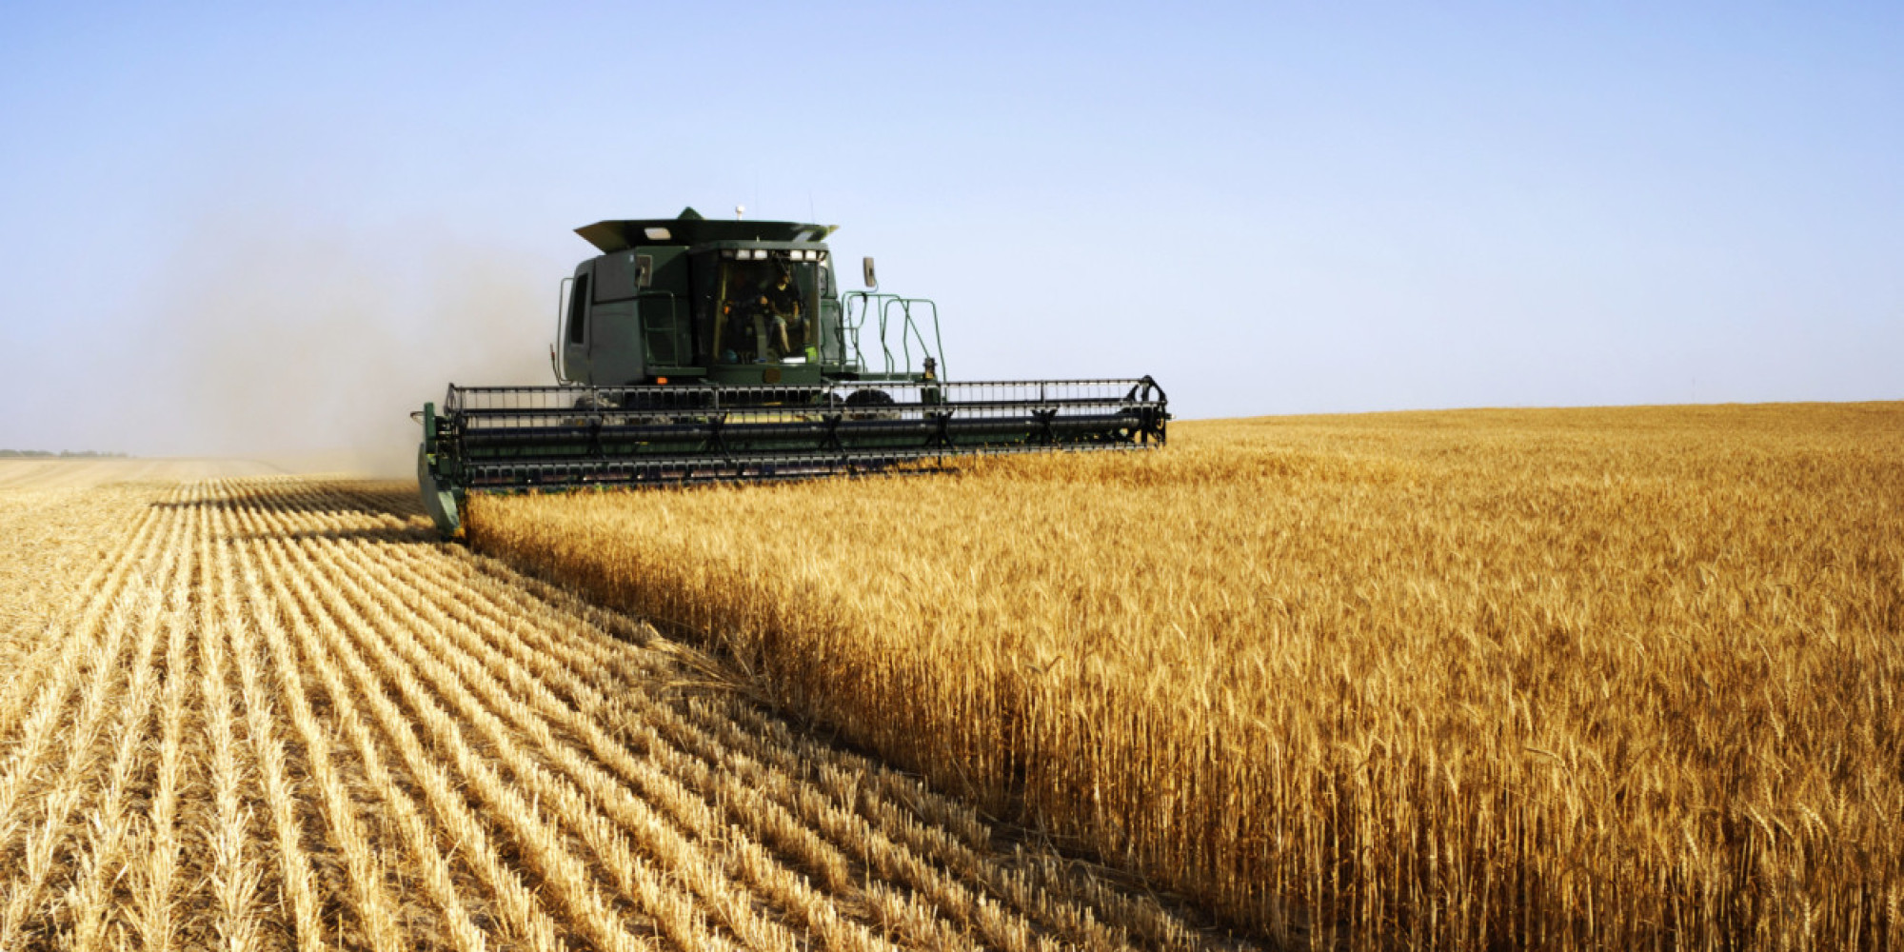
THANK YOU

