Slide 1


RA Update 2026
Team Captains Meeting Minutes
Take 2

Slide 2

The Team Captains' Meeting may be held either in person or online.
This meeting is where Team Captains (coaches)
verify entries
observe the draw
review the schedule
notified of special Jury instructions as well as any penalties that may be assessed for violations
notified of area regulations
review the “Event Medical Plan” and the location of first aid services
advised of future meeting schedules
hear the weather forecast
able to express their concerns

Slide 3

RA Update: Team Captains Meeting Minutes Take 2
Team Captains’ Meeting Minutes must be generated for each codex and must be included in the submitted event document packet.
Attendance must be kept.
Program & TCM Minutes: FIS and non-FIS

Slide 4
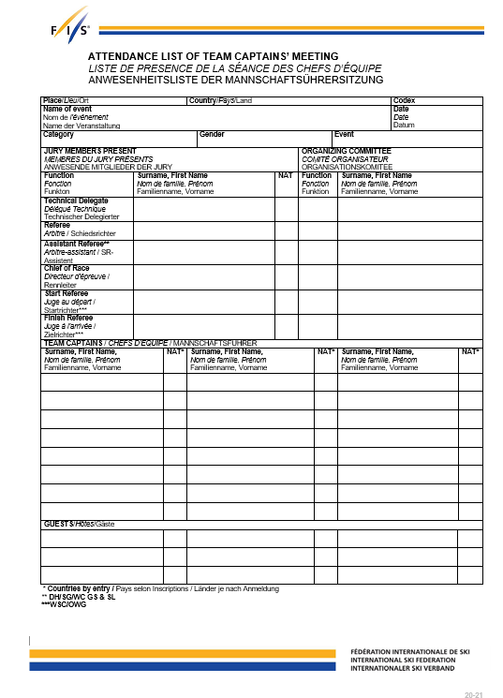
RA Update: Team Captains Meeting Minutes Take 2
Attendance must be kept. Same doc for FIS and National events.

Slide 5
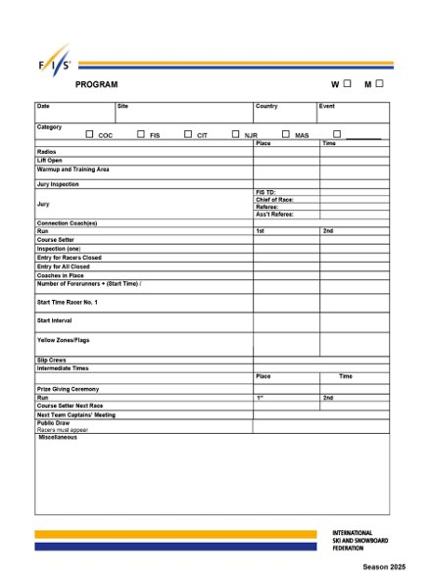
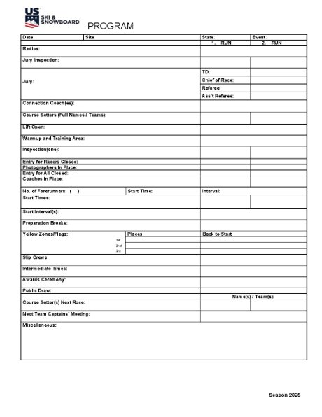
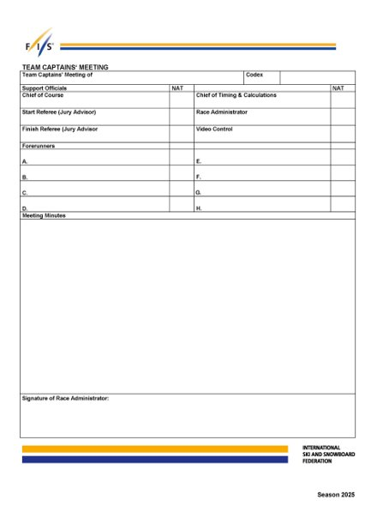
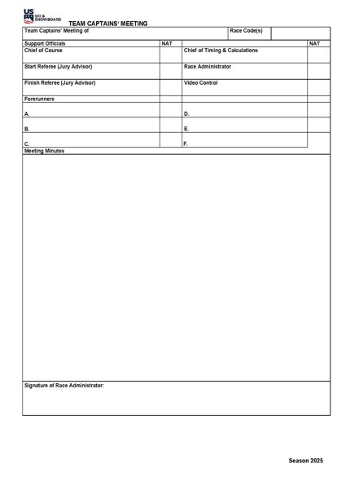
RA Update: Team Captains Meeting Minutes Take 2
Program & TCM Minutes: FIS and non-FIS

Slide 6
RA Update: Team Captains Meeting Minutes Take 2
Minutes of Team Captains' Meetings are required, and a second page has been added to the Program form to aid in this documentation. This form should be used along with the Attendance List. The Race Administrator must sign the Team Captain Meeting Minutes.

Slide 7
RA Update: Team Captains Meeting Minutes Take 2
The summary of discussion items on the Minutes of Team Captains' Meeting should note who spoke about the following items:
roll call of competitors and/or nations is conducted, and
whether or not unrepresented competitors are removed from the Board.
If competitors who are not represented are left on the Board, a reason should be stated.

Slide 8
RA Update: Team Captains Meeting Minutes Take 2
Summary should also note that the following were discussed, and who discussed them:
race day schedule (program)
event Medical Plan
location(s) of “Stop the Bleed” packs, if present
presentation of an Avalanche Control Report and weather

Slide 9
RA Update: Team Captains Meeting Minutes Take 2
The summary should also include
Rule interpretations
Board was accepted as set;
What rules were used to set the Board (e.g., series standings or Continental Cup, etc.), the validity date of the applicable Points List, and the procedure used for the draw - whether “double draw” or computer-generated draw.
For events where quotas are in effect, this should also be noted. If quotas are expanded, the Minutes must note the date of the request for quota expansion (when applicable), as well as the name and title of the individual(s) who approved the request.

Slide 10
RA Update: Team Captains Meeting Minutes Take 2
The Program/Minutes forms are required documents and must be included in the event document packet submitted to U.S. Ski & Snowboard.
  The Attendance list should be used for all events but is not included in the event document packet submitted to U.S. Ski & Snowboard; it is filed in the Organizer’s event document file.
MINUTES MUST NOT INCLUDE OPINIONS AND MUST BE SIGNED BY THE RACE ADMINISTRATOR!

Slide 11
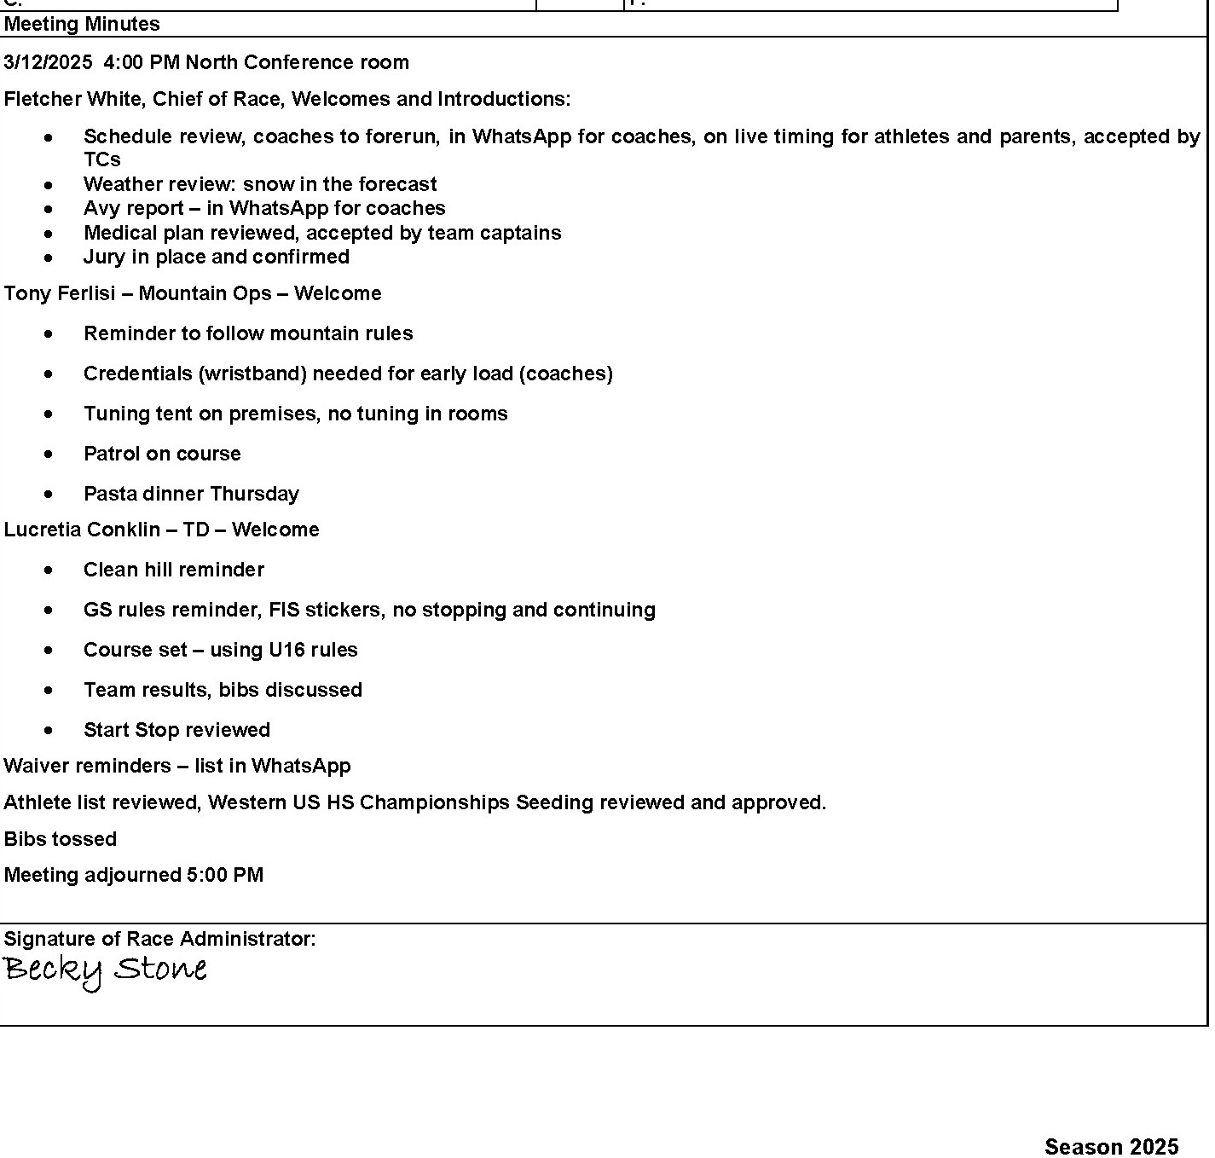
RA Update: Team Captains Meeting Minutes Take 2
Example #1: National Program

Slide 12
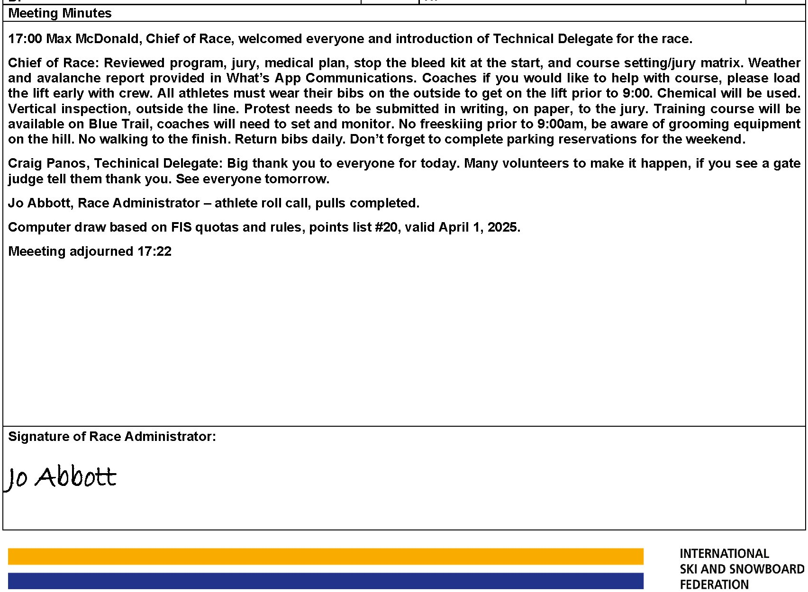
RA Update: Team Captains Meeting Minutes Take 2
Example #2: FIS Example

Slide 13
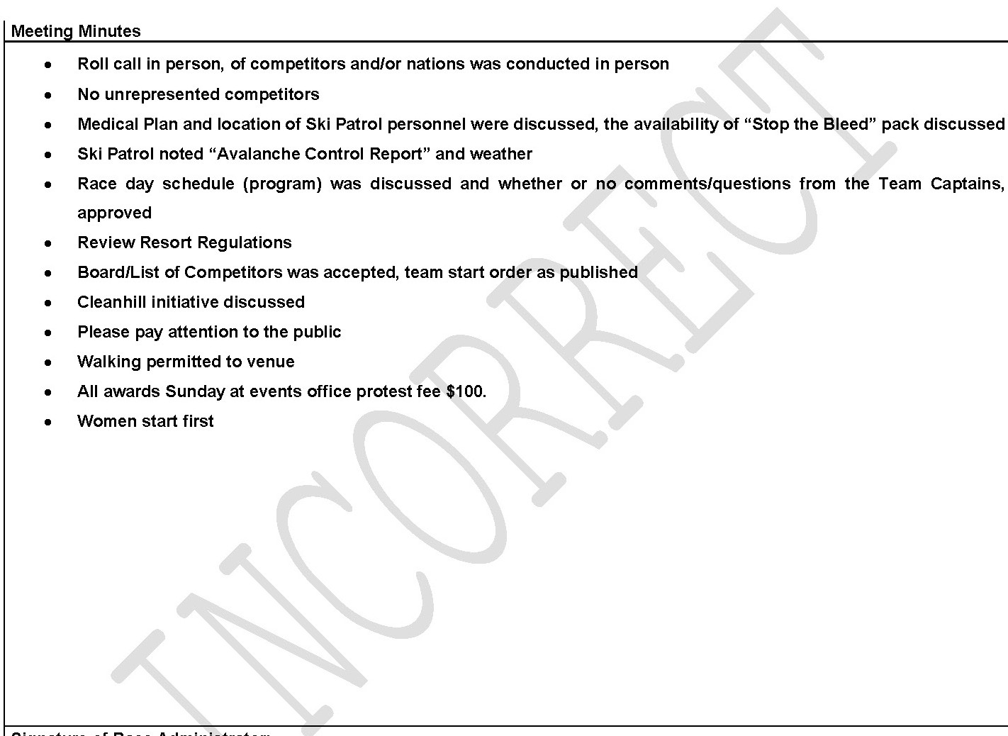
RA Update: Team Captains Meeting Minutes Take 2
Example #3: What we are trying to correct

Slide 14
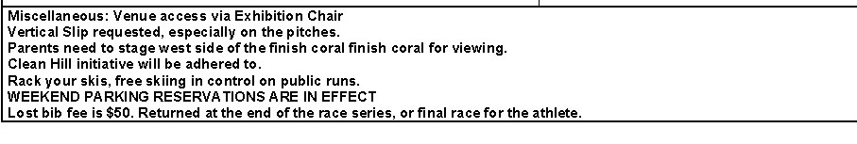
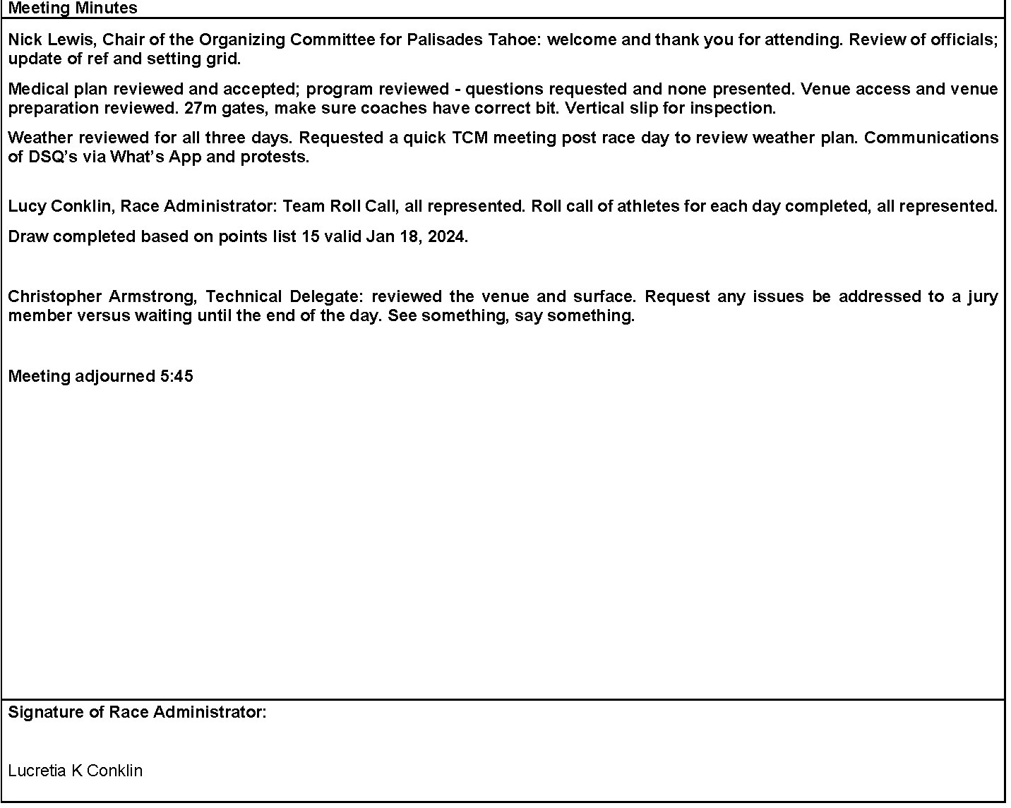
RA Update: Team Captains Meeting Minutes Take 2
Example #4: Announcement Section on Front Page of Program
Team Captains Minutes on a
back side of page

Slide 15
RA Update: Team Captains Meeting Minutes Take 2
Let’s fix these minutes!!
On the next slide there are minutes to use to create a best practices set of minutes!
Utilize the name of your Chief of Race, yourself as the RA, and any key personnel that would report from your ski area at a TCM.
Work together with a few other RA’s in the room to create a better set of TCM minutes by coordinating these minutes into ‘who said what’
Allow about 15 minutes for each group to work on these before sharing with other groups attending
your workshop.
Notes:
No voice over on this page.

Slide 16
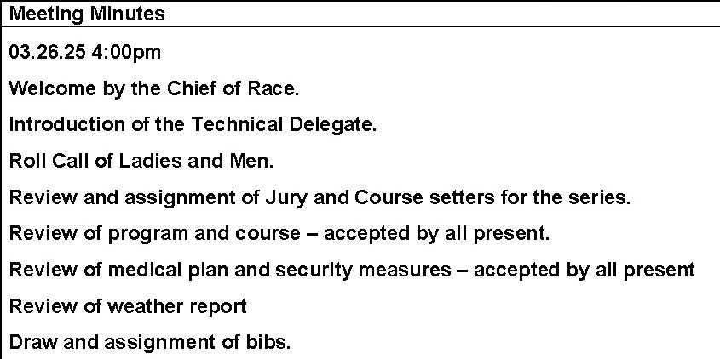
RA Update: Team Captains Meeting Minutes Take 2
Use a simple checklist to cover your basics: Roll call, unrepresented competitors left on board or not, Program reviewed, questions to the program, Medical plan, Stop the Bleed Kits, Weather and Avalanche reports, rules interpretations, points list used, rules used to set the board (seeding method), etc.

