Slide 1
Advocacy Update Jim Phelps, Chief Advocacy Officer Cornerstone Credit Union League

Slide 2
Our Advocacy Goal
To favorably influence public policy on behalf of credit unions and create a more favorable operating environment.

Slide 3
Texas Ballot Initiatives
Election November 7, 2017
National Advocacy Fund support $325K
Comprehensive campaign plan includes:
Polling
Direct mail
Websites
Op-eds

Slide 4
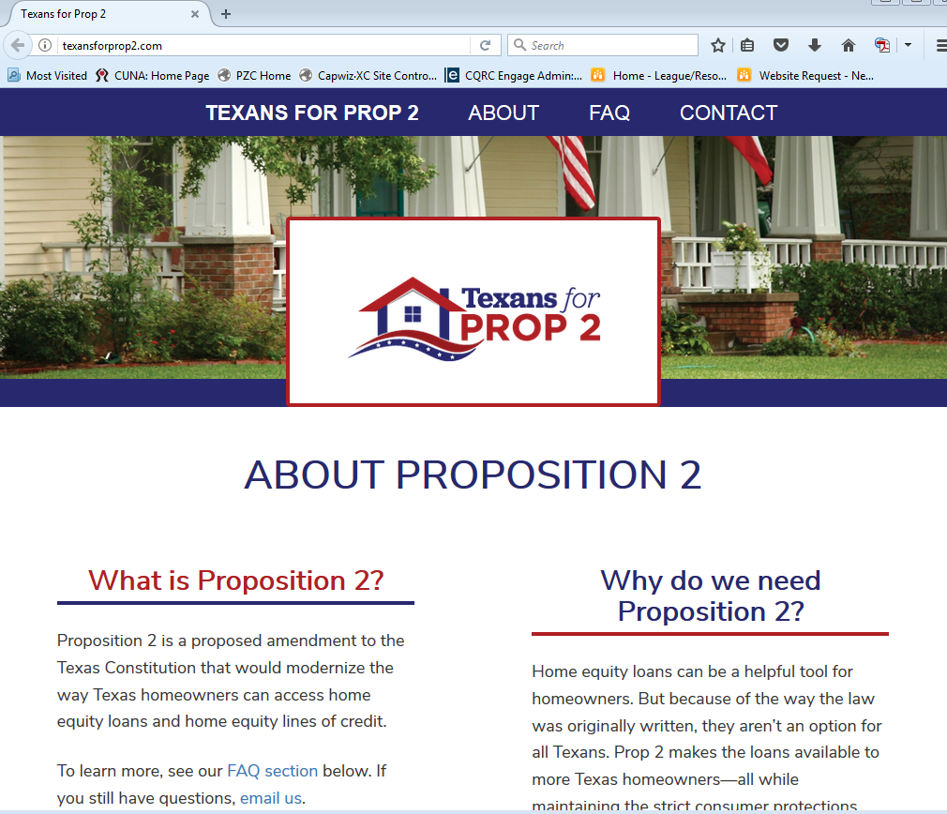
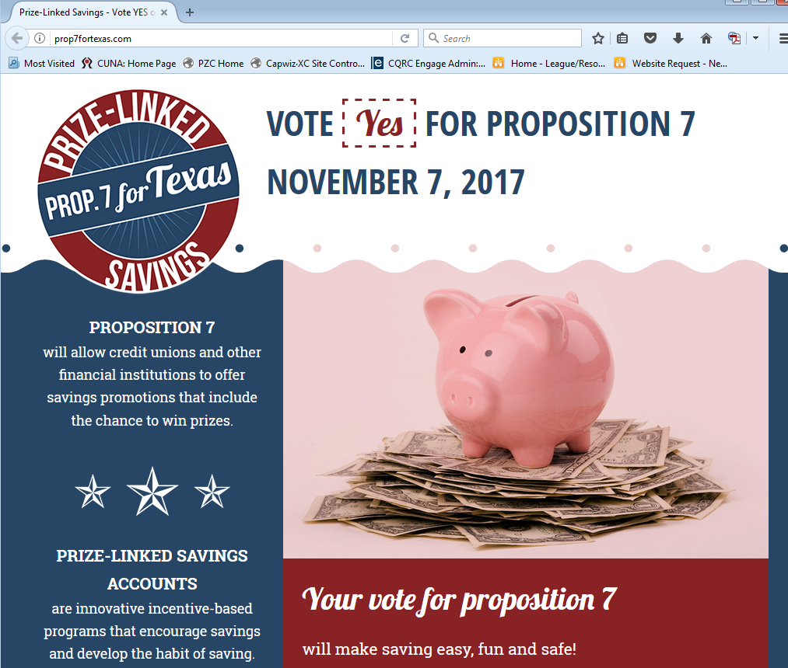

Slide 5
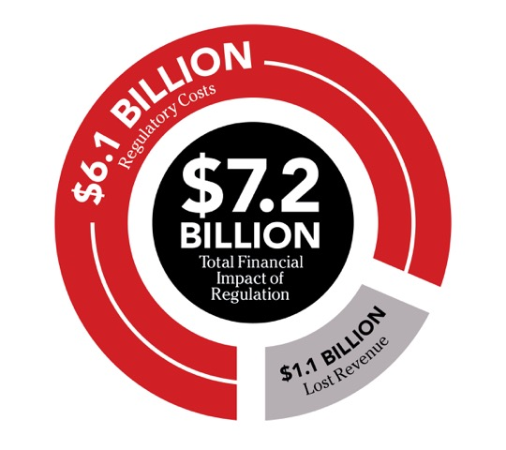
Impact of Regulatory Burden on Credit Unions

Slide 6
Federal Advocacy
NCUA kept out of congressional appropriations process
Telephone Consumer Protection Act (TCPA) petition
Repeal of CFPB Arbitration rule
Tax reform

Slide 7
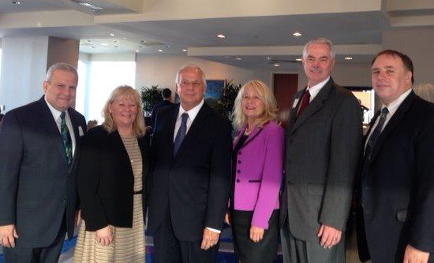
Political Engagement
2018 elections – PAC
MAP – 62 credit unions;
2,964,814 members
7 Chapters hosted lawmakers

Slide 8
Thank You!
Questions? Contact Jim Phelps at jphelps@cornerstoneleague.coop or call 469-385-6481

