Slide 1


What’s
In the compliance World?
2017 South Texas Credit Union Conference
November 3, 2017

Slide 2
Disclaimer
This program is designed to provide accurate and authoritative information. It is done with the express understanding that CU Service Network and its employees are not engaged in rendering legal advice. If legal advice is required, consult an attorney.
Notes:
Not an attorney; try very hard not to practice law without a license

Slide 3



Slide 4
Agenda
BSA Customer Due Diligence Rule
Regulation CC Amendments
UDAAP
ADA Website Compatibility

Slide 5
FinCEN Customer Due Diligence Rule
2 Main Provisions
  Beneficial Ownership Requirements
  Anti-money Laundering Programs
Effective date – May 11, 2018

Slide 6

Fifth Pillar
CDD becomes 5th “pillar” of AML program
  Internal Controls
  AML Officer
  Training
  Independent Review
  Customer Due Diligence

Slide 7
CDD Obligations
Identify and verify identity of “customers”
Identify and verify identity of “beneficial owners” of legal entity customers
Understand nature of customer relationship
Ongoing monitoring

Slide 8
Identify and Verify Customers
Already required as part of your CIP/MIP process
  Individuals
  Legal entities
    Corporations, LLCs, partnerships, other similar business entities

Slide 9
New Requirements under CDD
Identify beneficial owners of legal entity members
Verify identity of beneficial owners of legal entity members
Procedures for identifying and verifying beneficial owners
Recordkeeping
Record retention

Slide 10
Legal Entity Account
Accounts owned by legal entities rather than natural person accounts
Includes
  Corporation, LLC, general partnership, other entity created by filing of public document with Secretary of State
Does not include
  Government agencies, sole proprietorships, unincorporated associations, natural persons opening accounts on own behalf

Slide 11
Identify Beneficial Owners
Beneficial owner – 2 prongs
  Ownership – Each individual who owns 25% or more of the equity interests
  Control – at least one person who has significant managerial control
    CEO, CFO, COO, General Partner, President, VP, Treasurer

Slide 12
Identify Beneficial Owners
Collect information from party opening account
  Name
  Date of birth
  Address
  SSN/other gov’t ID number
Method of collecting information
  Certification form – Appendix A of final rule
  Credit union’s forms
  Any other means
Verify identity of beneficial owners via CIP procedures

Slide 13
Customer Due Diligence
Objective of CDD
  Predict kinds of transactions
  Identify suspicious transactions
CDD should address
  Verifying identity of customer
  Assessing risk with that customer
  Enhanced due diligence for higher-risk customers
  Ongoing due diligence of customer base

Slide 14
Customer Due Diligence
CDD guidelines should
  Be commensurate with BSA/AML risk assessment
  Contain statement of management’s expectations and establish staff responsibilities
  Ensure credit union gets enough customer info for suspicious activity monitoring
  Document analysis of due diligence process
  Ensure credit union maintains customer information

Slide 15
Beneficial Owners and Other AML Rules
Transaction aggregation for beneficial owners
  Maybe
OFAC
  Yes
Section 314(a) requirements
  No

Slide 16
CDD & Beneficial Ownership Steps
Develop business owner certification form
Develop checklist/form for information gathering
Document procedures
Determine system adjustments
Train staff
  Help them understand WHY they are doing something
    Critical aspect of combatting illegal financial activity
    Required by regulation and CU’s policies
    It’s their job

Slide 17

Member Service vs. Customer Due Diligence

Slide 18
CCD/BSA Resources
FinCEN Customer Due Diligence Rule https://www.federalregister.gov/documents/2016/05/11/2016-10567/customer-due-diligence-requirements-for-financial-institutions
FinCEN FAQs on CDD Rule https://www.ffiec.gov/bsa_aml_infobase/documents/FAQs_for_CDD_Final_Rule_(7_15_16).pdf

Slide 19
Regulation CC Changes
Effective July 1, 2018
Two main issues
  Returned checks must be returned by 2:00 p.m. on the 2nd business day
  Warranties/indemnity on remotely deposited checks

Slide 20
Timeframe To Return Checks
“Two-day test” if CU isn’t going to pay check/draft
  2:00 p.m. of 2nd business day
When amount of returned check is $5,000 or more, notice of nonpayment must be sent
  2:00 p.m. of 2nd business day

Slide 21
Remote Deposit Capture Liability

Slide 22

Remote Deposit Checks
In a dispute caused by check being deposited more that once, the FI holding the paper check wins

Slide 23
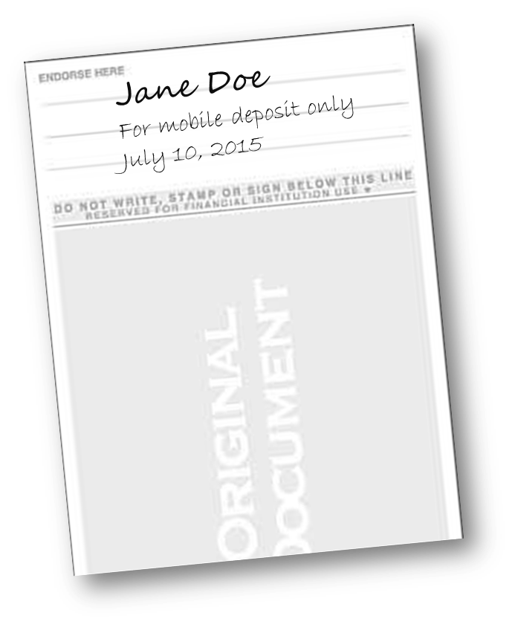
Remote Deposit Checks
Exception to holder of paper check’s victory
  Check deposited remotely has restrictive endorsement – “For mobile deposit only”

Slide 24
Regulation CC Resources
CUNA: https://www.cuna.org/Compliance/Compliance-E-Guide/E-Guide-Entries/Expedited-Funds-Availability-Act---REG-CC/
FRB press release https://www.federalreserve.gov/newsevents/pressreleases/files/bcreg20170531a1.pdf

Slide 25

Unfair, Deceptive, or Abusive Acts or Practices

Slide 26
Unfair Act or Practice
Causes/is likely to cause substantial injury to consumers
Injury is not reasonably avoidable
Injury is not outweighed by benefits

Slide 27
Deceptive Act or Practice
Misleads consumer
  4 Ps Test
    Prominent
    Presented
    Placement
    Proximity
Consumer’s interpretation is reasonable under the circumstances
  Is material

Slide 28
Abusive Act or Practice
Materially interferes with ability to understand term/condition of a financial product or service
Takes unreasonable advantage of consumer’s:
  Lack of understanding of material risks, costs, conditions
  Inability to protect interests in selecting product/service
  Reasonable reliance on a covered person to act in interest of consumer

Slide 29
UDAAP and Advertising
Messages must be accurate and not misleading
Unfair or misleading advertisements
  We have the best rates in town!
  We’ll lower your loan rate!
  We’ll beat the competition!

Slide 30

UDAAP and Advertising

Slide 31
UDAAP Deposit Account Advertising Issues
“Join today!” or “Anyone can join!”
  Membership eligibility required
“Free checking”
  There really can’t be any maintenance or transaction fees
“Federally Insured”
  Need official insurance statement or logo

Slide 32
UDAAP Loan Advertising Issues
“Rates as low as 1.99 % APR”
  Need disclaimer that not all will qualify for lowest rate
“No payments for 90 days”
  Need statement that interest will accrue
“Skip your December payment”
  Need statement that interest will continue to accrue
“Refinance with us and we’ll lower your rate by 2%”
  Any floor rate needs to be disclosed
  Not everyone will qualify

Slide 33
CFPB UDAAP Enforcement Actions
Manufactures and Traders Trust Co
  Advertised “Free” checking that wasn’t
  $2.045 million reimbursement to customers, $200,000 CMP
Wells Fargo
  Opened unauthorized accounts, issued credit & debit cards without consent
  $5 million reimbursement to consumers, $100 million CMP

Slide 34
CFPB UDAAP Enforcement Actions
Navy FCU
  Deceptive representations regarding collection efforts
  Threats of contacting commanding officers
  Account access restrictions
  Lack of adequate disclosures about practices
  $23 million reimbursement to members; $5.5 million CMP

Slide 35
UDAAP Resources
CFPB Examination Manual, Version 2, October 2012 (UDAAP section starts on page 174 of the PDF document) http://files.consumerfinance.gov/f/201210_cfpb_supervision-and-examination-manual-v2.pdf
Conducting a UDAAP Risk Assessment, Sheshunoff/Pratt http://assets.complianceexpert.com/fileserver/file/17571/filename/SR_
Managing UDAAP Compliance Risks in Financial Institutions https://www.treliant.com/Portals/0/Documents/Byline%20Articles/Farrell%20Journal%20of%20Taxation%20and%20Regulation%20of%20Financial%20Institutions%20Nov_Dec%202013.pdf

Slide 36
ADA Website Compatibility
Numerous lawsuits, letters of intent to sue because websites aren’t ADA compliant
Issues
  Not specifically required
  No regulations

Slide 37
ADA Website Compatibility
Perform ADA compliance review
  WCAG 2.0 guidance
  Consult website designer
Consider adding ADA statement to website
  ABC Credit union is committed to providing a website that is accessible to the widest possible audience in accordance with ADA standards and guidelines. We are actively working to increase accessibility and usability of our website to everyone. If you are using a screen reader or other auxiliary aid and are having problems using this website, please contact us at PHONE NUMBER between the hours of XX a.m. and XX p.m. EDT.

Slide 38
ADA Website Compatibility
If your credit union gets letter seeking damages or threatening a lawsuit
  Consult bond carrier
  Consult attorney

Slide 39
ADA Website Resources
WCAG 2.0 https://www.wuhcag.com/wcag-checklist/
How to Meet WCAG 2.0 https://www.w3.org/WAI/WCAG20/quickref/
Lexology article https://www.lexology.com/library/detail.aspx?g=8103d40e-44af-40a3-9a8c-a55a14a2c110
Global Hospitality Group article https://hotellaw.jmbm.com/judge-dismisses-ada-website-suit.html

Slide 40

Questions

Slide 41
Speaker Information
Kristen Tatlock, CUCE, NCCO, BSACS, NCBSO
Senior Compliance Manager
CU Service Network
720-575-6926
ktatlock@cusn.com
http://compliance.cusn.com/
Facebook: CUWorksCompliance
Twitter: @CUSN_Compliance

