Slide 1
Lending Laws & Regulations
2017 South Texas Credit Union Conference
November 3, 2017

Slide 2
Disclaimer
This program is designed to provide accurate and authoritative information. It is done with the express understanding that CU Service Network and its employees are not engaged in rendering legal advice. If legal advice is required, consult an attorney.

Slide 3
Agenda
Fair Lending Laws
Equal Credit Opportunity Act & Regulation B
Fair Housing Act
Home Mortgage Disclosure Act (HMDA) & Regulation C
Truth in Lending (TIL) and Regulation Z
NCUA Regulations
Military Lending Act (MLA) and Servicemembers Civil Relief Act (SCRA)

Slide 4
Lending Discrimination
Three “types” of lending discrimination
Overt discrimination
Disparate treatment
Disparate impact

Slide 5
Overt Lending Discrimination
Exists whenever lenders openly discriminate against loan applicants on a prohibited basis
We don’t make motorcycle loans to people under the age of 25
Exists whenever lenders express a discriminatory preference
We don’t like to make motorcycle loans to people under the age of 25 but we have to

Slide 6
Disparate Treatment
Treating a credit applicant differently based on one or more prohibited factors
Less likely to occur when applicants are well qualified or clearly unqualified
Most likely to occur when lender discretion is involved

Slide 7
Disparate Impact
Occurs when lender treats all applicants equally but a certain group of applicants is disproportionately impacted
All members of impacted group do not have to be adversely impacted
Does not require intent on part of lender

Slide 8
Protected Classes under Fair Lending Regulations
Regulation B prohibits discrimination on basis of
Fair Housing Act prohibits discrimination on basis of
Sex
Marital status
Race
Color
Religion
National origin
Age
Receipt of public income
Exercise of legal rights under the consumer protection laws
Race
Color
National origin
Religion
Sex
Handicap
Familial status

Slide 9
Fair Lending Prohibited Practices
Expressing a preference based on prohibited factors
Failing to provide information
Discouraging applicants
Using different standards to determine creditworthiness

Slide 10
Fair Lending Prohibited Practices
Varying terms of credit
Using different standards to evaluate collateral
Treating borrowers differently in servicing or collecting a loan
Engaging in advertising that indicates discrimination

Slide 11
Fair Lending Prohibited Practices
A lender may not discriminate because of the characteristics of:
Any person involved in the transaction
Any person associated with a person involved in the transaction
Residents of the property being financed
The neighborhood of property being financed

Slide 12
Regulation B Notification of Action Taken
Timeframe for notification of action taken
30 days – approval, counteroffer, adverse action
30 days – adverse action on incomplete application
30 days – adverse action taken on existing account
90 days – after notification of counteroffer if not accepted

Slide 13
Adverse Action Notice
Statement of action taken
Name and address of credit union
ECOA Notice
Name and address of federal agency that administers compliance
Federal Credit Unions – NCUA Office of Consumer Protection
State Credit Unions - FTC
Either statement of specific reasons for action or a disclosure of applicant’s rights to a statement of specific reasons

Slide 14
Fair Housing Act
Prohibited activities
Racial steering
Redlining
Excessively low appraisals
Racially exclusive image
Discouraging applications
Excessively burdensome standards
Onerous terms and conditions
Practices that discriminate against women

Slide 15
Nondiscriminatory Advertising
Regulation B & FHA
Use pictures of people of various:
Races
National origins
Ages

Slide 16
Fair Housing Act
Requires Fair Housing poster
Requires Equal Housing logo in real-estate related ads

Slide 17
Fair Lending and the CFPB
Hot button issue
Numerous enforcement actions

Slide 18
Recent Enforcement Actions
Fifth Third Bank
Indirect lending practices led to discrimination against African-American and Hispanic borrowers
$18 million in restitution
American Honda Corporation
Indirect lending practices led to discrimination against African-American, Hispanic, Asian and Pacific Islander borrowers
$24 million in restitution

Slide 19
Recent Enforcement Actions
BancorpSouth Bank
Redlining and discrimination against African-American and minority borrowers
$4 million in subsidies, $2.78 million in restitution, $3 million penalty

Slide 20
BankcorpSouth Enforcement Action
Targeted advertising and outreach
Support local partnerships
Put branches in high-minority areas
Extend credit offers
Treat applicants fairly

Slide 21
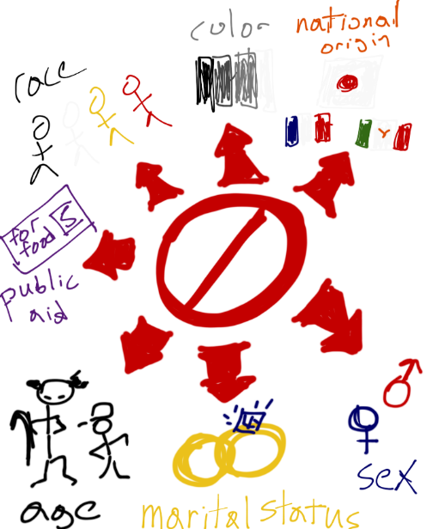
Action Steps for Fair Lending Laws
Review advertising/marketing collateral
Review Adverse Action Notice process
Conduct fair lending training
Do a fair lending review

Slide 22
Regulation C and HMDA
Citation 12 CFR 1003
Purpose
Determine if financial institutions are serving housing needs of communities
Help public officials target funds for assistance
Identify possible discriminatory lending patterns

Slide 23
Coverage Criteria for 2018
Meets asset threshold as of December 31, 2017
Has home/branch office in MA/MSA
Made at least one home purchase loan/refinance of a home purchase loan secured by a first lien in preceding calendar year
Federally insured/regulated or mortgage loan insured/guaranteed by Federal agency or loan will be sold to FNMA or FHLMC
Made at least 25 closed-end mortgage loans or at least 500 HELOCS in 2016 and 2017

Slide 24
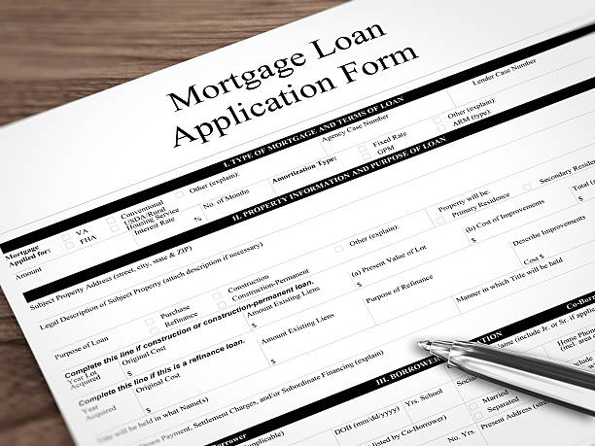
HMDA Transactional Coverage
All dwelling-secured loans
Closed-end mortgages
HELOCs
Reverse mortgages

Slide 25
Reportable Activity
Report information for actions taken on
Applications for covered loans
Originations of covered loans
Purchases of covered loans

Slide 26
Info about Borrower
Collect and report information on ethnicity and race
Report whether ethnicity, race, and sex were collected based on basis of visual observance or surname
Aggregated and disaggregated info on ethnicity and race
Report age of applicant(s)

Slide 27
Reportable Data
Universal loan identifier
CU’s Legal Entity Identifier (LEI) plus a loan or application number plus a two-character check digit
Application date
Application channel*
Whether loan application was submitted directly to CU
Whether obligation was/would have been payable to CU
Preapproval request
* Indicates new data point

Slide 28
Reportable Data
Loan type
Conventional
FHA/VA/RHS/FSA
Loan purpose
Home purchase
Home improvement
Refinancing
Cash-out refinancing
Other

Slide 29
Reportable Data
Loan amount
Originated – loan amount
HELOC – amount of credit available under plan
Refinancing – loan amount for new debt
Accepted counteroffer – loan amount
Rejected counteroffer – amount applied for
Approved but not accepted loan – approved loan amount
Denied, closed for incompleteness, withdrawn by applicant – amount applied for

Slide 30
Reportable Data
Loan term*
Example – 120 months
Action taken and date
Loan originated/date of closing
Loan approved but not accepted/approval date, deadline for accepting offer, or date file was closed
Application denied/date application denied or date notice sent
Application withdrawn by application/date withdrawal request received or date on written request
File closed for incompleteness/date file closed or date notice sent to applicant
* Indicates new data point

Slide 31
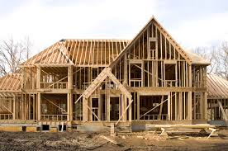
Reportable Data
Reason(s) for denial*
Up to 4
Property address and location
Property address
State, county, and census tract
Construction method*
Site built
Manufactured home
* Indicates new data point

Slide 32
Reportable Data
Occupancy type*
Principal residence
Second residence
Investment property
Lien status
Manufactured home information*
Secured property type
Land property interest
* Indicates new data point

Slide 33
Reportable Data
Property value*
Total units*
Multifamily affordable units*
* Indicates new data point

Slide 34
Reportable Data
Debt-to-income ratio*
Combined loan-to-value*
Credit score information*
Automated underwriting system information*
* Indicates new data point

Slide 35
Reportable Data
Interest rate*
Originated loan – loan interest rate
Application approved but not accepted – rate in LE or applicable when CU approved the application
Application denied/withdrawn/closed for incompleteness – N/A
Introductory rate period*
Rate spread
* Indicates new data point

Slide 36
Reportable Data
Contractual features*
Balloon payment
Interest only
Negative amortization
Other contractual terms
* Indicates new data point

Slide 37
Reportable Data
Data points for loans subject to Reg Z*
Total loan costs on Line D of CD
Total points and fees charged
Total borrower-paid origination charges*
Total discount points*
Lender credits*
* Indicates new data point

Slide 38
Reportable Data
Prepayment penalty term*
HOEPA status
MLO identifier*
Type of purchaser
* Indicates new data point

Slide 39
Other HMDA Issues
Data collected must be submitted by March 1
Disclosure statement

Slide 40
Action Steps for HMDA/Reg C
Develop written procedures
Talk to system providers
Update forms
Conduct training
Have backup

Slide 41
Regulation Z
Truth-In-Lending
Purpose – promote informed use of consumer credit by requiring disclosures about its cost and terms

Slide 42
Regulation Z
Coverage
Credit is extended to a consumer
Credit for personal, family, or household purposes
Credit is subject to a finance charge or is payable in more than 4 installments

Slide 43
Regulation Z
Exemptions
Nonconsumer credit
Amounts over $54,600 not secured by real property or a principal dwelling or not a private education loan as defined in the regulation (threshold adjusted annually)
Federal Student Loans

Slide 44
Definitions
Annual Percentage Rate – APR
Cost of credit expressed as a yearly rate
Disclosures
Initial disclosures
Periodic statements
Accuracy
1/8 of 1%

Slide 45
Definitions
Open-end credit
Repeated transactions
Finance charge on unpaid balance
Credit limit available
Lines of credit, credit cards, HELOCs
Closed-end credit
Defined maturity
Car loans, mortgages

Slide 46
Disclosures
General disclosure requirements
Clear/conspicuous
In writing
In form member can keep
Account opening disclosures
Additional open-end credit disclosures
Periodic statements
Change in terms notices

Slide 47
Special Rules
Mortgages
HELOCs
Closed-end mortgages
Credit cards
Disclosures
Restrictions
Student loans

Slide 48
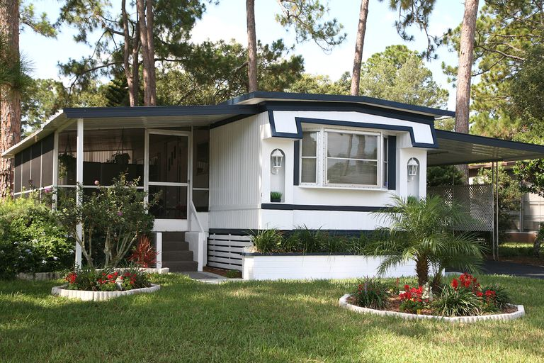
Right of Rescission
Borrowers/owners of collateral have 3 business days to rescind
Non-purchase money loans secured by principal dwelling
Dwelling includes house, condo, mobile home

Slide 49
Right of Rescission
Disclosures
2 copies to borrowers and owners of collateral
Rescission period can be waived only in case of financial emergency
Borrower must provide written, dated statement
Can’t use preprinted forms
Effect of rescission
Security interest is void
Return any money paid within 20 days

Slide 50
Action Steps for Regulation Z
Review disclosures
Conduct TRID review
Review rescission process

Slide 51
NCUA Regulations
General rules for loans, Part 701.21(c)
Written loans policies
Credit applications and overdrafts
Loan maturity
Early payment of loans
Loans to officials, Part 701.21(d)

Slide 52
Action Steps for NCUA Regulations
Update/review loan policies
Review process for loans to officials

Slide 53
Military Lending Act
Changes in past 2 years expanded coverage
Definition of “consumer credit”
Requirement to identify covered borrowers
Military Annual Percentage Rate (MAPR) calculation
Required disclosures

Slide 54
MLA Definition of Consumer Credit
Credit extended primarily for personal, family or household purposes that is:
Subject to a finance charge; or
Payable in more than 4 payments
Signature loans, vehicle refinance loans, lines of credit, overdraft lines of credit, private student loans

Slide 55
Consumer Credit Exceptions
Residential mortgage loans
Credit for purchase of motor vehicle
Financing negative equity cancels this exemption
Credit for purchase of personal property
Credit excluded under Regulation Z
Business purpose, commercial
Credit cards until October 3, 2017

Slide 56
Covered Borrower
Member of the armed forces on active duty or active guard or reserve duty
Dependents
Spouse
Child under the age of 21 or 23 if a full time college student
Parent
Other unmarried person under 21 or 23 if full time college student and lives with the member

Slide 57
Assessing a Covered Borrower
Department of Defense data base
Credit report

Slide 58
Military Annual Percentage Rate (MAPR)
Can’t exceed 36%
MAPR calculation includes
Any finance charge
Any fee/premium for credit/debt cancellation insurance
Any fee for credit-related ancillary product
Any application fee
Any fee for participation in a credit plan

Slide 59
MLA Disclosure Requirements
MAPR
Description of required payment
Other Reg Z disclosures
Statement of MAPR
Federal law provides important protections to members of the Armed Forces and their dependents relating to extensions of consumer credit. In general, the cost of consumer credit to a member of the Armed Forces and his or her dependent may not exceed an annual percentage rate of 36 percent. This rate must include, as applicable to the credit transaction or account: The costs associated with credit insurance premiums; fees for ancillary products sold in connection with the credit transaction; any application fee charged (other than certain application fees for specified credit transactions or accounts); and any participation fee charged (other than certain participation fees for a credit card account).
In writing and orally

Slide 60
SCRA Purpose
Protect those who are serving to protect us
Coverage
Active military servicemembers who have been materially affected by service
Key Provisions for credit unions
Reduced interest rate
Limited legal proceedings to collect debts and foreclose

Slide 61
SCRA Coverage
Members on active duty in the military who are “materially affected” by their service
Active duty = full-time duty
Dependents (sometimes)
Spouse, child, other individual

Slide 62
Protections under the Act – Interest Rate Limitation
6% Interest rate on loans incurred prior to active duty
Credit cards
Auto loans
Share secured loans
Signature loan
6% on mortgages
1 year after service ends

Slide 63
Protections under the Act – Court Proceedings
Default judgments
CU must file affidavit that defendant is not in military
Repossessions
Must get court order

Slide 64
Protections under the Act – Court Proceedings
Mortgage foreclosure
Must get court order to foreclose
Servicemember protected up to 12 months thru December 31, 2017, then reverts to 90 days after service ends

Slide 65
MLA vs. SCRA
MLA
SCRA
Applies to loans entered into while members is on active duty
MAPR cap of 36%
Applies to “covered borrower,” which is a service member on active duty and dependents of the covered borrower
SCRA applies to loans entered into before member is on active duty
Interest rate cap of 6%
Applies to service members and dependents in some situations

Slide 66
MLA vs. SCRA
MLA
SCRA
Covers LOCs, personal loans, non-purchase money vehicle loans; non-purchase money personal property loans, credit cards, and private student loans
Covers most loan types including
Open-end loans such as credit cards, HELOCs, and LOCs
Closed-end loans including mortgages, auto loans, and unsecured loans

Slide 67
Actions Steps for MLA & SCRA
Review MAPR disclosure process
Ensure MAPR calculations are correct
Review SCRA-affected loans for interest rate limitations and default protections

Slide 68
Questions

Slide 69
Resources
Fair Lending
NCUA Fair Lending Guide https://www.ncua.gov/Legal/GuidesEtc/GuidesManuals/OCP_FairLendingGuide.pdf
NCUA Fair Lending FAQs https://www.ncua.gov/Legal/GuidesEtc/GuidesManuals/NCUA-Fair-Lending-Compliance-Program-FAQs.pdf
NCUA Fair Lending Best Practices https://www.ncua.gov/Legal/GuidesEtc/GuidesManuals/Fair-Lending-Compliance-Best-Practices-FCU.pdf

Slide 70
Resources
Regulation C/HMDA
CFPB HMDA rule implementation resources page https://www.consumerfinance.gov/policy-compliance/guidance/implementation-guidance/hmda-implementation/
NCUA Regulations
https://www.ecfr.gov/cgi-bin/text-idx?SID=bfc588830c223db9f7059325b724713d&mc=true&tpl=/ecfrbrowse/Title12/12CVIIsubchapA.tpl

Slide 71
Resources
MLA
NCUA Regulatory Alert RA 2016-04 https://www.ncua.gov/Legal/Documents/Regulatory%20Alerts/RA2016-04-Enclosure-Complying-with-Changes-Military-Lending.pdf
SCRA
NCUA Letter to CUs, 09-CU-12 https://www.ncua.gov/Resources/Documents/LCU2009-12.pdf

Slide 72
Speaker Information
Kristen Tatlock, CUCE, NCCO, BSACS, NCBSO
Senior Compliance Manager
CU Service Network
720-575-6926
ktatlock@cusn.com
http://compliance.cusn.com/
Facebook: CUWorksCompliance
Twitter: @CUSN_Compliance

