Slide 1

Hybrid Hosting and Disaster Recovery
Case Study: Security First Credit Union and OnRamp

Slide 2
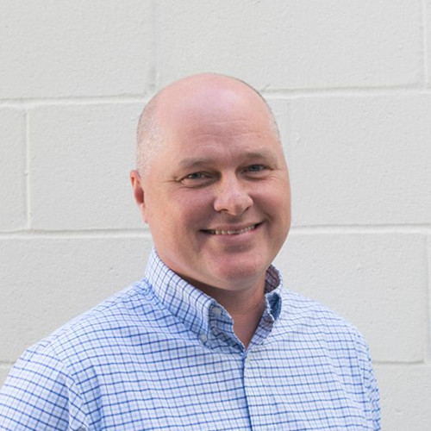
Meet the Speaker
With 20 years of experience in tech and hosting, Ashley Mayfield helps organizations translate business needs into technology initiatives that increase efficiencies. As a Senior Solutions Consultant at OnRamp, Ashely offers insights into how to leverage best practices in security, compliance, cloud and disaster recovery.
He’s always been at the forefront of new IT advances, from the emergence of VoIP to cloud computing, and continues to find new ways to assist his customers. Outside of work, Ashely volunteers for the Muscular Dystrophy Association.
Ashley Mayfield
Senior Solutions Consultant
OnRamp

Slide 3




Who Is OnRamp?
OnRamp is a HITRUST-certified data center services company specializing in high security and compliant hybrid hosting.
Compliance & Security Expertise
Our Goal Is to Provide You Flexible Solutions, Maintain the Security and Compliance of Your Infrastructure, and Deliver Outstanding Support.
20+ Years of
Operating Experience
Full Hybrid Support, 24/7/365
300+ Data Center
Service Customers

Slide 4
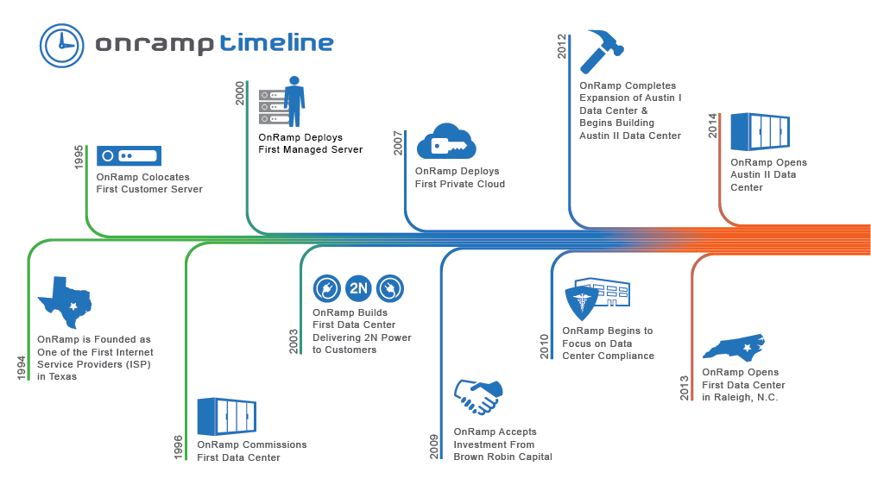

Slide 5
Josh info?

Slide 6
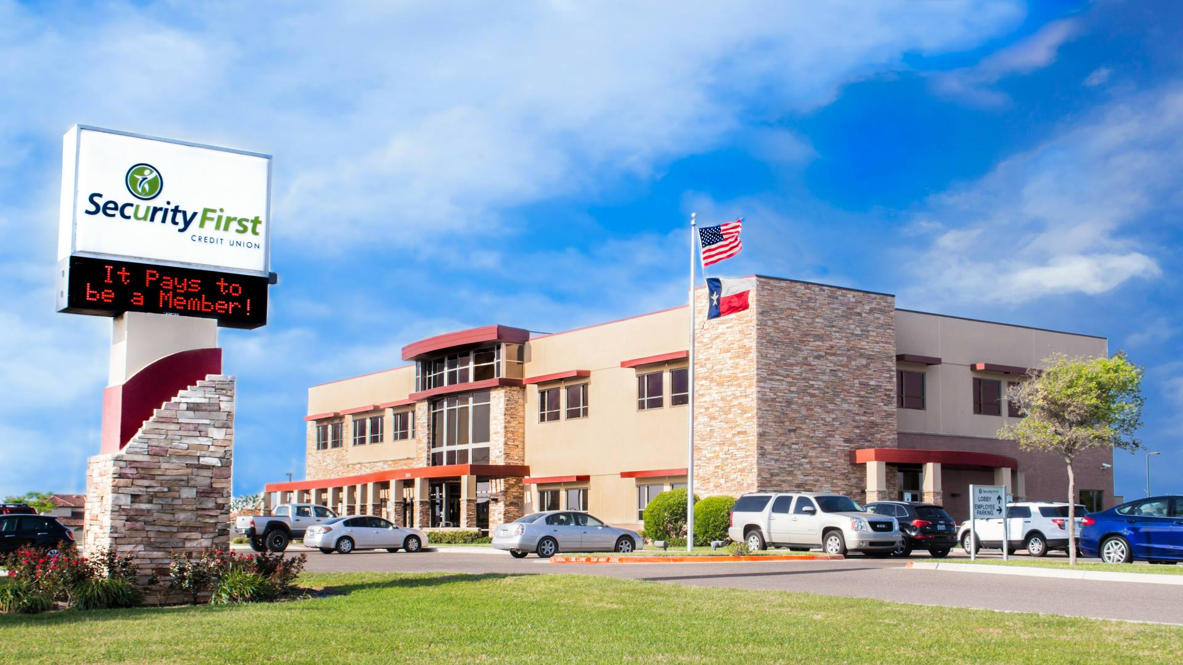
About Security First
Text Here

Slide 7

The Challenge
Security First needed a redundant data center in a stable geographic location for their disaster recovery
Wanted to implement an effective disaster recovery plan
  Were restoring cloud backups 10 miles away
Had concerns over compliance and security due to PCI-DSS mandates

Slide 8
The Solution
Hybrid solution in OnRamp’s Austin II data center
Secure, dedicated cage for colocation
Cross-connect to a managed private cloud
Implemented private circuits for Internet
Implemented a Disaster Recovery Plan
  Data replicates from on-premise infrastructure to Austin II data center
  Use Zerto technology for real-time replication

Slide 9
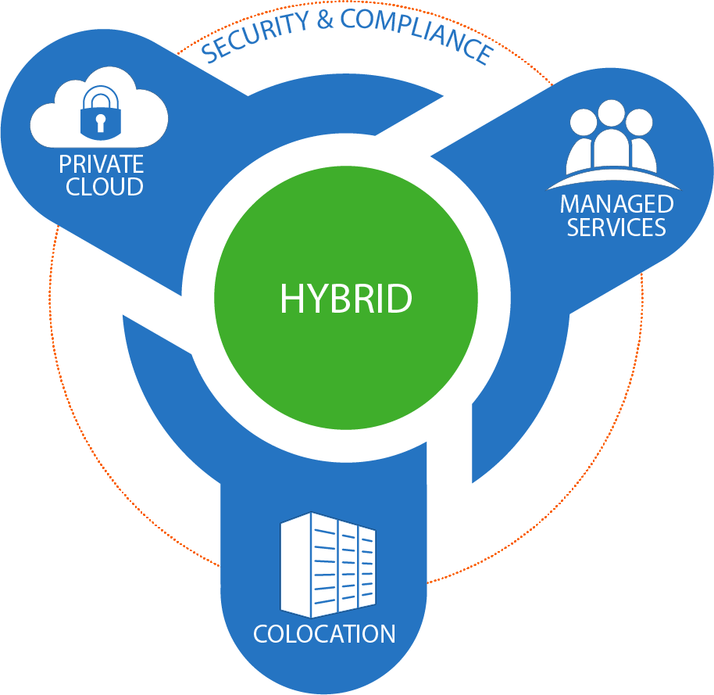









Why OnRamp?
Reduce risk and stay focused on your business with OnRamp’s deep expertise in compliant hosting.

Slide 10




HITRUST Certified Hosting
HITRUST is responsible for bringing a certifiable, universal framework that includes all HIPAA, PCI, ISO, and NIST compliance regulations.
OnRamp achieved its HITRUST certification to pass the benefits on to you. Protect your brand, customers and critical assets using our certified hosting.
Colocation Services
Cloud Solutions

Slide 11

Dedicated to Security & Uptime
OnRamp Facilities
Physical and Logical Security
SOC 2 Type 2 and SOC 3 and HITRUST-Certified Centers in Austin, TX & Raleigh, NC
State-of-the-Art Power and Cooling for High Density Computing
Fully Redundant Infrastructure with 2N Power from the Substation to the Rack
Staffed 24/7/365 with Experienced Support Team
Intrusion Detection
CCTV Monitoring
Motion Sensors
Fire Suppression
Pre-authorized
Visitors
Two-Factor Authentication
Firewalls
Data Encryption

Slide 12
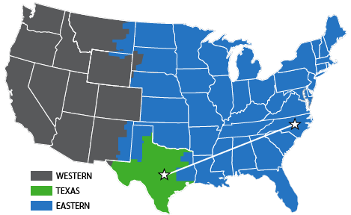
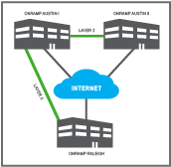
Disaster Recovery

Slide 13
Questions?

Slide 14




Thank you! Get In Touch:
amayfield@onr.com
512-968-4941
www.onr.com

