Slide 1
Maximizing Quality, Liquidity and Yield
in Times of Low Interest Rates
Fernando J. Pulido
Senior Vice President
Multi-Bank Securities, Inc.
October 18, 2019

Slide 3
Fernando J. Pulido
1989 BBA, University of Wisconsin – Eau Claire, WI
2002 MBA, Florida Atlantic University – Boca Raton, FL
Fixed-income securities industry experience since January 2009
Principal of Multi-Bank Securities, Inc.’s office in Austin, TX
Licensed and registered in 13 U.S. states and territories
FINRA Securities Licenses:
Series 4 Registered Options Principal
Series 7 General Securities Representative
Series 24 General Securities Principal
Series 50 Municipal Advisor Representative
Series 53 Municipal Securities Principal
Series 63 Uniform Securities Agent State Law

Slide 4
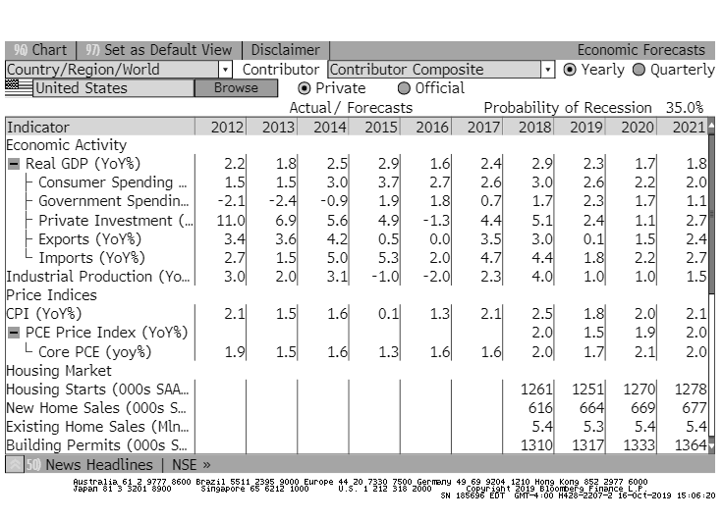
Economic Forecast

Slide 5
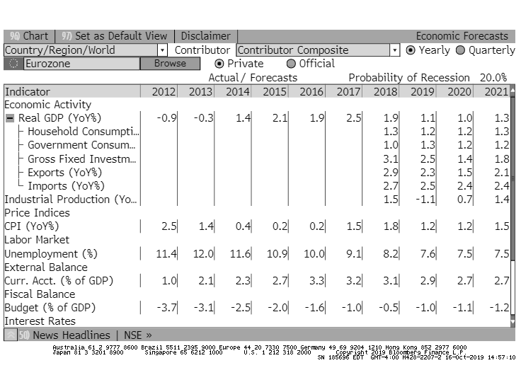
Economic Forecast

Slide 6
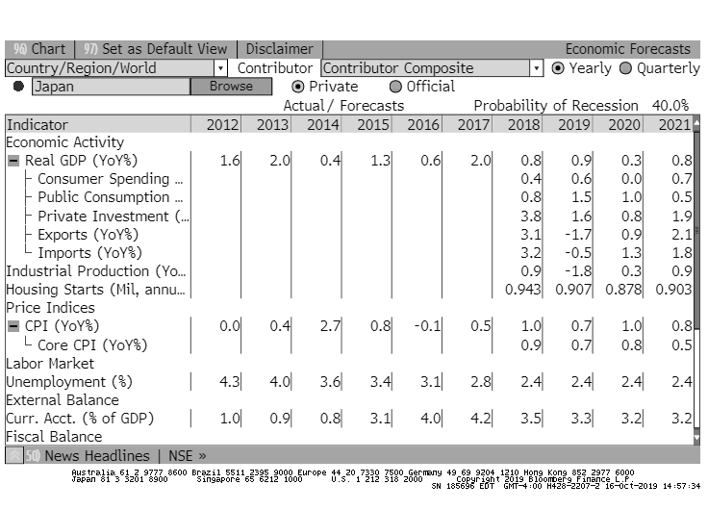
Economic Forecast

Slide 7
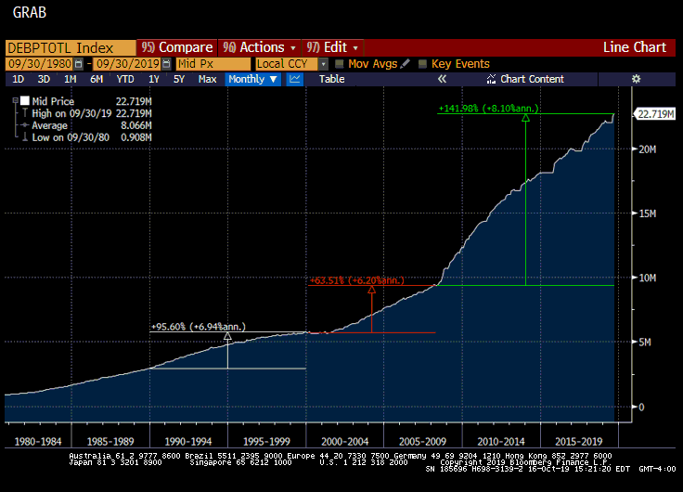
U.S. Total Debt Outstanding

Slide 8
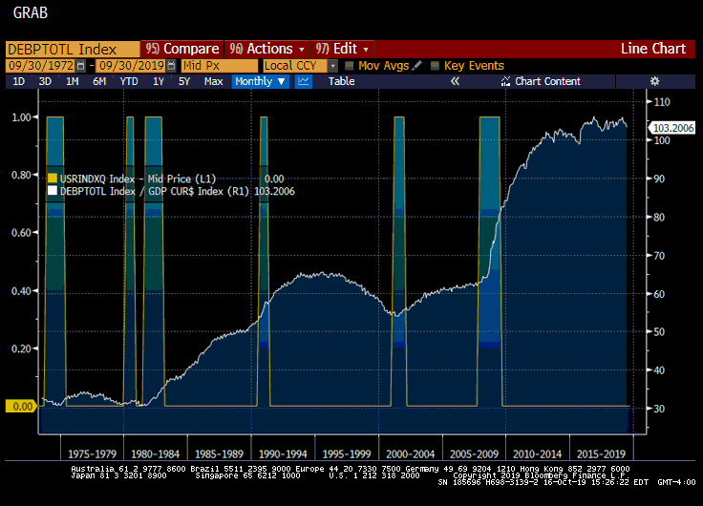
U.S. Total Debt to Nominal GDP

Slide 9
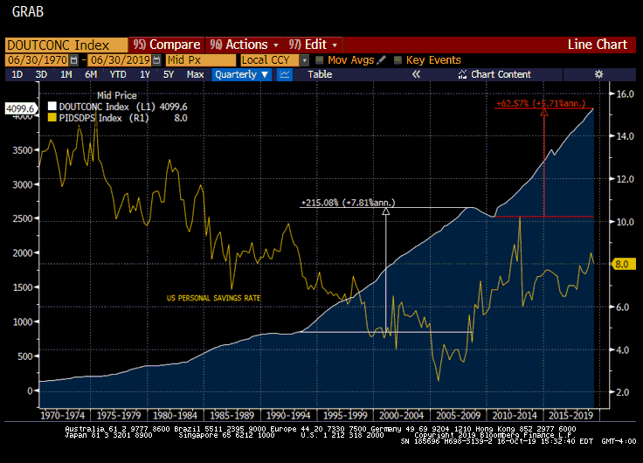
U.S. Consumer Debt Outstanding

Slide 10
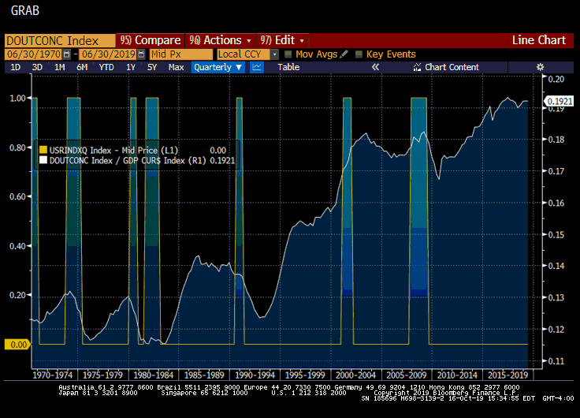
U.S. Consumer Debt to Nominal GDP

Slide 11
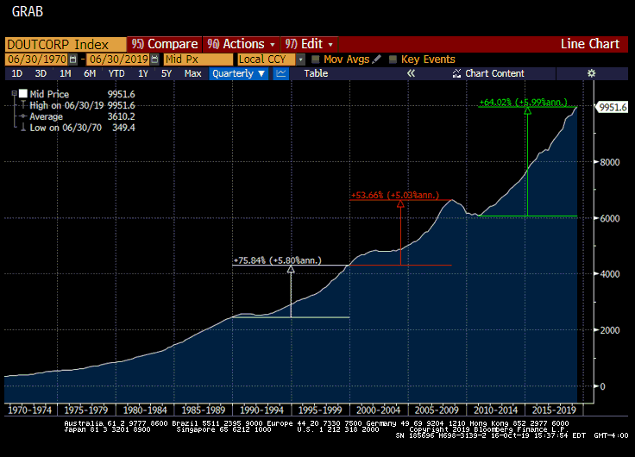
U.S. Corporate Debt

Slide 12
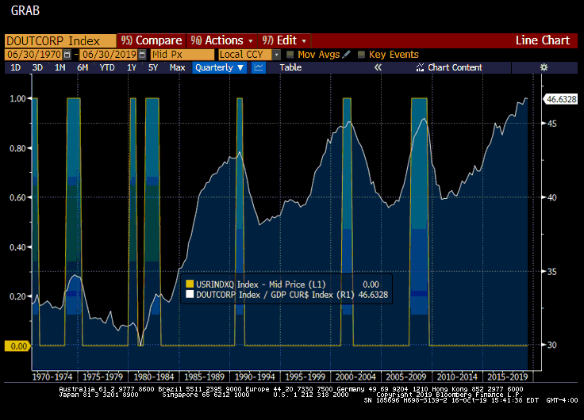
U.S. Corporate Debt to Nominal GDP

Slide 13
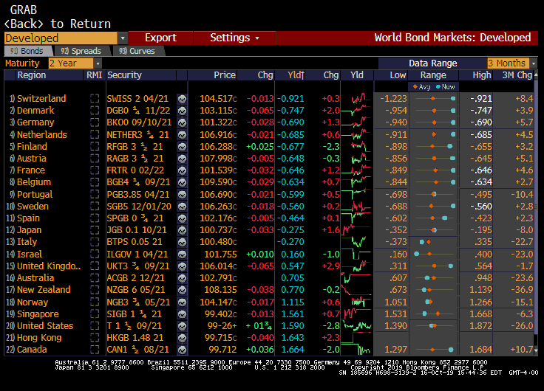
World Bonds 2-Year

Slide 14
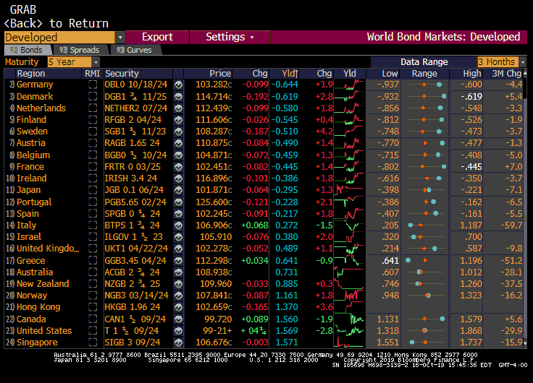
World Bonds 5-Year

Slide 15
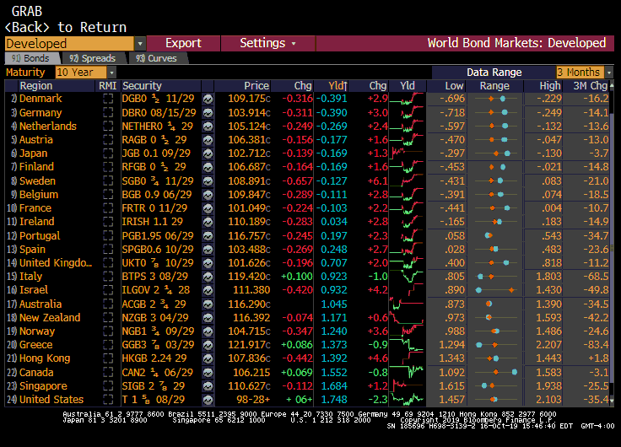
World Bonds 10-Year

Slide 16
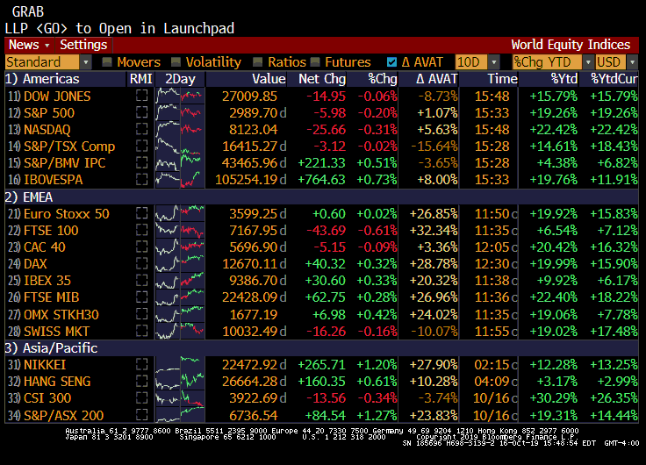
World Equity Indices

Slide 17
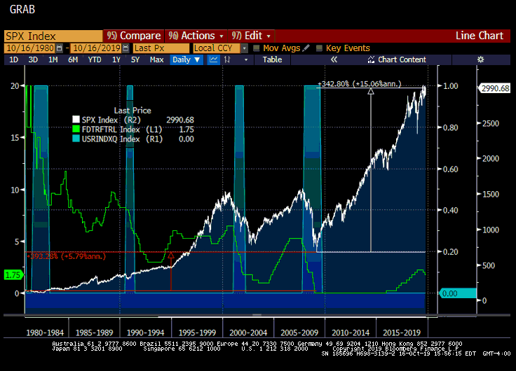
Fed Funds Target Rate vs. S&P 500

Slide 18
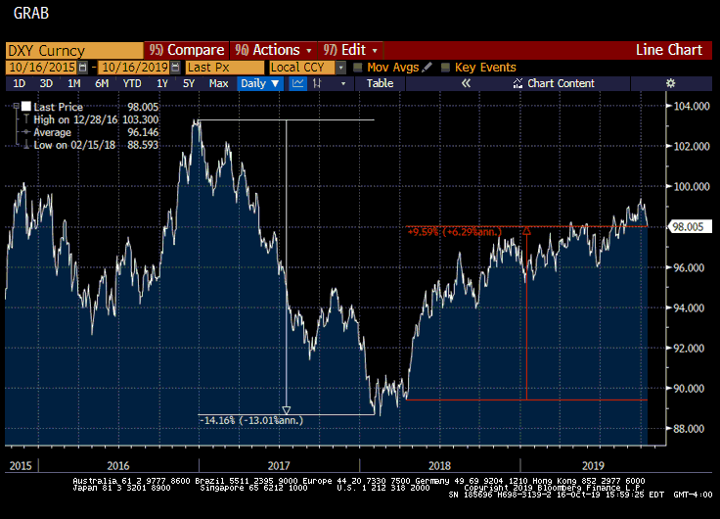
U.S. Dollar Index Spot Rate

Slide 19
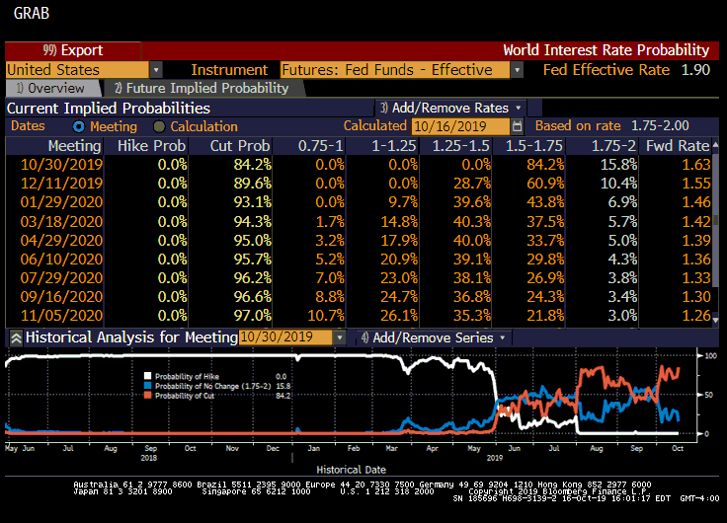
World Interest Rate Probability

Slide 20
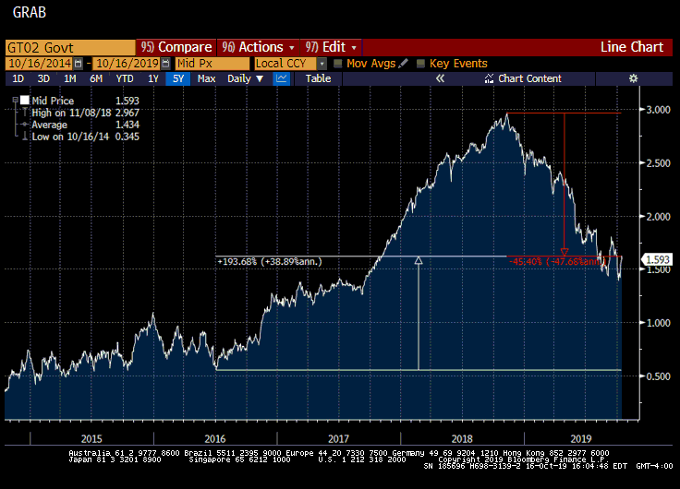
2-Year UST Yield Curve

Slide 21
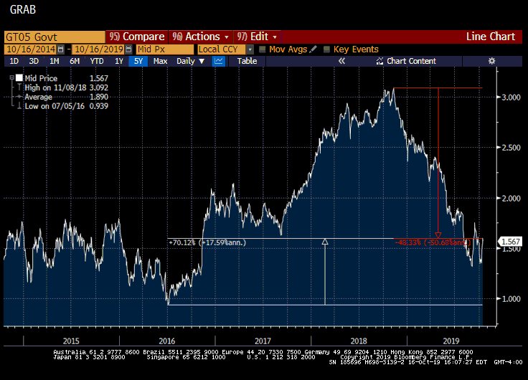
5-Year UST Yield Curve

Slide 22
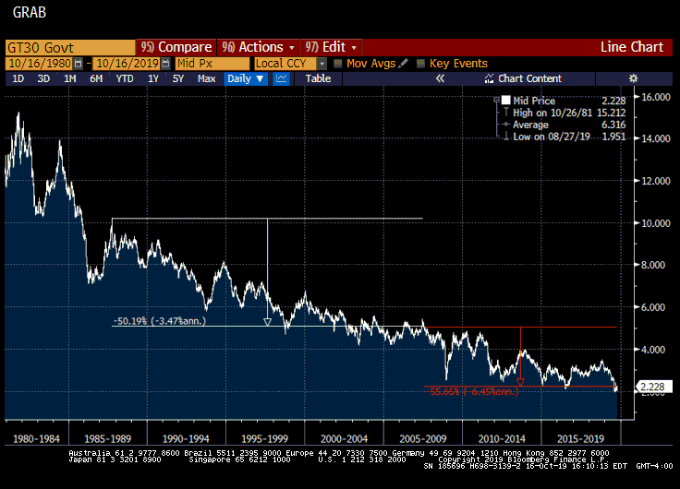
30-Year UST Yield Curve

Slide 23
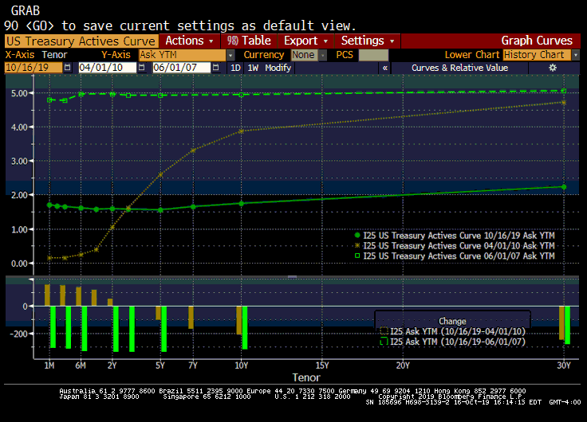
UST Yield Curve

Slide 24
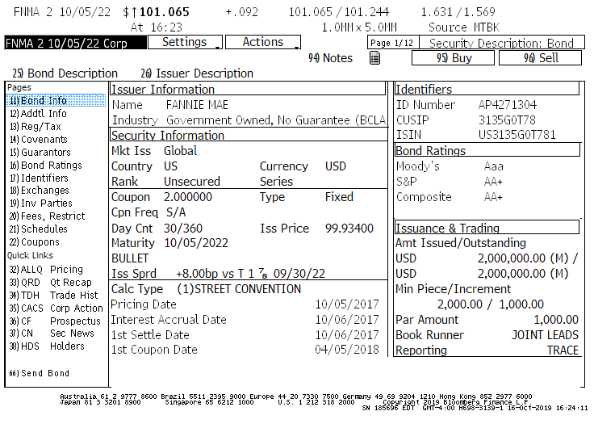
Bullet Investment (Description)

Slide 25
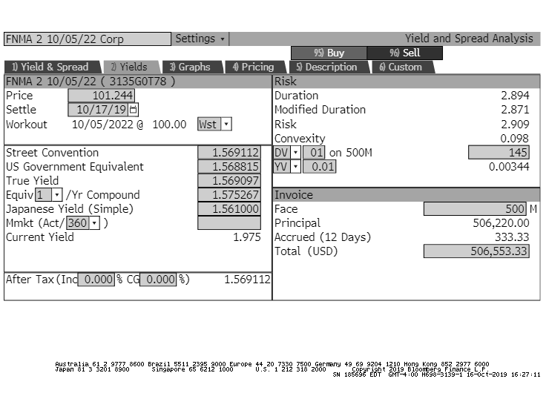
Bullet Investment (Yield Analysis)

Slide 26
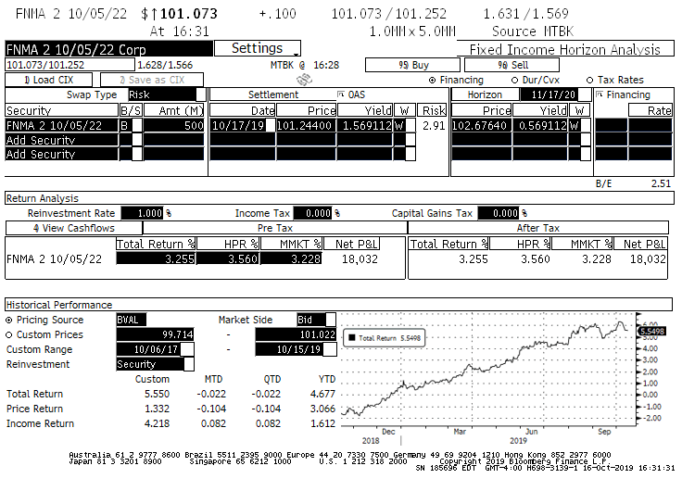
Bullet Investment (Horizon Analysis)

Slide 27
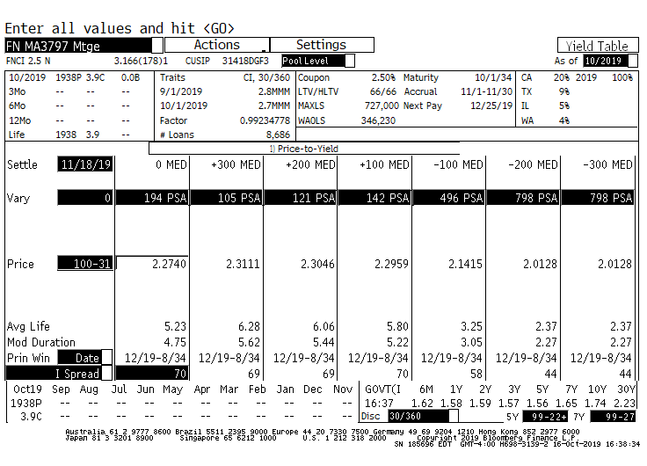
Pass-Through Investment (Yield Table)

Slide 28
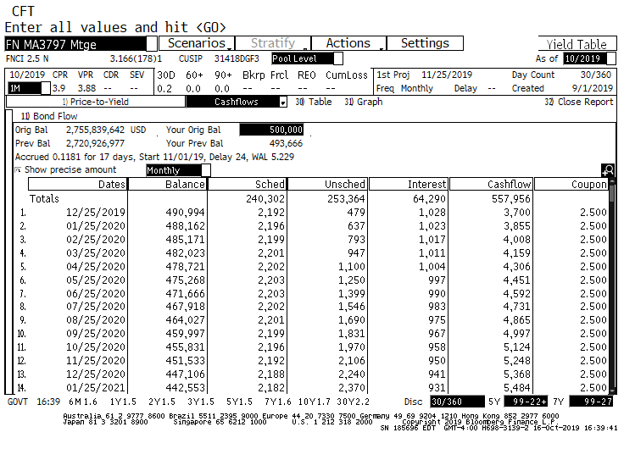
Pass-Through Investment (Cash Flows)

Slide 29
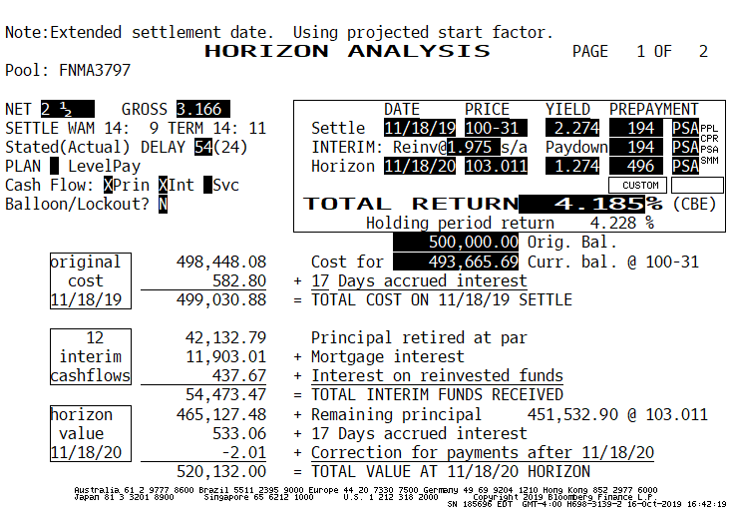
Pass-Through Investment (Horizon Analysis)

Slide 30
Conclusions
Formulate a long-term strategic plan for the credit union
Expect lower yields and tighter margins
Expect greater regulatory oversight and risk mitigation
Maximize economic opportunities and local partnerships
Maintain alternative sources of funding
Invest conservatively and strategically
Monitor economic parameters affecting interest rates
Monitor Fed actions and consensus expectations
Monitor the entire yield curve
Monitor investment portfolio parameters and invest according to cash flow needs
Invest in liquid instruments
DTC-eligible CDs
GSE callable and bullet bonds
GSE and agency pass-through securities and CMOs
U.S. Treasury bills and notes

Slide 32
Thank you!
Fernando J. Pulido
(512) 288-5069
fpulido@mbssecurities.com

