Slide 1
Can a neural network predict outcomes from MrGfus thalamotomy
Will Gilmour
16.4.24
Notes:
Script:
Good afternoon everyone, my name is Will. I'm excited to be here today to answer the question above.
Just to give you a bit of background about myself: I originally trained as a doctor and had the opportunity to work with the Dundee MRgFUS team as a clinical research fellow. This project,, has been a significant part of my professional journey for nearly two years now, and it's something I am truly passionate about. So much so, that this year I have transitioned into the tech world and am currently working as a software test engineer.
Enough about me – lets get started
Introduction of self:
Background in medicine
Transitioned to software test engineering
Passion for machine learning and AI
Personal connection to the project (2 years of involvement)

Slide 2
Overview
MOTIVATION
CONCEPT: MACHINE LEARNING
RESULTS
WHAT’S NEXT
CLOSING
Notes:
Script:
Today, I've structured this session to focus primarily on the clinical aspects of our project. However, for those who are curious about the more technical elements, I'm more than happy to dive into those details in our Q&A or after the session.
We'll begin today by delving into the specific problem that we have been addressing.
Following that, I'll provide a brief introduction to why machine learning is a game-changer in our field.
We'll then move on to discuss some of the key results and of the work.
Finally, we'll look ahead to what's next for this project.
With that overview in mind, let's dive into the specifics.
Focus on clinical aspects; technical details available on request
Understanding the problem: Detailed exploration
Introduction to the advantages of machine learning
Review of key results and outcomes
Future outlook and potential developments

Slide 3
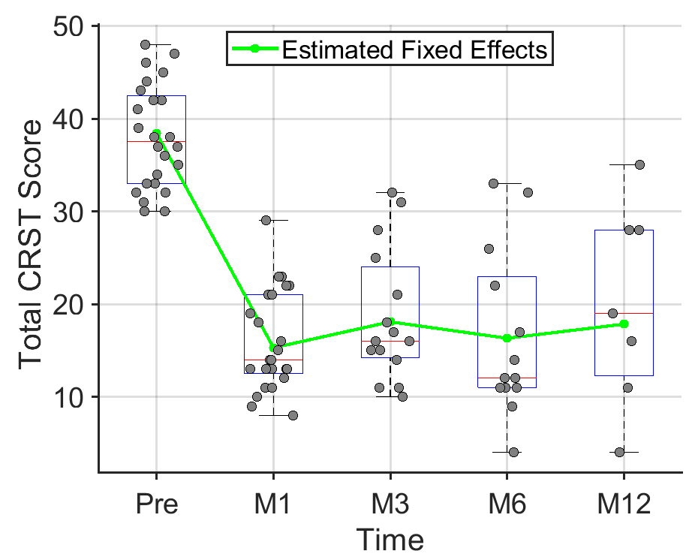
Motivation
Notes:
Script:
Let's start by getting to the heart of the problem we're addressing.
On this slide, I've plotted the Clinical Rating Scale for Tremor (CRST) scores for several patients treated in Dundee.
As you can see, pre-operatively, the scores are universally high—these patients come to us with significant tremor issues. Shortly after the operation, at one month, there's generally a strong improvement—a hopeful sign.
However, the crux of the issue, and what this graph starkly illustrates, is the variability in treatment response over time. By the one-year mark, some patients' scores regress to levels comparable to their pre-operative state, indicating a relapse.
This brings us to our crucial question: What happened to these patients? And perhaps more importantly, can we identify which patients are at risk of this relapse early enough to intervene effectively? I'll talk more on this later, but keep this question in mind as we move forward.
Overview of tremor scores (CRST) pre and post-operation
Initial success vs. long-term variability
Example scatter graph: CRST scores before and after surgery
Challenge: Identifying patients at risk of relapse
Goal: Early identification for timely intervention

Slide 4
Data available
Sequential Scanning
Patients:
30 Dundee treatments, 87% male, 87% left hemisphere treated, average age: 70.3
Imaging:
3T MRI Scans available from day 1, 1 month, 3 months, 6 months and 12 months for most participants
Scans are normalized to MNI space and at present just T2 flair used
Total of 129 scans available
Clinical scoring:
Same day scoring using CRST
Able to compare against pre-op assessment to give a more standardized % improvement
Notes:
Script:
So looking at the data we have available, Dundee has been meticulously documenting the patient journey through the treatment process.
We have data on 30 patients, and for each patient, we've captured scans at 5 critical post-operative milestones: Day 1, 1 month, 3 months, 6 months, and 12 months. Each of these scans is paired with a Clinical Rating Scale for Tremor (CRST) score taken on the same day, effectively linking clinical outcomes with imaging data.
In total, this gives us 129 scans, which serve as a foundation for both learning and testing our machine learning models, although in machine learning terms this is a tear drop compared to the oceans of data usually used.
Origin of the dataset: Collected from Dundee patient treatments
Dataset details: ~30 patients, approximately 150 scans
Timeline of data collection: Day 1, 1 month, 3, 6, and 12 months post-operation
Data components: CRST scores and corresponding scans
Purpose: Used for machine learning model training and testing

Slide 5
cONCEPT: Machine learning
CNNs & RNNs
Data Driven Discovery: Processing the results without the traditional biases including knowledge of anatomy
Adaptive Learning: Evolves with new data, improving accuracy over time without forgetting insights learned
Individualized care: Able to process on an individual basis once fully learned to give insights on a case-by-case basis, rather than simply group level insight
Adjunct to Expertise: Plan to find ways to have machine learning be a tool for assisting the decision-making, not replacing it
Notes:
Script:
I think this could be a whole talk in it’s own right but I wanted to briefly discuss what machine learning is and how it works for us as healthcare professionals.
The most important thing is that this is data driven discovery. The computer has no prior knowledge about anatomy, what the patient wanted or what happened during the operation. For us, it simple sees scans and scores, giving an unbiased analysis.
The data driven nature leads to it’s own problems though, all AI are hungry for data, the more you feed them, the better they should get. To learn from a small amount of data, it must be of sufficiently high quality that the important features shine out from the noise.
I’d like to stress I think it’s really important to have an idea of why you what to have this tool available and what it can provide along side your own expertise. I think for healthcare particularly, we shouldn’t be thinking about how any AI will replace us, but rather what additional insights it can provide to support our more rounded view of the world.
Machine learning as a tool to harness rich data sets
Advantage: Bias removal through data-driven analysis
Contrast with traditional methods: ML finds patterns without prior assumptions
Limitation: Dependency on the quality and size of the dataset
Potential: Uncovering new insights and augmenting expert analysis

Slide 6
Combo neural net for MRgFUS
Preprocessed 3D Image In
Predicted Tremor Improvement Out
Notes:
Script:
Let's have a peak inside the black box then at the current architecture which I've custom built.
Before any data enters the system, it goes through quite a rigourous pre-processing, the scans are all normalised and we carefully chop out just the region surrounding the thalamus since this is the bit we're interested in.
Then the convolutional component helps us learn about what’s significant within these images, by applying a series of learned filters. That information can then be used in a more traditional neural network to predict the CRST score associated with that scan.
Now, what's very cool is that there is some information stored within the network, meaning that for the next scan, the network remembers some of the previous scans.
This overview is quite streamlined, so if anyone is interested in a deeper dive into the technical specifics, I'd be more than happy to explore this further towards the end of our session.
Overview of model architecture: Combination of CNN and RNN
Input: MRI scans
Process: Learning key features from scans
Output: CRST scores for each scan
Sequence processing: Retaining information from previous scans
Pre-processing steps: Normalization and flipping for consistency

Slide 7
results
Let’s Dive In
Notes:
So that's the technical stuff out of the way, lets have a look at some results.

Slide 8
R² = 0.87, p = 0.0024
Notes:
To start with, I thought I’d share with you a small sample of the predictive qualtities of the network. For this section, the images were all treated as being independent, so it's just given a scan and asked to produce a predicted score. This chart shows a small section of scans that the network had never seen during its training, with the purple bars being the predicted improvement and the green as the real improvement.
As you can see, the network is remarkably accurate – this is good as it implies two things:
The operation works – the scans are enough data to predict the CRST scores on their own, without any other inputs, meaning the two things are highly linked
The network has the ability to learn from our data-set, this is particularly important as this is a relatively small set in ML terms and probably only works due to the nature of the pre-processing.
It’s all well and good having a good predictive model, but at the moment all this can do is remove the need for a neurologist to assess the patient to tell us how they’re doing with the tremor – it’s not that helpful yet. Although Tom might be happy I can shorten his clinics!
Sample of predictive results from the model
Chart display: Purple bars (predicted improvement) vs. Green bars (actual improvement)
Result Insight 1: High accuracy of the network suggests strong link between MRI scans and CRST scores
Result Insight 2: Demonstrates network's learning capability with a small dataset, enhanced by effective pre-processing
Can replace Tom's clincs!

Slide 9
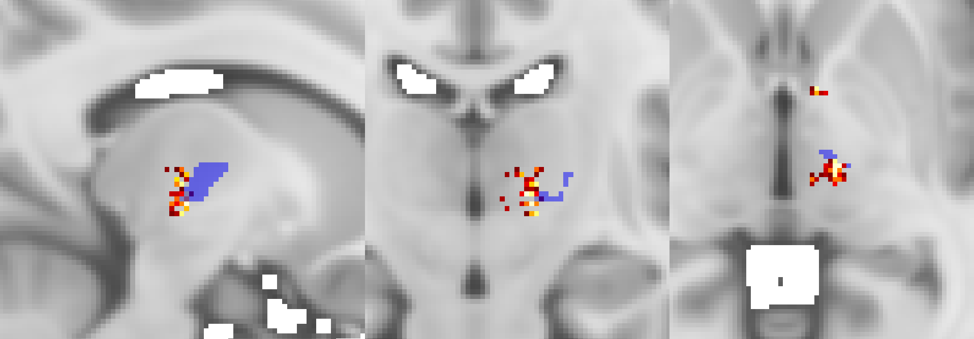
Heatmap
Notes:
Script:
From our neurologist-replacing network, we can extract information about where abouts the model is looking when processing scores – that’s the red/yellow map you see here.
Overlayed in blue is the VIM, the ventral intermediate nucleus, which is the traditional target for these types of operations. Notably, our model suggests that the optimal lesion target is very close to—but not exactly the same as—the VIM. It's just posterior and slightly inferior.
This finding is particularly intriguing because it's derived in a way that's completely agnostic of human anatomy. The model doesn't 'know' about the brain's traditional landmarks; it's learning purely from the data on where the most effective treatment results are seen.
We can take a look at the peak voxel retrospectively, I went through and re-planned each patient to get a set of AI coordinates, which we can compare against the real target used.
Heatmap visualization: Model focus areas (red/yellow)
Overlay information: VIM region in blue (traditional surgical target)
Model Prediction Insight: Optimal target just posterior and inferior to VIM
Significance: Model predicts near, yet distinct, target areas without anatomical bias
Implication: Potential refinement of targeting in surgical procedures
LIME (Local Interpretable Model-Agnostic Explanations): LIME is a technique used to explain the predictions of any machine learning classifier. LIME generates an interpretation of a prediction by approximating the model locally with an interpretable model (like a linear model). This is done by perturbing the input data point and understanding how these changes affect the output of the model. The important features for the decision are those that cause large changes in the output when perturbed. When applied to images, it generates a heatmap indicating which areas of the image were most influential in the model's prediction.
Occlusion Sensitivity: Occlusion sensitivity is a visualization technique used to understand which parts of an image are important for a convolutional neural network's decision. In this method, a small patch of the image is systematically occluded, or covered up, across the entire image. At each step, the image is passed through the network and the change in output is recorded. The regions that cause the most significant drop in performance when occluded are considered important and are highlighted in the heatmap.

Slide 10
R² = 0.38 p=0.002
R² = 0.45 p=0.006
R² = 0.42 p=0.004
Notes:
Script:
There appears to be a significant correlation between the predicted targets and patient outcome improvements, but interestingly, this correlation is only significant in the anterior-posterior direction. The further away from the AI prediction spot, the worse the patient does. At the time we were doing this, most of our surgical discussions had been on adjustments in the medial-lateral and superior-posterior dimensions, but the model suggests the only dimension worth discussing is the one we weren’t focused on as much.
Regardless of whether this is actually the right spot to do the operation I do think this highlights an important feature about this type of work —it challenges and expands our understanding of effective treatment approaches. It encourages us to consider aspects that might have been overlooked or underappreciated in traditional practices.
So great, I've got a computer to firstly replace Tom and now I can also replace Sonnie as well! Well, of course I don't think that's going to happen I do hope I've demonstrated how this might be a useful tool for providing extra information to both of them again, on an individual basis!
Analysis focus: Comparing AI-predicted peak voxel (from heatmap) to actual surgical targets
Finding: Significant correlation in the anterior-posterior direction
Previous focus: Considerations were on medial-lateral and superior-posterior adjustments
Insight: AI analysis prompts reevaluation of targeting strategies
Caution: AI predictions augment but do not replace expert surgical decision-making
Light-hearted conclusion: AI is not yet replacing our neurologists, Tom and Sonnie!

Slide 11
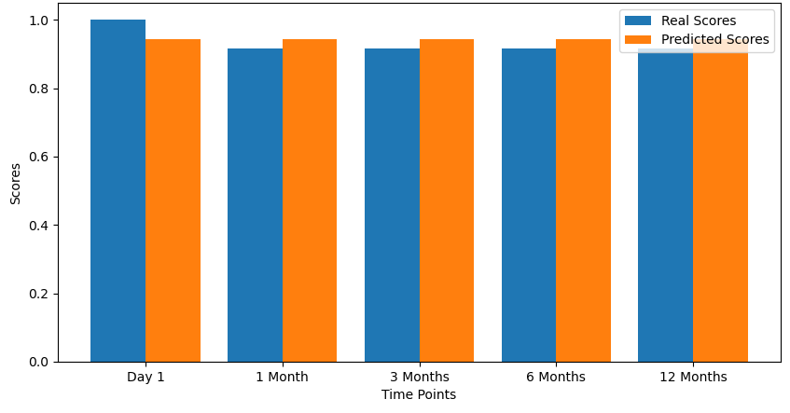
Predicting the future
Shown only day 1 image – predicting all the way to 1 year
Notes:
Script:
Now, let's discuss the forward-looking capabilities of our network. This time the model has a more challenging scenario: using just the day 1 post-operative image, it must predict how the patient's condition will evolve at all subsequent time points.
The results so far are promising, as you can see from the charts—our model is performing relatively well. Although I think there is definitely room for improvement having fought with this network for an extended period!
One of the most compelling implications of our current findings is that the way a lesion reduces in size over time can be predicted. This predictive ability suggests a tantalizing possibility: imagine being able to predict, while the patient is still on the operating table, how their tremor will change over the next year.
Model task: Predict long-term outcomes from day 1 image
Current performance: Good predictions but room for improvement
Key implication: Lesion size reduction can be predicted
Future potential: Predict tremor outcomes a year in advance while still in surgery
Transition: Explore further implications in the next slide

Slide 12
What’s next
Ai replace us?
Notes:
So that’s where we’re up to with the research, I’d like to just take a quick look at what the next bits could be

Slide 13
Future work
Verify and Deploy
Targeting verification and assistance:
Ideally need a simple tool for generating targeting plans based on pre-op image, need to do a prospective study to show this is valuable information
Intraoperative prediction:
Need to know if long-term outcomes are likely to be poor at a point where the treatment can still be adjusted
Will need to verify this is doable first, then prospectively verify this works in practice
Notes:
Script:
As we look towards the future of this project, there are two critical areas where we can truly revolutionize patient care, though to advance these, your support is crucial.
Firstly, we aim to refine and verify the surgical target points. This task is relatively straightforward but requires the development of a tool that can process pre-operative scans quickly and without hassle. Happily, this would be easier and quicker to do compared with more advanced imaging such as DTI.
The more ambitious, yet profoundly impactful goal involves developing the capability to use our neural network in real-time during surgeries. If the patient looks like they are well treated but the model suggests 1 further treatment to prevent a relapse at a year… That’s isn't just an improvement; it's a game-changer.
As we look ahead then I think there's some key support to make this a reality:
Data Sharing: As I've elluded to the AI is hungry for data, 30 patients is enough to prove the concept but for this to move forward we need a lot more – happily in terms of scans, the requirements are much less now, we can start really focusing on the perioperative scans, the longer term post-operative scoring is needed rather than scans.
Integration Support: I think working with Insightech we could push this from theoretical academic work into real, clinical impact. Like I say, this would be one of if not the first operation to work like this – it's a really exciting time, but we have to keep actively pushing this!
Funding: is needed to sustain the research.
PAUSE!!!!
Immediate Goals: Refinement and verification of target points
Required Tool: Development of a quick and efficient pre-op scan processing tool
Long-term Vision: Real-time predictive capabilities during surgery
Call to Action: Need for financial support and collaboration
Impact: Enhancing surgical precision and patient outcomes

Slide 14
SUMMARY
CNN ABLE TO EVALUATE CRST
From this we are potentially able to improve targeting practice for the operation
THE FUTURE CAN BE PREDICTED
Using the combination of a CNN with an RNN, we are able to predict the long term follow-up from a relatively small number of scans.
NEXT STEP – INTEGRATION INTO OPERATION
Ideally we need this information during the operation, when something can be done about it!
Notes:
Script:
To summarise then.
We’ve looked at how neural networks can predict real scores based on the imaging.
We can extend this by prediciting not just the immediate score but also up to a year in the future.
Finally, I’ve talked about where I think this is going and the support that will be needed to get there.
Recap: Neural networks predict immediate and future clinical outcomes.
Technological Impact: AI's role in advancing medical treatments.
Call for Support: Emphasizing the need for continued collaboration and funding.

Slide 15
THANK YOU
Will Gilmour
07977477095
William-Gilmour@outlook.com
WWW.MEDICALTOOLKIT.CO.UK
Notes:
Thank you everyone – I know we're tight on time, so can either take questions now or potentially afterwards!

Slide 16
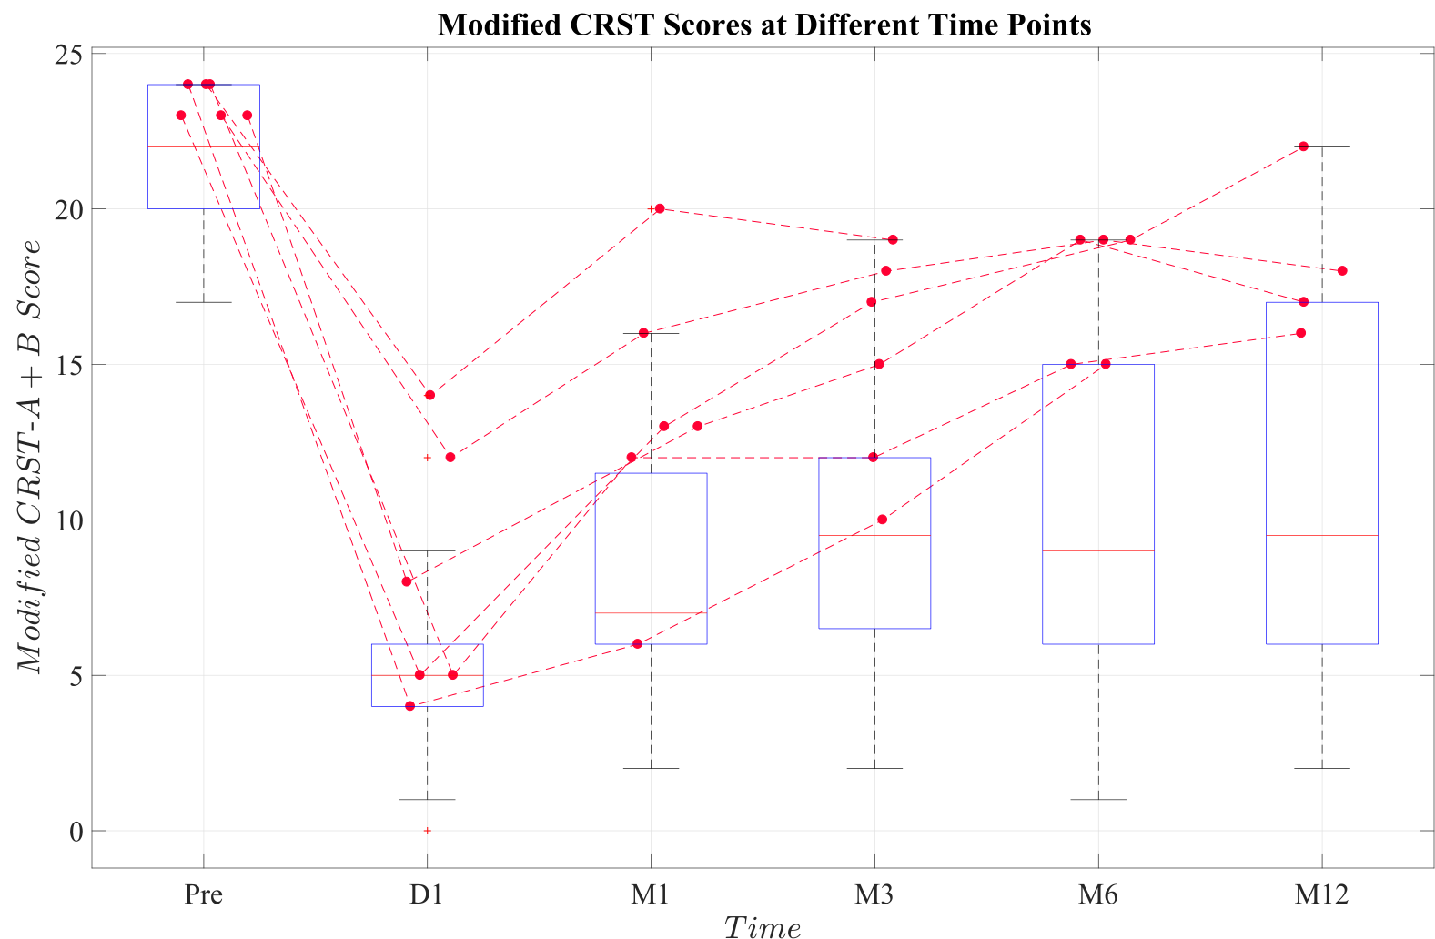
Specific patients

Slide 17
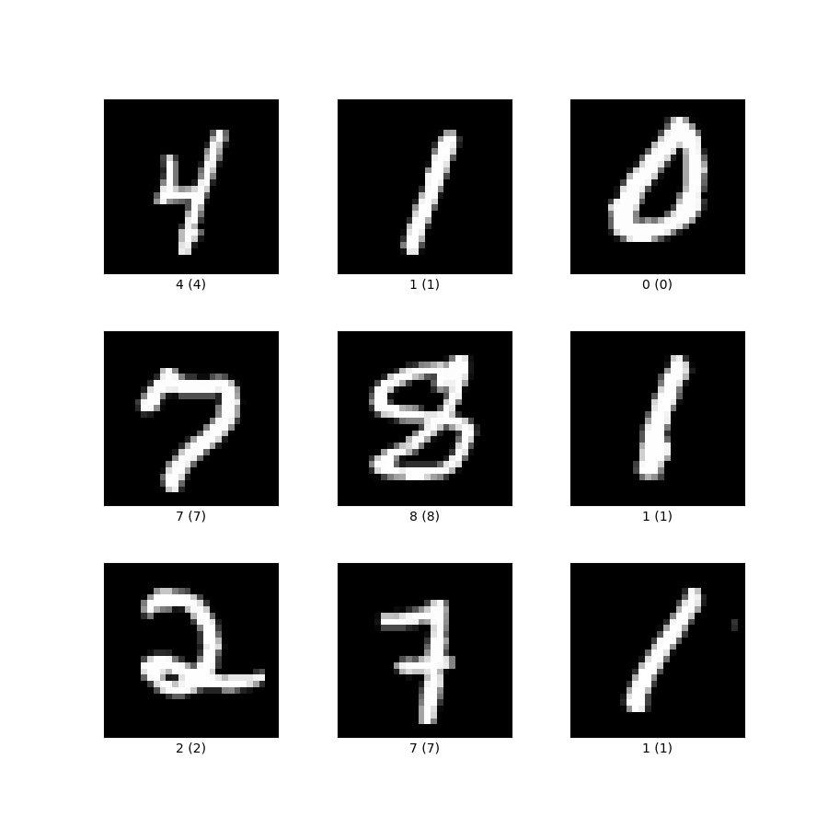
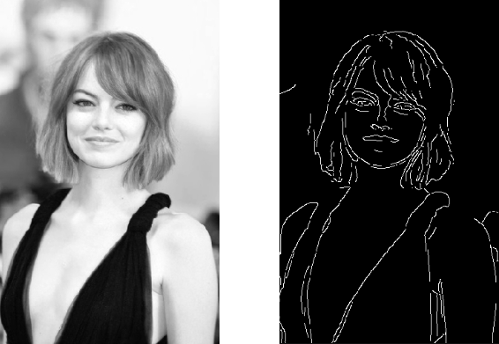
Basics of convolution
Notes:
To introduce CNNs properly, I wanted to have a look at a couple of images and talk about why convolution is such a great tool for image processing
Take Emma Stone here, I’ve taken a complex image here and run a filter over it so that just the edges are highlighted. The result is a picture that can be much more easily processed since it is just 0s and 1s now and actually does capture quite a lot of the information from the original image.
Edges for example can be really important, for example, looking at the numbers as a simple case, this vertical line in the middle, could be part of a 1, a 4, a 7 maybe – it’s an important thing to note, and taken in context of the surrounding lines can tell you what image you are looking at
The concept of a CNN detecting lines is useful for illustrating the idea but the reality is, the filters it ends up learning can be very uninutive for us to look at – this is part of why people think about AI as being a black box, the middle sections can look really bizarre to us!

Slide 18
Feedforward network (ffn)
Age
Smoking history
Likelihood of having stroke in next 5 years
Golf Handicap
Notes:
Let’s start with the simplest model, this was originally introduced in 1958 and shows the connection of different nodes moving from left to right.
In the example I’m showing here I’m starting with some metrics that are associated with an individual and I want to predict their likelihood of having a stroke in the next 5 years
The network will have to learn what features are important from the inputs as well as associations of the inputs – some inputs might not be as important, for example golf handicap, so the weight of that nodes impact would be much less compared to smoking history
The weights are all random initially and the model must learn by reviewing cases, seeing what happened in the real data and updating accordingly
The maths behind this model are still the fundamentals of the whole AI space – ChatGPT uses something like this within it’s architecture at a couple of different points even
This network is great at processing inputs that are simple but images are not so straight forward, that’s why in the 1980s convolutional neural networks were invented

Slide 19
Recurrent Neural network
Age
Smoking history
Likelihood of having stroke in next 5 years
Golf Handicap
Notes:
For sequential data RNNs are a straightforward method for processing. These have been in use really since 1997, when the LSTM arcitechture was described
Essentially, they work in the same way as the FFN, but there is sort of memory function built into the model, some retained information about the previous iterations is stored and used for the future runs
This is great for predicting the next steps in a sequence and also can be used to review information that might otherwise have seemed not as important.
For example our Golf Handicap on it’s own might not be that helpful in predicting strokes, but if the handicap was improving dramatically throughout the sequence, this might infer that the person is spending lots of time out on the course, working hard on improving their technique – maybe this would suggest they are very active and therefore are less likely to have a stroke.
Implementing an RNN on the back of a CNN is not common at all, so forgive me for the next slide which shows this off a little

